Slide 1
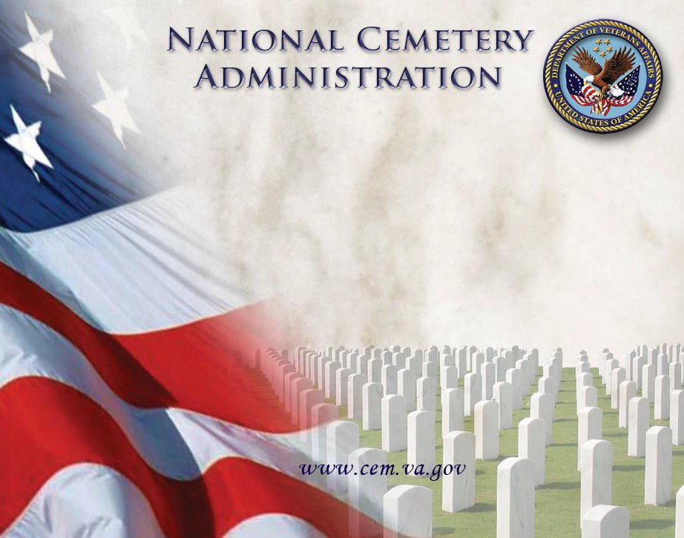
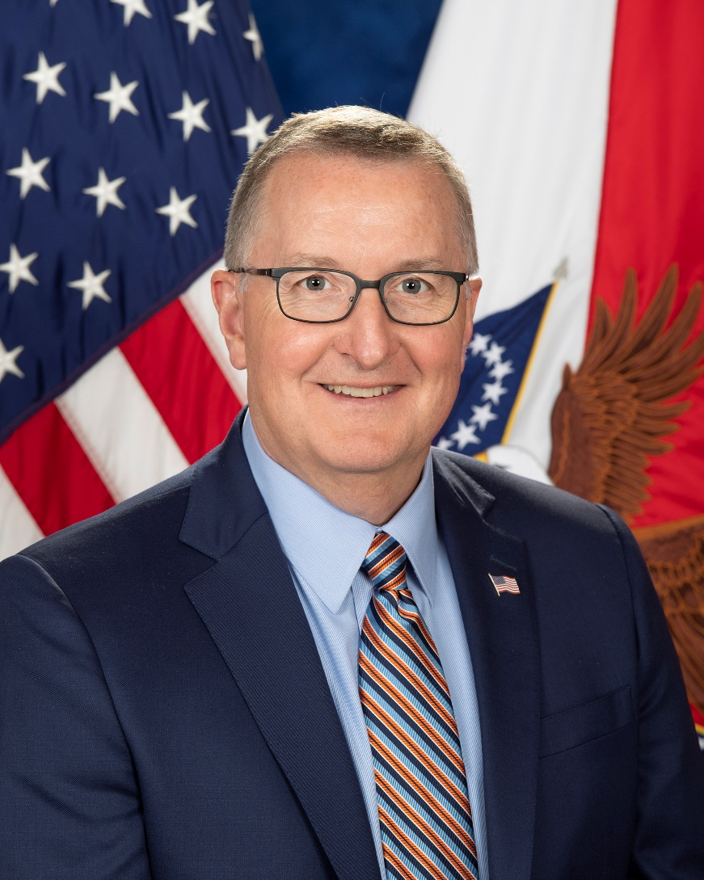


1
The Honorable Matthew T. Quinn
Under Secretary for Memorial Affairs
NCA Overview
October 3, 2023

Slide 2
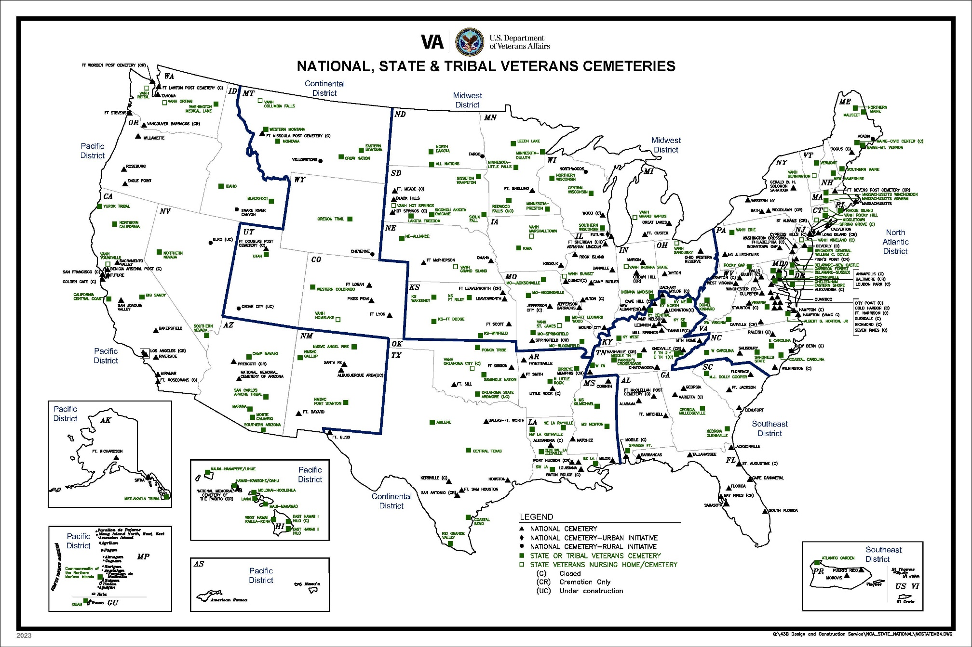
National, State and Tribal Cemeteries
NCA’s Coverage
Current: 93.81%
Goal: 95%
(As of October 2023)

Slide 3


Pre-Need Eligibility
    Launched December 8, 2016
  Assists Veterans and their families in planning for their future burial needs
  Subject to a final eligibility verification at time of need
  Does not guarantee burial in a specific cemetery or reserve a gravesite until time of need
PRESS OPTION 4
https://www.cem.va.gov/cem/pre-need/index.asp
Notes:
In 2016, NCA launched Pre-Need Determination of Eligibility to assist Veterans with burial decisions in advance of their time of need. The pre-need option helps families with end of life planning and is consistent with private sector practice.

Slide 4
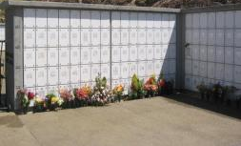
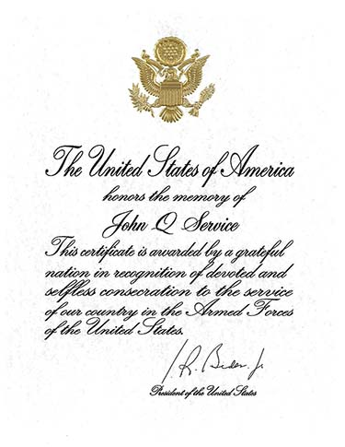
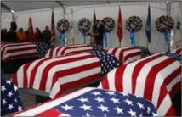
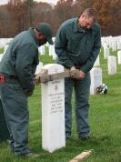
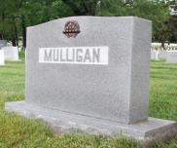

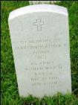
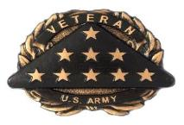
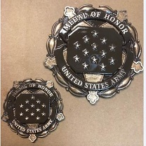
Burial and Memorial Benefits
Burial Flag
Niche Covers
Upright
Headstone
Presidential
Memorial
Certificate
Flat Marker
Medal of Honor Medallion
“In Memory
of…”
Bronze Medallion
Notes:
The Burial Benefits that NCA provides include a gravesite, the opening and closing of the grave, a grave liner, and perpetual care of the gravesite.
The Memorial benefits we provide can be seen on this slide. These are examples of different headstones, niche covers for columbaria, medallions and Presidential Memorial Certificates.
We provide H/M to eligible individuals all over the world, whether they are buried in a national cemetery or private cemetery. Last year, we processed 323,051 marker requests. We also sent 547,019 PMC’s to veterans’ families and loved ones.

Slide 5
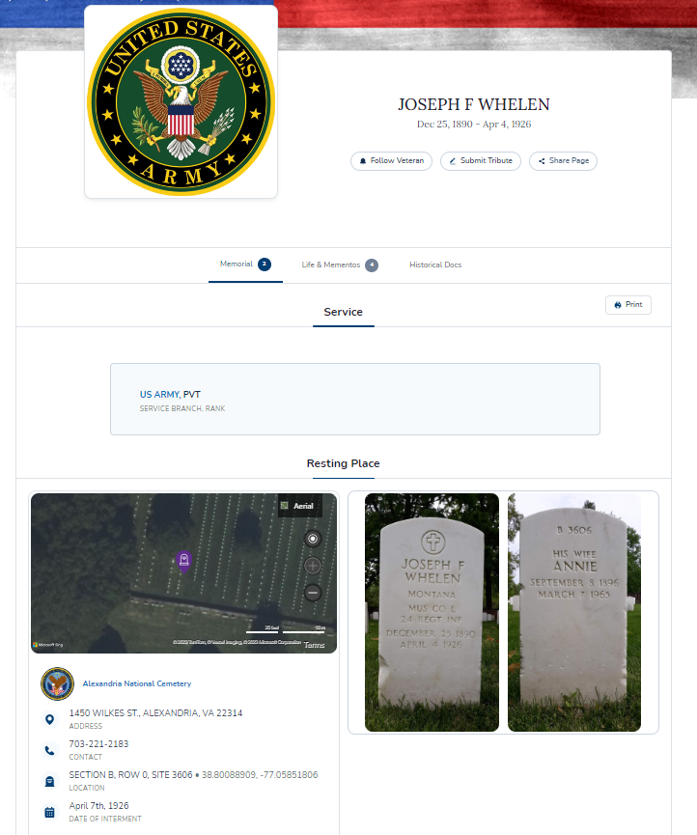
Veterans Legacy Memorial
NCA Web App launched in 2019 to honor Veterans in VA National Cemeteries. Expanded in 2021 and 2022 to include VA-grant funded state, tribal, territory Veteran cemeteries, and 2 of the 14 National Park Service cemeteries.
For Memorial Day this year,
added 27 DoD cemeteries (including
Arlington National Cemetery)
with ~300K more Veteran pages
Site is fully interactive, and
users can submit content to
Veteran pages. All content is
moderated before posting.
Currently 4.8+ Million Veteran
pages and 67K+ items posted.
www.va.gov/remember
Notes:
In 2016, NCA launched the Veterans Legacy Program (VLP). This is an educational outreach program which engaged students and educators in researching the lives of Veterans interred in our national, State and tribal cemeteries. Ultimately this research is shared with the general public and is incorporated into lesson plans for use by teachers and other educational materials.
The benefits and “reach” of this program is many fold.
Students gain a new appreciation for history by exploring how these individuals' lives contribute to the broader story of our nation.
They also gain a deeper understanding and appreciation of military service, which may o provide an entry point for exploring a career of public service to the Nation
To date, the Veterans Legacy Program has formed 16 partnerships with educational institutions have engaged over 1,000 college students, 200 college professors, 500 K-12 teachers, and over 10,000 K-12 students.
A law passed last year, will allow NCA to transition from contracts to grants. This is an important evolution of the program which will ultimately allow even greater reach.

Slide 6
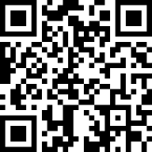
1
We want to hear from you
Please take our survey
Notes:
CONCLUSION/QUESTIONS
That concludes my presentation. Thank You very much!

