Slide 1





Undergraduate Research
Experiences at VSCC
Dr. Jerry Faulkner, President
Parris Powers, Associate Professor of Chemistry
Justin Pemerton, VSCC Student
Corbette Jackson, VU student

Slide 2
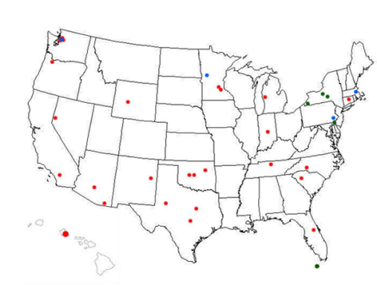

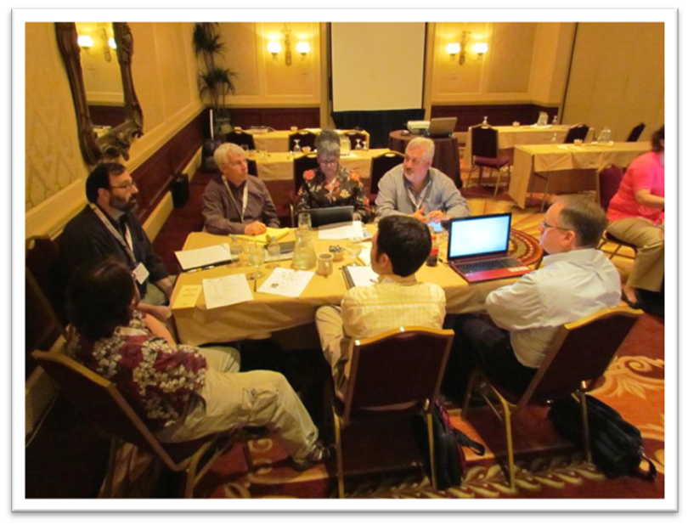
TUES Type III : $4.37M Total Funding (NSF)
IUSE: $1.7M Funding (NSF)
Vol State was selected as one of 25 Community College partners in 2011

Slide 3
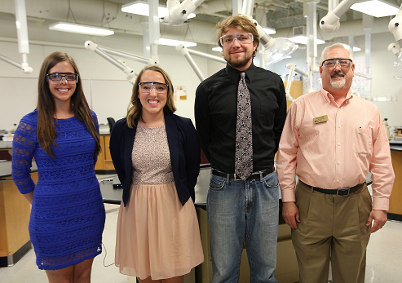
The Vol State case study
Self-study / strategic plan
Top down drivers (administrative priority)
CURE - Embedded research experience (required courses - barriers)
CCURI faculty development
External community research collaborations (network)
Internal CCURI research collaborations (network)
Univ. of Tennessee Univ. of Alabama, Wake Forest, Univ. of North Carolina, NC State, Univ. of Kentucky, Texas Tech, Univ. South Carolina, Mercer, Furman, Virginia Military Institute, UAB, APSU, TTU, TSU, LSU.....the list goes on……80 universities in the southeast ! !

Slide 4
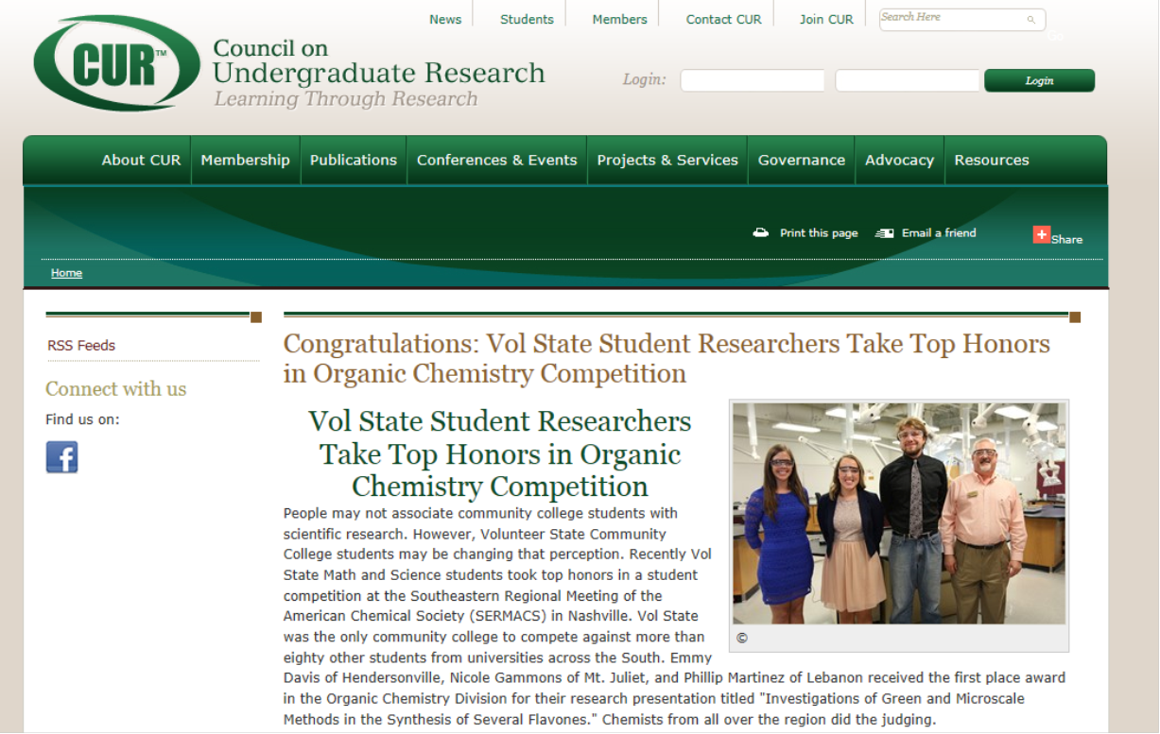

Slide 5
Undergraduate Research
Experiences at VSCC
Green and Microscale Techniques in the Synthesis of Flavones
Genomic Annotation of Acidianus hospitalis
Species Richness of Wildlife Using Non-Invasive Infrared Camera Trapping
Toxicity vs Wattage determination of 10 Solvents in Vapor Cigarettes

Slide 6
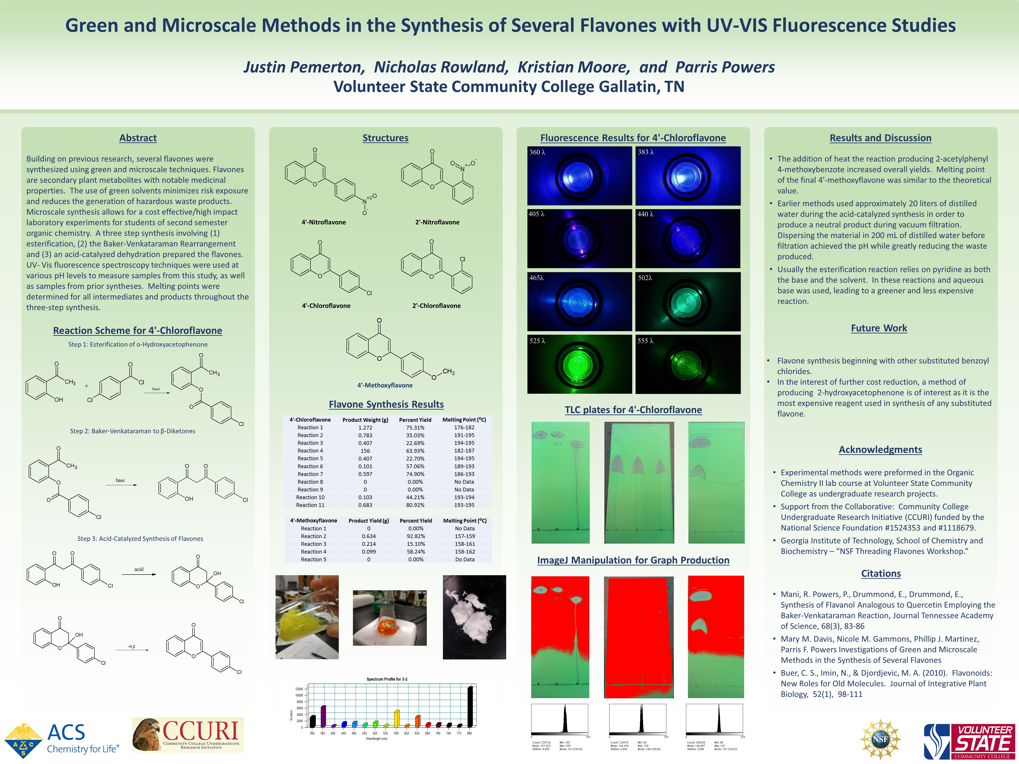

Slide 7
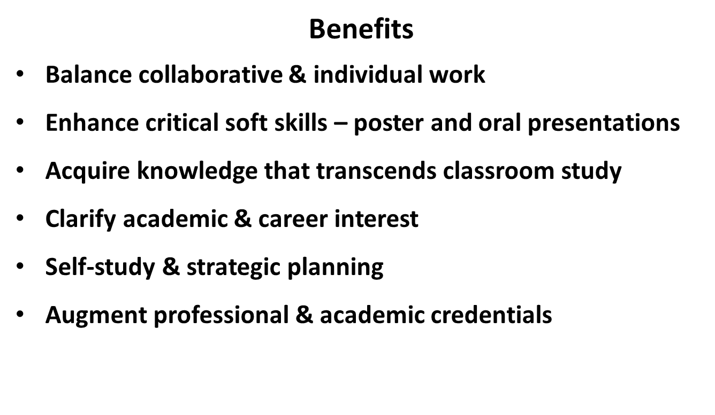
Undergraduate Research
Experiences at VSCC

Slide 8
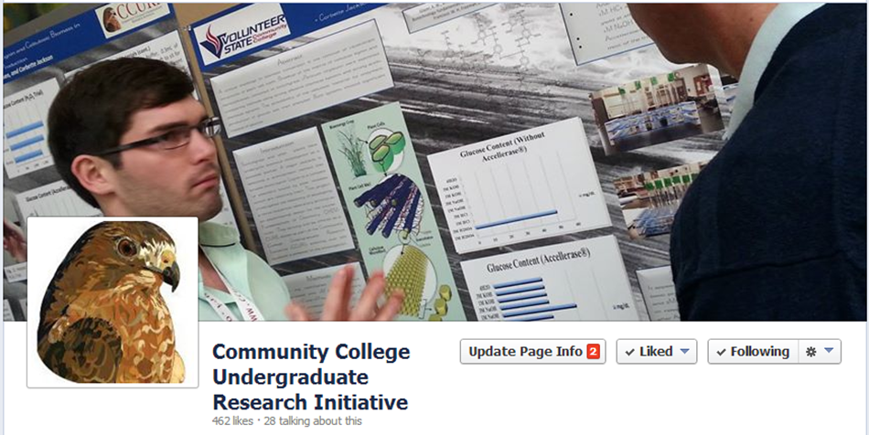
Undergraduate Research
Experiences at VSCC

Slide 9
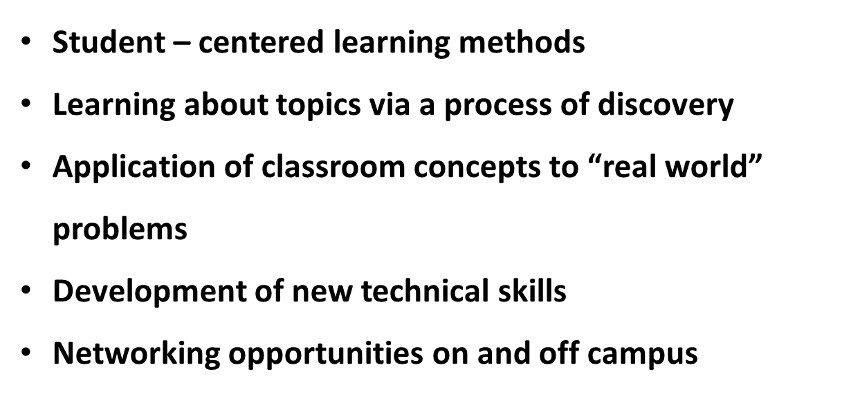
Undergraduate Research
Experiences at VSCC

Slide 10
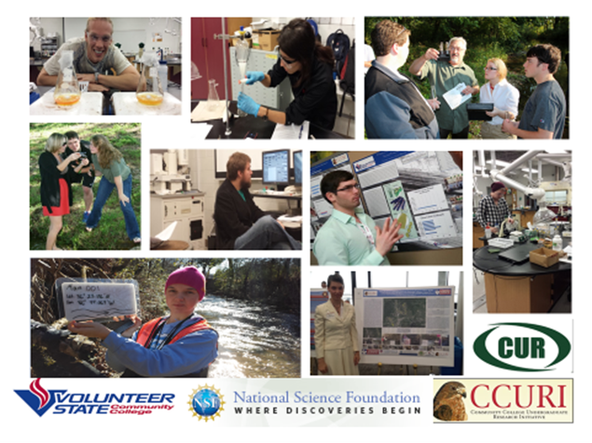
Undergraduate Research
Experiences at VSCC
Thank You

