Slide 1

Tennessee Board of Regents
Dr. Tristan Denley
Vice Chancellor for Academic Affairs
Tennessee Board of Regents
Tristan.Denley@tbr.edu
Twitter: @TDenley

Slide 2
Taking Student Success to Scale: Achieving Collective Impact
Math Pathways
High Impact Practices
Predictive Analytics

Slide 3


Co-requisite Remediation
Full System
Implementation
Fall 2015

Slide 4
Completion of Gateway Math by ACT Sub-score

Slide 5
Completion of Gateway English by ACT Sub-score

Slide 6
Completion of Gateway Reading Class by ACT Sub-score

Slide 7
Completion of Gateway Math by ACT Sub-score

Slide 8
Completion of Gateway English by ACT Sub-score

Slide 9
Average Community College Instructional Cost
per Successful Student in Mathematics
D. Jenkins et al., Community College Research Center, Columbia University

Slide 10

Co-requisite Remediation
Disaggregation

Slide 11
Completion of Gateway Math by ACT Sub-score
Community College Pre-requisite Model vs. Co-requisite Model

Slide 12
Completion of Gateway Math by ACT Sub-score
Community College Pre-requisite Model vs. Co-requisite Model

Slide 13
Completion of Gateway Math by ACT Sub-score
Community College Pre-requisite Model vs. Co-requisite Model

Slide 14
Completion of Gateway Math by ACT Sub-score
Community College Pre-requisite Model vs. Co-requisite Model

Slide 15
Completion of Gateway Math by ACT Sub-score
Community College Pre-requisite Model vs. Co-requisite Model

Slide 16
Completion of Gateway Math by ACT Sub-score
Community College Pre-requisite Model vs. Co-requisite Model

Slide 17

Natural order
Global centrality
Major centrality
Grade prediction
Academic Mindset

Slide 18


Primary Drivers of Productive Persistence
Believe they are capable of learning the material…
Feel connected to their institution
and that they belong…
Believe their coursework has value…
Believe they have the skills, habits
and knowhow to succeed

Slide 19
Believe they are capable of
learning the material…
FIXED
MINDSET
NEUTRAL
MINDSET
GROWTH
MINDSET
Mathematics

Slide 20
Believe they have the skills, habits
and knowhow to succeed
NEUTRAL
STRONG
CONFIDENCE
LITTLE
CONFIDENCE
Mathematics

Slide 21
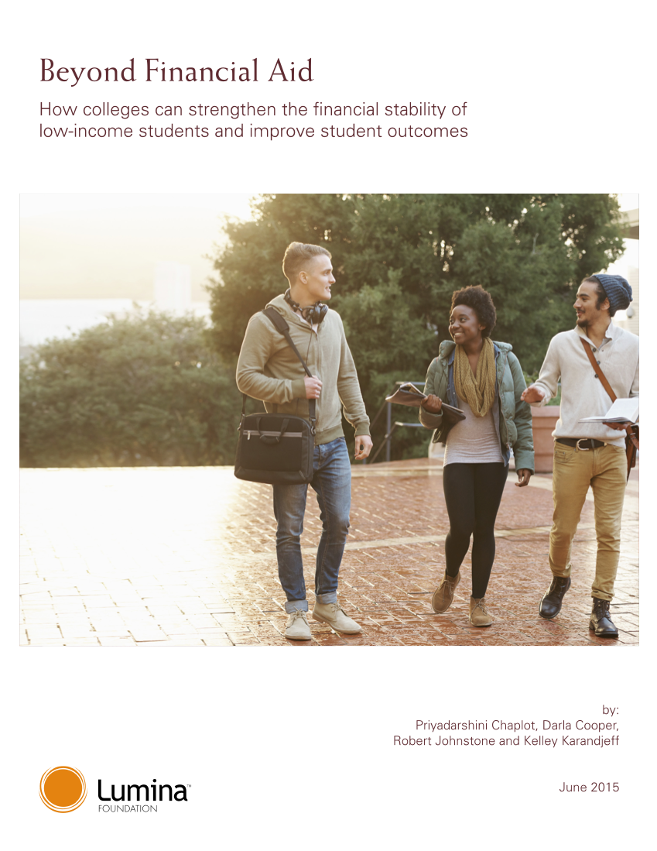
Beyond Financial Aid
Convening
Teams representing all universities, community colleges and TCATs
Two day event with support from Lumina and the Bill and Melinda Gates Foundation
Each institution made their own implementation plan

Slide 22
Thank you
Dr. Tristan Denley
Vice Chancellor for Academic Affairs
Tennessee Board of Regents
Tristan.Denley@tbr.edu
Twitter: @TDenley

