Slide 1
Statutory Reports:
Overview and Findings
Emily House
Tennessee Higher Education Commission
Winter Quarterly Meeting
January 27, 2016

Slide 2
Three reports, plus TN Promise
Articulation and Transfer
Profiles and Trends
Supply and Demand
TN Promise update

Slide 3
Reports available
https://www.tn.gov/thec/topic/legislative-reports

Slide 4
Articulation and Transfer

Slide 5
TN undergraduates are mobile.
Among those who earned a Bachelor’s degree in AY 2013-14:
  44.6 percent transferred at least once.
  33.7 previously enrolled at a 2-year institution (in- or out-of-state; public or private.)
  29.4 percent attended a CC in Tennessee.
Notes:
Not necessarily graduating from the first place you go. Informs conversation about transfer, pathways, seemless-ness of things.

Slide 6
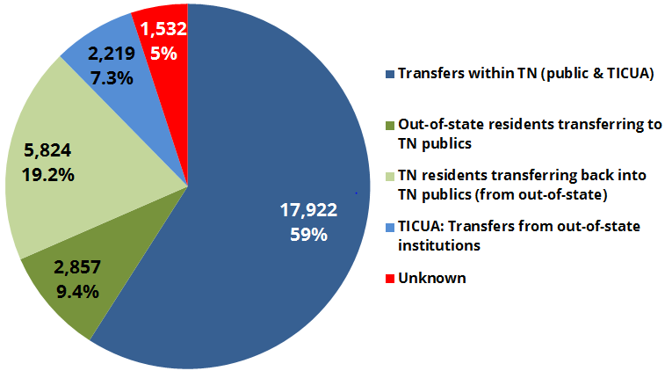
Where transfer occurs:
Notes:
Primarily within TN higher ed, or TN residents coming back into the state after leaving to enroll out-of-state. About 60 percent is people moving around in TN; about 20 percent is people coming back to TN after going somewhere else.

Slide 7
Transfer is multi-directional.
PUBLIC UNIVERSITY
6,092
47.2%
1,740
13.5%
Vertical
Horizontal
COMMUNITY COLLEGE
PUBLIC UNIVERSITY
N = 12,917
1,709
13.2%
Horizontal
Vertical
3,376
26.1%
COMMUNITY COLLEGE
Notes:
Interested in vertical transfer due to Promise. Bulk is upward, vertical transfer but there’s some swirl, too.

Slide 8
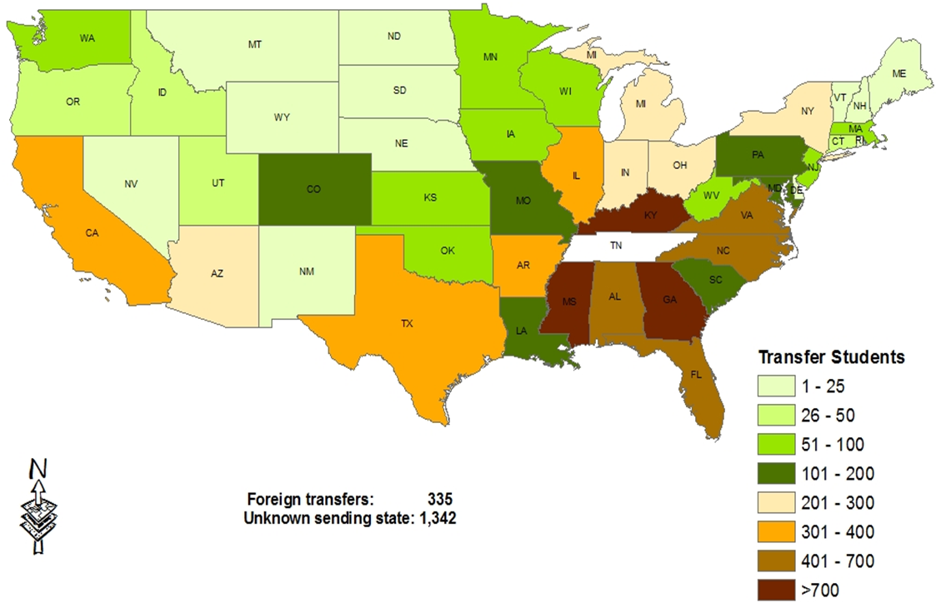
Out-of-state transfers
Notes:
Transfers from FL, TX, and CA are more than 60 percent returning Tennesseans.

Slide 9
Moving forward:
Transfer Pathways
  Time to degree?
  Impact on major choice?
Tennessee Promise
  How many Promise students transfer (to four-year institutions?)
  Students who transfer vs. those who do not?

Slide 10
Profiles and Trends
Notes:
How does TN compare to region? To USA? On a number of metrics – enrollment, graduation, affordability

Slide 11
New this year
Figures and data available on the THEC website.
Notes:
In the spirit of NCHEMS. No person-level data, so it’s fine. Can view figures and descriptions, just like in report, but can also download data as Excel file for any manipulation you’d like to do.

Slide 12
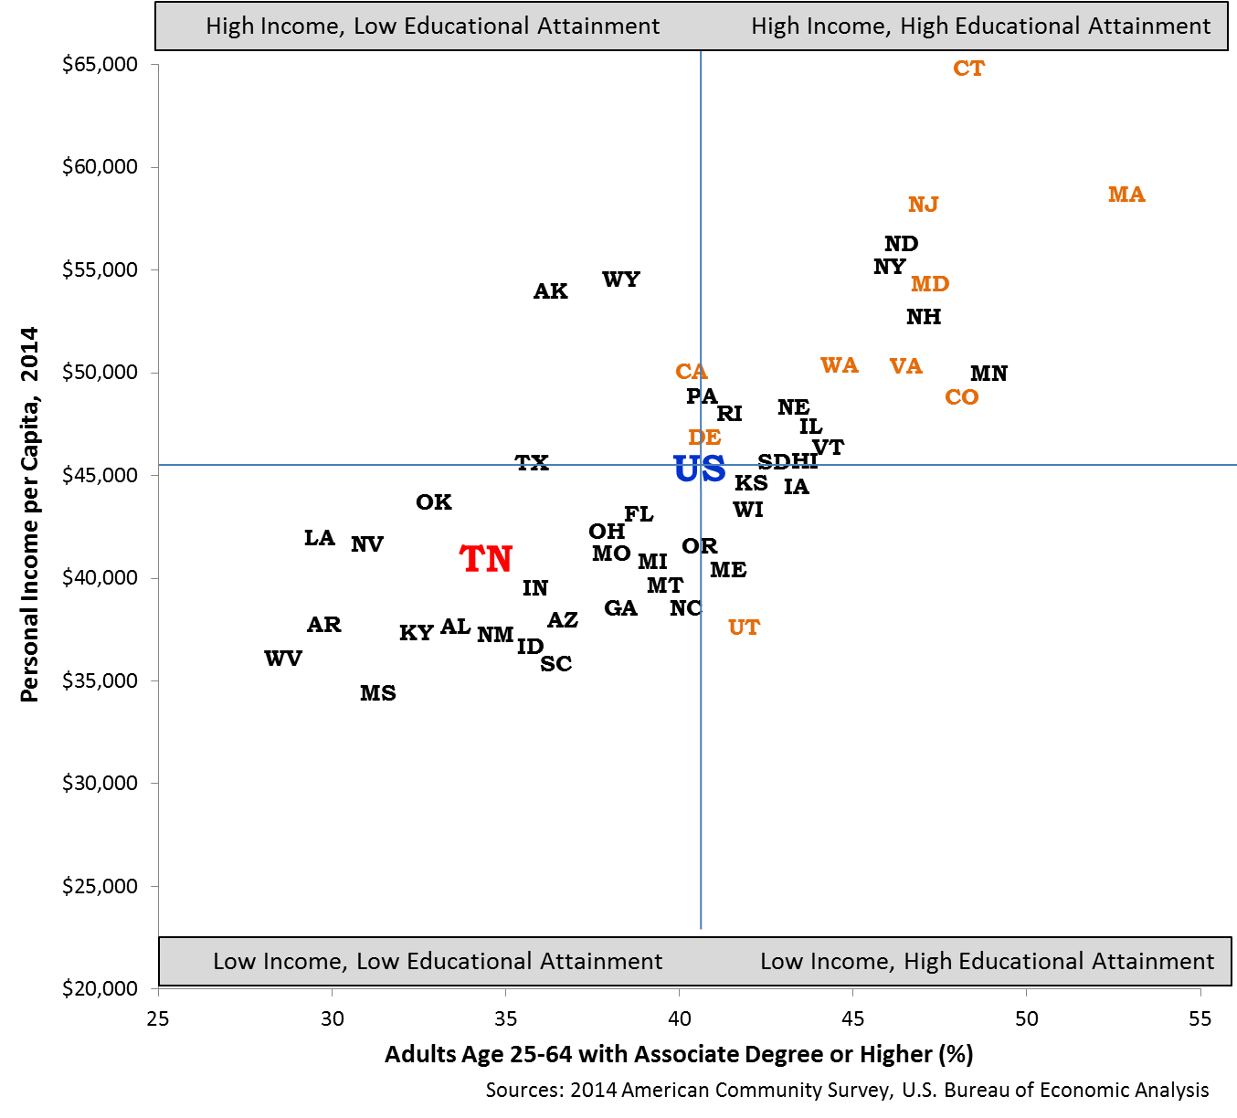
Attainment and personal income
Notes:
In the spirit of workforce alignment, attracting business, etc. We want to be in Q1. This is part of the point, right? Education and income are intertwined.

Slide 13
High school graduation rate
Notes:
This is great, but as Dennis says – going to take more than enrolling these students to meet D55. But this is something to feel good about.

Slide 14
College going rate – by race
Notes:
This is for TN. Overall CGR is about 57-58 percent. Interesting to see what TN Promise does to CGR overall, as well as by race and income.

Slide 15
College going rate – low income
Notes:
Still some work to do here. Defined as FARM eligible

Slide 16
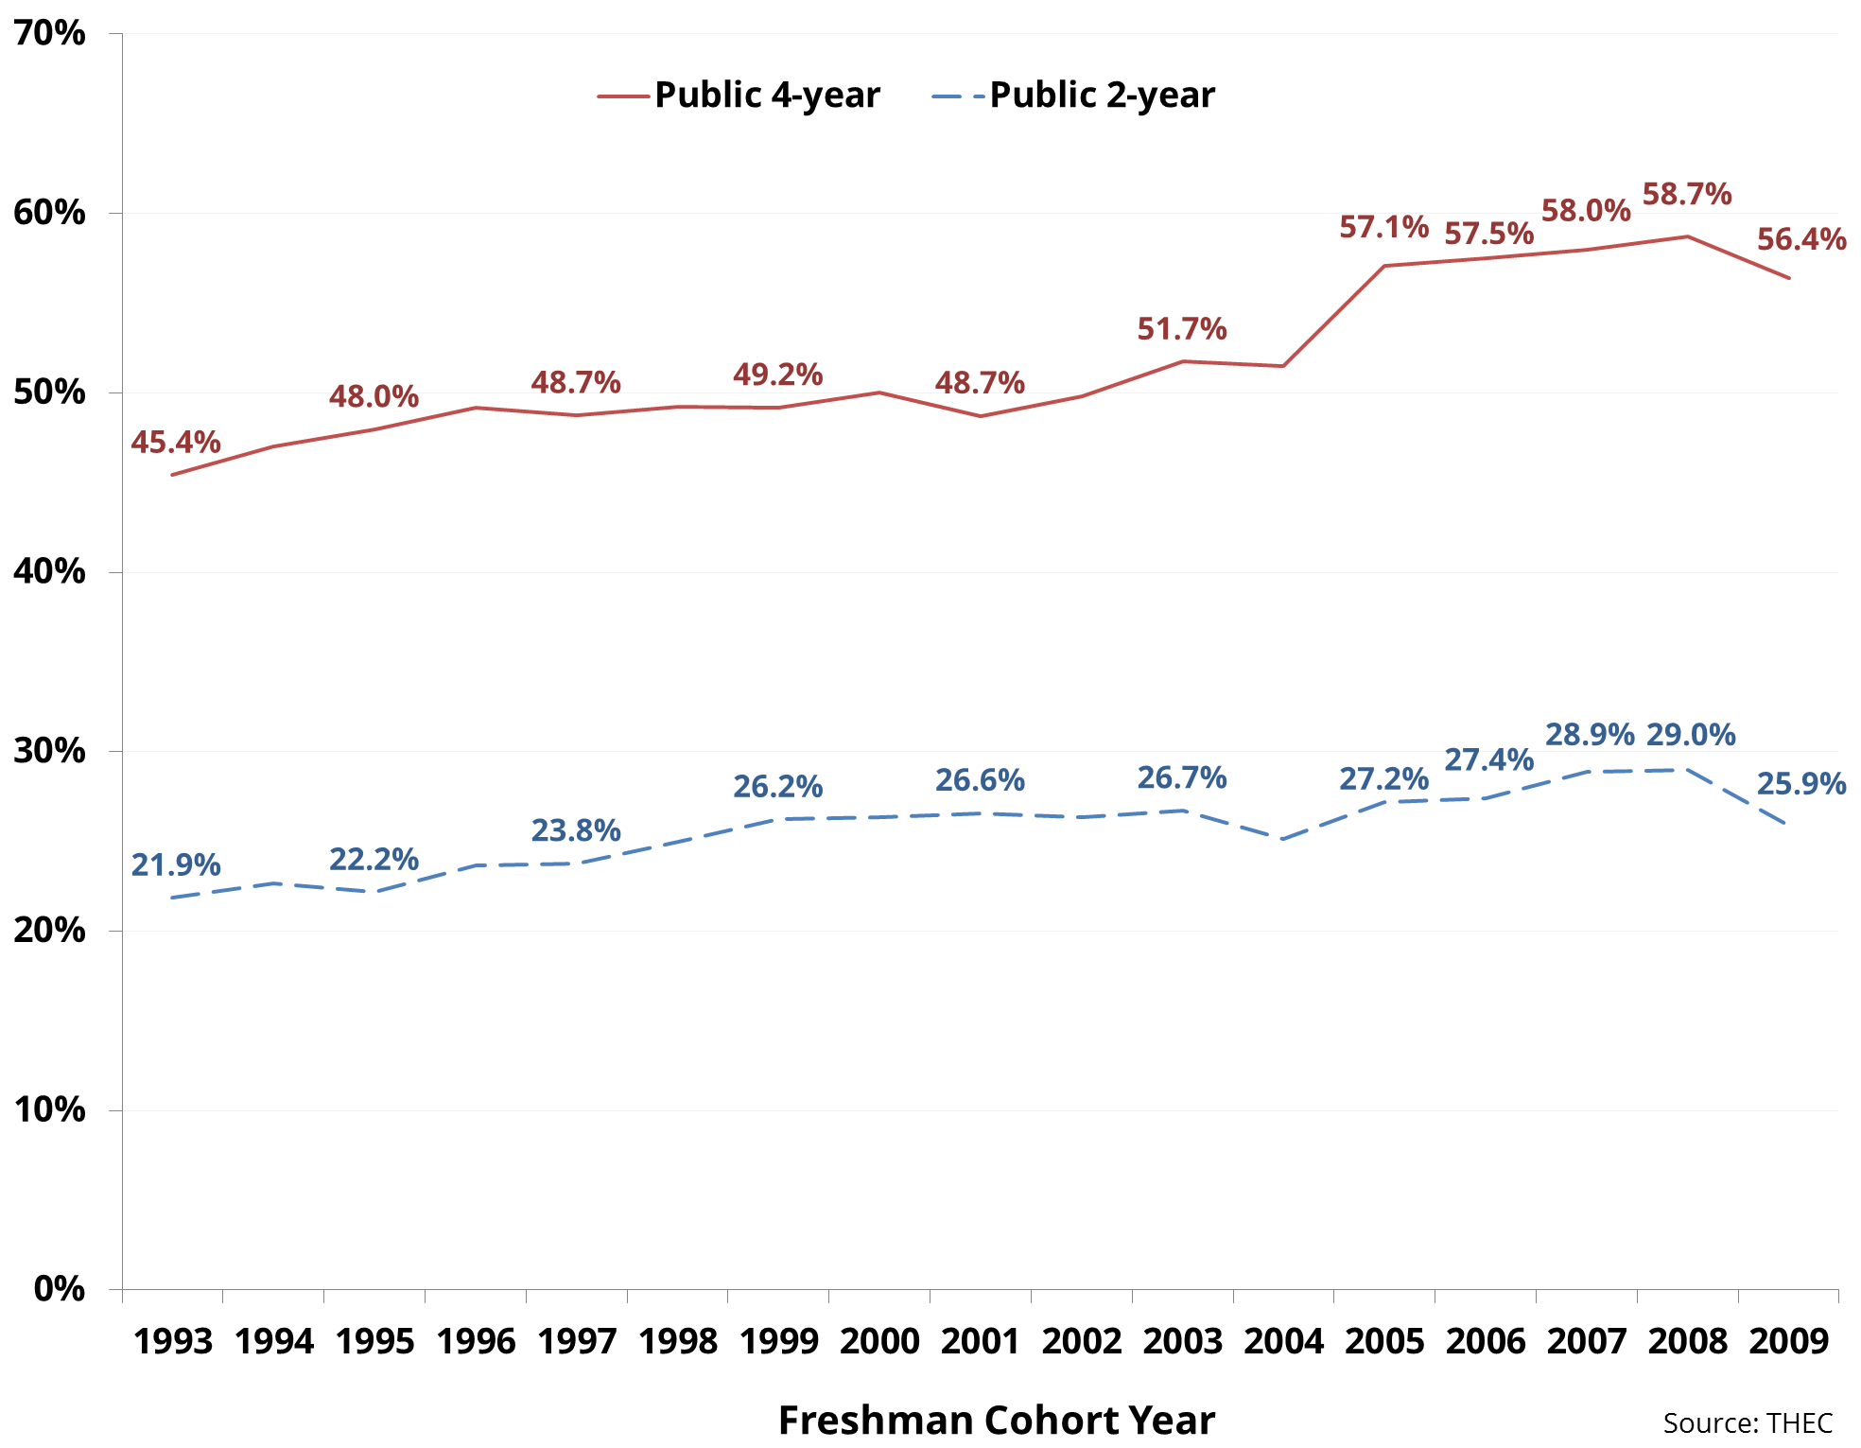
6-year graduation rate
Notes:
Beginning in 2005, new method used. Interesting to see what happens moving forward – push to enroll marginal students, more students in CCs, enroll more adults, etc.

Slide 17
6-year grad rate – by subgroup

Slide 18
Key takeaways:
Tennessee performs well on some metrics, and not as well relative to the nation as a whole and the Southern region on others.
How will trends change in next 1, 5, 10 years due to recent programs and interventions related to the Drive to 55?

Slide 19
Academic Supply and Occupational Demand
Notes:
Complements the LEAP report that Curt will talk about, as well as the LEAP report that ECD’s research team produced recently

Slide 20
Report overview
Degrees awarded in Tennessee will increase over the next decade.
  All degree levels
  Natural growth AND additional growth
There is high demand for skilled labor in a number of fields.
  Conversely, some fields oversupplied
Many institutions offer programs to meet workforce needs.

Slide 21
Expected awards
Greatest growth in BAs and certificates; public and for-profit institutions.
Growth does not account for “shocks” to higher education.
  Tennessee Promise
  Tennessee Reconnect
Notes:
Calculations and projections from Master Plan

Slide 22
Workforce needs
High-demand occupations are similar to those in past years:
  Manufacturing
  Construction
  Transportation
  Banking and finances
  Education
Salaries for these positions > statewide median per capita income (~ $25,000.)
Notes:
Median household income is $45,000, per TN Dept of Labor

Slide 23
Workforce needs
Occupation | Deficit | Average Salary
Manufacturing | 2,633 | $33,297
Transportation | 1,758 | $41,461
Construction | 1,500 | $42,000
Banking & Finance | 971 | $52,694
Education | 685 | $47,394

Slide 24
Program offerings
Academic and job-training programs to meet needs of high-demand occupations available at all institution types across the state.
  Not limited to one type of institution or region of the state.

Slide 25
i.e. - Construction
Program | Institutions | Award type
Building and Construction Technology | TCATs – Chattanooga, Livingston, Memphis, Nashville | Diploma, Certificate
Plumbing | TCAT - Chattanooga | Diploma, Certificate
Masonry | TCATs – Chattanooga, Memphis | Diploma, Certificate
Electrical Installation and Repair | TCATs Athens, Chattanooga; Pellissippi, Southwest CCs | Certificate
Electrical Engineering Technology | Chattanooga State Nashville State Southwest Northeast State CCs | AA
Construction Management | MTSU | BA
Notes:
To say nothing of the proprietary schools.
Look at the web media management one in the report, it’s a ton of different degrees.

Slide 26
Caveats:
There is not a one-to-one relationship between degree programs and jobs.
  i.e. highly specific certificates or doctoral degrees versus more general Bachelor’s degrees
Report does not fully demonstrate the role of proprietary institutions, due to data limitations.

Slide 27
Many resources address this:
THEC LEAP report
ECD reports
EduTrendsTn.com

Slide 28
Apprenticeships?

Slide 29
TN Promise update

Slide 30
Fall – Spring retention
We’ll know soon –
  14th day enrollment files forthcoming.
~80 percent of Promise students completed community service by December 1.
Who persists without TN Promise?
  Similar to TELS program?
  Transfer behavior

Slide 31
TN Promise: Next steps
Research, research, research
  TN Promise students enrolling elsewhere
  “Waterfall” – when do students drop off the TN Promise, and where do they end up?
  Students enrolling in 2- vs. 4-year institutions
  Variation by region, county, high school
    TDOE analyses
  Financial aid packaging

Slide 32
Thank you! Questions?
emily.house@tn.gov

