Slide 1

Seamless Alignment and Integration of Learning Support
January 27, 2016
Notes:
SAILS under umbrella of Drive to 55 in that in order to reach 55% with post secondary credential have to set them up for success. That is a joint effort between K-12 and higher education.
In TN, 75% of students at CCs require at least one remedial course but success is terrible. Of those placed in remedial math in college, only 5% complete a credential within 3 years!
SAILS changes the way we do remediation in TN.

Slide 2
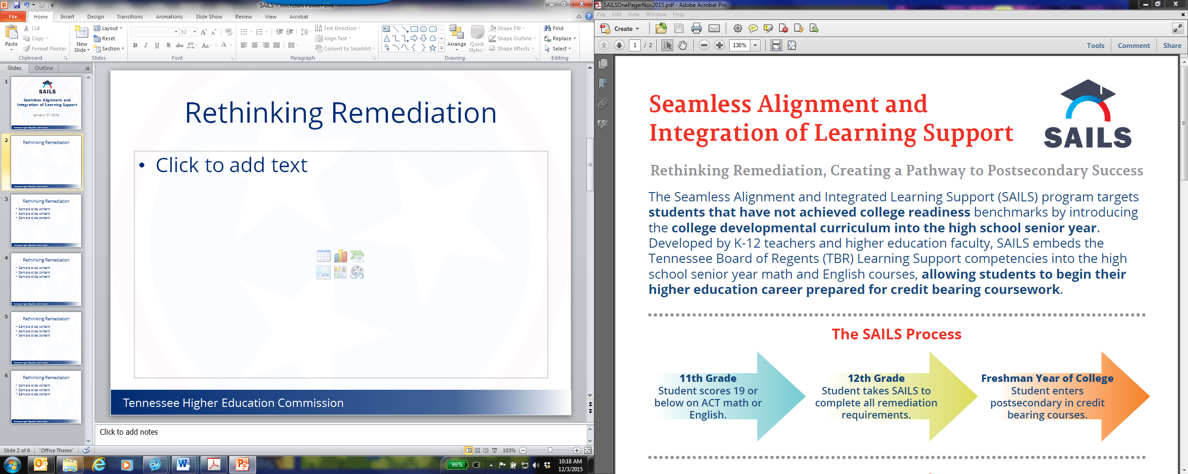
Rethinking Remediation
Developed by K-12 and higher education faculty, SAILS embeds the Tennessee Board of Regents Learning Support competencies into the high school senior year in blended learning environment, allowing students to begin college in credit bearing courses.
Notes:
Key Features:
Students with 18 or below considered not college ready.
K-12 AND Higher Ed – initial and field coordinators
Competency based – Embed TBR competences so good for credit at any TN public institution, not take ACT again
Blended learning – traditional not working for these students
Credit bearing in college – STAT for what happen if begin in remediation!!!
Save time and money

Slide 3
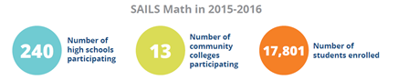
SAILS Math
Embed 5 TBR math learning support competencies in high school Bridge Math course
91 percent success rate in 2014-15
Notes:
Began as pilot project at ChSCC and local HS with 20 students in 2012. By end of 2015-16 reach over 37K students
Self Paced- If finish early, can take college level math and be ahead.
17,000 represents over half of the aprox 30K students identified as not college ready at end of 11th grade.
Highlighted by Inside Higher Ed and Bill and Melinda Gates Foundation as best practice
82% success rate over all

Slide 4
SAILS English
Embed TBR English and Writing Learning Support into English IV
Fully aligned to TN Academic Standards
Pilot: Chattanooga State partnered with 5 local high schools
Notes:
Fully aligned to TN High School and TBR (including speaking and listening)
Blended learning but not as self paced in that read and discuss literature together
5 schools on different schedules to get the best sense of if this is possible for expansion.

Slide 5
Questions
Victoria Harpool victoria.harpool@tn.gov

