Slide 1
Tennessee Promise:
Fall 2015 Update
Emily House
Tennessee Higher Education Commission
Fall Quarterly Meeting
November 19, 2015

Slide 2
Points of Interest
Characteristics of Tennessee Promise students
  Who is participating in the program?
Composition of first-time freshmen class, as compared to prior years
  Effect of Tennessee Promise on enrollment, student demographics, etc.
Notes:
This is a first look at these data – very descriptive and still preliminary. We have a lot of questions still to answer FOR SURE, these are just some of the first on the list.

Slide 3
Data Sources
TSAC
  Students who applied and/or met each TN Promise benchmark
  FAFSA and demographic information
Fall 2015 preliminary enrollment files (UT and TBR)
  Enrollment (not just Promise students)
  Demographic information
Notes:
Thank you to Tim and James at TSAC, James Hawkins, and Dennis Hengstler and Chris Tingle for their help with this.

Slide 4

Mar-April
Second
Mandatory
Meeting
August 1
Community
Service Deadline
Jan-Feb 5
First mandatory meeting
February 15
FAFSA Completion
Deadline
14-15 Public and Private HS Seniors: ~74,400
22,500
31,985
38,165
Nov 1
Application
Closes
43,105
58,000
Fall 2015: 16,291 enroll
Notes:
65,000 PUBLIC high school seniors, and about 10,000 PRIVATE HS seniors so 58,000 is about 90 percent of PUBLIC and 80 percent of PUBLIC AND PRIVATE. Very important to note that this final number is still moving, and we’ll have more info in the spring. This is due to certification, withdrawals and drop outs, etc.

Slide 5
Tennessee Promise Students
Where TN Promise students enroll:
  85 percent community colleges (and APSU)
  13 percent TCATs
  2 percent Promise-eligible TICUA institutions
Of those who completed all requirements but did not enroll:
  Four-year institutions (~1000 at public four-years)
  Private/out of state
  Did not enroll
Notes:
More to come about those who did not take advantage of TN Promise – where did they go? This will require a pull from Clearinghouse, which has not happened yet.

Slide 6
Tennessee Promise Students
 | TN Promise CC students | FTF out of HS, Fall 2014 (CCs) | FTF at CCs, Fall 2015 | FTF at CCs, Fall 2014
Race
White | 74% | 70% | 74% | 69%
African Amer | 14% | 19% | 18% | 19%
Hispanic | 4% | 5% | 3% | 4%
Female | 56% | 56% | 56% | 56%
Average ACT | 19.1 | 18.7 | 18.9 | 18.7
Average GPA | 3.05 | 3.04 | 3.00 | 3.04
Financial aid – VERY preliminary
ANY Pell | 53% | 53% | 55% | 51%
FULL Pell | 34% | 40% | 33% | 40%
Pell covers T&F | 45% | 53% | 44% | 51%
TELS | 58% | 48% | 43% | 48%
Notes:
TELS eligibility is shaky because we are still waiting for certifications. TELS seems high but makes sense, given that average GPA is 3.05.
Median EFC is $4,038; average annual TN Promise award amount is $1,020, per Tim Phelps. This only includes students for whom we have a FAFSA record – does not include those who don’t have a record for Pell, TELS, etc.

Slide 7
Program Cost
Average TN Promise award: $1,020
  Less than projected; less than Tennessee Achieves awards in prior years
Net program cost for 2015-16: $10.6M
  Accounts for savings from changes to TELS
Notes:
This is an annual award. Tuition at CCs about $4,000 and $3,500 at TCATs

Slide 8
First-time Freshmen: Enrollment
 | Fall 2015 | Fall 2014 | Delta
FTF Enrollment
TBR CCs | 21,679 | 17,379 | 24.7%
TCATs | 10,432 | 8,691 | 20.0%
TBR Universities | 10,977 | 11,983 | -8.4%
UT | 7,611 | 7,977 | -4.6%
TOTAL | 50,699 | 46,030 | 10.1%
Notes:
This varies by institution.
Not using causal language, but this likely has a lot do to with Promise. BUT – this is not BECAUSE OF PROMISE.
Likely some new entrants, though – the decrease in 4 years is not equal to the increase in CCs and TCATs, so we must have some new people in there too.

Slide 9
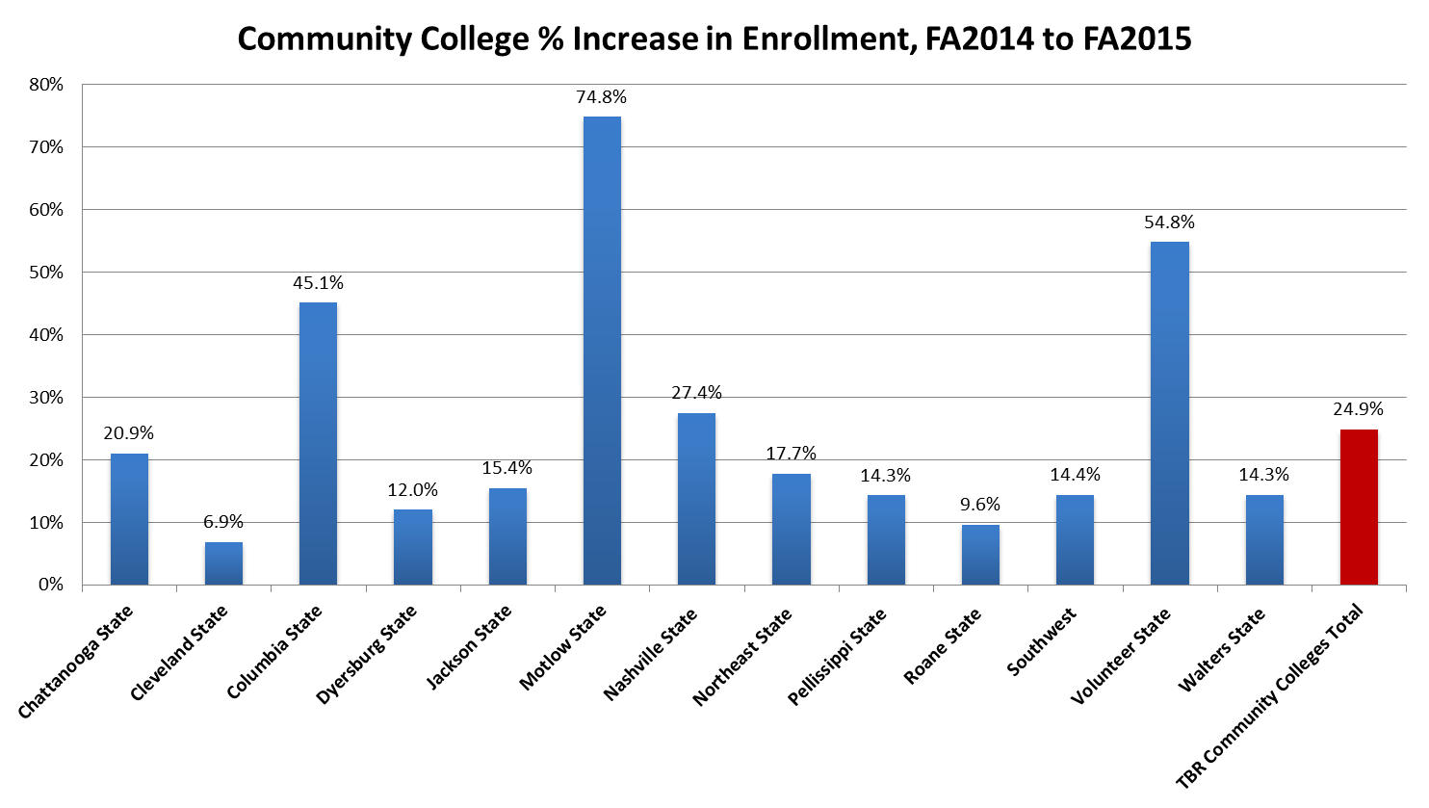

Slide 10
Non-TN Promise enrollees at CCs
(N = 6,600)
6,660 CC FTF
1,874 (28%) signed up for Promise but fell off “waterfall” (most did not attend first meeting.)
1,178 are HS class of 2015 who did not sign up for Promise (25% from out of state.)
2,709 from prior high school graduating classes (2007-2014.)
Notes:
There’s still about 1,000 people – who are they? Still digging.
These people had a slightly higher mean GPA than Promise kids (3.2 versus 3.0) which makes me think they thought they are going to a four-year.

Slide 11
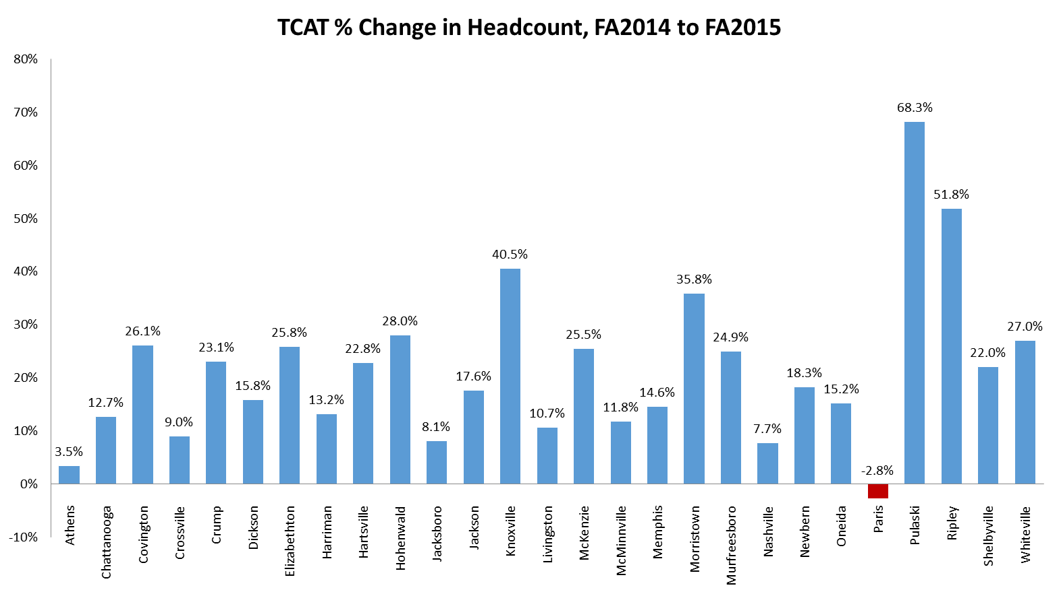
Notes:
A lot of this can be attributed to Reconnect more so than Promise, per Carol Puryear, but about 2,000 Promise kids are at TCATs.

Slide 12
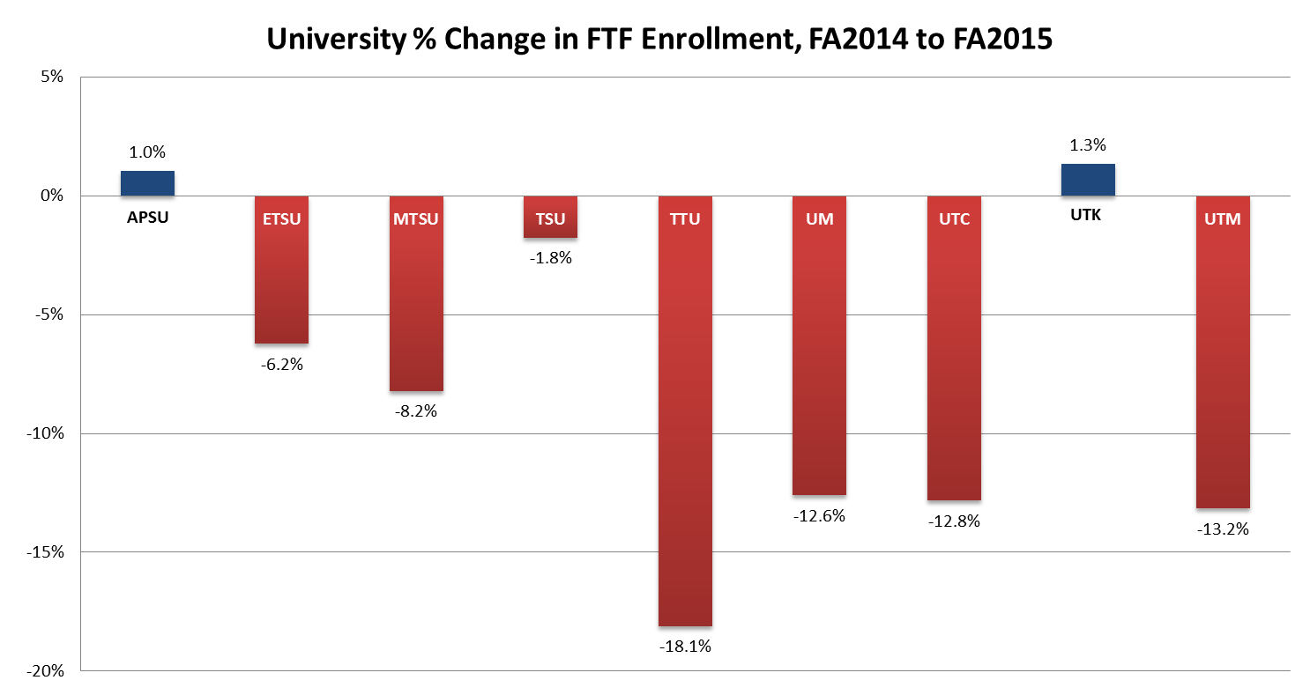

Slide 13
College-going Rate
Changes to college-going rate (CGR)
  Approximately 4,000 new entrants into higher education in Tennessee.
    Most at CCs and TCATs
  CGR will likely increase ~5-6 percent.

Slide 14
CGR by state

Slide 15
CGR by state

Slide 16
First-time Freshmen: ACT Scores
 | Fall 2015 | Fall 2014 | Delta
FTF average ACT score
TBR CCs | 18.9 | 18.8 | 0.1
TBR Universities | 22.1 | 21.9 | 0.2
UT | 25.5 | 24.7 | 0.8

Slide 17
Average ACT by Institution, FTF
 | Fall 2014 | Fall 2015 | Delta, Fall 14 to Fall 15
TBR Community Colleges
Chattanooga State Community College | 18.5 | 18.9 | 0.4
Cleveland State Community College | 19.0 | 18.9 | -0.1
Columbia State Community College | 19.6 | 19.9 | 0.3
Dyersburg State Community College | 18.9 | 18.7 | -0.2
Jackson State Community College | 18.6 | 18.4 | -0.2
Motlow State Community College | 19.2 | 19.1 | -0.1
Nashville State Community College | 17.6 | 18.0 | 0.4
Northeast State Community College | 19.3 | 19.2 | -0.1
Pellissippi State Community College | 19.9 | 20.1 | 0.2
Roane State Community College | 19.2 | 19.4 | 0.2
Southwest Tennessee Community College | 16.6 | 16.5 | -0.1
Volunteer State Community College | 19.3 | 19.3 | 0.0
Walters State Community College | 19.4 | 19.4 | 0.0
TBR Community Colleges Total | 18.8 | 18.9 | 0.1
Notes:
Just FTF

Slide 18
Average ACT by Institution, FTF
 | Fall 2014 | Fall 2015 | Delta, Fall 14 to Fall 15
TBR Universities
Austin Peay State University | 21.8 | 21.5 | -0.3
East Tennessee State University | 22.0 | 22.9 | 0.9
Middle Tennessee State University | 22.1 | 22.1 | 0.0
Tennessee State University | 18.0 | 17.9 | -0.1
Tennessee Technological University | 23.5 | 24.3 | 0.8
University of Memphis | 22.4 | 22.8 | 0.4
TBR Universities Total | 21.9 | 22.1 | 0.2
University of Tennessee
University of Tennessee, Chattanooga | 23.0 | 23.4 | 0.4
University of Tennessee, Knoxville | 26.0 | 26.9 | 0.9
University of Tennessee, Martin | 22.4 | 22.7 | 0.3
University of Tennessee Total | 24.7 | 25.5 | 0.8

Slide 19
Average ACT by institution, FTF
Increases in average ACT scores at universities – why?
  Students in the middle of the ACT distribution (17-26) are more likely to enroll in CCs in Fall 2015, as compared to prior semesters.

Slide 20
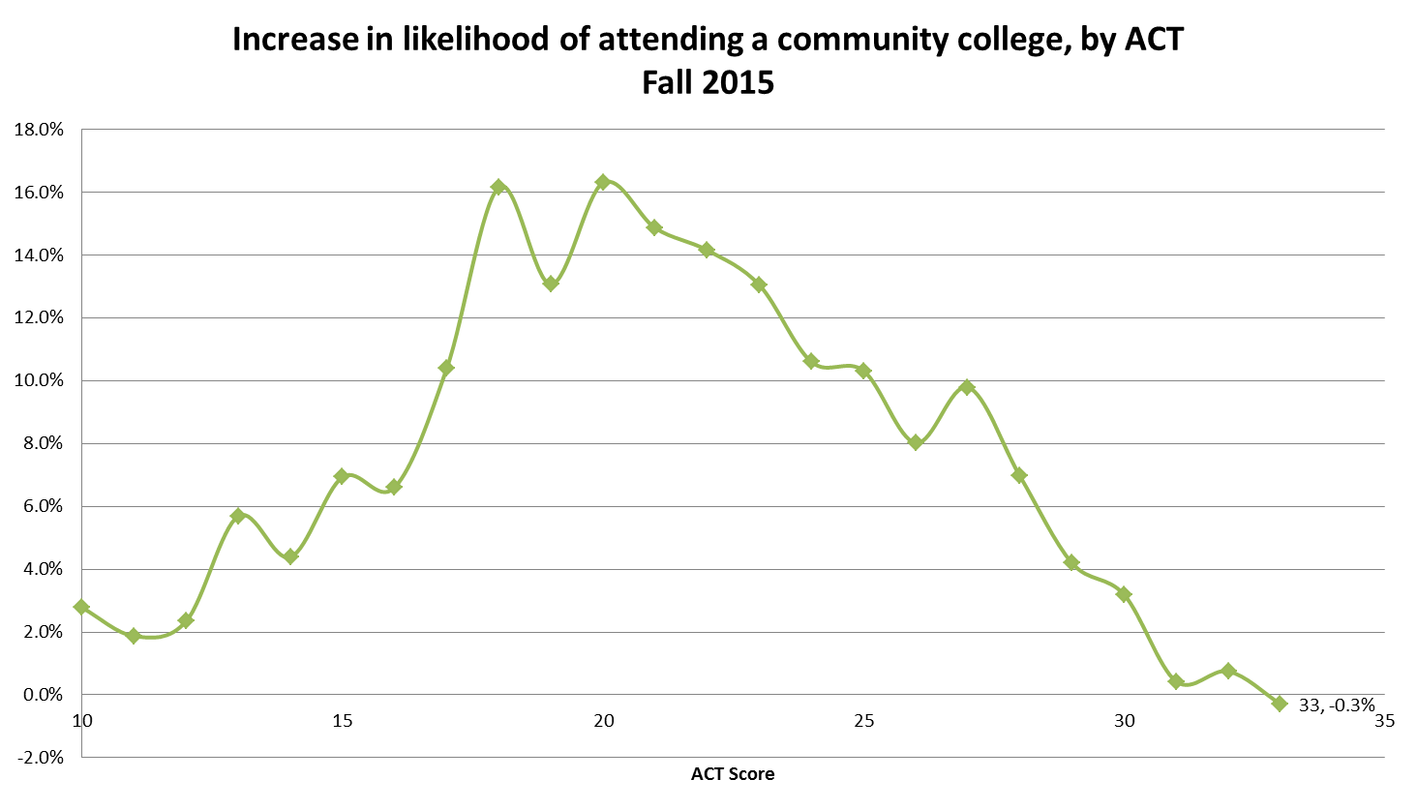
Notes:
Most of these students are on the margin of being academically eligible to attend a four-year versus a two-year. Increase in odds compared to past 3 years (2012-2014.)

Slide 21
ACT Pop Change
2014 to 2015 | Chattanooga | Cleveland | Columbia | Dyersburg | Jackson | Motlow | Nashville | Northeast | Pellissippi | Roane | Southwest | Volunteer | Walters | Total
15 | 36 | 10 | 29 | 9 | 1 | 72 | 58 | 18 | 8 | 8 | 64 | 69 | -3 | 379
16 | 36 | 12 | 42 | 18 | 39 | 89 | 50 | 30 | 10 | 21 | -5 | 78 | 11 | 431
17 | 46 | 13 | 25 | 14 | 8 | 80 | 39 | 37 | 52 | 2 | 41 | 115 | 18 | 490
18 | 52 | 11 | 53 | 11 | 35 | 58 | 75 | 61 | 50 | 29 | 58 | 89 | 36 | 618
19 | 47 | 5 | 36 | -5 | 20 | 29 | 57 | 45 | 30 | 26 | 40 | 87 | 6 | 423
20 | 41 | -9 | 52 | 15 | 31 | 99 | 41 | 36 | 39 | -4 | 27 | 109 | -4 | 473
21 | 45 | 3 | 22 | 2 | 10 | 62 | 44 | 23 | 0 | 18 | 17 | 68 | 53 | 367
22 | 39 | 3 | 16 | 6 | -19 | 53 | 43 | 18 | 24 | 19 | 19 | 28 | 19 | 268
23 | 25 | 0 | 33 | 1 | 6 | 32 | 31 | 31 | 30 | 24 | 12 | 43 | -3 | 265
24 | 21 | 3 | 25 | 8 | 17 | 27 | 10 | -2 | 52 | 2 | 9 | 25 | -1 | 196
25 | 10 | 4 | 22 | -5 | 15 | 26 | 21 | 5 | 29 | -2 | -9 | 37 | 14 | 167
26 | 5 | 0 | 16 | 4 | 11 | 21 | 13 | 5 | 7 | 10 | -4 | 28 | 18 | 134
27 | 12 | 2 | 20 | 0 | -6 | 8 | 8 | -1 | 19 | 2 | 4 | 29 | 8 | 105
28 | 15 | 1 | 8 | -1 | -1 | 12 | 4 | 3 | 16 | 12 | 2 | 13 | 3 | 87
29 | 2 | 0 | 8 | 1 | -2 | 14 | 2 | -1 | 4 | 2 | 3 | 7 | -1 | 39
30 | 2 | -1 | 2 | 3 | 0 | 3 | 1 | 2 | 6 | 2 | 1 | 6 | 4 | 31

Slide 22
ACT Pop Change
2014 to 2015 | APSU | ETSU | MTSU | TSU | TTU | UM | UTK | UTM | UTC | Total
15 | 13 | -15 | 11 | -17 | -2 | 3 | 0 | 1 | 0 | -6
16 | 29 | -13 | 35 | 4 | 1 | 1 | -2 | -1 | -3 | 51
17 | 21 | -27 | 32 | 7 | -36 | -7 | -1 | -10 | -5 | -26
18 | 21 | -30 | -7 | -21 | -15 | -48 | -22 | 3 | -14 | -133
19 | 8 | -5 | -9 | 24 | -41 | -37 | -34 | -41 | -8 | -143
20 | -31 | -39 | -48 | 20 | -47 | -70 | -17 | -20 | -28 | -280
21 | -22 | -61 | -60 | 10 | -64 | 1 | -33 | -40 | -63 | -332
22 | -8 | -8 | -65 | 2 | -61 | -52 | -150 | -14 | -74 | -430
23 | -21 | -25 | -39 | -13 | -46 | -49 | -81 | -18 | -25 | -317
24 | 19 | -2 | -43 | -9 | -17 | -10 | -101 | -17 | -18 | -198
25 | -3 | 29 | -23 | -20 | -12 | 18 | 1 | -11 | -38 | -59
26 | 5 | 2 | -8 | 1 | 3 | -8 | -5 | -8 | -10 | -28
27 | -9 | 7 | 8 | 2 | 13 | 8 | 11 | -3 | 8 | 45
28 | -13 | 32 | -9 | -1 | 15 | -10 | 103 | -2 | 4 | 119
29 | -18 | 22 | 8 | 2 | 31 | 14 | 33 | 6 | 7 | 105
30 | 7 | 22 | 13 | -1 | -9 | 5 | 95 | 8 | -3 | 137

Slide 23
Average ACT by institution
Increases in average ACT scores at universities – why?
  Recruit and enroll a greater number of high-scoring out-of-state students

Slide 24
% out-of-state FTF
 | Fall 2015 | Fall 2014 | Delta
APSU | 142 | 131 | 8.4%
ETSU | 344 | 305 | 12.8%
MTSU | 175 | 226 | -22.6%
TSU | 593 | 504 | 17.7%
TTU | 47 | 85 | -44.7%
UM | 258 | 294 | -12.2%
UTC | 78 | 70 | 11.4%
UTK | 801 | 679 | 18.0%
UTM | 94 | 88 | 6.8%

Slide 25
% out-of-state FTF, high ACT
 | Fall 2015 | Fall 2014 | Delta
APSU | 26 | 13 | 100%
ETSU | 28 | 13 | 115.4%
MTSU | 41 | 29 | 41.4%
TSU | 10 | 9 | 11.1%
TTU | 7 | 12 | -41.7%
UM | 56 | 50 | 12%
UTC | 11 | 11 | 0%
UTK | 434 | 248 | 55.6%
UTM | 12 | 19 | -36.8%

Slide 26
Next Steps
Research, research, research
  TN Promise students enrolling elsewhere
  “Waterfall” – when do students drop off the TN Promise, and where do they end up?
  Students enrolling in 2- vs. 4-year institutions
  Variation by region, county, high school
  Persistence and retention (Fall to spring, Year 1-2)
Notes:
As I said earlier, this is just a first pass using this data. We have many more questions that we can and will explore – these are just some of them.

Slide 27
Key Takeaways
Increase in FTF enrollment will increase Tennessee’s college-going rate by 5-6%.
Shifts in enrollment to CCs and TCATs from four-years more profound than expected.
Students in the middle of the ACT distribution are more likely to enroll in CC than in past.
Increases in high achieving out-of-state enrollment at universities.

Slide 28
Tennessee Promise – Cohort 2
59,621 high school seniors have signed up for 2016 Tennessee Promise
  Deadline to sign up was November 2
Similar to Cohort 1 at this point in time
  67 percent White
  50 percent female
  Majority state intention to attend CCs; 10 percent list TCAT as preferred institution.
Notes:
Last year, we had 58,000 and this year, applications increased by about 1,600. This is about 92 percent of public HS seniors.

Slide 29
Questions?
Thank you!
emily.house@tn.gov

