Slide 1
Office of P-16 Initiatives Update
November 19, 2015

Slide 2
Latino Student Success
Project concluded September 30, 2015
$600,000 four-year grant from Lumina Foundation
Focus: to increased Latino degree attainment in Memphis
  Collaborative partnership building
  Abriendo Puertas college access program

Slide 3
Latino Student Success
Outcomes
Collaborative-building
  Latino Student Success work group integrated into the Strive network
  Memphis received a Community Partnership for Attainment (CPA) grant from Lumina Foundation
    Focus on Latino students
  Increased focus on role of Latino students in meeting community-wide attainment goals

Slide 4
Latino Student Success
Outcomes
Abriendo Puertas
  Program model is cost-effective and sustainable
  Community college access and success workshops and events
  College Advising services to ~400 students at 7 high schools
  90 percent college enrollment (3 year avg)
  96 percent high school grad rate
  3.07 avg GPA

Slide 5
Latino Student Success
Increased college affordability
  Higher education institutions discount tuition through targeted financial aid
  Private funders provide LSS Scholarships and small, interest-free loans
  Student support on campus: dedicated staff member + student organization
  $12.5 million commitment to support LSS scholarships at Christian Brother’s University
  CBU goal: 15% of incoming class is Latino

Slide 6
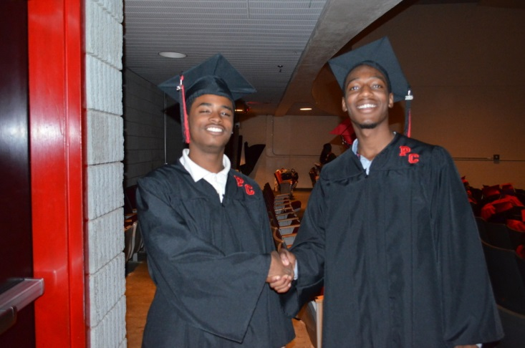
Path to College Events
College App Week 2015
  252 schools and organizations in 78 counties
College Planning Night
  Parent-focused workshop on what parents need to know as their student prepares to enter senior year – 77 participating high schools
College Signing Day
  School-wide event that celebrates the seniors who are continuing on to postsecondary education – 68 participating high schools
College Goal Tennessee
  Students and parents receive assistance
  with completion of the FAFSA form and
  can get other financial aid and planning
  advice
  Working with TDOE, TSAC, and Tennessee
  Promise partnering organizations to align
  FAFSA completion initiatives to the new
  FAFSA filing calendar

Slide 7
Overview of CollegeforTN.org
Initiative began in 2005 as a partnership between the Tennessee Higher Education Commission, the Department of Education, and the Tennessee Student Assistance Corporation.
Goal: CollegeforTN.org will serve as Tennessee’s premier college and career exploration and planning resource
Data:
    493,860 accounts created since 2005
    51,641 accounts created on average per year
    Last school year, over 130,000 users visited the site, spending on average approximately 12 minutes on the site per use. Over 2 million page views.

Slide 8

CollegeforTN.org and Transcript Exchange
New vendors selected
Current electronic transcript solution ceased operation on October 31
Current web portal solution will cease operation at the end of the calendar year
Relaunch of CollegeforTN.org and the electronic transcript solutions will occur in Spring 2016

Slide 9
Vision for a New CollegeforTN.org
Serves as a single, integrated destination for information and resources regarding college-going in Tennessee
Gives students back their data so that they can adequately plan and make informed decisions regarding postsecondary education
Provides educators, parents, and other key influencers tools and data to track students’ progress towards a successful postsecondary transition

Slide 10

New CollegeforTN.org Vendor
Xap Corporation – 2005 to 2015
      Web portal and electronic transcripts
Request for Proposals released Summer, 2015
      High school, career, college, and financial aid planning resources
      Vendor relationship that is adaptable and a product that is agile to meet the needs of Tennessee and its students
Kickoff Meeting – October 1

Slide 11
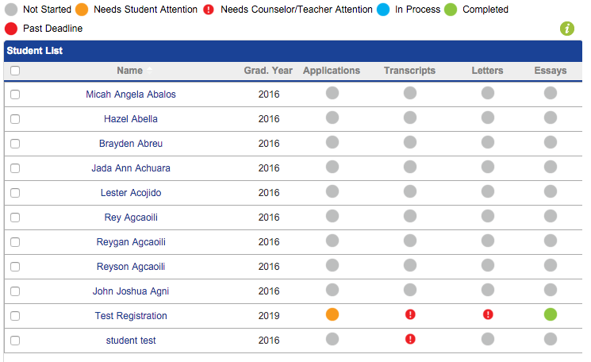
CollegeforTN.org Functionality
Statewide creation of accounts
Student planning resources
Educator management resources inspired by GEAR UP TN and the Ayers Foundation

Slide 12

Vision for an Electronic Transcript Solution
Seamless movement of transcript data:
High School
Higher Education
High School
TSAC
Higher Education
Higher Education
Compatibility with K-12 and higher education student information systems

Slide 13

New Transcript Vendor
Request for Proposals released Summer, 2015
      Compatibility with K-12 student information systems and higher education ERP systems key
      Transcript data flow: high school to higher ed, high school to TSAC, and higher ed to higher ed
Working group convened on October 16 to discuss business processes, workflow, etc.
Scheduled launch – Spring 2016

Slide 14
Questions?

