Slide 1
Postsecondary Attainment in the Decade of Decision
The Master Plan for Tennessee Postsecondary Education
2015-2025
July 23, 2015
Tennessee Higher Education Commission

Slide 2
Overview
Statutory charge
Policy agenda-setting document
Extended (ten-year) planning window
“Decade of Decision”

Slide 3
Outline
Key accomplishments to date
D55: framework for the work ahead
  Adequacy: How many awards?
  Alignment: For what purpose?
Focus populations
  Adult learners
  Low-income students
  Academically underprepared students

Slide 4
Outline
Available Tools and Strategies
  D55 itself
    Promise
    Reconnect
    LEAP
  CCTA
    Articulation and transfer
    Alignment of financing strategies with policy goals

Slide 5
Outline
Available Tools and Strategies (cont’d)
  Outreach
    P-16
    Adult Learners
    Connecting theme: building capacity in communities for a culture of PSE access and success
  Ongoing evaluation for accountability and improvement

Slide 6
Observations & Recommendations
D55 - Adequacy
Number Awards Needed to Meet D55 Goal
Number credentialed residents (2013) who won’t age out by 2025 | 1,037,157
Holders of an associate's degree or higher | 940,650
Certificate holders (4%) | 96,507
Needed number of credentialed individuals in 2025 | 1,978,283
Number of credentials awarded in 2014 | 69,817
Number of credentials needed to meet the D55 goal | 871,309
Annual needed growth to meet the D55 goal | 79,210

Slide 7
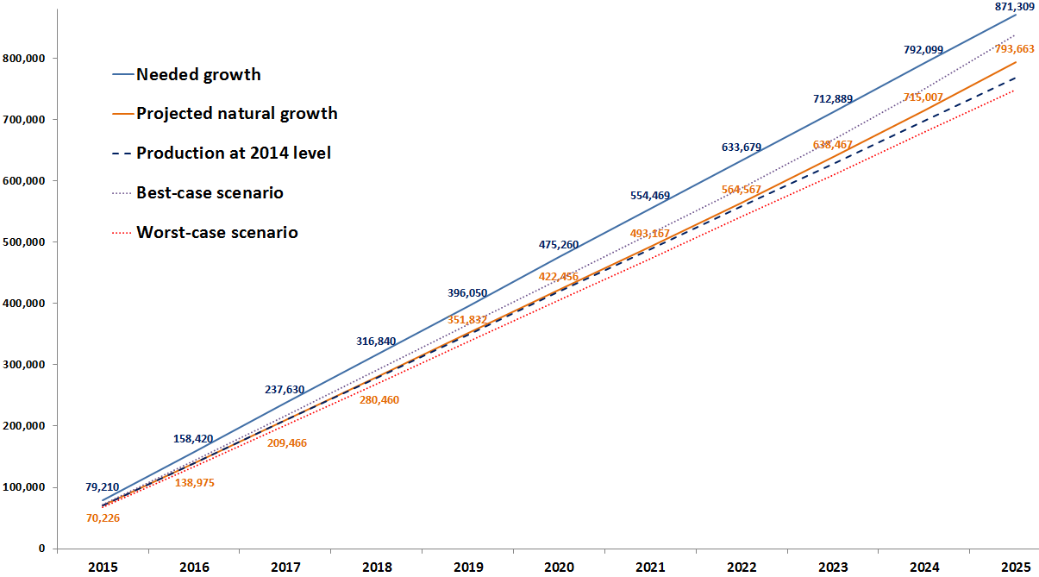
Observations & Recommendations
D55 - Adequacy
Gap between “natural growth” and D55 growth needed

Slide 8
Observations & Recommendations
D55
  Adequacy
    Need better definition of terms
    Cumulative gap of 79,000 awards by 2025
    Majority of growth from adults
    System/sector shifts

Slide 9
Observations & Recommendations
D55
  Alignment
    As much about communication as calculation
    “Hot list”
    Actionable at the local level
    Affirm value of liberal arts to D55
    Guided by Governor’s Workforce Sub-cabinet

Slide 10
Observations & Recommendations
CCTA
  Articulation and transfer
    Dual admission
    Importance of Articulation & Transfer Council
    Reverse transfer

Slide 11
Observations & Recommendations
CCTA
  Aligning finance with policy goals
    Outcomes-based formula
    Capital process
    Tuition and aid
    D55 funding “summit”

Slide 12
Observations & Recommendations
Outreach: community capacity-building
  Actionable community-specific D55 data
  Localized adult learner strategies essential
  Focus first on adults with critical mass of prior PSE experience
  Institutions must first self-study their capacity to serve adults (ALFI)

Slide 13
Observations & Recommendations
Other issues
  Online education
  Competency-based education
  Prior learning assessment (PLA)
  Ongoing evaluation for accountability and improvement
    Qualitative and quantitative aspects
    Quality Assurance Funding
    Master Plan Progress Report

Slide 14
Postsecondary Attainment in the
Decade of Decision
Discussion

