Slide 1



The Composites Institute
Presentation to THEC (11-19-15)
T. Taylor Eighmy, PhD
CCS Corp Board Co-Chair
http://iacmi.org

Slide 2

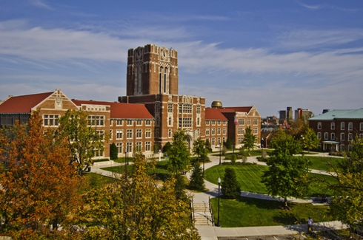
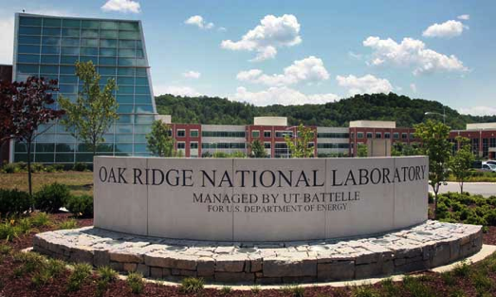
Our RD&D Foundation:
15 Governor’s Chairs
4 Distinguished Scientists
215+ joint faculty
Six joint institutes
Ph.D. Programs
Bredesen Center
Many joint collaborations
Cherokee Farm Innovation Campus
Significant investments in people & infrastructure
$1.3B annual budget
$0.25B research enterprise
1,500+ faculty
6,000 graduate students
$1.5B annual budget
$1.0B research
1,600+ Ph.D.s
9 DOE user facilities (e.g., SNS, HFIR, Titan, MDF, CFTF)

Slide 3










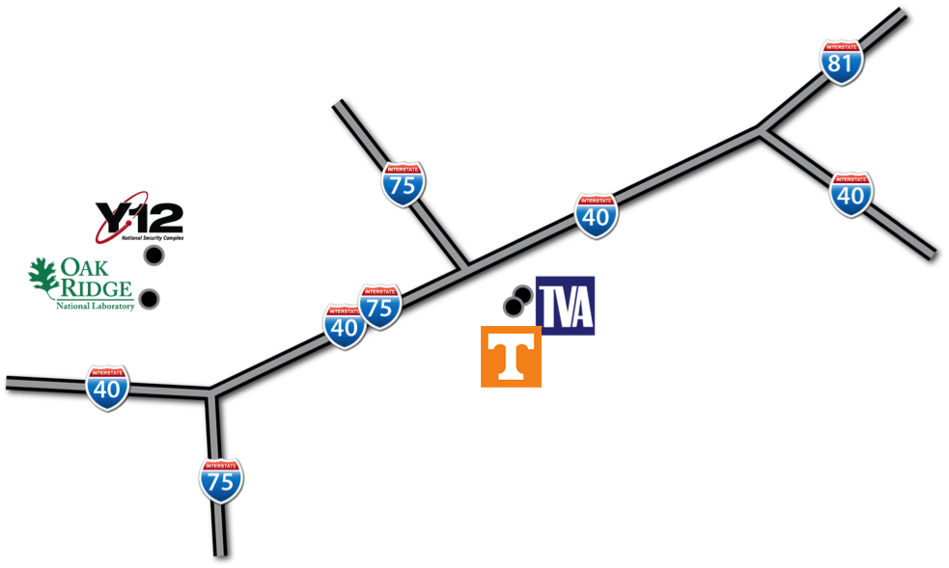













Our Growing Automotive and Aerospace Advanced Manufacturing R&D Ecosystem:

Slide 4
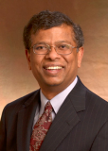
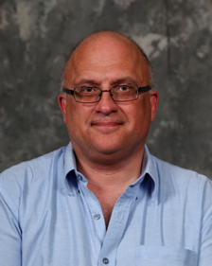
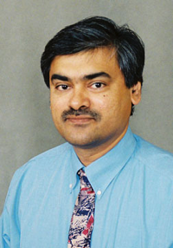
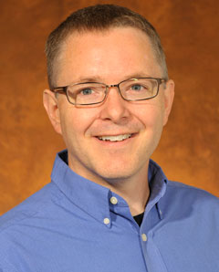
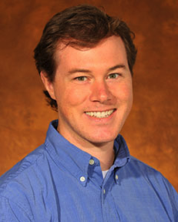
Strategic Investment in Automotive and Aerospace Advanced Manufacturing R&D:
2013
2014
2015
2015
2015
Dr. Suresh Babu
Mechanical, Aerospace & Biomedical Eng.(Ohio State) light weight metals additive manufacturing
Dr. Art Ragauskas
Chem. Biochem Eng.
(Georgia Tech) biopolymers and carbon fiber
Dr. Uday Vaidya
Mechanical, Aerospace & Biomedical Eng.(UAB) composites manufacturing
Dr. Chad Duty
Mechanical, Aerospace & Biomedical Eng.(Virginia Tech) composites 3D printing additive manufacturing
Dr. Brett Compton
Mechanical, Aerospace & Biomedical Eng.(UCSB) hybrid materials

Slide 5
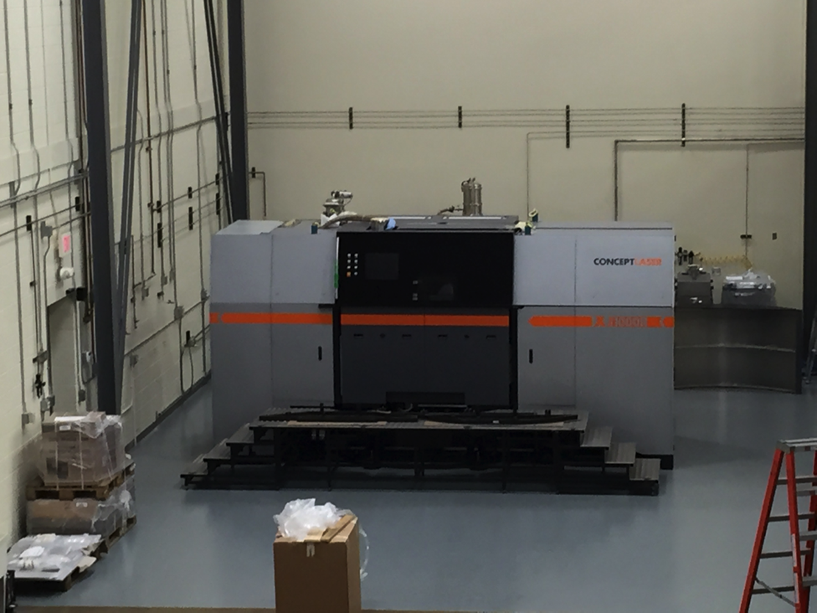


Strategic Investment in Automotive and Aerospace Advanced Manufacturing R&D: Concept Laser
Concept Laser at MDF: 3D printed aluminum pieces

Slide 6
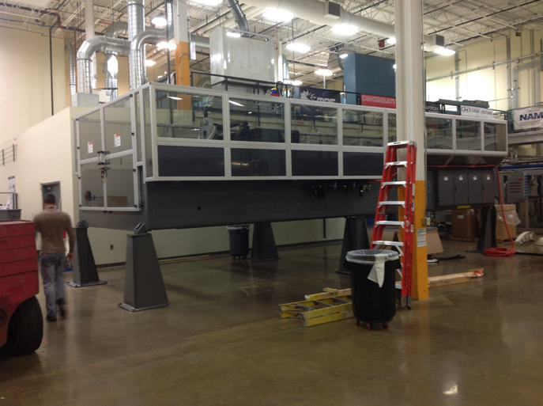
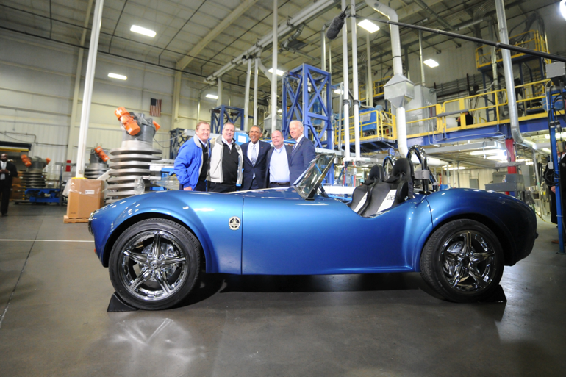

Strategic Investment in Automotive and Aerospace Advanced Manufacturing R&D: BAAM
3D Printed Shelby Cobra, President Obama, VP Biden
BAAM at MDF:

Slide 7
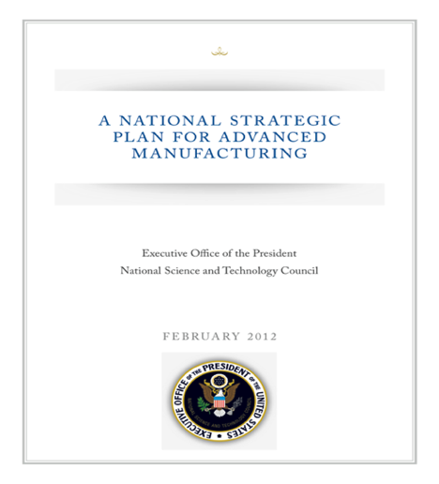
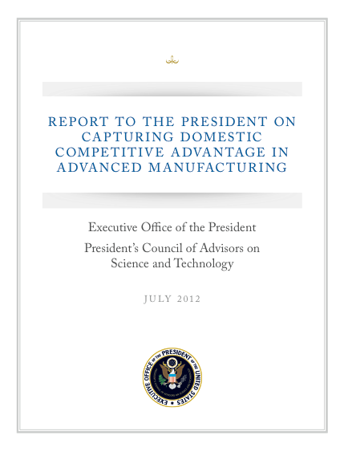
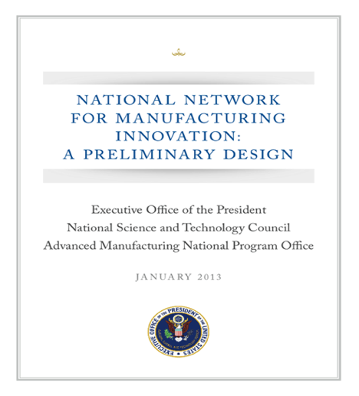
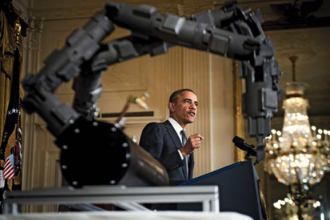
The National Network for Manufacturing Innovation:
NSTC, 2012
PCAST, 2012
NSTC, 2013
“Today, I’m calling for all of us to come together- private sector industry, universities, and the government- to spark a renaissance in American manufacturing and help our manufacturers develop the cutting-edge tools they need to compete with anyone in the world,” said President Obama. “With these key investments, we can ensure that the United States remains a nation that ‘invents it here and manufactures it here’ and creates high-quality, good paying jobs for American workers.” President Barack Obama, Advanced Manufacturing Partnership (AMP) Launch, June 24, 2011

Slide 8








Manufacturing Innovation Institutes:
Perhaps 8 More Expected:
Functional Fabrics
(DOD)
Smart Manufacturing
(DOE)
7
National
Institutes

Slide 9


Operated by CCS Corp., an
independent not-for-profit 501c3
Governed by a board of directors
A wholly owned subsidiary of the University of Tennessee Research Foundation
Incorporated in the State of Tennessee
Headquartered in Knoxville, Tennessee
$259M in funding with $70M from DOE and $189M in cost share from partners (including $100M in new cash)

Slide 10
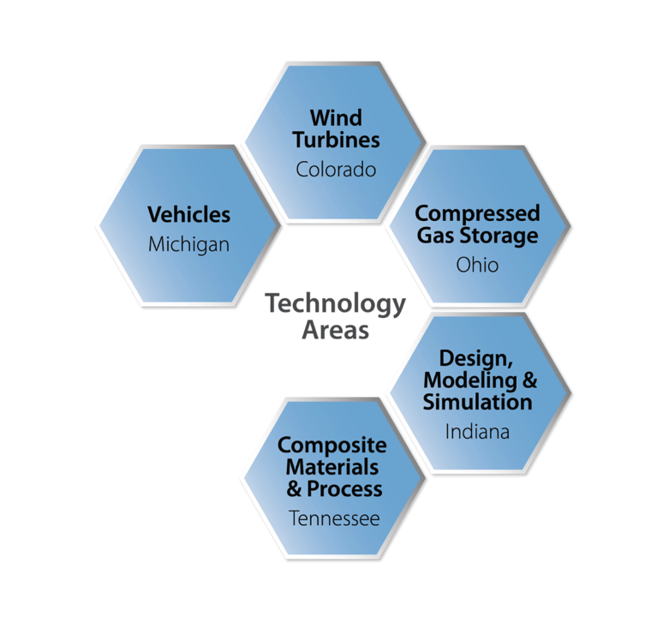
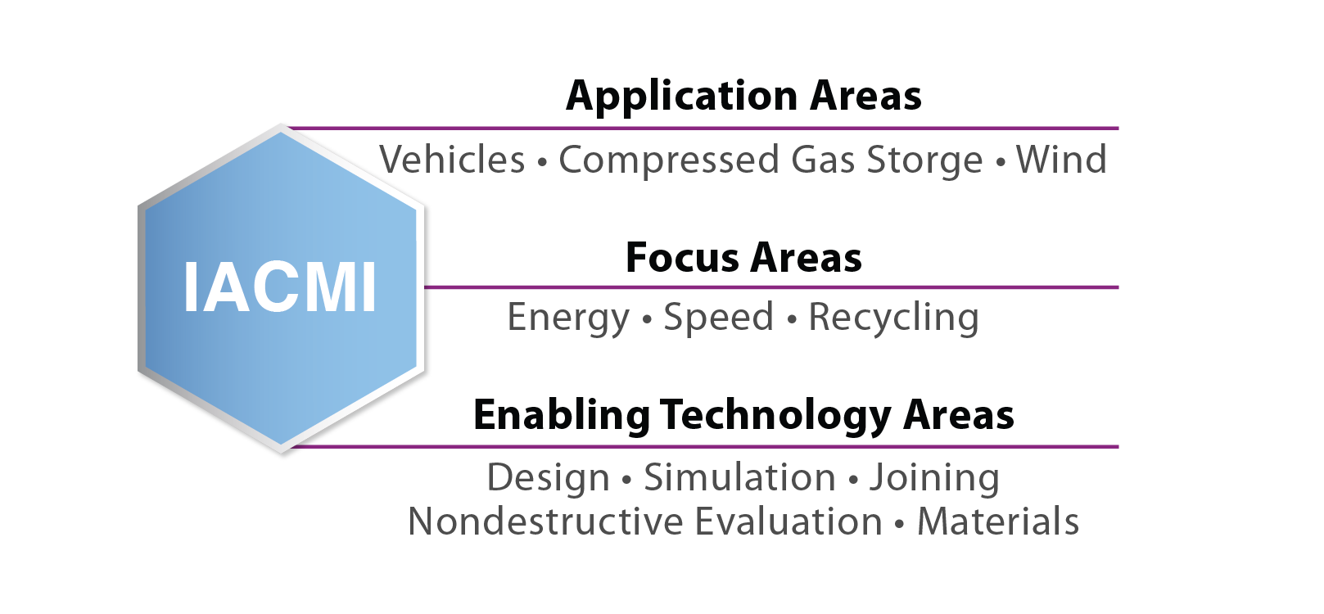
Technical Focus on
Advanced Composites and Structures
Shared RD&D Facilities Support Industry ($400M
Capitalization)
Notes:
Some acronyms spelled out

Slide 11

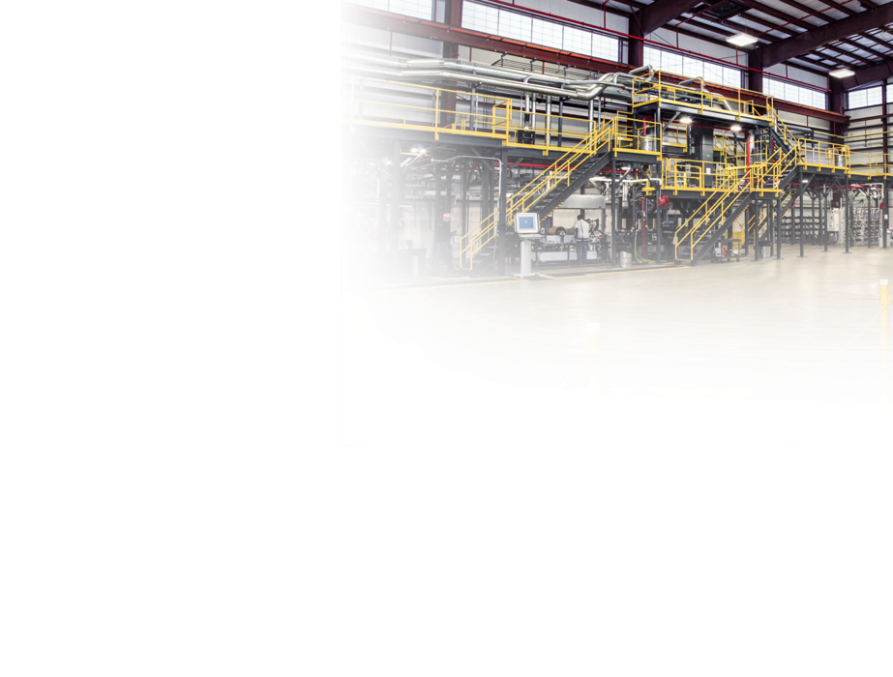
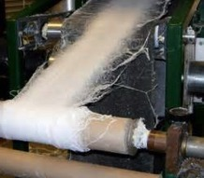
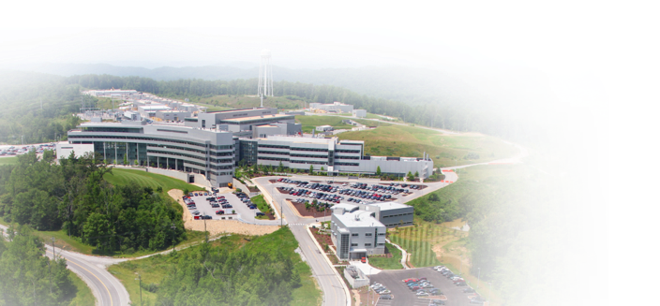
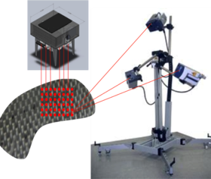
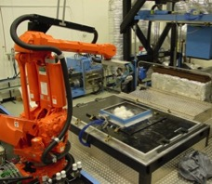
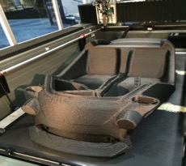
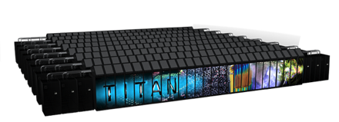
Materials and Process Technology Area:
Carbon fibers (ORNL, UK, UT)
Lab-scale intermediates and composites prototyping (ORNL, UT)
Recycling (ORNL, UT)
Nondestructive evaluation (Vanderbilt)
Materials characterization (UT, ORNL)
Carbon Fiber Technology Facility
Nonwovens
Research Lab
Polymer
AM Cell
ORNL:
US leading neutron characterization and
computing power
Robotic preformer
Wide area flaw
detection

Slide 12
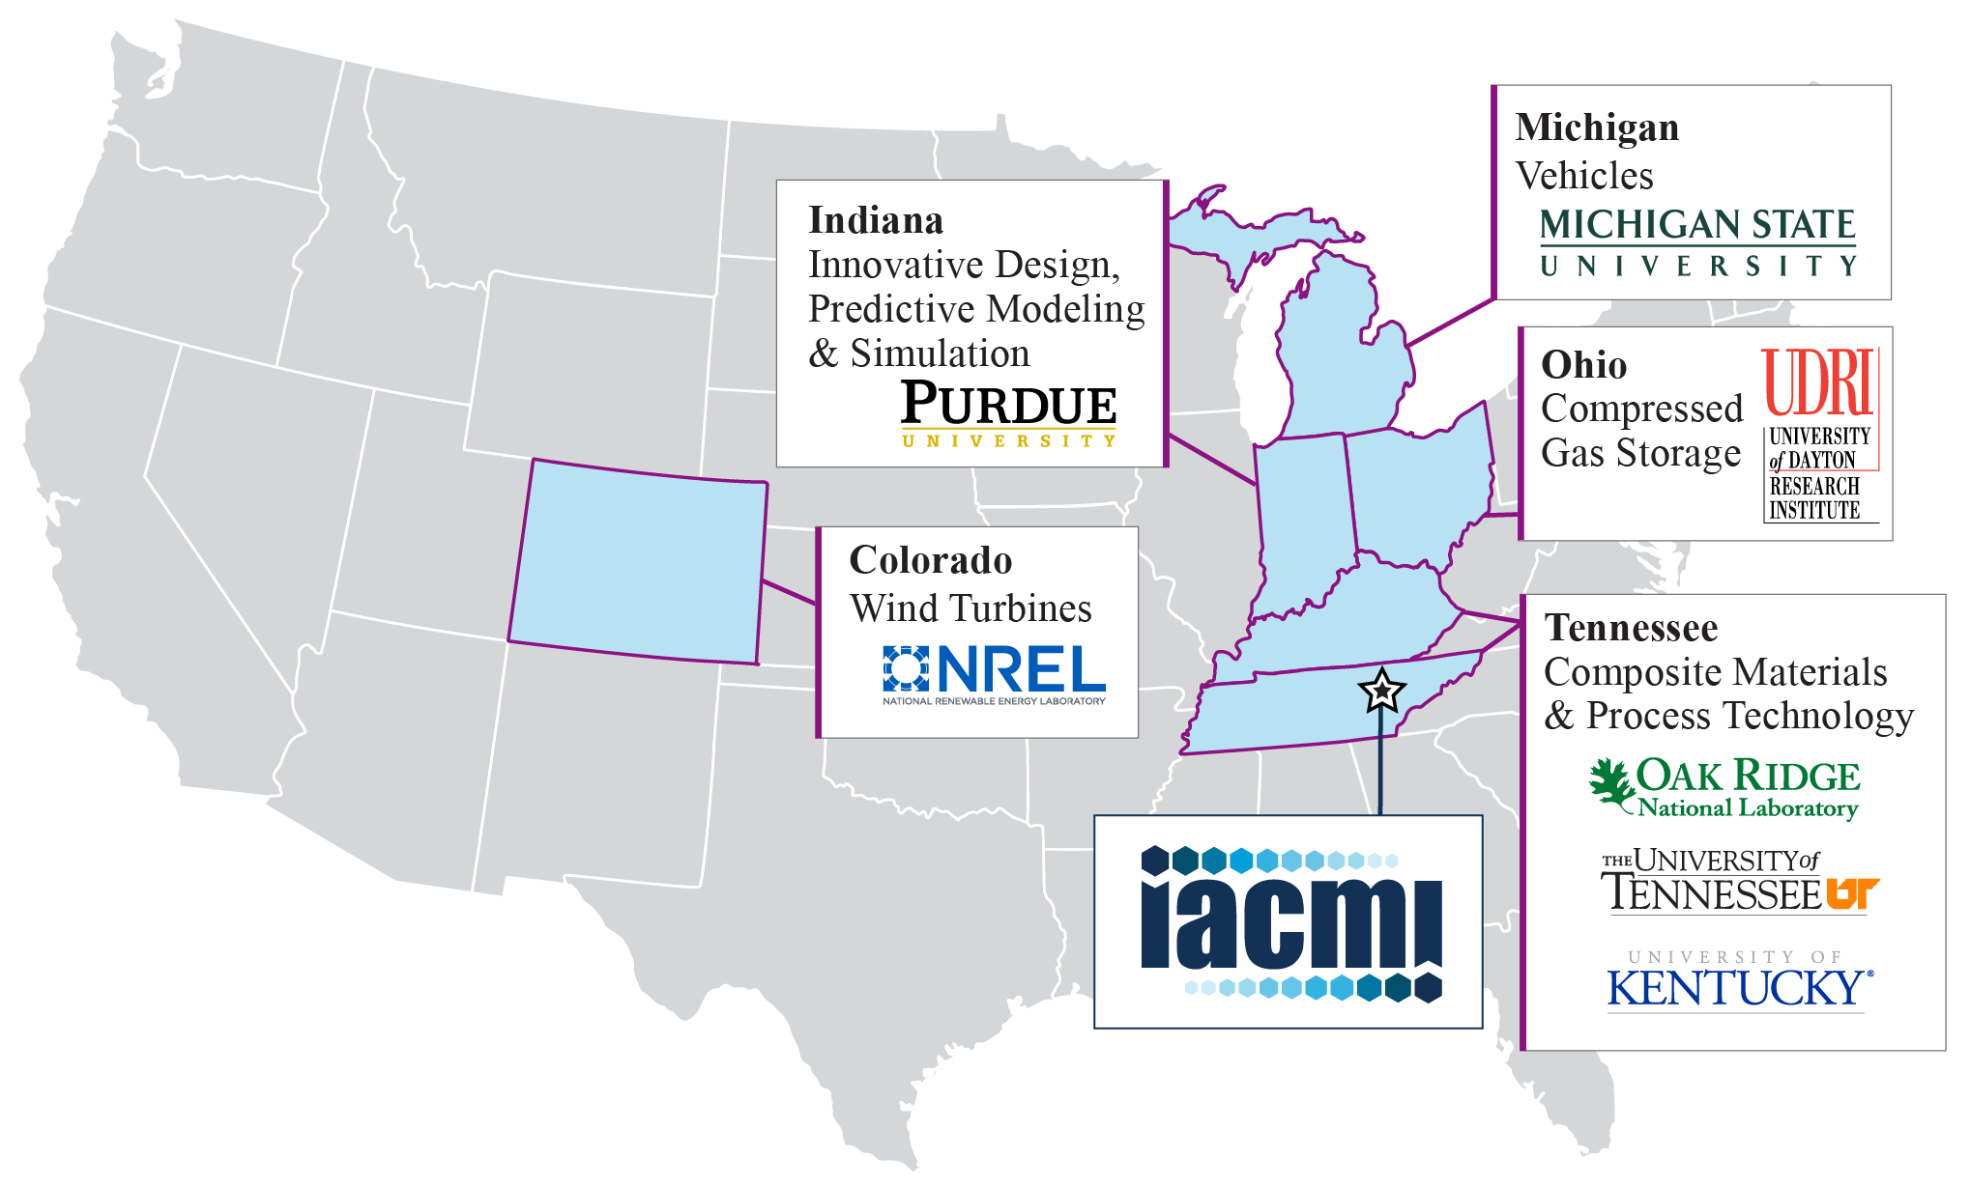
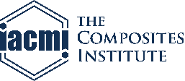
National institute addressing critical challenges
Clean energy Productivity
Domestic production capacity
Job growth and economic development
Life cycle energy consumption
Five/Ten Year Technical Goals:
25/50% lower carbon fiber–reinforced polymer (CFRP) cost
50/75% reduction in CFRP embodied energy
80/95% composite recyclability into useful products
Notes:
Mention Vanderbilt and Colorado School of Mines and Colorado State
60% of manufacturers of compressed gas-fueled vehicle with in half-day drive from IACMI focus areas.
Colorado has more blade facilities (factories plus technical centers) than
any other state
70% of US auto, R&D in Michigan alone
70% of automotive production occurs in IACMI states

Slide 13
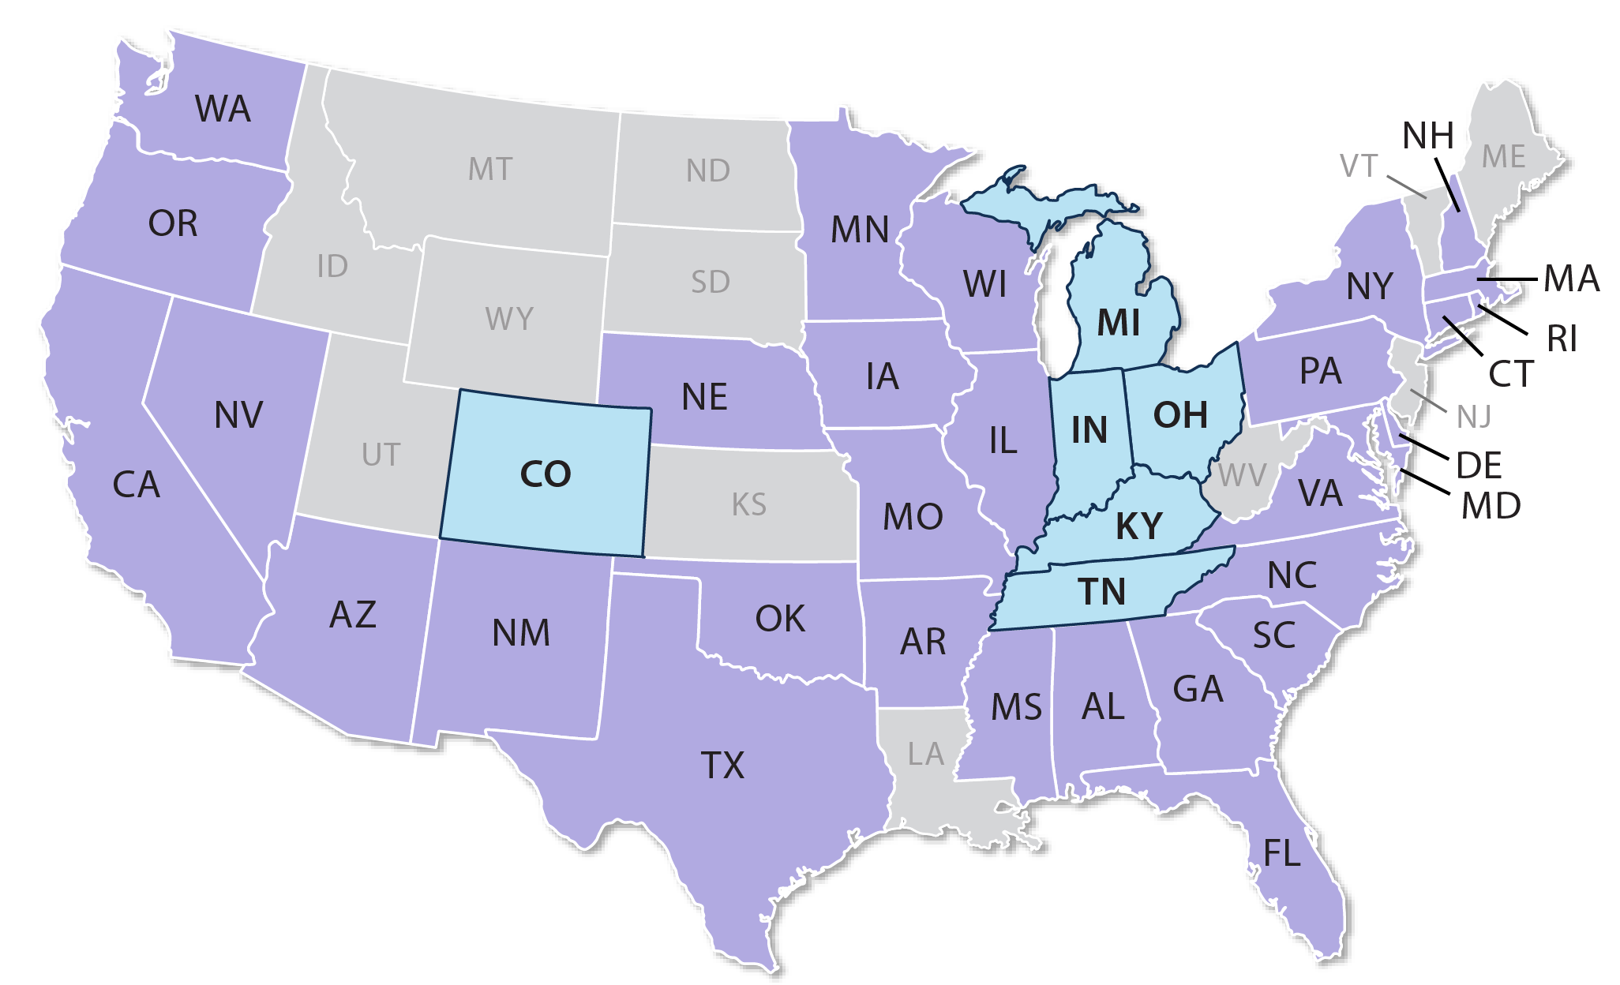
IACMI is a National Institute

Slide 14








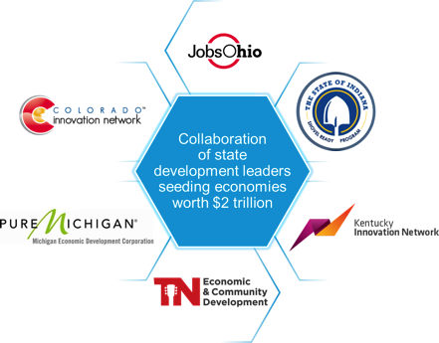

















Building on Existing Strong Partnerships
Serving a partnership of Industry, Academia and government
A partnership of world-class companies including:
Top universities including:
Economic Development Council to leverage state support and investment

Slide 15
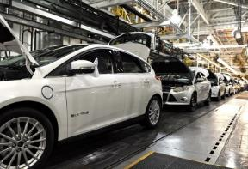
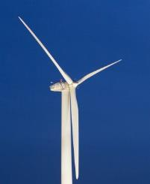
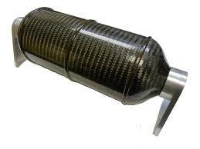
Three Projects Launched in Budget Period 1:
Vehicles
  Will develop automotive-specific carbon fiber, fast curing resins, and target high volume vehicle platforms
  Industrial partners: Ford, Dow Chemical, DowAksa
  Research team: ORNL, MSU, UT, UKy, Purdue, Vanderbilt, UDRI
Wind Turbines
  Will develop reactive infusion thermoplastic resins for improved cycle time, durability, recyclability
  Industrial partners: Johns Manville, TPI Composites
  Research team: NREL, ORNL, CSM, UT, Purdue, Vanderbilt
Compressed Gas Storage
  Innovative method to rapidly fabricate impact resistant, medium and large CNG Type-IV pressure vessels using braided fabric
  Industrial partners: xperion E&E USA, A&P Technologies
  Research team: UDRI, Purdue, Vanderbilt, UT, ORNL

Slide 16
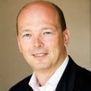
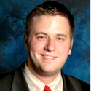
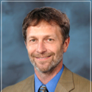
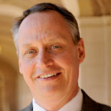
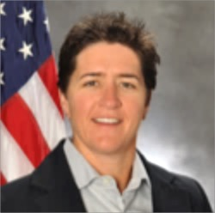
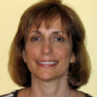
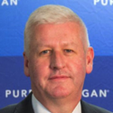
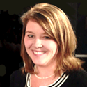
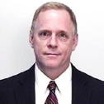
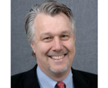
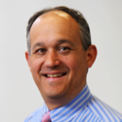
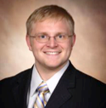
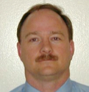
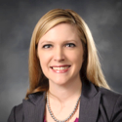
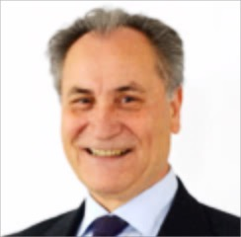
IACMI/ CCS Board of Directors
Charter Industry
Charter State EDA
Ex-Officio
Co-Chairs
Federal Advisory Board
Charter
Industry
Burkhard
Huhnke,
VW
Ian
Steff,
Indiana
Martin
Keller,
ORNL
Taylor
Eighmy,
UT
Adele
Ratcliffe,
DOD
Rani
Richardson,
Dassault
Systemes
Kevin
Kerrigan,
Michigan
Stacey
Patterson,
UTRF
Doug
Parks,
Dow
Mark
Johnson,
DOE
Mike
Whitens,
Ford
Chassen
Haynes,
TN
Premium,
SME Elected
Representatives
Needed
David
Howell,
DOE
Kristen
Bloschock,
Lockheed-
Martin
CO, OH,
Appointees
Needed
Mustafa
Yilmaz,
DowAksa
Notes:
Governance and Roadmapping (which TAB leads) keeps us focused

Slide 17
Leveraging Core State Partnerships for STEM and Workforce Development
Internships
Community
Colleges
K–12
Workforce
Retraining
Universities
Notes:
Have to add MEP somewhere

Slide 18
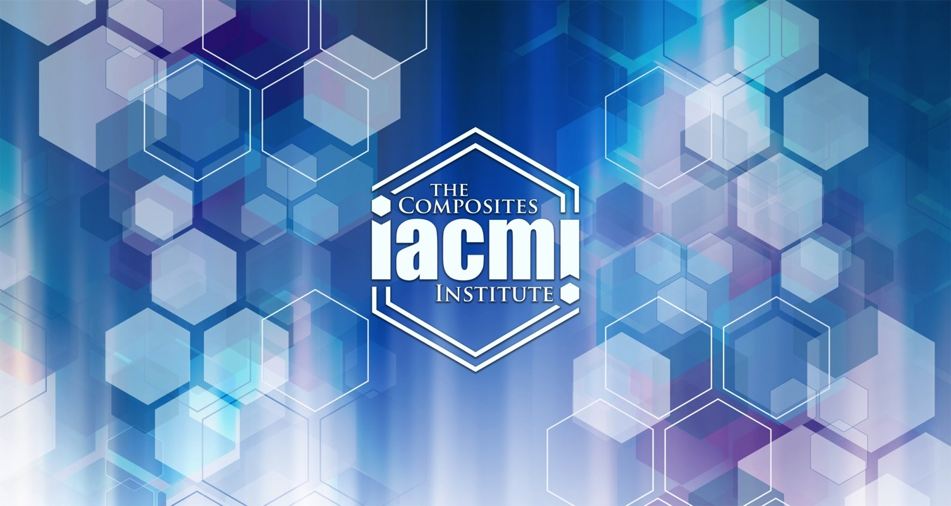
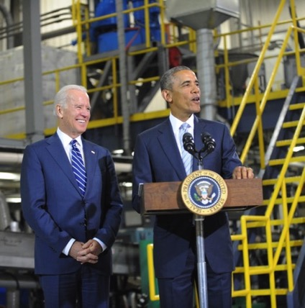
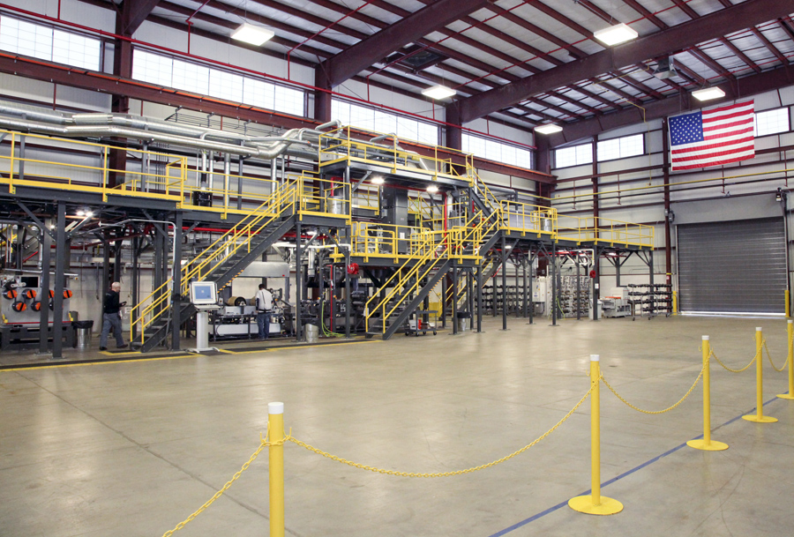

10 months
Building the Network
Jan 2015
President Obama, VP Biden announce IACMI
June 2015
18 | Inaugural IACMI Members Meeting with >350 attendees
23 | Purdue breaks ground on $50M composite facility
Sept 2015
4 | IACMI announces Call for Projects
9 | IACMI team presentation to over 700 attendees at SPE & Automotive Composites Conference
17 | VP Biden announces IACMI’s scale-up facility in Detroit
October 2015
16 | MOU announcement with CPC in NY establishing IACMI satellite in the Northeast
26 | IACMI ACMA and Composites One partnerships established and announced to over 7,500 attendees at CAMX.
  …and today, we’re proud to announce our latest manufacturing hub, and it is right here in Tennessee. Led by the University of Tennessee–Knoxville, the hub will be home to 122 public and private partners who are teaming up to develop materials that are lighter and stronger than steel.

Slide 19
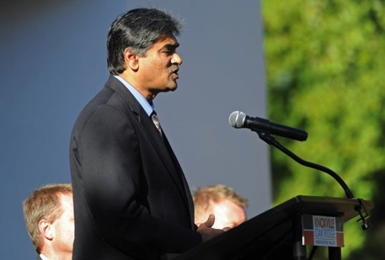


October 16, 2015: Leisure Pools Announces HQ relocation to Knoxville, creation of 1,000 jobs, credits partnership with IACMI and strong local composites workforce
Knoxnews Front Page:
Leisure Pools credits a strong composites workforce and partnerships with IACMI, UT and ORNL as deciding factors in the Knoxville location
Creation of 1,000 jobs
Facility will also house Orion Composites, an R&D and manufacturing affiliate of Leisure Pools
Notes:
Another article:
Fact check the date before using this.
http://www.areadevelopment.com/newsItems/10-23-2013/leisure-pools-corporate-headquarters-knoxville-tennessee893423.shtml

Slide 20







UT Composites Undergraduate Researchers:
Patrick Dinicola
Senior, MABE
Jonathan Trent
Junior, MABE
Brian Young
Junior, MABE
James Grandin
Sophomore, MABE
David McConnell
Junior, MABE
Luke Calderon
Sophomore, MABE
Jimmy Bray
Senior, MABE

Slide 21






UT Composites Undergraduate Researchers:
Jonathan Brackett,
Junior, MSE
Matthew Holliday,
Sophomore, MABE
Chris Wellenberg
Junior, MABE
Jacob Hegler
Senior, MABE
Conor O’Dell
Senior, MABE
Lee Fullam
Junior, MABE

Slide 22

Questions:
Please feel free to contact me:
teighmy@utk.edu
(865)974-8701 (office)
(806)252-6444 (cell)
http://iacmi.org

