Slide 1
Articulation and Transfer Report:
AY 2014-15
Emily House
Tennessee Higher Education Commission
Fall Quarterly Meeting
November 19, 2015

Slide 2
Report available
https://www.tn.gov/thec/article/2015-legislative-reports

Slide 3
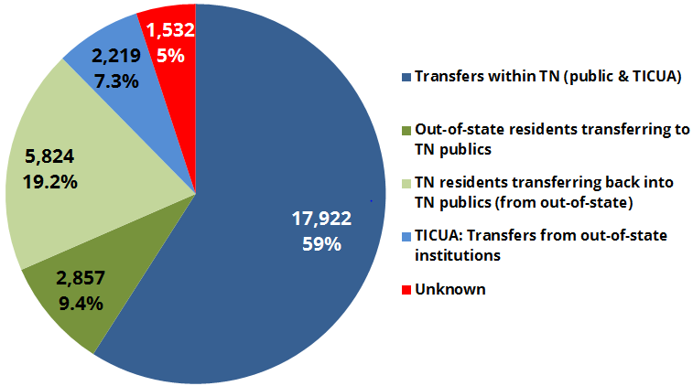
Where transfer occurs
Notes:
Primarily within TN higher ed, or TN residents coming back into the state after leaving to enroll out-of-state.

Slide 4
Transfer is multi-directional
PUBLIC UNIVERSITY
6,092
47.2%
1,740
13.5%
Vertical
Horizontal
COMMUNITY COLLEGE
PUBLIC UNIVERSITY
N = 12,917
1,709
13.2%
Horizontal
Vertical
3,376
26.1%
COMMUNITY COLLEGE

Slide 5
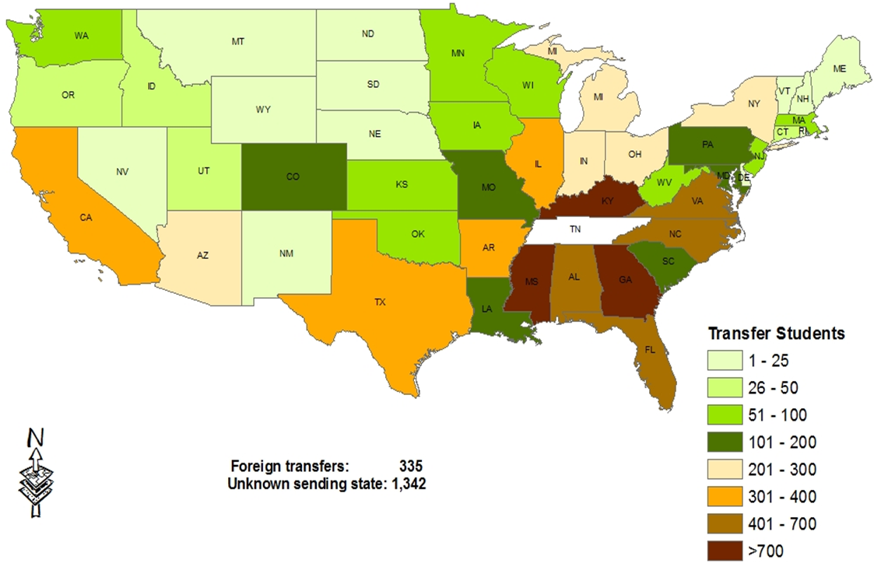
Out-of-state transfers

Slide 6
Questions?
alexander.gorbunov@tn.gov
emily.house@tn.gov

