Slide 1

INTRODUCTION TO
OPEN EDUCATIONAL RESOURCES (OER)
Nancy KingSanders, Austin Peay State University
Elizabeth Spica, The University of Tennessee, Knoxville
Ryan Korstange, Middle Tennessee State University
Ashley Sergiadis, East Tennessee State University
This webinar is a collaboration of the Tennessee Higher Education Commission Task Force on Textbook Affordability
Notes:
Except where otherwise indicated, this Introduction to Open Educational Resources Powerpoint (adapted from Open Education Workshop by Elizabeth Spica) is licensed under a Creative Commons Attribution 4.0 International License

Slide 2

Welcome!
Introduction to Open Educational Resources (OER)
What is OER?
What does an OER textbook look like?
How can I get started with OER?
Notes:
Image: Landscape. Pixabay. https://pixabay.com/photos/way-path-outdoor-landscape-nature-918900/

Slide 3
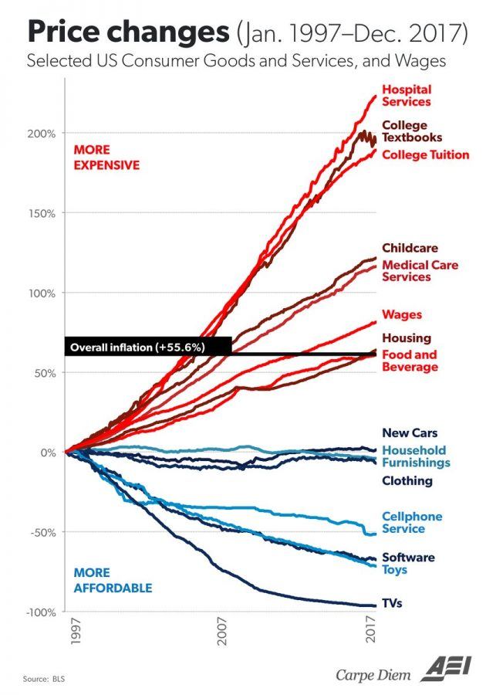

The cost of textbooks have outpaced inflation at a rate rivaling the cost of hospital services.
Notes:
We’re having this conversation today because OER presents a great solution to the problem of high-cost textbooks and course materials.
According to the US Bureau of Labor Statistics, between 1997 and 2015, textbook prices rose by 1,041 percent.
Bureau of Labor Statistics, US Department of Labor. (2016, August 30). College tuition and fees increase 63 percent since January 2006. The Economics Daily. https://www.bls.gov/opub/ted/2016/college-tuition-and-fees-increase-63-percent-since-january-2006.htm

Slide 4
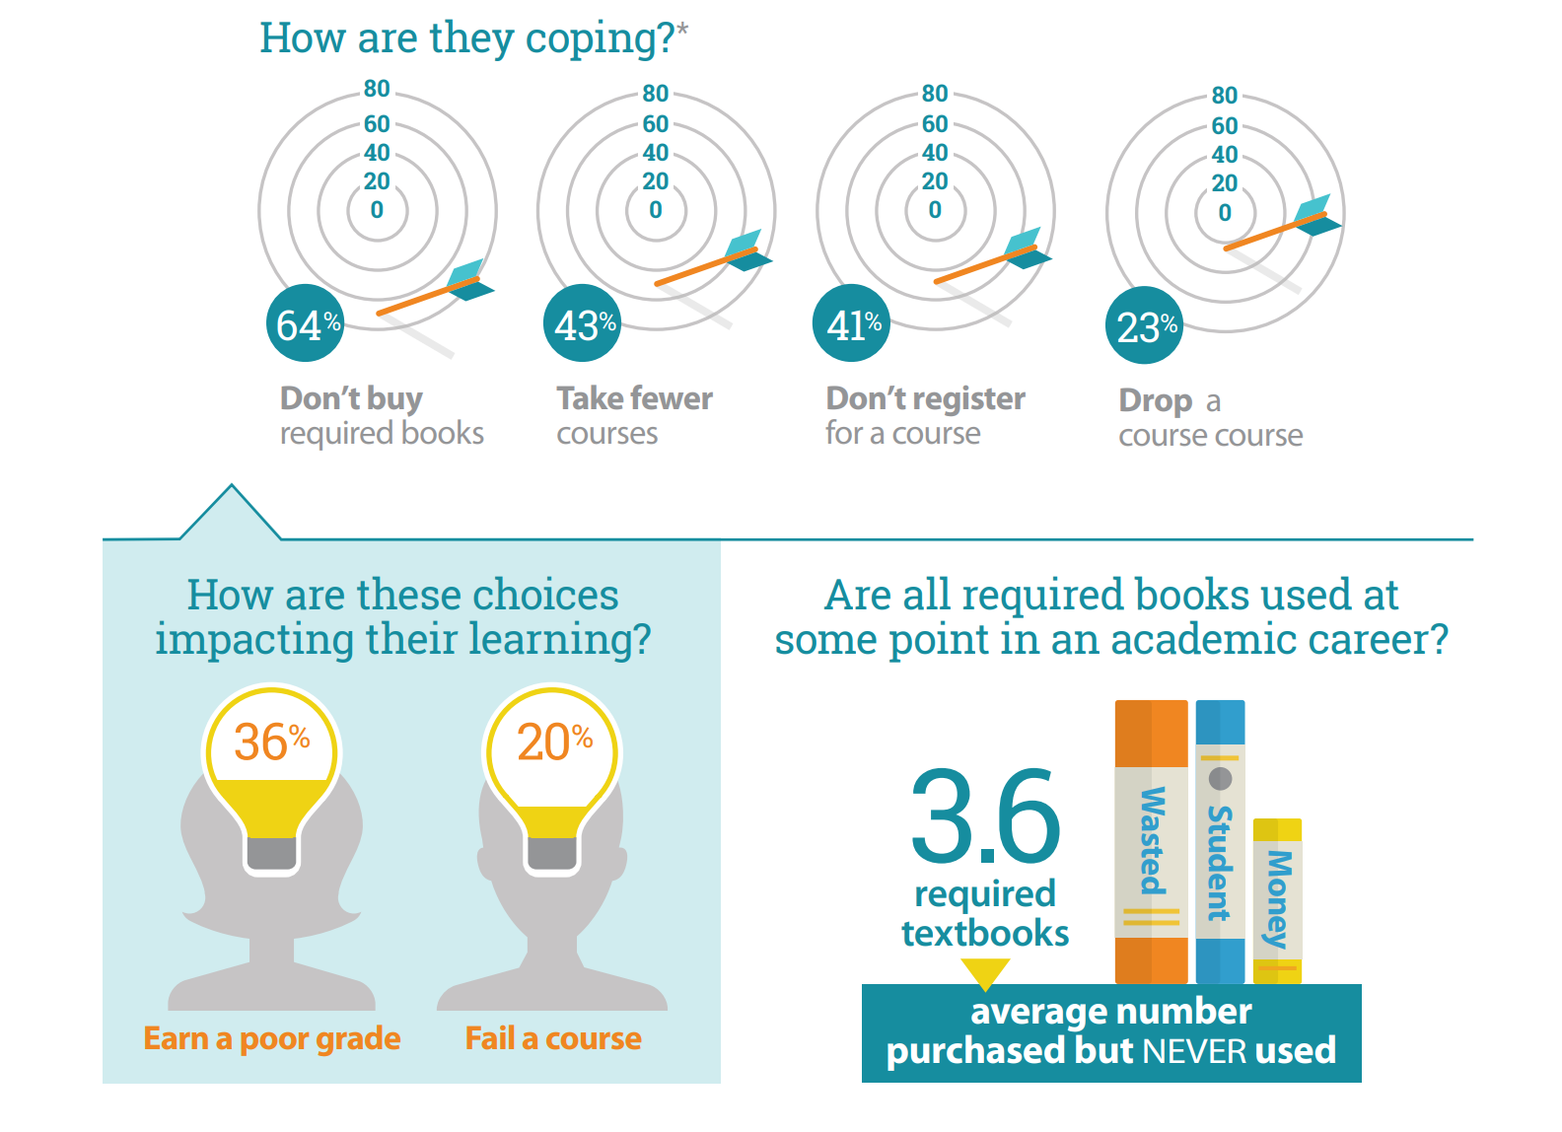
2018 Florida Virtual Campus Textbook and Course Materials Survey
2018 Florida Virtual Campus Textbook and Course Materials Survey
Infographic from FLVC Office of Distance Learning & Student Services (download infographic here)
Full report available at dlss.flvc.org
Notes:
Florida Virtual Campus. (2019). 2019 Florida Student Textbook & Course Materials Survey (p. 35). https://dlss.flvc.org/documents/210036/1314923/2018+Student+Textbook+and+Course+Materials+Survey+Report+--+FINAL+VERSION+--+20190308.pdf/07478d85-89c2-3742-209a-9cc5df8cd7ea
Vitez, K. (2018, March 7). Student Government Leaders Unite in Call for Federal Open Textbook Grant Program. Student PIRGs. https://studentpirgs.org/news/sp/student-government-leaders-unite-call-federal-open-textbook-grant-program

Slide 5
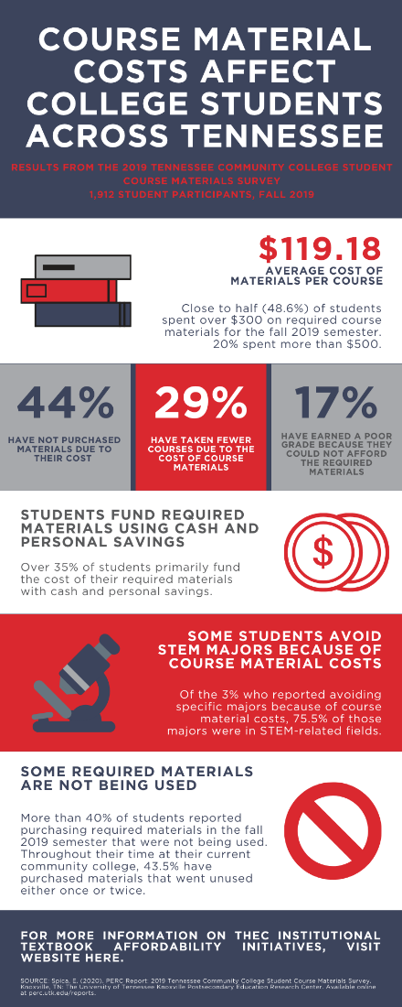
Tennessee CC Student Survey Results
Infographic adapted from Spica (2020). 2019 Tennessee Community College Student Course Materials Survey. Full report available at perc.utk.edu. CC-BY 4.0.
Notes:
Spica, E. (2020). PERC Report Infographic: 2019 Tennessee Community College Student Course Materials Survey. Knoxville, TN: University of Tennessee Knoxville Postsecondary Education Research Center. Retrieved from perc.utk.edu/reports. CC BY 4.0 International license.

Slide 6
Tennessee CC Student Survey
Infographic adapted from Spica (2020). 2019 Tennessee Community College Student Course Materials Survey. Full report available at perc.utk.edu. CC-BY 4.0.
Notes:
Spica, E. (2020). PERC Report Infographic: 2019 Tennessee Community College Student Course Materials Survey. Knoxville, TN: University of Tennessee Knoxville Postsecondary Education Research Center. Retrieved from perc.utk.edu/reports. CC BY 4.0 International license.

Slide 7
Benefits of OER
STUDENT BENEFITS
Average savings $116.94 per course (Nyamweya, 2018)
Easy to access – before, during, and AFTER your course
Less likely drop or avoid courses; More likely to take more courses
Students perform as well or better than students in courses with traditional materials
FACULTY BENEFITS
Ability to fully tailor content to your specific learning outcomes
Academic freedom to modify, add, remove, and expand content
Improved student perceptions of faculty member as kinder, more encouraging, and more creative (Vojtech & Grissett, 2017)
Ability to engage in new teaching and learning practices
Notes:
SOURCES:
Nyamweya, M. (2018, December 20). A New Method for Estimating OER Savings. SPARC. https://sparcopen.org/news/2018/estimating-oer-student-savings/
Colvard, N., Watson, E., & Park, H. (2018). The Impact of Open Educational Resources on Various Student Success Metrics. International Journal of Teaching and Learning in Higher Education, 30(2), 262–276.
Colvard (2018) OER improve end-of-course grades and decrease DFW (D, F, and Withdrawal letter grades) rates for all students for Pell recipient students, part-time students, and populations historically underserved by higher education.
Hilton III, J. (2016). Open educational resources and college textbook choices: A review of research on efficacy and perceptions. Educational Technology Research & Development, 64(4), 573–590. https://doi.org/10.1007/s11423-016-9434-9. Hilton (2016) synthesized the results of 16 studies that examined either (1) the influence of OER on student learning outcomes or (2) the perceptions of college students and instructors of OER.
Hardin, E. E., Eschman, B., Spengler, E. S., Grizzell, J. A., Moody, A. T., Ross-Sheehy, S., & Fry, K. M. (2019). What Happens When Trained Graduate Student Instructors Switch to an Open Textbook? A Controlled Study of the Impact on Student Learning Outcomes. Psychology Learning & Teaching, 18(1), 48–64. https://doi.org/10.1177/1475725718810909 “Finally, students from traditionally underserved populations reported the lower cost of the book had a significantly higher impact on their decision to enroll in and remain enrolled in the course.”
Brandle, S., Katz, S., Hays, A., Beth, A., Cooney, C., DiSanto, J., Miles, L., & Morrison, A. (2019). But What Do The Students Think: Results of the CUNY Cross-Campus Zero-Textbook Cost Student Survey. Open Praxis, 11(1), 85–101. https://doi.org/10.5944/openpraxis.11.1.932. “Of 882 respondents in a spring 2018 survey of students in City University of New York (CUNY) Zero Textbook Cost (ZTC) courses, 90% of students accessed either prior to or in the first week of class.”
Grissett, J. O., & Huffman, C. (2019). An Open versus Traditional Psychology Textbook: Student Performance, Perceptions, and Use. Psychology Learning & Teaching, 18(1), 21–35. https://doi.org/10.1177/1475725718810181 No significant differences in course performance or textbook use across two sections of an introductory psychology course (Grissett & Huffman, 2019).
Students rated college faculty who use open materials to be kinder, more encouraging, and more creative than faculty using a traditional copyrighted textbook (Vojtech and Grissett, 2017).
Jhangiani, R., Dastur, F., Grand, R. L., & Penner, K. (2018). As Good or Better than Commercial Textbooks: Students’ Perceptions and Outcomes from Using Open Digital and Open Print Textbooks. The Canadian Journal for the Scholarship of Teaching and Learning, 9(1). https://doi.org/10.5206/cjsotl-rcacea.2018.1.5 -- “The single largest study to date evaluated the impact of OER adoption among students enrolled in 15 courses at 10 institutions (Fischer, Hilton, Robinson, & Wiley, 2015). In two out of the fifteen classes, students in the treatment (OER) group were significantly more likely to complete the course (there were no differences in the remaining thirteen) whereas in five of the classes students in the treatment group were significantly more likely to receive a C- or better (there were no significant differences in nine of the classes and only in one class were control students more likely to receive a C- or better)1. Finally, treatment students were found to have enrolled in significantly more classes than control students during the semester of OER implementation as well as the subsequent semester. For these analyses, 4147 control participants were matched with 4147 treatment participants using propensity score matching.”
Fischer, L., Hilton, J., Robinson, T. J., & Wiley, D. A. (2015). A multi-institutional study of the impact of open textbook adoption on the learning outcomes of post-secondary students. Journal of Computing in Higher Education, 27(3), 159–172. https://doi.org/10.1007/s12528-015-9101-x
Vojtech and Grissett (2017, ERIC link here). Essentially, students rated college faculty who use open materials to be kinder, more encouraging, and more creative than faculty using a traditional copyrighted textbook.

Slide 8
What are Open Educational Resources?
Elizabeth Spica, PhD Candidate at UT Knoxville
OER Research Fellow, The Open Education Group

Slide 9
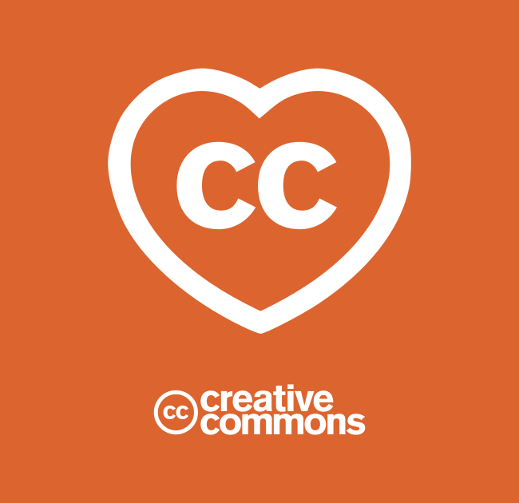
OER Definition
“Open Educational Resources (OER) are teaching, learning, and research materials that are either (a) in the public domain or (b) licensed in a manner that provides everyone with free and perpetual permission to engage in the 5R activities [retain, reuse, revise, remix, redistribute].“
creativecommons.org
This Photo by Unknown Author is licensed under CC BY

Slide 10


OER: Materials in the Public Domain
“Open Educational Resources (OER) are teaching, learning, and research materials that are either (a) in the public domain or (b) licensed in a manner that provides everyone with free and perpetual permission to engage in the 5R activities [retain, reuse, revise, remix, redistribute].“
creativecommons.org
This Photo by Unknown Author is licensed under CC BY-SA-NC
This Photo by Unknown Author is licensed under CC BY-SA-NC

Slide 11

Creative Commons (CC) License Elements
Attribution (BY) – No Derivatives (ND) – Share Alike (SA) – Non-Commercial (NC)
This Photo by Unknown Author is licensed under CC BY-SA-NC
Notes:
Other OPEN works have the Creative Commons license I mentioned. There are six of them in total, and they all comprise a combination of these four elements, each of which indicates the rights that the creators of those materials wish to reserve.
The first element –Attribution – is present on every license. Essentially, this means when you use OER, you’ll credit the creator of that material. Plain and simple -- creators of CC-licensed material receive credit for their work no differently than creators of traditionally copyrighted materials.
The second symbol means NoDerivatives or “ND,” indicates cases where the creator says that reusers must share the work as-is, without adapting that work.
The third symbol means ShareAlike or “SA,” means that any adaptations based on the work must be licensed under the same license of the original work. This means that if you remix a CC-BY-SA work with other material, you need to license your adaptation under an SA license as well.
The fourth and final symbol means NonCommercial or “NC,” which means you can only use the work if your purpose is non-commercial. For us in the educational sphere, our purposes are almost always noncommercial; that said, there is debate as to whether materials under this Non-Commercial license actually count as Open.

Slide 12
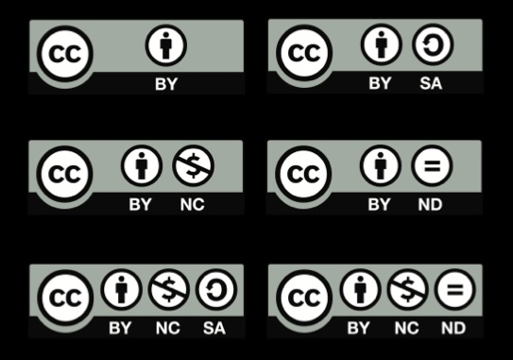

The 6 Creative Commons Licenses
“Some Rights Reserved”
This Photo by Unknown Author is licensed under CC BY-SA-NC
This Photo by Unknown Author is licensed under CC BY
Notes:
Here are the six different licenses, each of which again indicate the rights – No-Derivative, Share Alike, Non-Commercial – that the author wishes to reserve for their creations.
These CC licenses – along with materials in the public domain -- are how you recognize what is OER. Just as copyright is “all rights reserved” Creative Commons licenses are “Some Rights Reserved” – they don’t violate copyright law, they build upon and compliment copyright law.

Slide 13
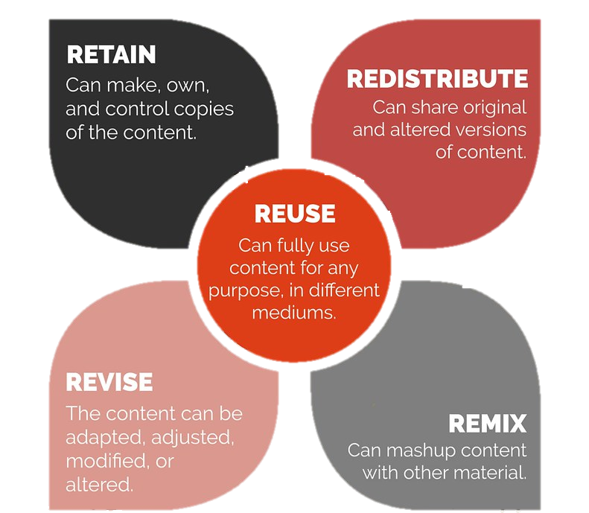
OER: Creative Commons Licensed Materials
“Open Educational Resources (OER) are teaching, learning, and research materials that are either (a) in the public domain or (b) licensed in a manner that provides everyone with free and perpetual permission to engage in the 5R activities [retain, reuse, revise, remix, redistribute].“
creativecommons.org
This Photo by Ellen Metter is licensed under CC BY
Notes:
The magic of OER is that they allow you to engage in what my mentor David Wiley coined as the “5R” activities. OER gives you the ability to retain, reuse, revise, remix, and redistribute material:
Retain. Make, own, and control copies of the content (e.g., download, duplicate, store, and manage)
Reuse. Use the content in a wide range of ways (e.g., in a class, in a study group, on a website, in a video)
Revise- adapt, adjust, modify, or alter the content itself (e.g., translate the content into another language)
Remix. Combine the original or revised content with other material to create something new (e.g., incorporate the content into a mashup)
Redistribute. Share copies of the original content, your revisions, or your remixes with others (e.g., give a copy of to a friend)

Slide 14

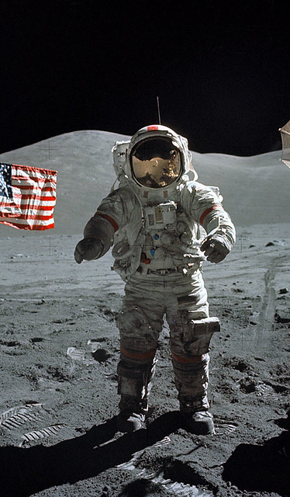



OER is All Around Us: Examples of OER
This Photo by Unknown Author is licensed under CC BY-SA
This Photo by Unknown Author is licensed under CC BY-SA
This Photo by Unknown Author is licensed under CC BY-SA-NC
This Photo by Unknown Author is licensed under CC BY-SA
Notes:
To put it in perspective, although we’re focusing today on openness in the context of education, the world around us is increasingly “Open” and people like you across every industry are taking advantage of Creative Commons licenses to share and further knowledge and creativity in the world.
In the music industry, openly licensed materials are allowing artists to gain exposure and create new products that build from and incorporate the work of others.
The image in the center of the Commander Gene SIR-NUN Cernan next to a US flag on the moon in 1972 is one of many images NASA makes available to the public as part of their mission. Under United States copyright law, works created by the U.S. federal government or its agencies cannot be copyrighted. Governmental agencies openly license images, videos, research, and other materials.
On YouTube you can find historical and openly licensed videos, and institutions like the Metropolitan Museum of Art, the Smithsonian and other museums, have all released collections of openly licensed images and materials that anyone can use and build upon.
Today, Creative Commons licenses are used by more than 1.6 billion works online across 9 million websites.
SOURCES (i.e. those not credited on the slide):
Piwowar, H., Priem, J., Larivière, V., Alperin, J. P., Matthias, L., Norlander, B., Farley, A., West, J., & Haustein, S. (2018). The state of OA: a large-scale analysis of the prevalence and impact of Open Access articles. PeerJ, 6, e4375. https://doi.org/10.7717/peerj.4375
NASA. Apollo 17 Commander Eugene A. Cernan is photographed next to the U.S. flag in 1972—marking NASA’s final mission to the Moon. This image is in the public domain via NASA.

Slide 15
What does an OER Textbook look like?
Walkthrough with Dr. Ryan Korstange, Assistant Professor
Middle Tennessee State University

Slide 16
Example: UNIV 1010 @ MTSU
 | Cost Per Book | Student Enrollment | Cost to Students
Major Publisher | $55 - $90 | 883 (FA 2018) | $48,565 - $79,470
OER | 0 | 840 (FA 2019) | $0

Slide 17
OER Cost-Savings
Semester | Enrollment | Savings to Students ($55 –$90 /book)
FA 2020 | 660 | $36,300 – 59,400
SP 2019 | 102 | $5,610 – 9,180
FA 2019 | 840 | $46,200 – 75,000
TOTAL | 1,602 | $88,110 – 144,180

Slide 18
Making the Transition to OER
There is work involved.
Increased instructional design (no help from a publisher)
OER Community Support
Pedagogy

Slide 19
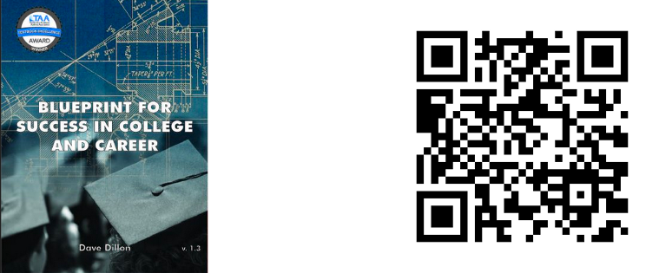
Our OER: Dave Dillon, Blueprint for Success in College and Career

Slide 20
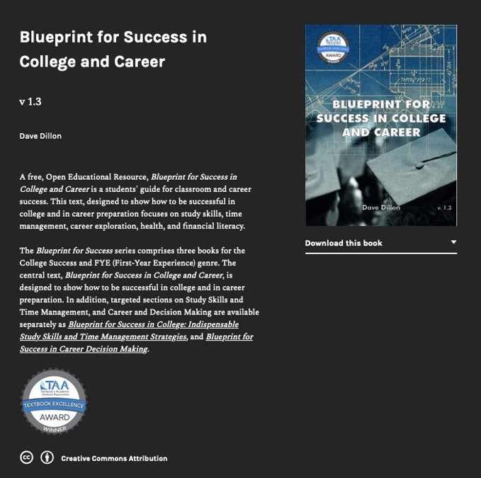
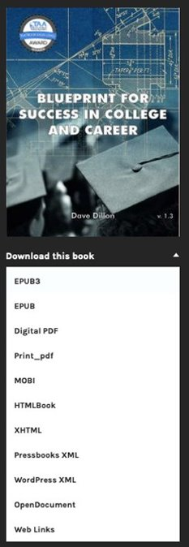
Navigation

Slide 21
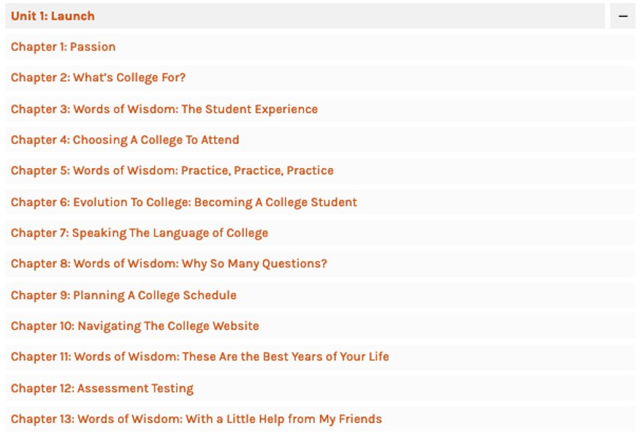
Navigation
Part 1

Slide 22
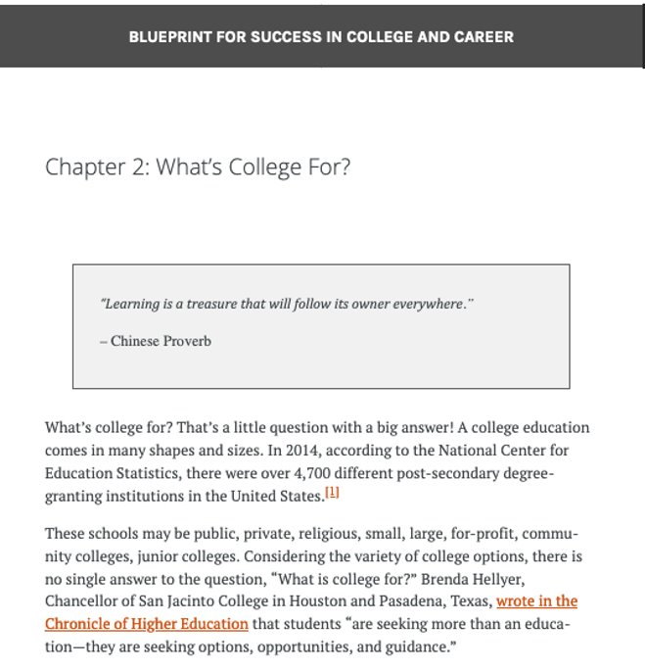
Navigation
Part 2

Slide 23
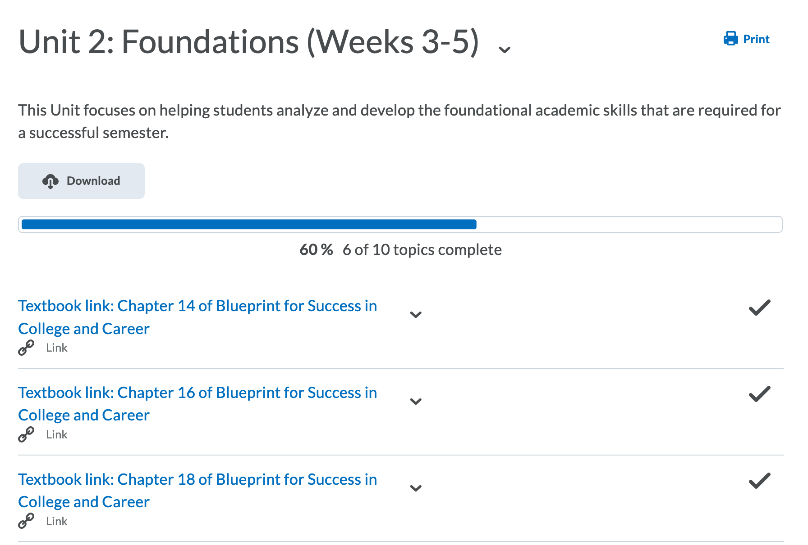
Implementation

Slide 24
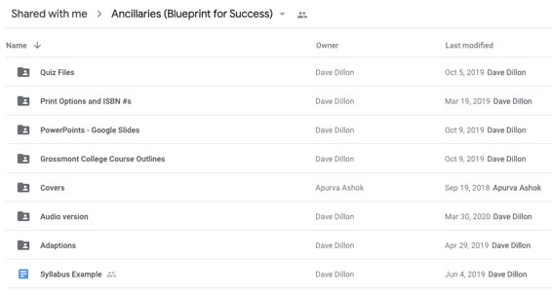
Instructor Support

Slide 25
Benefits
Immediate access
Perpetual access
Instructional flexibility
Information literacy

Slide 26
How can I get started with OER?
Ashley Sergiadis
Digital Scholarship Librarian and Assistant Professor
East Tennessee State University

Slide 27

Step 1: Brainstorm
Learning Outcomes?​
​Material Types?
Time Commitment?
Notes:
Pixabay. https://pixabay.com/vectors/thoughts-speech-bubbles-idea-24152/

Slide 28

Step 2: Explore
Notes:
Pixabay. https://pixabay.com/vectors/magnifier-magnifying-glass-zoom-1925162/

Slide 29
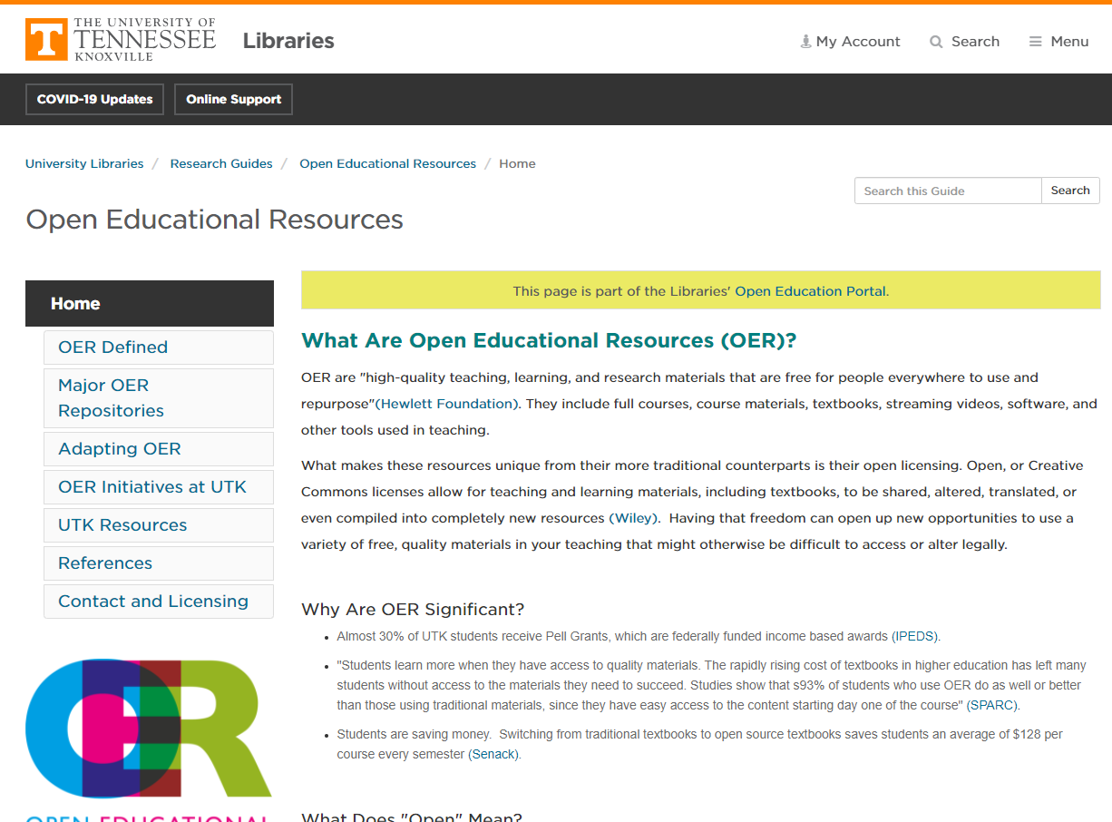
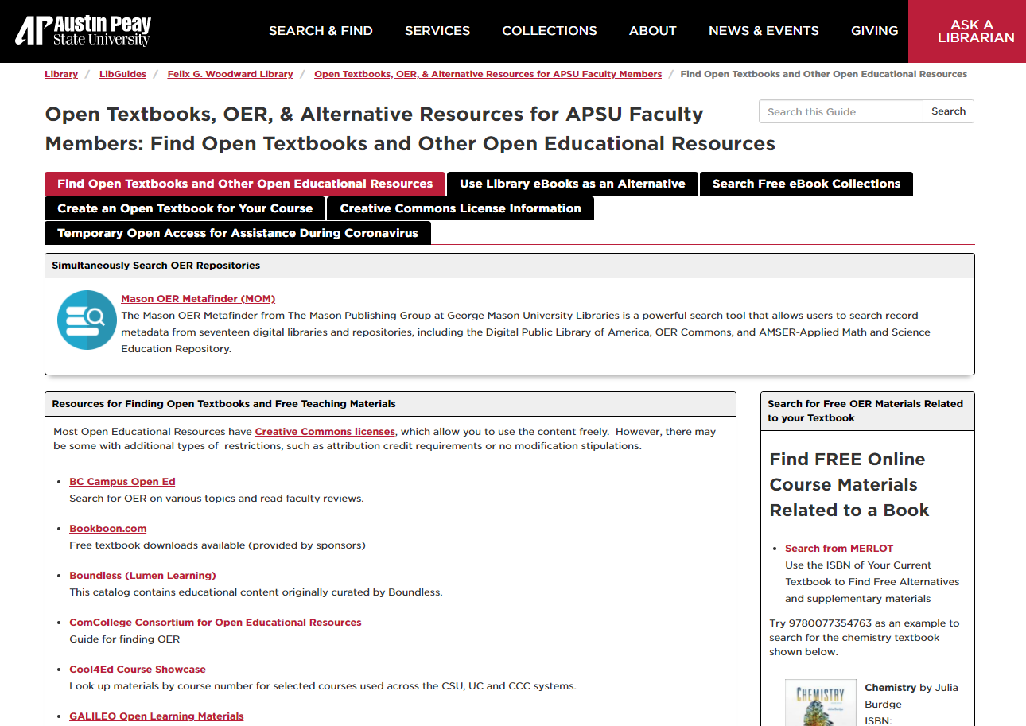
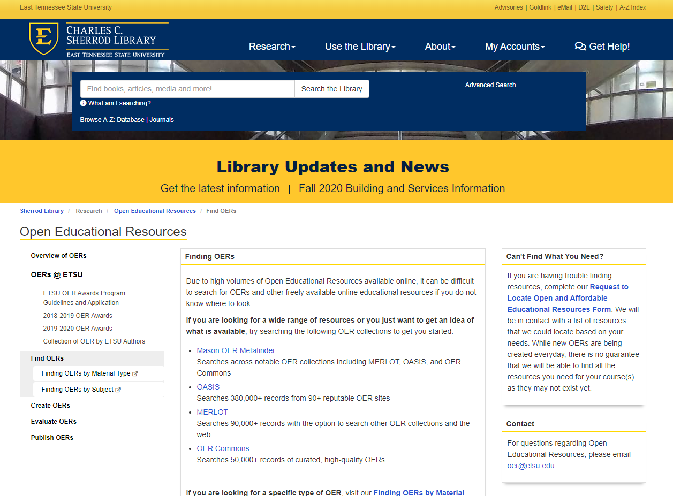
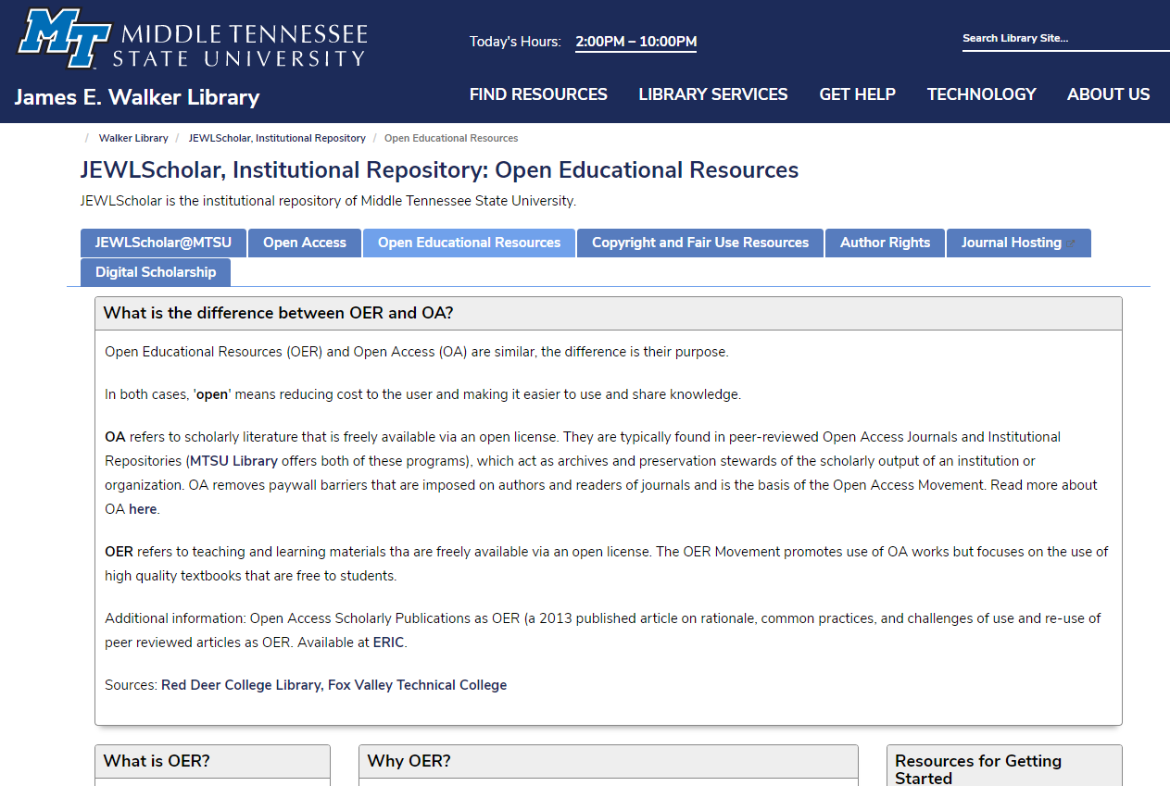
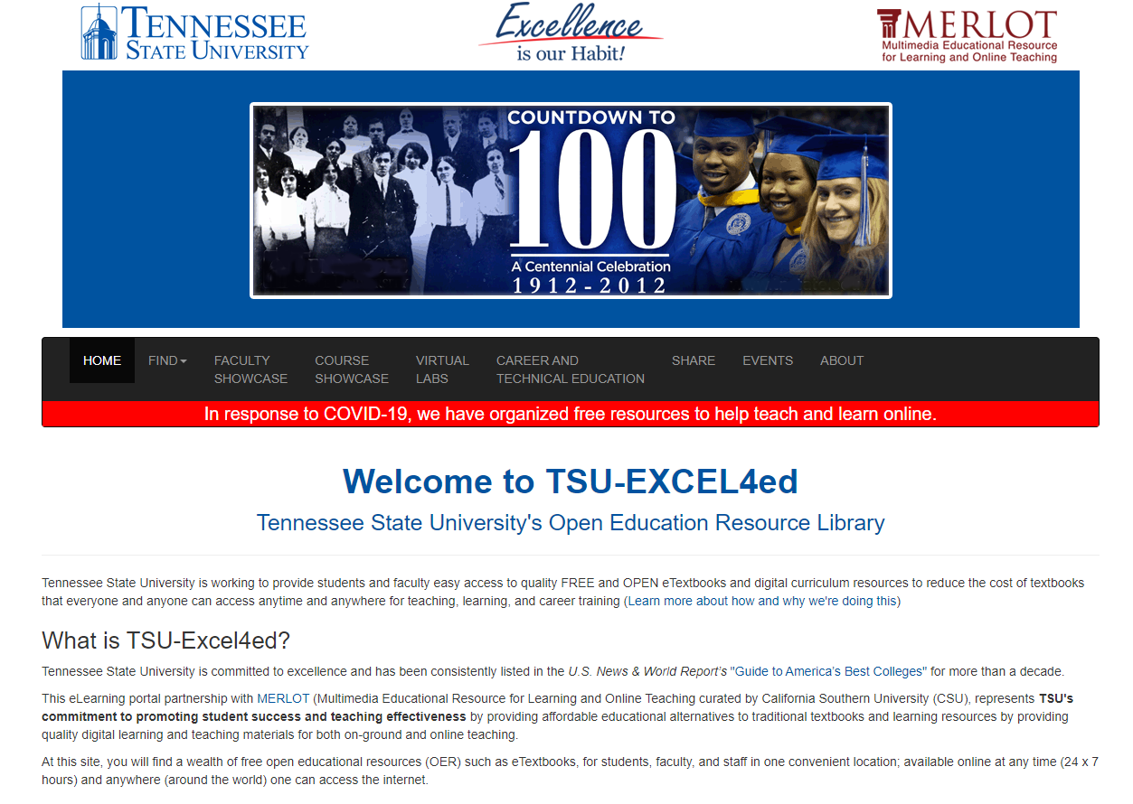
Check out your institution's (library) websites for OER guides

Slide 30
Creative Commons Directory lists where to find different types of OER...
Textbooks​
Lectures & Tutorials​
Simulations and Animations
Courses​
Images/Videos/Audio​
And more!
https://bit.ly/cc-oer
This Photo by Unknown Author is licensed under CC BY

Slide 31
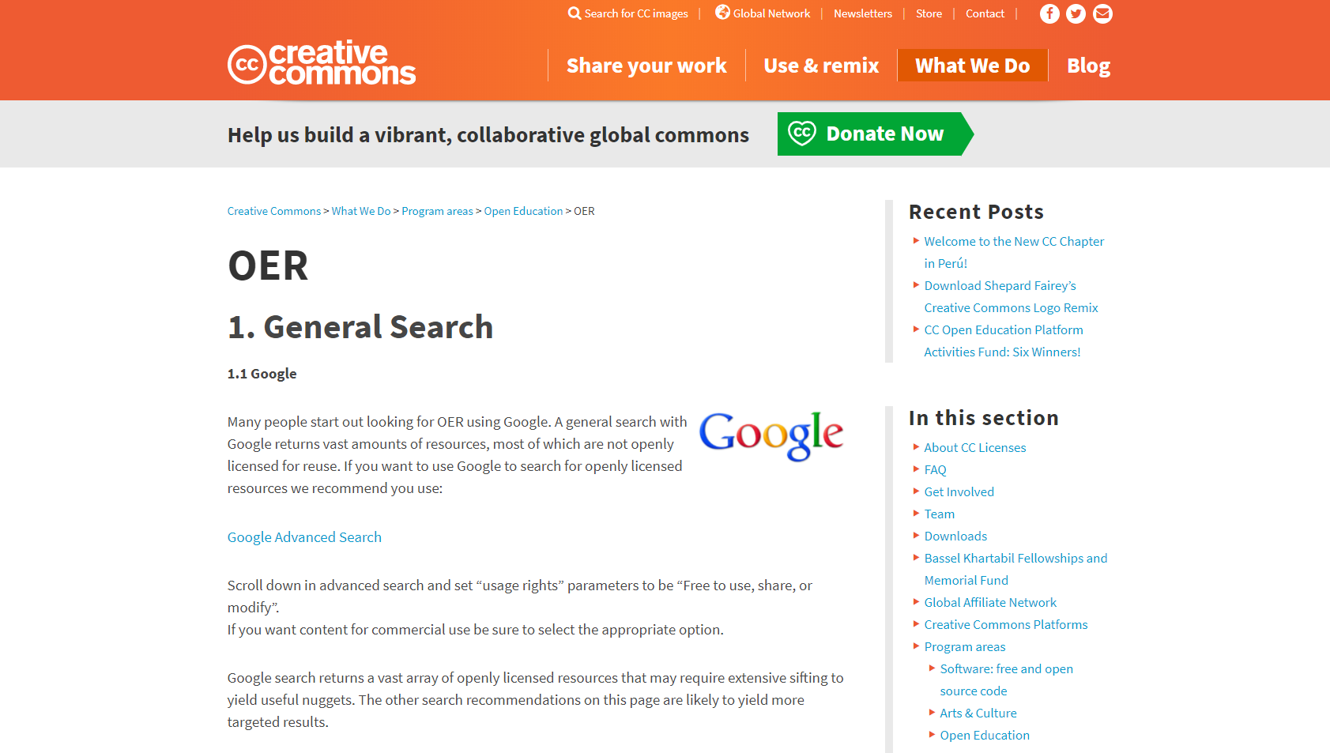
Creative Commons Directory Search

Slide 32
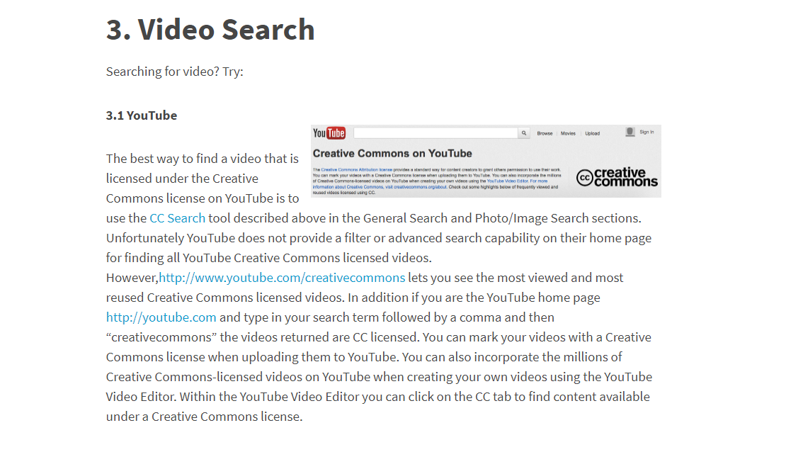
YouTube Video Searches

Slide 33
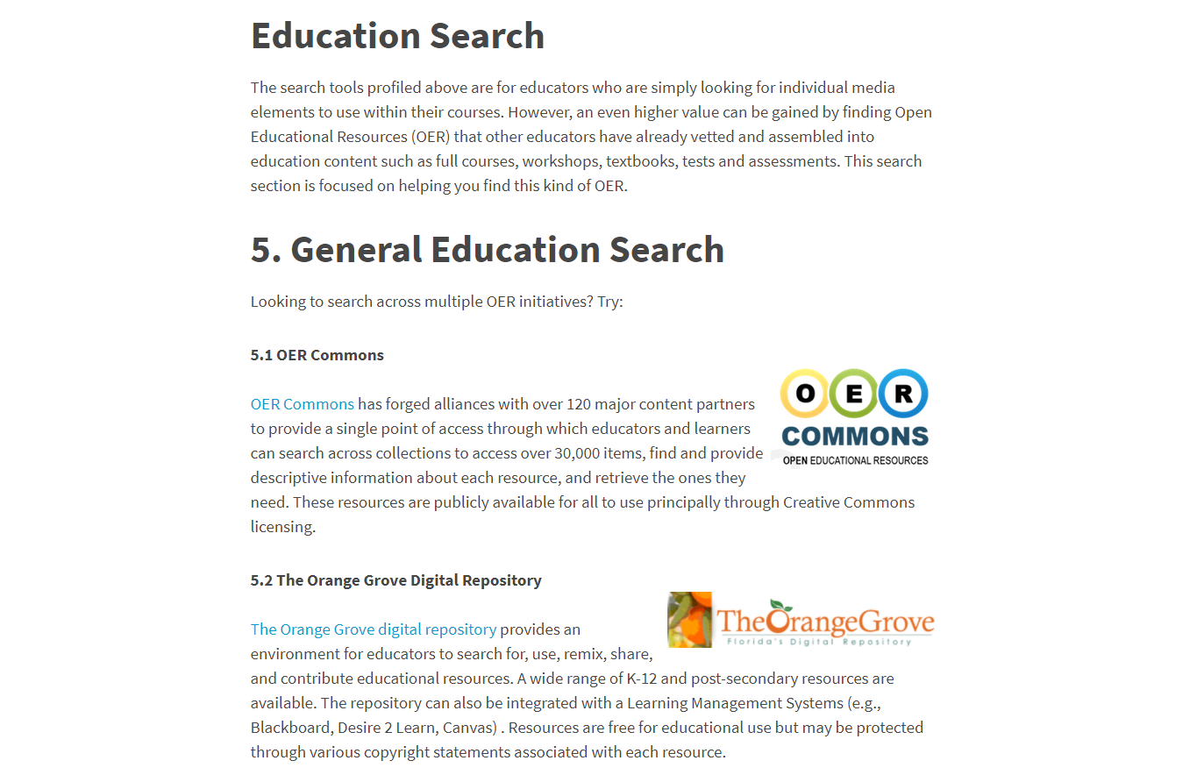
OER Commons Education Search

Slide 34
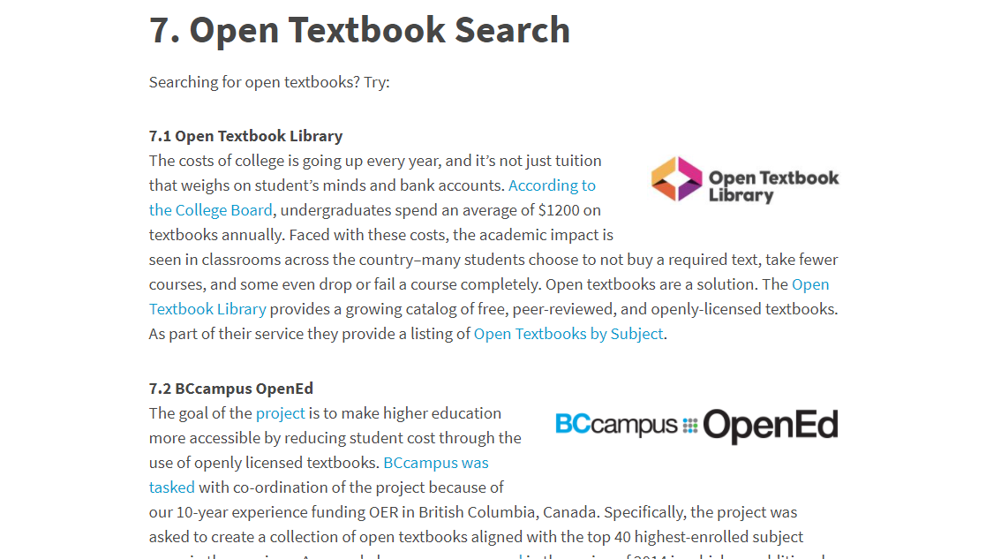
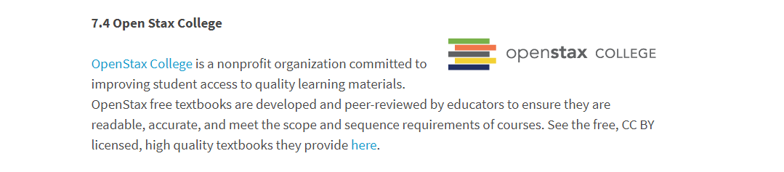
Open Textbook Searches

Slide 35

Step 3:
Adopt,
Adapt, and/or
Create
Notes:
Pixabay. https://pixabay.com/vectors/book-laptop-silhouette-icon-4753250/

Slide 36
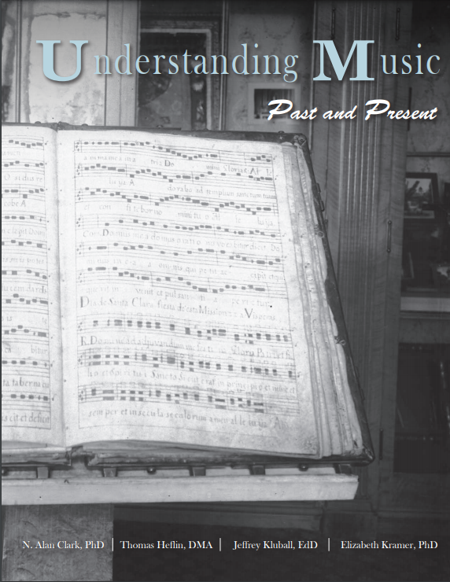
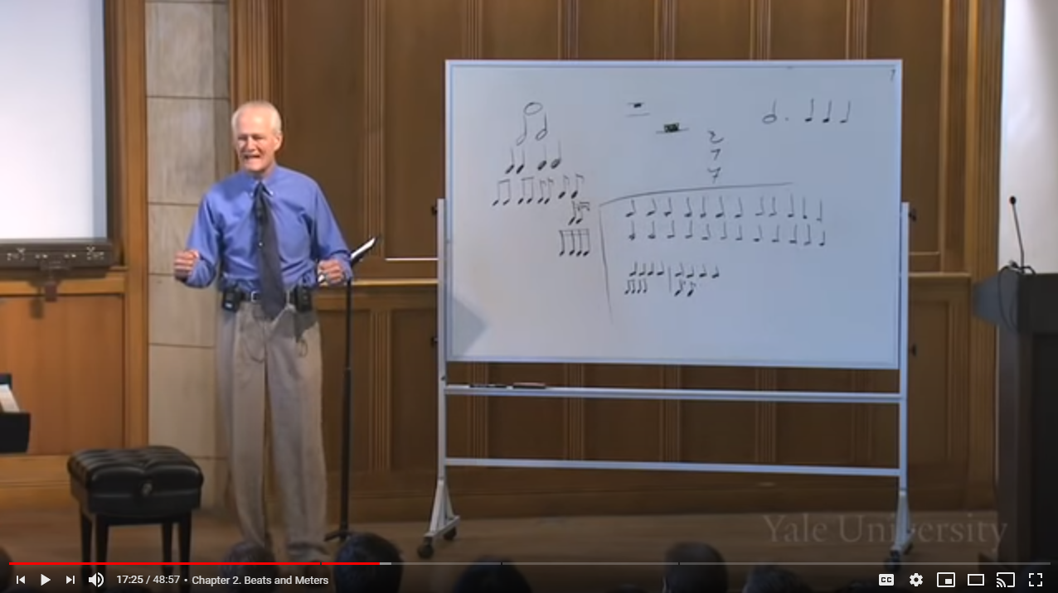
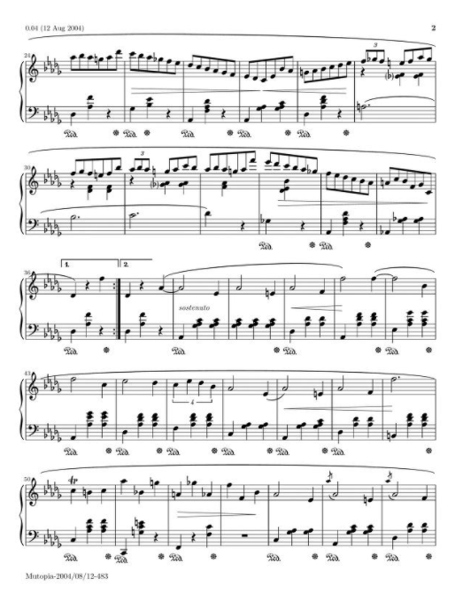
ADOPTION
Assigning OER in your course without customizations to the resources
This image is from Yale Lecture 3. Rhythm: Fundamentals under a CC-BY License.
This image is from Anders' Anthology of Classical Piano Sheet Music under the Public Domain.
This image is from Understanding Music: Past and Present under a CC-BY-SA License.

Slide 37
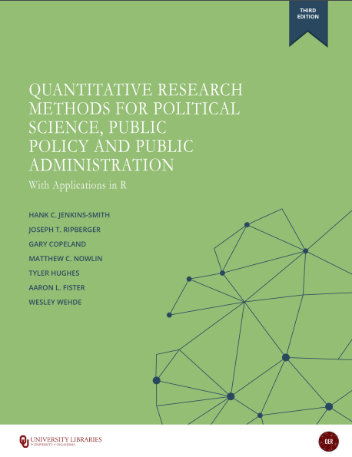


ADAPTATION
Assigning OER in your course with customizations to the resources
This image is from a textbook under a CC-BY License.
This image is from a textbook under a CC-BY License.
This image is from a textbook under a CC-BY License.

Slide 38



CREATION
Assigning OER in your course created by you
Notes:
Pixabay.
https://pixabay.com/vectors/video-template-website-youtube-1606945/
https://pixabay.com/vectors/book-study-education-school-2943367/
https://pixabay.com/vectors/science-business-experiment-4496467/

Slide 39
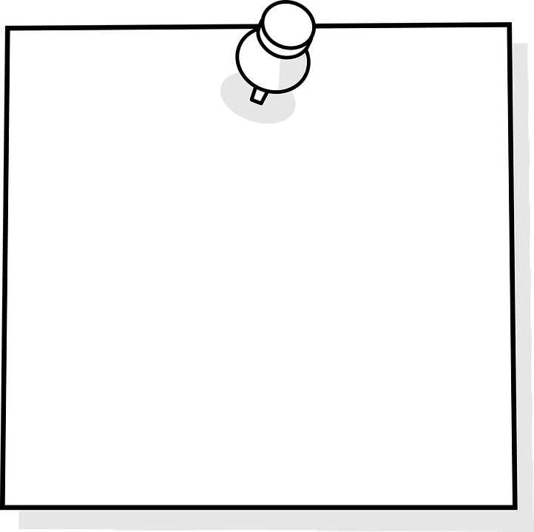
Share your adaptations & creations!
Reminder!​
Notes:
Pixabay. https://pixabay.com/vectors/sticky-note-note-blank-memo-paper-154504/

Slide 40

Implementing OER in your courses does not have to be a race to the finish line.
Notes:
Pixabay. https://pixabay.com/vectors/man-running-silhouette-black-40739/

Slide 41
Next Steps
1. Connect with the TN OER Community – email lauren.collier@tn.gov.
2. Visit the TN Textbook Affordability website
https://www.tn.gov/thec/bureaus/academic-affairs-and-student-success/textbook.html
3. Gather your learning outcomes and connect with your campus OER liaison.
Notes:
https://www.tn.gov/thec/bureaus/academic-affairs-and-student-success/textbook.html
Image: Landscape. Pixabay. https://pixabay.com/photos/way-path-outdoor-landscape-nature-918900/

Slide 42
Questions? Thoughts? Experiences?
Nancy KingSanders kingsandersn@apsu.edu
Elizabeth Spica spica@utk.edu
Ryan Korstange ryan.korstange@mtsu.edu
Ashley Sergiadis sergiadis@etsu.edu

