Slide 1
Tennessee T.E.S.T Program
Tabletop Exercise Series
Education Scenario 2: Active Aggressor

Slide 2
Welcome
Introductions
Name?
Organization?
What is your role in today’s exercise?
Housekeeping
Sign-in Sheets
Emergency Exits
Restrooms
Phones/radios
Breaks
Refreshments
Feedback Forms

Slide 3

Exercise Agenda
Pre-Exercise (15 minutes)
Welcome and introductions
Purpose & objectives
Roles & guidelines
Exercise (1-2 hours)
Module 1- Initial Notification
Module 2- Response
Module 3- Short-Term Recovery
Module 4- Long-Term Recovery
Post-Exercise (20 minutes)
Hotwash/Take-away discussion

Slide 4
Exercise Purpose and Scope
The purpose of this exercise is to provide participants an opportunity to exercise current plans, procedures, and capabilities to respond to an active aggressor event.
  Tabletop exercises are intended to test plans and procedures, not individuals.
The exercise will focus on the roles, responsibilities, and response aspects of personnel and emergency partners necessary to protect human health and safety.
The focus will be on processes and decision-making abilities rather than minute details.

Slide 5




Roles and Responsibilities
Participants
Represent your agency & discuss your planned response to the scenario.
Evaluators
Record strengths, note areas of improvement, and capture lessons learned
Facilitators
Moderate the flow of discussion and keep the TTX moving and on-track.
Observers
Here to gain insight from the exercise, refrain from interjecting during the exercise.

Slide 6
Guidelines
This is an open, low-stress, no-fault environment
The scenario is plausible, the events occur as presented
There is no hidden agenda or trick questions
Don’t fight the scenario
Be a respectful and active participant
Base your response actions on the current plans and capabilities of your department
Decisions made during the exercise do not set policy
Consider different approaches & suggest improvements
Participants are encouraged to discuss issues in depth

Slide 7
Functional Content Areas
Lockdown
School staff will initiate a lockdown procedure immediately following an active aggressor event.
Emergency Communication-Internal
School officials will ensure quick and accurate incident notification to staff and response agencies and disseminate information as incident progresses.
Mental Health & Healing
Once immediate safety issues have been addressed, staff will assess need for mental stress following trauma and provide services to those in need.
Student Accountability and Reunification
Students are accounted for and reunited with parent/guardian during unsafe situations while ensuring secure and calm procedures.

Slide 8
Exercise Participants
List the specific participants or stakeholders that will be participating in the exercise today
Recommended participants include:
  School Administration
  Various School Staff, including health officials
  School Security
  School maintenance or janitorial staff
  Local Law Enforcement
  Local Fire and Emergency Medical Service
  Local Emergency Management
  Dispatch Center (911)
  Anyone else who may have a role in response or recovery

Slide 9
Setting the Stage
Consider including the following information:
Date and Time
School Name
Number of students
Number of staff
Weather conditions (simulate or real world)
Current events in the area
Maps, floor plans, diagrams, etc.

Slide 10
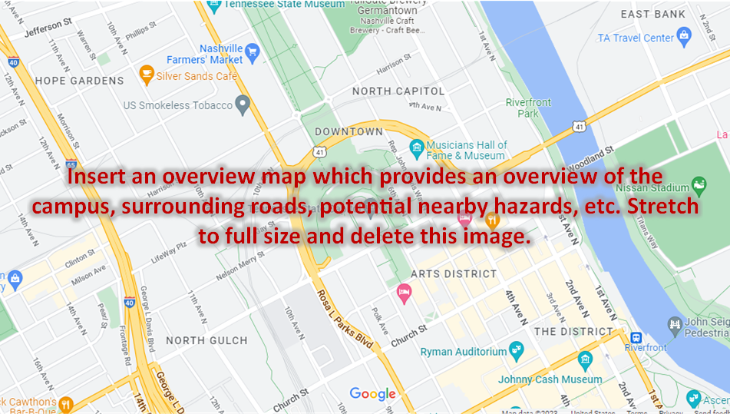
Overview Map

Slide 11
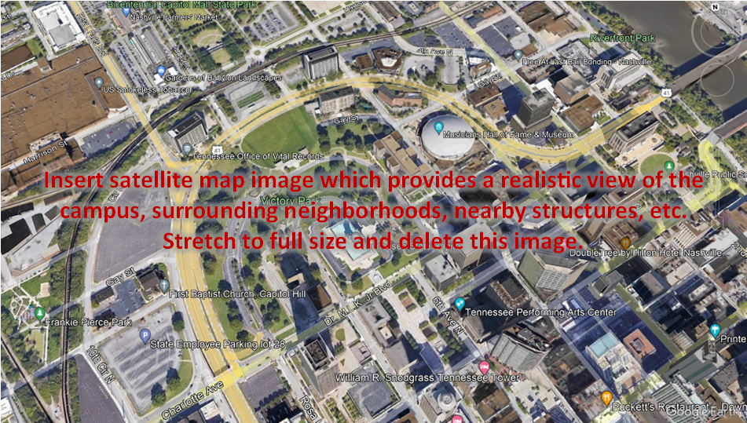
Satellite Map

Slide 12
Module 1 – Initial Notification
Today is Friday, June 2, 2023
At 9:05 a.m., at XYZ Elementary multiple shots are heard by staff in the main office and are determined to be in close vicinity.
At 9:06 a.m., students are tweeting “Active Shooter!”
Based on this information, what initial actions are taken?
Notes:
Facilitator Questions:
*Note: The facilitator questions should only be used as a guiding tool for the facilitator to engage the group is not discussing these topics naturally.
Operations/Coordination
What plans, policies, and procedures does your school have in place to respond to an active shooter event?
What are your school’s initial response priorities?
What does the first (after recognition or notification) 30-seconds for a staff member look like?
What does the first (after recognition or notification) 30-seconds for a student look like?
What are the teachers trained to do in response to shots heard?
Lockdown?
Evacuate?
Are substitute teachers, volunteers, and other transient staff trained in the school’s response measures?
Who can place the school on lockdown?
What is the process for this?
How is this communicated?
What is the process for notifying the School Resource Officer (if staffed)?
Who calls 911?
What are your initial actions and the actions of the staff?
What are the immediate concerns?
What are the students taught for response?
Run, Hide, Fight / Avoid, Deny, Defend?
How to interact with officers?
If they’re engaged or near the shooter, what to do: phone on silent, hide, etc.?
Where to evacuate?
How to communicate with others?
What resource gaps could limit your school’s ability to respond to an active shooter?
Security, Protection, and Law Enforcement
What agencies are notified to respond and how are these agencies notified?
The school is on lockdown, how does law enforcement gain access to the building?
In terms of securing the scene, what are the immediate priorities?
Given the situation, what protective measures would you adopt at this point, if any?
How would resource needs be prioritized in the event of a secondary attack?
Has the school trained or exercised with local first responders?
Medical/Mass Care
What are the immediate medical/mass care priorities?
What partners would you begin to coordinate with at this point?
What critical decisions/preparations might need to be made at this point?
Public Information and Warning
How does your school issue warnings, alerts, and other emergency messaging?
What plans, policies, and procedures does your school have in place to guide your internal and external communications strategies?
What individual (or position) coordinates and delivers your school’s public messaging?
Community Resilience
How does your school encourage students, staff, and families to take individual steps to prepare for a potential active shooter incident?
How does your school/district encourage staff, students, and the community to report suspicious activity/threats?
What method does the school/district use to allow staff, students, and the community to report suspicious activity/threats?

Slide 13
Module 2 – Response
Lockdown has been initiated.
First two law enforcement officers arrive on scene at 9:09am:
  Dispatch (9-1-1) has received multiple text messages and calls about an active shooter in the school.
  Multiple injuries and deaths reported
  Initial reports stated shots may be coming from the library.
  Callers/texters do not know how many shooters are in the building or location.
  One student reports the shooter has an assault rifle.
  Another student reports the shooter has a large backpack.
Based on this information, what actions are taken at this time?
Notes:
Facilitator Questions:
*Note: The facilitator questions should only be used as a guiding tool for the facilitator to engage the group is not discussing these topics naturally.
Operations/Coordination
Who is the lead agency on this incident?
What plans, policies, and procedures does your school have in place to guide response efforts at this point?
How would your school maintain an effective command structure to coordinate emergency response efforts?
How would your school establish a command structure to coordinate your immediate response efforts?
Is a staging or incident command post being created?
How do key decision-makers collect information to assess the extent of the situation, including injuries and fatalities?
What resources are currently available?
Who are the key external partners that would support response efforts?
What risk does the backpack pose?
Is additional support needed to address this threat?
Security, Protection, and Law Enforcement
How do responders enter:
Wait and group/tactical team approach?
Immediate tactical intervention/first man in?
Another strategy?
What actions do the responders on-scene take? What kind of response is needed?
What response plans and protocols would your school activate at this point?
How will students and staff know when the threat is neutralized, and the scene is secure?
What communications methods are the officers using while entering and clearing rooms in the school?
What additional protective measures would be implemented at this time based on your earlier decision to either evacuate, shelter-in-place, or lock-down the school?
Are any additional agencies or resources needed?
Medical/Mass Care
What potential mass care challenges does this type of incident pose for emergency managers and law enforcement response personnel?
How would your school address challenges of injured students both on-scene and those fleeing away from the scene?
Does the jurisdiction engage in Rescue Task Force training?
Does the jurisdiction have the proper equipment to perform this function?
Public Information and Warning
Who at the school is taking lead on communication with outside agencies?
How does your school ensure consistent, coordinated public messaging throughout this phase of response operations?
How does your school ensure timely and accurate situational updates for internal and external partners throughout the response period?
How and when does your school activate its crisis communications plan?
How does your school notify families, key partners, and the public of fatalities or serious injuries?

Slide 14
Module 2 – Response (continued)
Several students are running out of the building near the main entrance while the rest remain in lockdown.
School staff is made aware that a classroom with 25 students is on a field trip and they are scheduled to return to the school at 9:30 a.m.
Based on this information, what actions are taken at this time?
Notes:
Facilitator Questions:
*Note: The facilitator questions should only be used as a guiding tool for the facilitator to engage the group is not discussing these topics naturally.
Operations/Coordination
How would you begin to conduct accountability for students and staff?
Security, Protection, and Law Enforcement
Where are the fleeing students being told (or trained) to go?
Are fleeing students being searched for weapons?
Are the students being tracked once they’ve exited school?
Medical/Mass Care
Are fleeing students being helped?
Is someone screening fleeing students for injuries?
Public Information and Warning
Is there a notification system used to alert families/all staff?
How do we gather parents/guardians to keep them informed and calm?
Does social media have a part in the school systems response to the public?
How are the off-grounds teacher and students notified of the incident?
What directions are they given?

Slide 15
Module 3 – Short-Term Recovery
It is now 9:25 a.m.
The shooter has been neutralized. There are 9 confirmed fatalities.
Law Enforcement has confirmed there are no other shooters in the building.
Media is on scene.
Parents are arriving on scene and calling to ask how they can pick up their children.
Students are seen crying and very distraught.
Based on this information, what actions are taken at this time?
Notes:
Facilitator Questions:
*Note: The facilitator questions should only be used as a guiding tool for the facilitator to engage the group is not discussing these topics naturally.
Operations/Coordination
How does your school coordinate the transition from response to short-term recovery efforts?
Who has the authority to end the lockdown? How is this communicated and what is the process?
How are the students moved out of the area and safely reunited with parents?
Are buses used to transport students off-site? How are busses summoned? How long does it take for busses to arrive?
Are other resources/locations needed for drop-off/pick-up?
What plans, policies, and procedures guide your school’s short-term recovery process?
What resource gaps could limit your school’s ability to meet these priorities?
How are we reunifying parents with students?
How are we addressing the parents who are not being reunified?
Is there any changes that would be made to the reunification site?
Parents of victims
Parents of multiple students (one victim)
Site Security
Mental Health
Debrief / Interview Areas
Parents / Guardians without proper identification
Custody concerns
Non-English speaking parents/guardians
How is the school system handling the death of on-duty employees?
Notification of next-of-kin?
Security, Protection, and Law Enforcement
What plans or procedures are in place to manage and secure the scene following the incident?
What partners would be engaged to assist with these efforts?
What is your process for tracking the status and location of individuals who have been injured or fatally wounded?
What investigative response methods need to be used?
Evidence collection
Field interviews
Medical/Mass Care
What are your school’s mass care recovery priorities at this point?
How does your school handle the notification of death or injury to relatives?
What plans or policies are in place to support affected populations with counseling and behavioral health resources?
What additional resources, if any, would be needed to support family reunification and other support services for families, students, and staff?
Public Information and Warning
What information is being pushed out to media, and how? Is there a public information officer (PIO) at your school?
How does your school ensure consistent, coordinated public messaging throughout the recovery period?
How does your school provide internal and external partners with timely updates concerning recovery efforts? With families, students, staff, and alumni?
Do your recovery communications methods include the capability to communicate with students and staff who have language or access and functional needs requirements?
Community Resilience
Has your school and your community thought about the aftermath of this type of incident and what the priorities, needs, and expectations are of the students, staff, families, and community?
What district resources are we deploying and where? (for short-term recovery goals)
Psychological/Mental Health
Reunification
Security
Maintenance
Medical
Social Workers
Transportation

Slide 16
Module 4 – Long-Term Recovery
Topics of Discussion
  Continuity of Learning
  Community Events, Remembrance, and Dedication
  Return to School
  Mental Health and Supports
  Threat Monitoring
  Public Information and Rumor Control
Notes:
Facilitator Questions:
*Note: The facilitator questions should only be used as a guiding tool for the facilitator to engage the group is not discussing these topics naturally.
Continuity of Learning
How long would the school be shut down for? Alternate facility?
Does learning continues during the period of school closure? What plans exist to facilitate this?
Operations/Coordination
How does your school coordinate the transition from short-term to long-term recovery efforts?
Are other resources/locations needed are needed?
Victims
Students/staff present during the incident
Parents of victims
Parents of multiple students (one victim)
Site Security
Mental Health
Non-English speaking parents/guardians
What plans, policies, and procedures guide your school’s long-term recovery process?
What resource gaps could limit your school’s ability to meet these priorities?
Security, Protection, and Law Enforcement
What plans or procedures are in place to provide continued security to the campus?
What partners would be engaged to assist with these efforts?
What plans/procedures exist to monitor threats and suspicious activity?
Public Information and Warning
What information is being pushed out to media, and how?
How does your school provide internal and external partners with timely updates concerning recovery efforts? With families, students, staff, and community?
Community Resilience
Does your school/district have the ability to support long-term behavioral health needs for students and staff? If not, are there public or private resources that can support these requirements?
What actions, if any, have been identified to help the community heal?
What district resources are we deploying and where? (regarding long-term recovery goals)
Psychological/Mental Health
Security
Maintenance
Medical
Social Workers/Guidance Counselors

Slide 17
Hotwash
What went well?
What are some areas for improvement?
Any additional comments/questions?
Please remember to fill out your feedback form!

Slide 18
Thank You!

