Slide 1
Section 5310 Program: Enhanced Mobility of Seniors & Individuals with Disabilities
PTRF Division, Public Transportation Section
August 12, 2024

Slide 2
About the 5310 Program…
This program supports transportation services planned, designed, and carried out to meet the special transportation needs of seniors and individuals with disabilities in all areas.
It does not offer Operating dollars, only rolling stock (vehicles); funded 80% by the Federal Transit Administration (FTA),10% by TDOT, and 10% local (your agency - which cannot be from other Federal funding). Note: In 2022, all awards were 100% Federally funded, with no local match required.
https://www.transit.dot.gov/funding/grants/enhanced-mobility-seniors-individuals-disabilities-section-5310

Slide 3
Eligible Subrecipients
Private nonprofit organizations
    Usually offer alternatives to public transportation projects that assist seniors and individuals with disabilities with transportation.
    Entities such as Senior Centers and Community Centers for individuals with disabilities.
State or local government authorities
Operators of public transportation

Slide 4
Important Contacts & Resources
Emily Duchac- Mobility and Accessible Transportation Supervisor
Emily.Duchac@tn.gov, (615) 741-2963
Nicky Moore – Program Monitor coordinating the Compliance Site Visits for all 5310 subrecipients/Civil Rights Liaison/ADA/EEO
Nicquayleeonntea.Moore@tn.gov, (615) 741-3865
Lesley Unterwegner – Asset Monitor
Lesley.Unterwegner@tn.gov, (615) 741-8742
Related Forms can be found at: 5310 Program (tn.gov) under “Required Vehicle Reporting” and “Other Compliance Documents”

Slide 5
Coordination Plan
Each Human Resource Agency has a Transportation Coordination Plan, with a thorough analysis of the area they serve. Non-profit agencies are covered by this plan, and are able (encouraged) to coordinate services with the HRAs, to better serve the target audience of the 5310 program (you may ask TDOT Public Transportation Section for a copy of the Coordination Plan that covers your Agency).
FTA allows and encourages grantees to coordinate and assist regularly providing meal delivery service for homebound individuals, if it does not conflict with providing transportation for the target audience of the 5310 Program.

Slide 6
Vehicle Management/Maintenance
The following forms are to be submitted to TDOT.MultiModalAdmin@tn.gov
Quarterly Reports are due to TDOT Public Transportation, on April 20th, July 20th, October 20th, and January 20th. Reminders will be sent for every quarter.
TDOT Basic Vehicle Inspection Sheet is due annually by September 30th.
Basic Maintenance Log Sheet is due annually in January, for the previous year.
If a vehicle is not in use for more than 30 days, an Out of Service Request Form must be submitted.
If grantee wants to dispose of a vehicle, grantee will have to submit a Request for Title Form, and a Final Disposal of Vehicle Capital Asset Information Sheet. Please contact Lesley Unterwegner for a thorough explanation of this process.
For vehicle maintenance, you must follow the service intervals denoted in your Preventative Maintenance Plan (e.g., Change oil every 5,000 miles, and save your oil change receipts). Service must be performed on time at least 80% of the time.

Slide 7
Vehicle Management/Maintenance
The grantee’s Preventative Maintenance Plan must include several required elements. A template is available from TDOT.
Adequate insurance coverage must be provided on the 5310 vehicle(s), as noted in the grantee’s contract with TDOT.
Grantee must maintain an asset inventory, including the following elements: description of the property (make, model, and year), vehicle identification number (VIN), source of funding (grant number), name of physical title holder (TDOT), name on title, acquisition date, cost, percentage of cost covered by Federal funds, current location of the vehicle(s), current use (Active, Back-up, Reserve, Awaiting disposition), current condition (Excellent, Good, Fair, Poor), disposition information (if applicable, date of disposal and sale price)
Grantee must keep adequate maintenance records, including receipts for all maintenance performed and a log for each vehicle of maintenance performed.
Grantee must track and report all incidental use of the 5310 vehicle.

Slide 8
Vehicle Management/Maintenance Q&A
Q: If our Agency doesn’t have an updated or approved Maintenance Plan, what should we do?
A: To ensure the correct information is listed in your plan, the “Lead” reviewer for your Site Visit will be able provide you with helpful templates to assist you in formulating a compliant plan and will work with you through the approval process.
Q: Would our agency need to keep track of ALL maintenance done on our 5310 vehicle(s)?
A: Yes. All 5310 subrecipients must keep a running maintenance log and receipts of all work completed on the vehicle(s). If you don’t have this form, you can locate it on our website. These forms are to be kept on file at a minimum from when the vehicle is awarded through disposition of the vehicle.
Q: At what point do we need to request an Out of Service status on a vehicle?
A: If the vehicle will not be used for more than 30 days, you will need to submit an “Out of Service Request” form to TDOT.MultiModalAdmin@tn.gov.

Slide 9
Vehicle Reporting 2024 Due Dates
Tennessee Department of Transportation 5310 Subrecipient Reporting Schedule
Below are listed the quarterly and annual reports that are due to TDOT and the dates each is due.
Due dates that fall on a weekend will be due the following Monday.
January 20, 2024 Quarterly report for vehicle usage October-December 2023
Annual vehicle maintenance logs from 2023 for each vehicle
April 20 Quarterly report for vehicle usage January - March 2024
July 20 Quarterly report for vehicle usage April – June 2024
Annual vehicle inspections for each vehicle (begin requesting in July, submit by September 30)
October 20 Quarterly report for vehicle usage July – September 2024
All forms should be submitted to the TDOT Public Transportation Admin email: TDOT.MultiModalAdmin@tn.gov
Submissions are considered late if they are received more than 5 days after the due date.

Slide 10
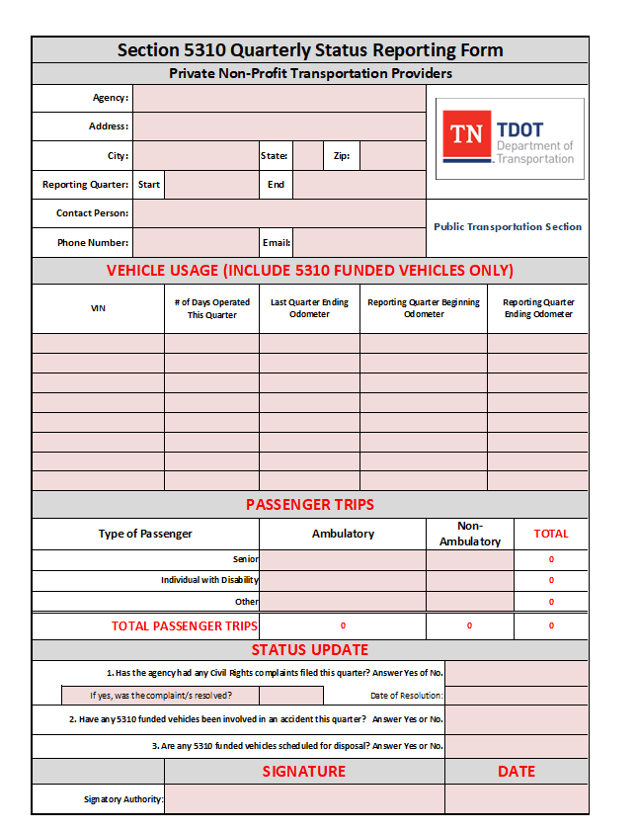
Vehicle Reporting Example - QR
Quarterly Status Report
Submit after each quarter
Report days operated, mileage, and passenger trips for the quarter
Due on the 20th of the month following each quarter (see Due Dates slide)

Slide 11
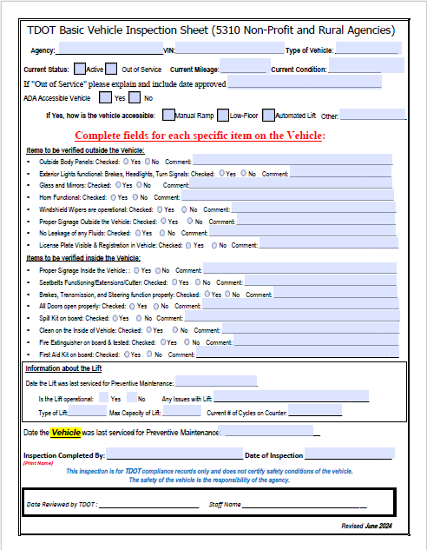
Vehicle Reporting Example - Inspection
Annual Vehicle Inspection
Submit once a year
Submit one for each vehicle
Fill in checklist about various aspects of the vehicle
Does not need to be completed by a shop, your staff should be able to complete by looking at the vehicle and accessing internal maintenance records
Due September 30, may be submitted any time before that in the calendar year

Slide 12
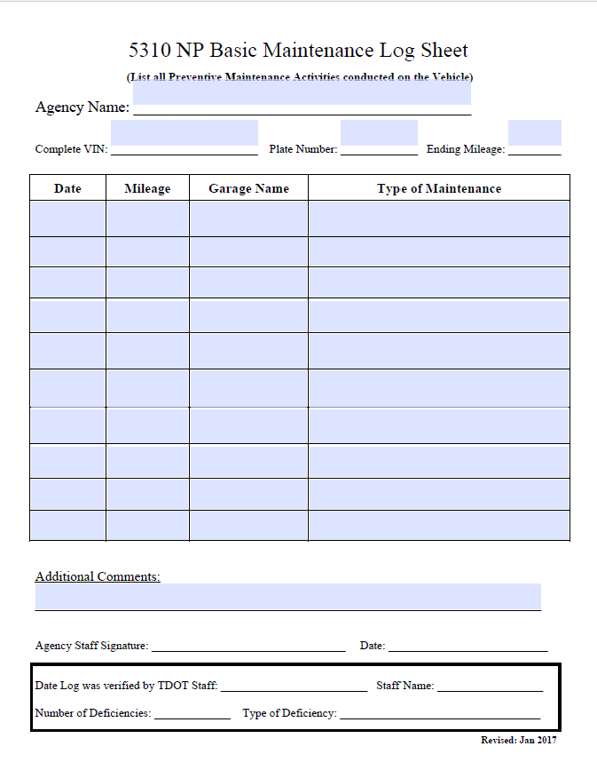
Vehicle Reporting Example – Maint Log
Annual Maintenance Log
Submit once a year
Submit one for each vehicle, showing all maintenance service done on vehicle for the year just ended
Be sure to specify oil changes
May use printouts from your maintenance software in place of TDOT template but must include all information requested on this form. E.g., you will have to add Ending Mileage (as of 12/31) and some kind of signature if those are not on printout.
Due January 20, showing maintenance for the previous year

Slide 13
Vehicle Reporting Q&A
Q: Can reports be submitted after the due date and grace period?
A: Yes! Reports will continue to be accepted, and will be requested, to complete our records but failure to submit on time will put your agency in a state of deficiency. Consistent late submissions and/or failure to submit required reports may result in a letter of noncompliance, which will put future awards and current possession of vehicles at risk. If reporting has been a struggle for your agency, work with your lead reviewer to get back on track.
Q: Where can we locate the forms that we need to submit?
A: The blank forms can be found on TDOT’s website under “Required Vehicle Reporting” https://www.tn.gov/tdot/multimodal-transportation-resources/omat/5310-program.html
If you have questions about any of these forms, please contact:
Lesley Unterwegner, TDOT Transit Asset Monitor.
Lesley.Unterwegner@tn.gov

Slide 14
Title VI, Civil Rights of 1964
The grantee must have a Title VI Assurance statement and LEP (Limited English Proficiency) poster posted in an open space where it is visible (e.g., bulletin board). Title VI notice must include Local, State, and Federal contact information.
Grantee must submit a Title VI Assessment to the Civil Rights Division of TDOT via the Title VI Coordinator for their region.
Region 1&2: Pamela Sharp, Pamela.Sharp@tn.gov
Region 3&4: James Wes White, James.W.White@tn.gov
Please contact your respective Title VI Coordinator for a copy of the assessment, and technical support. Title VI approval must be renewed every three years.
Your agency’s Organizational Chart MUST have a designated Title VI Coordinator.

Slide 15
Equal Employment Opportunity (EEO)
Grantee must have a designated EEO Officer in the Organizational Chart
Grantee must have the EEO Statement Poster and the EEO Supplement Sheet posted in an open space, visible to the public. (For the latest poster: https://www.dol.gov/general/topics/posters)
EEO Policy should be included in Personnel Policies/Employee Handbooks/Job Applications/ Notices (e.g., “Grantee, Inc. is an Equal Opportunity Employer”)

Slide 16
Americans with Disabilities Act (ADA)
If grantee does not have an Accessible Vehicle (ramp, lift, lowered floor), they must have coordination with another Agency to be able to provide Equitable Service to persons with disabilities.
Grantees must allow individuals with disabilities to travel with attendants and service animals.
Grantee must have a designated ADA Coordinator in their Organizational Chart.

Slide 17
Other State Requirements
Grantee must post the Comptroller’s hotline number in an area visible to the public (posters may be obtained from the Comptroller’s office at megan.chalk@cot.tn.gov).
Grantee’s Preventative Maintenance Plan must be approved by TDOT and should be updated as necessary to reflect currently recommended mileage intervals, new fleet information, and/or new maintenance vendors. For minor changes, an addendum may be added to the existing approved plan.
Disposal of vehicles must be done in coordination with TDOT, as the FTA retains an interest in each vehicle. As noted above, contact Lesley Unterwegner for details.

Slide 18
Vehicles Should have…
Safety Equipment:
• Fire extinguisher (should have a current inspection tag, we will check this during Site Visit)
• Bio-Hazard Clean-up Kit (Should you need a new one, you can purchase them pre-made or you can make a kit on your own. Please contact TDOT if wanting specific guidance on making your own.)
• First Aid Kit
• Seatbelt cutter (not required, but it’s recommended)
Tire tread depth should be above 4/32”
Vehicle cleanliness is noted

Slide 19
If vehicle has accessibility features:
Wheelchair securement hardware
• Have the belts stowed properly and NOT left on the floor. This can be a tripping hazard, as well as induces rusting of equipment. We inspect this during site visit (or in pictures for virtual visits)
• Belt tracks are clean and free of dirt
• No obstacles blocking wheelchair station
*Grantee must have a section in their Preventative Maintenance Plan that specifically addresses Accessibility Features maintenance.

Slide 20
Compliance Reviews
TDOT Public Transportation’s approach is one of offering technical assistance. These are NOT Audits.
Reviews are to be conducted at a minimum every three (3) years for each 5310 Program subrecipient.
Following the slides in this PowerPoint, and performing vehicle maintenance at the appropriate times, should help you in meeting minimum grant requirements. If in doubt consult your contract and/or TDOT Public Transportation.
Do not hesitate to contact TDOT Public Transportation with any questions.

Slide 21
Thank you, for all you do for the citizens of Tennessee!

