Slide 1

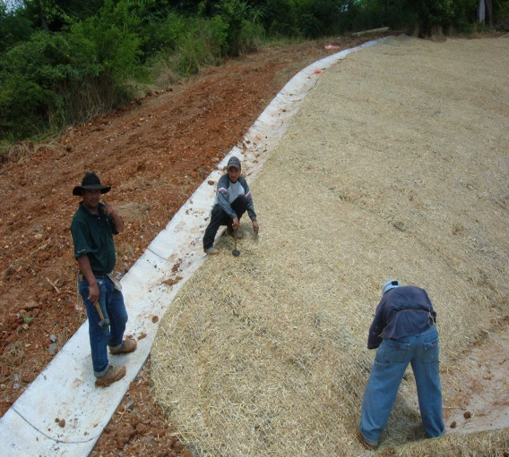

TDOT
Civil Rights Division
Small Business
Development
Program

Slide 2

Statement of Commitment
The DBE program is intended to remedy past and current discrimination against disadvantaged business enterprises, to ensure a “level playing field,” on which DBEs can compete fairly for contracts.

Slide 3

DBE Program
What is the program?
This program was developed by the Federal Highway Administration and is administered by the Tennessee Department of Transportation Civil Rights Division Small Business Development Program to encourage minority, female and other disadvantaged firms to work in the highway/bridge industry. Both state and federal construction projects and monies are included in it.

Slide 4



DBE Ethnic Classifications
MBE | Minority Male Business Enterprise
MFBE | Minority Female Business Enterprise
AIA | Asian Indian American
APA | Asian Pacific American
BA | Black American
HA | Hispanic American
NA | Native American
FBE | Female Business Enterprise

Slide 5
DBE Breakout By Category

Slide 6

Commercially Useful Function (CUF)
Expectations of State DBE Program
Definition of CUF, is that the DBE is responsible for the execution of the work where the DBE manages, supervises, obtains the materials, and performs the work items with his/her own forces.

Slide 7
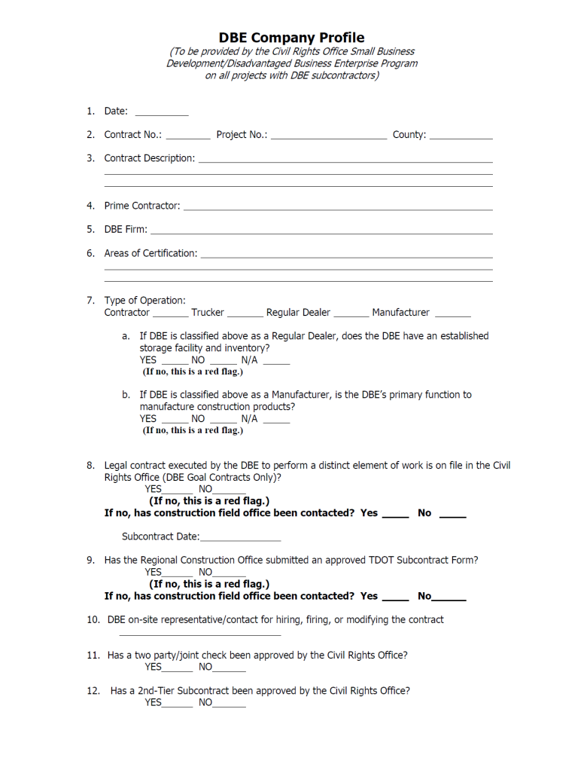
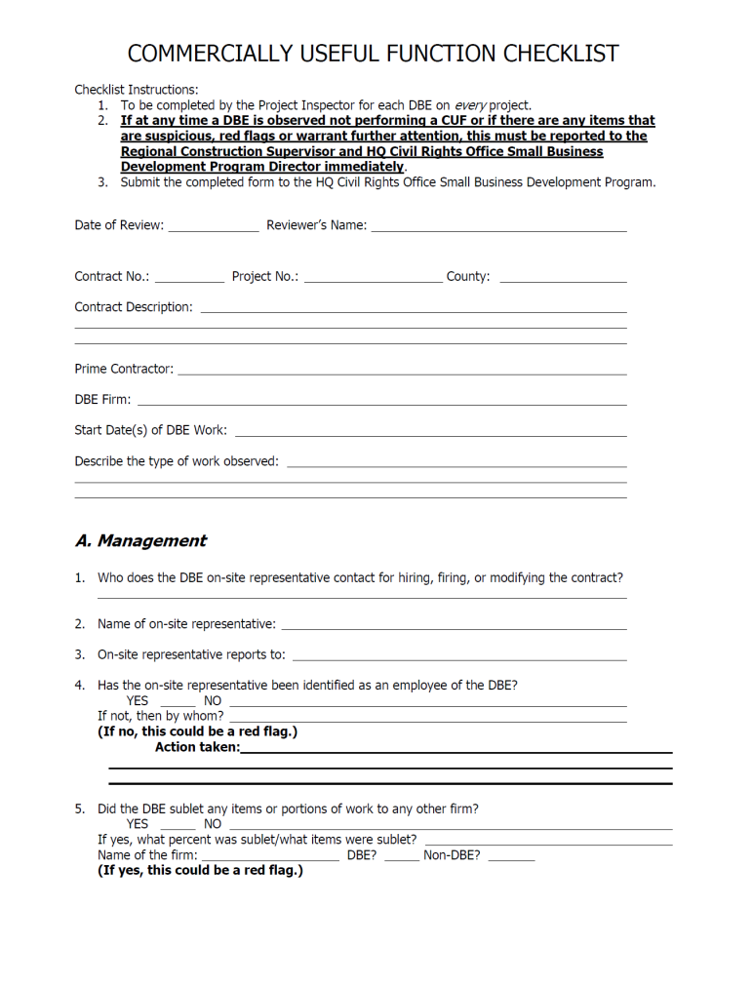
Commercially Useful Function Checklist

Slide 8
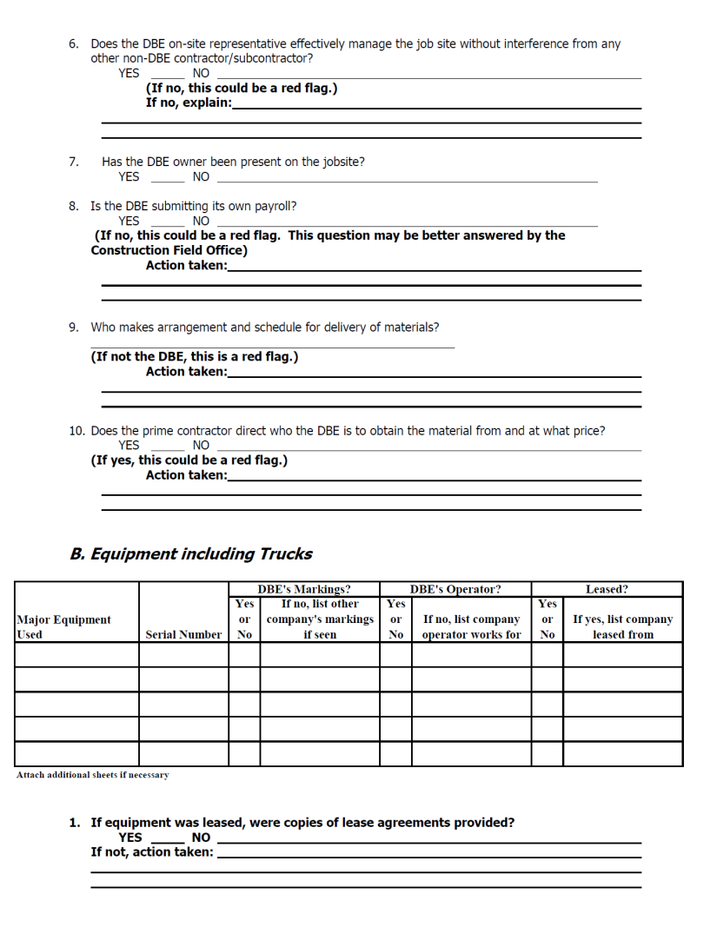
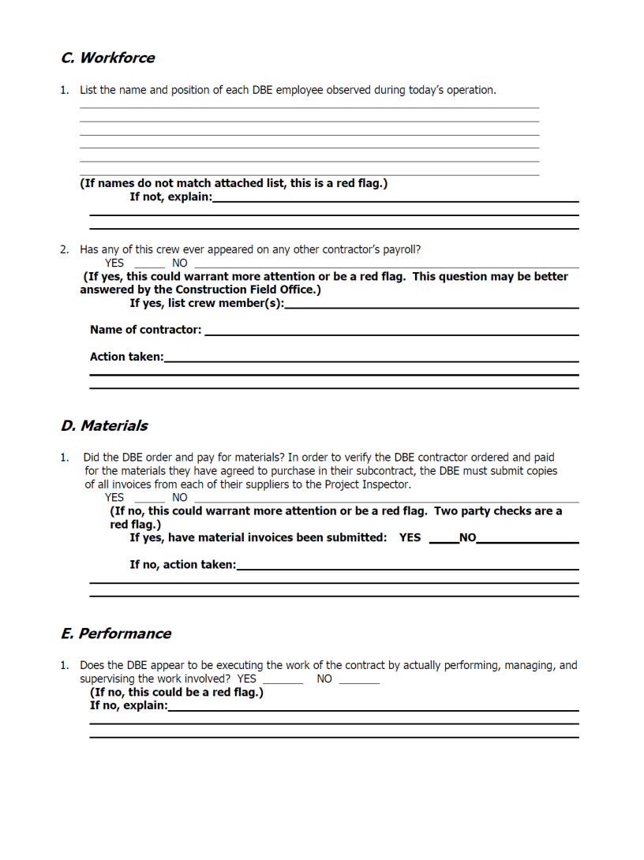
Commercially Useful Function Checklist (Cont’d)

Slide 9
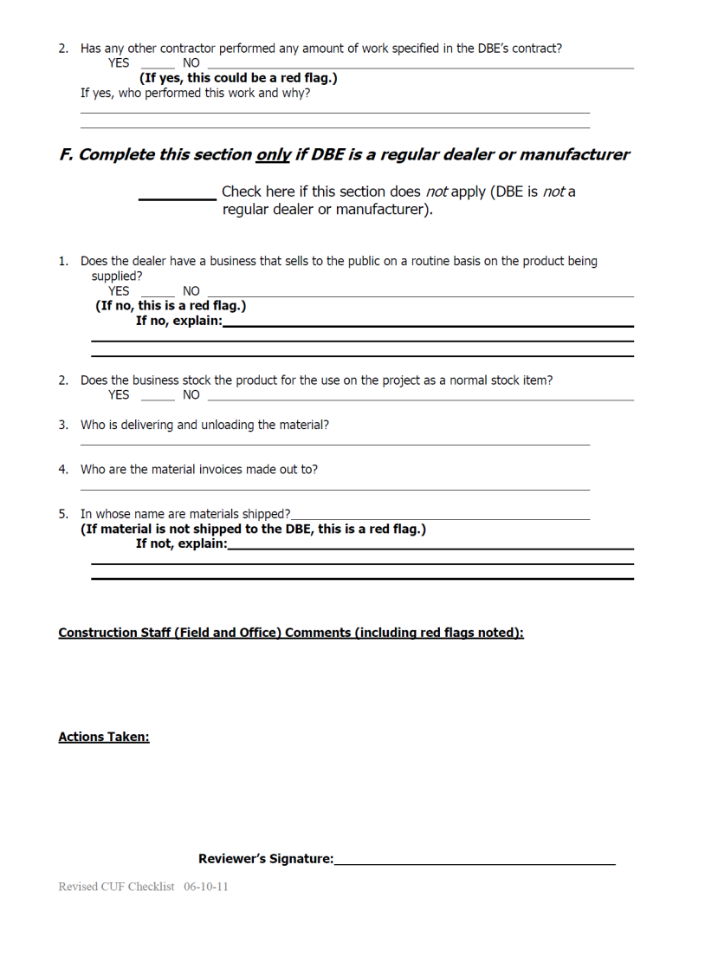
Commercially Useful Function Checklist (Cont’d)

Slide 10

Key Points to Remember When Completing CUF Checklist
Include the actual date the DBE work was observed
Information in Site Manager should match CUF Checklist
Initial and date any changes on CUF Checklist
Sign CUF Checklist on last page

Slide 11
Monitoring Responsibilities
Prime contractors have an obligation to make every effort in complying w/ intent when awarded goal projects.
TDOT Project Engineers, in addition to assigned responsibilities from the Region, monitor CUF functions and other DBE matters.

Slide 12

Monitoring Responsibilities
(Cont’d)
Replacement: A DBE can only be replaced w/ approval from the Civil Rights Office SBDP. A letter, from the prime, should be written stating: reason for replacement, company they wish to use, & if company’s not a DBE, how the goal will be achieved.

Slide 13

How To Comply With DBE Utilization Requirements
TDOT Special Provision (SP) 1247 requires contractors to use DBEs for subcontracts or suppliers on federal-aid contracts. TDOT tracks usage & reports to Federal Highway Administration (FHWA) & the Commissioner of TDOT. Prime contractors have an obligation to make every effort in complying w/ intent when awarded goal projects.
    Posted on the Civil Right’s Small Business Development Program’s website @:
    www.tn.gov/assets/entities/tdot/attachments/Const-1247.pdf
      (It can be made available for those that do not have Internet access)

Slide 14
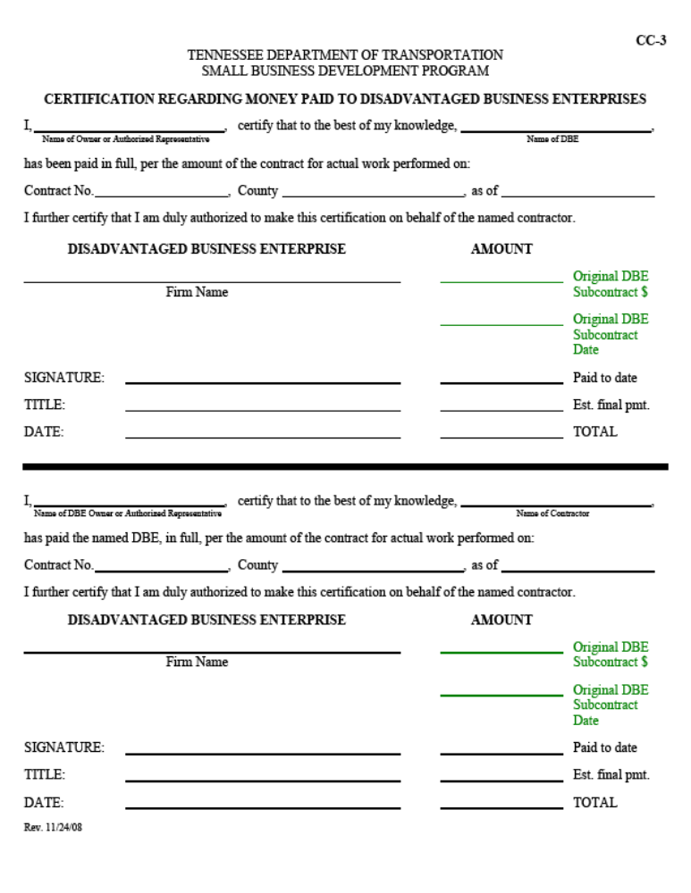
CC-3 Form

Slide 15
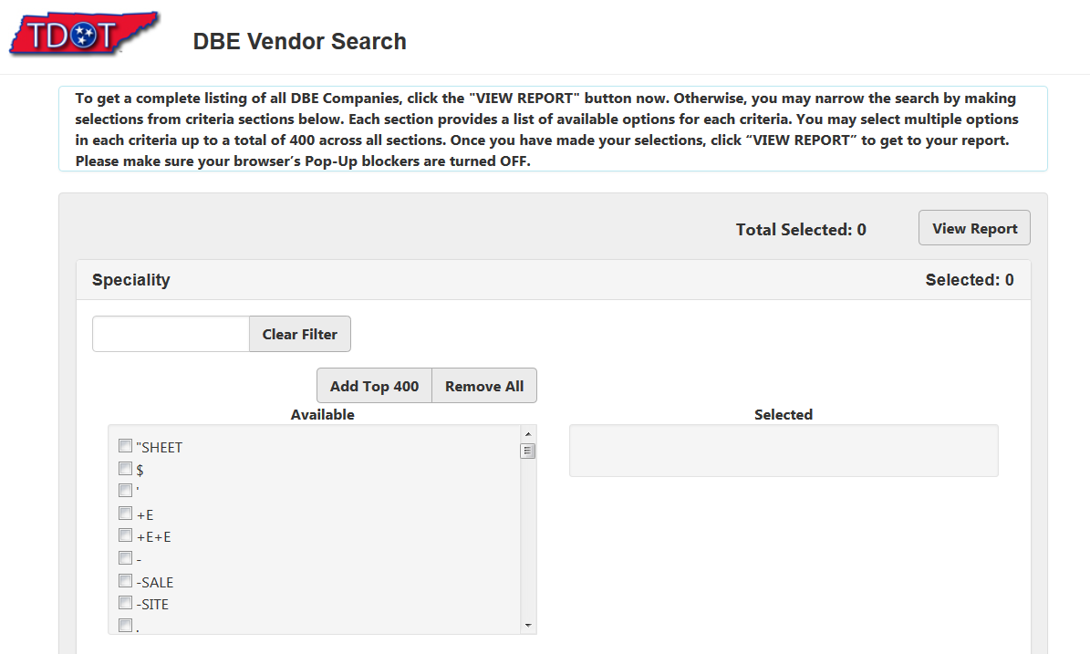
DBE/TNUCP Online Directory

Slide 16
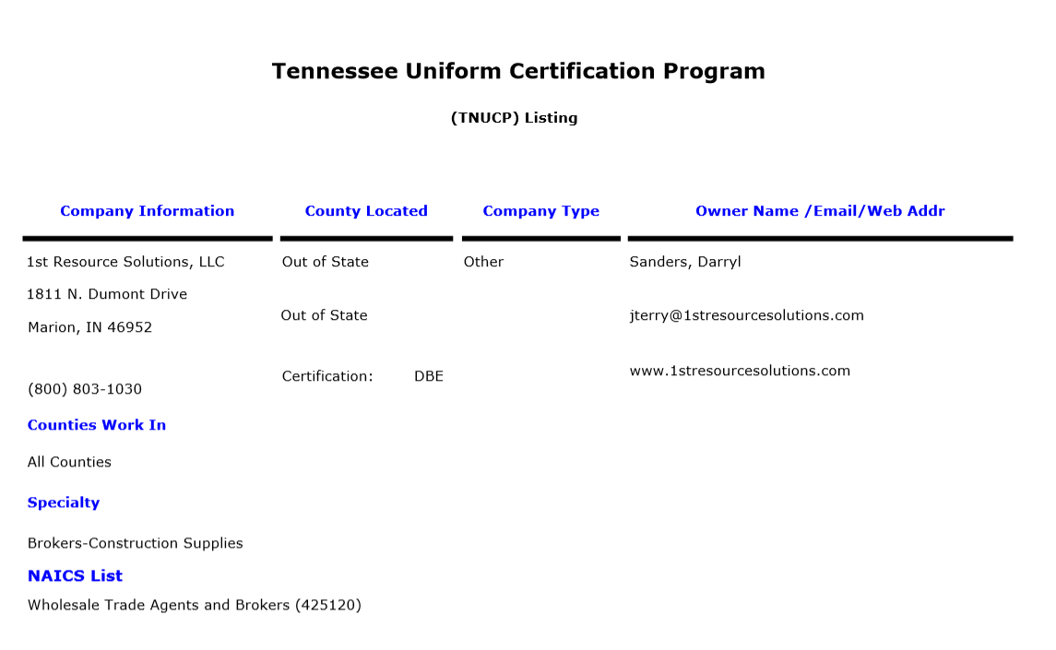
DBE/TNUCP Online Listing

Slide 17
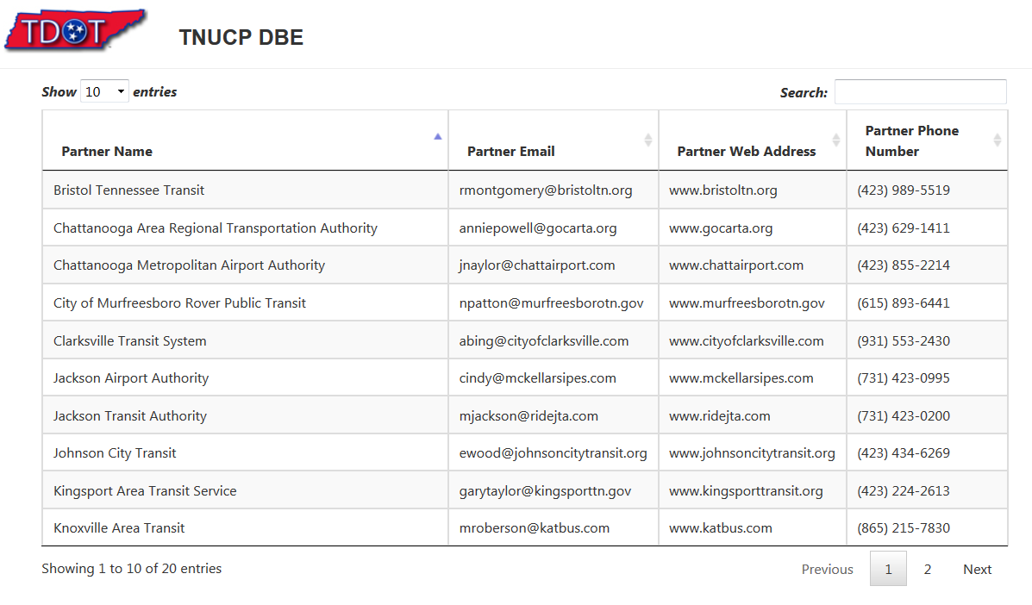
DBE/TNUCP Partners Listing

Slide 18
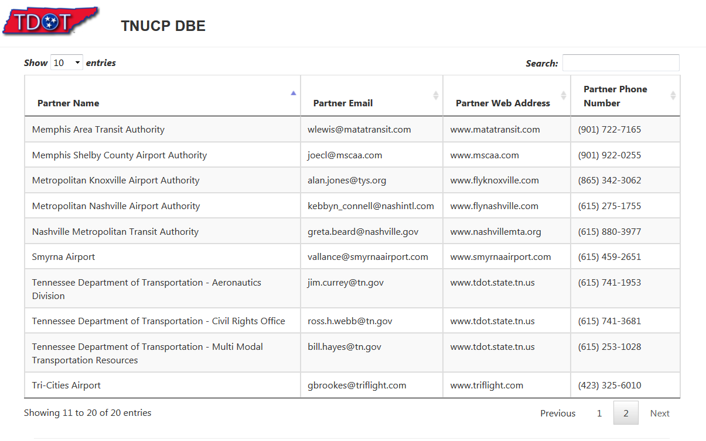
DBE/TNUCP Online Listing Cont’d

Slide 19
Should you have any questions/concerns regarding the DBE Program or issues regarding DBEs on projects, you may contact:
David Neese
Small Business Development Program Director
David.Neese@tn.gov
(888) 370-3647 Toll Free
(615) 741-3681 Phone
(615) 741-3169 Fax

Slide 20
Small Business Development Program Team (click name for email)
David Neese, Director
Vacant, Small Business Development Coordinator
Stephanie Brooks, Contract Compliance Officer
Ross Webb, Contract Compliance Officer
Deantwaine Moye, Contract Compliance Officer

