Slide 1
CNU224 Roane County
I-40 Emergency Slide Repair Mandatory Pre-Bid Meeting
Letting Date: May 15, 2020
Please make sure your microphone is muted at this time unless you are speaking. Thank you!

Slide 2
Pre-Qualification Requirements
Standard Pre-Qualifications still apply.
  Please check to make sure your TDOT Pre-qualification is not expired
  Contractors with an expired prequalification that has surpassed the 90 day grace period will not be authorized to bid
  Prospective Bidders must have filed their standard prequalification questionnaire at least 14 days preceding the date of letting.

Slide 3
Pre-Qualification Requirements
Special Pre-Qualification
  Special Pre-qualification Packages are due to HQ Construction no later than Friday, April 24, at 10:00 a.m. CDT. Please take special note of requirement 13 that was added per the update on 4/15/2020. Requirement 13 does not supersede the requirements for the prime/specialty subcontractor as listed in the plans
  Contractors will be notified of Qualification Status by Wednesday, April 29 at 4:00 p.m. CDT
  Contractors must still request bid-authorization by 4:00 p.m. CDT on Thursday, May 14, to be able to bid.

Slide 4
Pre-Qualification Requirements
Questions:
Please submit RFIs by email to Jamie.Fitzpatrick@tn.gov.
Please submit with subject line as, “CNU224 Roane RFI”
RFIs will be accepted up until Friday, May 8, at 4:00 p.m. CDT.
Responses will be posted on TDOT Construction webpage.

Slide 5
Scope and Overview of Project
1.311 miles of I-40 on both the Eastbound and Westbound sides
ADT: 17,020
Designer: TDOT
Geotech Designers: Golder Geotechnical Engineering – Westbound
KSWA - Eastbound
Emergency slope stabilization on I-40 WB near M.M. 344
Emergency slope stabilization on I-40 EB between M.M. 342 and M.M. 344

Slide 6
Scope and Overview of Project
2 separate projects:
I-40 EB- Slope stabilization includes construction of a 4,385 SF soldier pile anchored retaining wall (SP624 – Contractor Design using the parameters in plans)
I-40 WB- Slope stabilization includes installation of horizontal drains and over 1,700 tie-back anchors with concrete anchor blocks (Engineered design in plans with 11 sheet anchor schedule)
DBE goal is 9.00%
Completion date is July 31, 2022.

Slide 7
Scope and Overview of Project
Opportunities for DBE utilization in the following areas:
Construction Stakes, Lines, etc.
Hauling (Road and Drainage, Stone, Asphalt)
Erosion Control
Storm Drainage
Guardrail
Rip-Rap
Concrete Median Barrier
Traffic Control

Slide 8
I-40 Rockwood Westbound
Pre-bid meeting
April 22, 2020

Slide 9
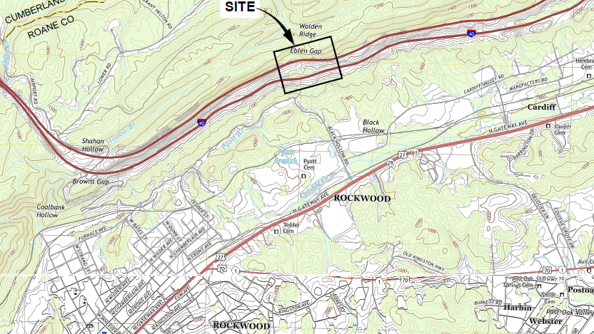
Outline
Geology overview
Drilling and grouting
Clarifications for R-sheets

Slide 10
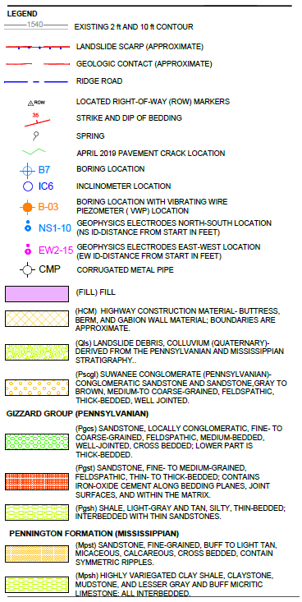
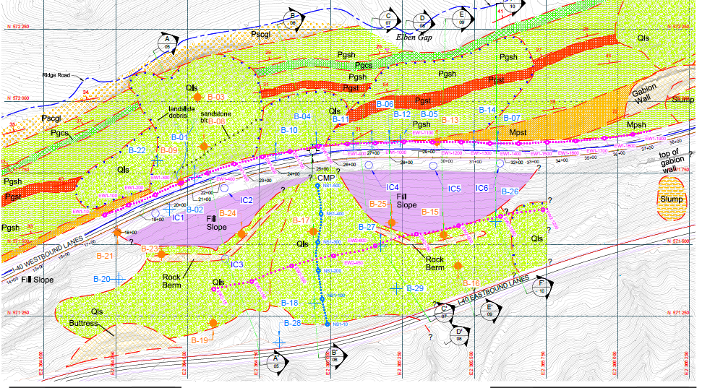
Site Geology
Geologic map and site investigation layout

Slide 11
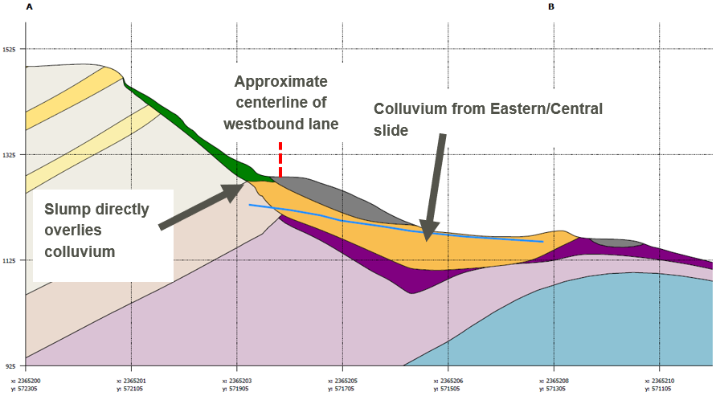
Site Geology
Geologic Section

Slide 12
Site Geology and Drilling
Difficult drilling Conditions
Drilling in Colluvium
Variable
Boulders
Voids
High grout intakes
Lost/Damaged tooling
No sample recovery
Water

Slide 13
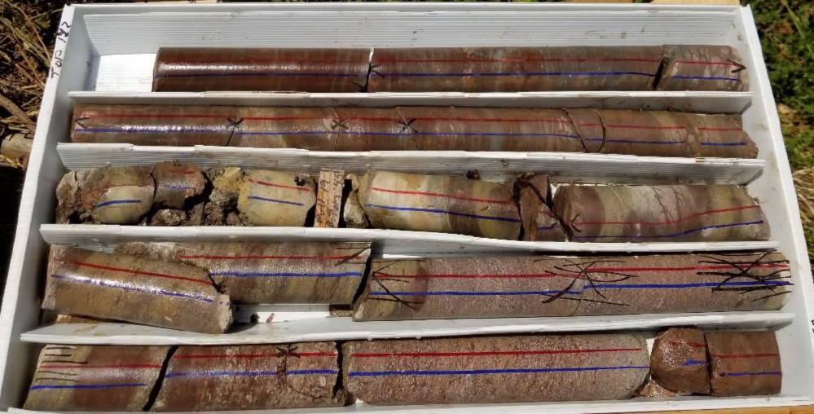
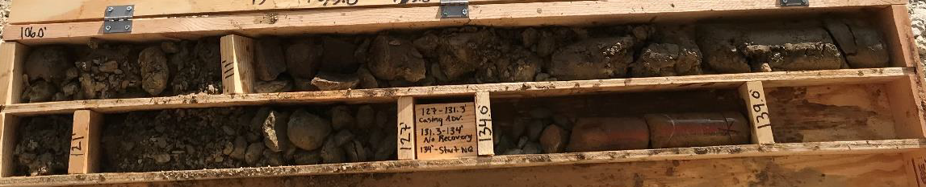
Site Geology and Drilling
Difficult drilling conditions
Pennington
Shale, Sandstone, and Limestone
Clay layers
Voids
High grout intakes
Lost/damaged tooling
Groundwater
Flowing Sands

Slide 14
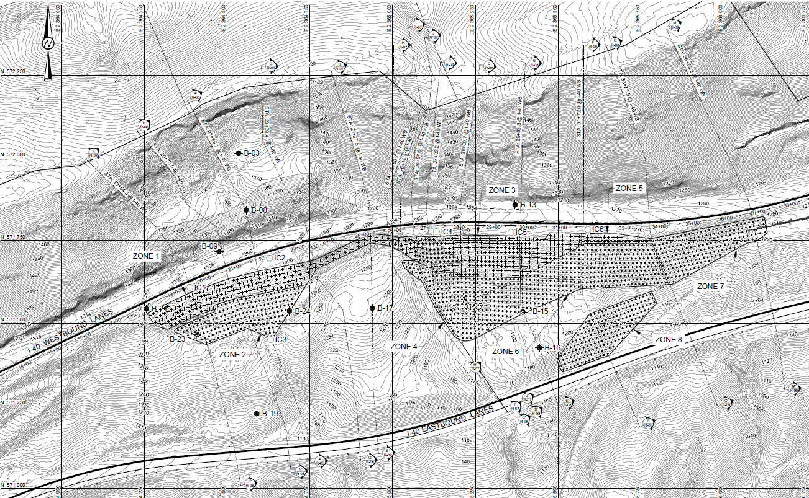
R-Sheets
Anchor Plan

Slide 15
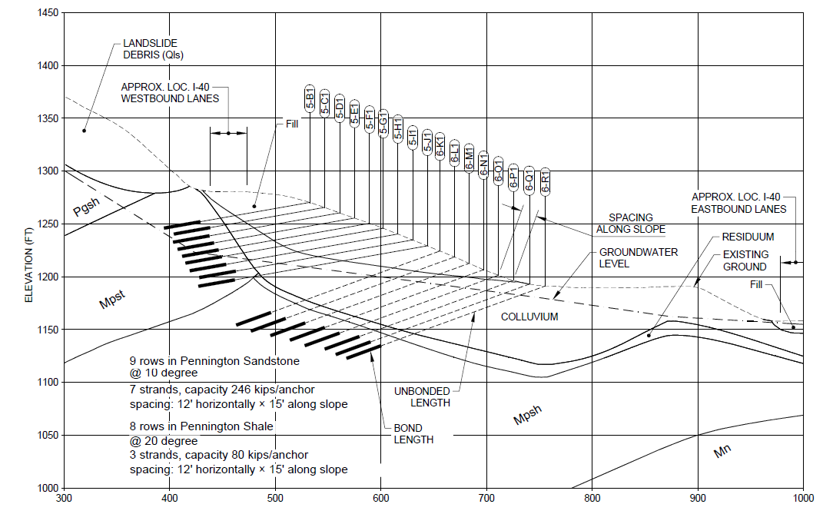
R-Sheets
Anchor Section

Slide 16
R-Sheets
Bond length and free length
1. FOR DESIGN LOAD OF 80 KIP, ANCHORS ARE 3-STRAND WITH PROOF TEST LOAD OF 106 KIPS
2. FOR DESIGN LOAD OF 246 KIPS, ANCHORS ARE 7-STRAND WITH PROOF TEST LOAD OF 327 KIPS
3. FOR DESIGN LOAD OF 317 KIPS, ANCHORS ARE 9-STRAND WITH PROOF TEST LOAD OF 421 KIPS
4. CONTRACTOR SHALL DETERMINE ANCHOR BOND LENGTH REQUIRED TO MEET LOADS LISTED IN ANCHOR SCHEDULE. PRESUMPTIVE BOND ZONE LENGTHS, BASED ON A PRESUMPTIVE ULTIMATE BOND STRESS OF 22 KSF FOR SANDSTONE AND 5 KSF FOR SHALE, ARE INCLUDED IN THE PAY ITEMS QUANTITIES. IN NO CASE SHALL THE BOND LENGTH BE LESS THAN 20 FEET.

Slide 17
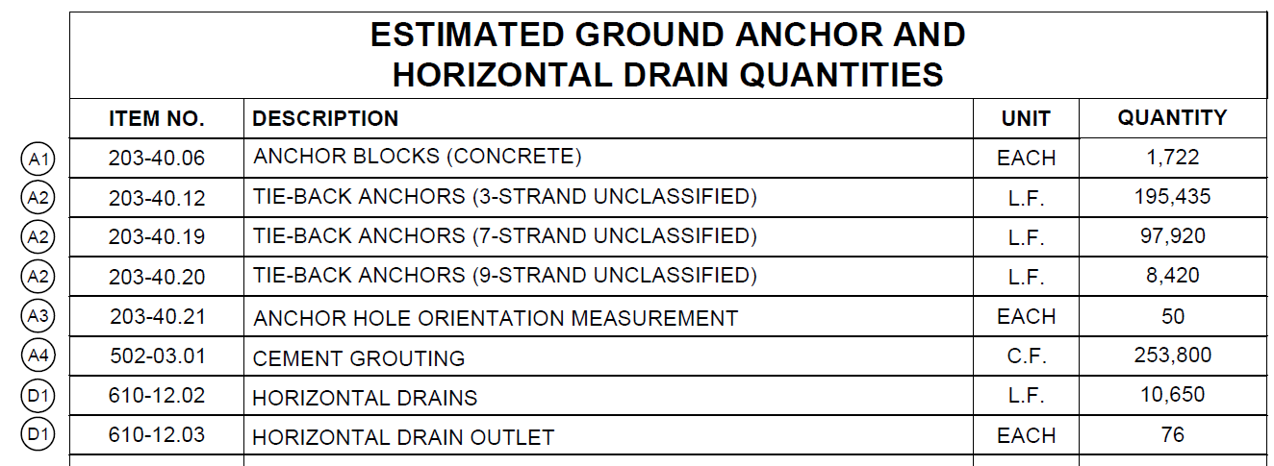
R-Sheets
Pay Items

Slide 18
R-Sheets
Anchor blocks
AVAILABLE BEARING FOR CONCRETE BEARING BLOCKS VARIES OVER THE SITE AND IN SOME LOCATIONS MAY NOT BE SUFFICIENT WITHOUT IMPROVEMENT TO SUPPORT THE REQUIRED ANCHOR LOADS. CONTRACTOR SHALL ASSESS CONDITIONS, DEVELOP DESIGNS FOR IMPROVED BEARING SUBGRADE PADS AND INSTALL THE DESIGNS WHERE APPROVED BY TDOT.

Slide 19
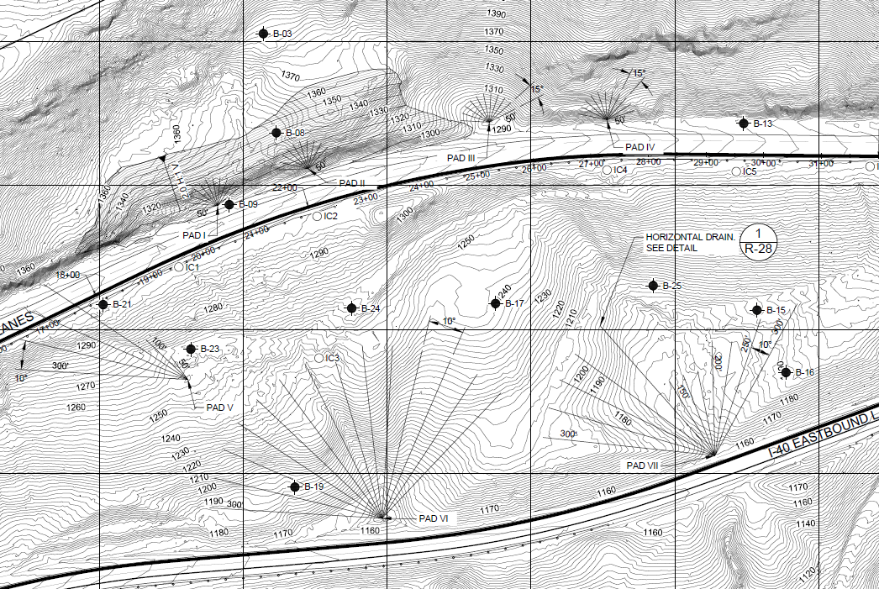
Horizontal Drain Plan

Slide 20
Summary of Special Geologic Considerations for Construction
Based on the investigation data, geologic mapping and the geological model, the following are considered potential construction challenges related to the engineering geology of the site:
Geophysical ERI profiles showed higher resistivity in the WBL and median at around Stations 27+00 and 31+00. These vertical features may represent possible discontinuities with preferential weathering and groundwater intrusion. They may also represent another feature. B-6 was drilled in one of the vertical features and displayed very poor returns until around 80 feet. Other boreholes with poor recovery or more clayey materials that may be part of this feature are IC-04 and B-25. We recommend one of the pre-production test anchors be located at 4-L6 in an attempt to test material that could be representative of some low strength shale on-site.
The Pennington Sandstone in B-4 showed intermittent weathering to residuum between 42 to 65 feet below surface. While outcrops and other subsurface encounters of the Pennington Sandstone indicated the formation is generally uniform and strong, where the Pennington Sandstone underlies the Colluvium, the weathering profile may affect the rock continuity and strength.
Karstic-like voids sometimes with a soft clay infill were observed in the limestone sections of the Pennington Shale.
Artesian water and running sands were observed during drilling. Details are included in the boring logs.
Drilling advancement was difficult through the variable colluvium and is likely to be during construction.
Grout intakes could be very high. Grout intakes during the geotechnical investigations are included in the boring logs.
Groundwater is variable at the Site. Groundwater levels can vary between strata and can be perched. Groundwater may be encountered at locations and depths during anchor installation beyond those observed during subsurface explorations.
Not many of the borings were drilled in locations that would encounter the Pennington Sandstone. Thus, the modelled base of the sandstone unit is based on boring data, where available, observed outcrops and structural data. The base of Pennington Sandstone may differ from that projected which would affect the estimated free anchor lengths.

Slide 22

K. S. Ware & Associates, LLC
East Bound I-40
Roane County LM 1.57 mm342
April 22, 2020

Slide 23
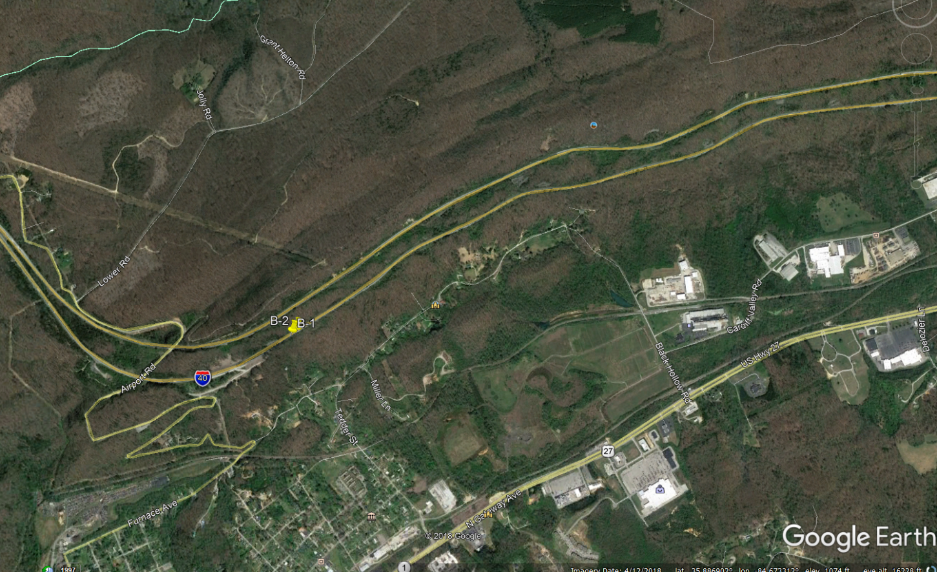

Slide 24
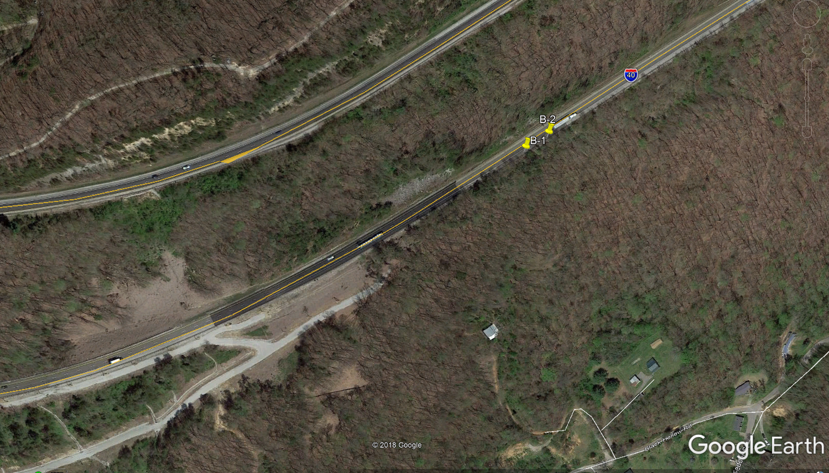

Slide 25
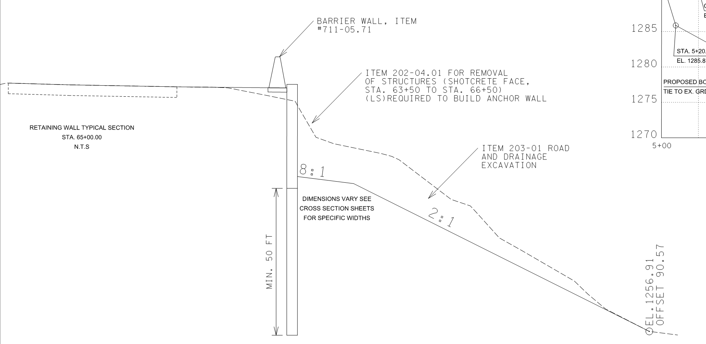

Slide 26
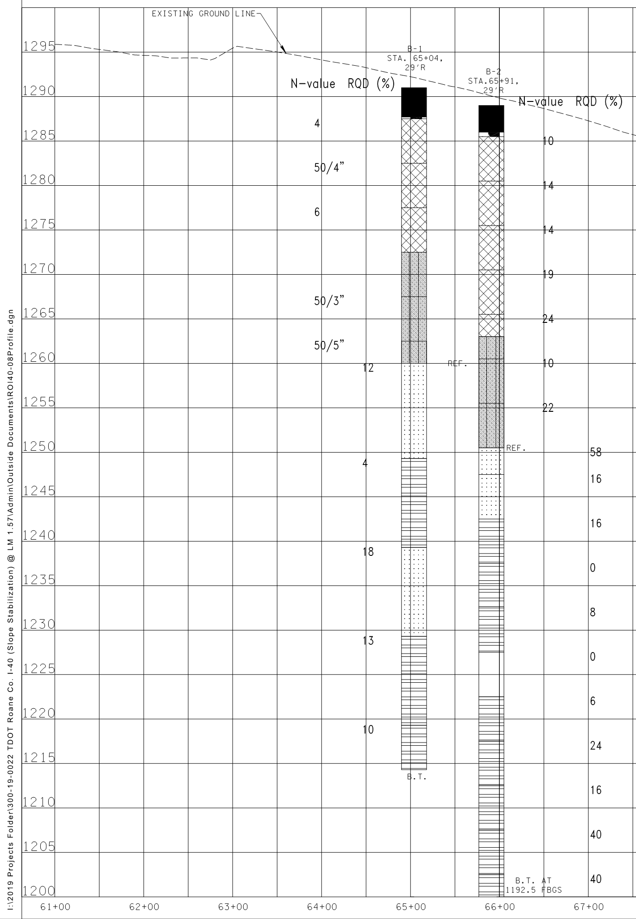
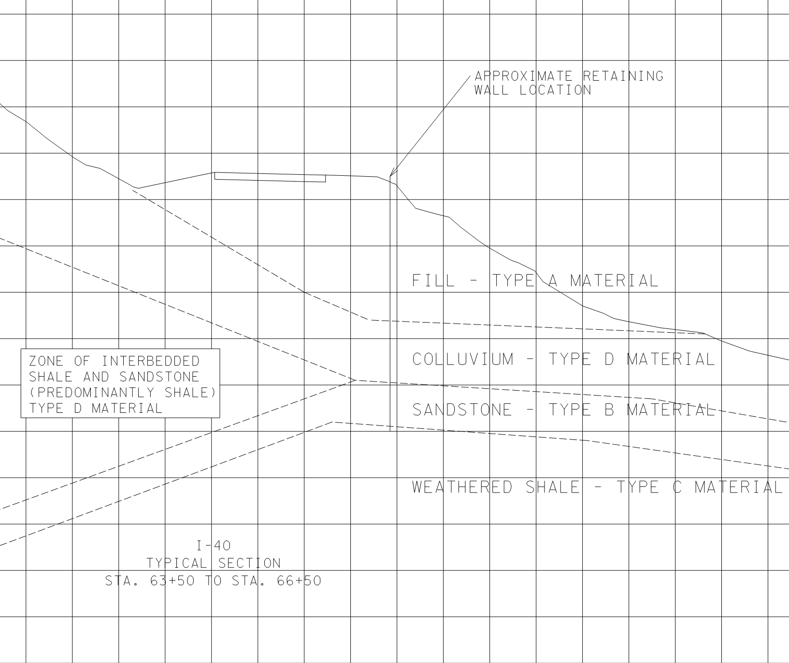


WALL
SS
PILE EMBEDMENT INTO SHALE AND SANDSTONE
Sh
Sh
Similar conditions expected in anchor bond zone
Shale is weathered, soft to medium hard, subject to hole enlargement or collapse during drilling

Slide 27
Subsurface Condition Challenges
Avoidance of existing soil nails during soldier pile installation
Boulders in fill and colluvial zone
Difficult drilling conditions in variable bedrock conditions – moderately hard sandstone and very soft shale
Anticipate water and potential for collapse in anchor holes during drilling

Slide 28
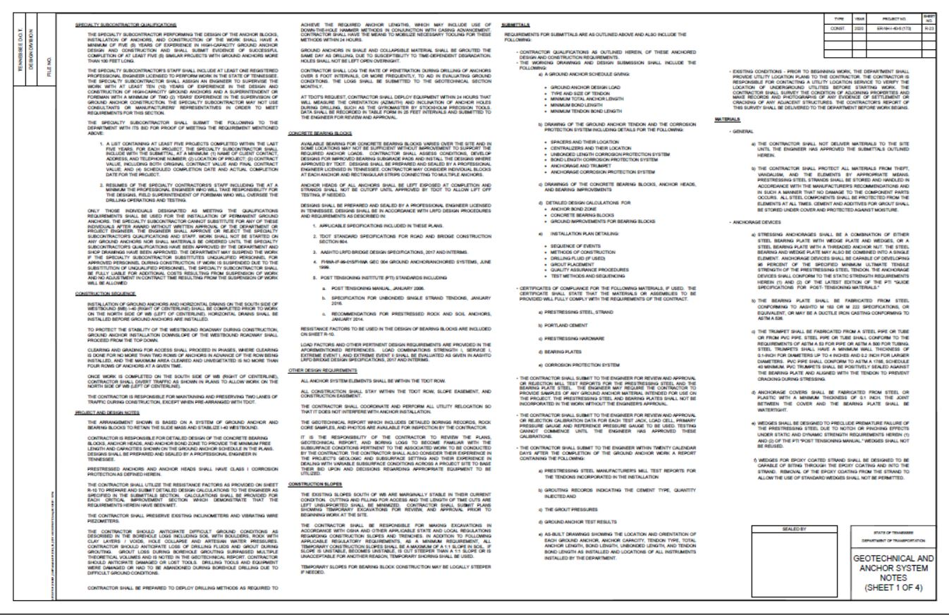

Slide 29
Contractor/Specialty Subcontractor Qualifications for Tie-back Anchors
Specialty subcontractor performing the design of the anchor block, installation of anchors, and construction of the work shall have a minimum of five (5) years of experience in high-capacity ground anchor design and construction and shall submit evidence of successful completion of at least 5 similar projects with ground anchors more than 100 feet long.

Slide 30
Contractor/Specialty Subcontractor Qualifications for Tie-back Anchors
The specialty subcontractors staff shall include at least one registered professional engineer licensed to perform work in the State of Tennessee. The Specialty Subcontractor shall assign an engineer to supervise the work with at least ten (10) years of experience in the design and construction of high-capacity ground anchors and a superintendent of foreman with a minimum of two years experience in the supervision of ground anchor construction. The specialty subcontractor may not use consultants or manufacturers’ representatives in order to meet the requirements.

Slide 31
Contractor/Specialty Subcontractor Qualifications for Tie-back Anchors
Shall submit the following:
A list containing at least five projects completed within the last five years. Include name of client and contact info, location of project, contract value (original & final), scheduled completion date and actual completion date.
Resumes for the specialty contractors staff including the professional engineer who will take responsibility for the design, and the field superintendent or foreman who will oversee the drilling and testing operations.

Slide 32
Contractor/Specialty Subcontractor Qualifications for Tie-back Anchors
Only those individuals designated as meeting the qualification requirements shall be used for the installation of the ground anchors. No substitution for these individuals will be permitted without written approval of the Department or Engineer. The Engineer shall approve or reject the qualifications and staff. Work shall not begin on any ground anchors not shall materials be ordered until the qualifications have been approved. TDOT may suspend work if the contractor substitutes unqualified personnel for qualified personnel. If work is suspended, the contractor shall be liable for additional costs resulting from the delay and contract time will not be extended.

Slide 33
Construction Sequence for Tie-back Anchors
Installation of ground anchors and horizontal drains on the south side of WB I-40 (right of CL) shall be completed prior to work on the north side of WB (left of CL). Horizontal drains shall be installed before ground anchors are installed.
Ground anchor installation downslope of the WB roadway shall proceed from the top down
Clearing and grading for access shall proceed in phases, where clearing is done for no more than two rows of anchors in advance of the row being installed, and the maximum area cleared and unvegetated is no more than four rows of anchors at a given time.

Slide 34
Construction Sequence for Tie-back Anchors
Once work is completed on the south side of WB (right of CL), the contractor shall divert traffic as shown in plans to allow work on the northside of WB (left of CL).
The contractor is responsible for maintaining and preserving two lanes of traffic during construction

Slide 35
Project and Design Notes for Tie-back Anchors
The contractor is responsible for detailed design of the concrete bearing blocks, anchor heads, and anchor bond zone to provide the minimum free length and capacities shown on the ground anchor schedule in the plans. Designs will be prepared and sealed by a Professional Engineer registered in Tennessee.
Prestressed anchors and anchor heads shall have Class I corrosion protection as defined in the plans

Slide 36
Project and Design Notes for Tie-back Anchors
Contractor should anticipate difficult ground conditions as described in borehole logs in the plans.
Loss of drilling fluids and grout during grouting should be anticipated.
Contractor should anticipate damaged or lost tools. Drilling tools and equipment were damaged or had to be abandoned during borehole drilling due to difficult ground conditions.
Contractor shall be prepared to deploy drilling methods as required to achieve the required anchor lengths, which may include use of down-the-hole hammer methods in conjunction with casing advancement.
Ground anchors in shale and collapsible material shall be grouted the same day as drilling.
All anchor system elements shall stay within the TDOT ROW. All construction shall stay within the TDOT ROW, slope easement, and construction easement.

Slide 37
Submittals for Tie-back Anchors
Contractor qualifications as outlined for anchor design and construction requirements
Working Drawings and Design Submissions for:
Ground anchor schedule with details as specified in the plans
Drawings of ground anchor tendon and corrosion protection system including details as specified in the plans
Drawings of the concrete bearing blocks, anchor heads, and bearing improvements
Detailed design calculations for anchor bond zone, concrete bearing blocks, and ground improvements for bearing blocks.
Installation plan detailing sequence of events, methods of construction, drilling fluid (if used), grout placement, quality assurance procedures, test methods and sequencing

Slide 38
Submittals for Tie-back Anchors
Certificates of compliance for the following materials:
Prestressed steel, strand
Portland Cement
Prestressing hardware
Bearing plates
Corrosion Protection System

Slide 39
Submittals for Tie-back Anchors
Mill test reports for the prestressing steel and bearing plate steel
Calibration data for each test jack, load cell, primary pressure gauge and reference pressure gauge
Within 20 calendar days of completion of the ground anchor work, submit:
Prestressing steel manufacturers mill test reports for the tendons
Grouting records (cement type, quantity injected)
Grout pressures
Ground anchor test results
As-built drawings

Slide 40
Anchorage Devices for Tie-back Anchors
Mill test reports for the prestressing steel and bearing plate steel
Calibration data for each test jack, load cell, primary pressure gauge and reference pressure gauge
Within 20 calendar days of completion of the ground anchor work, submit:
Prestressing steel manufacturers mill test reports for the tendons
Grouting records (cement type, quantity injected)
Grout pressures
Ground anchor test results
As-built drawings

Slide 41
Questions
Please submit RFI’s no later than Friday, May 8, at 4:00 p.m. CDT.
Responses will be posted on TDOT’s website as informational addendums.

