Slide 1
NOTAMs
(Notice To Airmen)

Slide 2
Purpose of This Course
The purpose of this course is to help airport managers/sponsors learn:
  What a NOTAM is.
  Why NOTAMs are issued.
  When NOTAMs are issued.
  How NOTAMs are issued.

Slide 3
What is a NOTAM?
“A Notice to Airmen, or NOTAM for short, is a notice containing information essential to personnel concerned with flight operations but not known far enough in advance to be publicized by other means. It states the abnormal status of a component of the National Airspace System – not the normal status” (Federal Aviation Administration).

Slide 4
Why NOTAMs Are Important
Accountability and Safety!
Airports are responsible for informing pilots of hazards they should be aware of when flying into the airport/airspace.
  Pilots who are not familiar with the conditions at the airport will want to know when unusual or non-standard conditions exist and when conditions differ from what is published.
  For example: If the airport’s runway lights are out a NOTAM should be issued so that pilots will be aware and can flight plan accordingly.

Slide 5

Building Blocks to NOTAMs

Slide 6
NOTAM Format
All NOTAMs follow a specific format, with several required items
This graphic below shows the mandatory elements of each NOTAM. There are several additional elements that may be included “when needed”
!TYS 12/023 TYS RWY 05L VASI U/S 1912111646-2111302000
(Broken Down Below)
!
Automatic Date Processor
Accountability
TYS
NOTAM Number
12/023
Affected Location
TYS
Keyword
RWY 05L
Attribute, Activity, or Surface Designator
VASI
Condition
U/S
Start of Activity
12/11/19 @ 16:46
End of Validity
11/30/2021 @20:00
! The exclamation mark serves an automated data processing function and has no bearing on the contents or meaning of the NOTAM

Slide 7
NOTAM Format – Accountability & NOTAM Number
Examples of the identifier of the accountability location:
  Facility (Airport Identifier)
  GPS (Global Positioning System)
A NOTAM Accountability is the agency identified by an ICAO that is responsible for transmitting a particular NOTAM series against a location. [For example: K0M2 (Reelfoot Lake Airport).
The NOTAM number (MM/NNN), comes after the accountability; MM is the two-digit month, and NNN is the three-digit number, ranging from 001 to 999. These are automatically populated and not something you have to worry about.

Slide 8
NOTAM Format – Location
The location identifier is the affected facility or location that appears after the NOTAM number, including:
  Airport
  Navigational Aid (NAVAID)

Slide 9

NOTAM FORMAT- Keywords Frequently Used
RWY – Runway
TWY – Taxiway
AD – Aerodrome
OBST – Obstruction
NAV – Navigation
COM – Communication
SVC – Services
APRON
AIRSPACE
U/S – Out of Service/Unserviceable
HLDG – Holding
PSN – Position
ACT – Active
CLSD – Closed
                Note: For a listing of all the keywords used in the NOTAM system, refer to FAA Order 7930.2
keywords are needed to describe the location, service, or issue that is being affected at/around the airport

Slide 10
NOTAM Examples
04/517 (A1129/20) - OBST CRANE (ASN 2018-ASO-5449-NRA) 360746N0863957W (0.7NM ENE BNA) 877FT (300FT AGL) FLAGGED AND LGTD DLY 1100-2300. 30 APR 11:00 2020 UNTIL 30 AUG 23:00 2020. CREATED: 30 APR 04:59 2020
  Obstruction crane (Aeronautical Study Number 2018-ASO-5516-NRA) at (lat and long position) 0.7 nautical miles East/North East of BNA, 877 ft tall (300FT above ground level), flagged and lighted daily from 11 am to 11 pm. From April 30, 2020 until August 30, 2020 at 11 pm. Created on April 30, 2020 at 4:59 am.

Slide 11
NOTAM Examples
!OWB 12/010 OWB TWY C3 CLSD 2012101606-2012151600
  Owensboro Airport, Taxiway C3 closed from December 10th, 2020 at 1606 to December 15th, 2020 at 1600
!HSV 11/022 HSV RWY 18R ALS U/S 2011160700-2109101500
  Huntsville Executive, Runway 18R (Right) ALS (airport lighting system) unusable from November 16, 2020 at 07:00 to September 10, 2021 at 15:00
!CSV 10/008 CSV RWY 26 PAPI UNUSABLE 2010081220-2104082111EST
  Crossville Memorial-Whitson Field, Runway 26 PAPI (precision approach path indicator) unusable from October 8th, 2020 at 12:20 (UTC) to April 8th, 2021 at 21:11

Slide 12
NOTAM FORMAT- Attribute, Activity or Surface Designator
When using the keywords RWY, APRON, TWY, ETC. a surface designator must follow the keyword.
  Example: …RWY 03 CLSD…and…APRON MAIN RAMP CLSD… and…TWY DB OPN…
    Notice the attribute follows the keyword (RWY, APRON, TWY).

Slide 13
NOTAM Components (When Needed)
Schedule
Start of Activity, end of activity
Remarks
  Any additional pieces of beneficial information for the pilots
Condition
  U/S – Unserviceable
  OPN – Open
  ACT – Active
  CLSD – Closed
Location Description
  EX: …SOUTHEAST SIDE FOR RWY 18/32
Facility, Feature, Service, System
  EX: …TWY A HLDG PSN SIGN…
Surface Segments
  Indicates a portion of the surface, instead of the entire segment
  EX: …South 100FT… , ….BTN TWY C and TWY B….

Slide 14
When to Issue a NOTAM
Runway Closures
Taxiway closures
Lighting Issues
Fuel not available
Airshows
ILS Equipment outage
Drone usage
New obstruction in the vicinity of the airport/airspace

Slide 15
How to Issue a NOTAM With NOTAM Manager

Slide 16
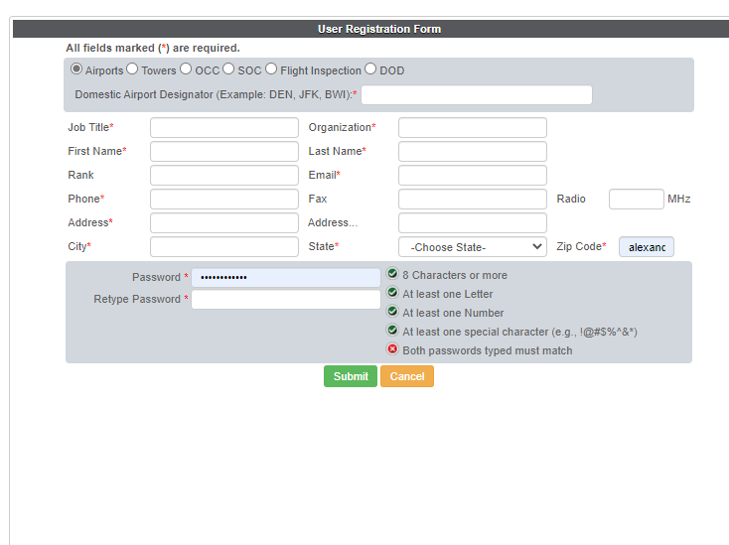
Registering With NOTAM Manager
When first registering a new airport, you will have to go through NOTAM Manager Orientation and Training.
  Register as a new user and set up a time to do orientation with Mark Falen
    mark.ctr.falen@faa.gov
  Once you have done orientation, you will then have an FAA required 3-hour NOTAM Manager training session to walk you through setting up your account and show you different techniques.

Slide 17
How to Issue a NOTAM With NOTAM Manager
https://notams.aim.faa.gov/dnotam/
  If not already registered, you can register as a new user
Enter FAA Airport Designator
Enter Airport Operations Phone #

Slide 18
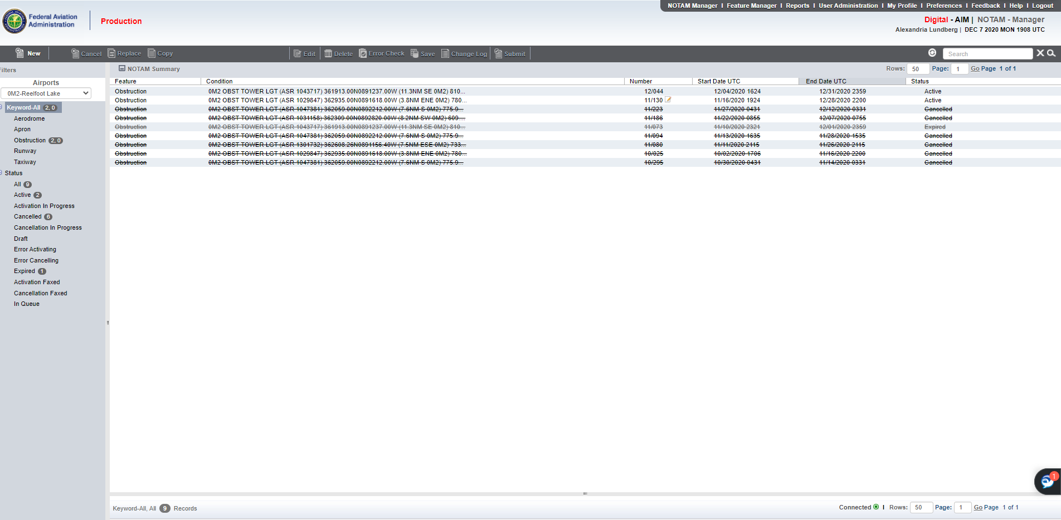
How to Issue a NOTAM With NOTAM Manager
Once logged in you will see your NOTAM Manager Home Page
Administration Toolbar
Action Toolbar
NOTAM Summary Pane
Airport Pane

Slide 19

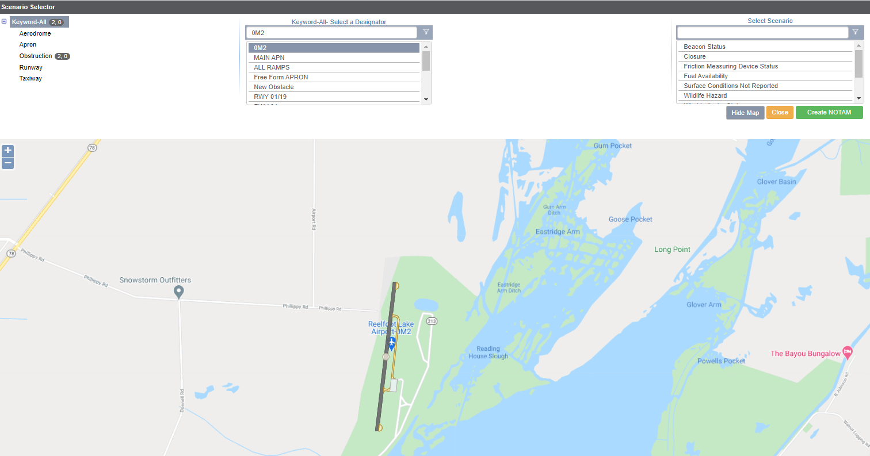
How to Issue a NOTAM With NOTAM Manager
Click on the New action tab at the top left of the page to start a new NOTAM
The resulting pop-up window, called the Options Screen, contains three columns and displays the Airport Layout below the three columns
Once the User has selected a Keyword, Designator, and Scenario, User selects Create NOTAM. This will open the NOTAM Editor Pane (next slide).
Scenario
Keyword
Designator
Airport Layout
Notes:
Add picture that includes the NEW button tab, add steps better

Slide 20
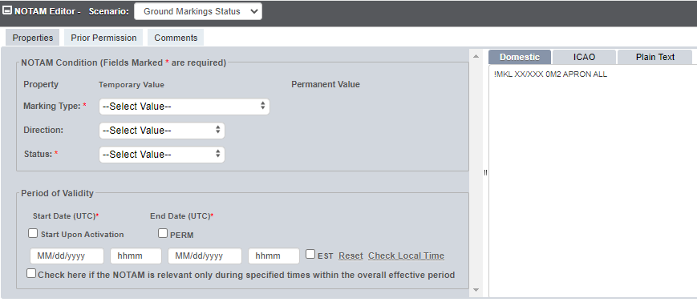
How to Issue a NOTAM With NOTAM Manager
Populate the necessary NOTAM information in the fields provided. The window on the right (translation window) will display the NOTAM the User is creating as the information is entered. The translation window allows the User to display the NOTAM in three formats: Domestic (FAA legacy), ICAO, and Plain Language.
NOTE: The fields provided in the NOTAM Editor Pane will vary based on the scenario selected. Scenario allows the User to create a NOTAM more efficiently by limiting the data entry fields to only those relevant to that particular NOTAM event.
NOTAM Displayed as entries are made
Notes:
Fix the way the words read and more info

Slide 21
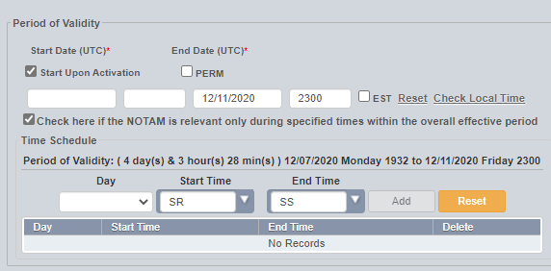
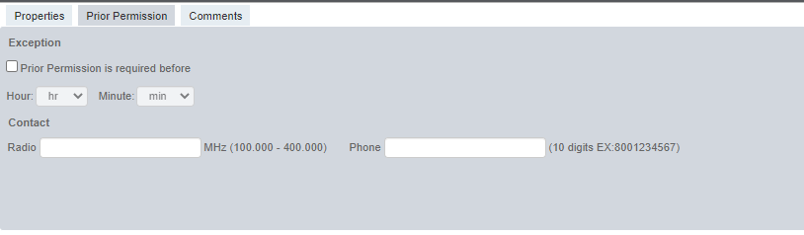
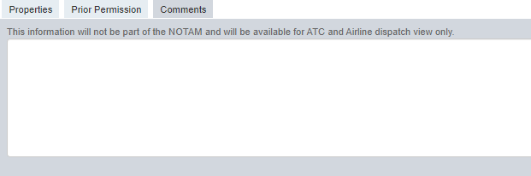
How to Issue a NOTAM With NOTAM Manager
- Period of Validity
  This information must be filled out.
  All NOTAMs require an end date and time.
  Time must be entered as UTC.
Prior Permission Tab
  The prior permission tab is for situations where an airfield may be closed, unless the pilot receives prior permission.
Comments Tab
  The Comments Tab may be used for internal purposes at the discretion of the User. They can only be seen by ATC and Airline Dispatch

Slide 22
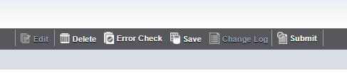
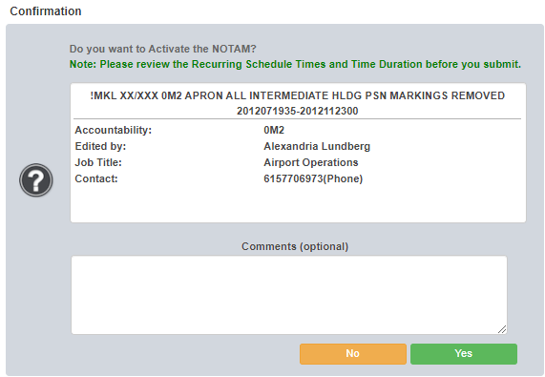
How to Issue a NOTAM With NOTAM Manager
Once complete, you will hit the submit tab at the top of the page
  The Submit Tab will error check the NOTAM before submission. If it fails, an error message will be displayed. If no errors are found, the NOTAM is submitted.
Notes:
Show where submit button is

Slide 23
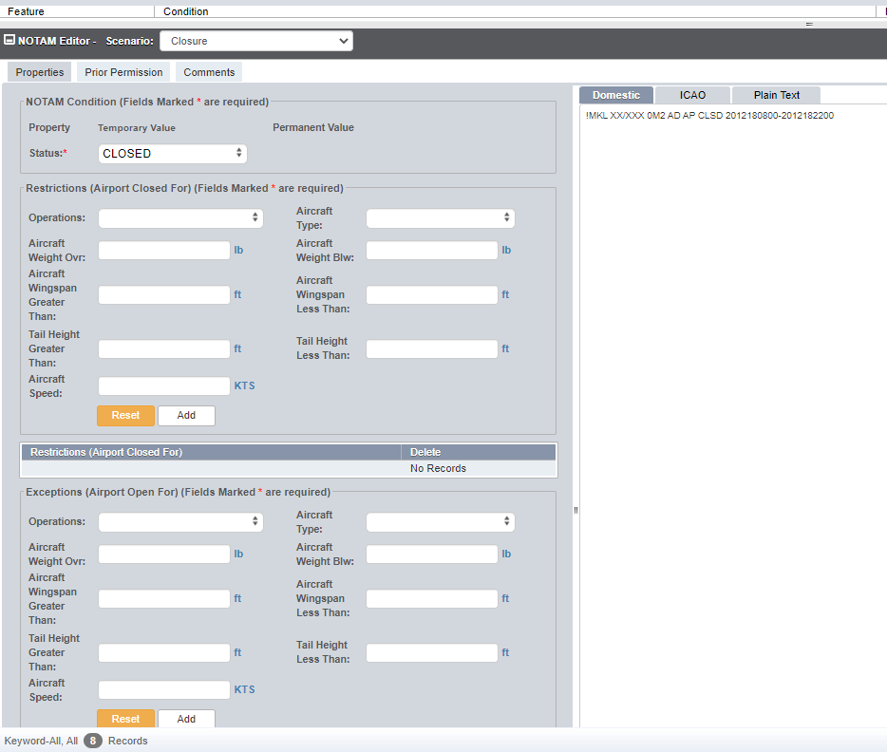
NOTAM Example
Information in these fields are optional

Slide 24
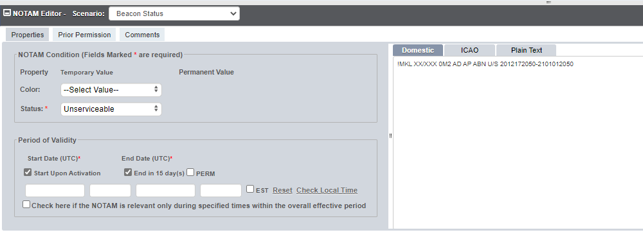
NOTAM Example
Rotating Beacon is unserviceable for the next 15 days

Slide 25
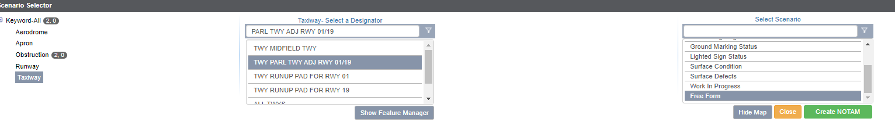
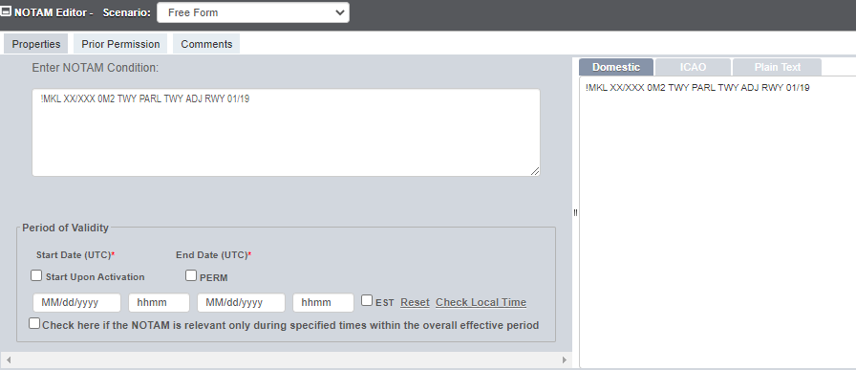
Free Form NOTAM
On occasion, there may be a NOTAM that has to be issued and a scenario is not available in the drop-down menu. If this occurs, the Free Form option is available. This allows the User to type the scenario via Free Form. When the NOTAM is submitted, it is routed to Flight Service to be processed. Free Form should not be used unless the desired NOTAM has the two following characteristics: the NOTAM does not fit in any of the other templates and the NOTAM falls under the airport’s authority.
Select Designator
Select Keyword
Select Free Form
Type NOTAM text here
Enter Period Of Validity
Notes:
Add more examples before this slide and explain when you may use a free form

Slide 26
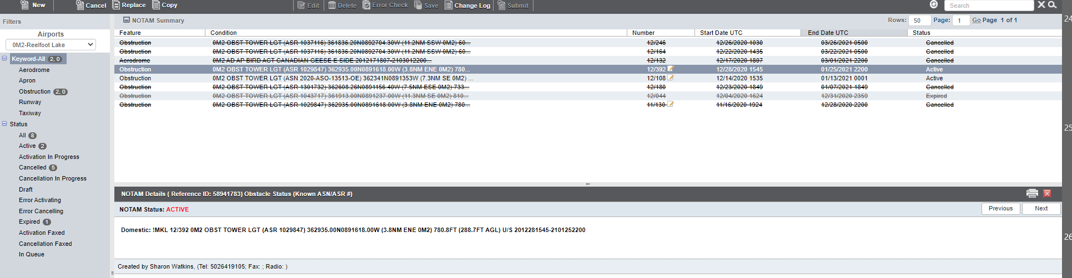
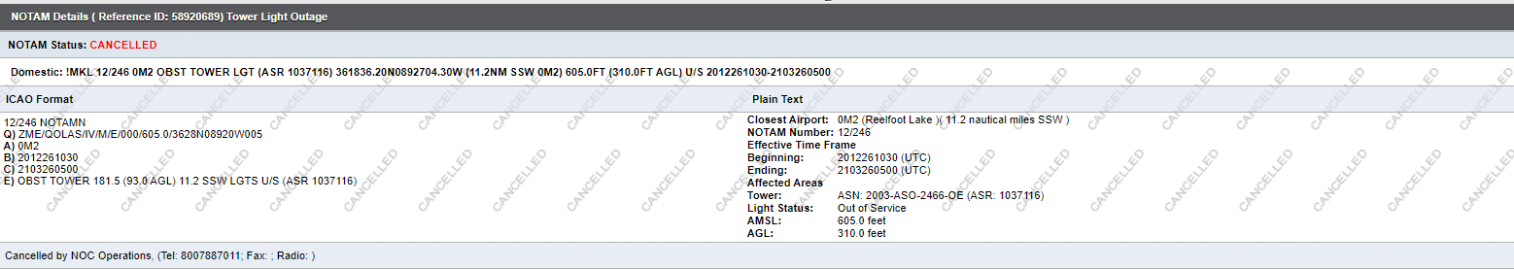
Closing or Cancelling a NOTAM
When on your home page, click on the NOTAM you wish to cancel or close. In the upper left-hand corner will be the “cancel” button. Click on this and it will ask you for conformation to cancel the NOTAM. Once cancelled the NOTAM will have a line through it. And show cancelled when clicked on.
  NOTE: Only NOTAMs created in NOTAM Manager can be cancelled through NOTAM Manager.

Slide 27
Complete Information
To find the full manual on NOTAM Manager, please follow this link:
  https://notams.aim.faa.gov/nmarptuserguide.pdf
Other resources:
  Advisory Circular 150/5200-28F, Notices to Airmen (NOTAMS) for Airport Operators
    https://www.faa.gov/documentLibrary/media/Advisory_Circular/AC_150_5200-28F.pdf
  FAA NOTAM Search
    https://notams.aim.faa.gov/notamSearch/nsapp.html#/
  FAA Order 7930.2S
    https://www.faa.gov/documentLibrary/media/Order/7930.2S_Notices_to_Airmen_(NOTAM).pdf

