Slide 1


Sex Offender Registry
DNA Collection:
An Overview

Slide 2

In CODIS Terms
A Sex Offender is
anyone who is qualified to be on
the sex offender registry. This person does not necessarily have to have a felony conviction.
(TCA Code 40-35-321)

Slide 3
TCA Code 40-35-321 (d)(1)
(d)(1) When a court sentences a person convicted of any felony offense committed on or after July 1, 1998, or any misdemeanor offense, the conviction for which requires the defendant to register as a sexual offender pursuant to chapter 39, part 2 of this title, on or after July 1, 2007, it shall order the person to provide a biological specimen for the purpose of DNA analysis as defined in subsection (a)

Slide 4

How do I obtain SOR/Convicted Offender DNA Kits?
Each agency should designate one individual responsible for ordering and maintaining Convicted Offender DNA kits.
Email TBI.CODIS@tn.gov to order kits. Include your name, your agency’s name, full address and phone number, as well as the type of kit you are requesting.
Kits will be shipped to you via FedEx Ground and typically arrive within 2-3 business days.
If you are dropping off evidence at the Nashville Crime Lab and would like to pick up kits then, we ask you to contact the CODIS unit at least 24 hours in advance so we will have enough time to get them ready and down to the Evidence Receiving lobby in time for your arrival.

Slide 5
Consistency
If your agency chooses to designate an individual to collect samples for the entire office (i.e., administrative assistant), it is important to specify the name of the supervising officer in the “Requesting Agency” field.
Example: TDOC/BOP-John Smith

Slide 6
DNA Verifications
TOMIS or the SOR should NOT be used as a verifying tool.
CODIS is the only entity that can accurately verify DNA submission.
Verifications are important in order to cut down on the number of repeats. Therefore, saving kits and your time.
Make a copy of the submittal form as your proof of collection.

Slide 7
DNA Verifications
(Cont’d)
When an offender comes to your office, you will need to perform a DNA verification prior to collection.
You must perform a DNA Verification on EVERY offender you supervise BEFORE collecting a kit. This includes juveniles, offenders from out-of-state, and anyone new to SOR.
Go to https://codis.tbi.tn.gov/login.aspx
Enter Username: DNAcheck2014
Password: CODIS@901!
If, after completing your search using all 3 search criteria, you find that the offender does not have a sample on file, collect the convicted offender DNA kit.

Slide 8
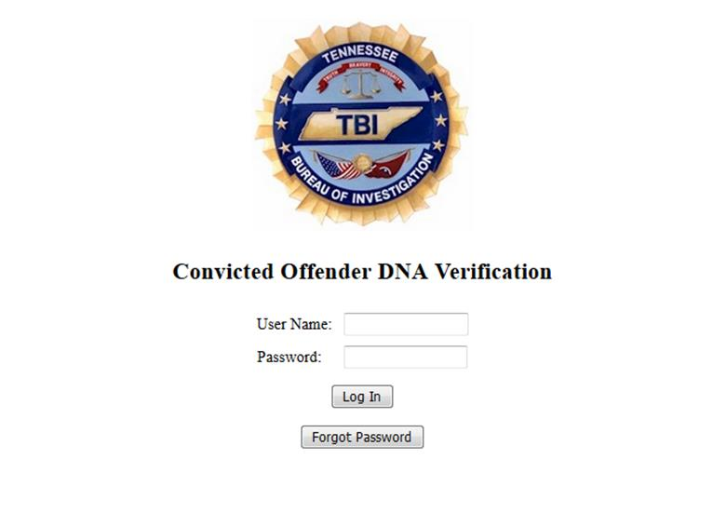
DNAcheck2014
CODIS@901!

Slide 9
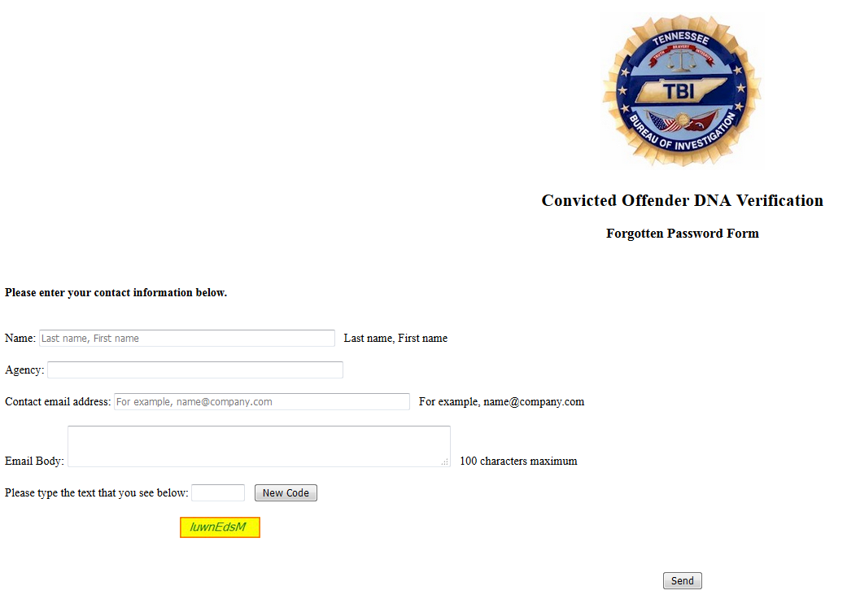

Slide 10
DNAcheck2014
CODIS@901!

Slide 11
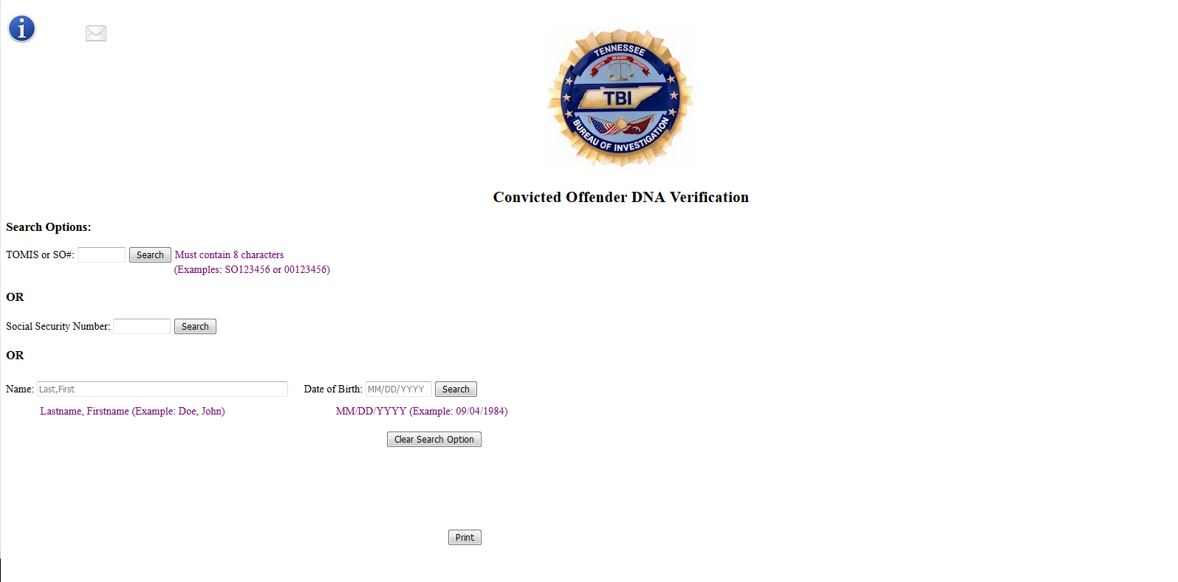

Slide 12
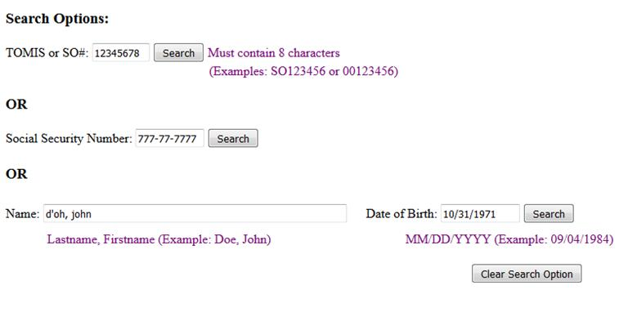
1
2
3

Slide 13
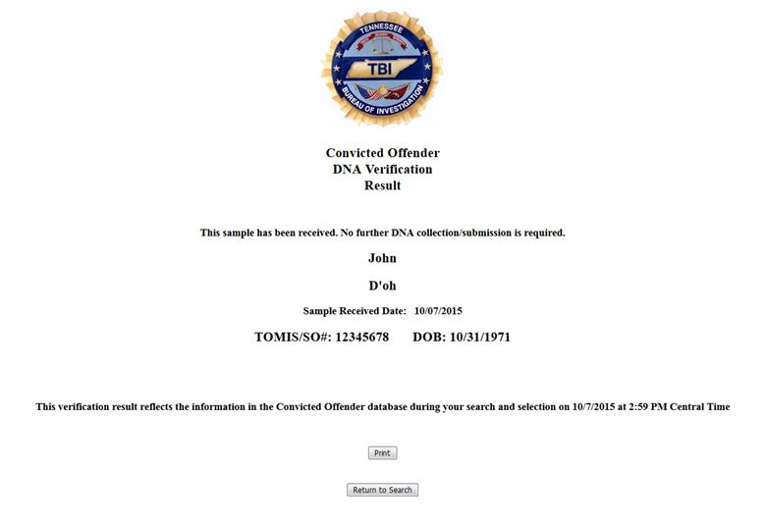
If a match is found, you will be given the option to print a copy
for the offender’s file to show that a sample has already been collected
and no further collection is required.

Slide 14
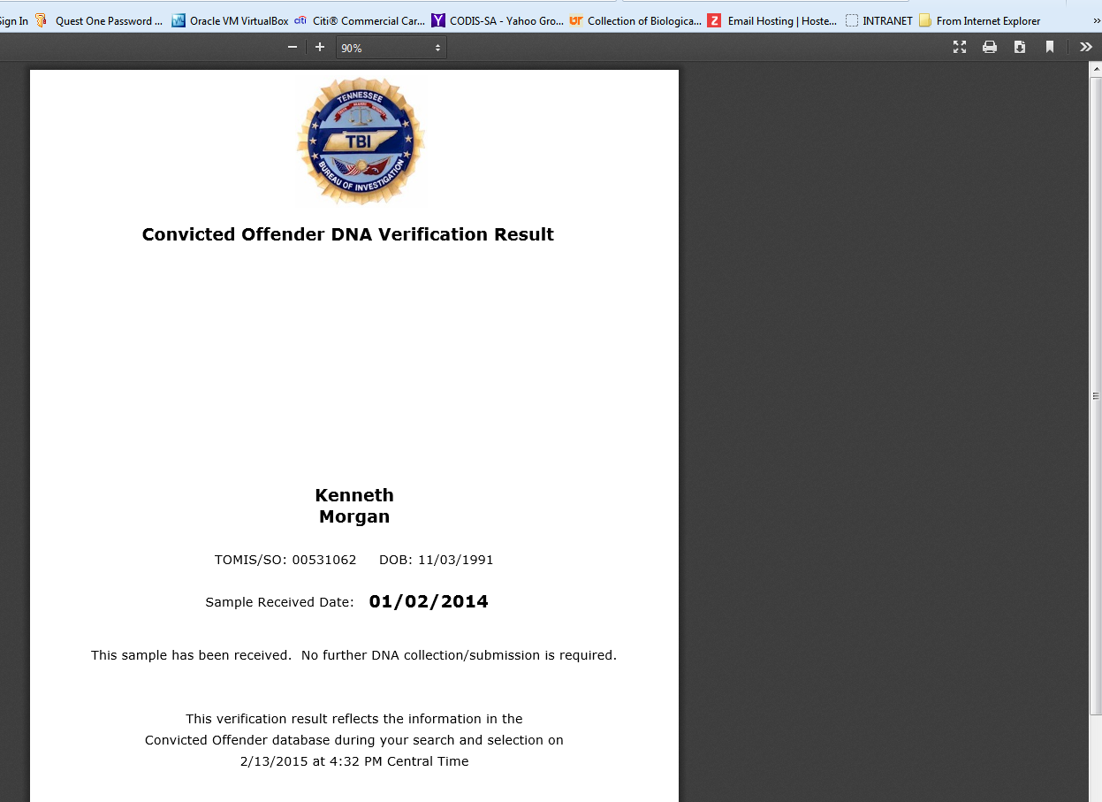
Use the browser’s print option or Ctrl+P
to print

Slide 15
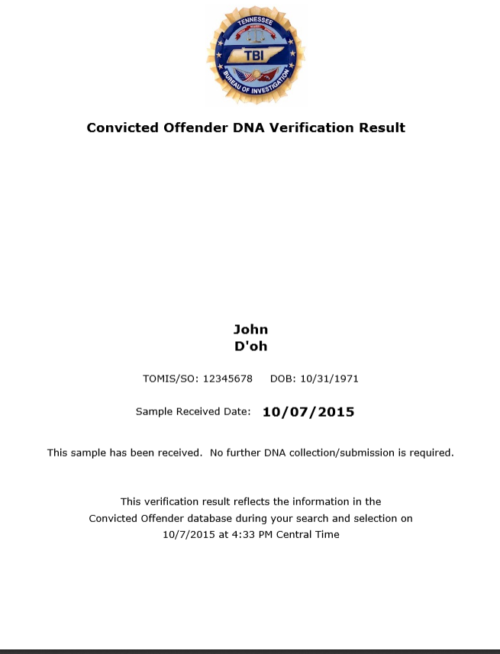

Slide 16
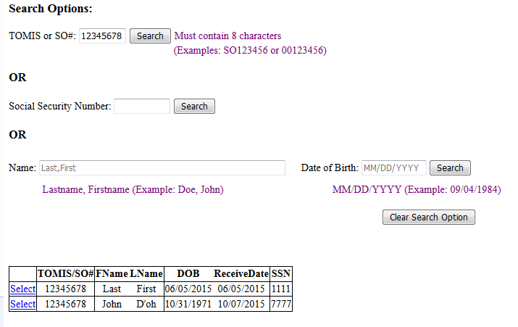
Some searches can result in multiple returns. If that happens, you will see a grid appear at the bottom of the screen.
Select the record that matches the person you are searching.

Slide 18
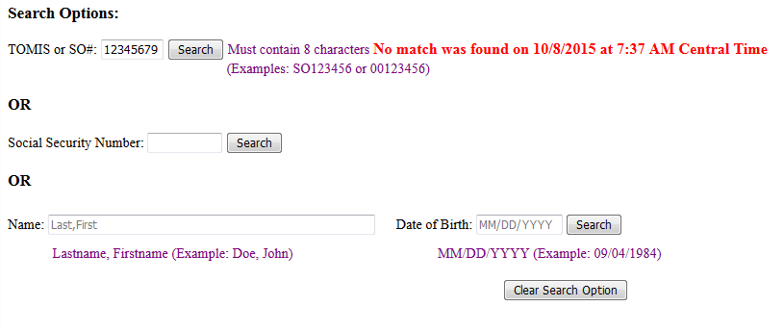


Slide 19
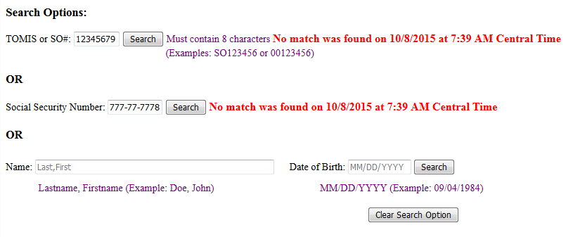

Slide 20
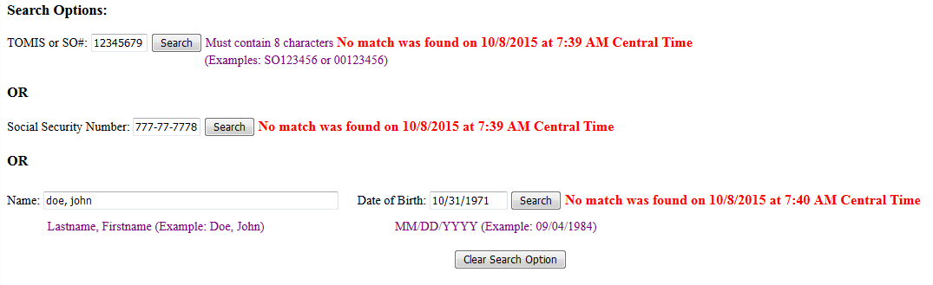

Slide 21
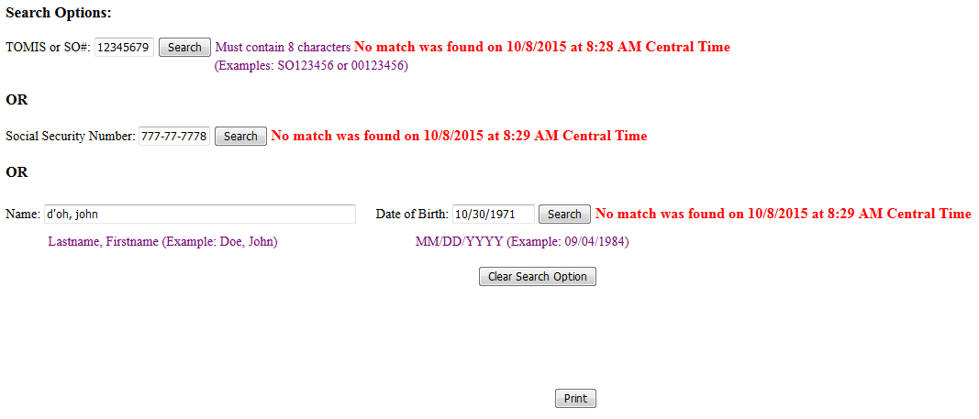

Slide 22
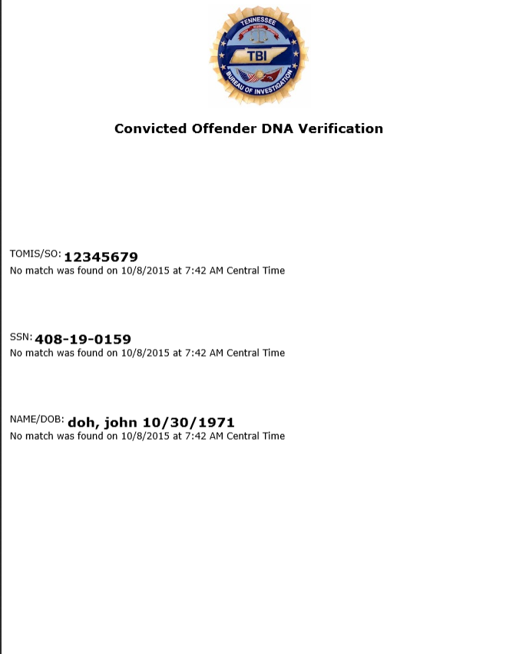

Slide 23
A Couple of Things You Can’t Do With The Website

Slide 24
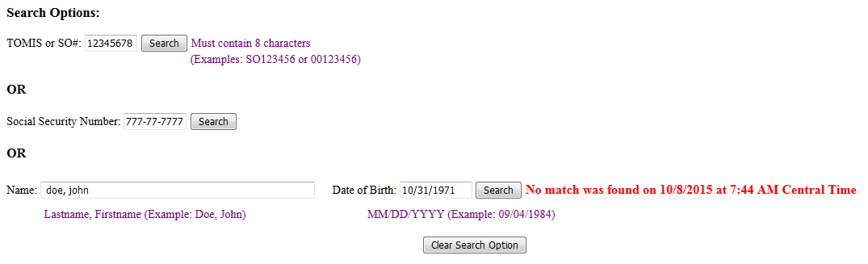
All three search options must be attempted prior to being
provided with the print option.
You can’t fill in all three search options, then hit the search button on just one. The website will not search all three at once.

Slide 25
Now let me direct your attention to
the upper left corner…

Slide 26
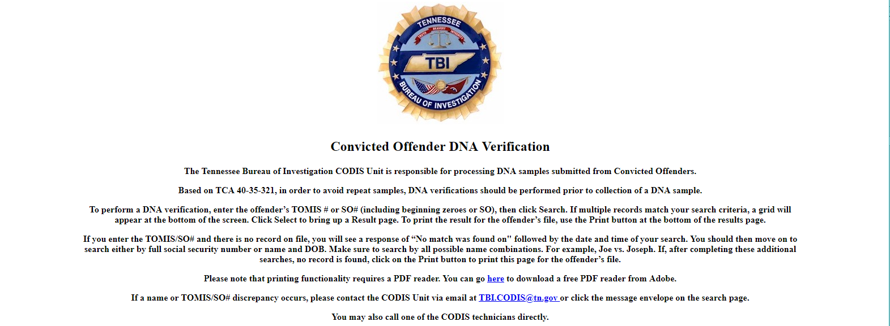

Slide 27
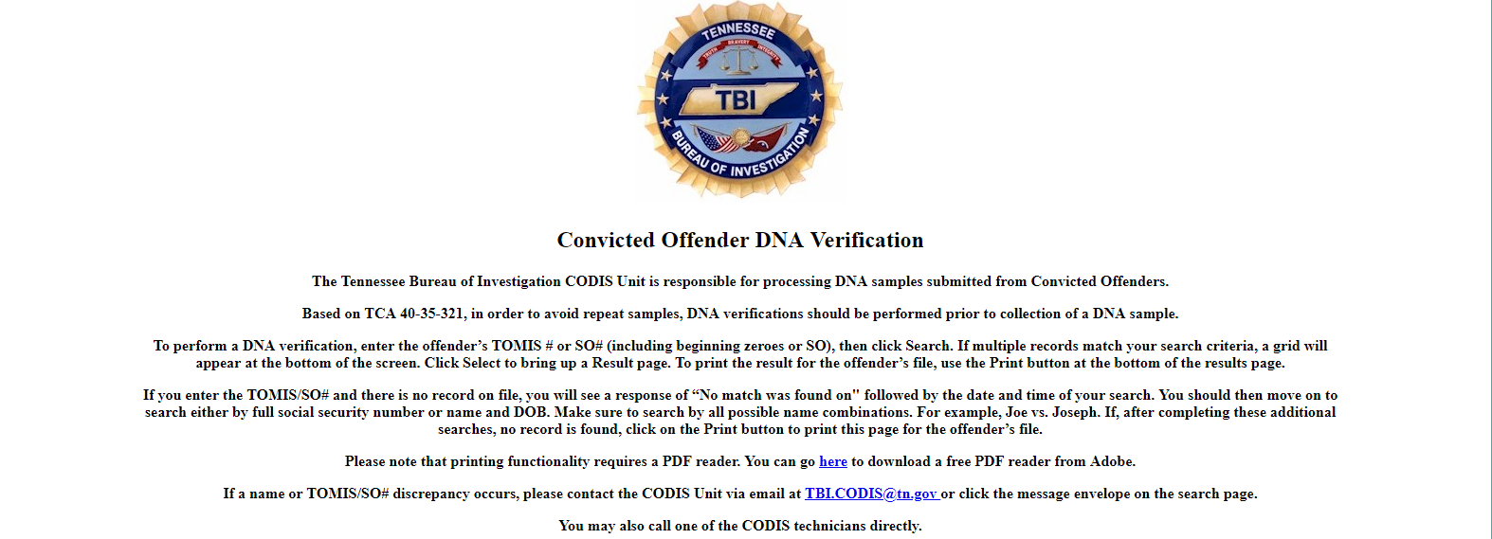

Slide 28
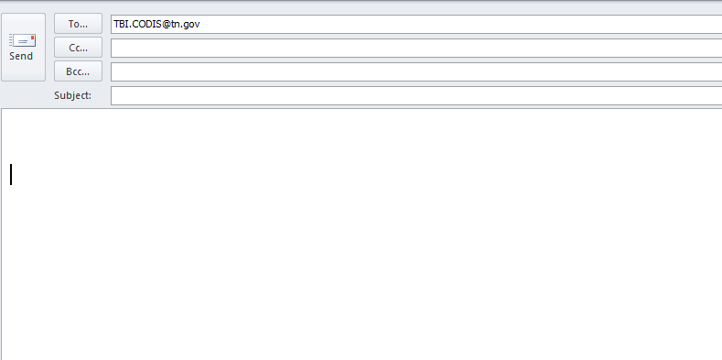

Slide 29
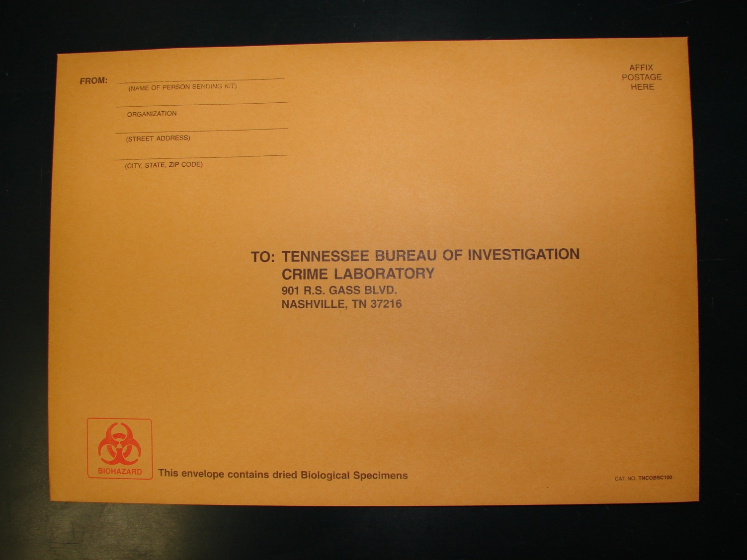
I have my kit…now what?!?!?!

Slide 30
I have my kit…now what?!?!?!
(Cont’d)
Each kit has everything needed to collect from one individual.
Inside the manila mailing envelope you will find a middle white envelope with instructions and qualifying offenses, a pair of biohazard barrier gloves, proper seals, four swabs, swab envelope, and a Convicted Offender DNA Sample Submittal Form.
It is not necessary for Medical Personnel to collect this sample.

Slide 31
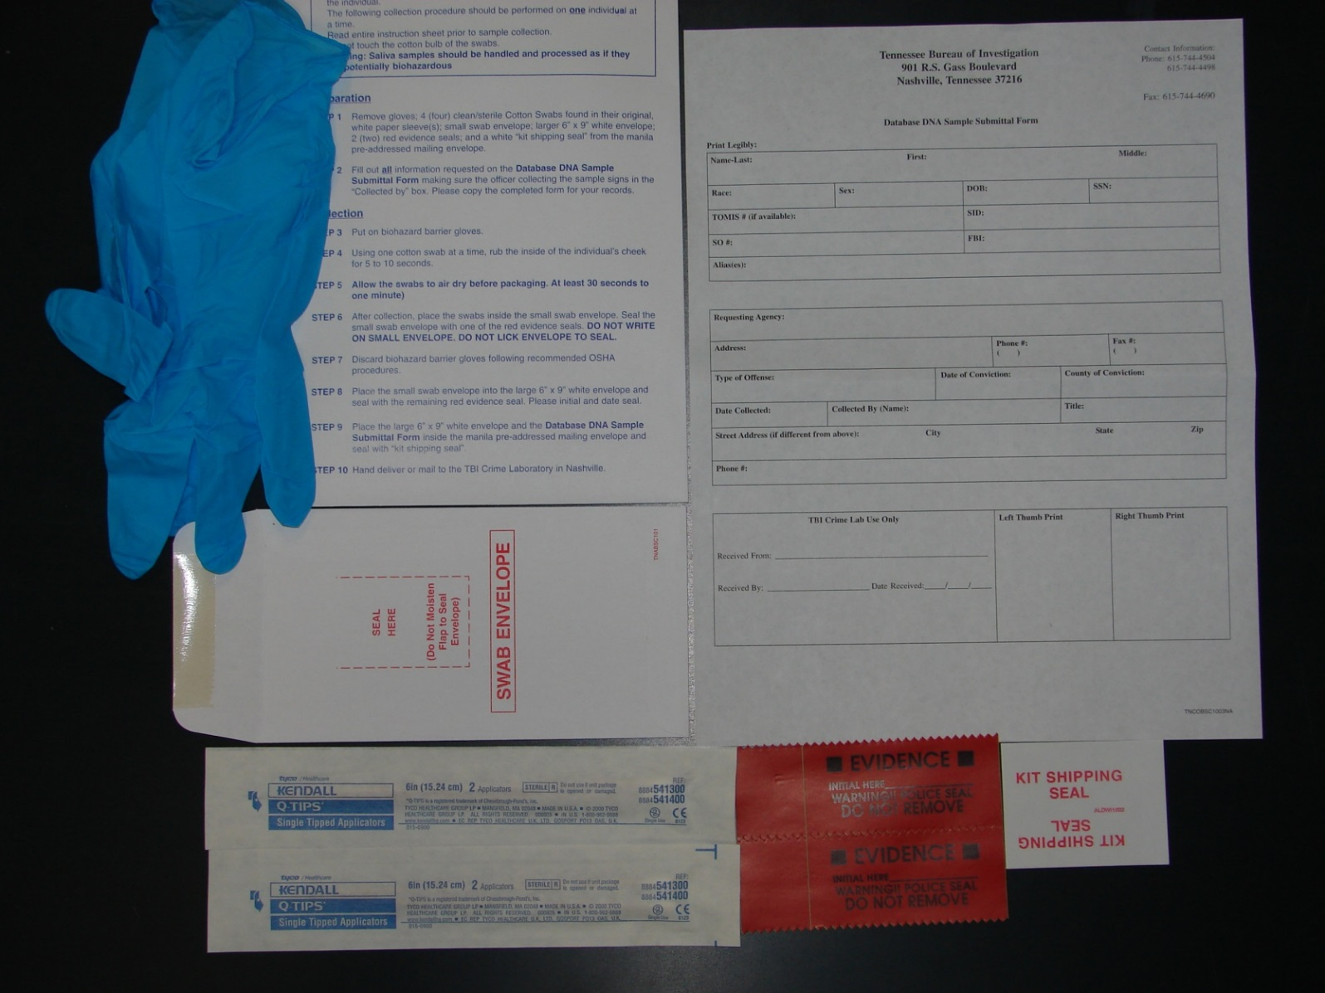
The Kit and its Contents

Slide 32
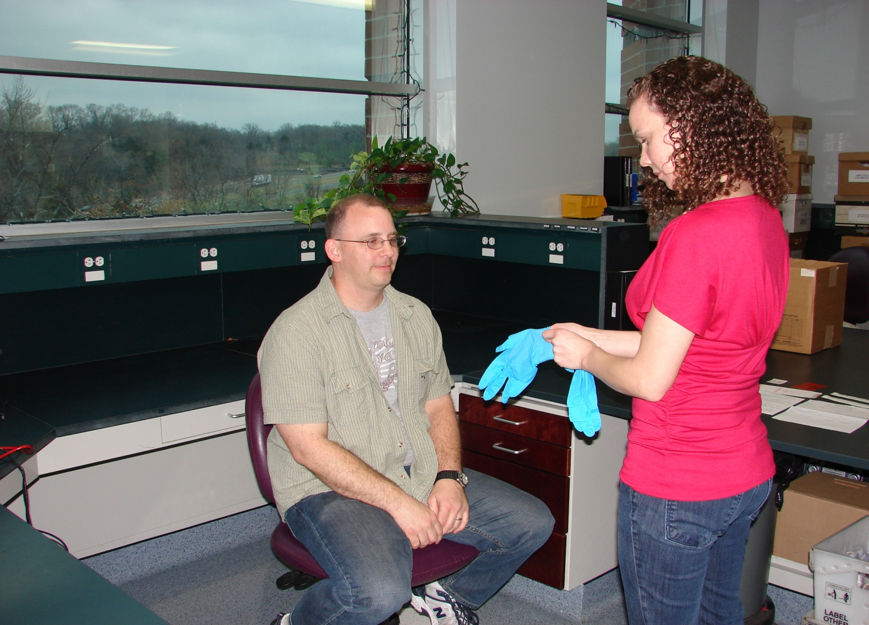
Put on biohazard barrier gloves.

Slide 33
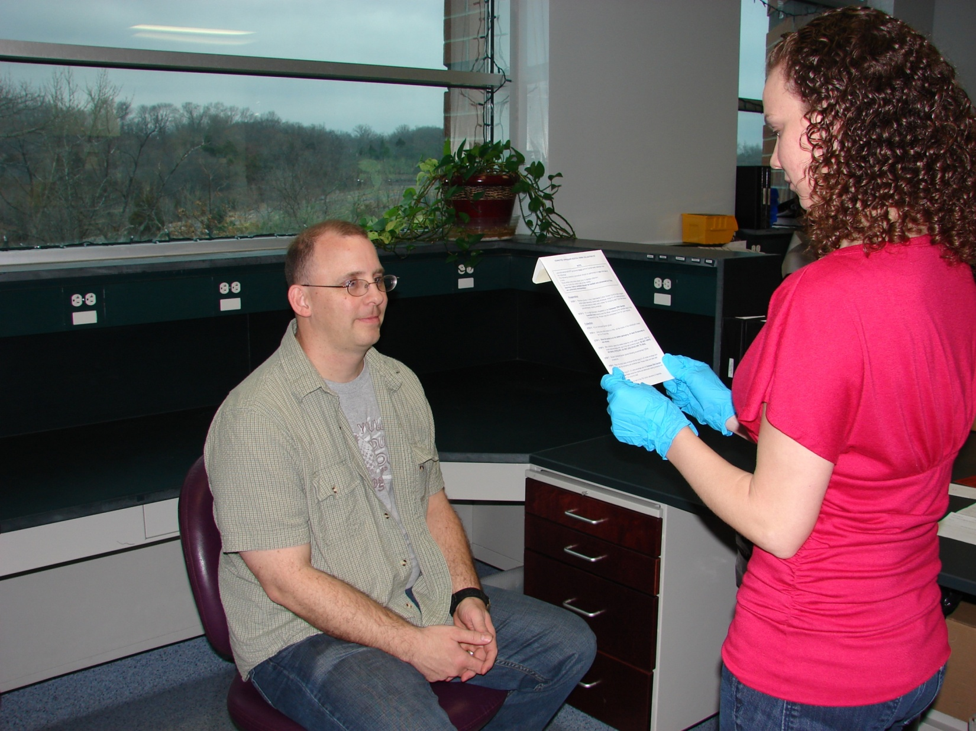
Read the instructions on the middle envelope carefully.

Slide 34
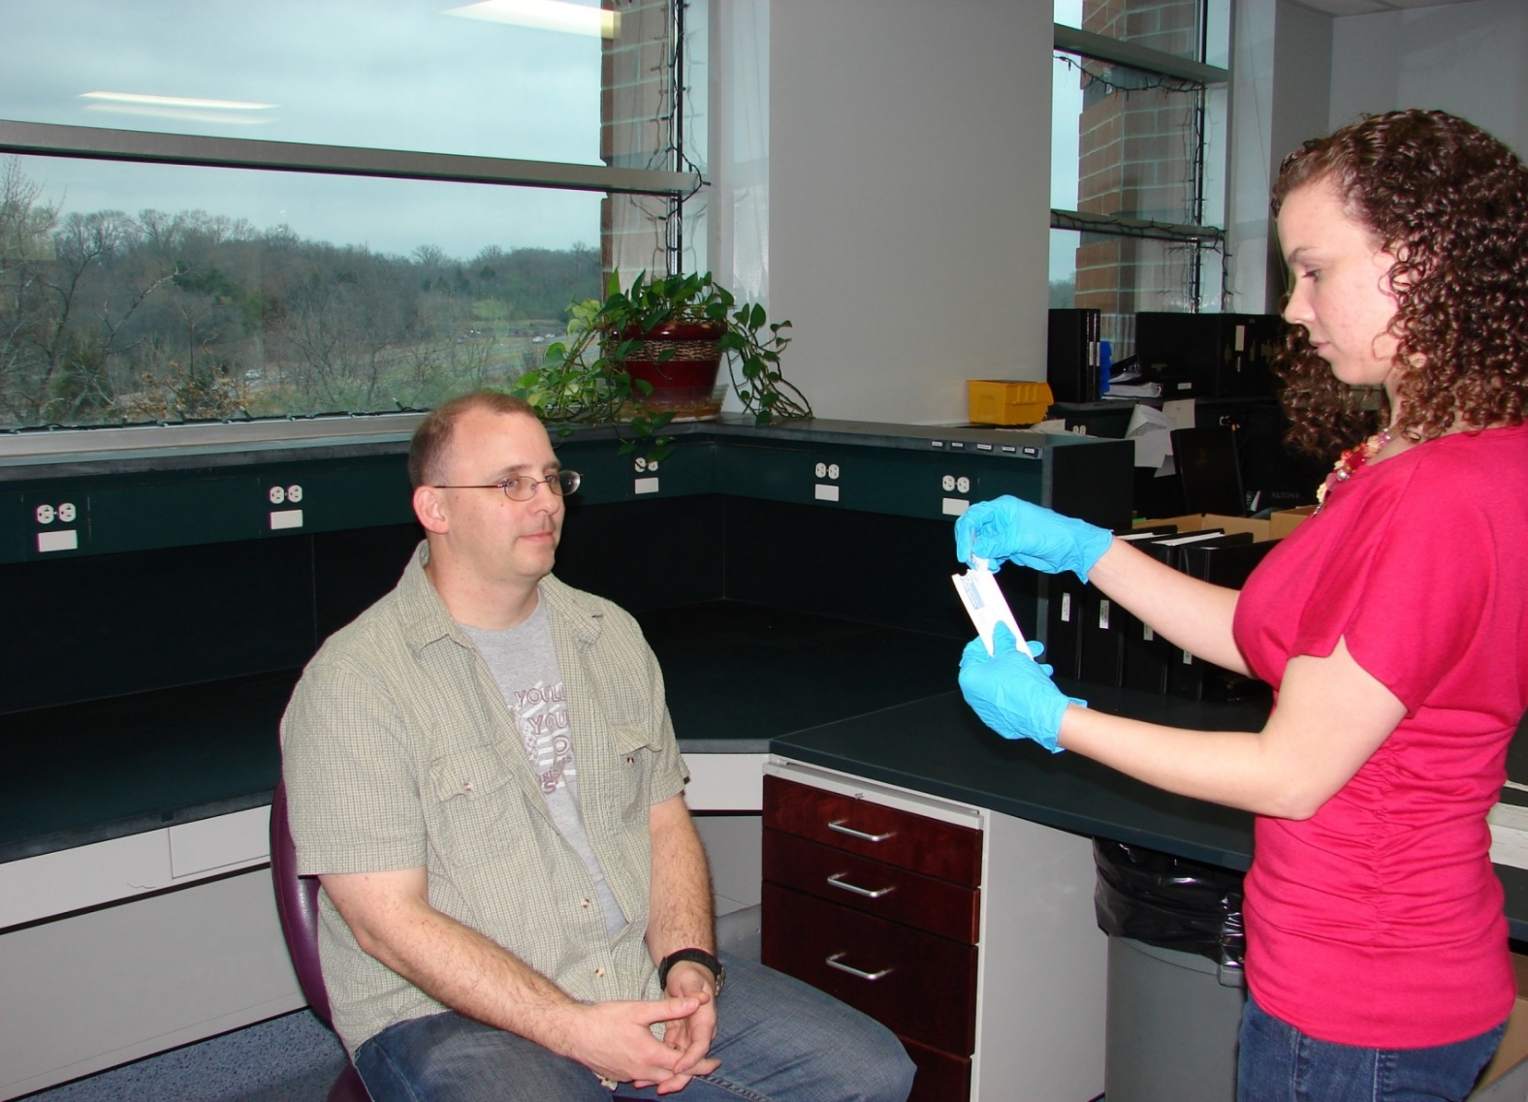
Have the Offender rinse their mouth out if they have been
eating or chewing tobacco prior to collection.
Open one swab package at a time.

Slide 35
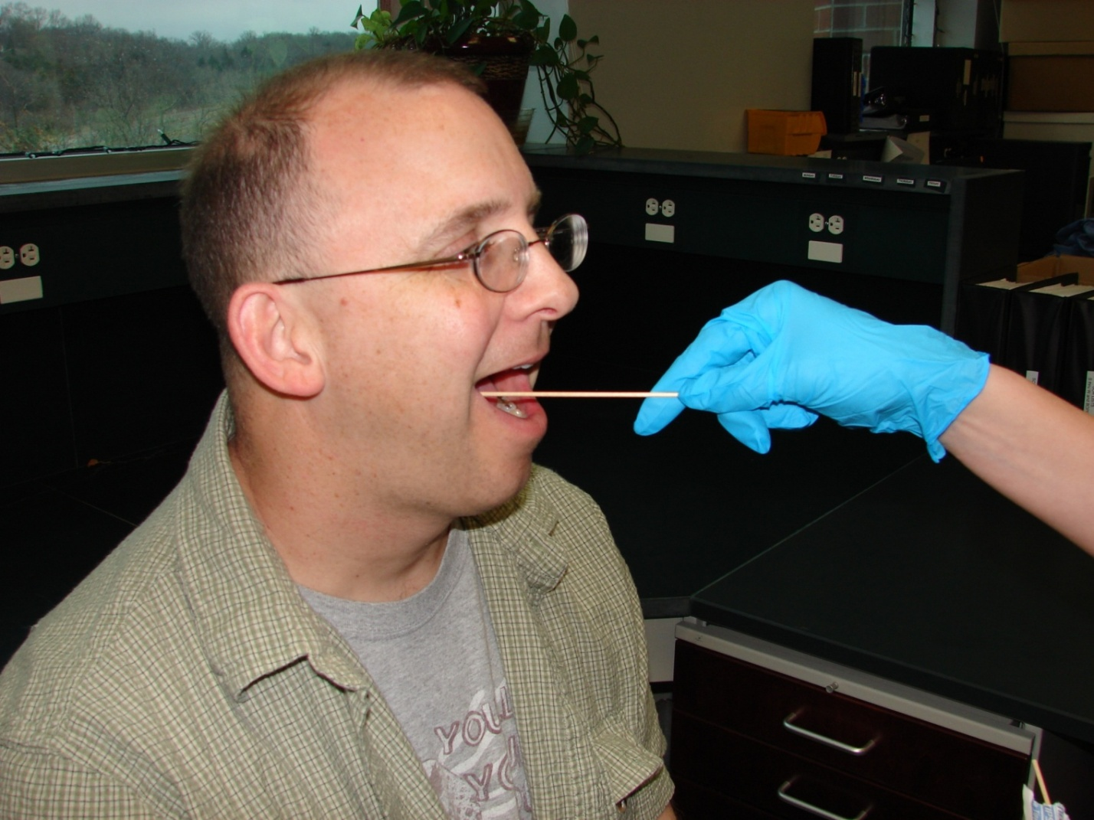
Using one swab at a time, rub the inside of
the individual’s cheek for 5 to 10 seconds.
Use all 4 swabs and both sides of the mouth.

Slide 36
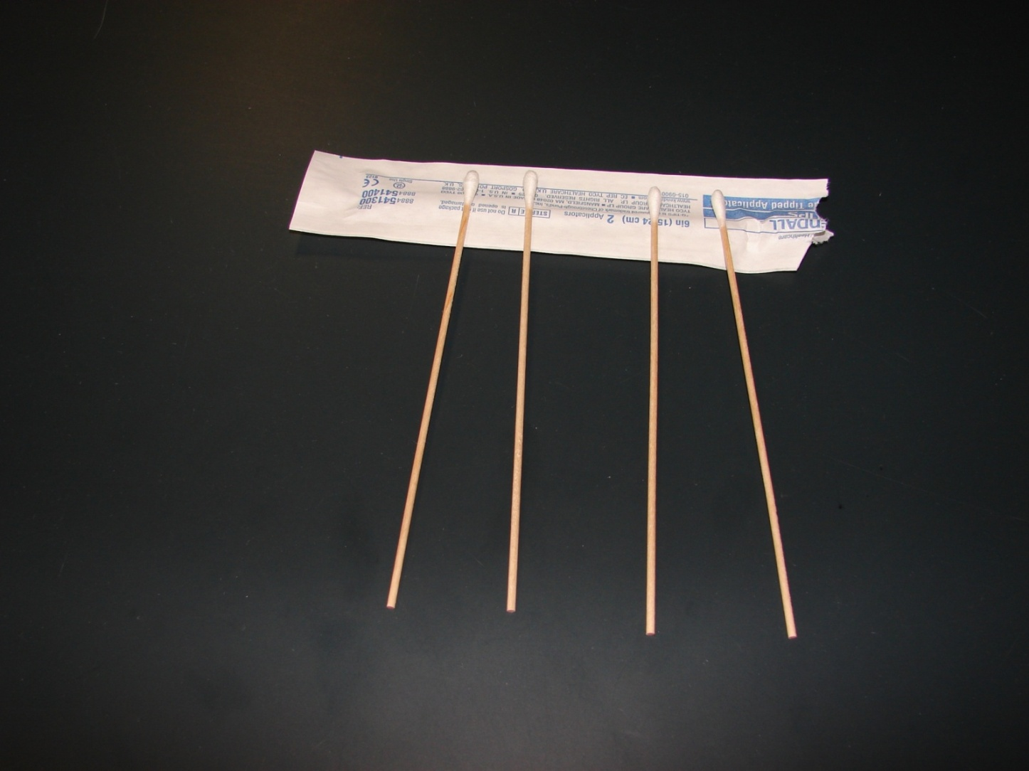
The swab packet can be used to rest the
swabs on as they air dry.
Allow the swabs to air dry at least
1-2 minutes before packaging.

Slide 37
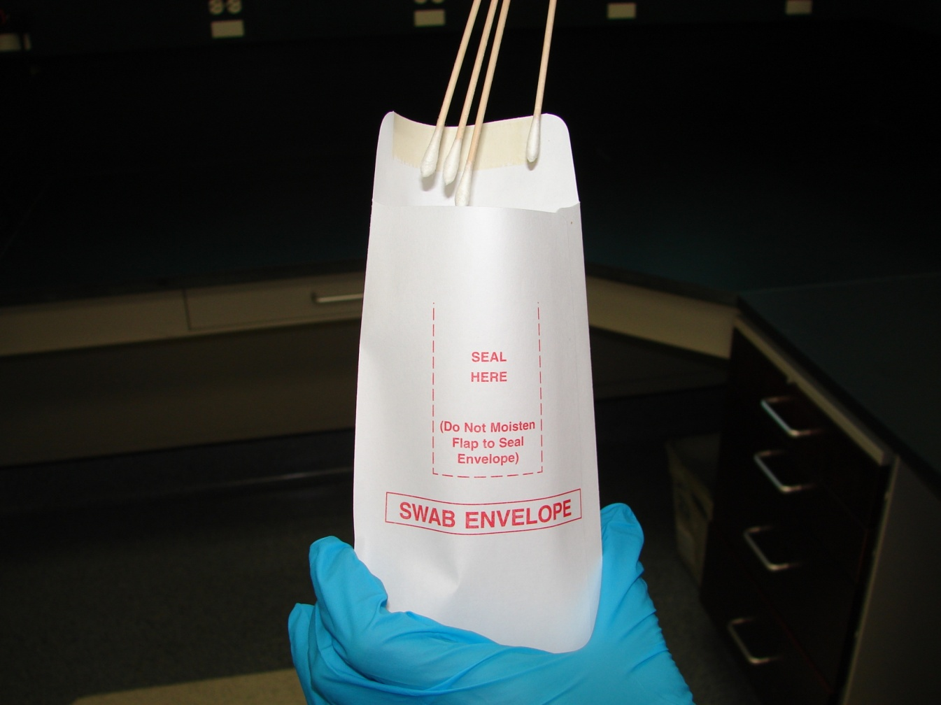
Place all 4 swabs inside the
small white envelope bulb end down.
Do not place swabs back into the paper
wrappers from which they came.

Slide 38
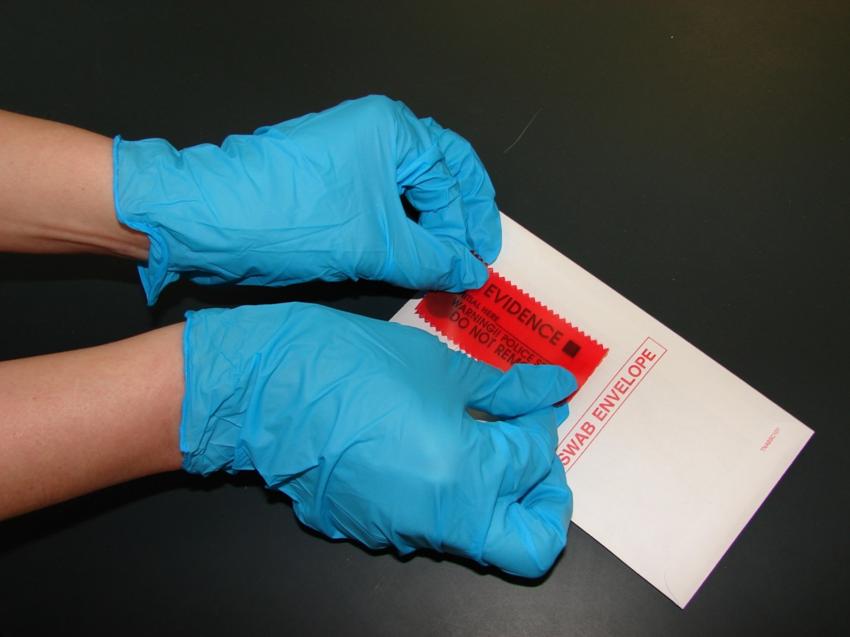
Seal the small swab envelope with
one of the red seals.

Slide 39
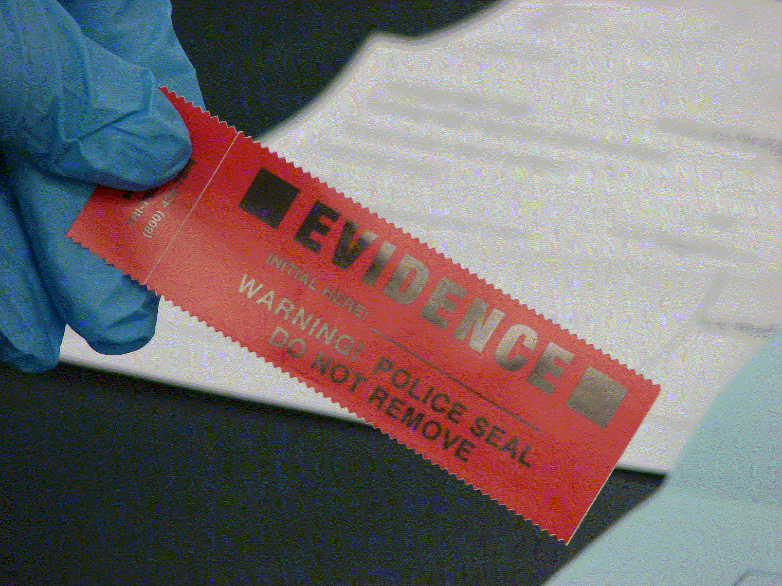
Remember this is not evidence even though the seal says “Evidence”.

Slide 40



DO NOT LICK ENVELOPE TO SEAL!!
NO
NO
NO

Slide 41
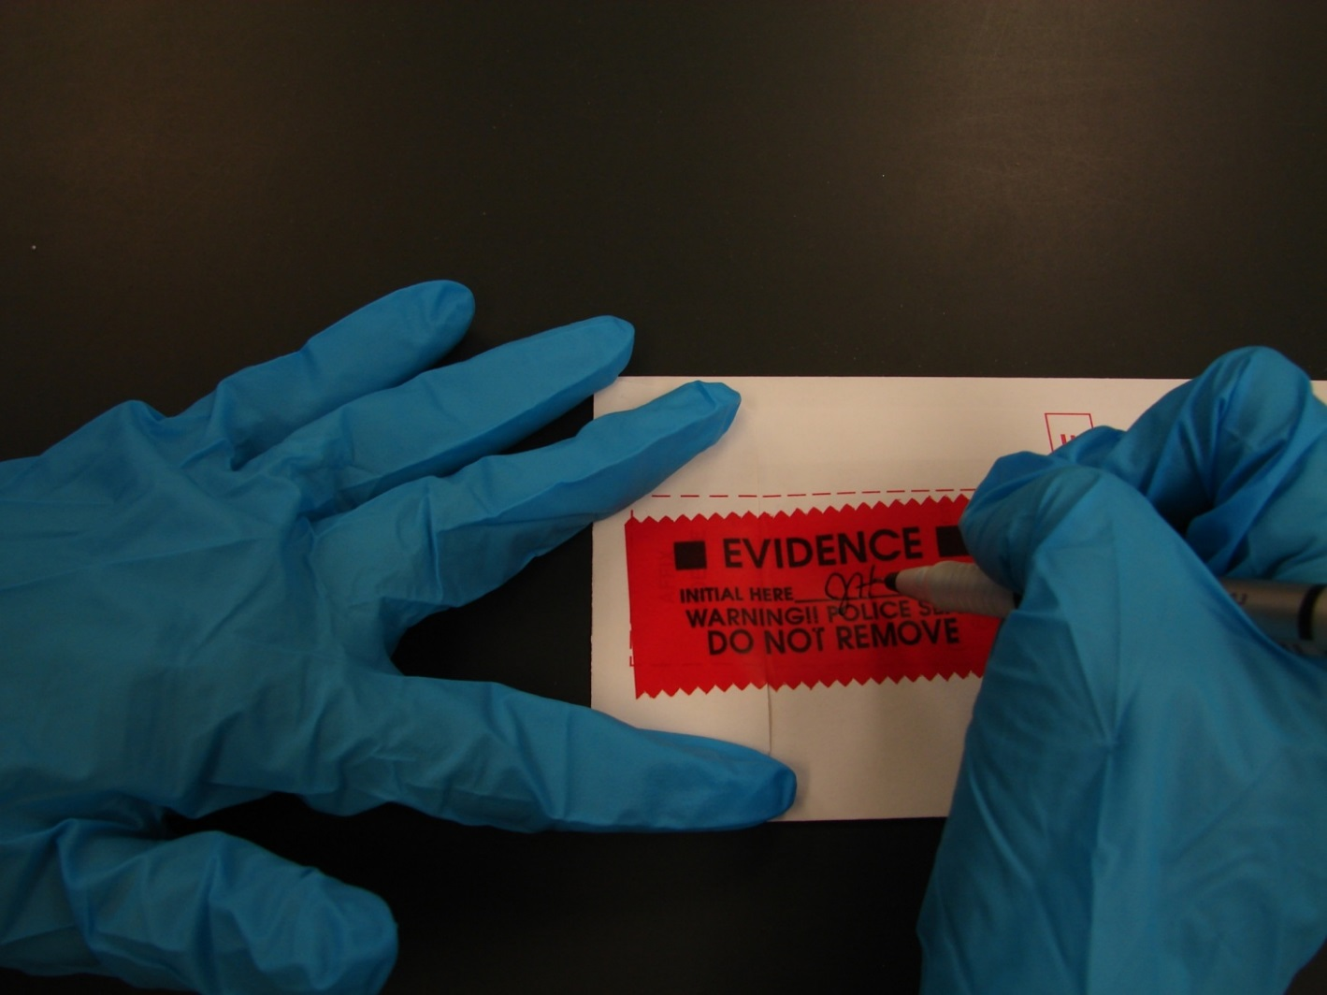
The person collecting the sample, not the offender,
should initial and date the seal.
Use a Sharpie or ball point pen to write initials.
Gel pens tend to smear.

Slide 42

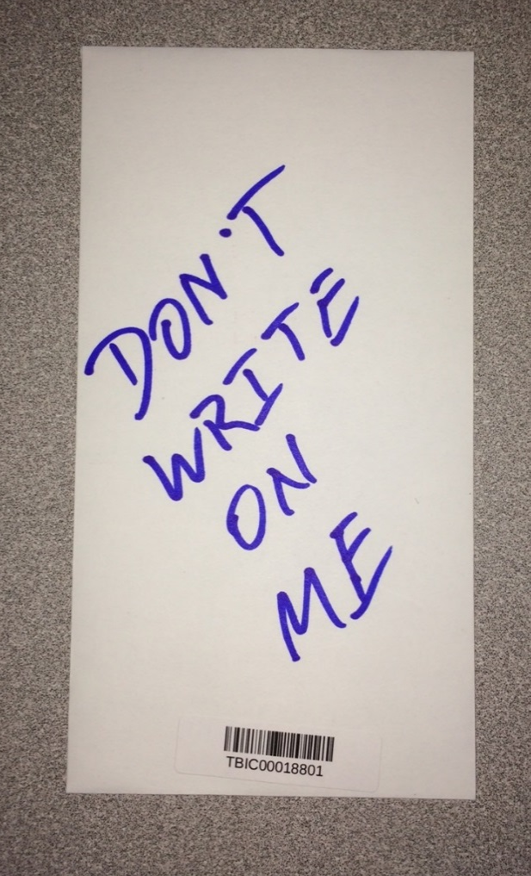
DO NOT write on the swab envelope other than the initials and date on the seal.
NO WRITING
on the envelope

Slide 43
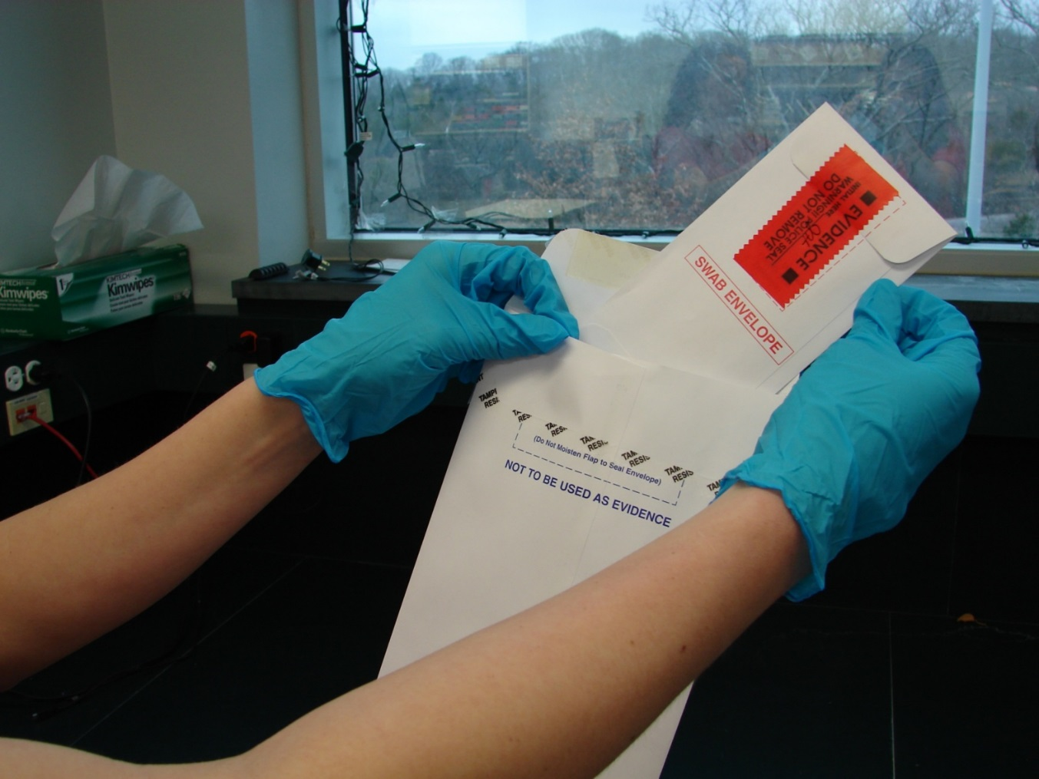
Place small swab envelope into
the middle white envelope.
Do not staple paperwork to swab envelope!

Slide 44
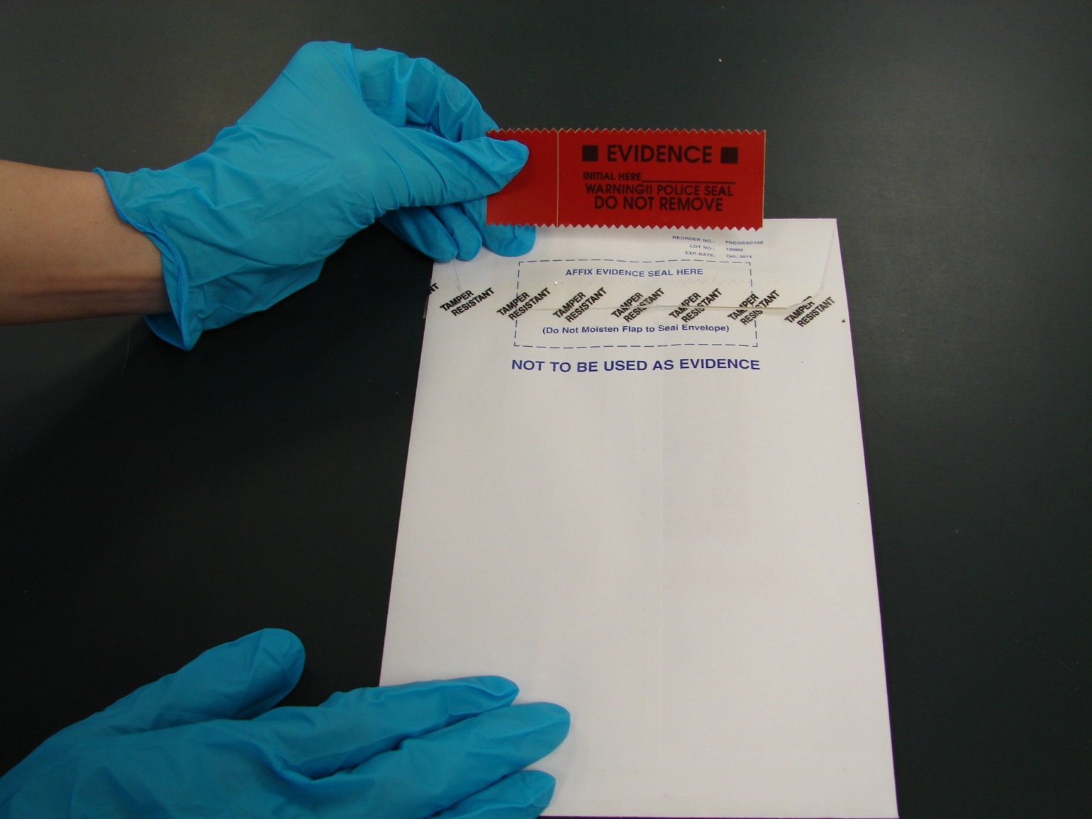
Seal with the middle envelope with the remaining red seal.

Slide 45
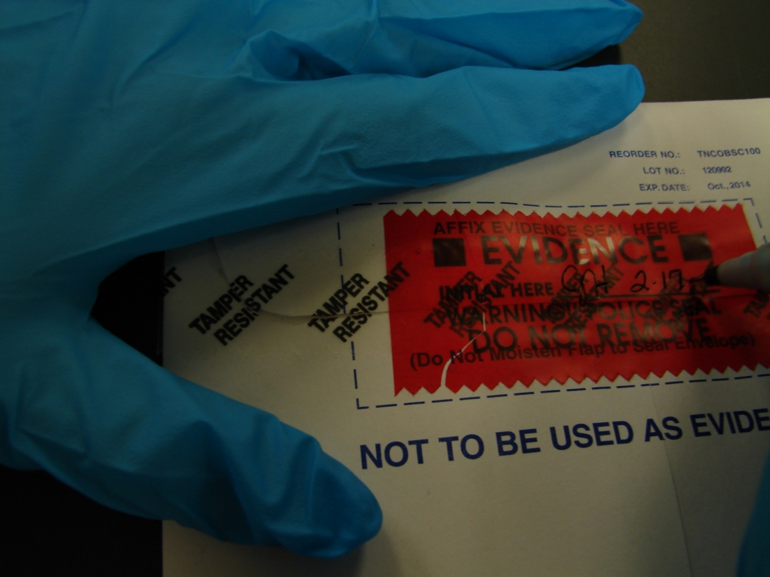
Initial and date the 2nd seal on the middle envelope.

Slide 46
Fill out all of the requested information on the Convicted Offender DNA Sample Submittal Form.
PLEASE Print Legibly
The Submittal Form may be hand written or filled out electronically.
A fillable PDF version is available on the TBI website (https://www.tn.gov/tbi/law-enforcement-resources/law-enforcement-resources0/forensic-services/dna-law--submissions---tbi-contacts.html).

Slide 47
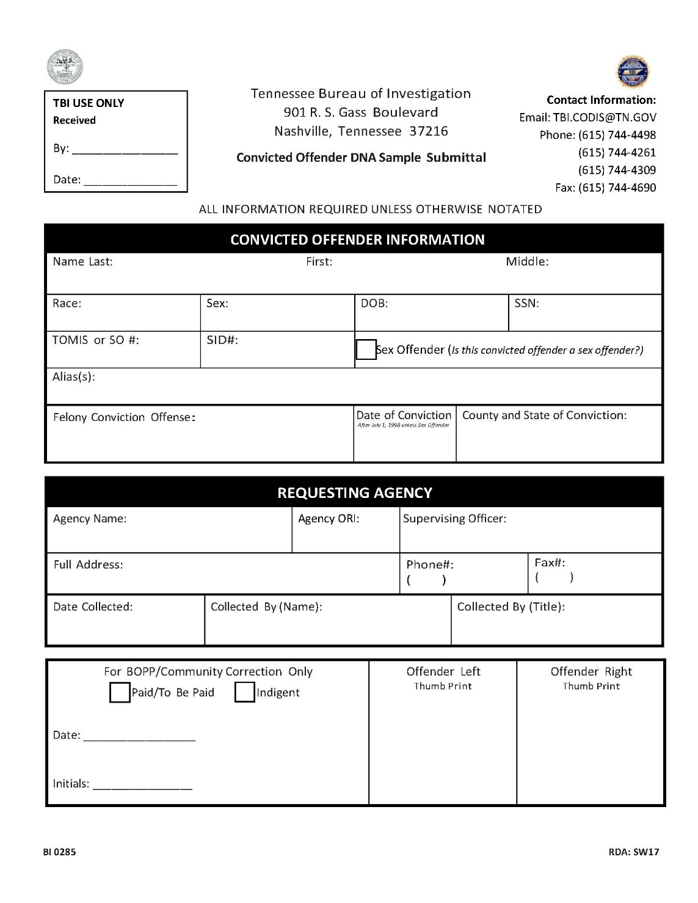
Fill out all the information on the Database DNA Sample Submittal Form.
SID #
Specific Conviction Offense
Requesting Agency
Full Date of Conviction
Complete Address
Offender’s Thumb prints

Slide 48
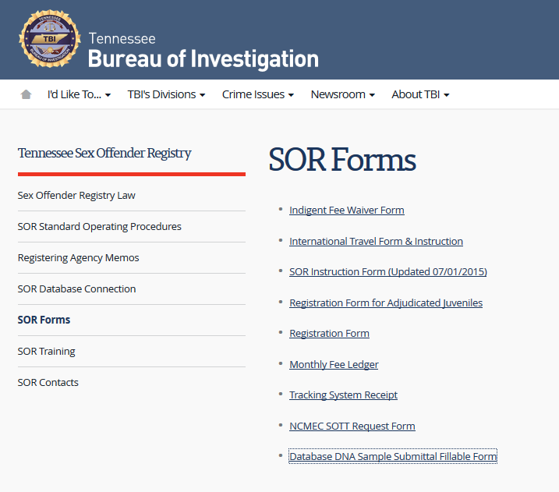
https://www.tn.gov/tbi/law-enforcement-resources/law-enforcement-resources0/tennessee-sex-offender-registry/sor-forms.html
A copy of the offender collection form is also available here

Slide 49
Required Information
Full name, date of birth, race, sex, and SSN
TOMIS/SO Number
SID number - TN SID or can be out of state SID
Felony conviction offense
Date of conviction
Your agency and address
  DO NOT USE THE OFFENDER’S ADDRESS!!!
Offender’s thumb prints

Slide 50
Fee Box
All offenders collected after May 10, 2012, must pay a $37 fee unless they are indigent.
Do not send money with the DNA kit.
All questions pertaining to the DNA fee need to be addressed through TDOC/BOP management

Slide 51
Indigency
Supporting paperwork must accompany a kit on an offender marked indigent.
An offender is not declared indigent due to receiving disability, being on Social Security, or having a Public Defender.

Slide 52
Thumb Prints
Please do not include 10 print cards as a substitute or indicate that they are “On file”.
It is the agency’s responsibility to acquire ink pads for the purpose of collecting the offender’s thumb prints.
No special ink is necessary such as UV ink. Any color is acceptable as long as we can see ridge detail in the thumb print.

Slide 53
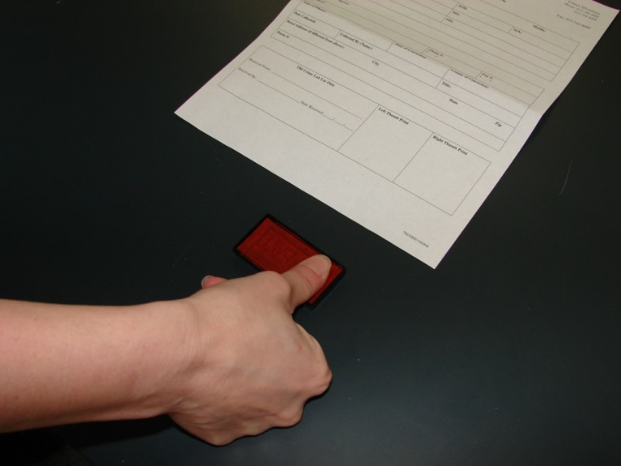
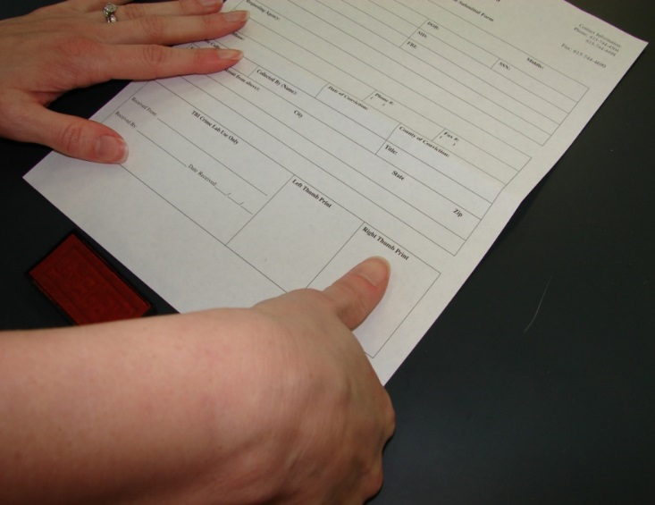
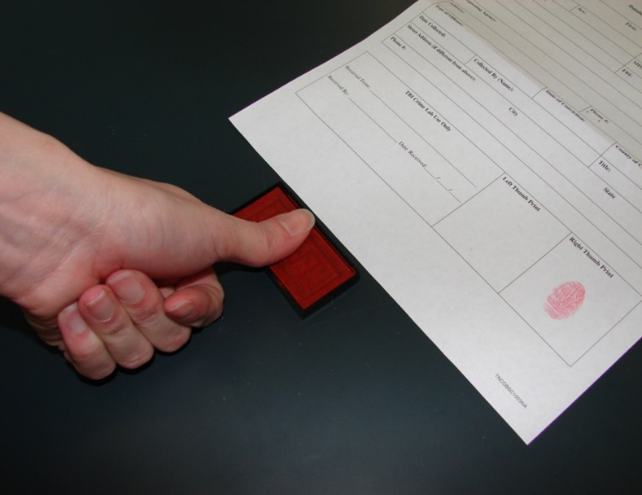
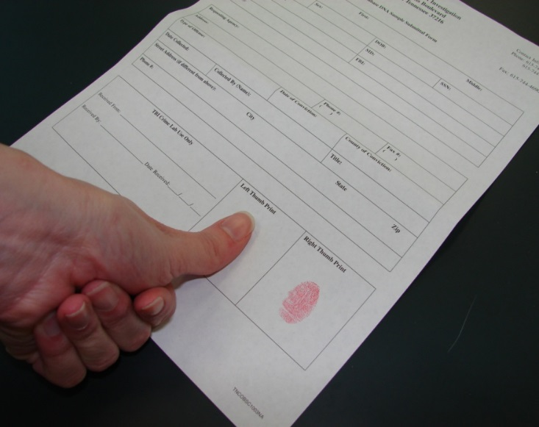

Slide 54
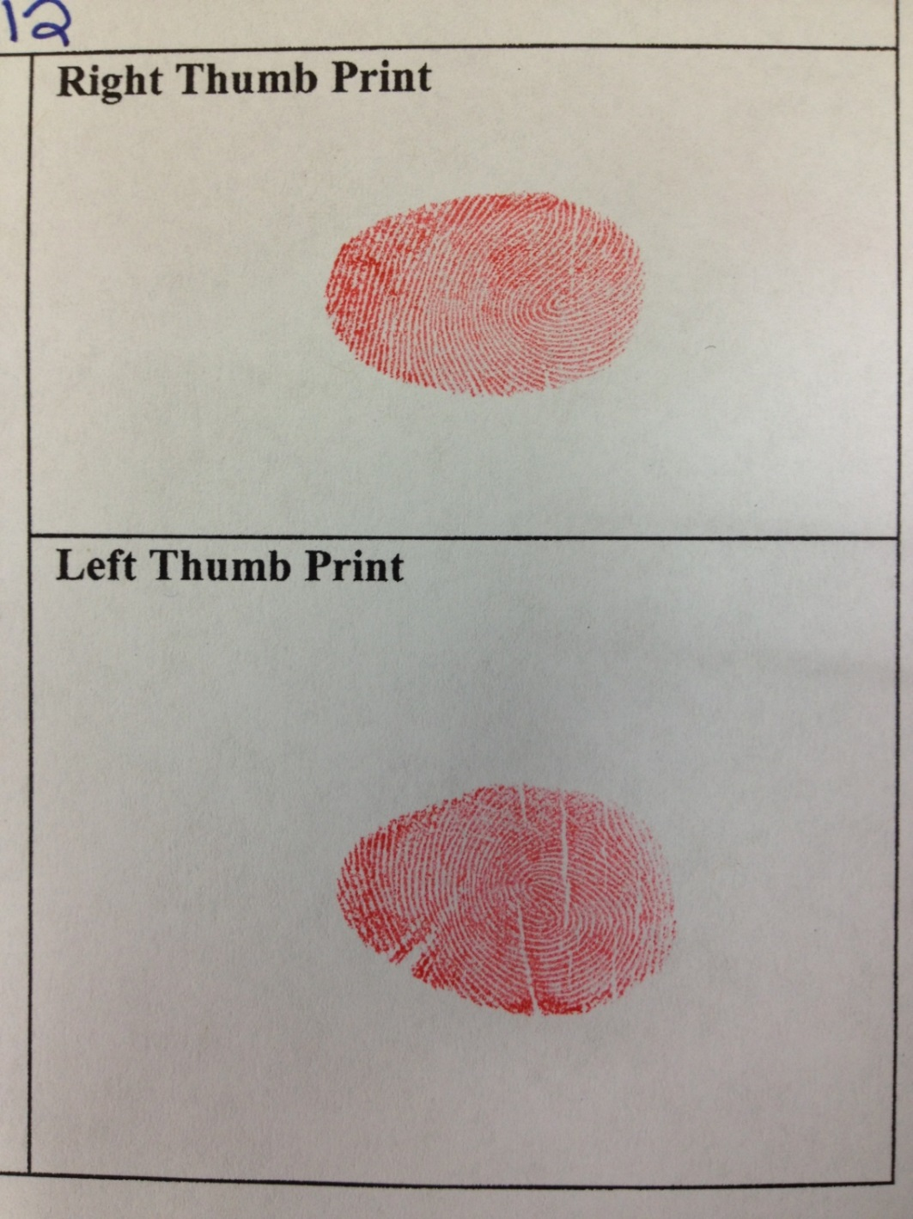
An Example of Acceptable Prints

Slide 55
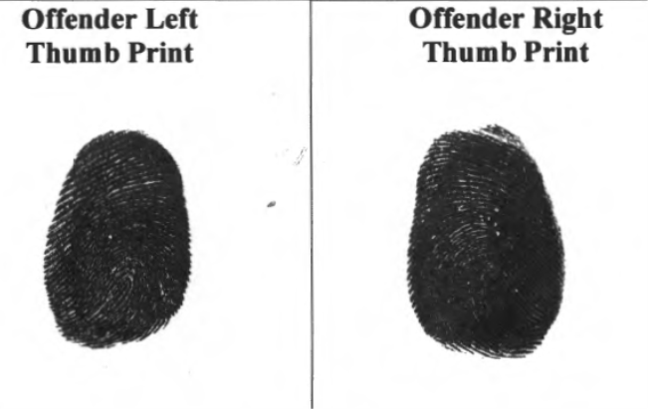
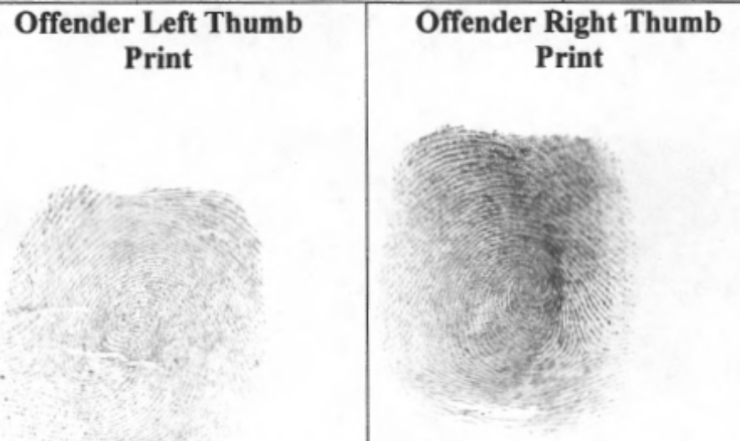
An Example of Unacceptable Prints
TOO dark
TOO light

Slide 56
Missing Thumb Prints
If a kit is received without thumb prints it will be mailed back for re-submittal. If sent more than once, it may also be sent to the Supervising Officer.
The offender should be called as soon as possible for thumb print collection.
The form with original thumb prints needs to be mailed to the TBI Attn: CODIS Unit as soon as possible.
We cannot process the DNA sample until thumb prints are received.
Collection of a new kit is not necessary.

Slide 57
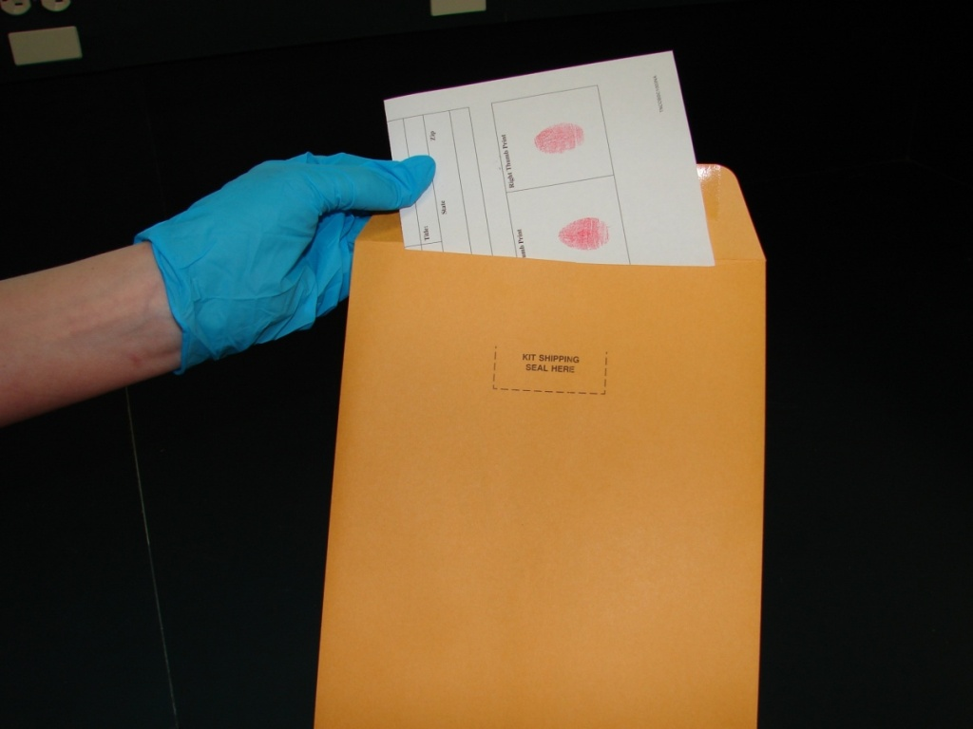
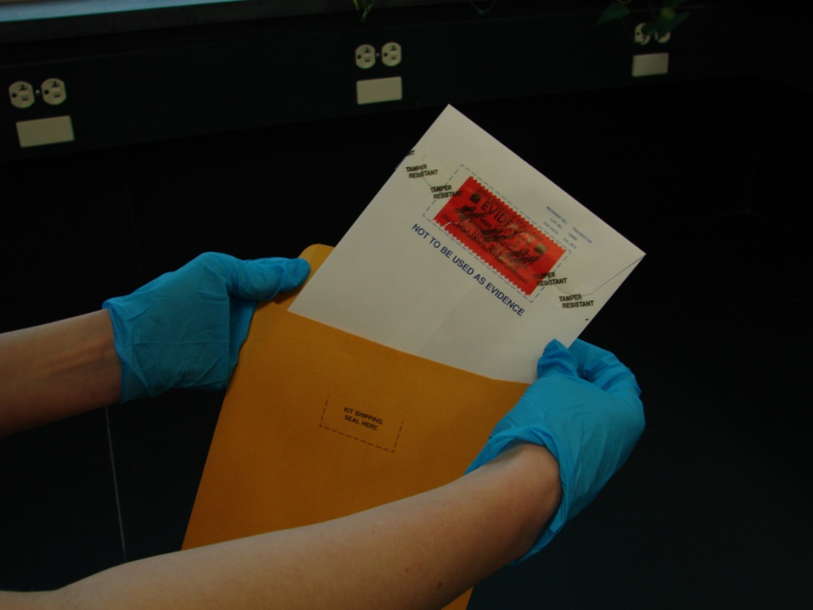
After the thumb prints are dry, make a copy of the completed form for your records. Fold submittal form and put the form and
the middle white sealed envelope into the larger manila mailing envelope.
To prevent paperwork contamination, please do not put
paperwork inside the middle envelope with
the swab envelope.

Slide 58
It is IMPERATIVE that you keep detailed records of the offenders you collect!

Slide 59
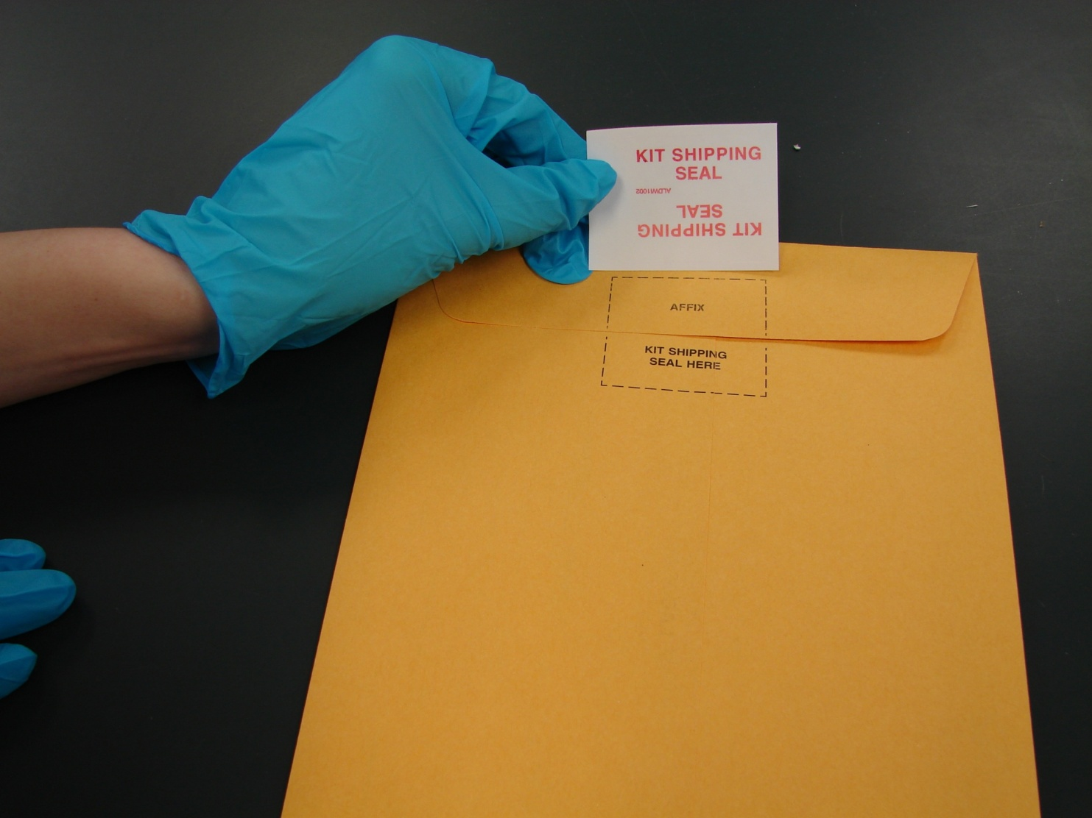
Seal the outer envelope with kit shipping seal.

Slide 60
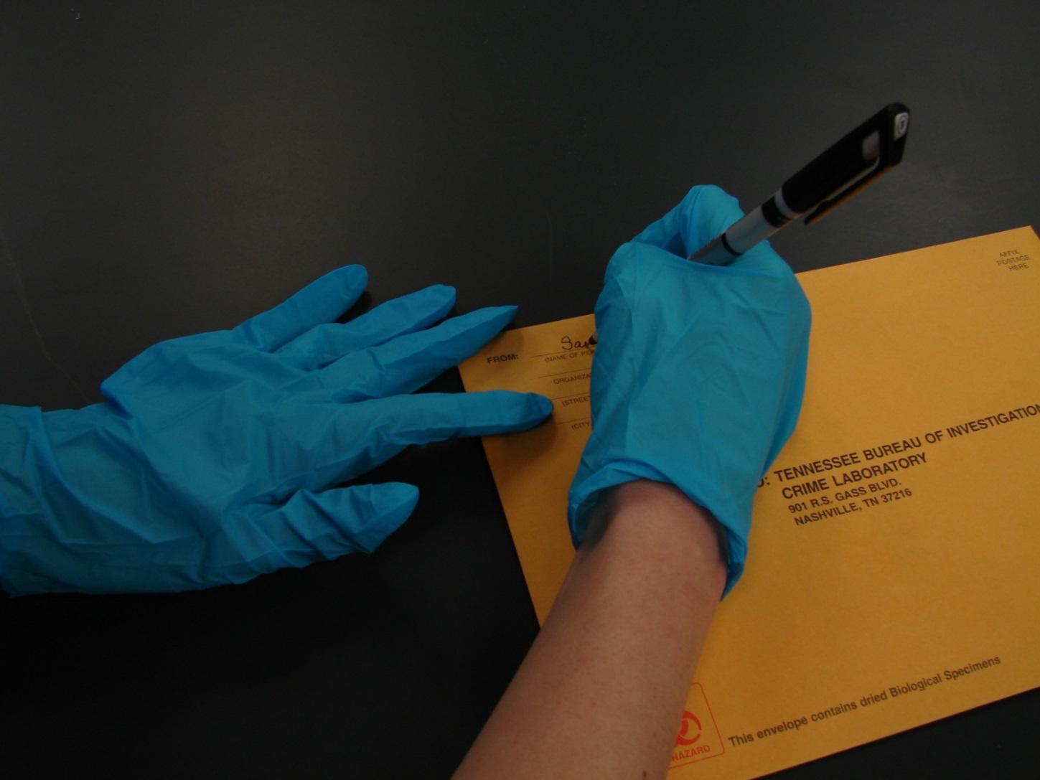
Put return address on the mailing envelope
even if you are hand delivering kits.

Slide 61
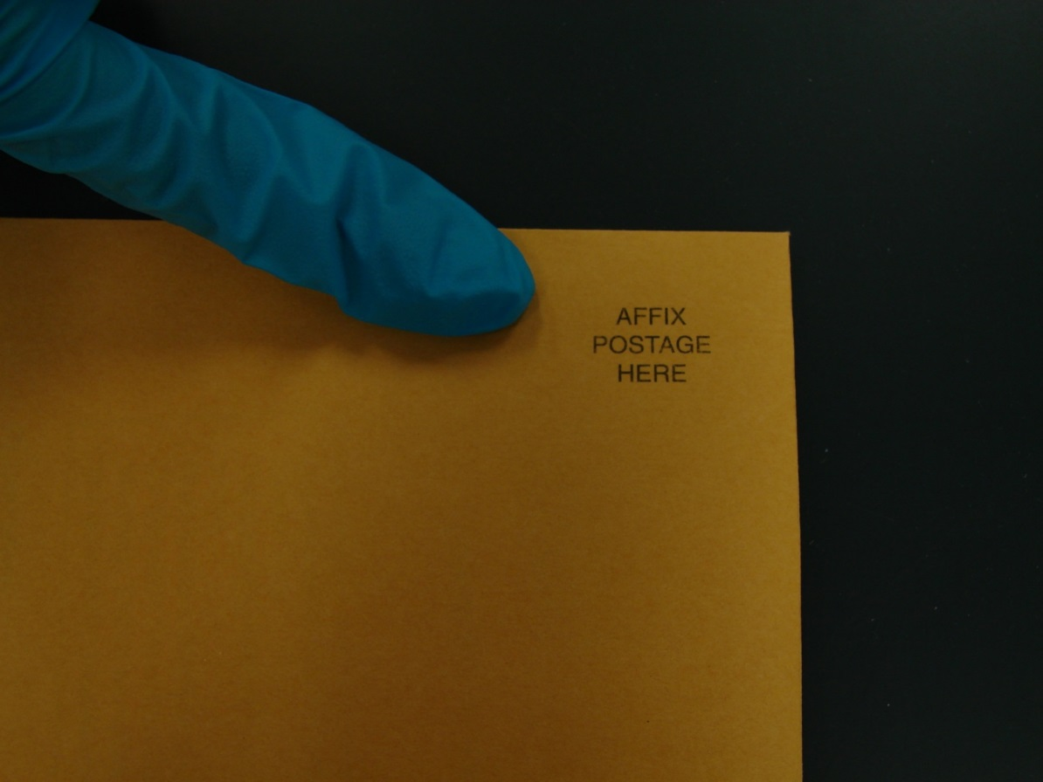

If the kit is mailed, please attach the proper postage.
The US Postal Service considers the kits to be a package and, as of December 2022 $4.50 per kit to ship.

Slide 62

If you are planning to mail multiple kits at once in a larger package, please note that the U.S. Postal Service requires you to have either the biohazard symbol, or “BIOHAZARD” written out on the outer packaging.

Slide 63
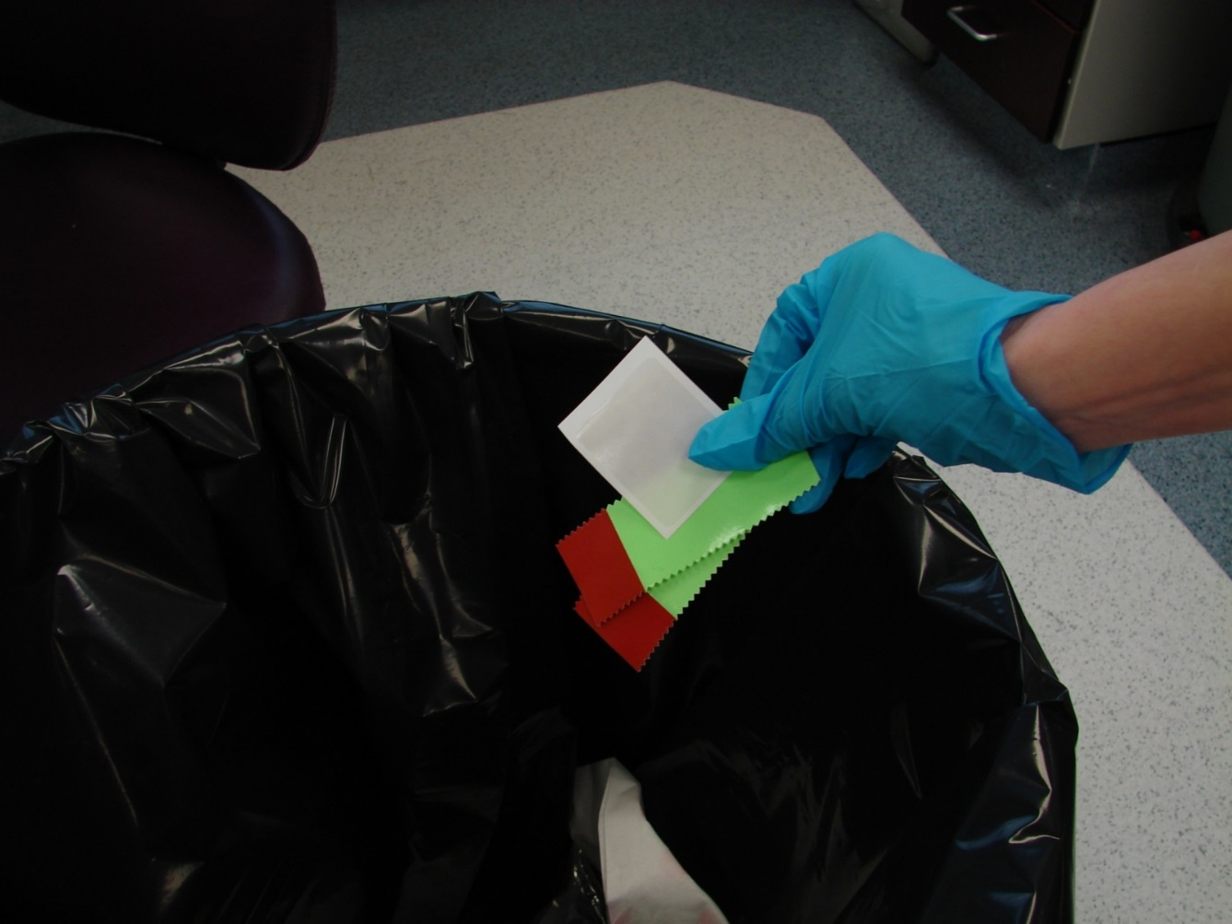
The remains of the seals may be disposed of in regular trash.

Slide 64
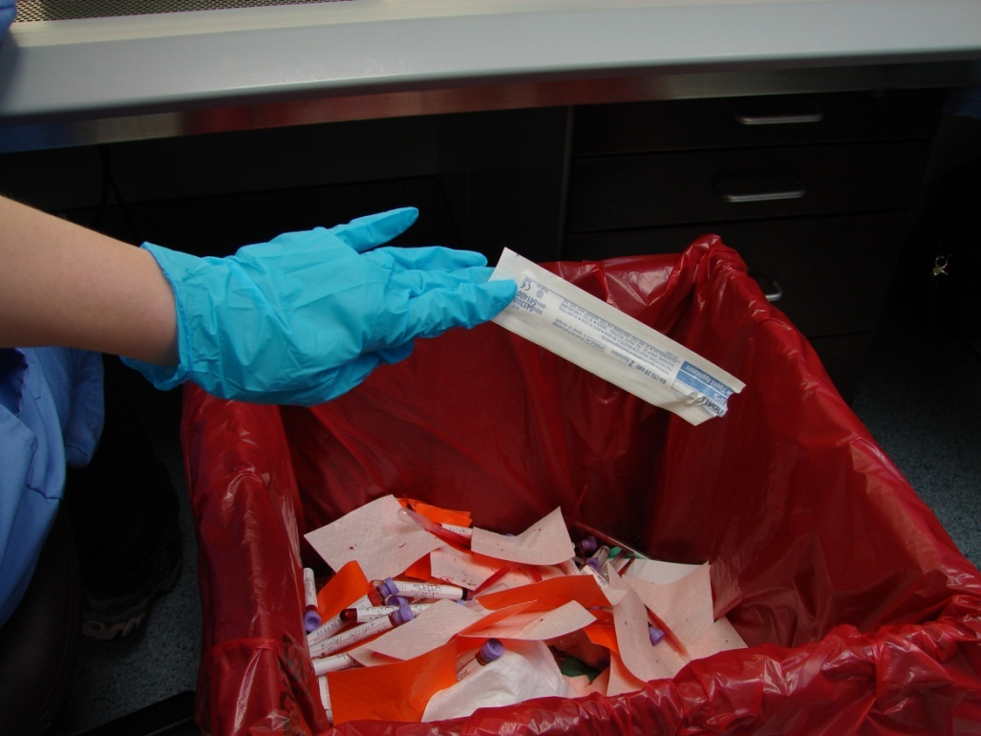
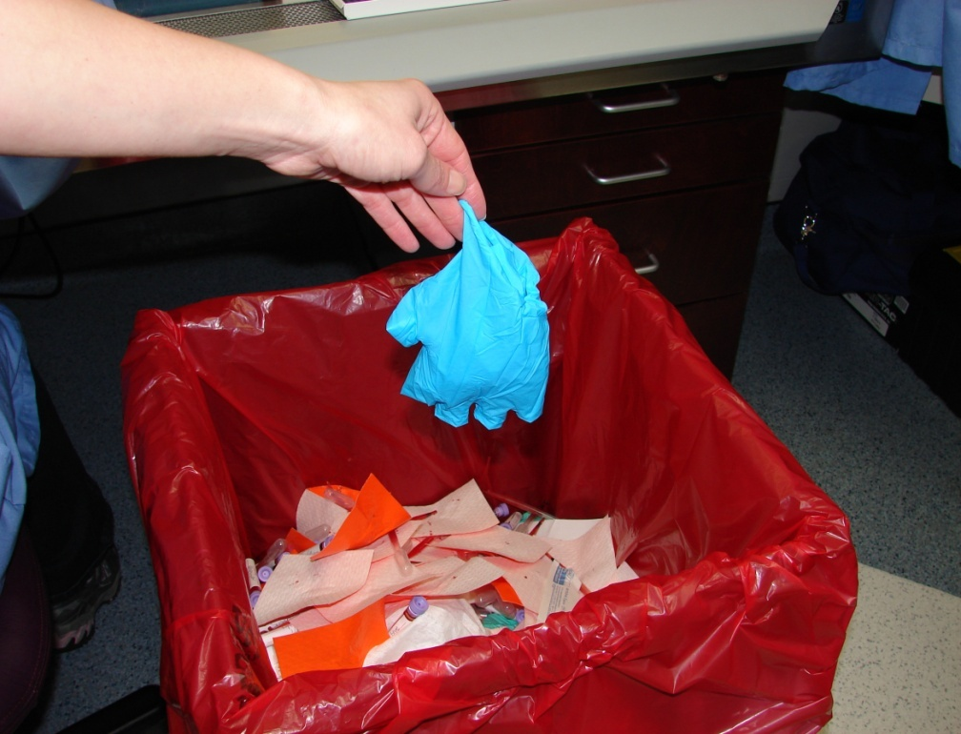
The swab packets (if used in the drying of the swabs) and biohazard barrier gloves should be disposed of by following your departments recommended OSHA procedures.
Please do not put the used gloves back in the envelope to be mailed back with the kit.

Slide 65
The kit is ready to be hand delivered or mailed to
TBI Nashville
Due to the sensitive nature of Convicted Offender/SOR
DNA, kits should be hand delivered or
mailed in a timely manner.

Slide 66
If a Convicted Offender kit is sent in as evidence
(the kit plainly states that it is not to be used as evidence)
the sample will not be worked and the submitting officer will be contacted and told that the sample is not acceptable.

Slide 67

If a sample is collected from an individual who does
not meet the qualifications or if the paperwork is not filled out COMPLETELY and CORRECTLY,
the kit will be returned to the submitting
agency for correction and re-submittal.

Slide 68
Convicted Offender Kit Returns
If a kit is returned to your Agency, please check to see why it is being returned.
A memo is included with each kit with an explanation as to why it was returned to you.
Please correct the paperwork, reseal the envelope with tape and initial. Return kit to the lab for processing.
DO NOT collect a whole new kit or take another kit apart to use the mailing envelope.

Slide 69
A Few Things to Keep in Mind
Offenders are not allowed to swab or print themselves
Offenders are not allowed to fill out the paperwork
Be familiar with the instructions before starting
If you realize that you have left something out of the kit, you may open the kit and reseal with tape.
Once sent to the lab the profile obtained from this sample will be put into the Convicted Offender Database
Collect from only one person at a time
Place the swabs in the swab envelope bulb end down
Do not touch the cotton bulb of the swab
Buccal samples should be handled and processed as if they are potentially biohazardous
Only fold the paperwork once to put in the envelope.

Slide 70
Verify, Verify, Verify
If you are unsure if your offender has had DNA completed in the past, please use the DNA Verification Website
https://codis.tbi.tn.gov
This eliminates repeat samples.

Slide 71

EVIDENCE
There is no chain of custody on this kit.
This collection kit is not evidence.
IT SHOULD NOT BE USED TO COLLECT EVIDENCE.

Slide 72
TBI CODIS
Contact Information
Fax: 615-744-4391
TBI.CODIS@tbi.tn.gov
Andrea Parsons
615-744-4309
Mark Gutknecht
615-744-4261
Kendall Stoner
CODIS Unit Supervisor
615-744-4291
kendall.stoner@tbi.tn.gov

