Slide 1


Arrestee
DNA Collection:
An Overview

Slide 2
In CODIS Terms
When a person is arrested for violent felonies that qualify under the Arrestee Law (TCA 40-35-321(e)(1)), a DNA sample is collected.
The sample can be collected by either the arresting or booking agency.

Slide 3
TCA Code 40-35-321 (e)(1)
“When a person is arrested on or after January 1, 2008, for the commission of a violent felony as defined in subdivision (e)(3), the person shall have a biological specimen taken for the purpose of DNA analysis to determine identification characteristics specific to the person.”

Slide 4
How do I obtain Arrestee DNA Kits?
Each agency should designate one individual responsible for ordering and maintaining Arrestee DNA kits.
We ship out kits based on your agency’s current monthly average.
Order kits as often as necessary and the average will be adjusted accordingly.
Do not wait until your agency is completely out of kits to reorder. Once your agency is down to one-third the kits you have received, go ahead and contact us so the new shipment will arrive before you run out.

Slide 5
How do I obtain Arrestee DNA Kits?
(Cont’d.)
Email TBI.CODIS@tn.gov to order kits. Include your name, your agency’s name, full address and phone number, as well as the type of kit you are requesting.
Kits will be shipped to you via FedEx Ground and typically arrive within 2-3 business days.
They are also available at Evidence Receiving in the Nashville Crime Lab, but if you want to pick up more than 10, we ask you to contact the CODIS unit at least 24 hours in advance as the stock kept on-hand in Evidence Receiving is low.

Slide 6
Additional Notes
Make sure that the individual is charged with one of the qualifying TCA Codes.
Please note: As of May 10, 2012, 6 new qualifying offenses were added to the list.
A complete list is available on the back of the middle envelope of each Arrestee kit, as well as on the TBI website.

Slide 7
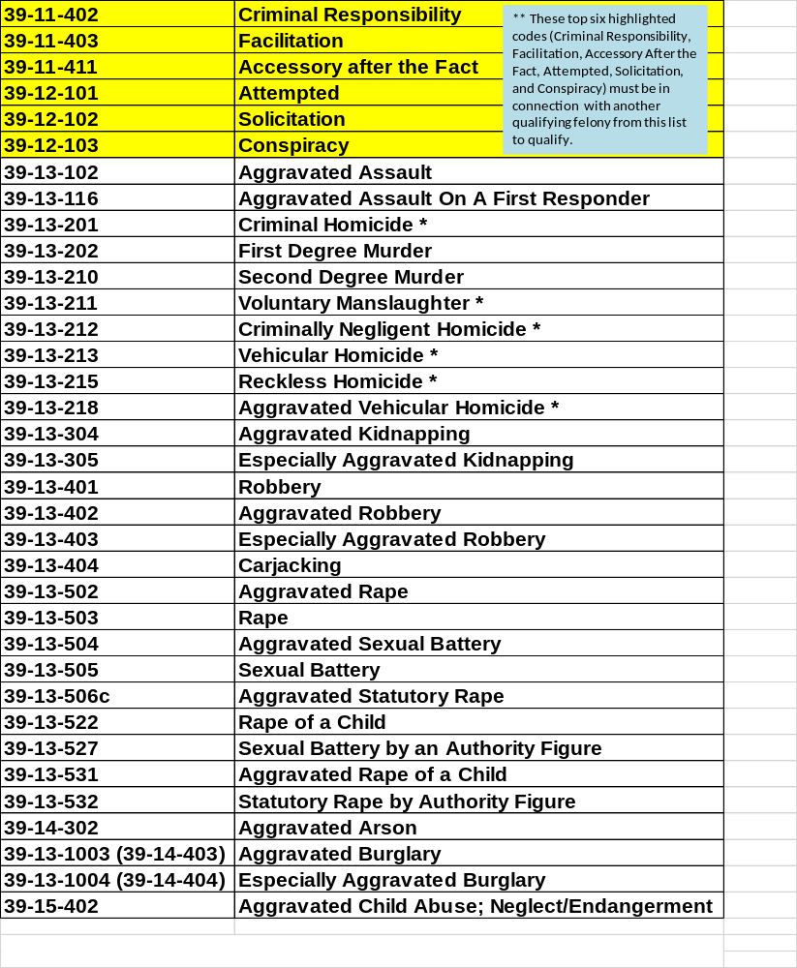

Slide 8
If the arrest is for one of the following, please use the corresponding TCA Code, in addition to the qualifying underlying offense.
Criminal Responsibility 39-11-402
Facilitation 39-11-403
Accessory After the Fact 39-11-411
Attempted 39-12-101
Solicitation 39-12-102
Conspiracy 39-12-103
Example:
Attempted Aggravated Assault 39-12-101 / 39-13-102

Slide 9
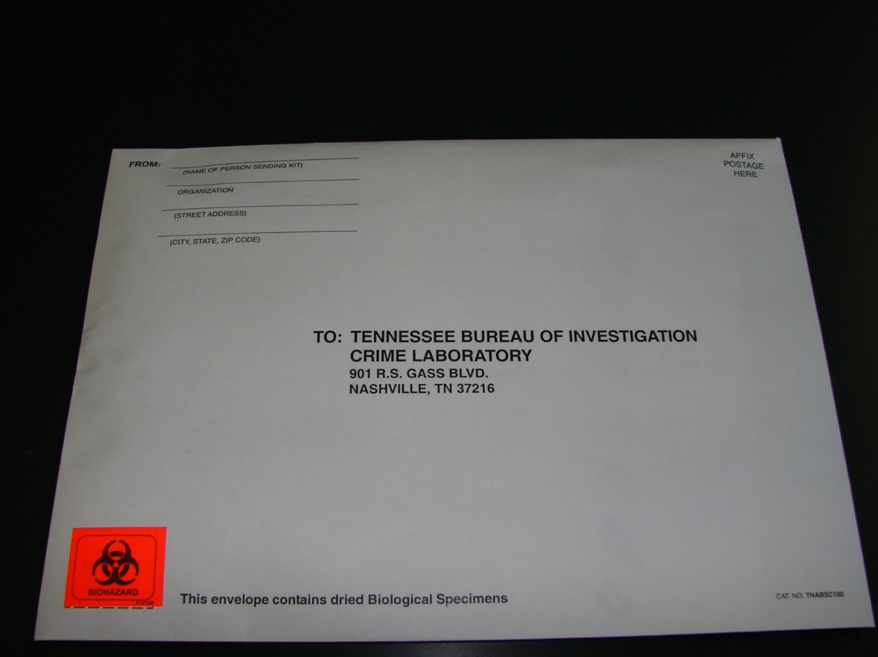

I have my kit…now what?!?!?!

Slide 10
I have my kit…now what?!?!?
(Cont’d)
Each kit has everything needed to collect from one individual.
Inside the white mailing envelope you will find a middle white envelope with instructions and qualifying offenses, a pair of biohazard barrier gloves, proper seals, four swabs, swab envelope, and an Arrestee DNA Sample Submittal Form.
It is not necessary for Medical Personnel to collect this sample.

Slide 11
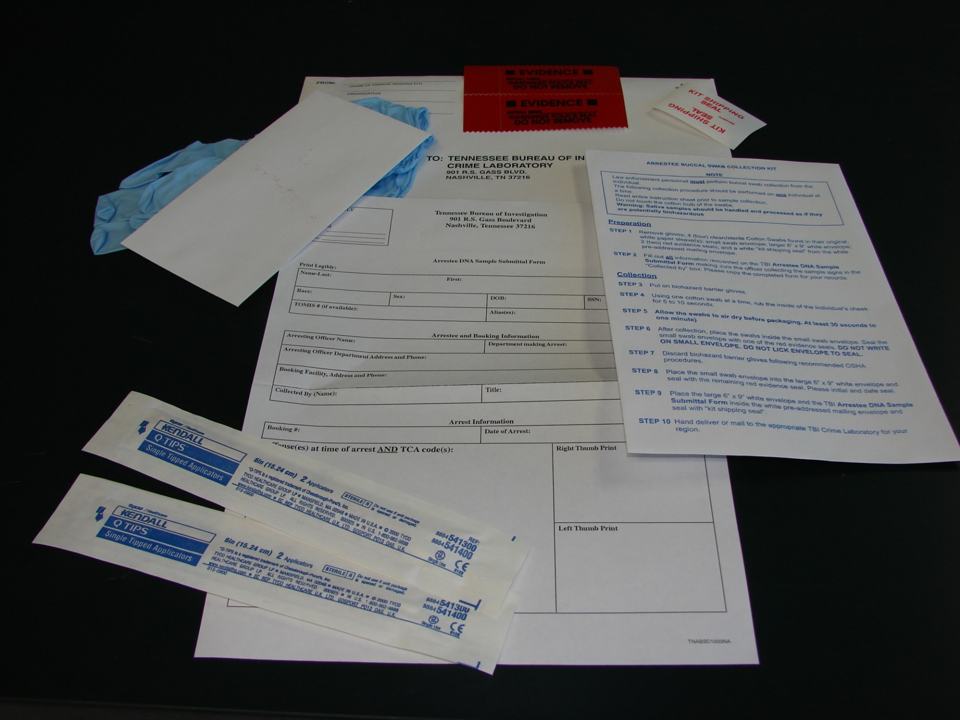
Seals
Small white envelope
Instructions
Gloves
Submittal form
Swab packets

Slide 12
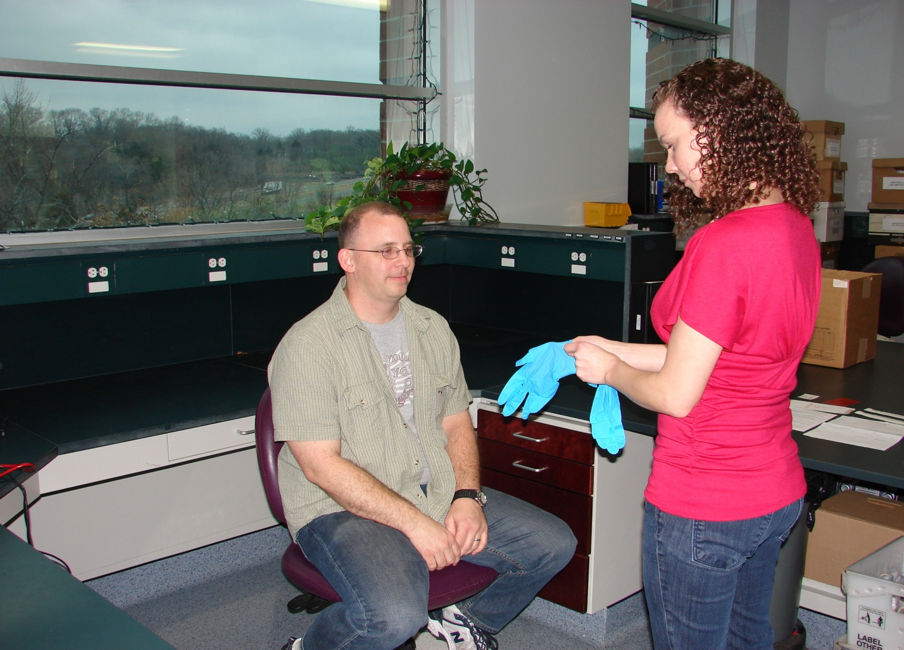
Put on biohazard barrier gloves.

Slide 13
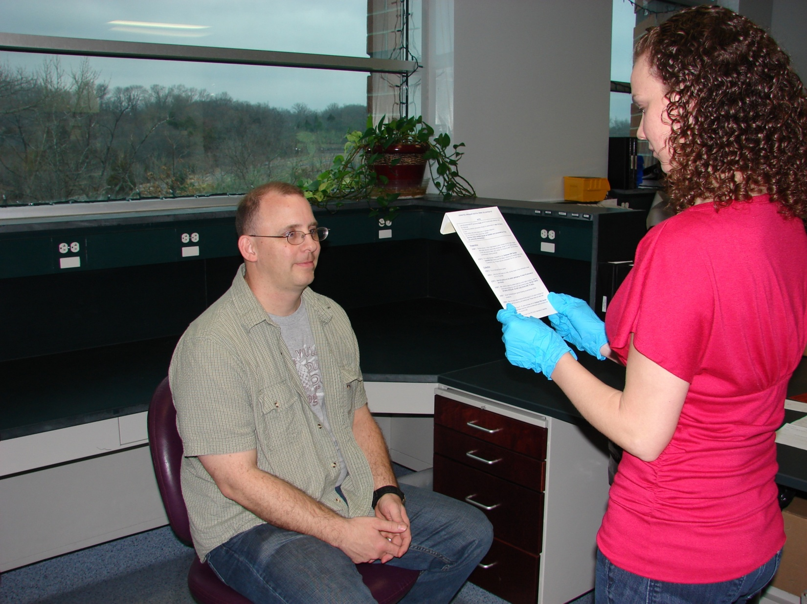
Read the instructions on the middle envelope carefully.

Slide 14
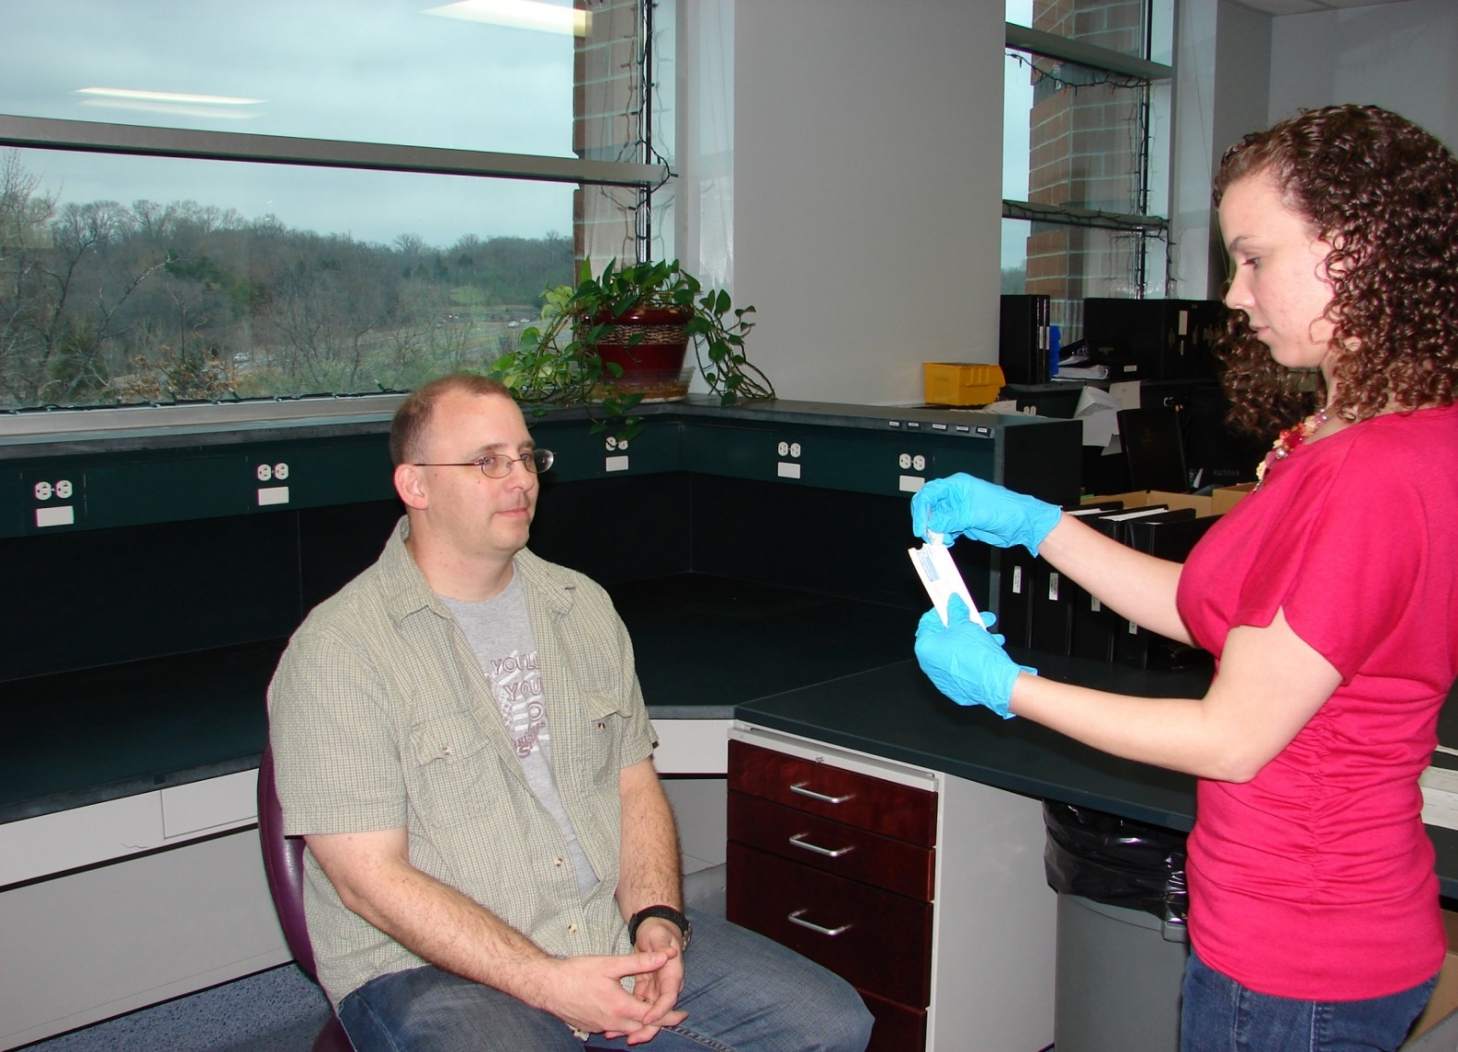
Have the Arrestee rinse their mouth out if they have been
eating or chewing tobacco prior to collection.
Open one swab package at a time.

Slide 15
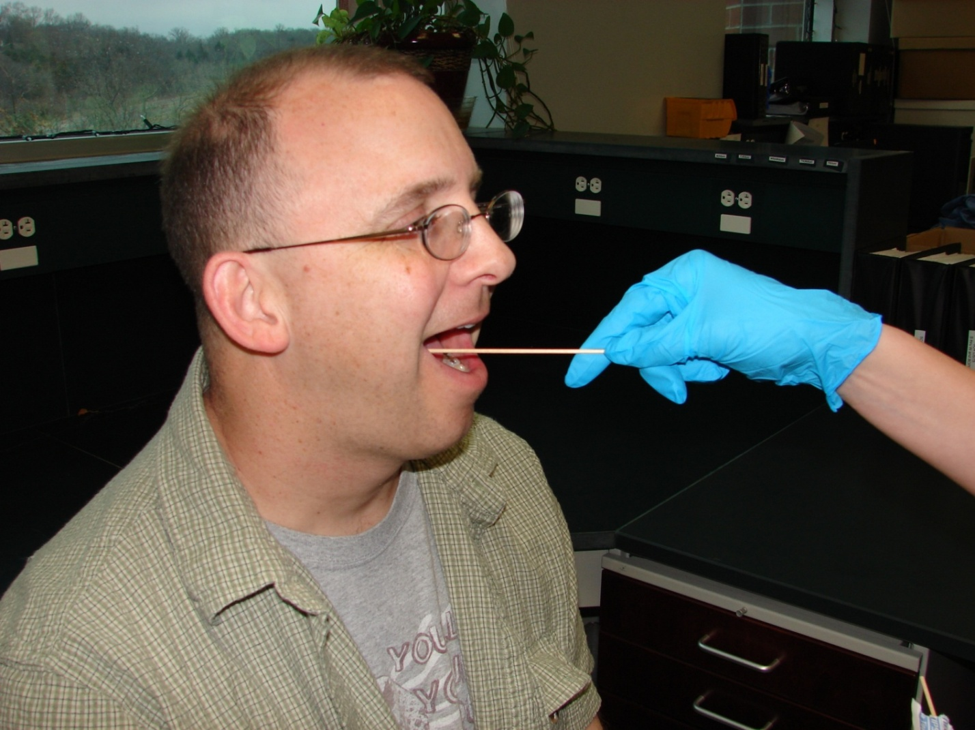
Using one swab at a time, rub the inside of
the individual’s cheek for 5 to 10 seconds.
Use all 4 swabs and both sides of the mouth.

Slide 16
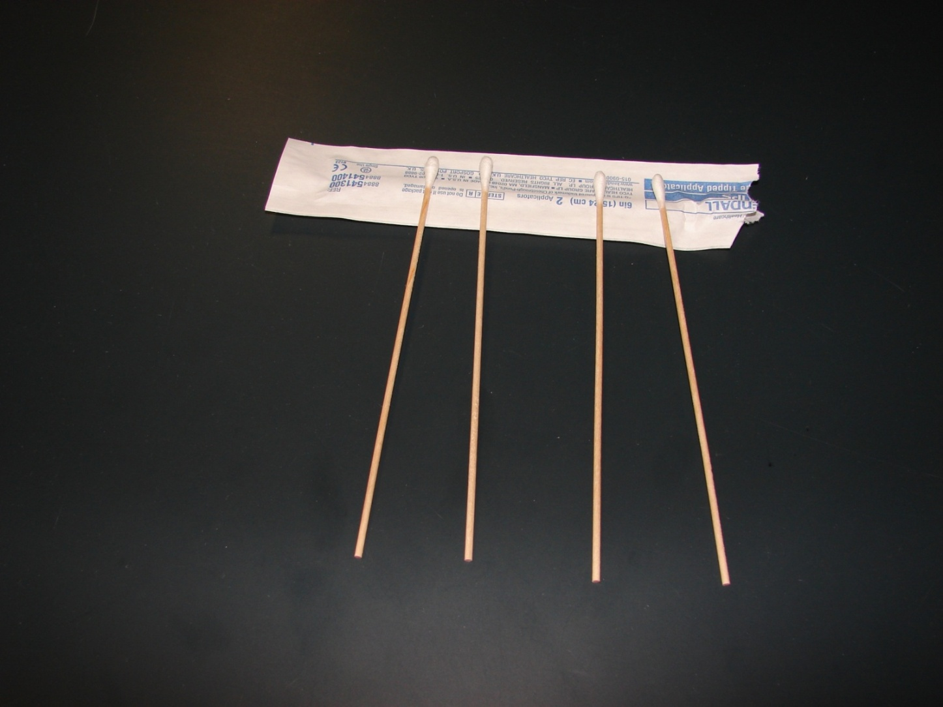
The swab packet can be used to rest the
swabs on as they air dry.
Allow the swabs to air dry at least
1-2 minutes before packaging.

Slide 17
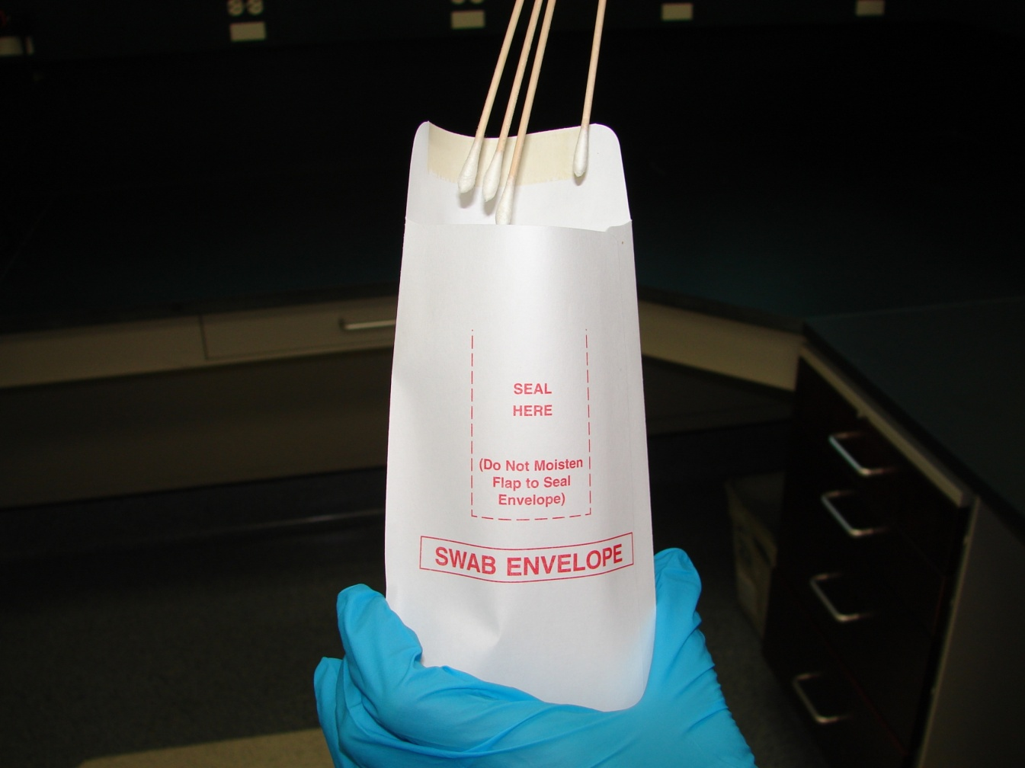
Place all 4 swabs inside the
small white envelope bulb end down.
Do not place swabs back into the paper
wrappers from which they came.

Slide 18
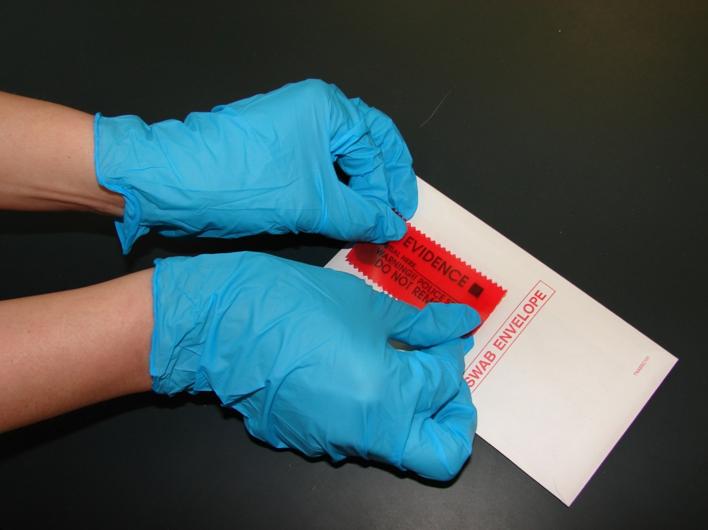
Seal the small swab envelope with
one of the red seals.

Slide 19
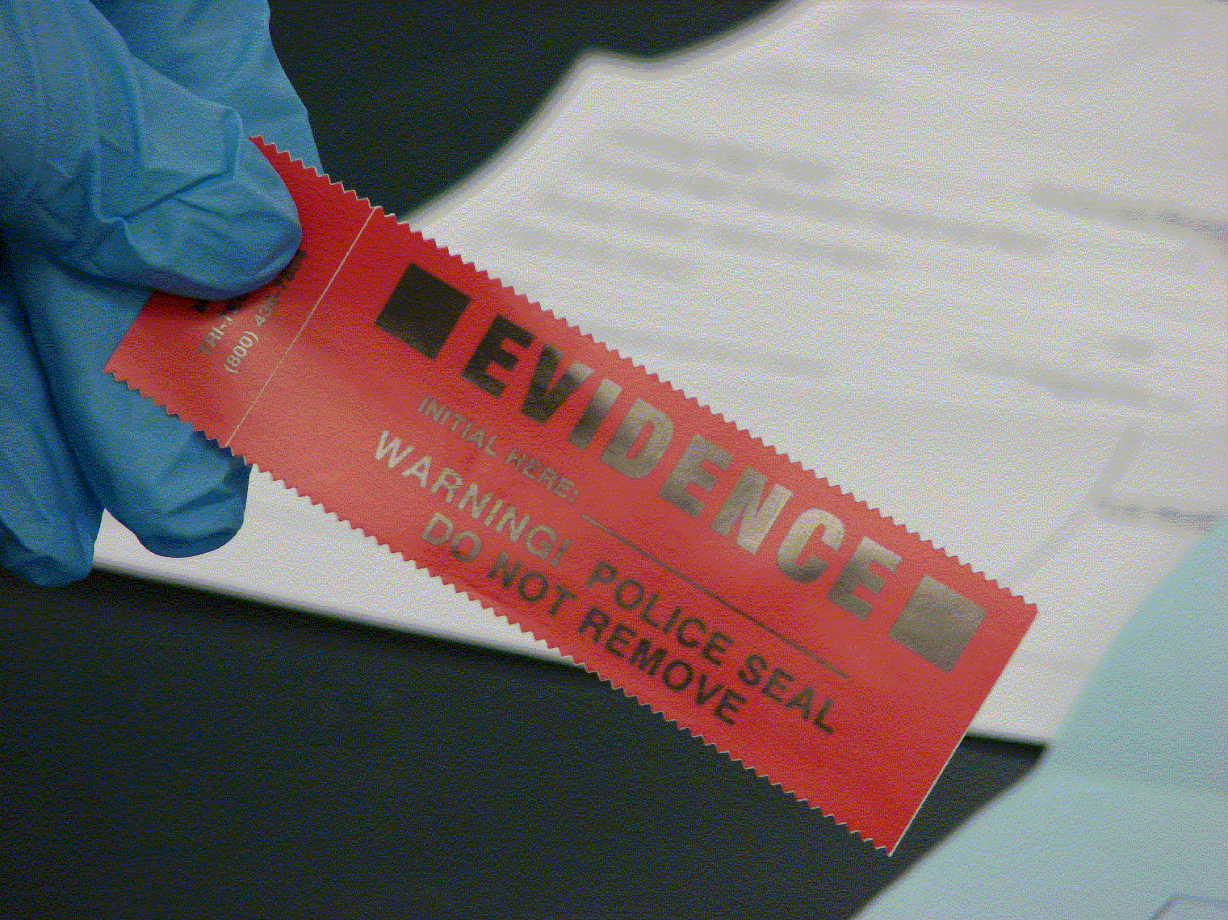
Remember this is not evidence even though the seal says “Evidence”.

Slide 20



DO NOT LICK ENVELOPE TO SEAL!!
NO
NO
NO

Slide 21
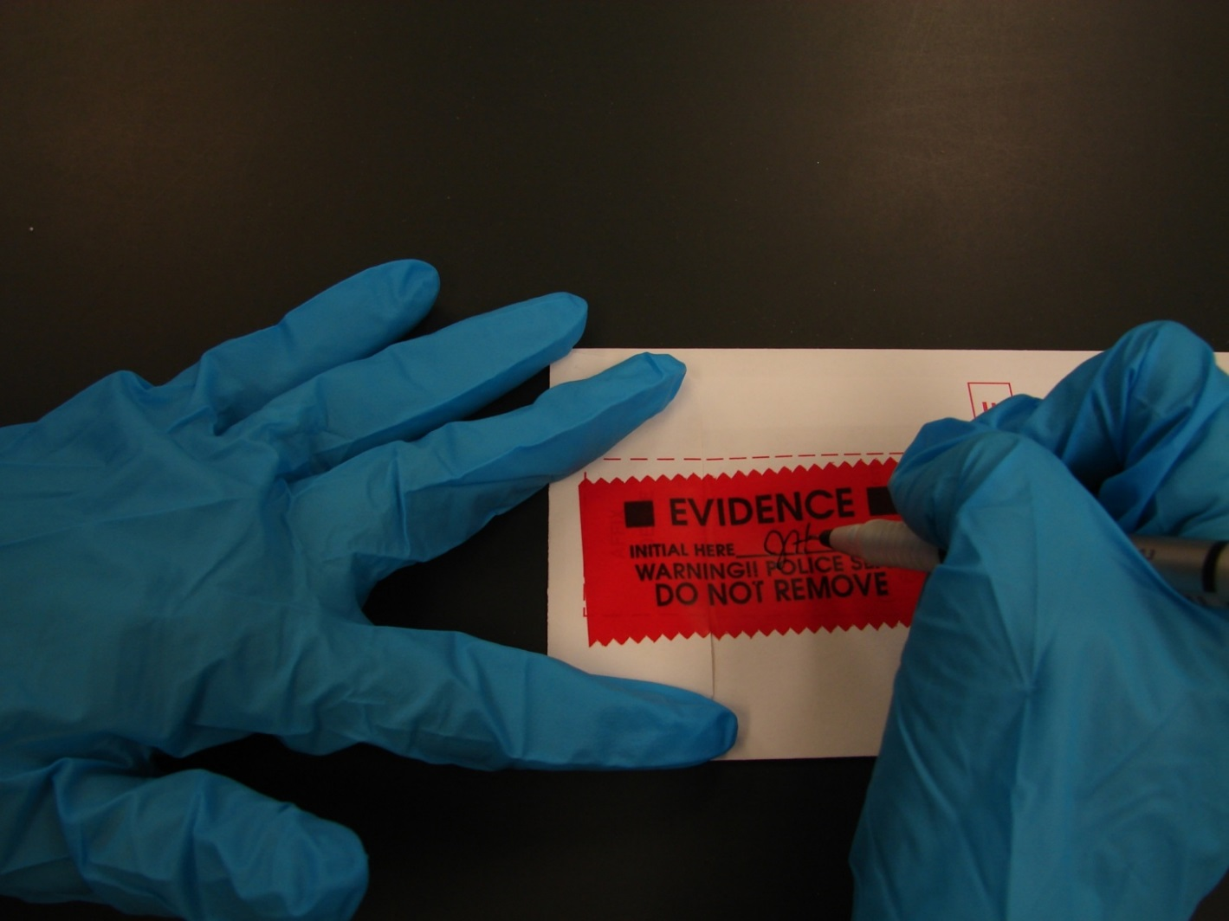
The person collecting the sample, not the Arrestee,
should initial and date the seal.
Use a Sharpie or ball point pen to write initials.
Gel pens tend to smear.

Slide 22
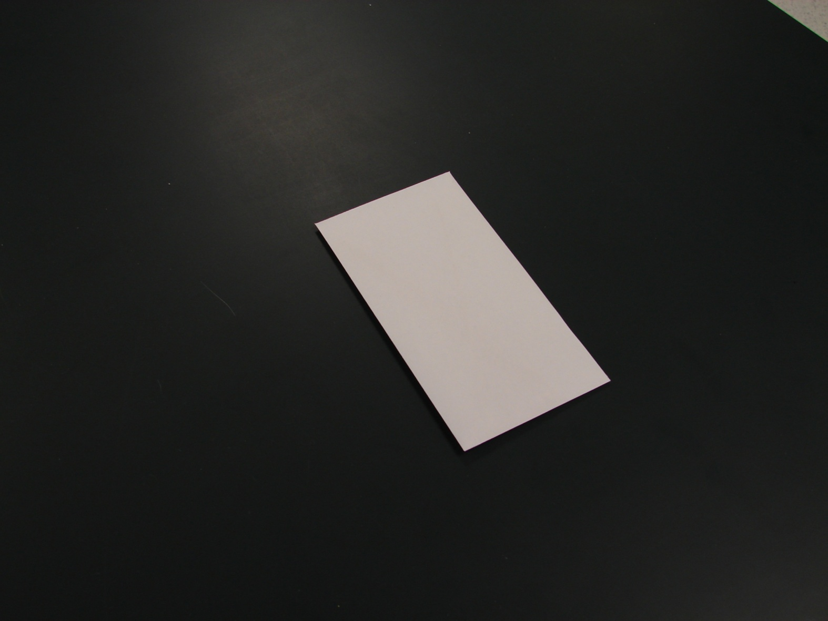
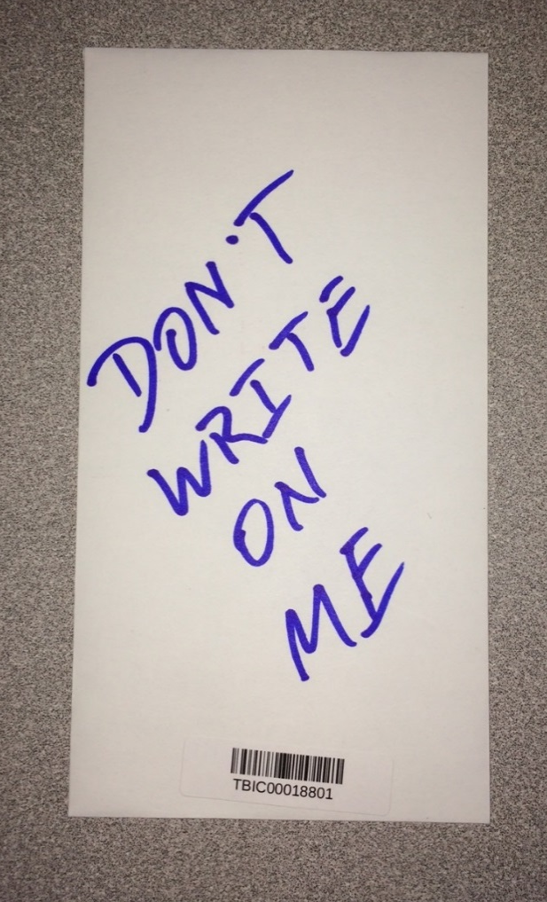
DO NOT write on the swab envelope other than the initials and date on the seal.
NO WRITING
on the envelope

Slide 23
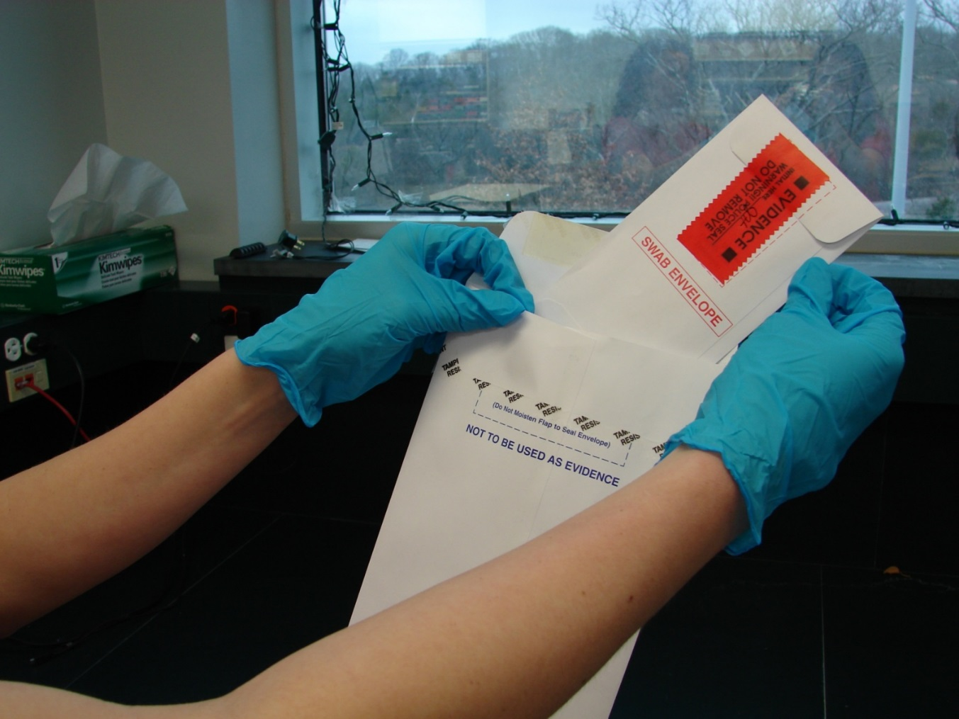
Place small swab envelope into
the middle white envelope.
Do not staple paperwork to swab envelope!

Slide 24
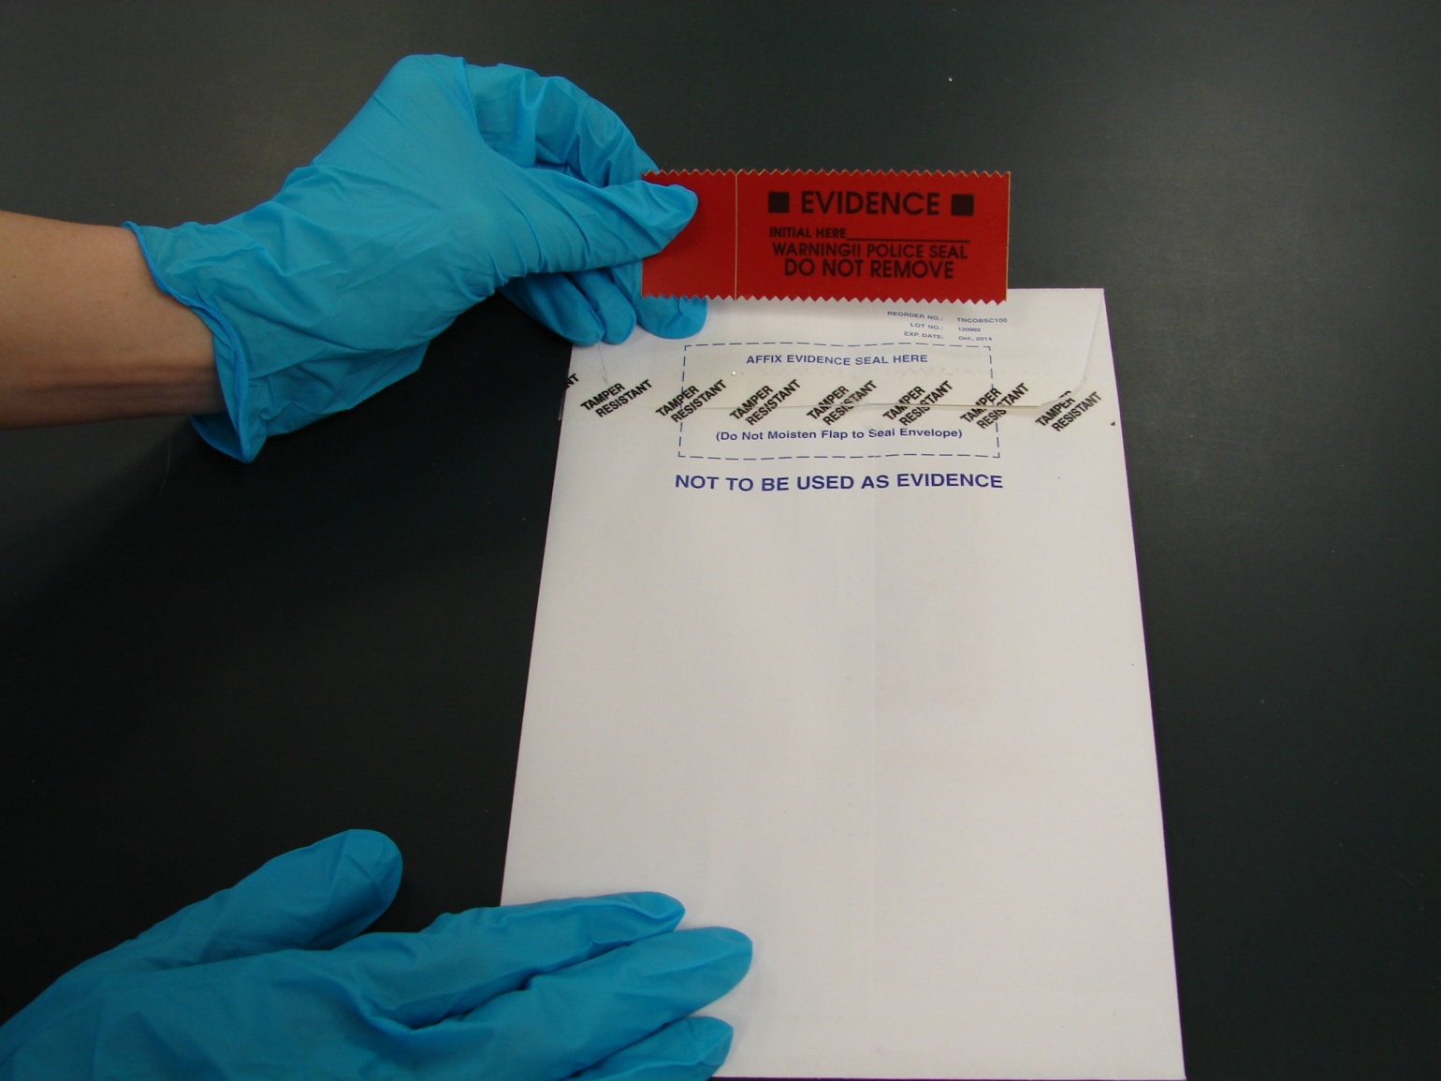
Seal with the middle envelope with the remaining red seal.

Slide 25
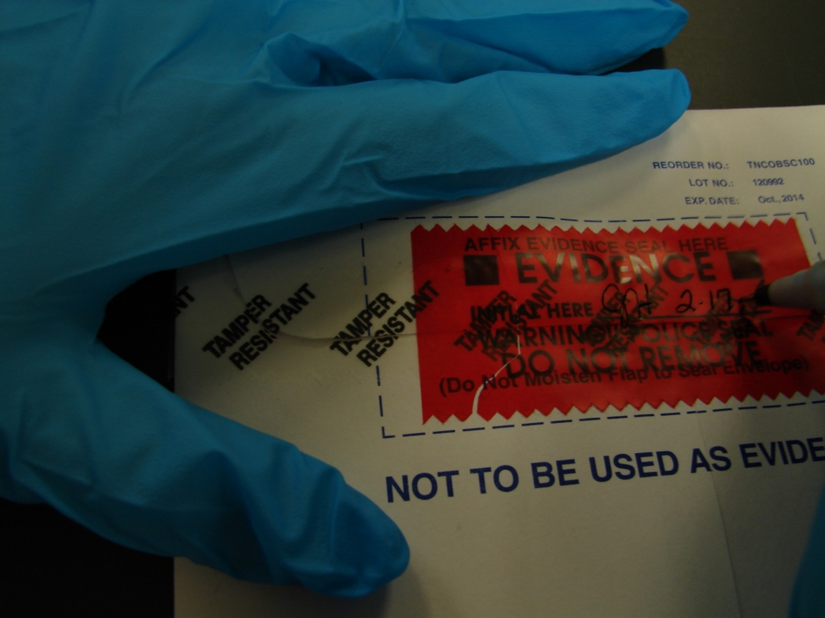
Initial and date the 2nd seal on the middle envelope.

Slide 26
Fill out all of the requested information on the Arrestee DNA Sample Submittal Form.
PLEASE Print Legibly
The Submittal Form may be hand written or filled out electronically.
A fillable PDF version is available on the TBI website (https://www.tn.gov/tbi/law-enforcement-resources/law-enforcement-resources0/forensic-services/dna-law--submissions---tbi-contacts.html).

Slide 27
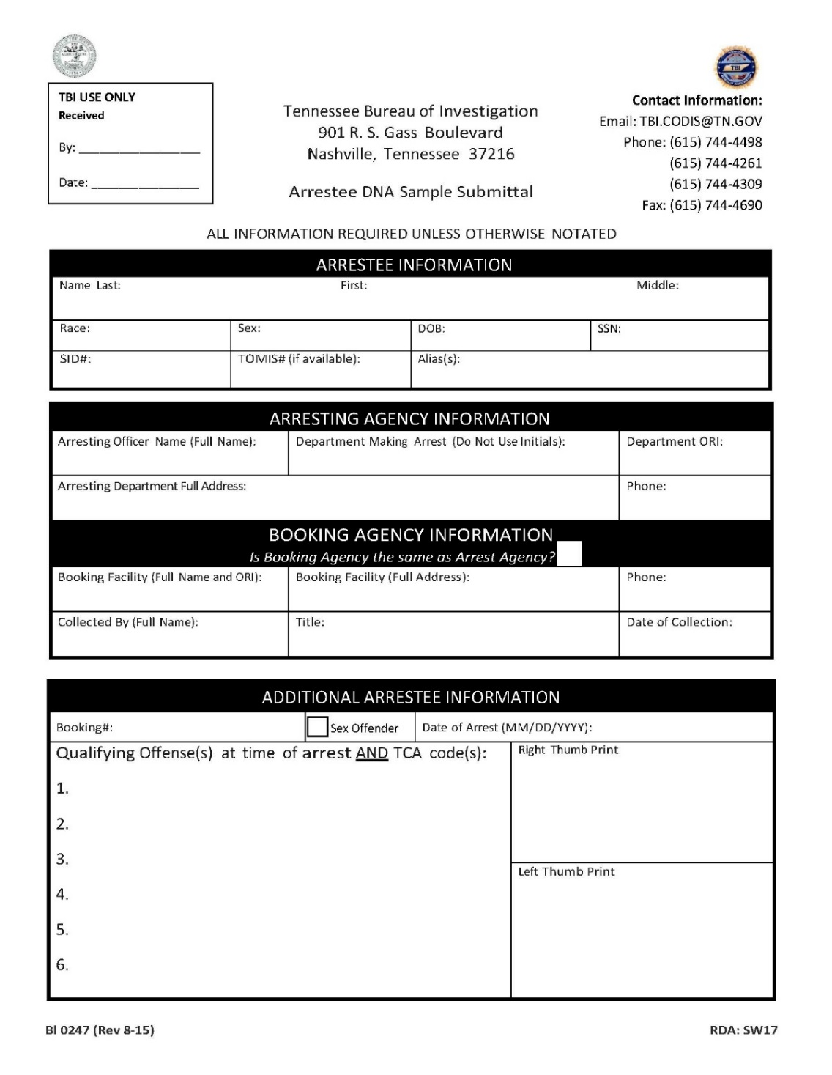
Fill out all the information on the Database DNA Sample Submittal Form.
Complete Name, R/S, DOB, and SSN
Full agency name. No initials.
State ID#
Complete address including city and zip code
Complete address including city and zip code (if different)
Complete Date of Arrest
Qualifying Offense and corresponding TCA Code
Arrestee Thumb prints

Slide 28
Juveniles
If the arrestee is a Juvenile at the time of arrest, you must notate that he/she will be bound over as an adult.
You must include a copy of the Bound Over paperwork.
Writing “Adjudicated Juvenile” is not sufficient.

Slide 29
Thumb Prints
Please do not include 10 print cards as a substitute or indicate that they are “On file”.
It is the agency’s responsibility to acquire ink pads for the purpose of collecting the Arrestee’s thumb prints.
No special ink is necessary such as UV ink. Any color is acceptable as long as we can see ridge detail in the thumb print.
If you do not have an ink pad, email TBI.CODIS@tn.gov and we can ship one to you.

Slide 30
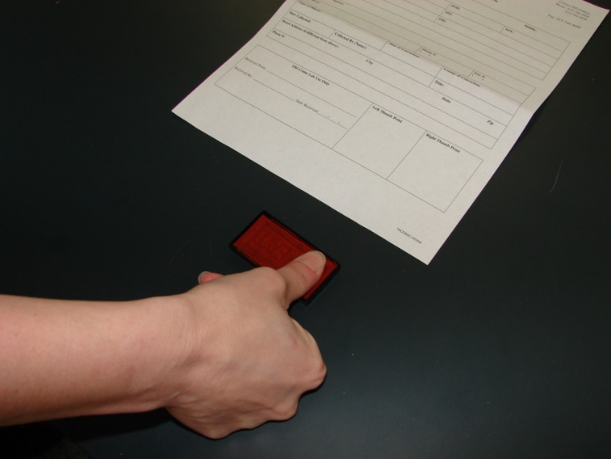
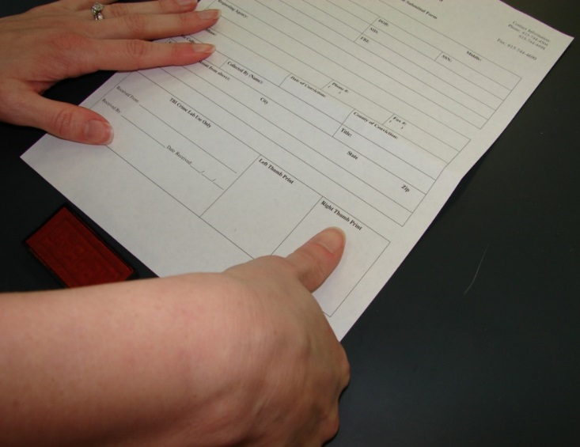
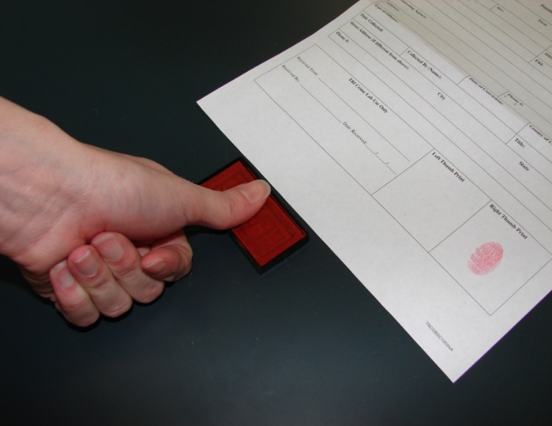
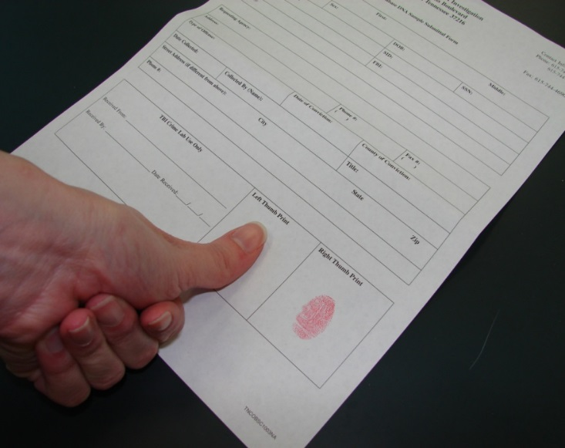

Slide 31
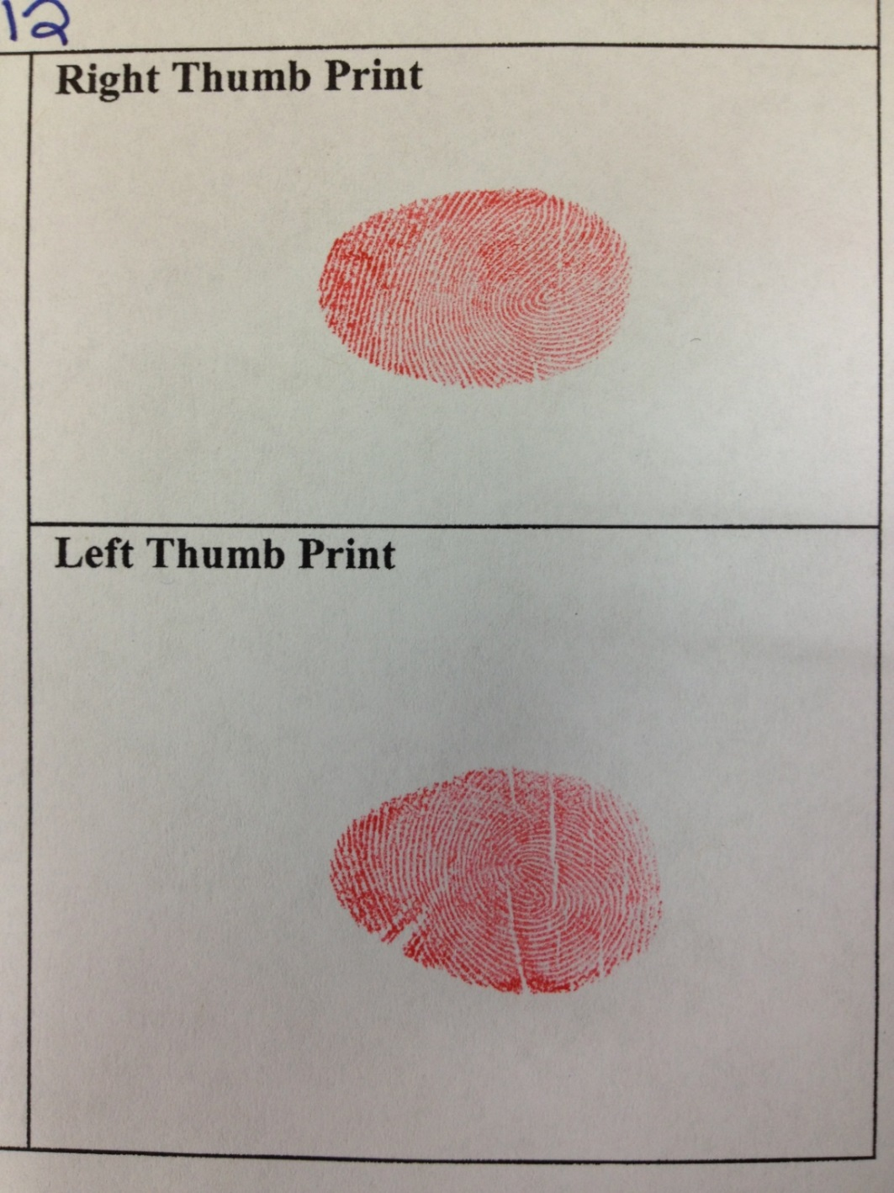
An Example of Acceptable Prints

Slide 32
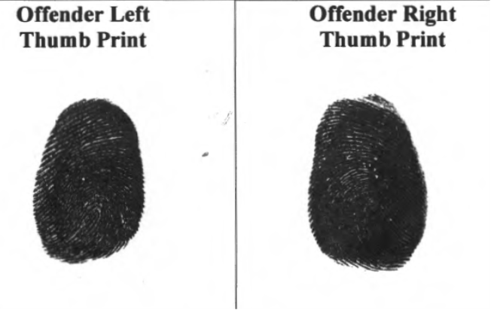
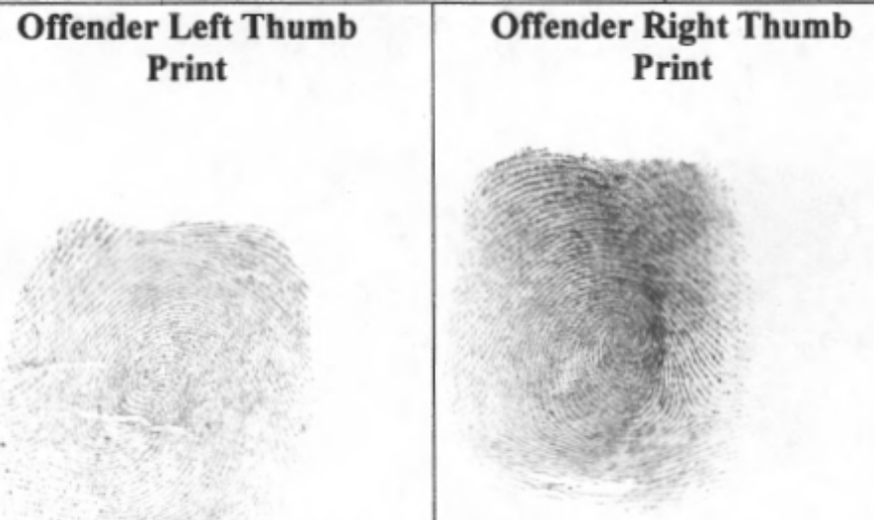
An Example of Unacceptable Prints
TOO dark
TOO light

Slide 33
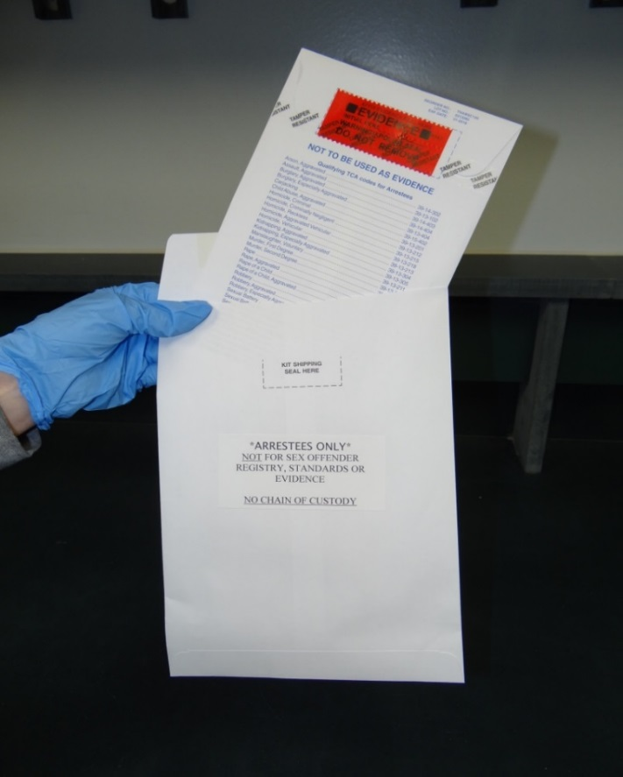
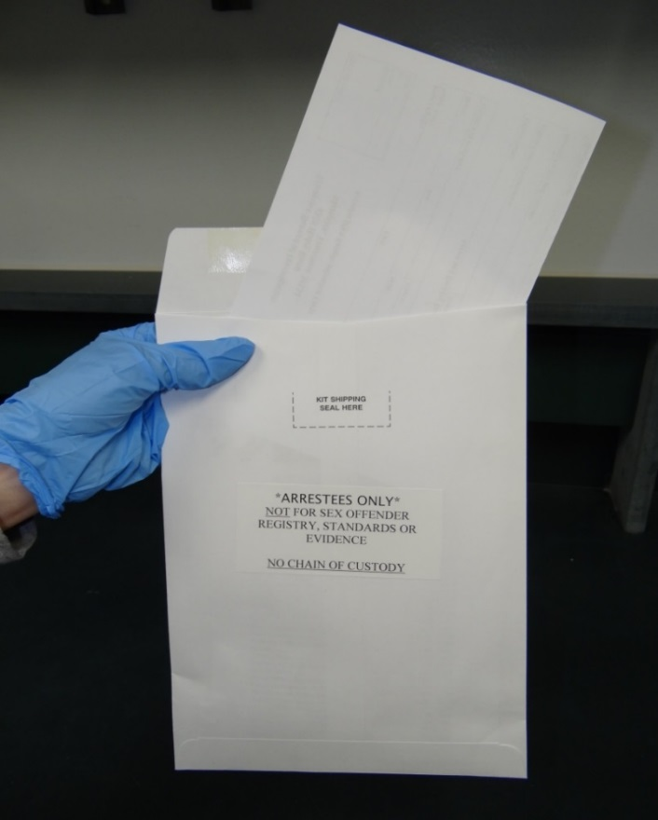
After the thumb prints are dry, make a copy of the completed form for your records. Fold submittal form and put the form and
the middle white sealed envelope into the larger mailing envelope.
To prevent paperwork contamination, please do not put paperwork inside the middle envelope with
the swab envelope.

Slide 34
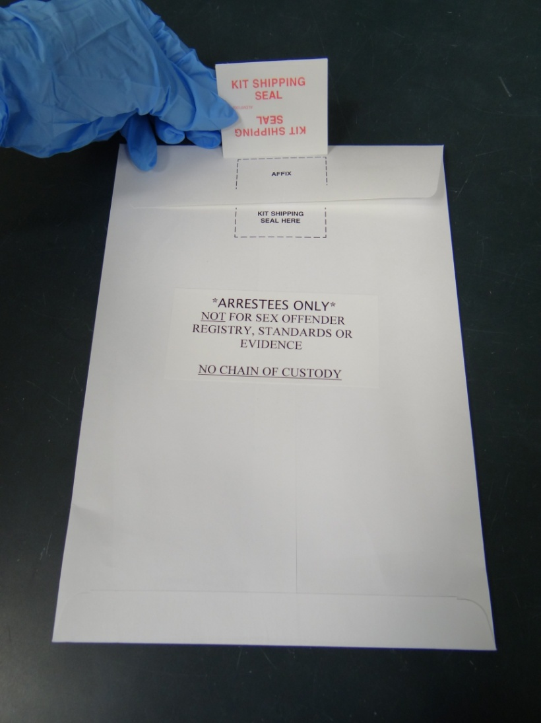
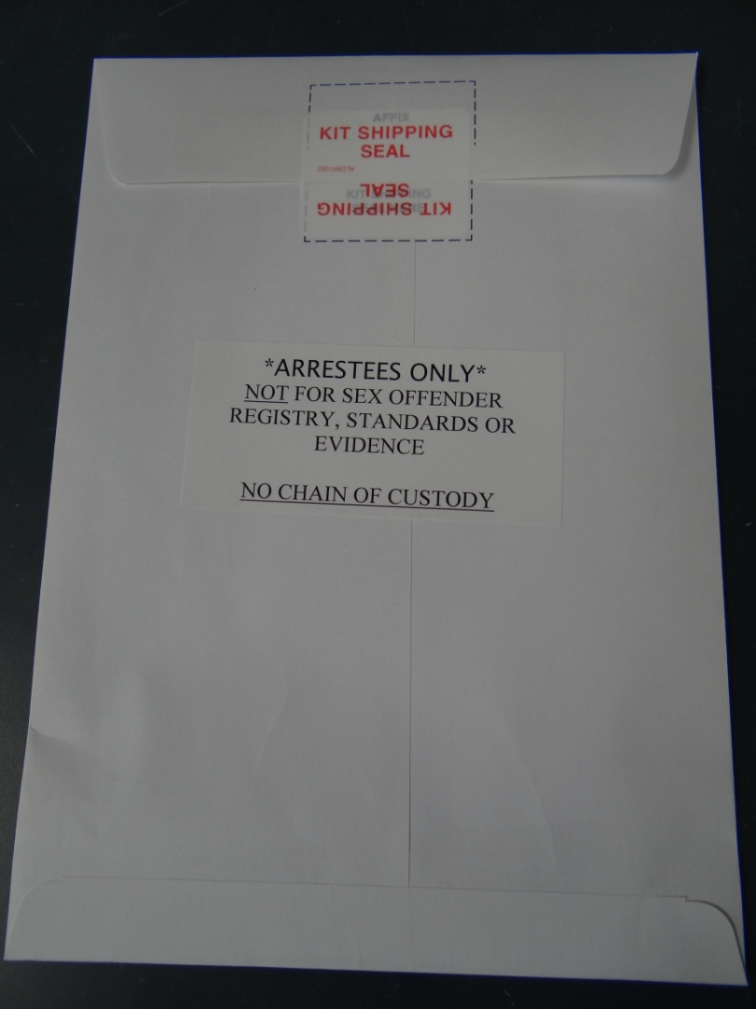
Seal the outer mailing envelope with the kit shipping seal.

Slide 35
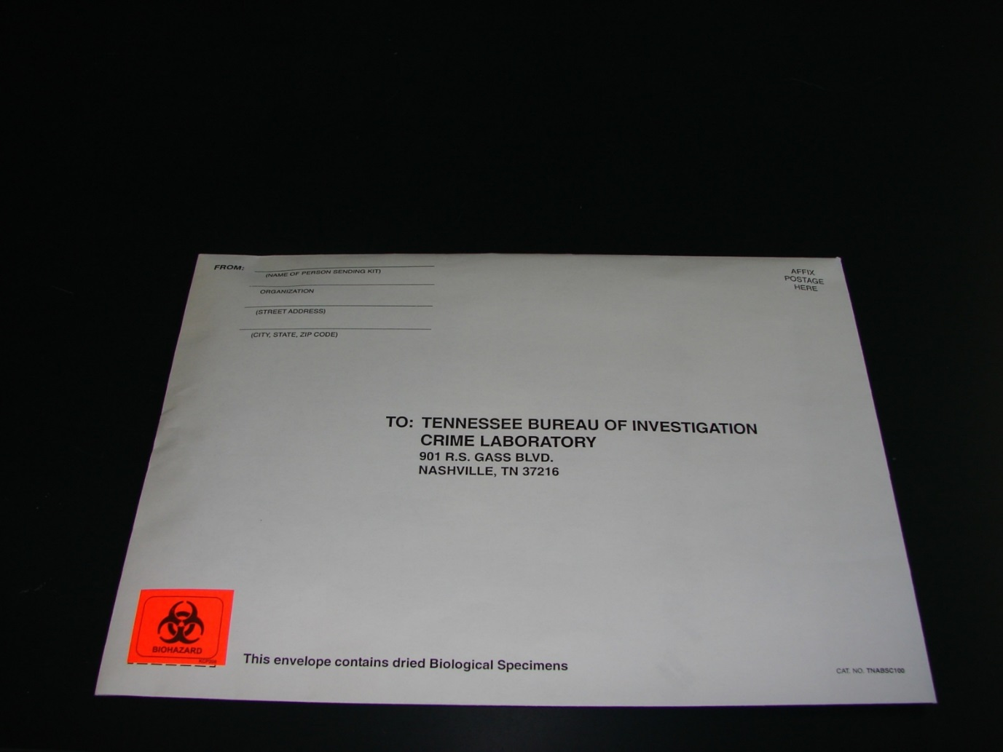
Put return address on the mailing envelope
even if you are hand delivering kits.
If you are collecting the sample for an arresting agency,
put the Arresting Agency name on the mailing envelope.

Slide 36
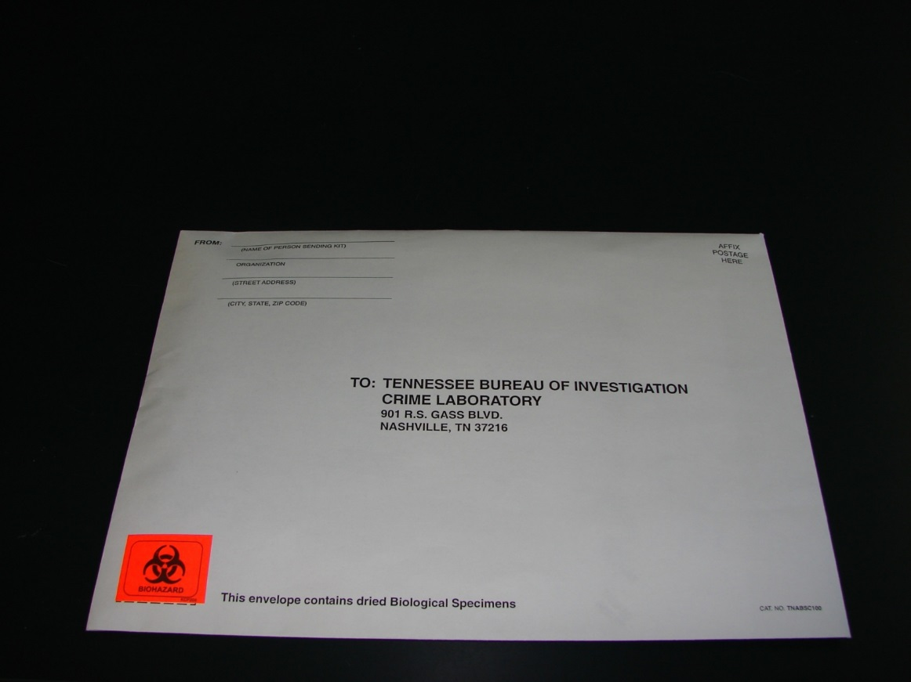
If being mailed, please attach the proper postage.
The US Postal Service considers the kits to be a package and, as of December 2022 $4.50 per kit to ship.

Slide 37

If you are planning to mail multiple kits at once in a larger package, please note that the U.S. Postal Service requires you to have either the biohazard symbol, or “BIOHAZARD” written out on the outer packaging.

Slide 38
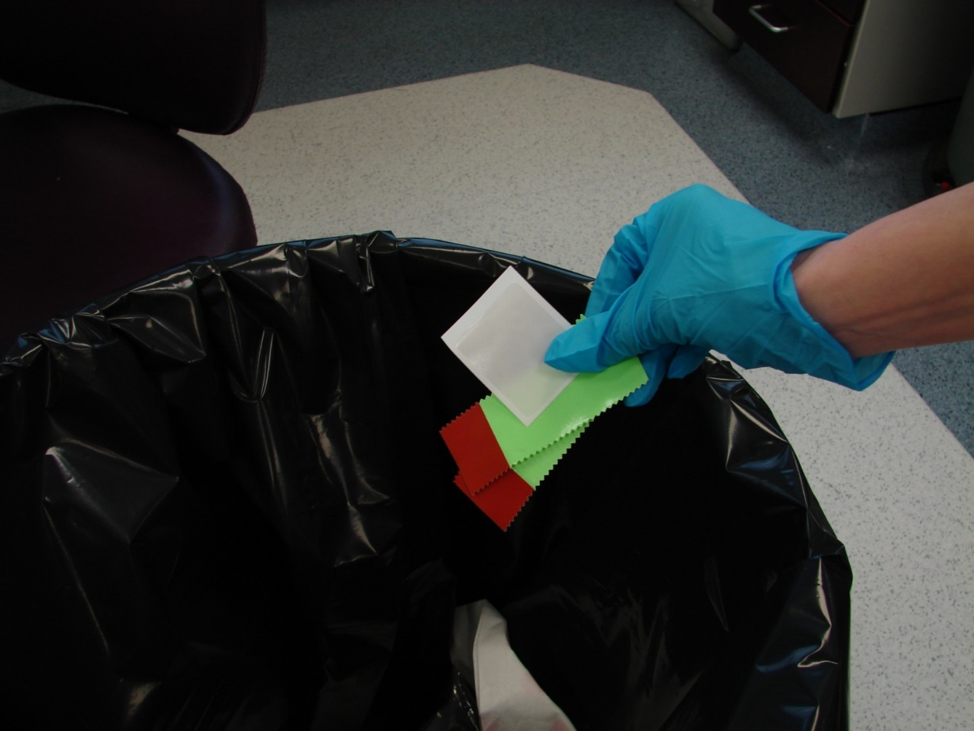
The remains of the seals may be disposed of in regular trash.

Slide 39
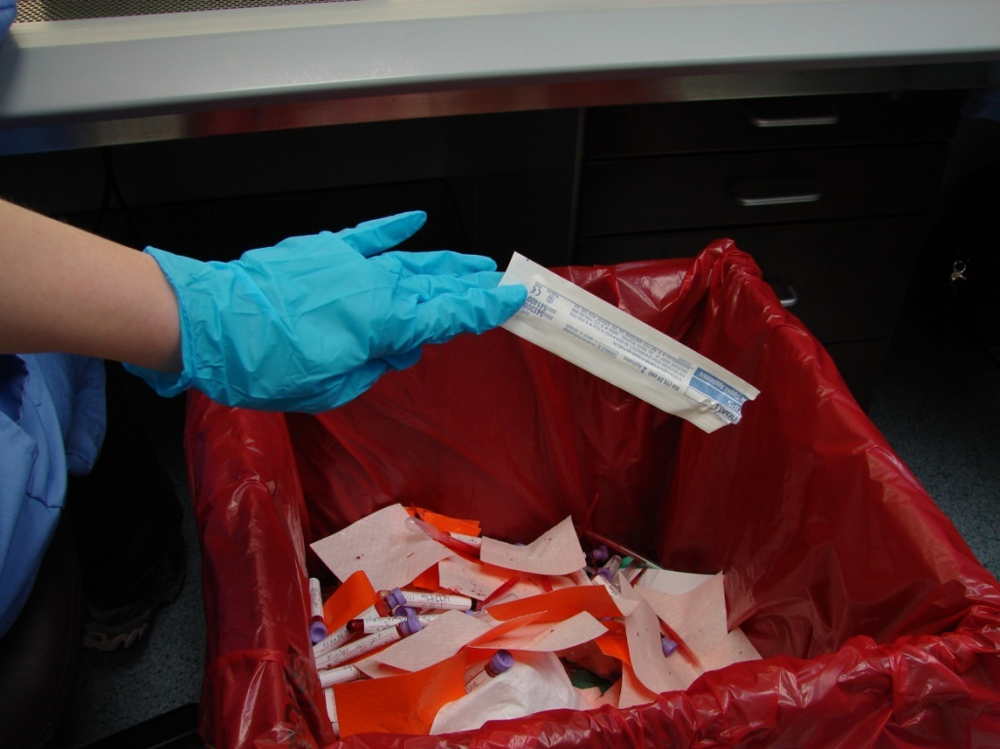
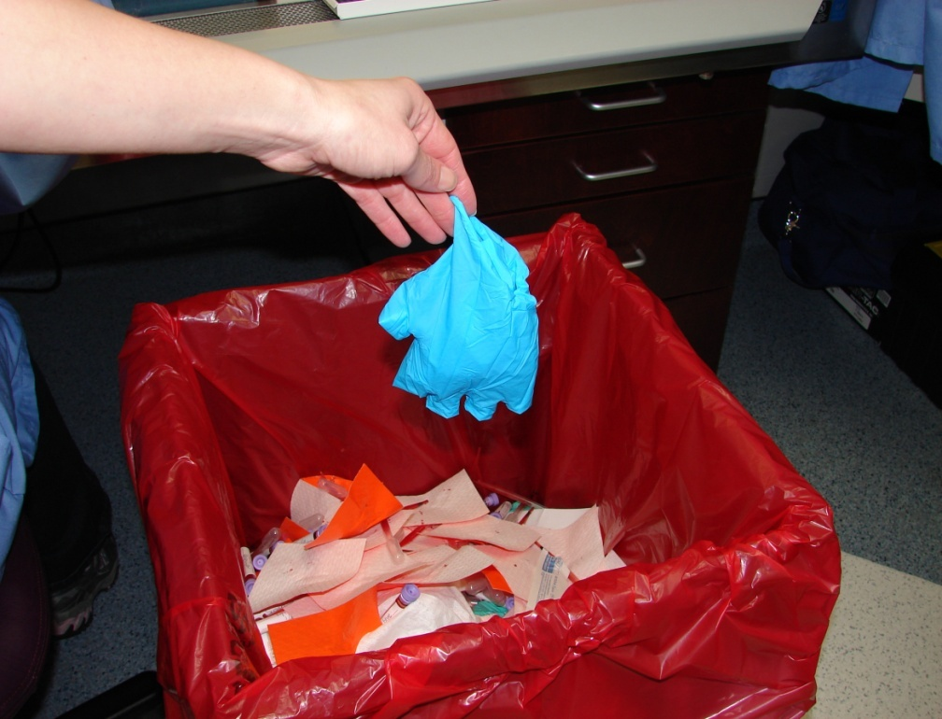
The swab packets (if used in the drying of the swabs) and biohazard barrier gloves should be disposed of by following your departments recommended OSHA procedures.
Please do not put the used gloves back in the envelope to be mailed back with the kit.

Slide 40
The kit is ready to be hand delivered or mailed to
TBI Nashville
Due to the sensitive nature of Arrestee
DNA, kits should be hand delivered or
mailed in a timely manner.

Slide 41
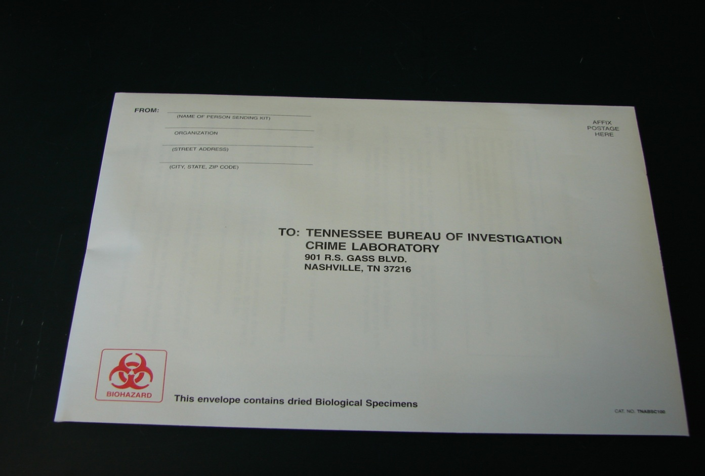
If an Arrestee kit is sent in as evidence
(the kit plainly states that it is not to be used as evidence) the sample will not be worked and the submitting officer will be contacted and told that the sample is not acceptable.

Slide 42


If a sample is collected from an individual who does
not meet the qualifications or if the paperwork is not filled out COMPLETELY and CORRECTLY,
the kit will be returned to the submitting
agency for correction and re-submittal.

Slide 43
Arrestee Kit Returns
If a kit is returned to your Agency, please check to see why it is being returned.
A memo is included with each kit with an explanation as to why it was returned to you.
Please correct the paperwork, reseal the envelope with tape and initial. Return kit to the lab for processing.
DO NOT collect a whole new kit or take another kit apart to use the mailing envelope.

Slide 44
A Few Things To Keep In Mind
Be familiar with the instructions before starting
To avoid a potential mix-up, please only process one kit at a time
Arrestees are not allowed to swab or print themselves
Arrestees are not allowed to fill out the paperwork or initial the seals
Place the swabs in the swab envelope bulb end down
Do not touch the cotton bulb of the swab
Buccal samples should be handled and processed as if they are potentially biohazardous.
If you realize that you have left something out of the kit, you may open the kit and reseal with tape.
Only fold the paperwork once to put in the envelope.
Once sent to the lab, the profile obtained from this sample will be put into the Arrestee Database

Slide 45

EVIDENCE
There is no chain of custody on this kit.
This collection kit is not evidence.
IT SHOULD NOT BE USED TO COLLECT EVIDENCE.

Slide 46
TBI CODIS
Contact Information
Fax: 615-744-4391
TBI.CODIS@tbi.tn.gov
Andrea Parsons
615-744-4309
Mark Gutknecht
615-744-4261
Kendall Stoner
CODIS Unit Supervisor
615-744-4291
kendall.stoner@tbi.tn.gov

