Slide 1
Update: Tennessee’s Economic Recovery
David A. Penn
Director and Associate Professor
Jennings A Jones College of Business
Middle Tennessee State University
dpenn@mtsu.edu

Slide 2
Economic Recovery Highlights
Recovery is underway, but the pace is not rapid.
Households are spending more: sales tax collections are on the rise.
Job outlook is improving:
  Job growth is positive (but modest).
  Unemployment rate is falling, but still very high.
  Good job news for some industries.
Housing market remains very weak.
No quick fix for recovery; must be considered a long-term goal.

Slide 3
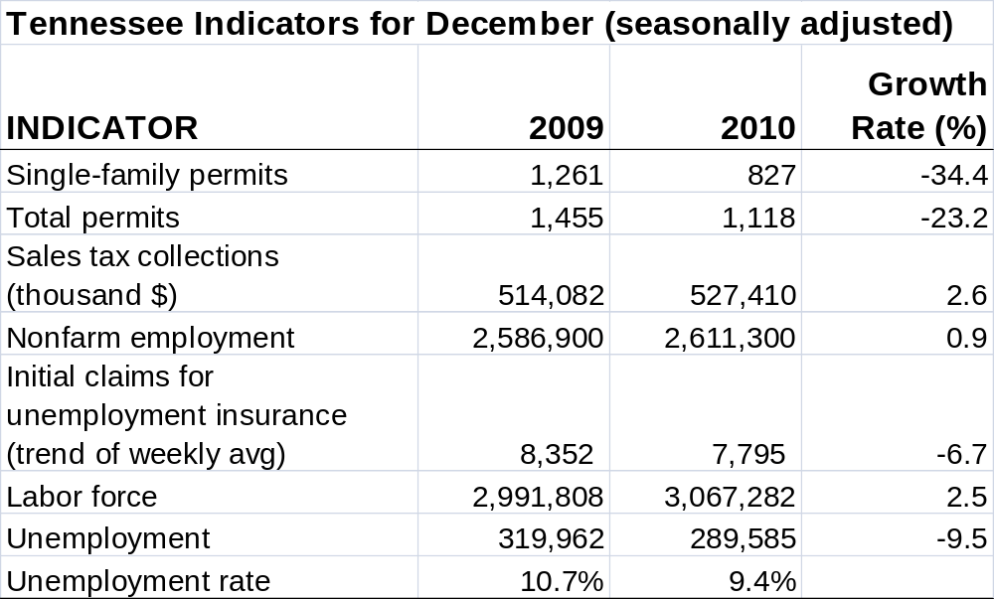
Current Indicators

Slide 4
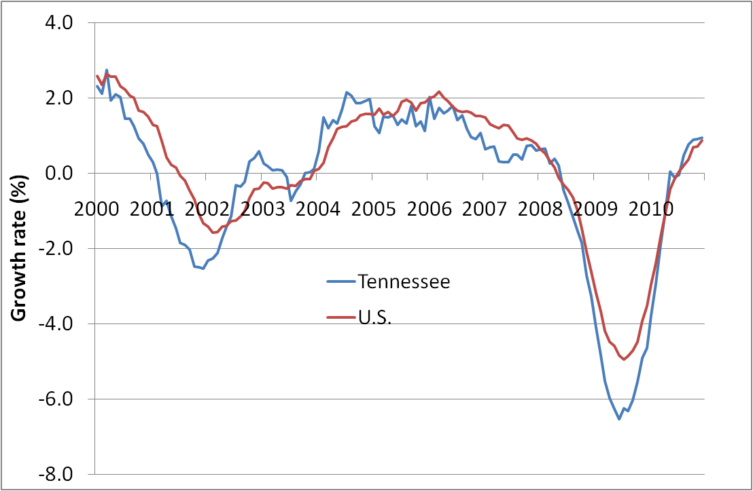
Nonfarm employment growth

Slide 5
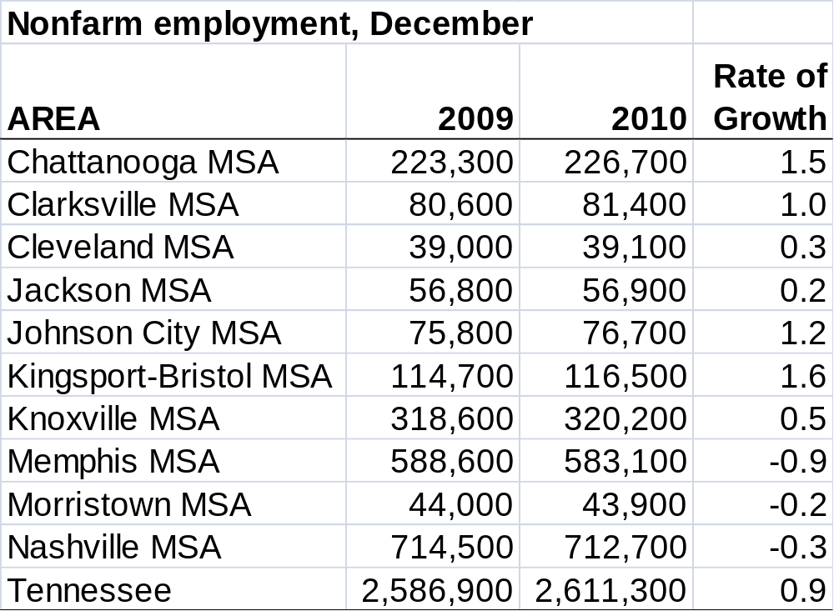
Job growth by area

Slide 6
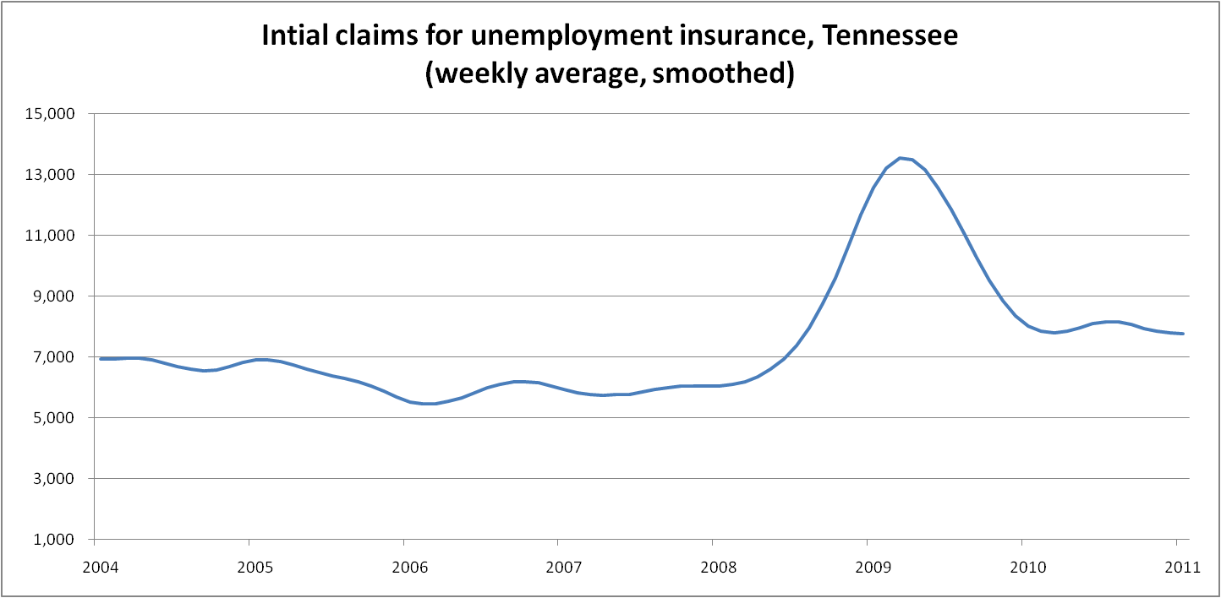
Initial claims

Slide 7
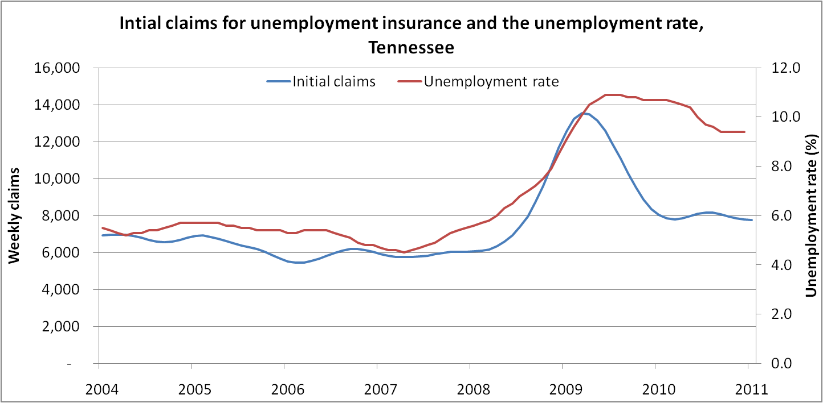
Initial claims and the unemployment rate

Slide 8
Unemployment
Layoffs are much lower than early 2009.
The large decline in initial claims has not pulled down the unemployment rate in proportion.
Employers have curtailed layoffs, but have been slow to hire.
Initial claims have leveled off at about 7,800 per week.
Another 10% decline in claims is consistent with job growth pre-recession.

Slide 9
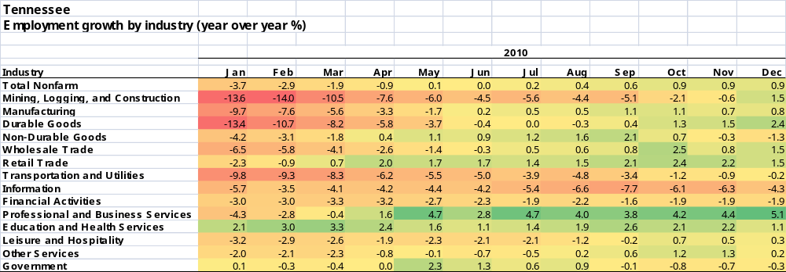
Employment growth by industry: current

Slide 10
Employment by industry
Manufacturing employment picking up modestly following years of decline.
Nationally, the manufacturing sector has grown for 18 straight months.
Retail trade and wholesale trade employment on the rise, consistent with growing consumer spending.
Biggest job gains in Professional and Business Services due to increased temporary help hiring.

Slide 11
Employment by industry
Continuing job losses in Information (newspapers, publishing, music recording) and Financial Activities (banking, real estate).
Government likely to experience job losses after July 1.
Overall, much better job picture than a year ago.
And not bad compared with the year prior to the recession (2007).

Slide 12
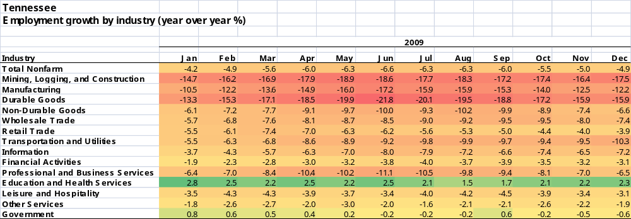
Employment growth by industry: year ago

Slide 13
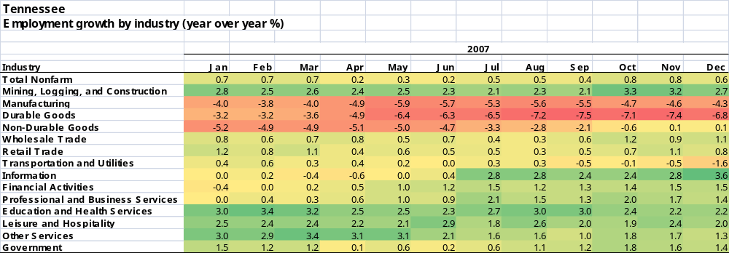
Employment growth by industry: 2007

Slide 14
Housing market
Housing prices still on the decline in Tennessee, down 1.2% over the year (3rd quarter 2010).
Prices are rising in Clarksville MSA and Johnson City MSA, and are even in the Chattanooga MSA.
Stable housing prices are a must for the beginning of a housing recovery.
Refer to our Housing Market Report for more detail.

Slide 15
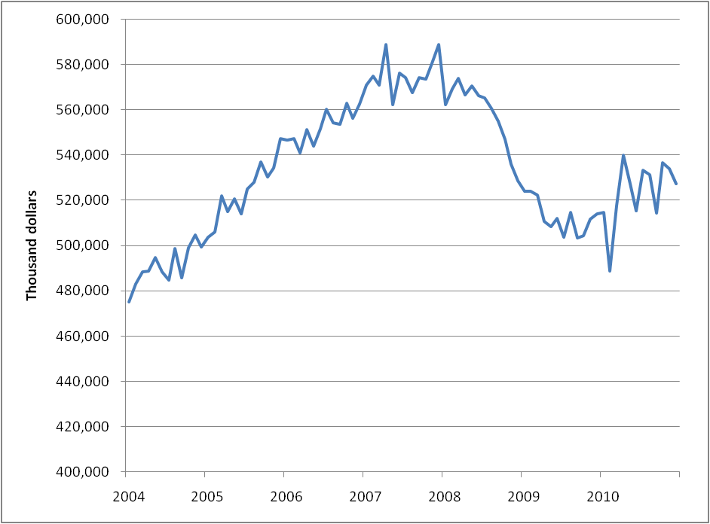
Sales tax collections
(seasonally adjusted)

Slide 16
Summary
State economy is improving, but progress is slow.
Continued recovery depends on the strength of the U.S. economy.
Manufacturing job growth is encouraging.
Little sign yet of improvement in the housing market.
Recovery is under way, but will require attention for years to come.

Slide 17
Tennessee’s Economic Recovery website
www.mtsu.edu/berc or
http://www.state.tn.us/tacir/.
Monthly data for the state and all ten metropolitan areas.
Indicators: sales tax, nonfarm employment, unemployment rate, housing construction permits, quarterly housing price indexes.
Coming soon: county data and quarterly briefs for the state and each MSA.

