Slide 1
Tennessee
Regional Water-Supply Planning: General Observations and Conclusions
TACIR February 7, 2011
W. Scott Gain
U.S. Geological Survey, Nashville

Slide 2
Water Supply Planning
Objectives
Tennessee Communities, Utilities, Stakeholders
?
Informed and effective decision making
for long-term economic and environmental
health and sustainability

Slide 3
Water Supply Planning Pilots: designing a process
All Tennessee Communities and Utilities
Advice and consultation
Consulting Engineers
Facilitation, policy, and oversight
State Government
and Regional Authorities
System data and description
State and Federal agencies (USGS)
Universities
Economic projections and analysis
Universities, City planners, TVA etc.
Alternatives and structural analysis
Federal agencies (COE) and
consulting engineers
Environmental limitations and decision support
The Nature Conservancy, other NGO’s
Informed and effective decision making

Slide 4
Identifying Gaps
Numerous Tennessee Communities and Utilities
Consulting Engineers
Facilitation, policy, and oversight
System data and description
Economic projections and analysis
Alternatives and structural analysis
Environmental limitations and
decision support
Informed and effective decision making

Slide 5
Two Outcomes
Specific
General
Analytical methods
And procedures
All Tennessee Communities and Utilities
Consulting Engineers
Facilitation, policy, and oversight
System data and description
Economic projections and analysis
Alternatives and structural analysis
Decision
Infrastructure:
Supporting Agency
Cooperation, Data,
Policies, and Tools
Environmental limitations and
decision support
Informed and effective decision making

Slide 6
Collaborative Dialog: TWOG
TACIR
USACE
USGS
TDEC
TDEC-WPC
TDEC-DWS
TAUD
TWRA
TNC
TTU
DRA
HVUD
UT
Land Trust for Tennessee
Municipal Governments and utilities

Slide 7
Recurring Themes:
Reasons for regional planning
The nature of a good plan
Necessary support
Good practice
State-wide application

Slide 8
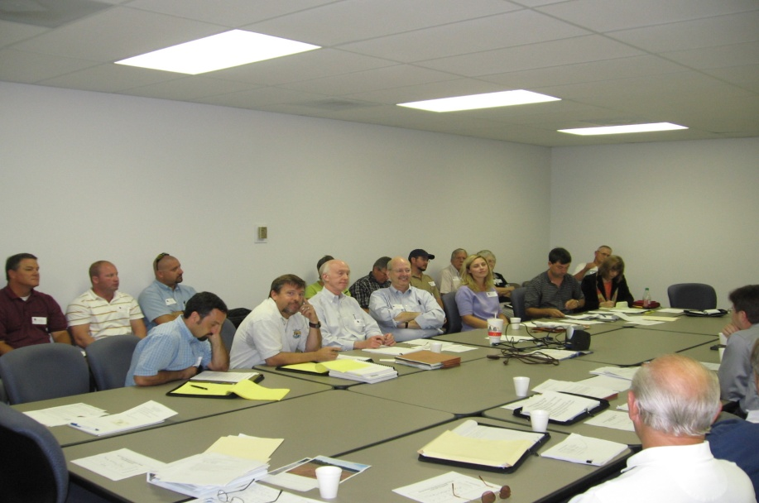
Reasons for regional planning
Growing interrelations among users demand that water-supply and drought-management plans address the needs of multiple interests within regions and watersheds and foster greater collaboration among local, state, and federal authorities…

Slide 9

Reasons for regional planning
Clean and reliable drinking water is vital to the State’s economic well-being and the health of its citizens…

Slide 10
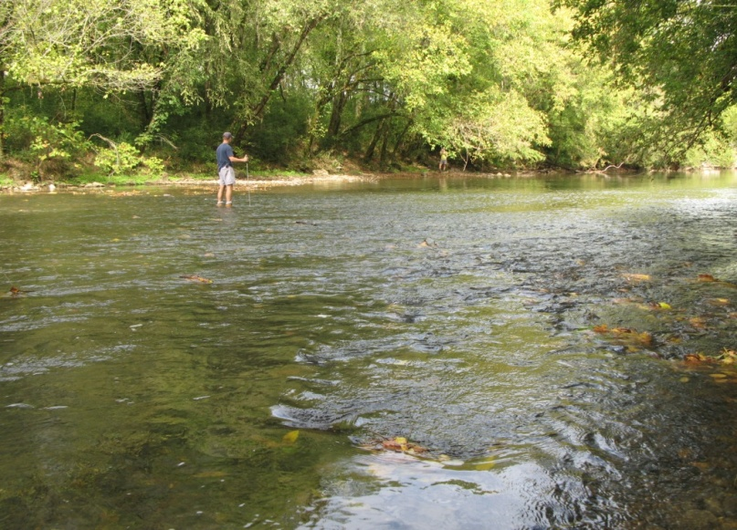
The nature of a good plan
  Water supply plans should promote the long-term sustainability of the State’s freshwater resources for the protection of multiple uses and users—including the protection of ecological integrity and biodiversity…

Slide 11
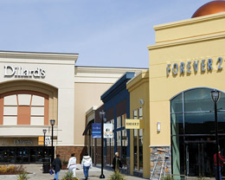
The nature of a good plan
  Water supply planning should consider economic and community development patterns including land-uses that may effect water quantity and quality region-wide…

Slide 12
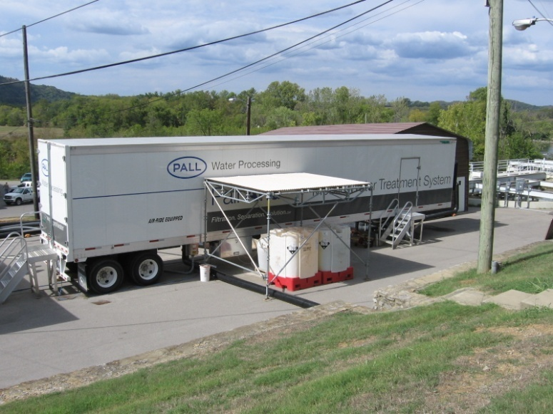
The nature of a good plan
Plans for reliable water supplies should provide flexibility, use-efficiency, and risk management with margins of safety…

Slide 13
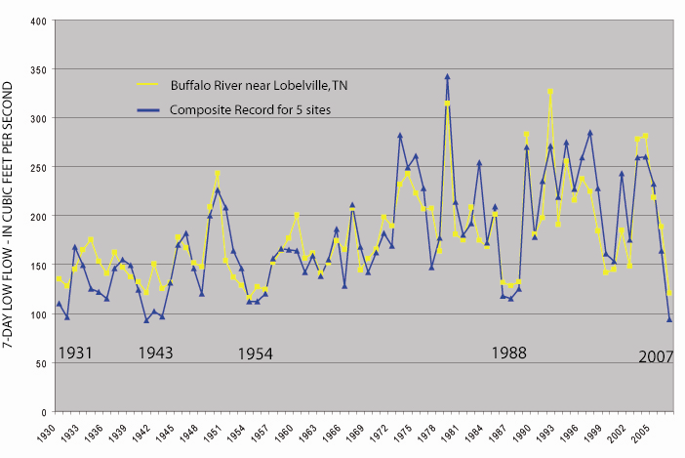
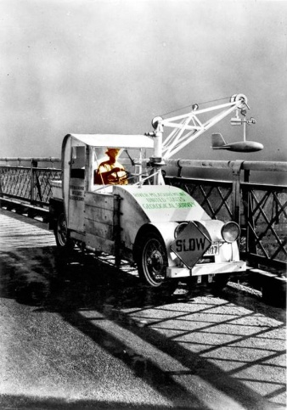
Necessary support
  Accurate descriptions of current and historic patterns of water availability (hydrology) and competing demands are essential to planning at regional and larger scales—these data must be regionally consistent and comprehensive…

Slide 14
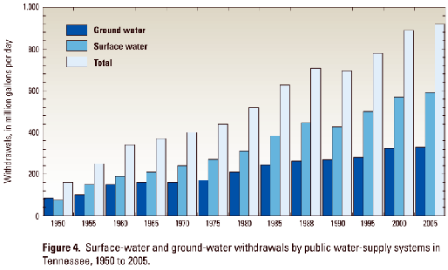
Necessary support
Timely monitoring and reporting of regional water resource use and system characteristics are essential to support water-supply planning at any scale or timeframe…

Slide 15
Good practice
Open cooperation and joint commitment to planning among multiple water utilities in a region encourages the most efficient use of regional water-supply and financial resources. Third-party mediation may at times be useful to improve trust and perceptions of fairness…

Slide 16
Good practice
Good financial management dictates that users pay the full price of services. Regional planning is most effective when systems are accountable for the full cost of their decisions…

Slide 17
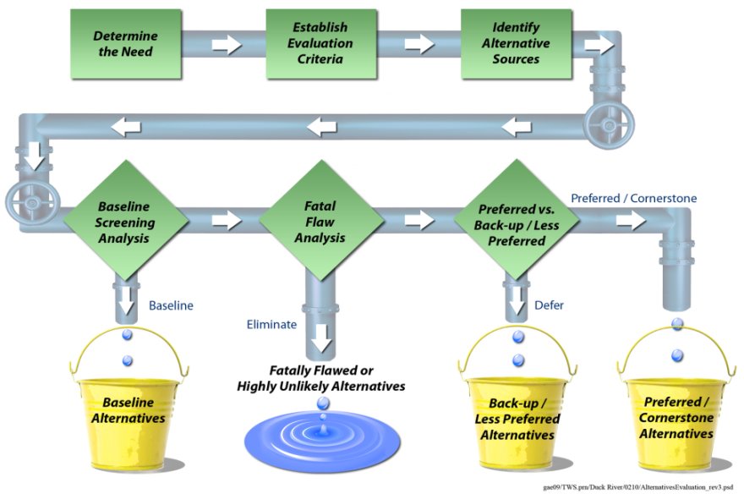
Good practice
  Regional planning is enhanced when funding and regulatory agencies favor appropriate regional planning in applications concerning grants and permits—particularly where public funding may be involved or the feasibility of alternatives is at issue…

Slide 18
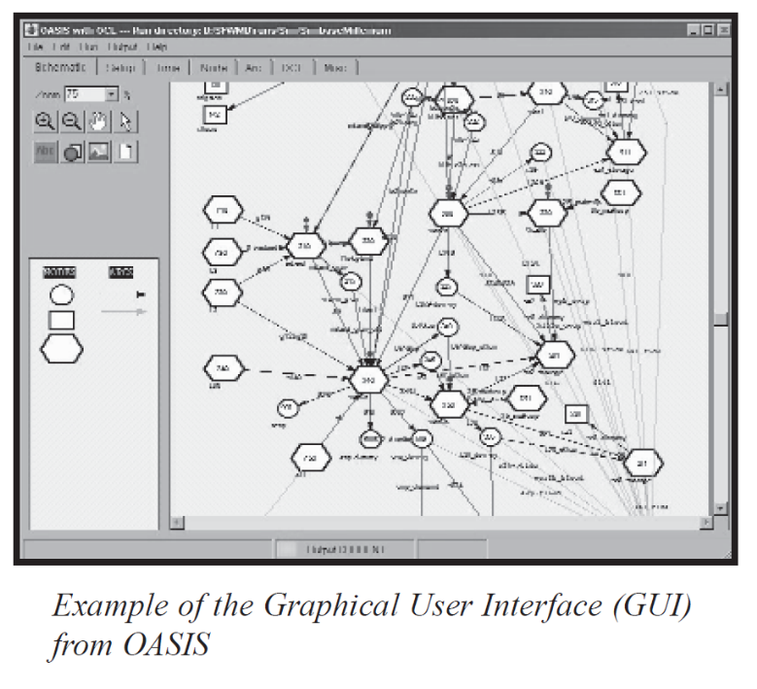
State-wide application
Supporting a common model and language (OASIS)…
State-wide OASIS Modeling
Numerous Tennessee communities and utilities
Consulting engineers
Common toolbox
Informed and effective decision making
Notes:
Scott
18

Slide 19
State-wide application
Defining regions, the content and character of “regional plans,” and a system to incorporate change…

Slide 20
Next Steps
Recommendations
General report

