Slide 1
Module 6
Interactive Read Alouds
Early Literacy Matters
8-1-2017 launch

Slide 2


Module 6 at a glance
In Module 5, you learned the importance of modeling writing, preparing for writing along the way, and creating opportunities for children to write.
In this module, you will:
Discover why choosing the right text matters for read-alouds.
Explore the rich ways interactive read-alouds enhance children’s language development and their interest in books.
Examine the different ways children can engage with literature and
informational text.

Slide 3
Learner Outcomes:
LO1: Learners will describe why reading aloud and selecting the right book sets matter.
LO2: Learners will explore the ways interactive read-alouds can support language development and learning for children birth to five.
LO3: Learners will build a unit of study including a text set and listening, speaking, reading, and writing opportunities to engage children with text and to help build knowledge around a big idea concept.

Slide 4
This module aligns to the current Read to be Ready Campaign’s following key
beliefs:
Early Literacy Matters: early language and literacy development must begin at birth because of its direct impact on later success in reading and in life.
Reading is more than sounding out words: reading is thinking deeply
about a texts meaning and how it builds knowledge of the world around us.
Teacher knowledge and practice are critical: educators must have a deep understanding of the art and science of literacy instruction in order to develop lifelong learners.
It takes a community: we each hold a piece of the puzzle, and we must do our part to improve literacy in Tennessee.
Video link to “Early Literacy Matters” from Read to be Ready Website: https://www.youtube.com/watch?v=60J8qRjRPkE

Slide 5

Overview: Module 6 will consist of 3 instructional presentations. These
presentations will help you reflect on Read-Alouds.
In Presentation 1, you will learn more about choosing the right literature text to read to children for optimal language and literacy development.
In Presentation 2, you will focus on read aloud strategies and supports
for informational texts.
In Presentation 3, you will examine the steps for building units of study and how to use a read aloud to introduce children to the unit of study.
Following each presentation, you will have the opportunity to apply your learning through Application Activities included in the Learning Guide.

Slide 6

Modules contain 4 short presentations that are designed to be completed during relaxed ratios or other times as set by your school or agency. Your director or program coordinator may suggest or establish a timeline for each presentation to be completed within the module. Please take a moment to confirm your site’s requirements while noting the submission deadline for the final Learning Application Assignment that you will submit electronically to your literacy coach for feedback and support. All other completed activities will remain in your participation guide and available for your coaches review.
Section 1: Start at beginning of module and complete Presentation 1 and
Practice Activity 1.
Section 2: Complete Presentation 2 and Practice Activity 2.
Section 3: Complete Presentation 3 and Practice Activity 3.
Section 4: Complete Learning Application Assignment for Module 6 and submit it electronically to your literacy coach for feedback and support.

Slide 7
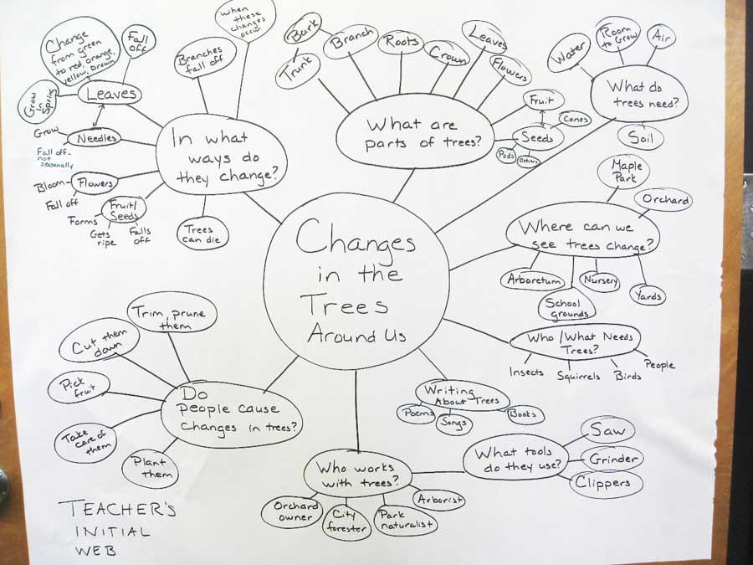
In Presentation 3, you will learn how to build an age-appropriate unit of study including:
Literature Read Aloud,
Informational Read Aloud, and
Supporting activities to enhance listening, speaking, vocabulary, early writing, and early reading development.

Slide 8
What’s the difference between thematic units and units
of study built around text?
Thematic units typically are centered around a common idea. Some examples of thematic units are: dinosaurs, apples, pumpkins, holidays, Spring, families, and transportation.
Units of study is centered around a big idea or conceptual understanding that children will learn.
Let’s explore how to build a unit of study together!

Slide 9


It begins with identifying a conceptual understanding you want to build knowledge around. Remember, these understandings are enduring across ages and life. You might say, these are the “Big Ideas” knowledge is built around.
Take some private think time and consider what might be some enduring understandings or big idea concepts appropriate to build knowledge around for the age group of children you teach. (Look back on the developmental standards to see make some connections.) Jot your ideas on the Brainstorming Big Ideas planning web found in your Learning Guide.

Slide 10
Did you brainstorm any of these “big ideas” to build enduring understanding?
Perseverance: You can do it!
Relationships are reciprocal: (plants/animals/people relationships) To have a friend; you need to be a friend.
Community: It takes a village!
Conservation: We can take care of our earth.
Adaptation: Change requires a response.
How might some of these apply to your particular age group of children?
10

Slide 11

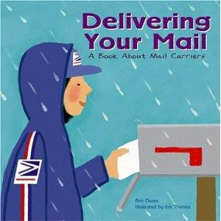
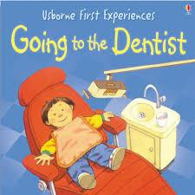
The next step to building a unit of study is to select and strategically sequence text (literature and information books) that will continually advance children’s understanding around the enduring understanding.
The idea is that each book read targets new knowledge to build for the child.
Instead of reading 8 books connected to a pumpkin theme, select books that build on the concept of harvest or the relationship between people, plants, and animals. What books could you choose to help children better understand this concept?
For infants, you might be focused on people helping one another and read books that show the different ways people help as well as the different types of people who are helpers (doctors, fireman, family, teachers, etc…)

Slide 12

According to the Read to be Ready initiative,
– “Literacy units are made up of a variety of texts, instructional strategies, and standard-aligned tasks to support students in gaining understanding of a concept (s). The length of the unit may vary depending on the concepts and enduring understandings.”

Slide 13

Essential refers to what is important or vital for personal understanding (McTighe & Wiggins, 2013, p. 8).
Essential questions help children to explore and think more deeply about concepts presented in a text or book. They begin asking “How do we know?”
Essential questions help children build on concepts learned from other text read.
Essential questions help children connect concepts learned to the big idea or enduring understanding that the unit is all about.

Slide 14
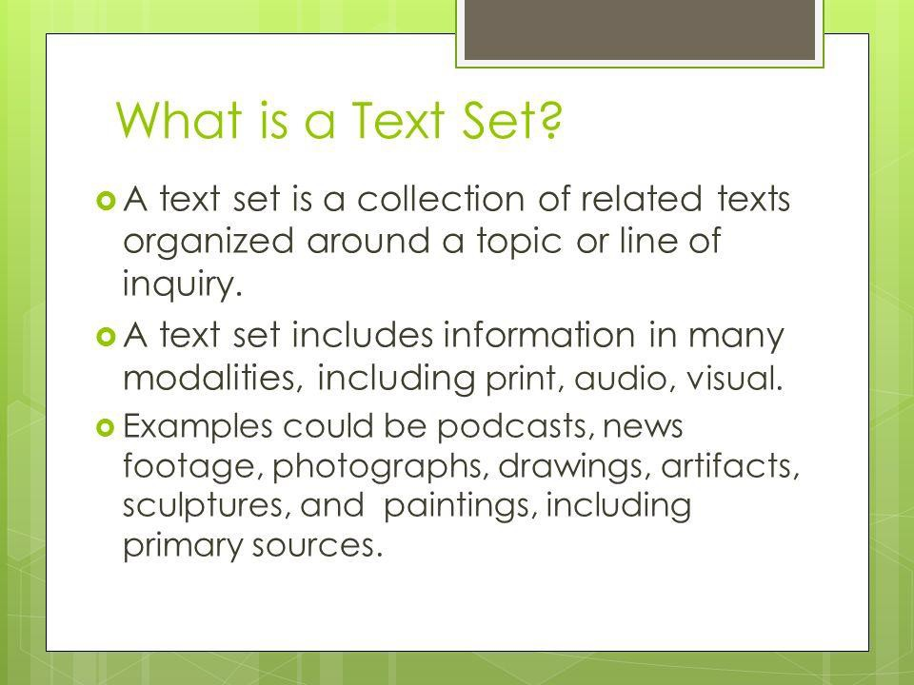
A teacher should develop a text set (group of books) based on the big idea concept selected.
A text set is a collection of related texts organized around a concept or line of inquiry.
Text sets are built by considering the level of text and the instructional strategy through which the text will be used (e.g. interactive read aloud, small group reading, or explicit foundational skill instruction).
Different books will be selected for different times and types of instruction.

Slide 15
The Read to be Ready initiative emphasizes that:
– “Texts should be intentionally selected and sequenced
to build students’ knowledge and vocabulary.”
The order in which you read the books should help
children continually build their knowledge.
Fill in the following statement to ensure you selected the right text:
– “This text was selected because it builds specific knowledge about……and contributes to the child’s development of the unit’s “big idea” concept by…”

Slide 16
We have already established that a unit of study is built
around an enduring understanding.
In the upcoming practice activity, we will apply what we have learned so far about building a unit of study by:
  Deciding what types of books should be strategically selected and sequenced to build children’s knowledge around the enduring understanding or big idea concept.
  Selecting specific activities and instructional supports to follow read aloud books included in a unit of study.

Slide 17
For this Practice Activity 3, you will Use the “Building a Unit of Study” planning sheet in the Learner Guide to plan your unit of study:
Choose a “big idea” from your brainstormed list earlier.
Think of 3-5 essential questions that will guide you in helping children build knowledge and understanding you around the “big idea” you selected (hint: what do you want children to learn?)
Choose the “right” text (book) to read for each essential question you created and list the book title beside the corresponding question. (Be sure to select at least one informational book and one literature book to be read).
Next to each book selected, describe a speaking, listening, reading, or writing activity that would help children apply the learning.

Slide 18
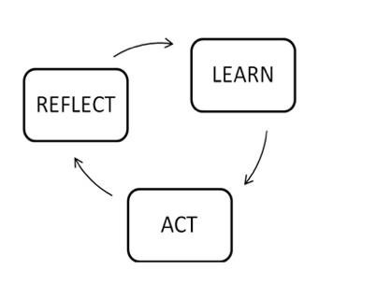
After building a unit of study, briefly reflect on these questions:
How did identifying essential questions help you select the right books to read?
How did these essential questions help you to plan appropriate activities to support the learning?
How will building units of studies help to build children’s knowledge?
Include your responses in your Learner Guide.

