Slide 1
Module 5
Developing Emergent Writers
Early Literacy Matters
8-1-2017 launch

Slide 2
Module 5: Developing Emergent Writers
Module 5 at a glance…
In Module 4, you considered ways learning spaces and activities provide valuable opportunities for scaffolding and supporting listening, speaking, vocabulary, and phonological awareness skill development.
In this module, you will:
Explore specific activities for developing hand-eye coordination, finger and hand muscle strength, and left-to-right directionality needed for writing.
Gain a better understanding of the important role of teachers in modeling meaningful purposes for writing.
Learn how to create age-appropriate activities to develop emergent writing skills.

Slide 3
Learner Outcomes for Module 5
Learner Outcomes:
LO1: Learners will describe the ways fine motor activities prepare children for writing.
LO2: Learners will describe the role teachers play in modeling purposeful writing and in providing opportunities for children to experiment with writing tools.
LO3: Learners will create age-appropriate activities to develop emergent writing skills for children in their classroom.

Slide 4
Connections to the “Read to be Ready” Campaign:
This module aligns to the current Read to be Ready Campaign’s following key beliefs:
Early Literacy Matters:
Teachers are critical:
It takes a community:
Video link to “Early Literacy Matters” from Read to be Ready Website:
https://www.youtube.com/watch?v=60J8qRjRPkE

Slide 5
Module 5 Overview
Overview: Module 5 will consist of 3 instructional presentations. These presentations will help you reflect on the special role a literacy-rich classroom environment plays in providing opportunities for children to develop emergent writing skills and interest in writing tools and materials.
In Presentation 1, you will learn the importance of providing activities for children to develop muscles for hand-eye coordination, finger control, hand muscle strength, and left-to-right directionality. These skills physically prepare children for writing.
In Presentation 2, you will focus on the important role teachers play in modeling the use of writing tools and meaningful purposes for writing.
In Presentation 3, you will examine developmentally appropriate activities for developing emergent writing skills for children in the classroom.
Following each presentation, you will have the opportunity to apply your learning through Application Activities included in the Learning Guide.

Slide 6
Suggested Timeline for Completing Module
Modules contain 4 short presentations that are designed to be completed during relaxed ratios or other times as set by your school or agency. Your director or program coordinator may suggest or establish a timeline for each presentation to be completed within the module. Please take a moment to confirm your site’s requirements while noting the submission deadline for the final Learning Application Assignment that you will submit electronically to your literacy coach for feedback and support. All other completed activities will remain in your participation guide and available for your coaches review.
Section 1: Start at beginning of module and complete Presentation 1 and Practice Activity 1.
Section 2: Complete Presentation 2 and Practice Activity 2.
Section 3: Complete Presentation 3 and Practice Activity 3.
Section 4: Complete the Learning Application Assignment for Module 5 and submit it electronically to your literacy coach for feedback and support.

Slide 7

Presentation 2: Modeling Purposeful Writing and use of Tools
Teachers play an important role in modeling purposeful writing and in providing opportunities for children to experiment with writing tools. Even our youngest children develop an interest in early writing when adults model writing with purpose to create:
Shopping lists
Messages for mom, dad, or friends
Signs with drawing and writing to label room
Dictated stories told to them by children
Books with pictures and writing
Can you think of other examples of when adults model purposeful writing?

Slide 8

Modeling Writing Daily for Four Year Olds
Think about your day working in the four year old room.
What kinds of things do you write throughout the day?
Are there opportunities for four year olds to watch and hear what you write?
How might you engage four year olds when you are writing?
Can the children help illustrate written charts, books, and messages displayed?

Slide 9
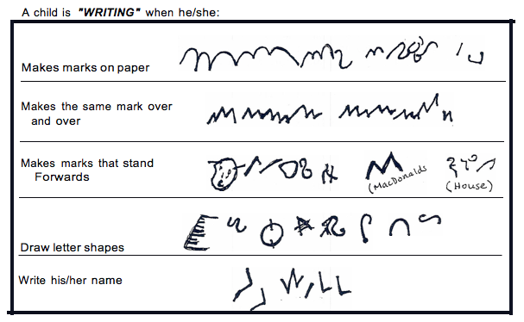
Writing Development Continuum
Along with modeling purposeful writing for children, it’s important for teachers to recognize how children’s writing continues to develop over time.
Children are eager to express themselves and communicate through writing. Their writing begins as simple marks or scribbles. It’s important to celebrate these early attempts at writing and to ask children to tell you about what they “wrote.”
Over time, scribbles become drawings, and pencil marks begin to take on letter formations. These are the early stages of writing.

Slide 10
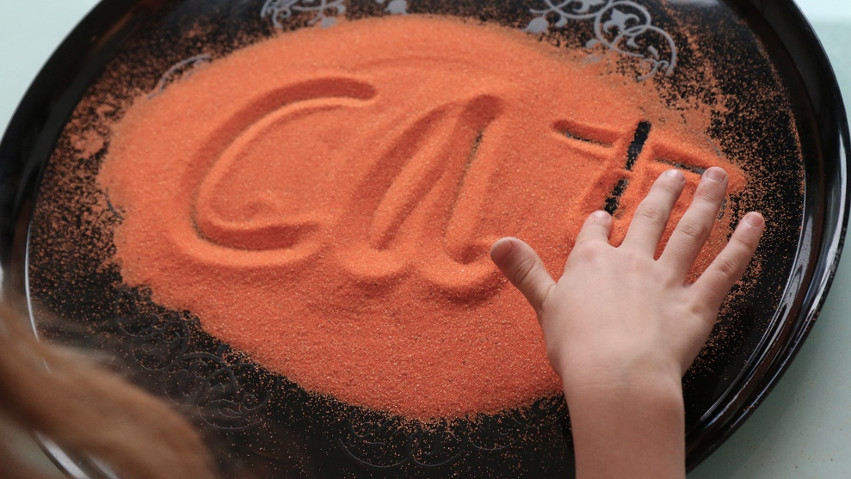
Writing tools and materials
Writing tools and materials include much more than pencil and paper such as:
Clay or play dough
Rubber stamps
Shape stencils
Lacing cards
Moveable letter tiles or pieces
Sand trays to “write” letters
Sand Paper letters & numbers

Slide 11
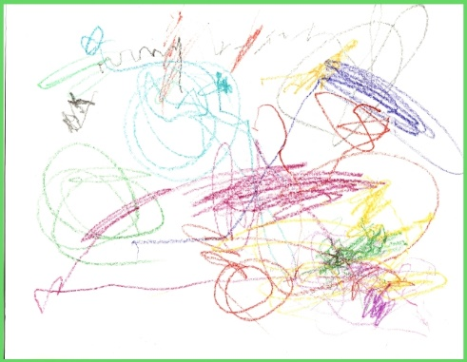
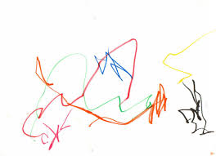
Introducing Writing Tools & Materials
Ages 2 to 5
Because we want to provide time and opportunity to develop muscle strength and hand-eye coordination, writing tools are made accessible for use for children ages 2 to 5. It’s important to note that writing tools include much more than pencils and paper.
Correct pencil grasp is modeled not forced since muscles and coordination is still developing and refining.
Thicker pencils and crayons are easier for young children to grip.
Writing tools are first used for making simple marks, scribbles, and attempts at drawing. Paper without lines allows children freely “write” without distraction or pressure to write within lines. They are still developing a sense of space and left-to-right orientation. Scribbles, marks, and drawings will be fill a paper.

Slide 12
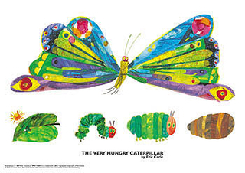
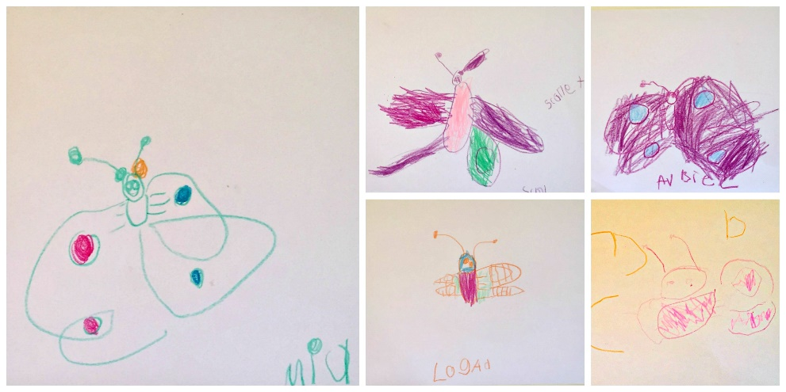
Practice Activity 2: Modeling Writing
Four Year Olds
For this practice activity, you will read a book to the child and talk about the story and what events happened. You will model making a picture and writing about your favorite part of the story.
Next, ask the child to make a picture and “write” about their favorite part of the story. The child will use a combination of pictures, drawings, letters, and/or words depending on his/her stage of writing development.
Think of how you will set the activity up for four year olds to see and hear you write about your favorite part of the book.
After interacting with the child during the “Modeling Writing” activity, proceed to the next part of Practice Activity 2 to reflect on the learning experience.

Slide 13
Practice Activity 2: Reflection Questions
Four Year Olds
Practice Activity 2: Reflect on the Modeling Writing activity you engaged in with three year olds and briefly respond to each of the questions below in the Learning Guide:
How was planning ahead helpful?
How was your language intentional?
How did the child respond?
Did your model help to reinforce the connection between talk and writing?
How did your interactions help to foster the child’s interest in writing?

