Slide 1


Slide 2


Video Segment
Notes:
Relink all videos…

Slide 3

Self Care
Immediate Assistance (thoughts of suicide)
National Lifeline
The Tennessee Employee Assistance Plan
- Website: https://www.magellanassist.com
- Phone: 615.741.1925
Health coach through your state insurance plan
- Website: http://www.partnersforhealthtn.gov/
Notes:
Local trainer should update as appropriate with
*local EAP information
*local insurance information

Slide 4
Prevention Potential
Consider:
What is the prevention potential of the information?
How can you tap into this potential given your role?

Slide 5
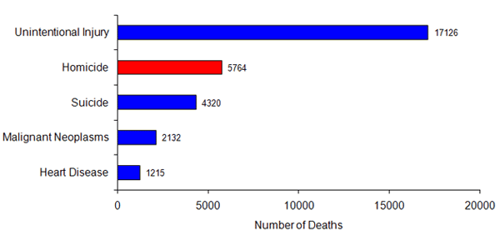
Leading Causes of Death
Youth Aged 10-24
(CDC, 2007)

Slide 6
General Background Factors in JJF
N=79
Nearly 75% of the youth had a history of substance abuse
68.4% were Caucasian
79.7% were male
Average (mean) age of victims was 15.7, with over 70% between the ages of 15 and 17
78.7% had a history of prior offenses, the majority of a nonviolent nature
(Hayes, 2009)

Slide 7
Method - Hanging
Juvenile justice facilities – 98.7%
General youth population – 23%
(Hayes, 2009)

Slide 8
History
74.3% had a history of mental illness, including depression
71.4% had a history of suicidal behavior, with 45.5% having had prior suicidal attempts
(Hayes, 2009)

Slide 9
Other Mental Health Concerns
Attention Deficit/Hyperactivity Disorder
Conduct Disorder
Post Traumatic Stress Disorder
Psychotic Disorder
  (Hayes, 2009)

Slide 10
General Circumstances
N=79
70.9% of suicides occurred during traditional waking hours with almost one-third (29.1%) sustained between 6:01pm and 9:00pm.
All Detention Center suicides occurred within the first four months of confinement, with over 40% occurring within the first 72 hours.
Despite being on suicide watch, almost half of the victims were observed more than 15 minutes before their suicides.
(Hayes, 2009)

Slide 11
Death Speaks
Fear of waiver to adult system, transfer to more secure juvenile facility or pending undesirable placement (including returning home) (10 cases)
Recent death in the family (6 cases)
Failure in the program (5 cases)
Contagion (3 cases)
Parents threat of/failure to visit (2 cases)
Other - loss of relationship, close to the youth’s birthday, suicide pact w/peer, ridicule from peers (4 cases)
(Hayes, 2009)

Slide 12
Local Slides
Number of suicides/suicide attempts at facility
Background factors
Access to means
History of depression/suicide
Housing and confinement status
Notes:
Local trainer should update this page with local information…

Slide 13
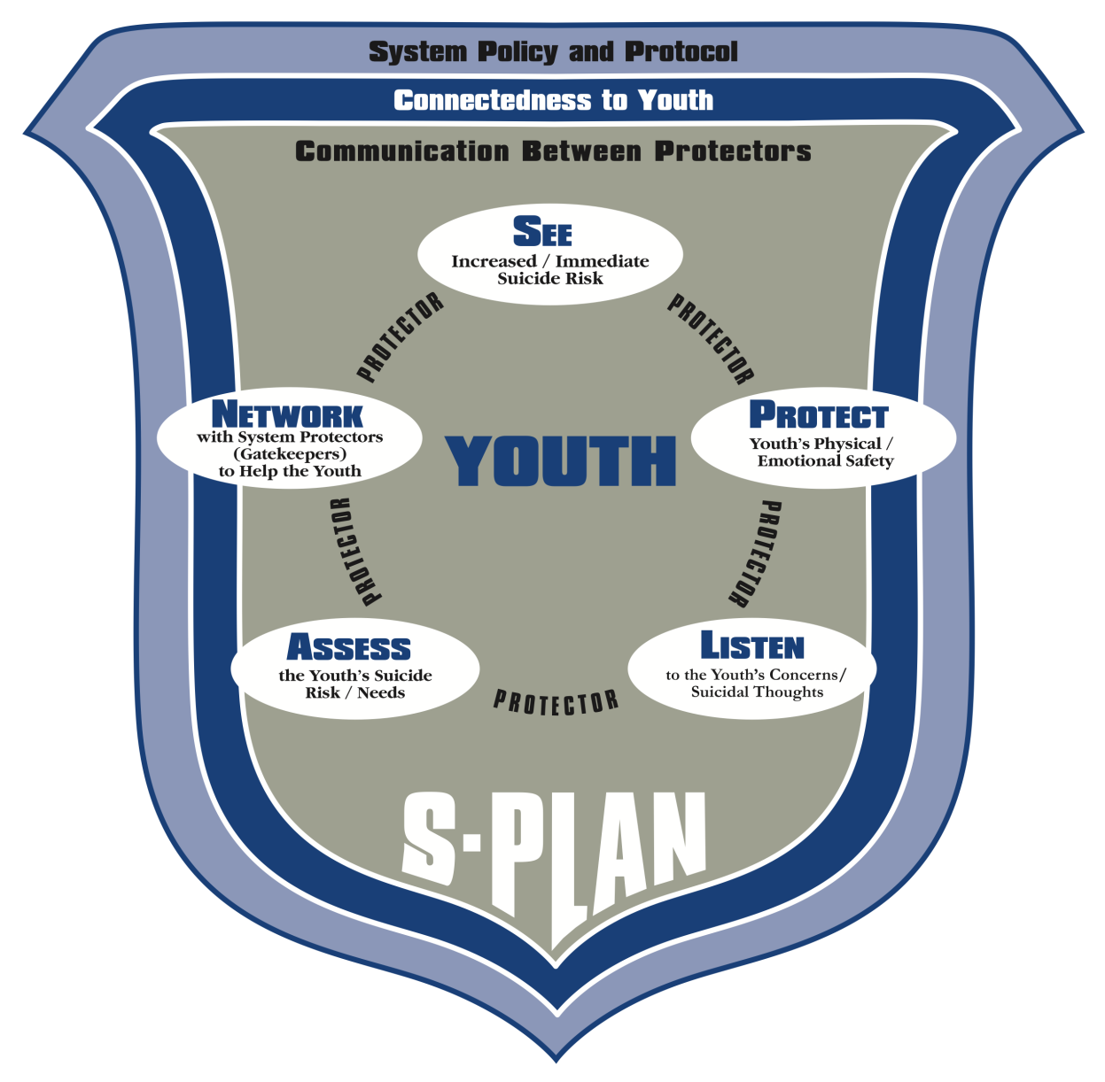
Shield of Care

Slide 14

S-PLAN
S - “See” youth’s increased/immediate risk for suicide
P - “Protect” the youth’s physical/emotional safety
L - “Listen” to youth’s concerns/suicidal thoughts
A - “Assess” the youth’s level of risk/need for help
N - “Network” with others to help the youth

Slide 15
Shield of Care

Slide 16
SEE
Seeing our own attitudes about suicide
Seeing the youth
  Development
  Attachment
  Effects of Trauma
Seeing depression and increased risk of suicide
Seeing the environment

Slide 17
PROTECT
Protection from immediate risk
Protecting youth until reaching the next level of help
Protecting through your attention to the environment…
  Access to means
  Housing
Protecting a youth’s emotional safety during high risk periods.

Slide 18
LISTEN
Once you identify a youth at risk…
Listen!
  empathize
  acknowledge
  reflect

Slide 19
ASSESS
Informal assessment of risk
If you suspect a youth is thinking about suicide, ask and respond as per P&P.
  Even if the youth denies it
Intake assessment is great BUT…
  Youth can become suicidal at any time - assessment should be on-going.

Slide 20
NETWORK
Know your responsibility in your work role and how to contact others
Avoid territorial issues, and work as a team
Overcome potential barriers to suicide prevention
Communicate
Document

Slide 21
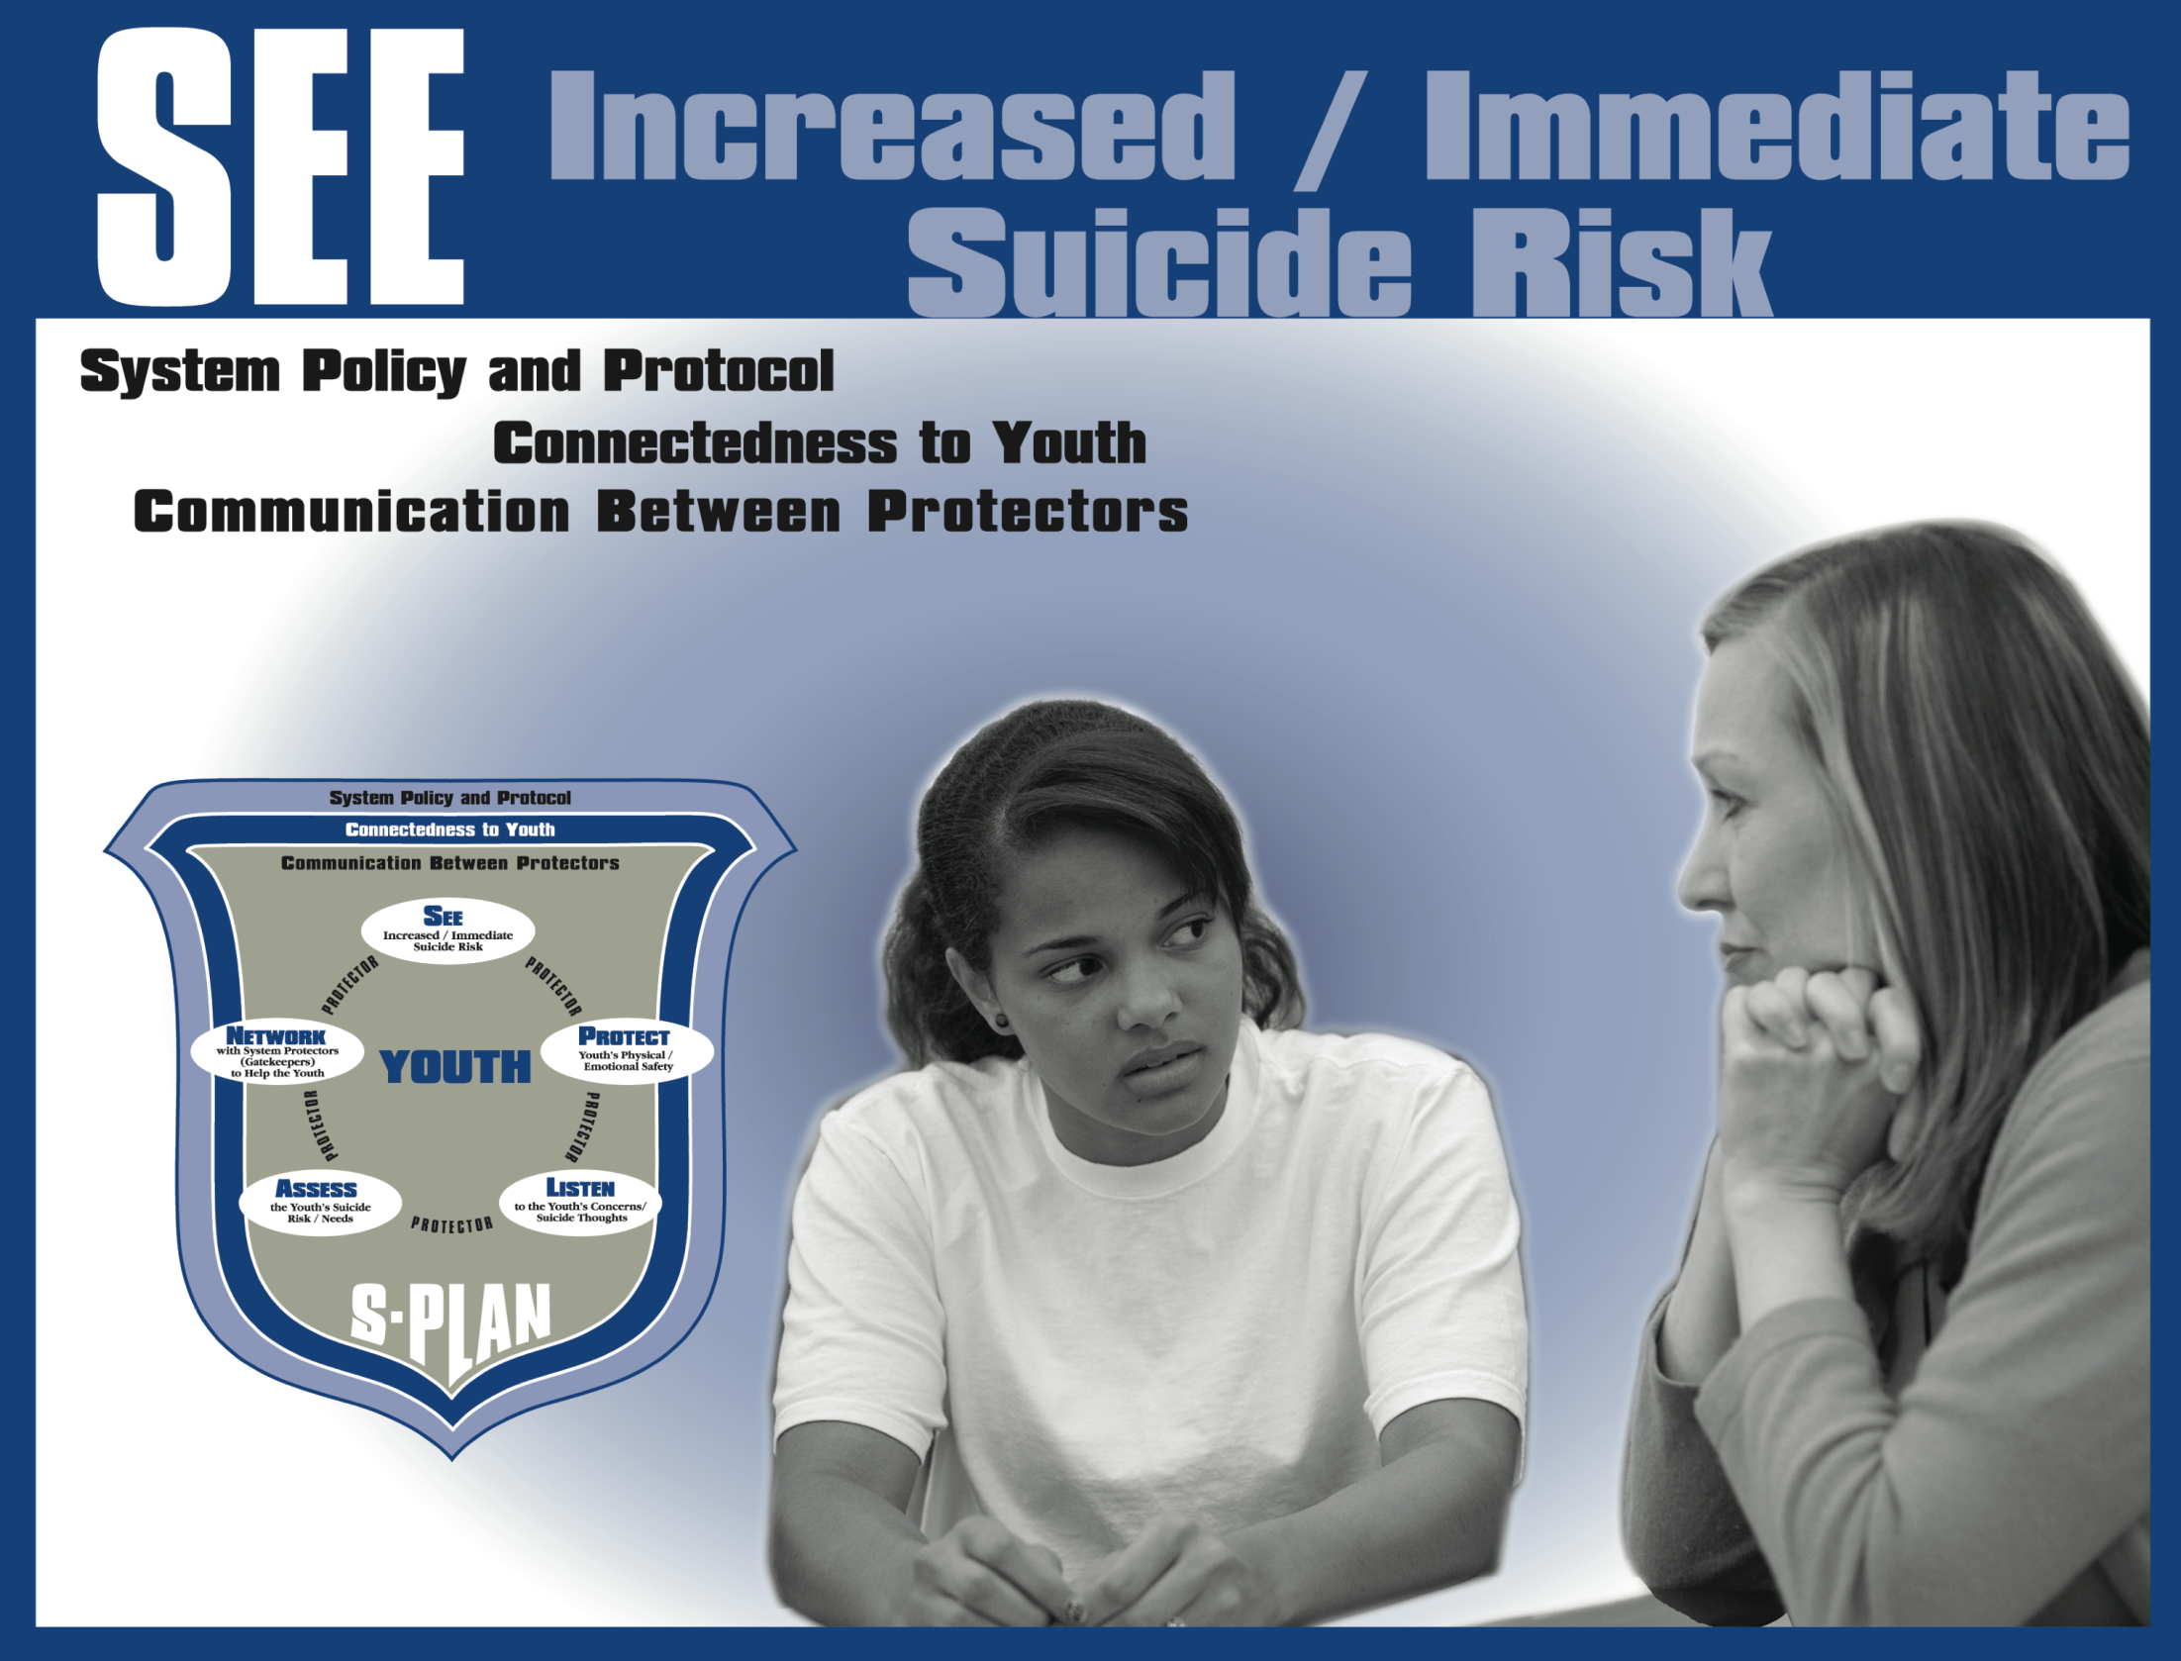

Slide 22
Seeing
Keep an open mind. Don’t judge.
Avoid common temptations by keeping the focus on the youth.
- Sharing your experience shifts this focus
Assume danger even if you feel you’re being manipulated.
Actions speak louder than words.

Slide 23
Thought Patterns and Suicide
1. Rigid thinking – “Either I’m out of here by my birthday or I’m going to die.”
2. Overgeneralizing – “I try so hard, and I always get blamed.”
3. Catastrophizing - “I have nothing to look forward to. I might as well be dead.”
4. Terminal Thinking– “I might as well just kill myself,” “I just can’t take it anymore.”
(Aarons et al., 2007)

Slide 24
Attachment
Youth may have had uncaring and/or unavailable caregivers.
Although they may have a negative attitude about problem solving, you can make a difference.
Having connections with other people is a strong protective factor against suicide.

Slide 25
History of Trauma
Trauma disrupts normal development
Youth may over-react (fight/flight) to stress
Youth may under-react (be paralyzed by fear/go numb) to stress
Youth may have difficulty trusting others
Hyperarousal (on edge – waiting for something to go wrong)

Slide 26
Death Speaks - Revisited
Fear of waiver to adult system, transfer to more secure juvenile facility or pending undesirable placement (including home) (10 cases)
Recent death in the family (6 cases)
Failure in the program (5 cases)
Contagion (3 cases)
Parents threat of/failure to visit (2 cases)
Other - loss of relationship, close to the youth’s birthday, suicide pact w/peer, ridicule from peers (4 cases)
(Hayes, 2009)

Slide 27
High Risk Periods in Confinement
Withdrawal from drugs/alcohol
Court or other legal hearing
Personally significant date for each youth/juvenile
Return to facility
Receipt of bad news
Impending release/transfer
(AACAP, 2005/Hayes, 2007)

Slide 28
Warning Signs
Talks, writes or draws about suicide
Engages in non-fatal suicidal behavior
Has a plan
Death of loved one
Terminal statements
Loss of relationship
Severe guilt or shame over offense
Sexual and/or physical assault (incl. threat in detention)
Increasing anxiety or deepening depression
Feeling trapped, hopeless or defeated
Giving away prized possessions
(AFSP, SPRC)

Slide 29
Risk Factors
Suicidal behavior of family members
Completed suicides within the family
Homicidal actions/thoughts
Being a bully and/or being bullied
Participating in cyberbullying
Sexual orientation
Sudden death of a family member
Prior suicide attempts or apparent rehearsals
Social withdrawal
Substance abuse

Slide 30
Signs of Depression
Depressed, angry or irritable most of the day,
nearly every day, for 2 weeks or more
Withdrawal from other people
Decrease or increase in appetite nearly every day
Difficulty sleeping, excessive sleeping or oversleeping
Fatigue or loss of energy nearly everyday
Extreme sensitivity to rejection or failure
Diminished interest or pleasure in all, or almost all, activities most of the day, nearly every day
Diminished ability to think or concentrate, or experiencing indecisiveness, nearly every day

Slide 31
Video Segment

Slide 32
Anchoring Devices
N= 78
Door hinge/knob (16)
Air vent (15)
Bed frame (15)
Window frame (11)
Closet rod (7)
Sprinkler head (6)
Only 34.5% of detention centers provide safe and protrusion-free housing for youth.
(Hayes, 2009)

Slide 33
Types of Ligatures
N= 78
Ligature: Anything that can be used to hang oneself
Bedding (56)
Clothing (10)
Belt (4)
Shoelace (4)
Other (4)
(Hayes, 2009)

Slide 34
Other (Potentially) Dangerous Objects
Any toxic substance (even in non-youth areas)
Razors
Pencils/pens
Staples/paperclips
Eye glasses
Hair ties
Eating utensils
Medical wraps
(Aarons et al., 2007)

Slide 35
Review
Be mindful of how attitudes may interfere with seeking help
Consider the youth’s perspective, experience and development
Know common risk factors, warning signs and high risk periods of confinement
Be aware of and restrict anything (means) that may be used for suicidal behaviors

Slide 36
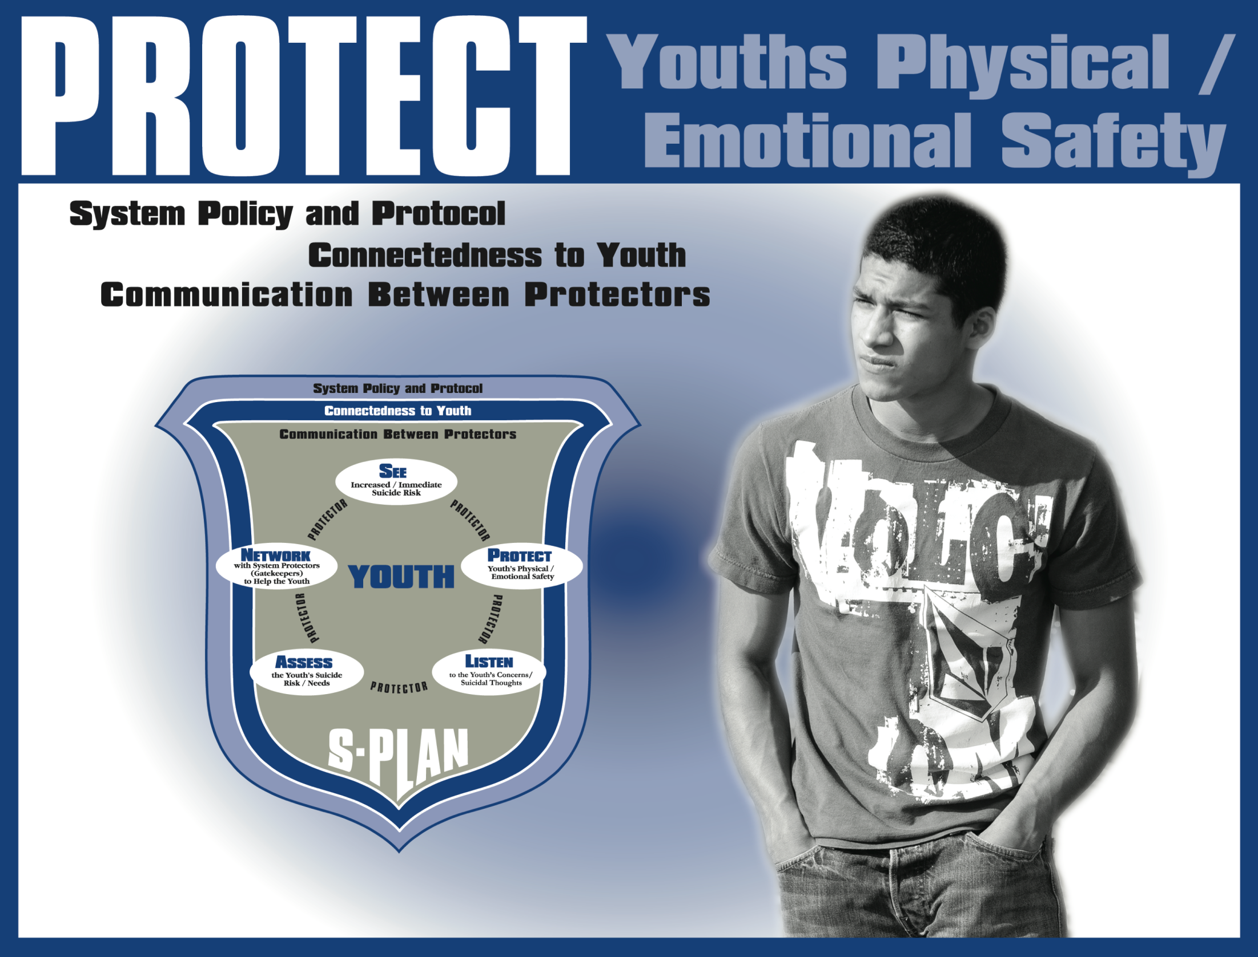

Slide 37
Intervention Suicide Attempt Security Staff Response
Immediately call for staff help by radio or verbal signal
Report to supervisor immediately. Report the method of suicide attempt is by (hanging/cutting, etc.). Provide location and type of assistance needed.
Acquire and bring emergency response kit and emergency rescue tools.
Check scene for safety (possible “set up,” items that could be used as a weapon, etc.).
Clear room of non–essential life saving personnel.
Use universal precautions (gloves, goggles, CPR mask).
If attempt is life-threatening, ask Central Control to contact 911.
If unconscious, administer immediate life saving action.
  (Hayes, 2005)

Slide 38
Intervention Suicide Attempt – Security Staff Response
Hanging
  Lift to restore airway; cut or untie ligature; place youth on floor; start rescue breathing/CPR until relieved by medical staff.
Cutting
  Apply direct pressure to injured area. Keep individual calm and treat for shock until relieved by medical staff.
Overdose
  Try to find the source of the overdose (poison, pills). Call Poison Control Center while medical staff is on their way.
  Use CPR and First Aid Skills as Needed in All Situations.
Debrief staff and gather all reports, observations and logs.
  (Vermont Correctional Academy)

Slide 39
If Youth is Uncooperative or Unresponsive to Verbal Commands
Use the least restrictive/forceful physical intervention to keep them from harming themselves or others.
Restraints should only be used if the person is actively trying to kill him/herself.
Restraints should be removed as soon as it is possible to do so.
Actively suicidal youth should never be placed in segregation. Monitor youth until given orders to cease.
Secure site.
Debrief staff and gather all reports, observations and logs.
(Vermont Correctional Academy)

Slide 40
Housing/Detainment Status
N=79
50% of victims were on room confinement at the time of death.
79.3% of the victims held in Detention Centers were on detained status.
74.7% were assigned to single-occupancy rooms.
16.5% of the victims were on suicide precaution at the time of their deaths, most of whom were required to be observed at 15-minute intervals.
(Hayes, 2009)

Slide 41
Our Facility Suicide Watch Levels
Notes:
Trainer should insert local information here.

Slide 42
Emotional Safety
Connect with youth
Choose a private place to listen to youth who might be thinking of suicide.
Do not discuss any personal information that may be embarrassing to the youth when in front of others.
Reduce distress related to high risk periods of confinement.

Slide 43
Reduce Stress of the Unknown
Review their understanding of Orientation. Clarify any misunderstandings.
All Staff – Help newly detained youth feel as comfortable as possible.
Inform youth…
Of expected behaviors toward staff.
  - Discuss pros and cons of treating staff with respect.
Of the appropriate way to request services.
- Verbally and physically take youth through process.
About visitation rules. Clarify any misunderstandings.
(Aarons et al., 2007)

Slide 44
Reduce Stress of Visitations (or Lack of), No Shows and Phone Calls
Monitor youth’s emotional well-being before or after visitations and phone calls.
Encourage youth to gather information from the people who they believe have let them down. There could be a misunderstanding about time or a good reason for the missed appointment.
Remind the youth of the appropriate way to request services.
Encourage youth to consider other ways to get their needs met rather than waiting for a particular person.
(Aarons et al., 2007)

Slide 45
Reduce distress due to conflict w/peers
Listen to the youth’s version of the conflict.
Discuss new ways of viewing the conflict and different responses if it occurs again.
Encourage youth to take responsibility for the part they played.
Encourage them to take the “high road” and not become involved in another youth’s struggles.
(Aarons et al., 2007)

Slide 46
Reduce distress of having to wear suicide smock
Inform youth
- about safety concerns, and communicate the priority of keeping the youth alive.
of process of getting risk level reduced without making any promises.
of any current behaviors that contribute to the concern that staff have for their well being and explore alternative behaviors with youth.
(Aarons et al., 2007)

Slide 47
Reduce distress - Court appearance
Encourage youth to share their specific concerns, questions and frustrations when appropriate and possible.
Encourage youth to role play, with you, their appeal to the judge or to their lawyer or next visit with their PO. Help them find the words to clarify their desires for placement, services, etc.
(Aarons et al., 2007)

Slide 48
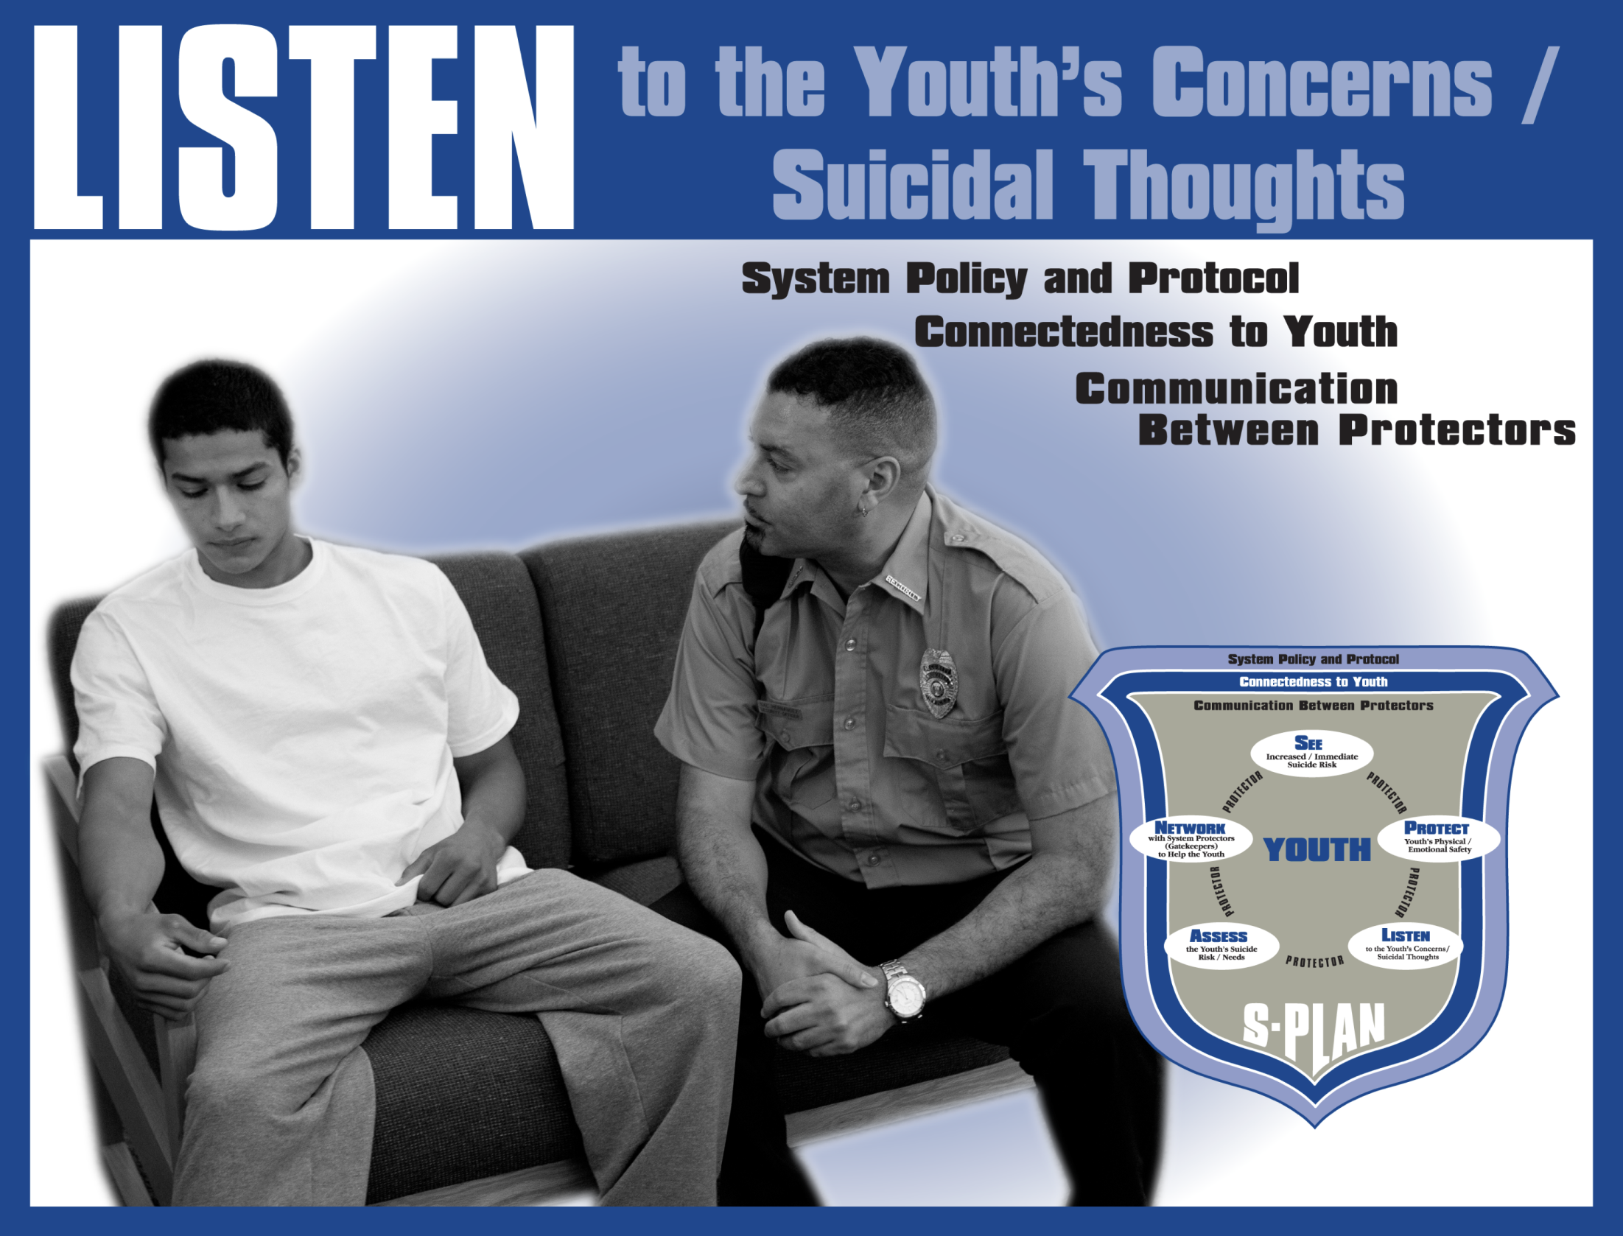

Slide 49
Reflective Listening
Restate without Judgment or Questioning
So you’re saying life is hard right now.
What I hear you saying is life is hard right now.
Mirror the statement: “Life is hard right now.”

Slide 50
Listening Pitfalls
Rushing to judgment
Trying to fix the situation
Asking too many questions
Giving advice
Interrupting with your experience
Closed body language

Slide 51
Paraphrasing
Sounds like you’re feeling pretty overwhelmed.
Sounds like you’ve got a lot on your mind right now.
Sounds like you’ve got the weight of the world on your shoulders.

Slide 52
Paraphrasing
“Sounds like you don’t have much hope that anyone could really understand how you’re feeling right now.”
“So what you’re saying is that no one can help you because no one can really understand what you’re going through.”
“What I hear you saying is that you feel really misunderstood by the people in your life.”

Slide 53
Paraphrase and Acknowledge
Paraphrase
“It sounds like you are really frustrated.”
… and Acknowledge the youth’s feelings…
“I’m sorry you’re in so much pain.”
“I can see why you would feel that way.”

Slide 54
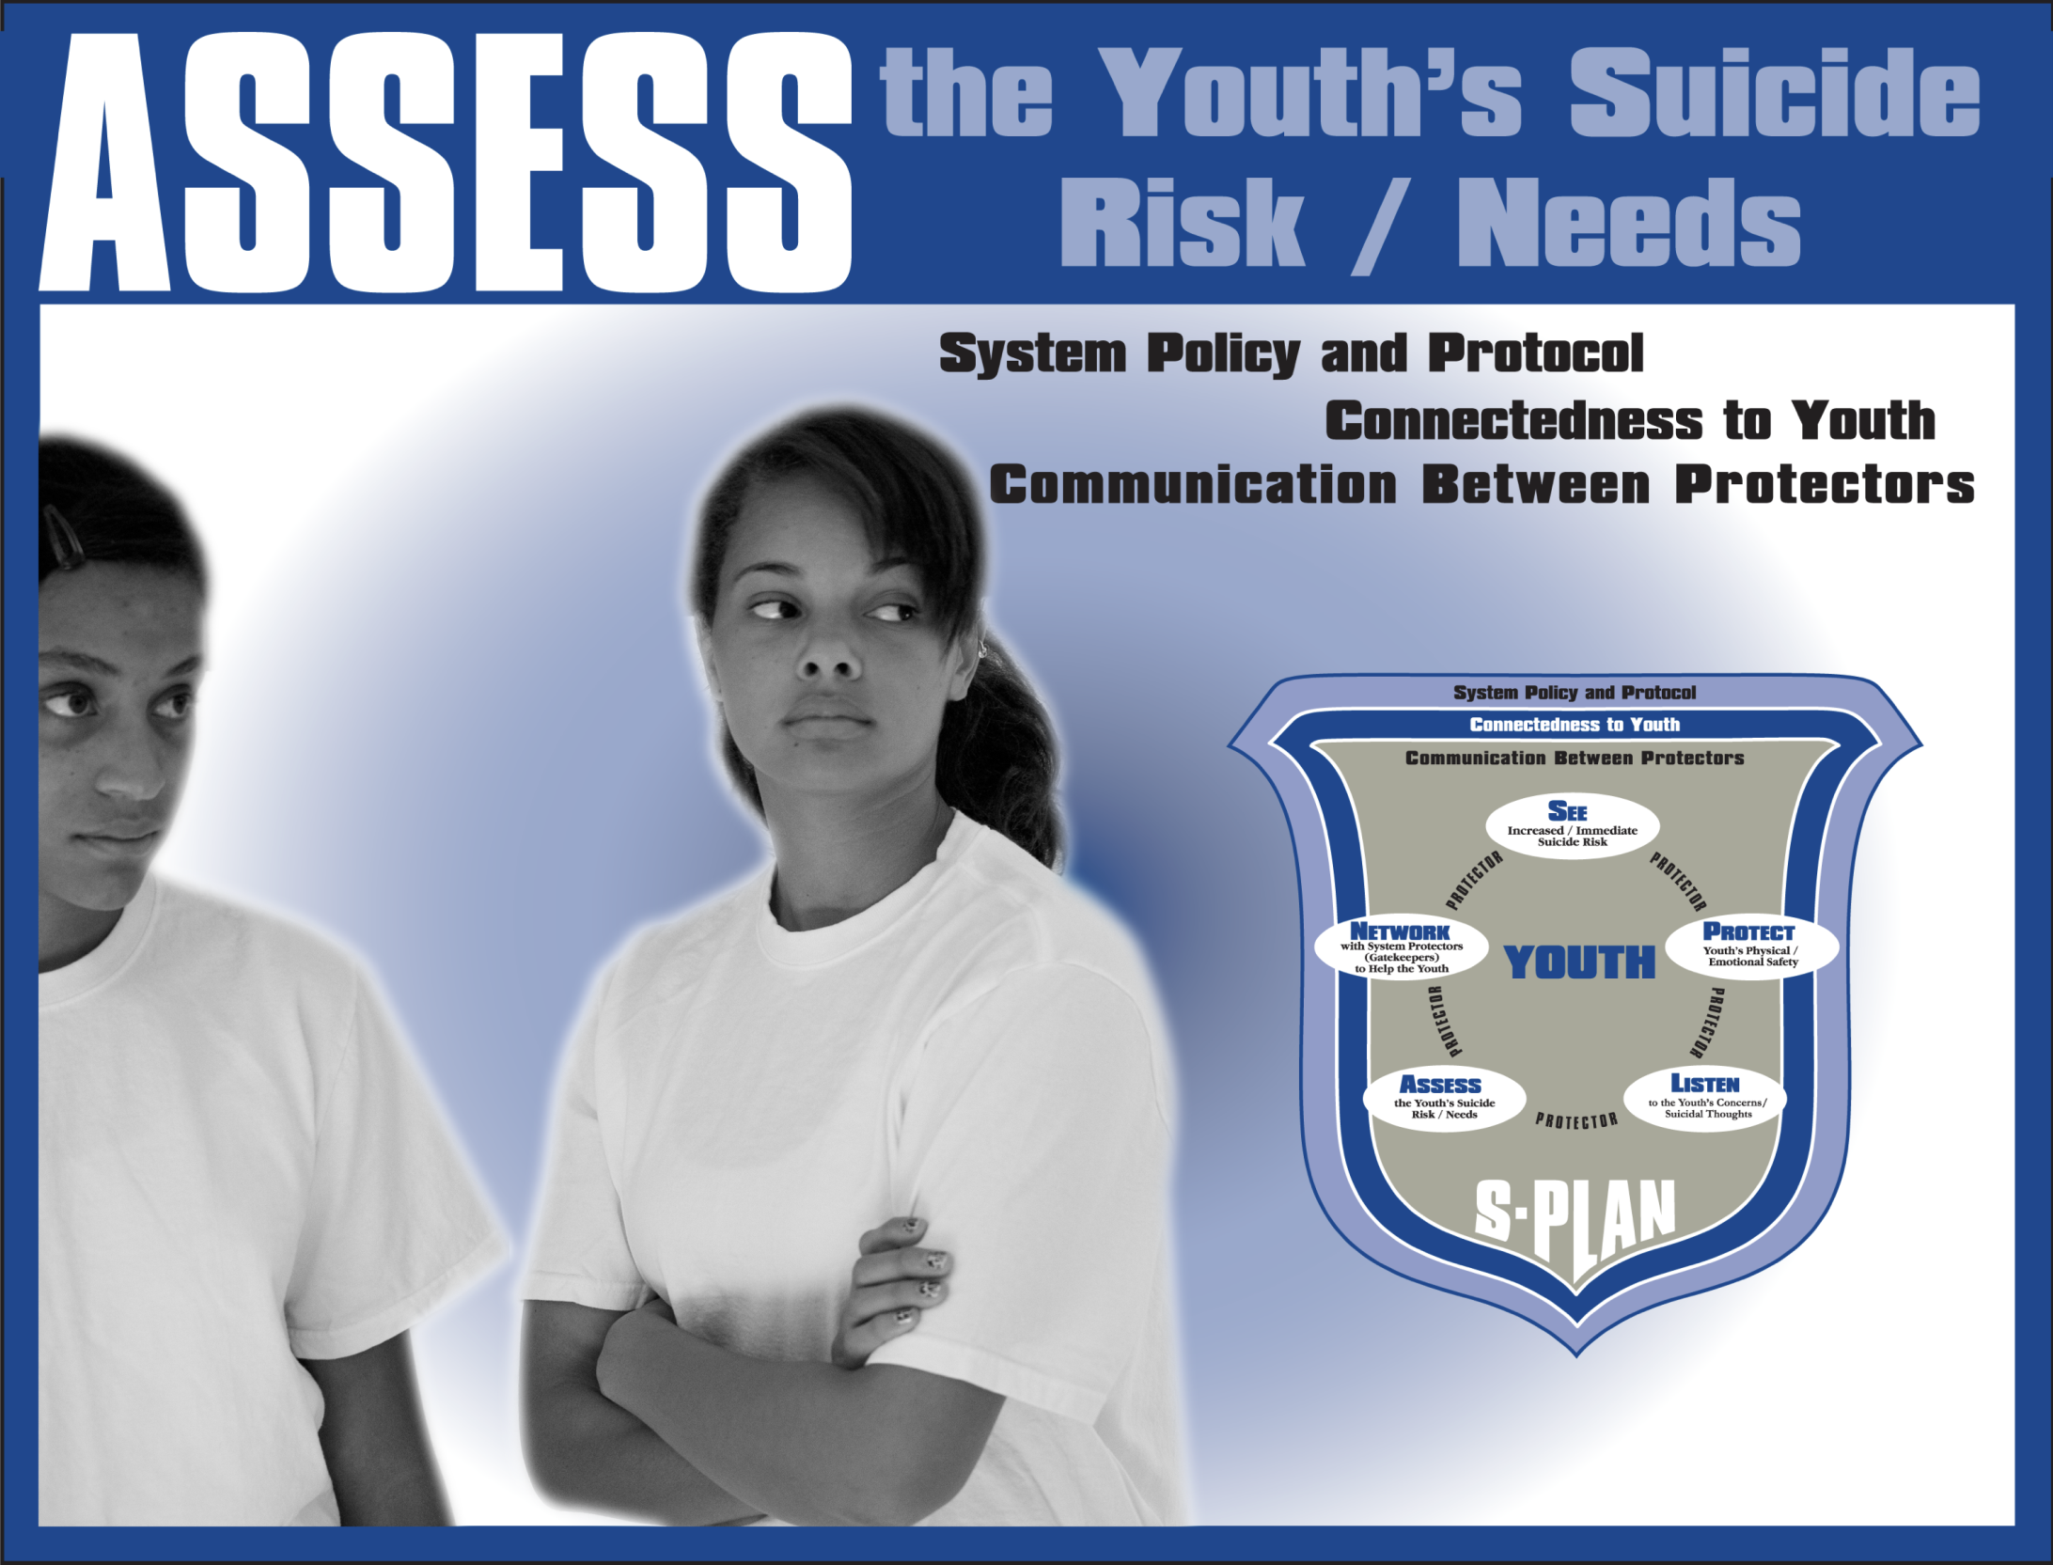

Slide 55
Asking about Suicide
Are you thinking about suicide?
Are you thinking about killing yourself?
Sometimes when people (insert warning sign here), they might be thinking about suicide. Are you?
You have a (court date) coming up and (you just said you can’t take it anymore). Are you thinking about suicide?”
Ask at least twice, specifically inquiring: “Are you thinking of killing yourself?; Ending your life, etc.”

Slide 56
Video Segment

Slide 57
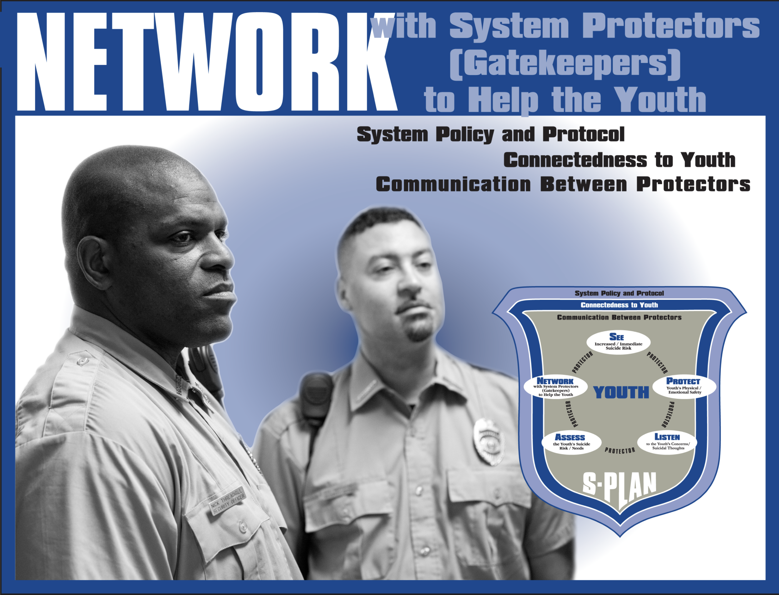

Slide 58
Privacy Considerations
HIPAA permits health information to be shared if the information…
… is necessary for the provision of health care to the individual, the health and safety of the inmate, and other inmates.
(Hayes, 2008)

Slide 59
Working as a Team
Communicate!
Avoid getting stuck in traditional clinical v. custodial roles in regard to suicide prevention.
Recognize concerns of support staff.
Information related to suicide risk that deals with the “here and now and the immediate future” should be shared freely with those working directly with youth.
Multidisciplinary team meetings should occur on a regular basis to discuss the status of an inmate placed on precautions.
(WHO 2007; Hayes, 200;/ Lomardo, 1985)

Slide 60
Video Segment

Slide 61
Reporting
In the event of a suicide attempt or suicide…
1. All appropriate staff should be notified through the chain of command.
2. The victim’s family should be notified, as well as appropriate outside authorities.
3. All staff who came into contact with the victim prior to the incident should be required to submit a statement as to their full knowledge of the youth and incident.
(Hayes, 2005: JSMHU)

Slide 62
Mortality Review
The circumstances surrounding the incident;
Facility procedures relevant to the incident;
All relevant training received by involved staff;
Pertinent medical and mental health services/reports involving the victim;
Possible precipitating factors leading to the suicide;
Recommendations, if any, for changes in policy, training, physical plant, medical or mental health services, and operational procedures
(Hayes, 2005: JSMHU)

Slide 63
Minimizing Contagion
Share facts: Will help prevent rumors and speculation.
Don’t simplify, glamorize, or romanticize the youth or his/her death.
Emphasize that the youth who died by suicide was likely struggling with a mental disorder.
Monitor youth and refer those who may be struggling with the death.
(SPRC/AFSP, 2011)

Slide 64
Liability
Plaintiff must:
1. Demonstrate a “serious medical need.”
2. Establish that defendants were aware of that need.
3. Prove that defendants were “deliberately indifferent to that need.”
(Hayes, 2005: JSMHU)

Slide 65
Shield of Care

Slide 66
Video Segment

Slide 67






Thank You
The Tennessee Department of Mental Health and Substance Abuse Services (TDMHSAS) is the author/owner of this material developed as part of the Tennessee Lives Count Juvenile Justice project funded via a grant (#2U79SM057400-04) from the Substance Abuse and Mental Health Services Administration (SAMHSA), U.S. Department of Health and Human Services (HHS). The views, policies, and opinions expressed are those of the authors and do not necessarily reflect those of SAMHSA or HHS.
The Tennessee Department of Mental Health and Substance Abuse Services is the recipient of this grant made possible through the Garrett Lee Smith Memorial Act of 2004. The TLC/JJ project is collaboratively implemented with the Mental Health Association (America) of Middle Tennessee, the Centerstone Research Institute, and the Tennessee Suicide Prevention Network.

