Slide 1



Fingerprint and Background Check Process

Slide 2
Comprehensive Background Checks
Comprehensive Background Checks are broader in scope than Criminal Records Checks, ensuring more thorough vetting to uncover past criminal, sexual, abuse, or neglect offenses that require exclusions from access to licensed childcare agencies.
Comprehensive Background Check Searches
National fingerprint-based criminal files (NICS)
TN fingerprint-based criminal files
TN child abuse and neglect registry (DCS)
TN Vulnerable Persons Registry (VPR)
TN sex offender registry
National sex offender registry
Criminal files in states not included in the National crime databases for individuals who have lived outside of
TN during the past five years.
Child abuse and neglect registries in states not included in national registries for individuals who have lived
outside of TN during the past five years.
Sex offenders registries in states not included in national registries for individuals who have lived outside of TN during the past five years

Slide 3
Who Needs a Background Check?
Anyone who works in a childcare facility licensed by Tennessee Department of Human Services (TN DHS) with unsupervised access to children, no matter what age, MUST complete a background check Tenn. Code Ann.§71- 3-507(a)
This includes:
  ALL employees, directors, managers, and substitutes working for 36+ hours per year, person who are over the age of 15 years who resides in a childcare agency.
  Contractors who provide services to children enrolled at the licensed childcare agency.

Slide 4
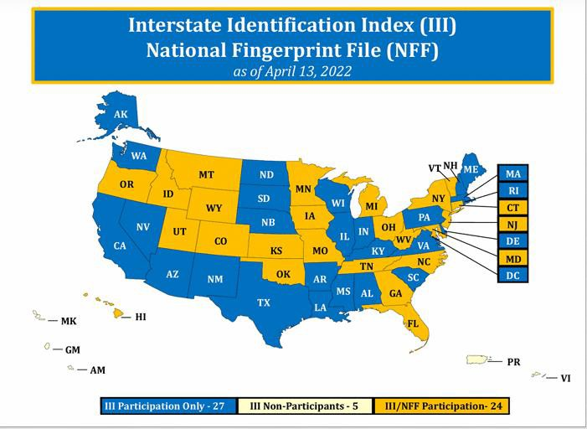
Why Does the Law Require Background Checks?
The link below shows a map of which states participate in background checks.
https://www.fbi.gov/file-repository/interstate-identification- index-iii-national-fingerprint-file-nff.pdf/view
  Tennessee and 23 other states and territories participate in nationwide criminal information indexes, fingerprint files, databases, and registries.
  The other 26 states, territories, District of Columbia, and commonwealth, and tribal lands do not.
  To ensure that no one slips through that gap, Federal Law (CCDBG – Child Care and Development Block Grant) now requires additional criminal records and background checks for applicants who have lived outside TN during the past 5 years in a state, territory, commonwealth, or Tribal Land.

Slide 5


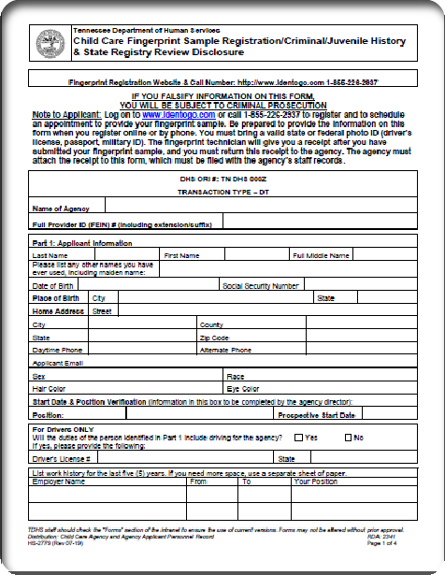
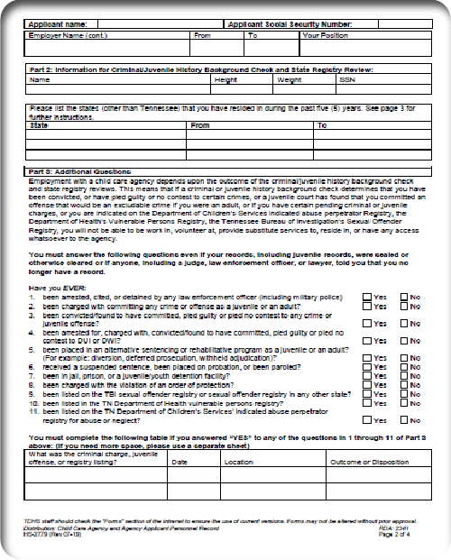


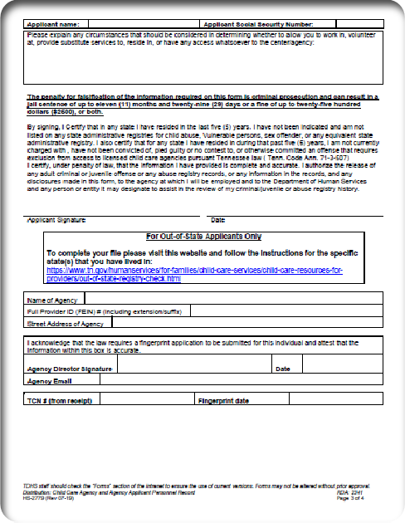
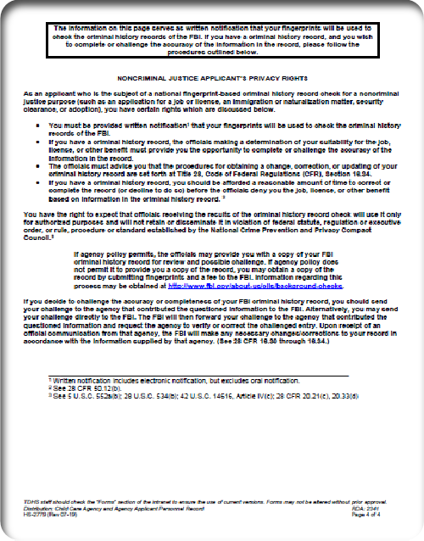
Fingerprinting Process
Prior to getting fingerprinted, ALL applicants must complete the Child Care Fingerprint Sample Registration/Criminal/Juvenile History & State Registry Review Disclosure Form: https://www.tn.gov/content/dam/tn/hu man-services/documents/hs-2779.docx
  ALL applicants, both in-state and out-of-state, must complete this form.
  This form must be kept in the
applicant’s file at the adult OR
childcare center Tenn. Code Ann.
§71-3-507(a)(5)

Slide 6

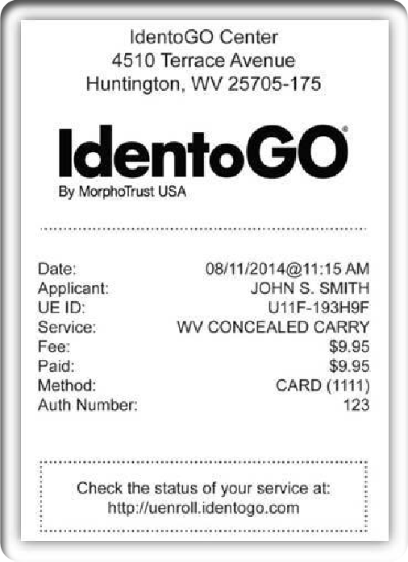


Scheduling Fingerprint Appointment
To schedule the applicant’s fingerprint appointment, go to:
www.identogo.com or call 1-855-226-2937.
  When scheduling the appointment, provide the
information listed on the applicant’s Child Care Fingerprint Sample Registration/Criminal/Juvenile History & State Registry Review Disclosure Form.
    * If prompted to provide a service code, or print code, due to the applicant having been fingerprinted within the last 5 years, contact the TN DHS Out of State Background Unit at 615-253-4170 or CCBackground.DHS@tn.gov*
  The applicant must bring a state or federal I.D. (driver’s license, passport, military I.D., etc.) to their fingerprint appointment.
  Once finished, the fingerprint technician will hand the applicant a receipt. This receipt must be given to the adult or childcare agency for proof of fingerprinting and kept in the applicant’s file.

Slide 7
Out of State Background Check Process
Out of State background checks are required if the applicant has lived/worked/attended
school outside of Tennessee within the last 5 years of the current fingerprint date.
The applicant must complete the out-of-state forms that are applicable to them.
  Go to https://www.tn.gov/content/tn/humanservices/for-families/child-care- services/background-checks-for-child-care-employees/child-care-out-of-state- registry-check0/out-of-state-registry-check--if-you-work-for-a-child-care-in-tn-
.html to find the correct form(s).
  The applicant will need to follow the specific instructions listed on the check list for each state form they are completing.

Slide 8
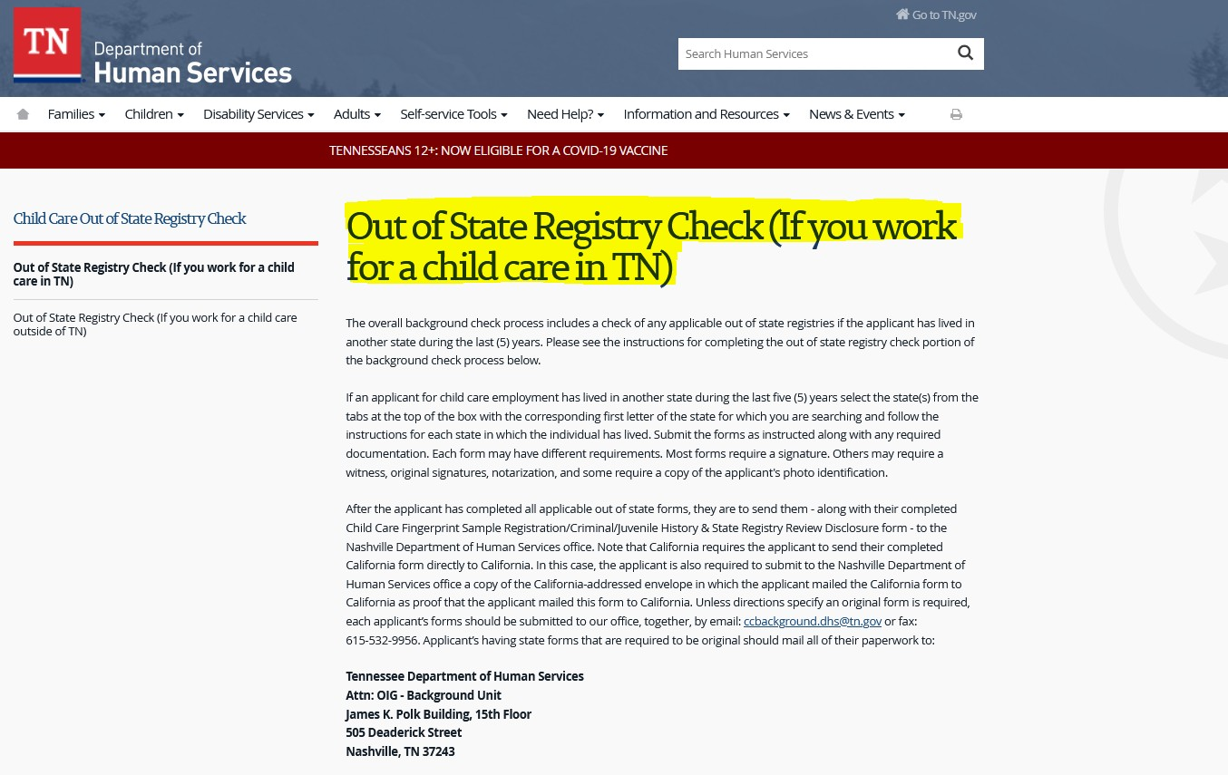
Steps to Retrieve Forms
*Click the link below to access the state forms.
https://www.tn.gov/content/tn/humanservices/for-families/child-care-services/background-checks-for-child-care-employees/child-care- out-of-state-registry-check0/out-of-state-registry-check--if-you-work-for-a-child-care-in-tn-.html

Slide 9
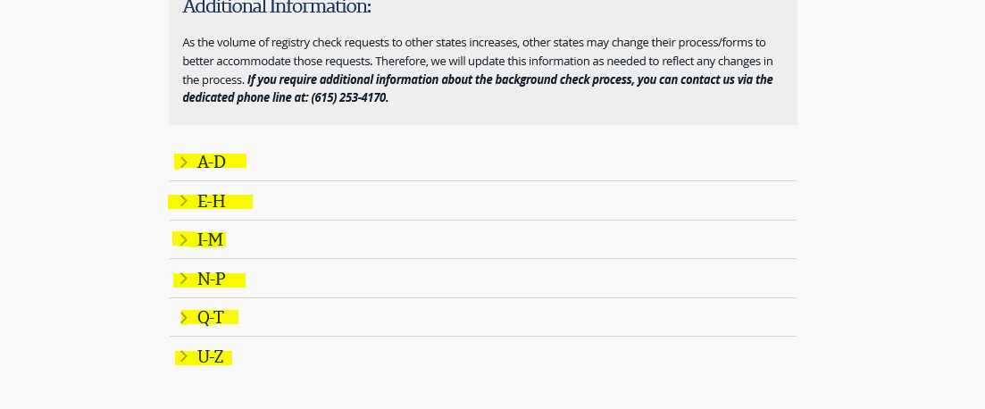
Scroll all the way down and choose the corresponding letter tab for the state you are searching for. Then scroll down for the state and read ALL instruction. Repeat for each state.

Slide 10
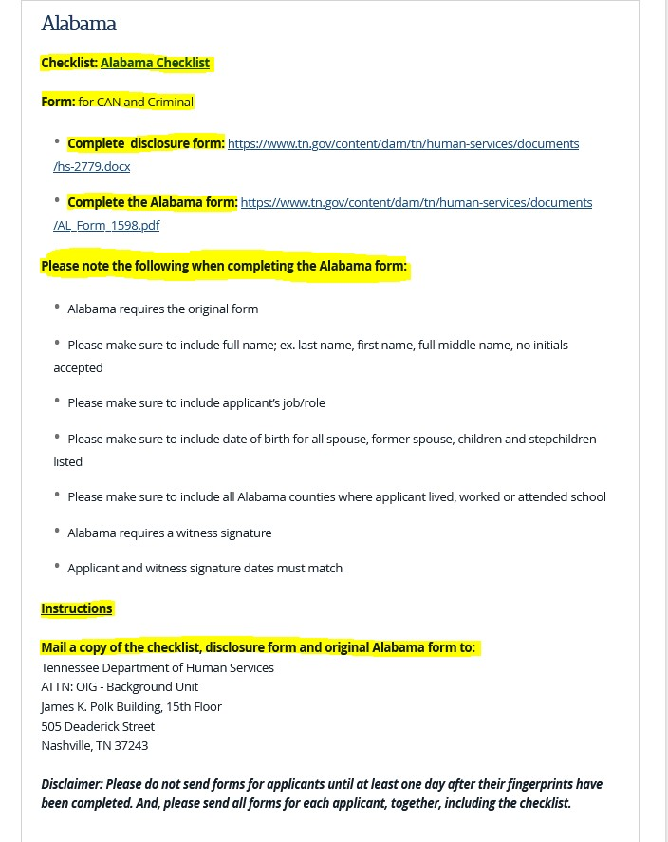


State Instructions:
First, under EACH state that applies to the applicant, click on the Checklist and read all instructions.
* Be sure to check off each item of the
checklist as it is completed.
Next, under EACH state that applies to the applicant, click on each blue link next to “Complete disclosure form” and “Complete the form”.
Lastly, under EACH state that applies to the applicant, read the Instructions on how to send the forms to TN DHS (TN Department of Human Services) Out of State Background Unit.
Do not send forms to the other states, unless
instructed to do so on the state’s Checklist.

Slide 11
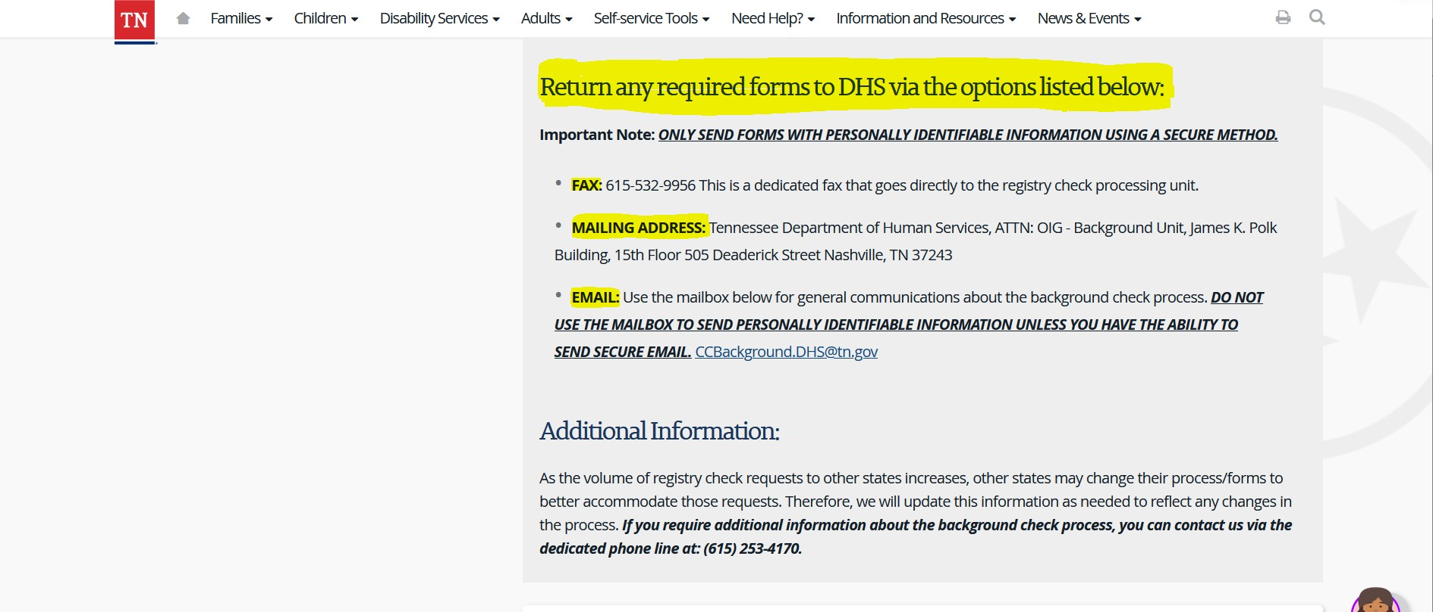
Where Do I Send the Out-of-State Forms?
*If ANY of the forms are required to be original (meaning the form was originally written on in black or blue ink and must be mailed directly to the TN DHS office), then ALL forms must be MAILED to DHS, along with ONE copy of the disclosure form.
*If none of the forms are required to be original, then you may email or fax them, along with ONE copy
of the disclosure form.
*Do NOT send the forms to the addresses on the state forms, unless instructed to do on the Checklist.

Slide 12
When Should I send the Out-of-State Forms?
Wait at least ONE day after the applicant has been fingerprinted before sending the out-of-state forms to TN DHS.
The forms must be sent to TN DHS within 30 days of the applicant being fingerprinted.

Slide 13
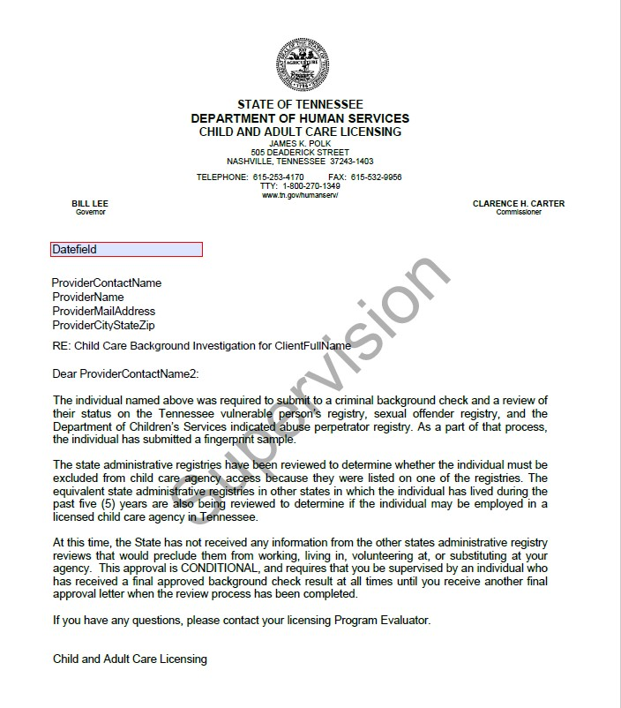
What Happens After TN DHS Receives the Out- of-State Forms?
Once TN DHS receives all necessary Out-of-State Documents correctly, a Conditional Letter will be issued.
  A Conditional Letter means that the applicant will only be allowed to work under supervision of another fully cleared applicant, until all results from the other state(s) have been received.
  Once all results have been received, the Final Clearance Letter will be issued.
45-day Final Letters: If TN DHS has not received the results from the other state(s) by 45 days after the date of the conditional letter, then TN DHS will go ahead and issue the final letter on the follow day – the 45th day.

Slide 14
Excludable Crimes
Crimes that would exclude an applicant from working in child care based on Tenn. Code Ann. §71-3-507(e)(1)(A)(i), Tenn. Comp. R. and Regs. 1240-4-1-
.07(3) are listed below:
Physical, sexual, or emotional abuse or gross neglect of a child
Any violence against a child
Any violence against any person
The manufacture, sale, distribution or possession of any illegal drug.
If the applicant is found listed on the Vulnerable Person’s Registry.
If the applicant has been convicted of or plead guilty to any felony charge of operating a motor vehicle while intoxicated, within the last 5 years.

Slide 15
Waivers
If an applicant is excluded, they will receive an exclusion letter in the mail.
If the applicant can prove extenuating circumstances that clearly warrant an exception from the automatic exclusion and is legitimate, they may apply for a waiver.
  However, *Pending Crimes: DHS will not, under any circumstances, grant a waiver while a criminal charge, juvenile proceeding, or perpetrator indication is pending. Individuals with a record showing a “pending” status of any type will not be granted a hearing before the Committee.*
Burden of Proof: the burden is on the appellant to prove the extenuating circumstances which clearly warrant an exception.

Slide 16
Waivers (cont)
Types of information that may be provided for Burden of Proof include:
  Statements by the appellant and/or a representative of the appellant;
  Statements from witnesses, e.g., a character witness who can speak regarding the
appellant’s activities since the last criminal violation;
  Documentary evidence, e.g., certificate of completion for a treatment program, employer recommendations, etc.
If there’s no pending charges, the applicant must write a letter regarding the circumstances surrounding the charge, and why they would like to be granted a waiver, and submit it to DHS along with proof extenuating circumstances.
To assist DHS in the waiver decision, there is a Waiver Advisory Committee, whose membership includes law enforcement personnel, persons experienced in child protective services, persons experienced in child development issues, child care providers, and persons representing elder care issues.

Slide 17
Waiver (cont)
After the informal meeting, the Advisory Committee will make their recommendations to the DHS Licensing Director. The DHS Licensing Director will make the final decision of whether to approve the Waiver or not.
If the waiver is DENIED, the applicant will receive instructions on how to appeal the decision and receive an Administrative Hearing.

Slide 18
Appeals
If the waiver request is denied, the appellant will be sent a notice letter will include instructions on how to appeal the denial and receive an Administrative Hearing.
In the appeal, you may only challenge the accuracy of the report of the Criminal Background Report by showing:
  The conviction is improperly classified as an excludable offense;
  Show that you are not the person identified on the record.

Slide 19
Waiver vs Appeal
*A waiver may be requested at any time, but an appeal can only be requested within
TEN days of the mailing date of the letter.
*NO OPTION FOR WAIVER IF:
1. You have pled no contest, pled guilty to, or were convicted of any of the following offenses:
*A) Felonies:
Murder
*(B) Misdemeanors:
Child abuse
Child abuse or neglect
Crimes against children including child pornography
Spousal abuse
Crime involving rape or sexual assault
Arson
Kidnapping
Physical Assault/Battery
Drug crime within past 5 years
Child endangerment
Sexual assault
Misdemeanor Child Pornography

Slide 20
Waiver vs Appeal (cont)
If you made a materially false statement regarding a criminal background check
If you are registered, or are required to be registered, on a State sex offender registry or repository or the National Sex Offender Registry
If you have pending adult or juvenile criminal charges for any excludable offense
If you have a pending administrative determination of your status as
“substantiated” on the Department of Children’s Services Abuse Registry

Slide 21
QUESTIONS?
If you have any questions regarding the fingerprint/background check process, or waiver hearing, you may contact the Out-of- State Background Unit at:
  Phone: 615-253-4170
  Email: CCBackground.dhs@tn.gov

