Slide 1

Talk With Me Baby:
Promoting Language Nutrition for Healthy Brain Development
August 31, 2019 Update
Patti Scott, DNP, RN, PNP, NCSN
Clinical Director, Office of Primary Prevention
Patricia.Scott@tn.gov
615-393-1363
Notes:
)

Slide 2
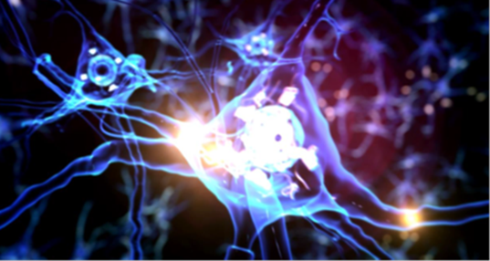

Talk With Me Baby
Early experiences affect the development of brain architecture, the foundation for all future learning, behavior, and health.
Just as healthy food nourishes a growing baby’s body, language nutrition nourishes a baby’s brain. Quantity and quality of nourishing language, like healthy food, is critical to brain development.
https://developingchild.harvard.edu/
http://www.talkwithmebaby.org/
https://www.kidcentraltn.com/development/0-12-months/loving-words-boost-brain-development.html

Slide 3
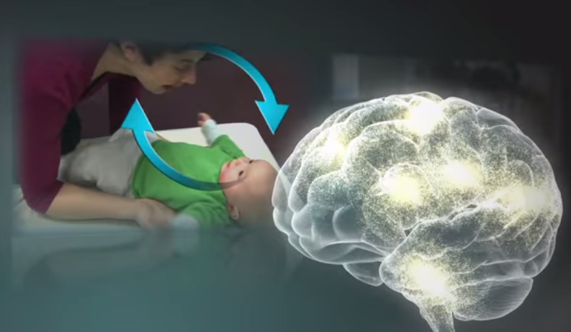
Language Nutrition: Serve and Return
Serve and return interactions shape brain architecture. When an infant or young child babbles, gestures, or cries, and an adult responds appropriately with eye contact, words, or a hug, neural connections are built and strengthened in the child’s brain that support the development of communication and social skills.
https://developingchild.harvard.edu/resources/serve-return-interaction-shapes-brain-circuitry/
Notes:
Much like a lively game of tennis, volleyball, or Ping-Pong, this back-and-forth is both fun and capacity-building. When caregivers are sensitive and responsive to a young child’s signals and needs, they provide an environment rich in serve and return experiences.
If asked:
The interactions of genes and experience shape the developing brain. Although genes provide the blueprint for the formation of brain circuits, these circuits are reinforced by repeated use. A major ingredient in this developmental process is the serve and return interaction between children and their parents and other caregivers in the family or community. In the absence of responsive caregiving—or if responses are unreliable or inappropriate—the brain’s architecture does not form as expected, which can lead to disparities in learning and behavior. Ultimately, genes and experiences work together to construct brain architecture.

Slide 4
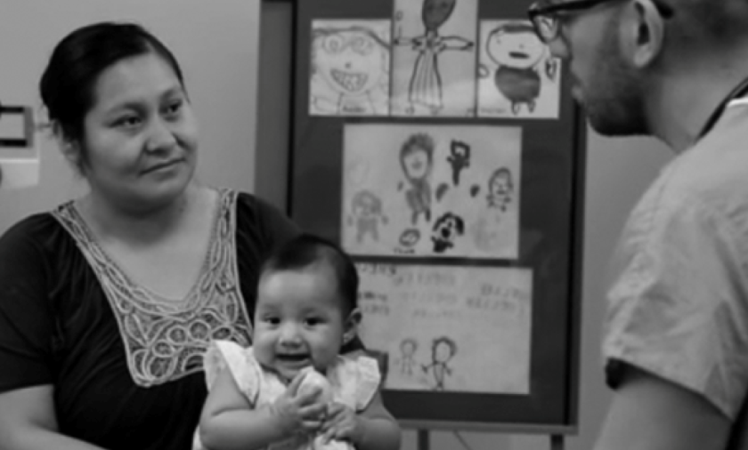
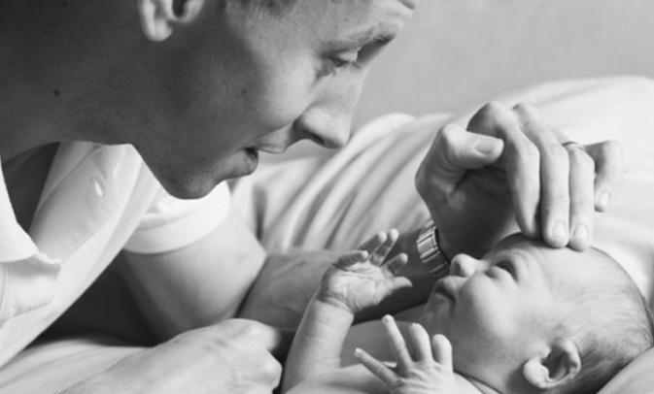

Talk With Me Baby Tennessee
A new TDH initiative borrowed from the Georgia Department of Public Health.
It isn’t a program, but simply the way we interact with families.
Goal: All health department staff members coach and model language nutrition at every infant/caregiver interaction.
Goal: Expand the initiative state-wide
so that every Tennessee infant
is nourished with loving words.
Photo credits: http://www.talkwithmebaby.org/
Notes:
http://www.talkwithmebaby.orghttp://www.talkwithmebaby.org/
http://www.talkwithmebaby.org/

Slide 5
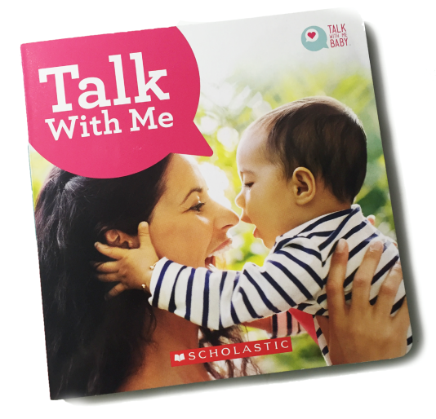
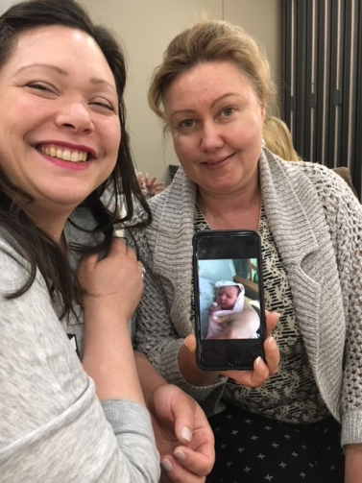
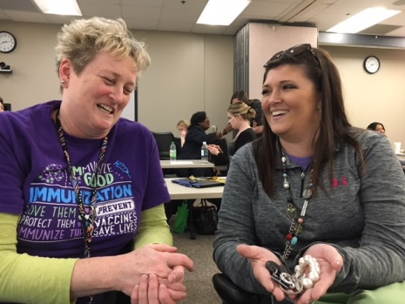
Progress to Date
596 TDH employees trained as TWMB coaches
400 TN home visitors trained as TWMB coaches
11 TDH employees from MCR and Central Office trained as coach trainers
TDH web-based coach training video
rolled out April, 2019
75,000 Talk With Me Baby books to county
health departments
Lively coach training sessions

Slide 6
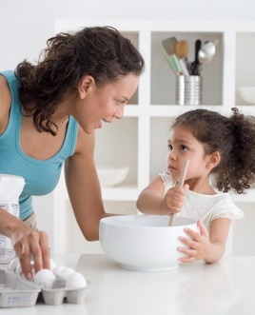
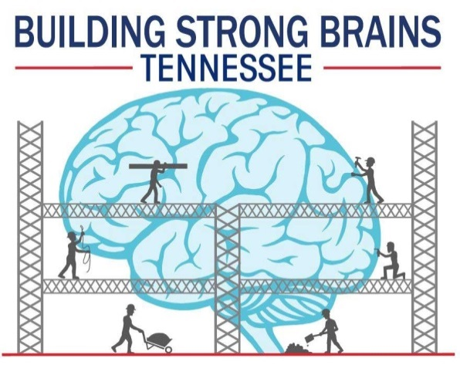

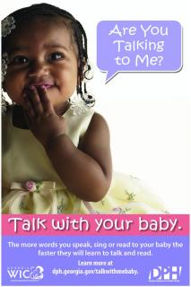
Partners
TDH “Language Nutrition Kitchen Cabinet”
  TDH Office of Primary Prevention, Family Health
  and Wellness, Community Health Services,
  and Vanderbilt School of Nursing
Georgia Department of Public Health
Notes:
Georgia Department of Public Health
Governor’s Books from Birth Foundation
Tennessee Three Branches Institute

Slide 7
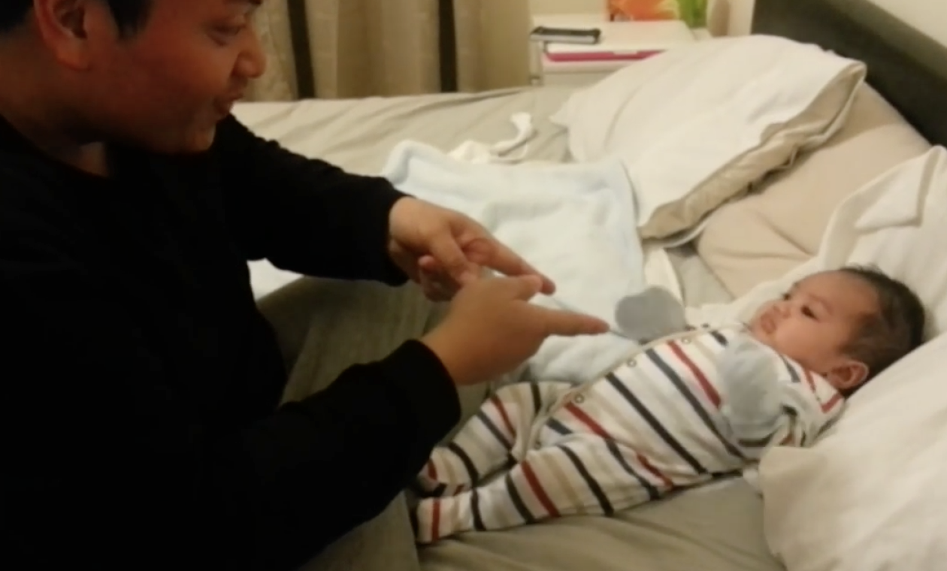
Talk, Read, Sing and Dance with Your Baby!
Who says babies don’t understand? Babies are soaking up everything in front of them, including dad’s sweet dance moves.
http://www.talkwithmebaby.org/watch_videos

