Slide 1
Oral health Assessment &
Fluoride Varnish Application
Tennessee Department of Health
Community Health Services
Oral Health Services
2015

Slide 2
A Call to Action
Why:
A person’s oral health impacts their overall health and quality of life
Most oral disease is preventable
Dental decay is an infectious disease
Bacteria in the mouth can travel to other systems in the body and have been found in samples removed from brain abscesses, pulmonary tissue, placentas, and arterosclerotic plaque in the arteries of the heart
50% of adolescents suffer from tooth decay
25% of seniors have no natural teeth

Slide 3
A New Approach
Engagement in oral health is a strategy to achieve primary care’s goal of improved care for individuals, improved health for populations, and lower overall costs
We believe that primary care teams can engage patients and families in the prevention of oral disease, offer preventive interventions such as fluoride, and detect disease in its earliest phase; referring those in need of treatment
Actively coordinating referrals, primary care providers facilitate the kind of partnership with dentistry that is the standard among health professionals across disciplines

Slide 4

Oral Health is a Primary Care Homerun
Rarely do serious health problems have effective and affordable solutions with an able delivery system

Slide 5

A Partnership
Americans are more likely to visit a primary care provider than a dentist, making the primary care setting a more reliable source of preventive oral health care
To reduce the burden of oral disease, the efforts and skills of both primary care providers and dentist, and their respective teams, will be required. The job is too great for either discipline alone

Slide 6
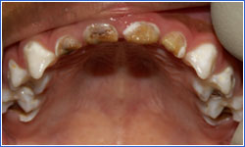
Early Childhood Caries (ECC)
ECC is an infectious, chronic disease that destroys tooth structure leading to loss of chewing function, pain, and infection in children up to five years old.
  It affects 35% of three-year-olds from low income families
Known variables:
  Feeding habits
  Socioeconomic status
  Access to dental care
  Fluoride exposure
  Family caries experience

Slide 7
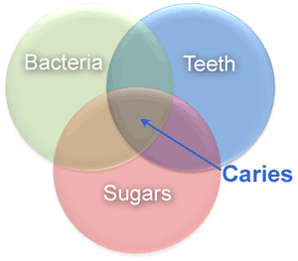
ECC Etiology
Cariogenic bacteria (including mutans streptococci) metabolize the sugars from dietary carbohydrates into acid.
The acid demineralizes the tooth enamel.
If the cycle of acid production and demineralization continues, the enamel will become weakened and break down into a cavity.

Slide 8
Etiology: Sugar
It's not just WHAT, but HOW, children eat:
Oral bacteria produce acids that persist for 20–40 minutes after sugar ingestion.
Oral acids lead to enamel demineralization.
Remineralization occurs when acid is buffered by saliva.
If sugars are consumed frequently, there is insufficient time for the remineralization process to occur. The tooth is then subjected to continued demineralization causing the caries lesion to progress.
If sugars are consumed infrequently, teeth are able to remineralize and the caries process halts.

Slide 9
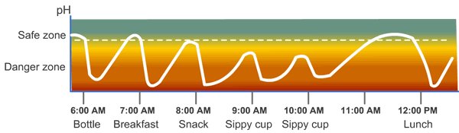
Change in level of pH due to sugar over time:

Slide 10
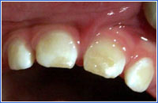
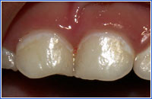
Etiology: Teeth
The cells that manufacture enamel are very sensitive to systemic insults. Disruption in the production of enamel will result in a defect which may be microscopic or macroscopic.
Nature of Enamel Defects:
  20% to 40% of children have enamel defects
  It may be difficult to distinguish enamel defects from early clinical signs of caries (lower photo), but this does not affect management.
  Enamel defects are associated with substantially increased risk of ECC.
  Increased incidence of enamel defects are associated with:
    Lower socioeconomic status (SES)
    Premature birth
    Certain congenital diseases and syndromes

Slide 11

Start
Oral Health Delivery Framework delineates the activities for which a primary care team can take accountability to protect and promote oral health. The activities are within the scope of practice of primary care

Slide 12

ASK
ASK about oral health risk factors and symptoms of oral disease
Mother, primary caregiver, or sibling have active decay
Lack of adequate fluoride exposure
Continual bottle/sippy cup use with fluid other than water
Frequent snacking
Special health care needs

Slide 13

ASK
Does the family have a Dental Home
Low socioeconomic status
Condition(s) impairing saliva flow
Drink fluoridated water
Fluoride varnish in the last 6 months
Brush teeth twice daily

Slide 14

LOOK
LOOK for signs that indicate oral health risk or active oral disease
Obvious Decay
White, chalky spots on teeth
Restorations (fillings) Present
Visible Plaque Accumulation
Gingivitis
Healthy Teeth

Slide 15

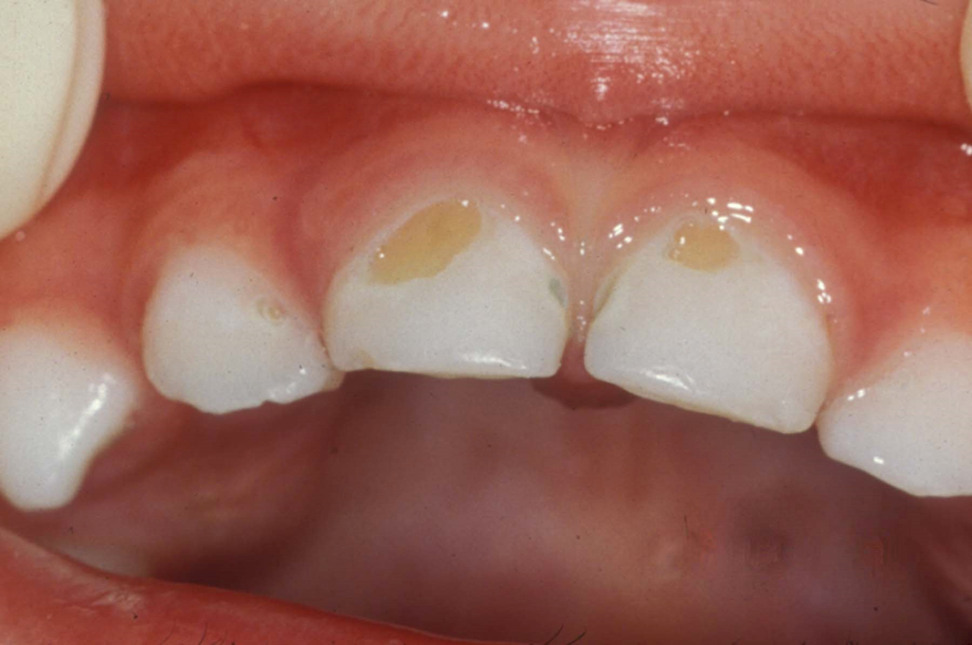
LOOK
Obvious Decay
This child is high risk
IMMEDIATELY-place the child in the high-risk category

Slide 16
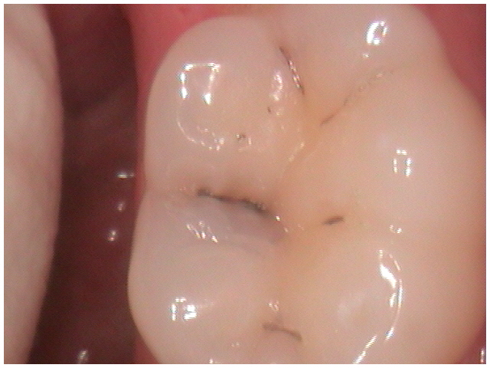
Tooth Decay

Slide 17
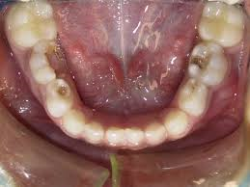
Severe Tooth Decay

Slide 18
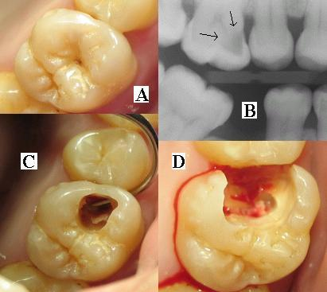
Decay May Look Small From the Outside, But…

Slide 19
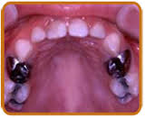
LOOK
Restorations (fillings) present
This child is high risk
IMMEDIATELY place the child in the high-risk category

Slide 20
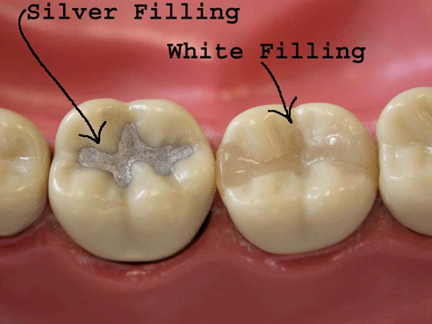
Restorations (fillings)

Slide 21
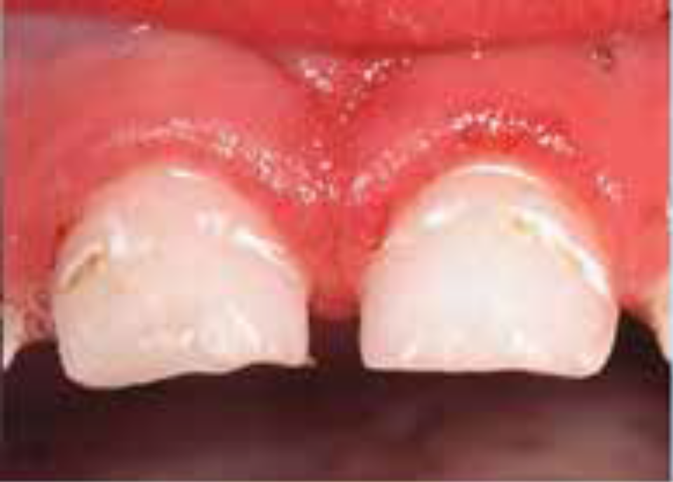
LOOK
White Chalky Spots/Decalcifications
This child is high risk
IMMEDIATELY place the child in the high-risk category

Slide 22
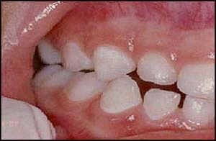
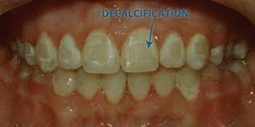
LOOK
Decalcification-first stage before tooth decay

Slide 23

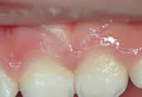
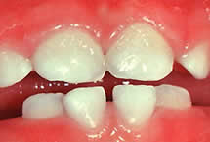

LOOK
Plaque Accumulation
This child is at a medium risk
Clinicians teach parents how to remove plaque

Slide 24

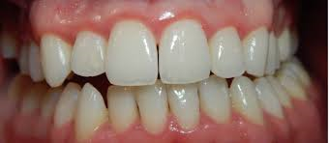
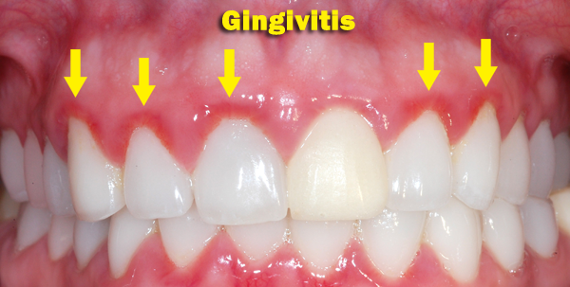
LOOK
Gingivitis
This child is at a medium risk
Clinicians teach parents the skills to reduce the inflammation

Slide 25


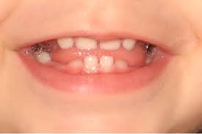

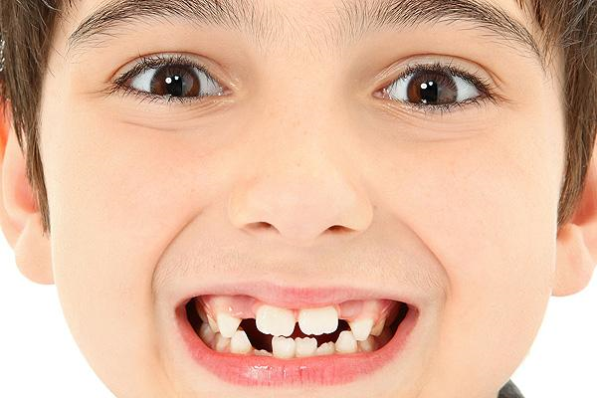
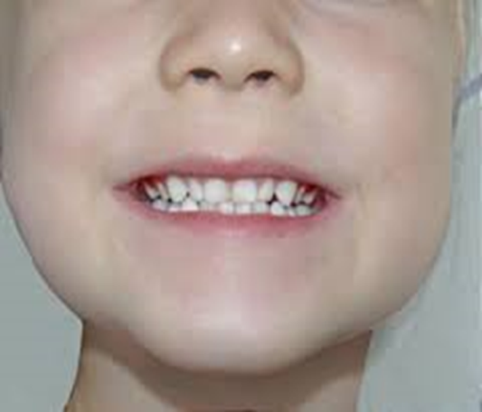
LOOK
Healthy Teeth
This child is at a low risk

Slide 26

DECIDE
Decide on the most appropriate response:
Review information gathered
Share results with patients and families
Determine a course of action using standardized criteria

Slide 27

ACT
  Preventive Intervention:
  HIGH RISK
  Professionally applied fluoride varnish
  Home care instructions given and stressed
  Active referral to a dentist (dental home)
  Medium Risk
  Professionally applied fluoride varnish
  Home care instructions given and stressed
  Active referral to a dentist (dental home)
  Low Risk
  Professionally applied fluoride varnish
  Review home care instructions
  Referral to a dentist (dental home)

Slide 28

DOCUMENT
Document the findings as structured data to organize information for decision support, measured care processes, and monitor clinical outcomes so that quality of care can be managed. (follow-up)

Slide 29




ASK
LOOK
DECIDE
ACT
DOCUMENT

Slide 30
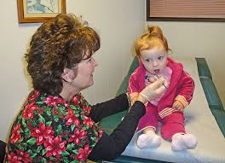
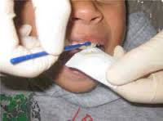
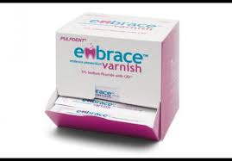
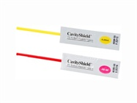
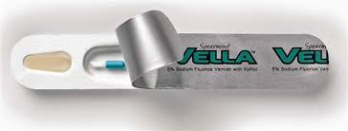
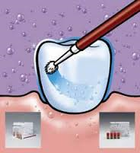
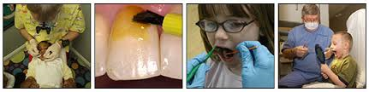
FLUORIDE VARNISH

Slide 31
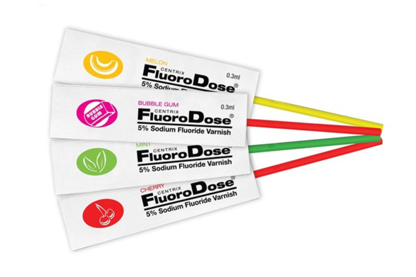
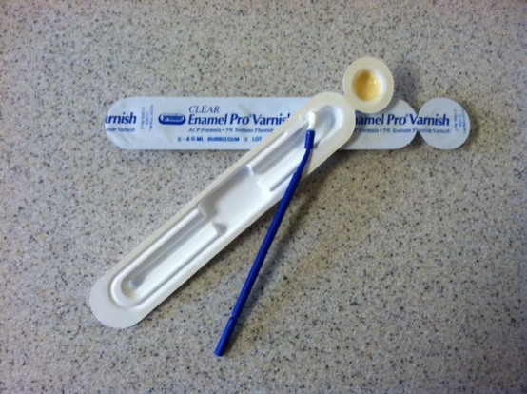
How Much Fluoride Varnish
“Thin to Win”
Maximum 0.25ml-primary dentition (baby teeth, milk teeth)
Maximum 0.40ml-mixed and permanent dentition (big teeth, adult teeth)
Fluoride varnish come in both sizes for single application

Slide 32
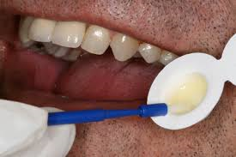
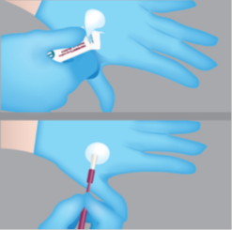
Application of Fluoride Varnish
Mix varnish with the brush (if required)

Slide 33
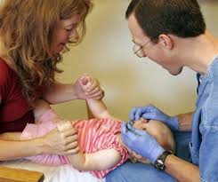
Knee to Knee Application with the Parent

Slide 34
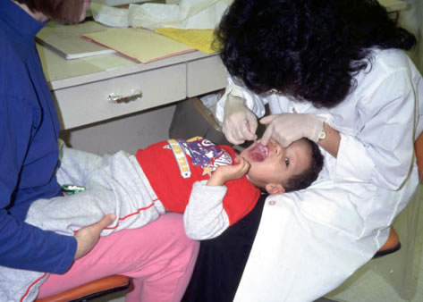
Knee to Knee Application with the Parent

Slide 35
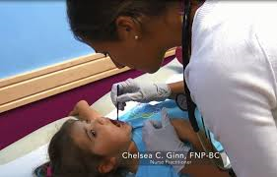
Exam Table Application

Slide 36
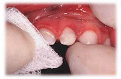
Dry Teeth with Gauze

Slide 37
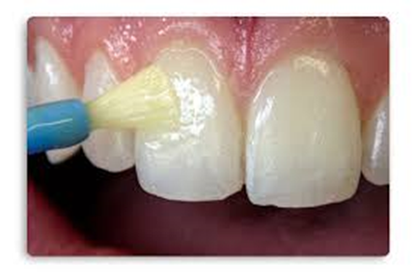
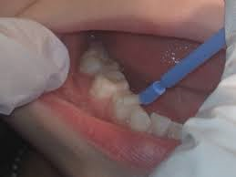
Apply a Thin Coat
One horizontal swipe of the brush
2-3 brush strokes per quadrant
Apply fluoride sparingly

Slide 38
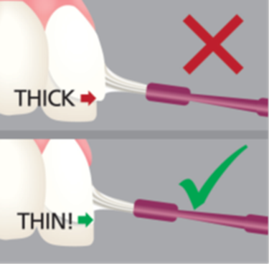
THIN TO WIN

Slide 39
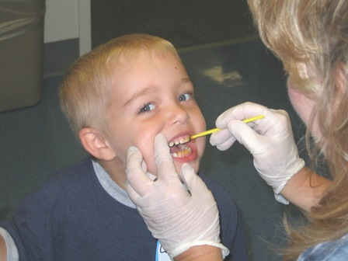
Post-Application Instructions
Patient can leave immediately after application
Child should not brush for 4 hours
Eat a soft diet for 4 hours
Avoid hot drinks and products containing alcohol (beverages, oral rinses) for 4 hours

Slide 40
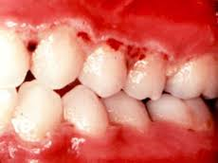
Contraindication to Fluoride Varnish
Ulcerative gingivitis and stomatitis (trench mouth)
Known allergies or reactions to colophony (Rosin)
  Rosin is the sap or sticky substance that comes from pine and spruce trees. Found in cosmetics, adhesives, medicines, and chewing gum.
  Professional fluoride application within the past 3 months
  Low risk children who consume optimally fluoridated water or receive routine fluoride treatments through a dental office

Slide 41
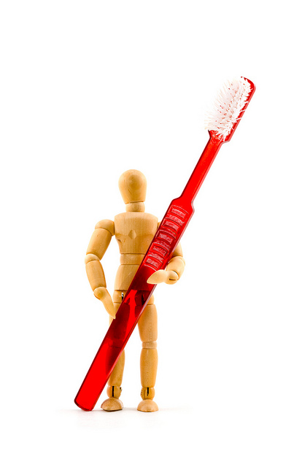
Fluoride Varnish and Oral Health Assessment
Code Both Each Time Fluoride Varnish Is Applied
D0190N
Oral screening
RN only
D1203N
Fluoride varnish application
RN or LPN
Reference current PHN protocol and codes manual

Slide 42
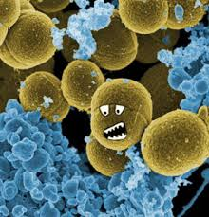


Patient Information
Bacteria causes tooth decay
Babies/Children can catch bacteria from parents, care givers, and/or siblings
If brushing is not possible, rinse the mouth with water
If brushing is not possible, chew sugar-free gum, 10 minutes

Slide 43


Help Protect Our Teeth
They Are Very Useful

Slide 44
Sources:
AAP.org/oralhealth
ADA.org
CDC.gov/oralhealth
Qualis Health. Oral Health: An Essential Component of Primary Care. White Paper June 2015
SmilesforLifeoralhealth.org

Slide 45


