Slide 1
Civil Monetary Penalty Reinvestment Program
Special Topics Webinar
August 5, 2020
1:00 PM CT
Notes:
*begin recording* Good afternoon, thank you all for joining us today. The Nursing Home Civil Monetary Penalty Reinvestment Program is proud to host our special topics webinar series. My name is Kristyn Long and I am the Assistant Director of the program. I am going to ask everyone on the line to use the chat box to let us know you’re in attendance by typing your name, email, place of employment, and title and please make sure your line is muted. To use the chat box to sign in, you can hover over the lower part of the screen and a tool bar will pop up. Then click on the icon that looks like a bubble. I encourage you all to utilize the chat box throughout today’s presentation to ask any questions you have and we will address those questions at the end of the presentation. Once again before we get started, please make sure your line is muted.

Slide 2
Civil Monetary Penalty (CMP)
Centers for Medicare and Medicaid Services (CMS) oversees compliance with Medicare health and safety standards of facilities serving Medicare and/or Medicaid beneficiaries
State Survey Agencies complete surveys to determine compliance (Section 1864 of the Social Security Act)
Penalties may be imposed against facilities if facilities are not in compliance with CMS regulations
Fines may differ depending on severity of deficiency
Notes:
First, I am going to provide you with a brief overview of the CMP Program. So, many of you know that CMS administers the Medicare and Medicaid programs across the nation.
CMS also oversees compliance with Medicare health and safety standards of facilities serving Medicare and/or Medicaid beneficiaries and entrust state agencies to oversee the State and Federal surveying process in order to determine compliance. (Section 1864 of the Social Security Act)
All Long-term care facilities must meet Code of Federal Regulations. Cases of fraud and abuse of the Medicare and Medicaid programs could result in fines.
90% of the fines (aka CMP funds) are given to the state to support activities that protect or improve quality of life or care of residents. (transition to next slide re: RFA)

Slide 3
CMP Funding Opportunity
Quarterly Request for Applications (RFA)
Funded programs must showcase a variety of enhancement philosophies through current and sound evidence-based practices
For more information on how to submit a proposal visit the CMP website:
  https://www.tn.gov/health/health-program-areas/nursing-home-civil-monetary-penalty--cmp--quality-improvement-program/redirect-cmp/cpm-how-to-apply.html
Or contact the CMP Program to be added to our listserv to receive notifications via email
Notes:
The Department of Health hosts a quarterly Request for Application process to disperse these funds appropriately. Funded programs must showcase a variety of enhancement philosophies through current and sound evidence-based practices. If you are interested in submitting a palliative care proposal or a proposal on any other topic, please visit our website for more information or contact the CMP Program to be added to our listserv to receive notifications via email.

Slide 4
Integrating Palliative care Into LTC
Mohana Karlekar, MD, FACP, FAAHPM
Section Chief, Palliative Care
Vanderbilt University Medical Center
August 5th2020
Notes:
At this time, it is my pleasure to introduce Dr. Karlekar ---- read from bio

Slide 5
Objectives
Define palliative care
Differentiate pal care from hospice?
List the access points to pal care
Outline a framework to think through prognosis and outcome based on trajectory
Palliative Care & Covid
List steps facilities, patients and families can take to achieve optimal care when facing a serious illness

Slide 6

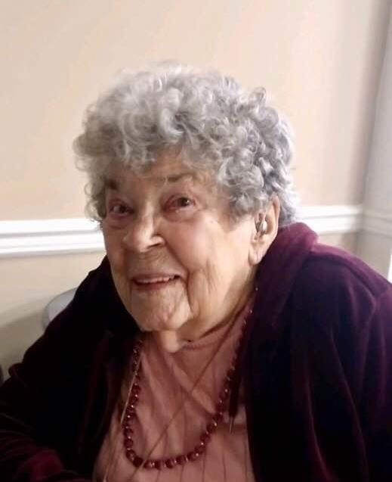

Mrs. W

Slide 7
palliative care
How is this different from hospice?
How do you access it?
Who provides it?

Slide 8
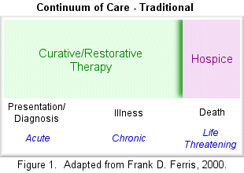
Traditional Model for Pal care

Slide 9
Current Model for Pal Care
Hospice
Curative, Aggressive Tx
Bereavement
Palliative Care Modalities
Diagnosis of Serious Illness/Injury
Death
Notes:
Ideally, patients and families living with a chronic debilitating and progressive disease could receive palliative care throughout the course of their disease and its treatment, and as they come close to death could transition seamlessly and without added distress into a hospice program of care.

Slide 10
Palliative Care vs. Hospice
Palliative Care
Hospice
Medical Specialty
Focuses on those that are seriously ill
No defined life expectancy
Ideally integrated while pursuing curative cure
Interdisciplinary care
Patient and Family Centered
Insurance Benefit
Requires a terminal illness/incurable condition
Life expectancy <6 mos.
Treatments are for palliation only
Interdisciplinary care
Patient and Family Centered

Slide 11
Palliative
Care
Symptom
Management
Hospice
Goals of Care
Discussions
Elicit Patient/Family’s Understanding
Psycho-social Support
Discussion of Prognosis
Including Uncertainty
Post Acute Support Services

Slide 12
Accessing Palliative Care
Inpatient Acute Care Hospitals
  Hospital based palliative care teams
  Partnerships with community hospices & community palliative care team organizations
Outpatient/Community
Home based palliative care via
  Hospice organizations
  Palliative care Organizations
Outpatient clinics
  Free standing
  Linked to a larger health care institution

Slide 13
Hospital Based Palliative Care Programs in TN
Location | 2019 Grade* | By Hospital Size
 |  | < 50 beds | 50-150 beds | 151-299 beds | 300+ beds
State | 61.7% B | 47.8% (11/23) | 47.1% (8/17) | 42.9% (6/14) | 93.8% (15/16)
Region | 48.2% C | 31.3% (40/128) | 23.6% (21/89) | 52.0% (26/50) | 86.5% (45/52)
National | 71.5% B | 36.3% (557/1535) | 51.1% (474/928) | 75.6% (578/765) | 93.7% (671/716)
East South Central Region = AL, KY, MS, TN
*The 2019 State-by-State Report Card on Access to Palliative Care in Our Nation’s Hospitals grade excludes hospitals that have fewer than 50 beds.
Report Card grades are as follows: A (80% or more of hospitals with 50+ beds have palliative care), B (60-79%), C (40-59%), D (20-39%), F (less than 20%).

Slide 14
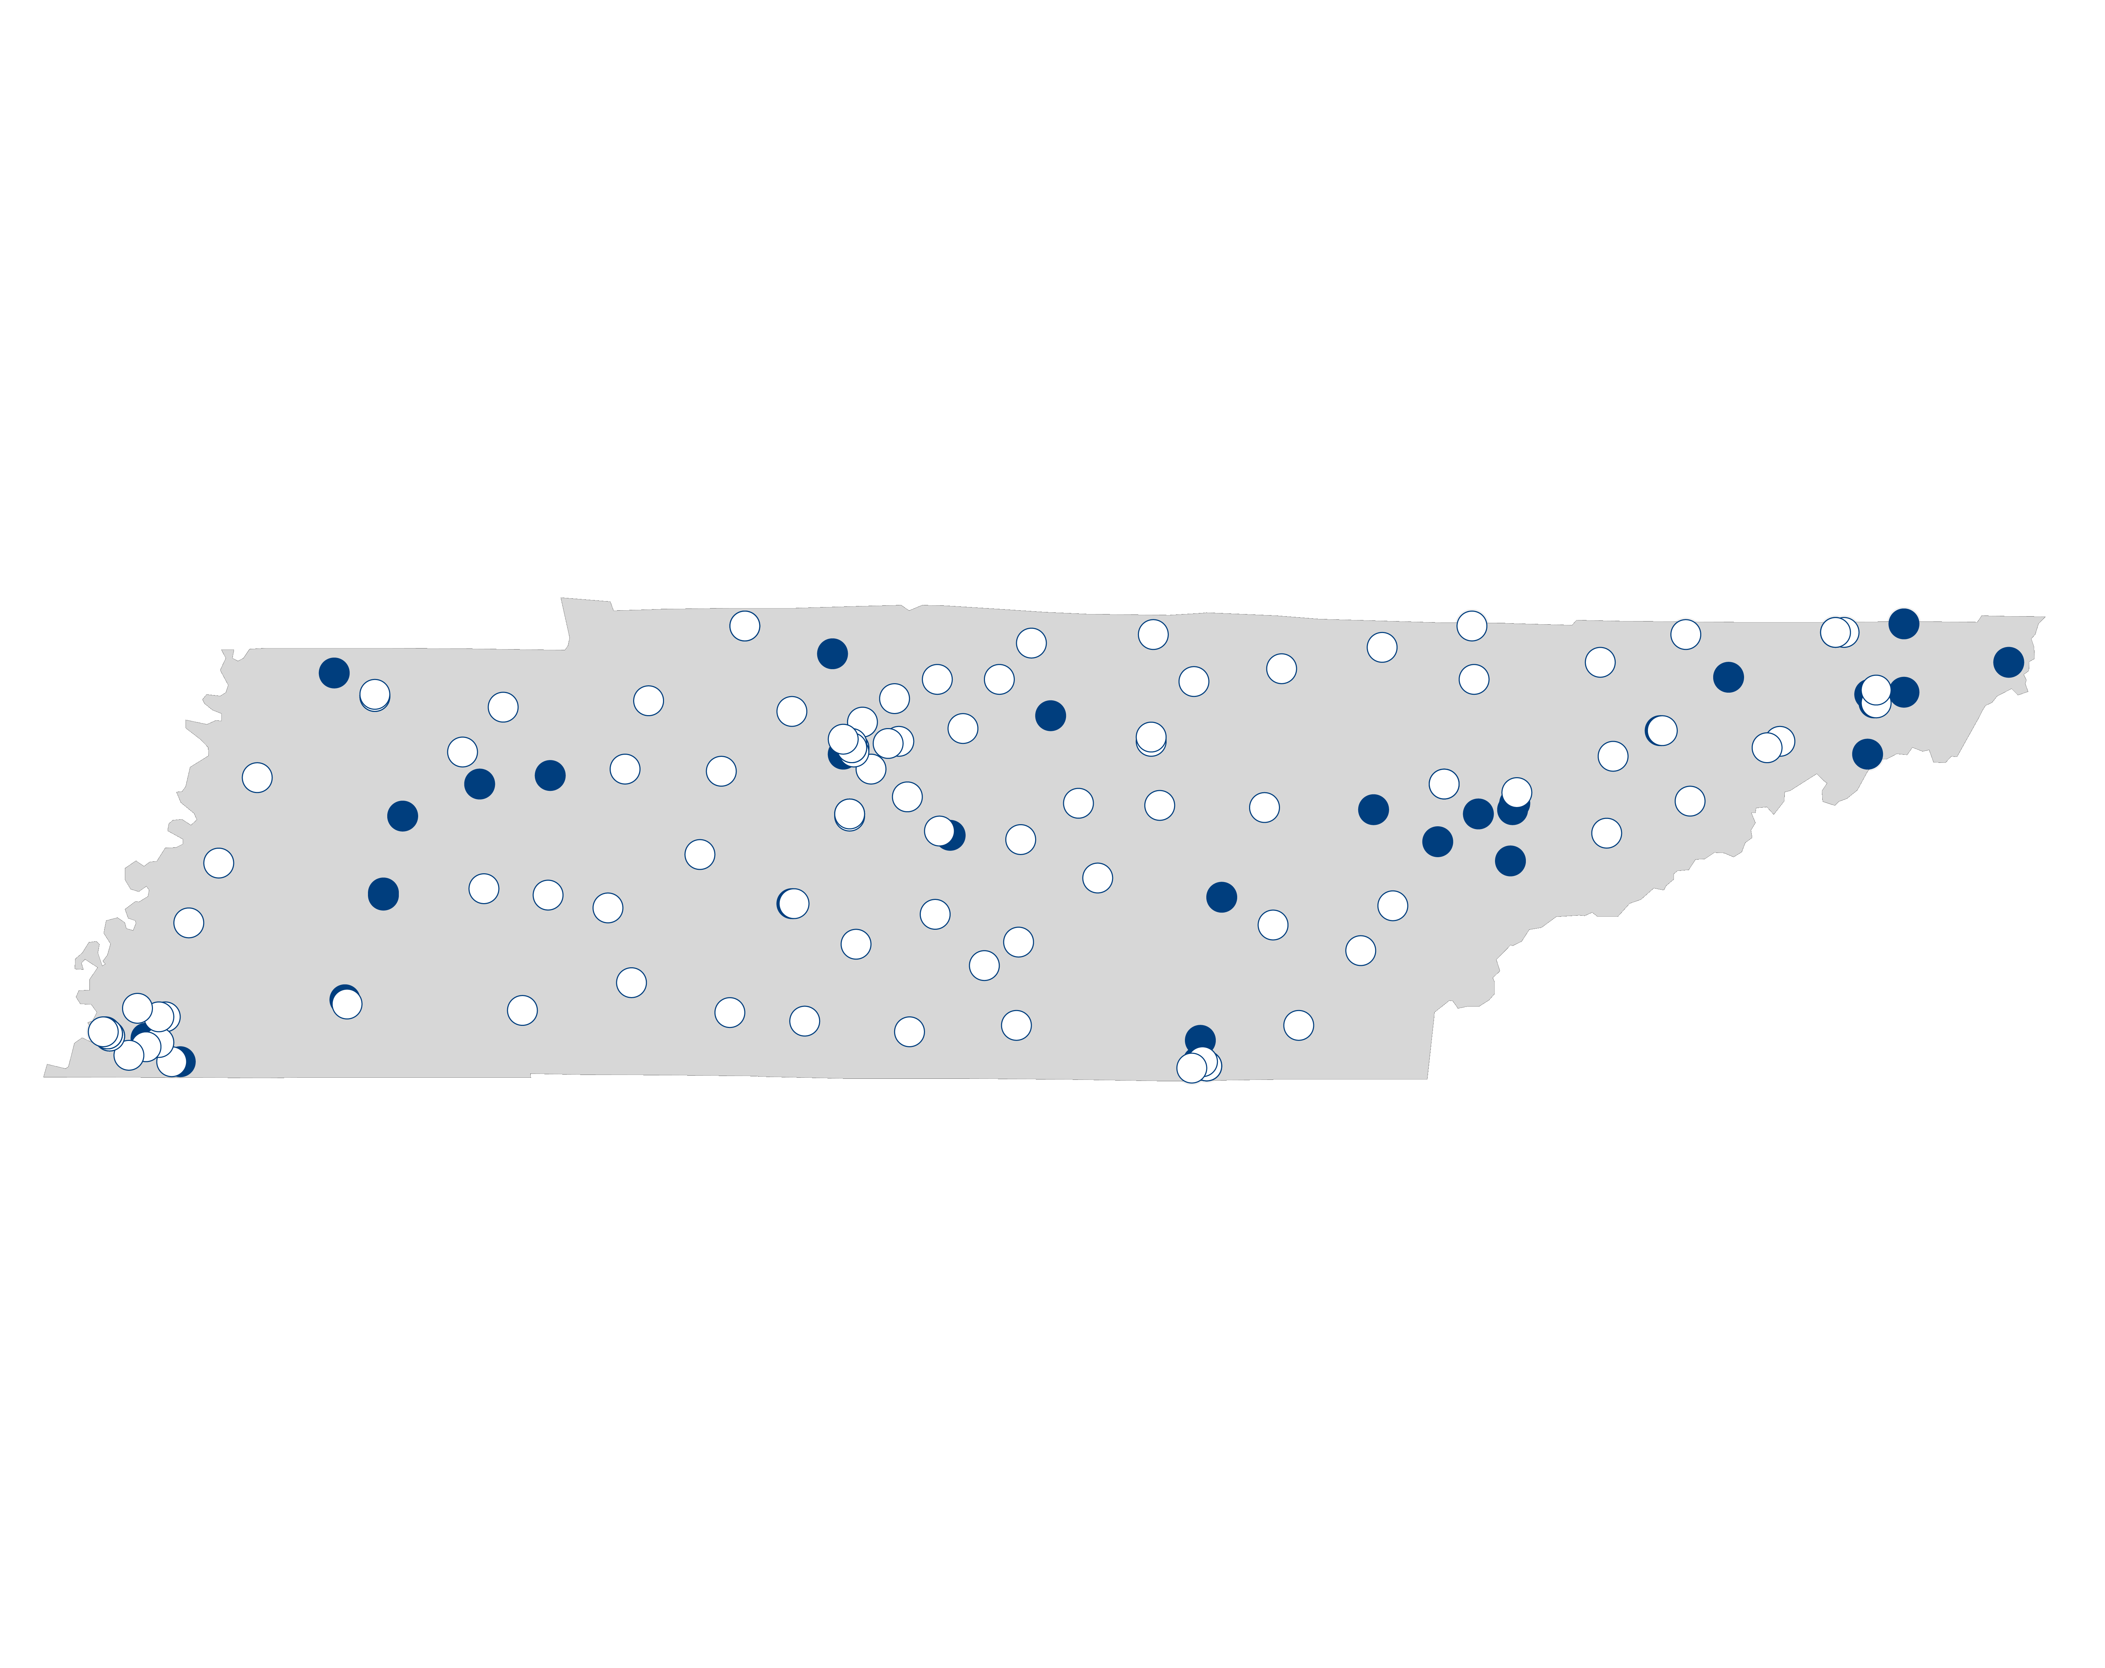
Hospital Palliative Care Availability in TENNEESEE includes hospitals of all sizes.¹
-Solid dots indicate hospitals that report palliative care programs -empty dots indicate hospitals that do not currently offer palliative care.

Slide 15
Who is able to provide pal care?
Truth about Diagnoses and Illness Trajectory

Slide 16

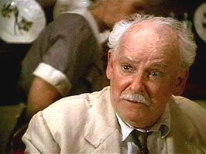
Palliative Care in the current state of health care
Hepatologist
What features distinguish palliative care providers/teams?”

Slide 17
Palliative Care
Primary Pal Care
Specialty Pal care
Clinicians not formally trained in pal care but feel comfortable managing:
Complex communication
End of life care
Hospice
Clinicians with specialty training in palliative care

Slide 18



Slide 19
Achieving the best care when facing a serious illnesS
“Goal Concordant Care”

Slide 20
Illness Trajectory

Slide 21
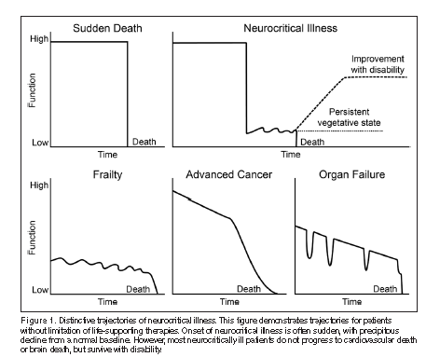
Illness Trajectory

Slide 22
Engage patients/families in GOC discussions

Slide 23
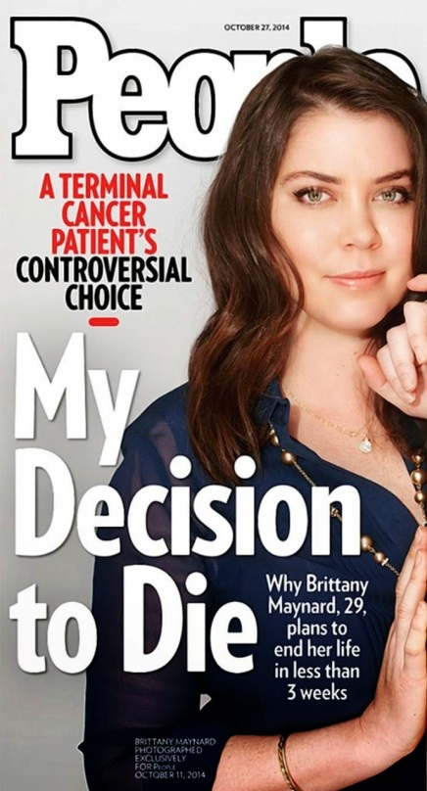

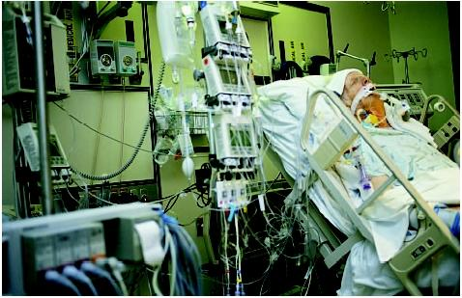


Slide 24
Revisit & clarify Goals periodically

Slide 25
Dying In America… http://www.apa.org/pi/aging/programs/eol/end-of-life-factsheet.aspx http://www.pbs.org/wgbh/pages/frontline/facing-death/facts-and-figures
70% deaths occur in older adult (>65 years of age)
7/10 Americans want to die at home
25% Americans die at home

Slide 26
Chronic disease http://www.apa.org/pi/aging/programs/eol/end-of-life-factsheet.aspx http://www.pbs.org/wgbh/pages/frontline/facing-death/facts-and-figures/
7/10 Americans die from chronic disease
>90 million Americans have at least 1 chronic disease
>80% of those with chronic disease want to avoid hospitalization/ICU at the end of life
Nearly half of Americans die in a hospital
Notes:
Facts on where people die at what cost and impact on others

Slide 27
“better”
Can go back home?
Discharge from the hospital?
Resume normal life?
What does that really mean?
Survival?
Take care of myself
Improvement in lab tests
Take care of my family?

Slide 28
What gets in the way of Achieving Goal concordant care?

Slide 29
Barriers to achieving
“goal concordant care”
Health Care Providers
Health Care System
Families
Patients

Slide 30
Prognostication…
We Are Just Not That Good At It
BMJ. 2000 Feb 19;320(7233):469-473
U. Chicago Medical Center Study: extent and determinants of error in prognostication
Study participants:
  343 physicians
  468 terminally ill patients

Slide 31
Christakis et al.
BMJ. 2000 Feb 19;320(7233):469-473
  Median survival for patients 24 days
  20% predictions were accurate (within 33% estimated survival time)
  63% predictions were over optimistic
  17% predictions were overly pessimistic
Notes:
That is that 20% predictions were accurate within ~8 days of their predicted survival time
Generally we predict that people will longer than is actually the case

Slide 32
Christakis et al.
BMJ. 2000 Feb 19;320(7233):469-473
Physicians overestimate prognosis by factor of 5
As duration of physician patient relationship increases, and time from last contact decreases, prognostic accuracy decreases
Notes:
We seem to be more accurate with med
Knowing a patient well, seems to make us less likely to be able to accurately predict prognosis

Slide 33
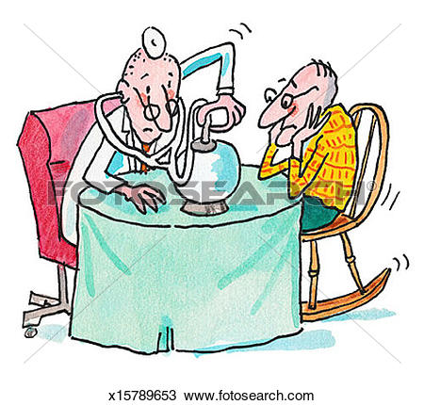
Discomfort with the truth if we had it…
Notes:
Crystal ball slide

Slide 34
Christakis et al
Annals of Internal Medicine. Jun 2001. Vol134(12);1096-1105.
Study:
  326 patients
  258 physicians
Physicians stated:
  37% of time they would provide frank estimates
  63% of time, would provide no estimate or either a conscious over/underestimate

Slide 35
Barriers to achieving
“goal concordant care””
Health Care Providers
Health Care System
Families
Patients
Notes:
Picture on communication plus minus maze

Slide 36

Health Care System is Complicated
  Health care professionals tend to avoid conversations on death and dying
  Mrs. W a d her family wanted to ensure her wishes were met at the EOL

Slide 37
Barriers to achieving
“goal concordant care”
Health Care Providers
Health Care System
Families
Patients
Notes:
Picture on communication plus minus maze

Slide 38
Families are…
Actively trying to advocate for loved ones
And also conflicted
  Hoping to extend life
  Do not want their loved one to suffer
Afraid

Slide 39
Barriers to achieving
“goal concordant care”
Health Care Providers
Health Care System
Families
Patients
Notes:
Picture on communication plus minus maze

Slide 40
Patients Are… http://www.apa.org/pi/aging/programs/eol/end-of-life-factsheet.aspx
Afraid
  That their symptoms will go untreated
  That they will die alone
  They will die in misery
  They will burden their family
Uncertain
  What to expect..
Notes:
Add pics

Slide 41
What can Health Care providers do?
Engage patients and families in discussions
Consider illness trajectory when thinking about outcome and prognosis
Ask patients what is important, engage in GOC discussions
Encourage completion of advance care directives and revisit these
Notes:
Picture on communication plus minus maze

Slide 42
Advance care planning

Slide 43
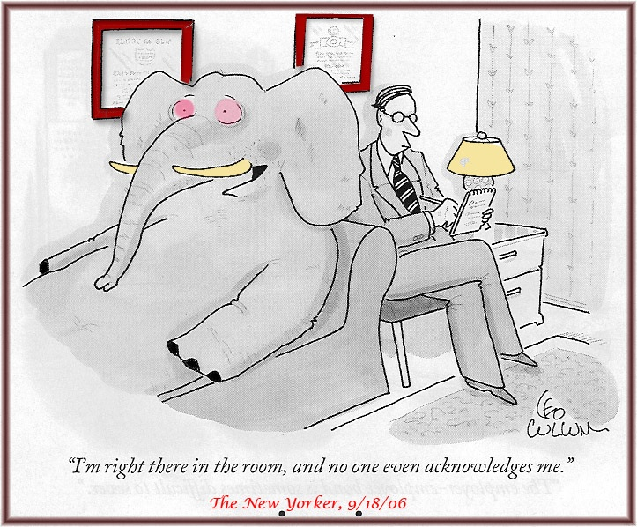
Avoiding conversations for some may be inevitable

Slide 44
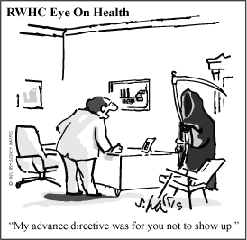
Avoidance of discussions

Slide 45
Advance care planning http://www.apa.org/pi/aging/programs/eol/end-of-life-factsheet.aspx http://www.pbs.org/wgbh/pages/frontline/facing-death/facts-and-figures /
Almost 1/3 Americans see >10 physicians in the last 6 months of life
Only 20-30% Americans have an advance care directive
In one study, only 25% surveyed physicians knew their patients had an advance care directive on file

Slide 46
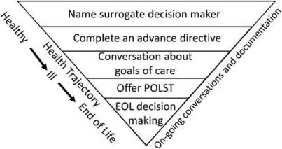
Advance Care Planning

Slide 47
TN advance care directives
Advance Care Directive
for Health Care
POST
Patient must have the “capacity” to make their own decisions
Must be interpreted by their health care provider
Document for the future
Patients who lack capacity can have this document completed
This is a medical order, must be followed
Valid in all community settings including the ED
Valid now

Slide 48
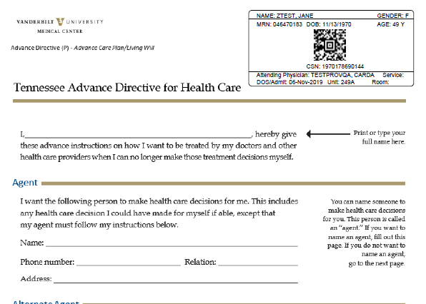
TN advance care directive for Health care
Agent Designation
Page 1

Slide 49
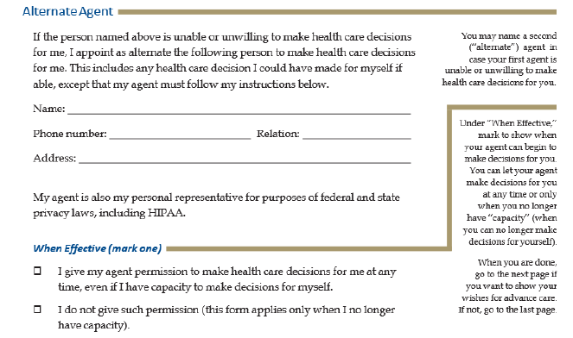
Alternate
Agent
Page 1

Slide 50
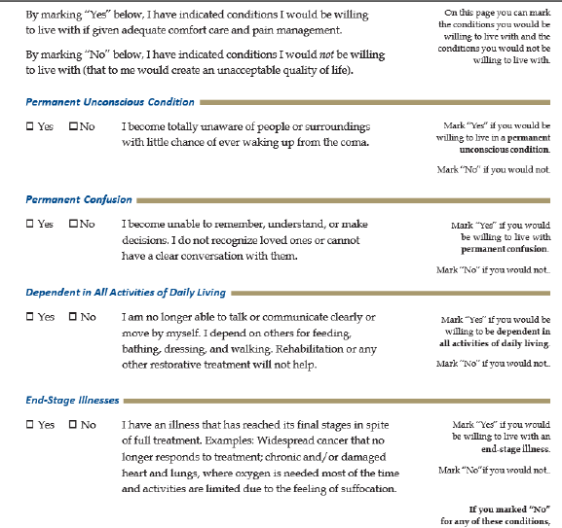
QOL
Page 2

Slide 51
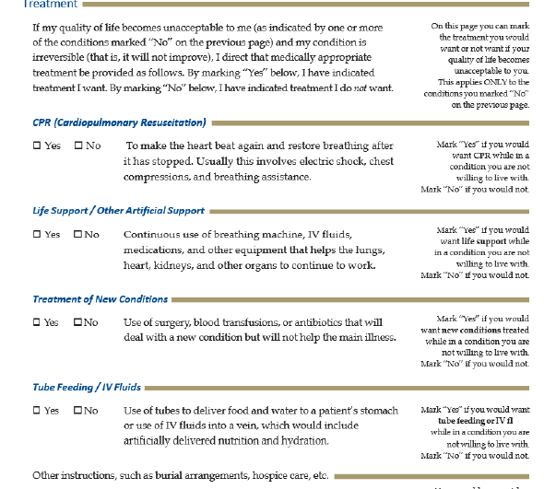
Treatments page 3

Slide 52

Organ donation –Page 3

Slide 53
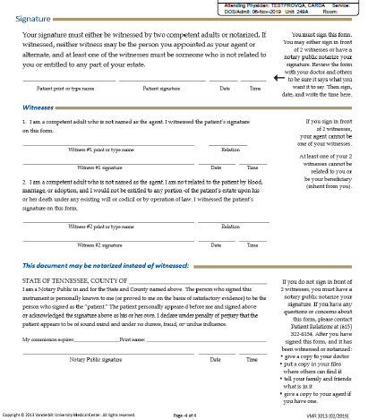
Signatures-Page 4

Slide 54
POST
Physician Order for Scope of Treatment

Slide 55
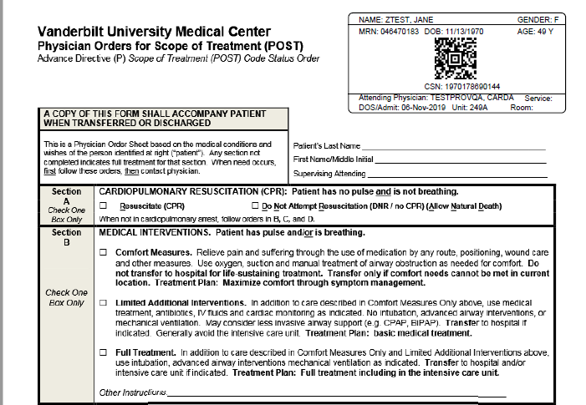
POST
Section A & B
CPR
Intent of hospitalization

Slide 56
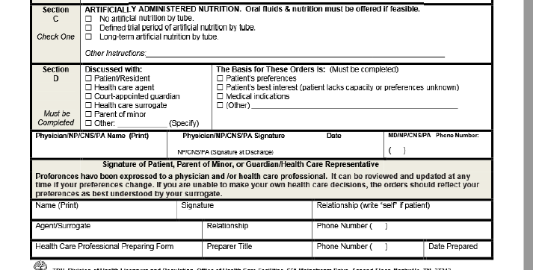
section c & D
Artificial Nutrition who reviewed form

Slide 57


We are not Scooby Doo
We are all born into this world and one day we will die
Engaging in conversations about our own wishes is empowering & integral to optimal patient centered care

Slide 58
Mrs. W…And her goals?
87-year old woman with HTN and hypothyroid is recently widowed and lives at home, she is forgetting more
At 89 she is moved into an independent living facility
At 93 she is moved to an assisted living facility
At 95, she is moved to a memory care unit

Slide 59
Would her goals change as a FUNCION of…
Life expectancy
Burden of illness-inability live independently
Medical diagnosis-dementia, frailty

Slide 60
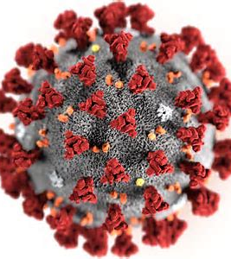
Novel
Coronavirus 19 Pandemic
Has impacted our older adult population especially hard
  In particular those in LTC
  Patients are scared to go to the hospital and scared to remain in their facilities
  Families have not seen their loved ones for months
Increased interest and attention in completing advance care directives
Key is being intentional & to engage patients and families in discussions on ACP & GIC

Slide 61

Take home messages
Palliative care appropriate for all patients facing serious illness at any point in their illness
Consider trajectory when considering prognosis
Engage patients and families in GOC and ACP discussions
Encourage completion of advance care directives as a routine practice
Establish GOC and revisit these frequently

Slide 62
ENHANCE GOC Discussions in LTC
“Empowering Nursing Homes to Accomplish Nuanced Communication Expertise and Goals of Care Discussions in TN Long Term Care Facilities”

Slide 63

Thank you!
Questions????

Slide 64


CMP Projects: Palliative Care
Previously funded palliative care project:
  St. Thomas Health Foundation
  Palliative Care Transitional Program
Currently funded palliative care project:
  Vanderbilt University Medical Center
  Empowering Nursing Homes to Accomplished Nuanced Communication Expertise and Goals of Discussion in TN LTC Facilities
Notes:
Following today’s presentation, we thought it might be helpful to share how CMP funding is being utilized to advance palliative care and end-of life care within Tennessee nursing homes. For example, The goal of the Palliative Care Transitional Program was to increase the numbers of patient care conversations that are conducted with and implemented for palliative care residents during transfers to, and residents at, skilled nursing facilities. St. Thomas implemented an End of Life policy that includes guidance for POST (Physician Orders for Scope of Treatment form) and as a result of the project, they had an 88% POST completion rate.
VUMC: Through this project, the Vanderbilt University Medical Center will engage 18 nursing homes in rural and distressed communities. Residents, family members, clinicians and staff in each participating facility will learn effective communication skills, and how to conduct conversations that will elicit the individual preferences of each resident. In addition, residents, family members and staff will be trained on advanced care planning and physician orders for life sustaining treatment. The project interventions will directly impact the quality of life of residents, morale of the staff, and delivery of the right care at the right time for the right residents based on their preferences.

Slide 65

Resources
Honoring Choices® Tennessee
TN Advance Directive for Health Care form
Create Your Own Advance Directive video
Palliative Care and Quality of Life Taskforce
  2018 Final Report
Palliative Care and Quality of Life Advisory Council
  2019 Update Report
Visit Honoring Choice Tennessee’s home page, www.advancedirectivestn.org, and follow the 4 easy steps:
Notes:
Dr. Karlekar referenced the TN Advance Directive for Health Care and POST documents during her presentation. We would like to share available resources as noted on this slide including a statewide coalition, Honoring Choices , which encourages Tennesseans to discuss health care decisions and document their choices through an advance directive for health. Every adult regardless of age and current health state needs an Advance Directive and here are a few resources to help make it really easy and free. The create your own advance directive video will help answer questions like, “What is an advanced directive?” and “Who needs an advanced directive?”. The referenced “fold up form” in the video replicates the TN model form and either form can be downloaded and completed. The importance of palliative care is being discussed at the national, state, regional and local levels. You can learn more about Tennessee’s efforts by reviewing the referenced Palliative Care and Quality of Life taskforce and advisory committee reports.

Slide 66
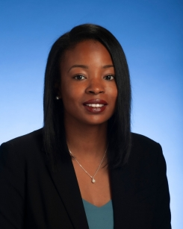
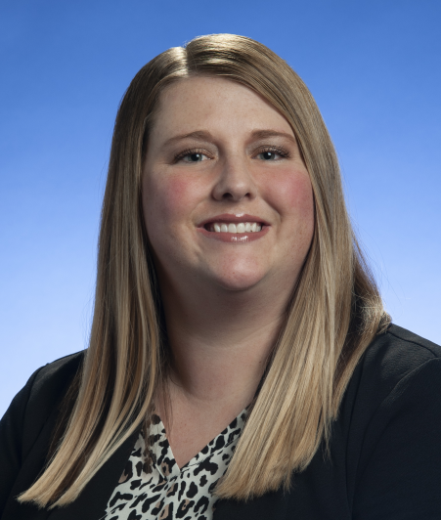
Contact Us
Shaquallah Shanks, MPH
Director, TN Civil Monetary Penalty Reinvestment Program
Shaquallah.Shanks@tn.gov
615-741-6823
Kristyn Long, BS
Assistant Director, TN Civil Monetary Penalty Reinvestment Program
Kristyn.Long@tn.gov
615-770-6805

