Slide 1
Guide to Using HDDS data
10.20.2020

Slide 2
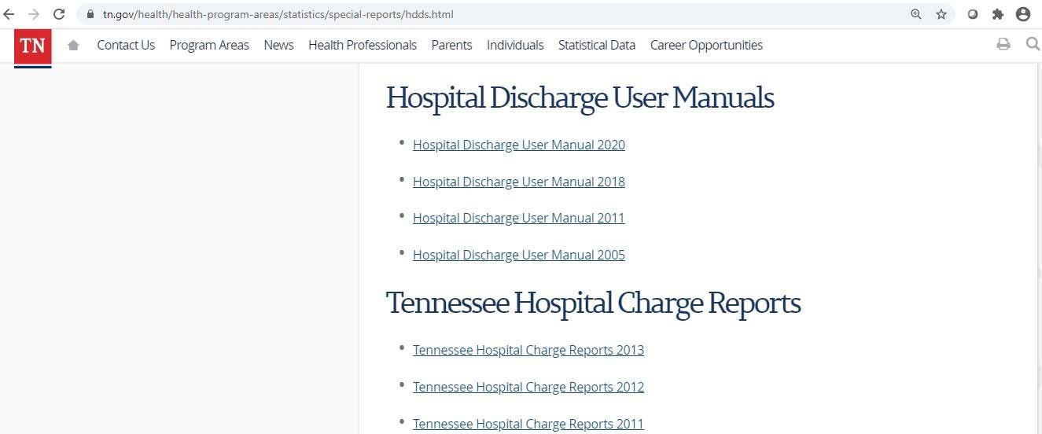
Locate the HDDS User Manuals

Slide 3

File Layout
Record level data can be provided as a SAS datafile or
CSV file.
Two different versions depending on year:
  Data years 1995 to 2006 uses UB-92
  2007 to current uses UB-04

Slide 4
Diagnosis Code Changes
HDDS data years 1995 to September 2015 uses ICD-9-CM coding format.
As of October 1, 2015, all patient data changed to the ICD- 10-CM coding format.

Slide 5
Using the JARID variable
A Joint Annual Report ID ( JARID) is issued to all registered TN hospitals by TDH.
HDDS creates 4-digit Hospital ID from the JARID.
  County location – defined by the first two digits.
  Type of Hospital – defined by the third and fourth digit of JARID
    Acute Hospitals (20-39 and 50-54)
Mental Health Hospitals (40-49)
Rehab & Specialty (75-84)
4721
County Location
Type of Hospital

Slide 6
Added Variables
As part of data processing, TDH adds additional variables that may not be referenced in the manuals. These are variables derived from the data.
Examples:
Flag for Tennessee Resident
Race Summarized
Infant Age in Months
Flag for Emergency Room Record
Patient ID. Randomized from Patient SSN. A file listing variables is available by request.

Slide 7
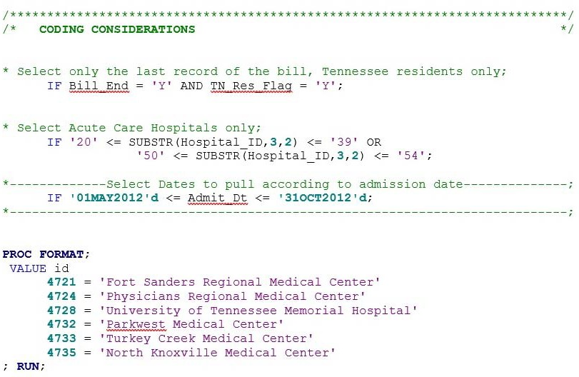
Coding Considerations

Slide 8
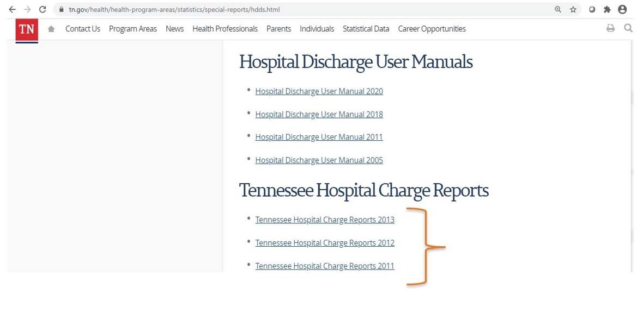
Locate the TN Hospital Charge Reports

Slide 9
Citing HDDS Data
Source/Reference: Tennessee Department of Health, Division of Population Health Assessment. Hospital Discharge Data Systems, (Year). Nashville, TN.
Acknowledgement: Hospital Discharge Data were provided by the Tennessee Department of Health, Office of Healthcare Statistics, Division of Population Health Assessment.

Slide 10

Questions?

