Slide 1

Data Availability

Slide 2
Years of Data
UB-92: 1995 – 1999-- Data from these years may not contain accurate information
  Contains under-reported variables (e.g. race, ethnicity) for both inpatient and outpatient data
  Hospitals were not required to report outpatient surgeries, ER visits and 23-hour observations
UB-92: 2000 – 2006;
UB-04: 2007 – Present

Slide 3
When is the latest data available?
Reports using aggregate final data may be released to the public at any time.
Record level data files are available for public release and purchase eighteen (18) months following the close of the data year.
  2018 data is available July 2020
  2019 data is available July 2021
  2020 data is available July 2022

Slide 4
Timeline to data release?
Hospital may request a 15- day extension
Hospital has 15 days to correct errors
Hospitals receive Edit Reports from THA
Data Due to TDH or THA
Hospital has 15 days to verify data
To THA for process through HIDI
Hospitals
Hospital has 15 days to correct errors
Provisional data
10 months Final data
13 months Public data
18 months
TDH processes data.
Sends out Verification reports.
THA
processes and submits all data to TDH
Re-submit data

Slide 5
Is there a charge for the data?
The public is charged for record level data:
The fee for a quarter of inpatient and/or outpatient data is $300.
Total cost for four (4) quarters or one (1) year data is
$1,200 (= $300 x 4).
The fee for a subset of a quarter of data, inpatient or outpatient is $300.
There is no charge for aggregate data.

Slide 6

Questions?

Slide 7

Discussing HDDS data needs

Slide 8

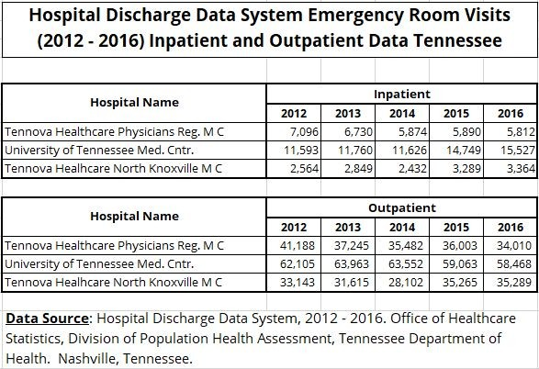

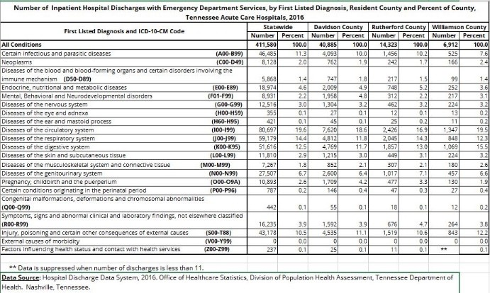

What are your data needs?
Reports
Research
Aggregate data

Slide 9


Contacts
Hospital Discharge Data System Office of Healthcare Statistics Division of Population Health Assessment
Andrew Johnson Building, 2nd Floor
710 James Robertson Pkwy Nashville, Tennessee 37243
Email: Healthcare.Statistics@tn.gov
Director
Office of Healthcare Statistics Phone: 615-253-6862
Fax : 615-253-1688
HDDS | Manager
Hospital Discharge Data Systems
Office of Healthcare Statistics Phone: 615-532-7861
Fax : 615-253-1688

