Slide 1


Vanderbilt Wellpoint IDD ECHO:
A Learning Community
Beth Malow, MD, MS
Professor, Department of Neurology
Vanderbilt University Medical Center

Slide 2


What if…
We created a community
On Zoom
Where clinicians caring for adults with intellectual and developmental disabilities can support each other and the people and families we serve
Extension for Community Healthcare Outcomes
Notes:
Providers are overwhelmed– what do they need?

Slide 3
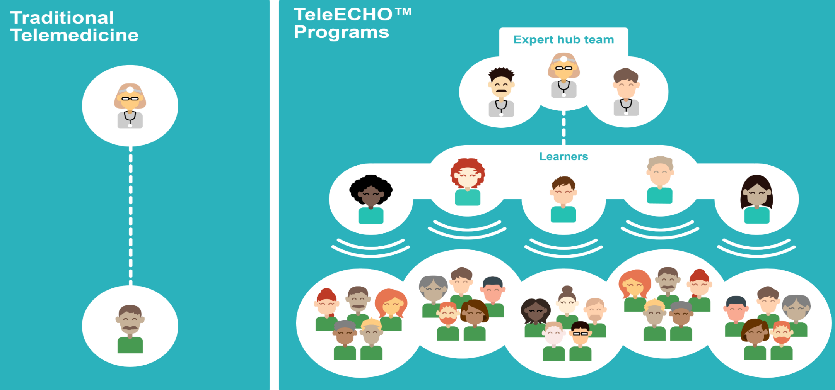
Telemedicine vs. Project ECHO

Slide 4
Anatomy of an ECHO
Welcome and Introductions
Announcements and Housekeeping Items (no PHI)
Patient Case Presentation
Clarifying Questions
Recommendations
ECHO Lesson

Slide 5
The Case Presentation
Presenters complete a case form with as much information as they are able
We put together one simple slide summarizing the case
Notes:
He is going to be kicked out of school even

Slide 6
ID: 51-year-old white woman with phenylketonuria (PKU), moderate to severe intellectual disability and possible drug-induced leukopenia. She has unspecified psychosis and self-injuring behaviors for most of her adult life which have stabilized with atypical antipsychotic.
CONSULT QUESTIONS | Given persistent leukopenia noted since starting paliperidone, what can be done?
Symptoms | Repetitive use of objects and insistence on inflexible routines (distress at minor changes), self-injury, challenging behaviors. Sensory-seeking. Headbanging (with significant injury) and elopement resulting in multiple ED visits have not recurred since starting paliperidone. Most recent ED visit related to behavior was 8/28/2019.
Medical or mental health diagnoses | Psychosis, environmental allergies, sleep disorder, anxiety, OCD, ODD
Communication level | Limited verbal skills, uses gestures and pictorials. Understands most communication.
Living situation, education, employment, financial status | Lives in group home. Not in employment or education. Receives Medicare, Tenncare/ Medicaid, Primate Insurance. Has conservator. Greater than 50 hrs/week of support.
Social and recreational/community participation | None listed
Psychotropic Medications | Paliperidone (Invega Sustenna)- atypical antipsychotic 156 mg IM/month. Also Venlafaxine (Effexor) 150 mg ER, trazadone 100 mg twice daily for insomnia, diazepam 2 mg in am and 15 mg in pm, carbamazepine 100 mg twice daily, chlorpromazine (Thorazine) 400 mg twice daily Unsuccessful dose reductions attempted for carbamazepine, chlorpromazine, venlafaxine, and trazadone.
Therapies | None
Other | Self-injury and unintentional injury to others limits her participation in activities

Slide 7
Participants– Come to sessions regularly with their camera ON, with their full attention and enthusiasm. Encouraged to invite staff from your practice as observers.
Observers – keep your camera off so participants can focus on each other.
Notes:
He is going to be kicked out of school even

Slide 8
Supporting adults with IDD during clinic visits in your practice Introduction to Pathfinder
Management of medical conditions in adults with IDD
Management of psychiatric symptoms and conditions in adults with IDD
Enabling technology including assisted communication devices
Government, housing & community supports for adults with IDD (including Pathfinder)
Post-secondary education & employment
Cultural competency and trauma-informed care
Supporting families of adults with IDD including through aging
Identifying autism in adults with IDD
Supporting the self-advocate with IDD
Self-determination and life skill and social skills development
Relationships and sexuality
Notes:
He is going to be kicked out of school even

Slide 9
To date, we have completed an entire cohort, and will meet again for Cohort 2 starting in May 2024 (second and fourth Thursday of the month from 12-1 pm Central Time) and running through Oct 2024
Practitioners include physicians, nurse practitioners, and licensed clinical social workers who accept Amerigroup (now Wellpoint) insurance
Contact projectECHO@vumc.org if interested, or share our brochure with your loved ones’ clinicians!
Notes:
He is going to be kicked out of school even

Slide 10
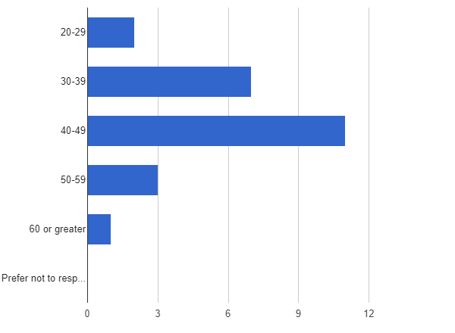
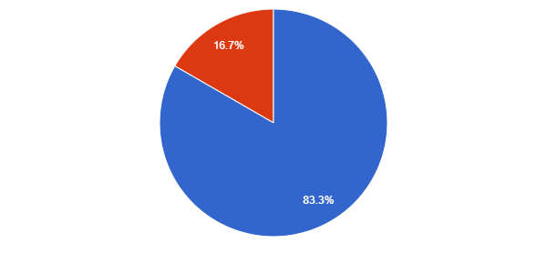
Demographics of Participants
Race
Age
Gender
*We had one participant who identified as Hispanic, Latino, or Latina
Male
Female

Slide 11
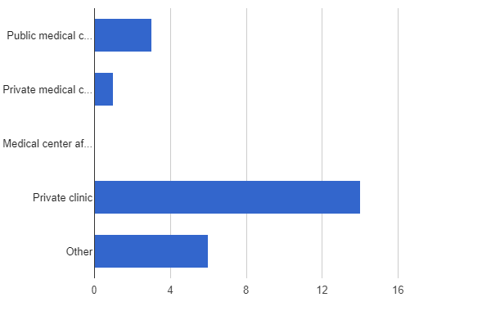
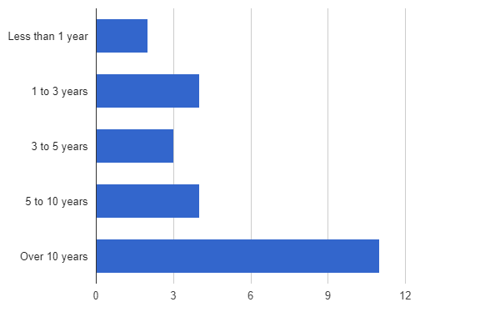
Clinic Setting and Years of Practice for Participants
In what type of setting do you complete the majority of your work?
How many years have you been practicing in your profession?

Slide 12
Degree/Titles of Participants

Slide 13
Evaluation/Research- Clinician Data
Participants will complete a demographics survey at baseline (pre-training), a self-efficacy survey (pre- and post-training) and a satisfaction survey after training is completed. These are based on surveys used in previous ECHOs.
Each participant will also identify a few key goals that they want to improve upon based on the ECHO training (e.g., learning about community resources, treating medical conditions, differential diagnosis related to mental health in population) and rate their progress post-ECHO.
1-not at all/minimal progress
2-some progress
3-fair progress
4-good progress
5-excellent progress

Slide 14
Initial Goals
“To become more competent in treating individuals with IDD and to recognize common issues they face when obtaining healthcare.”
“To become better equipped to serve the IDD population of patients– including assessment, treatment referrals, primary supports, and advocacy for the patient.”
“To improve my ability to screen, recognize, diagnose, and treat individuals with IDD and co-morbid psychiatric disorders.”
“To identify resources for patients and families to optimize their treatment outcomes”

Slide 15
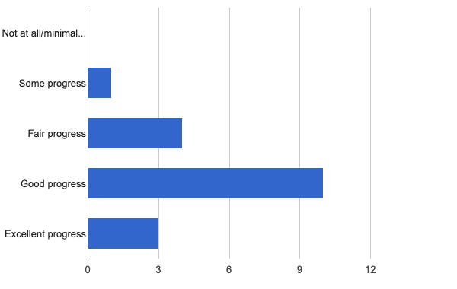
Based on the goals you set at the start of the project. How would you rate your progress?

Slide 16
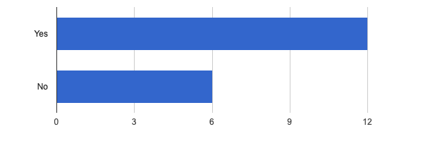
Have you taken on any more patients in with I/DD since participating in this ECHO? Do you plan to?

Slide 17
Feedback from our participants
“You all have given me so many great resources that I have created a folder in my favorites just for IDD and now sharing with other providers at my clinic”
“I felt like I was by myself trying to figure it all out. My nurse practitioner school did not provide IDD education”
“I feel more confident in being able to provide the resources necessary for patients and their families to live the fullest life possible.”

Slide 18
Evaluation/Research- Claims Data
Wellpoint will provide us with deidentified aggregate data from each clinician enrolled related to their panel of IDD patients (1-year pre-ECHO and 1-year post-ECHO) including:
Number of ED visits
Number of hospital bed days
Number of PCP visits per member
Number of specialist visits per member
Vaccinations
Lipid Screening
HbA1C < 8 (and how frequently ordered)
Height and Weight (to calculate BMI)
Mammograms
May be able to tap into medication prescription databases

