Slide 1

Tennessee Suicide Prevention Network (TSPN)

Slide 2

Tennessee Sources of Strength Implementation
Quick Summary
Implementing Sources of Strength is essentially creating a “club” led by peer-leaders who use creative campaigns to build the 8 strengths depicted on Wheel of Strength in youth. As an Adult Advisor, you will help facilitate 5-6 yearly meetings with peer leaders and support their chosen campaigns and provide any guidance to aid in their success.
Sources of Strength can be implemented in secondary schools, community organizations and faith-based organization in rural counties in Tennessee
Focuses on building 8 strengths to help youth navigate challenging times in their lives
The number of peer leaders is based on the size of the school
Adult Advisors and peer leaders will participate in the training
Peer leaders should be a diverse group of students that represent the entire student body or organization
Notes:
In collaboration with the DOH, we are seeking teachers, counselors, social workers, after-school program managers to participate in the Adult Advisor training. Anyone who works with students in rural counties is eligible to participate in the Adult Advisor training which is about 6 hours. Participants can also be trusted adults in community organizations like the Boys and Girls Club or other after-school programs. Sources of Strength can also be implemented in faith-based organizations. Adult Advisors will be responsible for nominating or selecting students to serve as peer leaders for the school or organization. The training will be led by National Trainers from Sources of Strength. The great thing about this program is that it is flexible and Adult Advisors can be educators but works well with any trusted adult that is willing to work with the students. The role can also be shared between two staff members or trusted adults. The Adult Advisor role in building a community of strength is essentially showing up and participating fully, playfully engage and connect strategically with the students. Also being a trusted adult who listens to students’ voices and facilitates equity, inclusivity and belonging. Finally, an Adult Advisor focuses on peer leader retention, celebrates the peer leaders regularly and coordinate logistics for strategic messaging. When you participate in the training, you will learn more about how this looks within your school or organization.

Slide 3
About Sources of Strength
STRENGTH-BASED-employs a radically strength-based approach to suicide prevention.
INNOVATIVE-has been responsive to the needs of a variety of populations, cultures, and communities.
UPSTREAM-primary mission is to move upstream in the prevention cycle
EVIDENCE-BASED-one of the most rigorously evaluated upstream prevention programs in the world.
PEER-LED-utilizes the power of peer social networks to spread messages of Hope, Help and Strength throughout entire communities
https://sourcesofstrength.org/about/#evidence-base
Notes:
STRENGTH BASED Sources of Strength employs a radically strength-based approach to suicide prevention. Turning the traditional practice of identifying risk factors and warning signs on its head, Sources of Strength focuses on developing protective factors, using a model that is innovative, interactive, and radically strength-based. Using an active learning model, incorporating art, storytelling, small group sharing and games, Sources of Strength explores the eight protective factors, depicted in the wheel of strength, to develop resilient individuals and communities.
INNOVATIVE Sources of Strength has been responsive to the needs of a variety of populations, cultures, and communities. This program has been implemented not only in rural, urban, and suburban middle and high schools, but also in universities and community colleges, juvenile justice facilities, LGBTQ+ drop-in centers, cultural centers, native/tribal groups, and more. This means that Sources of Strength can be utilized in multiple organizations that work with youth in rural counties.
UPSTREAM Most prevention work is actually crisis-driven intervention. Our primary mission is to move upstream in the prevention cycle. We work to build resilience, increase connection, change unhealthy norms around help-seeking, break down codes of secrecy and silence, and teach healthy coping strategies to ultimately prevent the very onset of suicidality. With a comprehensive model of upstream prevention, we can impact a wide variety of issues beyond suicide alone, including substance abuse, bullying, dating violence, and truancy. We are not just committed to keeping people alive, but to helping them live healthy and full lives.
After completing the training, Adult Advisors receive all the tools they need to guide their implementation and campaigns. You will receive a manual that will help with facilitating meetings, organizing campaigns and building the protective factors on the Sources Wheel.

Slide 4
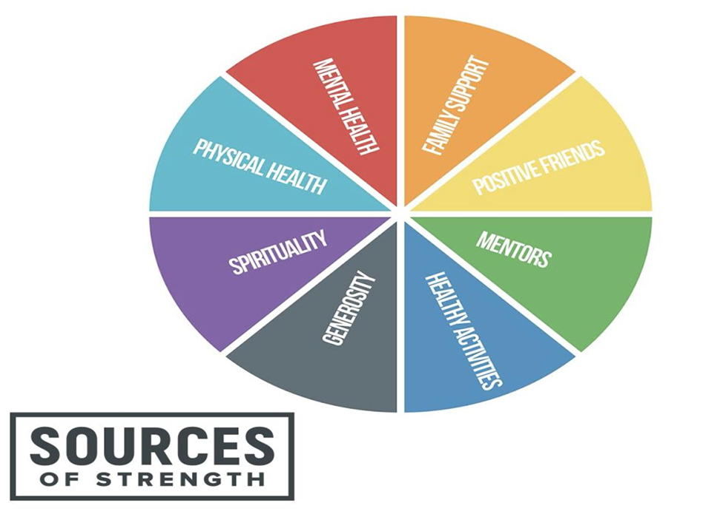
Who Can Participate
Educators
Counselors
Social Workers
Trusted Adults in
Community and Faith
Based Organizations
Notes:
In collaboration with the DOH, we are seeking teachers, counselors, social workers, after-school program managers to participate in the Adult Advisor training. Anyone who works with students in rural counties is eligible to participate in the Adult Advisor training which is about 6 hours. Participants can also be trusted adults in community organizations like the Boys and Girls Club or other after-school programs. Sources of Strength can also be implemented in faith-based organizations. Adult Advisors will be responsible for nominating or selecting students to serve as peer leaders for the school or organization. The training will be led by National Trainers from Sources of Strength. The great thing about this program is that it is flexible and Adult Advisors can be educators but works well with any trusted adult that is willing to work with the students. The role can also be shared between two staff members or trusted adults. The Adult Advisor role in building a community of strength is essentially showing up and participating fully, playfully engage and connect strategically with the students. Also being a trusted adult who listens to students’ voices and facilitates equity, inclusivity and belonging. Finally, an Adult Advisor focuses on peer leader retention, celebrates the peer leaders regularly and coordinate logistics for strategic messaging. When you participate in the training, you will learn more about how this looks within your school or organization.

Slide 5
How to Get Involved
To schedule a meeting to express interest and learn more about Sources of Strength contact:
Kearee Jackson
Youth Programs Director
kjackson@tspn.org
615.245.8016
Submit Implementation Participation Form
SPREAD THE WORD!
Participate in Training
Notes:
Getting involved is very easy! In order to participate in the upcoming training, please complete the following steps.
Contact me (Kearee Jackson) and express interest
Complete Implementation Form and submit to Kearee Jackson (kjackson@tspn.org)
Check email for training date confirmation
SPREAD THE WORD! After listening in today, please let others in your communities know about Sources of Strength and how they can join us in this implementation process.
Participate in Adult Advisor training (and peer leader training)
As I stated earlier, we are working with the Sources of Strength team to select a date for the training so after submitting your implementation form, we will provide you with updates and details about the training.

Slide 6

Notes:
You can learn more about Sources of Strength via the website or any of the social media platforms on the screen.

