Slide 1
Introducing Kramer Davis Health
Matt Holder, MD, MBA, FAADM
December 7th, 2023

Slide 2
Intro to Kramer Davis

Slide 3
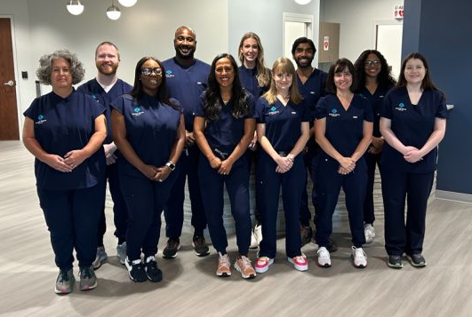
A New Model of Patient Care
Patient focused model of providing exemplary healthcare for people with IDD
Designed for adults and adolescents with IDD over the age of 13
Our goal is to help our patients live their happiest and most fulfilled lives. We do this by removing barriers to healthcare and by offering collaborative, preventive, and high-quality care across multiple disciplines

Slide 4
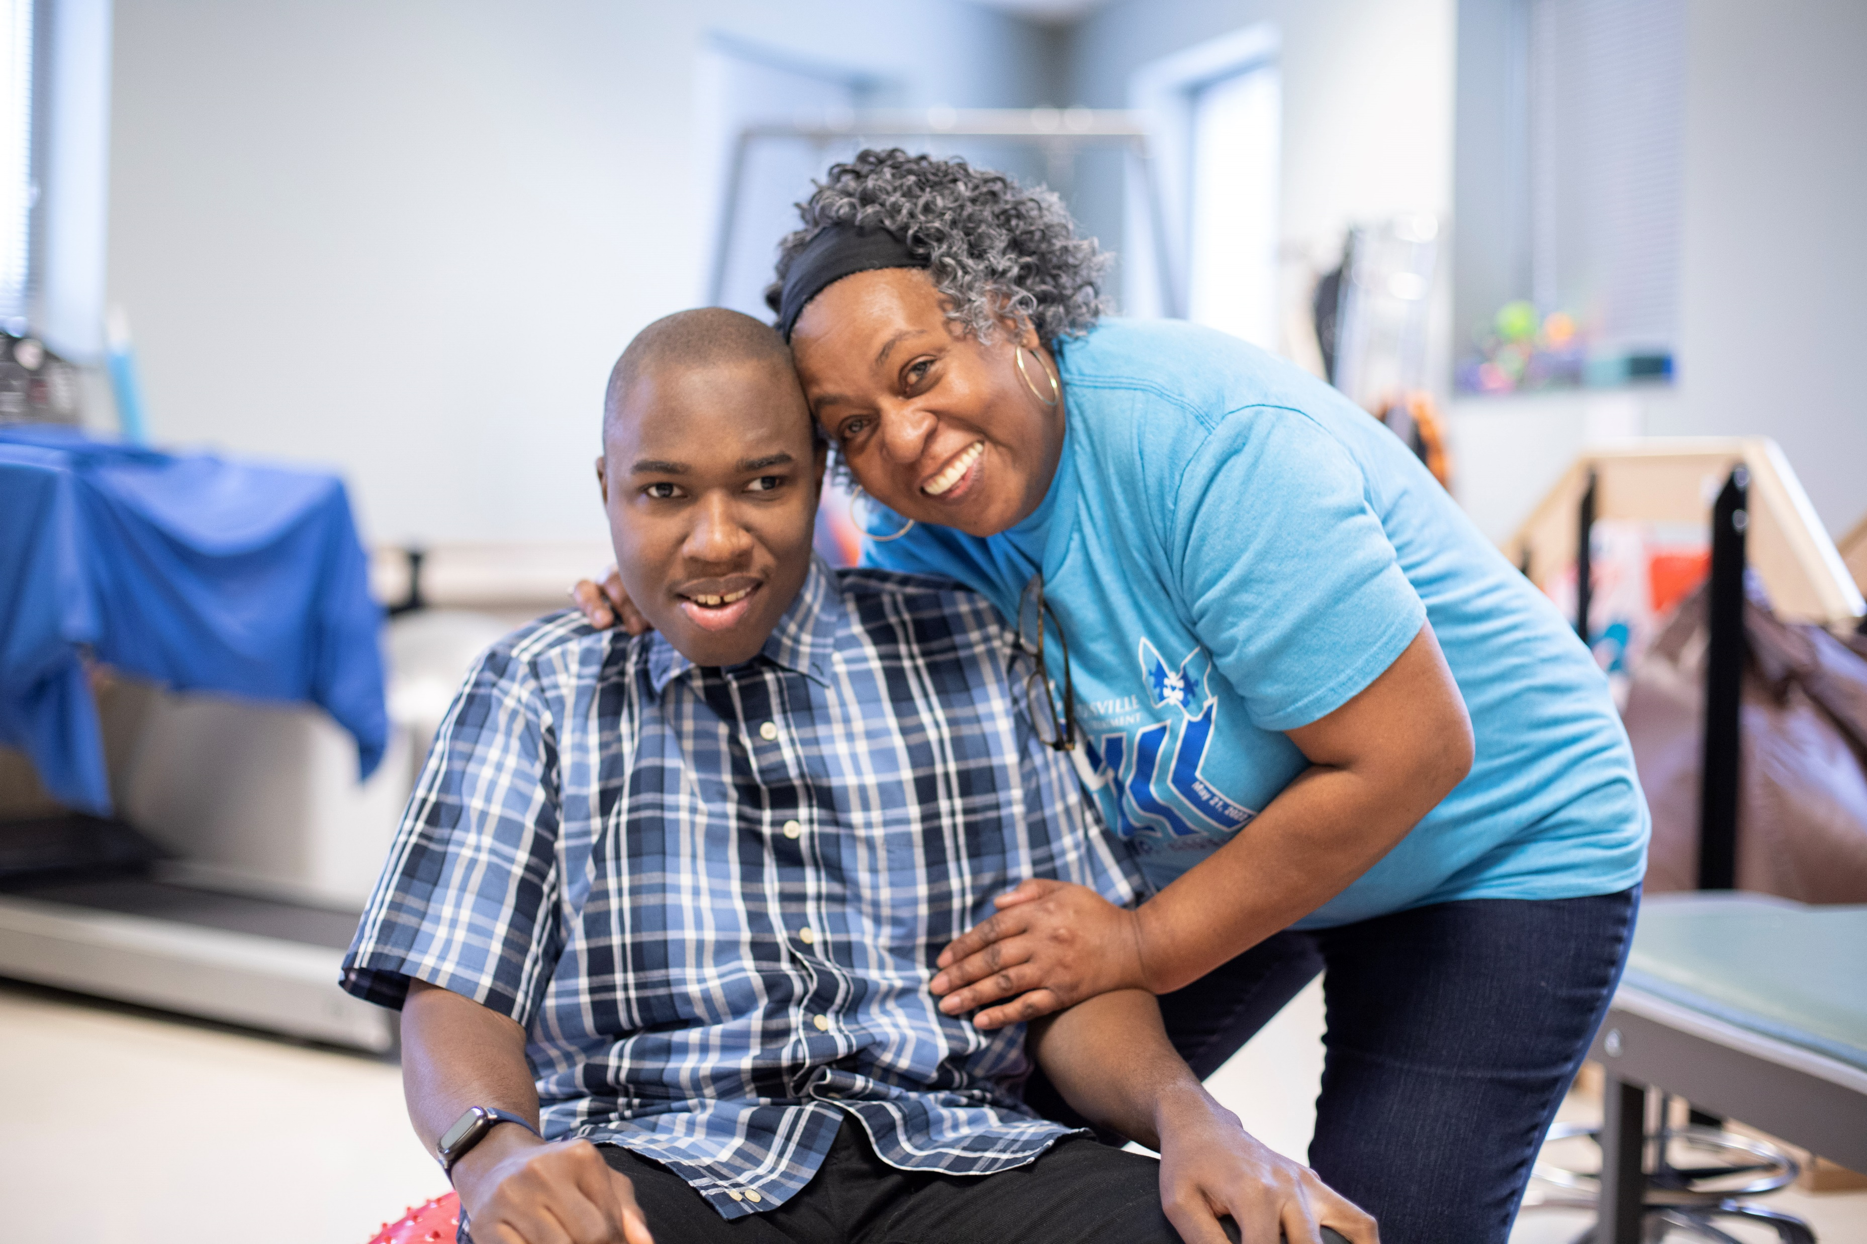
Whole Person Care
We offer an entire floor dedicated to patient care with experts in the following areas:
Developmental Medicine
Developmental Dentistry
Psychiatry
Behavioral Health
Physical Therapy
Occupational Therapy
Speech Pathology
Crisis Intervention

Slide 5
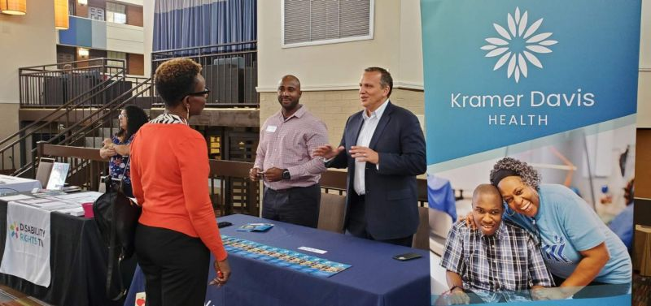
Contact Information
Kramer Davis – Nashville
3901 Central Pike, Suite 500
Hermitage, TN 37076
(615)-933-7300
hello@kd.health
Kd.health

