Slide 1
Community Engagement and Celebration of Black Motherhood

Slide 2

What is trust?
Assured reliance on the character, ability, strength, or truth of someone or something
Belief in a person’s/institution’s ability to complete a task
Cornerstone of the patient: doctor/academic institution relationship
Notes:
Merriam Webster defines trust as the assured reliance on the character, ability, strength or truth of someone or something or the belief in a person’s ability to complete a specified task. Indeed it is the foundation to any relationship of value and the cornerstone to the patient doctor relationship and as I hope to discuss in detail today the cornerstone to the community and academic partnership.

Slide 3
Why is trust necessary in the context of health and research?
Trust
Achieving
Equity
Eliminate disparities
Health
Research
Griffith et al. Am J Prev Med. 2021
Notes:
With trust as the touchstone between academic partners and the communities that they serve, indeed it is possible to conduct meaningful health research of projects with the goals of achieving equity and elimination of health disparities. Even though many of us here today know that trust is required to build and maintain relationships, not as many may clearly understand how to position ourselves to be trustworthy.

Slide 4
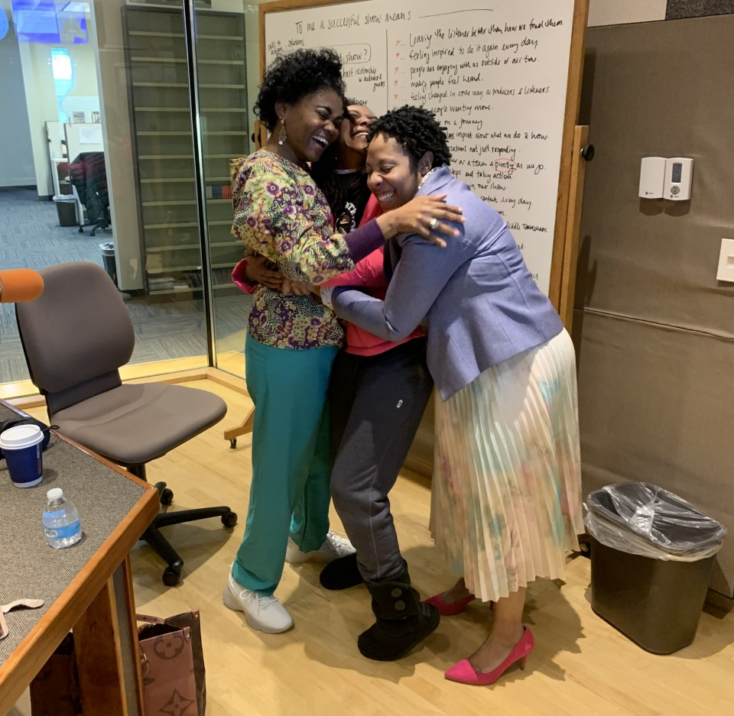
Strategies for Community Engagement
Notes:
So we are going to take a deep dive into strategies and principles for community engagement. This can apply to both research and community facing projects and events. This picture is me and my partners. This picture was taken at our local Nashville Radio Station talking on the topic of Black maternal mortality in Tennessee. Stephanie Devane Johnson-a nurse midwife and Kristin Mejia who is a community based doula and here today. When you see this picture, what do you see? (Audience question). We are close, genuine, honest and actually I can say after several years that we have love for one another and it is rooted in our desire to change the narrative of the Black birthing person.

Slide 5
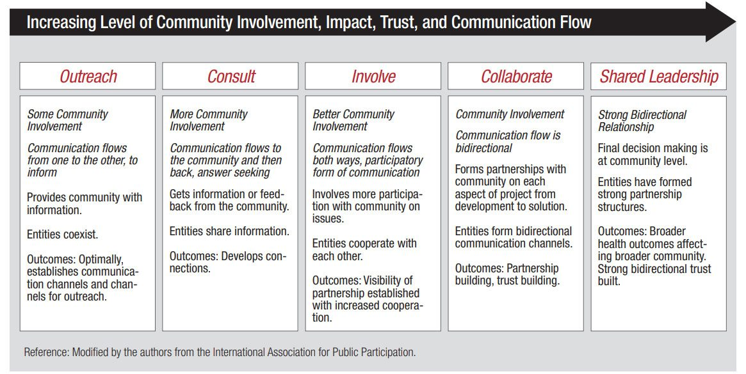

Principles of Community Engagement-2nd Ed.
Notes:
This chart was taken from the second edition of the Principles of Community Engagement jointly devised by the organizations that you see in the flow chart. As you go from outreach to consult to involve to collaborate to shared leadership, this document really describes the level of community involvement, the direction of communication and information and leadership structure.

Slide 6

Rolanda Lister, MD
Celebration of Black Motherhood
Saturday, April 20
3:00 p.m.
Cal Turner Family Center

Slide 7
Black Maternal Health Week
Saturday-April 20, 2024 (Celebration of Motherhood)
Time: 3 p.m.
Location: Cal Turner Family
Program format: Circle of Sisterhood
3 Black post-partum mothers, 2 moderators, Audience, 3 clinicians (Up to 75 expecting mothers+ families)/faculty, vendor.

Slide 8
Why we want to host a celebration of Black Motherhood.
BIPOC women are 2-4 times more likely to die from pregnancy related causes.
There is a lot of negativity that surrounds the conversation of Black motherhood creating a sense of anxiety for expectant mothers.

Slide 9
Love letter to Black birthing people…
“This collective consciousness of the risk that is carried with our pregnancies casts a shadow of fear over a period that should be full of the joy and promise of new life.”
“Unfortunately, lost in the messaging about racial inequities in maternal mortality is the reality that the vast majority of Black people and babies will survive, thrive and have healthy pregnancy outcomes…”

Slide 10
Goals of the program
Elevate the positive stories/experiences of Black birthing people.
Provide a platform for Black women who have had a positive birth to share with expectant mothers tips on how to have the birth they desire.
Celebrate the courage and beauty of Black motherhood.

Slide 11
Program outline (3 p.m.)
Photobooth for expectant mothers- 2:30-3:00 p.m.-Michelle Taylor Photography
Dinner or refreshments are served-2:30 p.m.
Introduction of Event: Rolanda Lister
Welcome: Jamie Ware and Ronald Alvarez
Introduce panel/moderators-Etoi Garrison
Panel discussion- sisterhood circle 3:00-4:30 p.m.
Vendor Booth visitation 4:30-5:30 p.m.
Release of lanterns (honoring our past, present and future)-March of Dimes representative 5:30-5:45 p.m.
Wrap up/Dismissal/Acknowledgements: Rolanda Lister

Slide 12
Panel discussion-Speakers and sisterhood circle participants.
High risk mother Kiwanna Frierson, March of Dimes Contact.
Midwife- Stephanie Devane-Johnson
Clinicians- Rolanda Lister, Connie Graves, Jamie Ware
Moderators: Dr. Quantrilla Ard (also mother), Michelle Dubois (also mother with hospital and home birth)

Slide 13
Questions for mothers who have given birth…
  Tell us about your baby and how he/she arrived.
  What are the common reasons for Black women morbidity and mortality?
  What advice do you have for your sisters to have a health pregnancy?

Slide 14
Props/environment
Floral crowns (Donated by Lana’s Flowers)
Photobooth-Michelle Taylor
Food (Meharry Medical College)

Slide 15
Giveaways for panel participants
Floral crowns
Wrapped baskets (Onesies, diapers, lotions, body products)-Love letter to Black women
“Village” elders sign up
Vendor booths

Slide 16

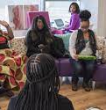



Mood boards
Celebration of Black motherhood

Slide 17
Community vendor booths/partnerships
Meharry Salt Wagon Clinic
Shade Tree Clinic
March of Dimes
Nurses for Newborns
Office of Health Equity
Homeland Heart
East Nashville Doulas
VUMC L&D inpatient representative
Lactation
SON Volunteer doulas
St. Thomas Midtown
VAN-Outpatient clinics
Tennessee Department of Health
New Life Center
VUMC Generalist Division
Vanderbilt Birth Center
McGruder Center
Matthew Walker Clinic

Slide 18
Wish List
Nurture the Next
Thistle Farms
Melrose Midwifery Clinic
Healing Trust
Boedecker Foundation
Meharry OBGYN Department
Ashyiya Swan-Nashville Freedom School
Mamaya Mental Health Support
Breastfeeding support/lactation support
WIC Office

Slide 19
How you can help
Publicize this event to your networks
Sign up to be a vendor

Slide 20
Publicize this event
Event Brite Registration
Tickets are free, but registration is required

Slide 21







What: “Celebration of Black Motherhood”
When: April 20, 2024, 3:00p
Where: Cal Turner Fam. Cntr
How much: FREE, QR code
Black Maternal Health Week
Center for Women’s Health/Office of Health Equity/Meharry Medical College
Sponsor:
In collaboration with…
*We invite you to join us for this community event where Black mothers, Black Clinicians and other Birth workers will share insights on how to have a healthy pregnancy.
*Food *Photo booth *Giveaways *Panel discussion

Slide 22
Sign up to be a vendor
  Set up a non-merchant informational table
  Fill out vendor interest form

Slide 23
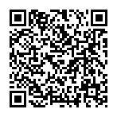
Register interest in events
Commit to donate money for the Celebration of Black Motherhood

