Slide 1
Instructionally Appropriate IEPs
Focus on the IEP Writing Process
Special Populations Student Support Services

Slide 2
Objectives
At the end of this training you will be able to:
  Write an instructionally appropriate IEP (IAIEP) including:
    Narratives
    Present Levels of Educational Performance (PLEPs)
    Measurable Annual Goals and where appropriate, short-term objectives
    Appropriate accommodations and/or modifications
    Service delivery plan
  Self-assess and self-reflect on your IEP writing practice

Slide 3
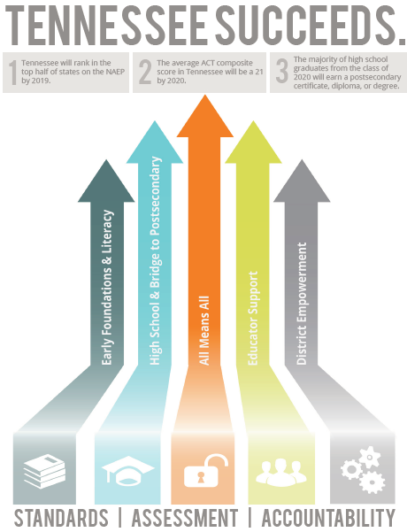
Early Foundations and Literacy
High School & Bridge to Postsecondary
All Means All
Educator Support
District Empowerment

Slide 4

Priorities

Slide 5
Key Goals of Special Populations
Improving Student Outcomes
Prevention
Intervention
Achievement
Outcomes
Managing Performance
Effective employees at every level of the organization with a focus on improving student outcomes

Slide 6

Special Populations Beliefs
All Means All
All students are general education first.
Strong leadership at every level is the foundation of a collaborative and inclusive environment that supports students.
Educators are professional, content experts, and the key to student success. They should be supported instructionally and professionally.
An effective office of special populations communicates proactively, clearly, and efficiently with all internal and external stakeholders.
Family and community engagement at every level is important and an integral component of student success.
Postsecondary success is attainable for all students.
Special education is not a place.

Slide 7
Tennessee Landscape for Students with Disabilities (SWDs)
SLI
SLD
OHI

Slide 8
Tennessee Landscape for SWDs
SLI
SLD
OHI

Slide 9
Indicator 14 – By Disability

Slide 10
Indicator 14 – By Exit

Slide 11
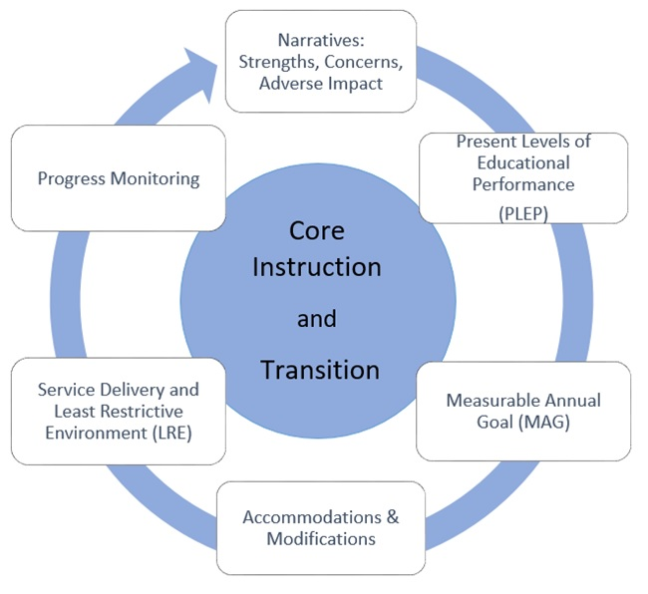
Core Instruction and Transition

Slide 12
Least Dangerous Assumption
States that in the absence of absolute evidence, it is essential to make the assumption that, if proven to be false, would be least dangerous to the individual.
Therefore, the IEP teams should operate from the criterion of least dangerous assumption by considering the least restrictive setting, general education, first, for all students, regardless of disability, before considering more restrictive settings.
Evidence and data collected should be discussed before making the determination that a student requires a more restrictive setting at each IEP meeting (Rossetti & Tashie, 2013).

Slide 13
Instructionally Appropriate IEPs

Slide 14
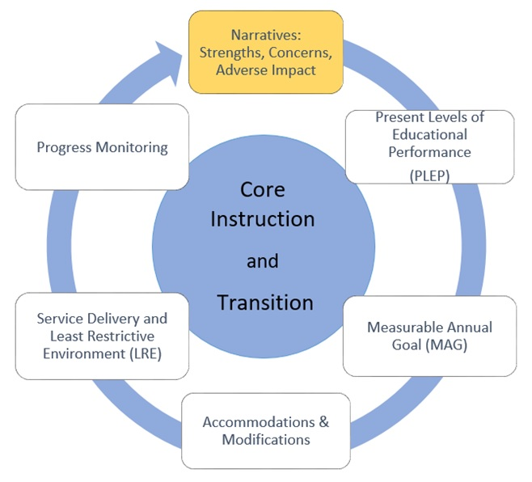
Narratives: Strengths, Concerns, Adverse Impact

Slide 15
Developing a Strong Narrative
The narrative section includes:
  Student’s strengths
    Includes academics but is not limited to academics
  Parent concerns
    In their own words to the greatest extent possible
  Adverse impact statement on the student’s access and participation in instruction
    How the disability impacts the student.
  Medical information
    If no concerns, you must still write a statement of no concerns.

Slide 16
Example Student Strength
Riley’s receptive language skills, math calculation skills, and conversational skills are strengths. Riley exhibits good attention in class, perseveres on tasks, and enjoys working with her peers.
Note: this is an example provided for training purposes only.

Slide 17
Example Parent Concern
Donna’s parents are concerned about behavior problems Donna has with others. When she is in a new place, she tends to have behavior problems initially but then adapts to the situation. They are also concerned that Donna may be struggling with learning to read, but they are proud of the academic progress she has made.
Note: this is an example provided for training purposes only.

Slide 18
Example Medical Information
Marcus has bilateral cochlear implants that he received in 2010 (left ear) and 2009 (right ear).
Do not leave this area blank.
If no medical information exists, then add “There are no medical concerns at this time.”
If parent reports a medical concern but does not provide documentation, you can write “As per parent report…”
  The team should also complete a request for records or plan how to receive this documentation.
Note: this is an example provided for training purposes only.

Slide 19
Example Adverse Impact
Hope’s expressive language impairment impacts her ability to answer questions, use subject-specific vocabulary, and express herself clearly in class. This impacts her ability to demonstrate her knowledge and skills in academic areas.
Note: this is an example provided for training purposes only.

Slide 20

Let’s Practice
The narrative section includes:
  Student’s strengths
    Includes academics but is not limited to academics
  Parent concerns
    In their own words to the greatest extent possible
  Adverse impact statement on the student’s access and participation in instruction
    How the disability impacts the student
  Medical information
    If no concerns, you must still write a statement of no concerns

Slide 21
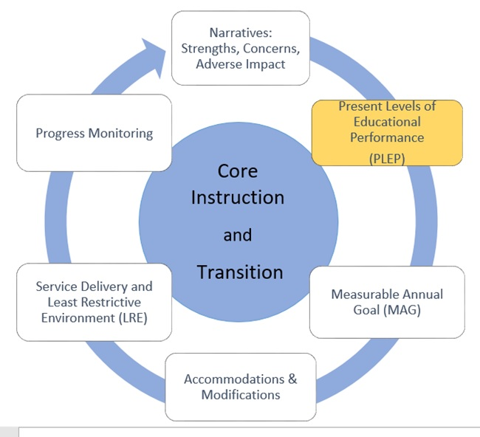
Present Levels of Educational Performance (PLEP)

Slide 22
Present Levels of Educational Performance (PLEP)
Describes the unique needs of the student that the IEP will address
  Identifies the student’s level of performance using current data
    What they can do
    What they are currently not able to do
  Identifies the student’s area(s) of strength
  Identifies area of exceptionality (deficit)
  Written in positive terms

Slide 23
Present Levels of Educational Performance (PLEP)
Provides the informational basis for generating goals, supports, accommodations, and services that are specifically designed to meet the student’s individual needs
Describes current academic and functional performance
Without proper PLEPs, the IEP team cannot develop appropriate goals, accommodations, or select an appropriate program for the student.

Slide 24
Associated Areas of Deficit
Eligibility
Adverse Impact
Exceptional PLEPs

Slide 25
Areas of Deficit: Reading
Basic Reading Skills
Phonological Awareness
Phonics
Reading Fluency Skills
Fluency
Text Comprehension
Vocabulary
Reading Comprehension Skills

Slide 26

WPM
Why?

Slide 27
Areas of Deficit: Math
Math Calculation
Basic Facts
Complex Computation
Math Problem Solving
Numbers and Operations
Base Ten
Decimals, Fractions, etc.
Place Value
Geometry, Algebra, etc.

Slide 28
PLEP Considerations
  Do you know in which area(s) the student is exceptional as indicated by a yes/no?
  Do you know in which area(s) the student requires intervention?
  Do you know where to begin instruction/intervention?
  Do you know how the area of exceptionality is aligned to the standards?
  Do you know how the area of deficit will impact the student on the mastery of standards?
    e.g., Reading fluency deficit will impact student in their access to grade-level texts and instructional materials in all content areas.
    e.g., Math calculation deficit will impact student calculating integrated math, problem-solving, and accessing new math concepts at a rate commensurate with their peers.

Slide 29
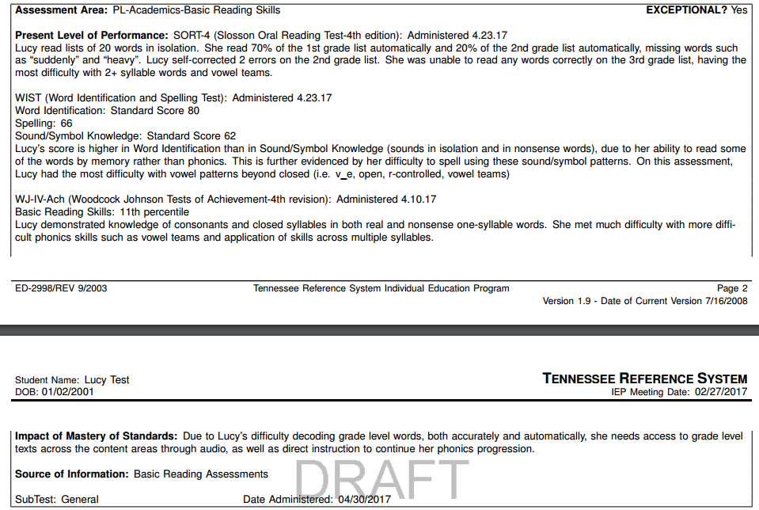
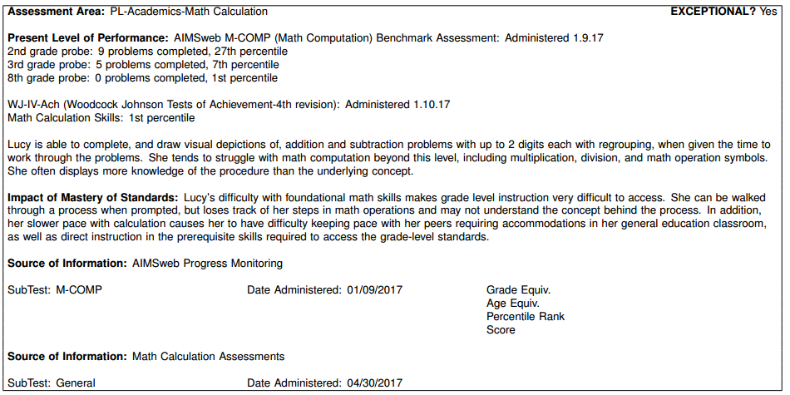
Example PLEP

Slide 30
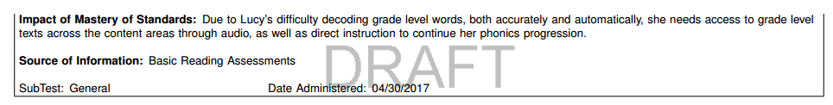
Example PLEP

Slide 31
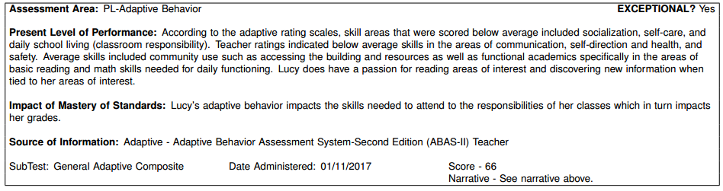
Example PLEP

Slide 32
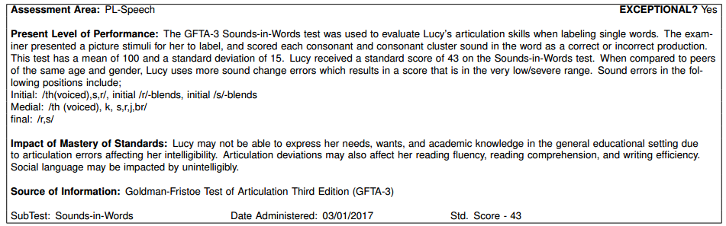
Example PLEP

Slide 33
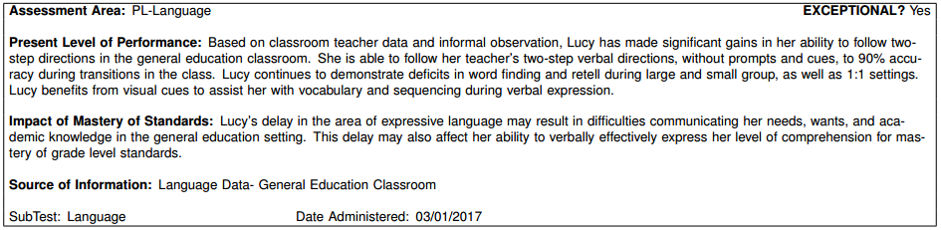
Example PLEP

Slide 34
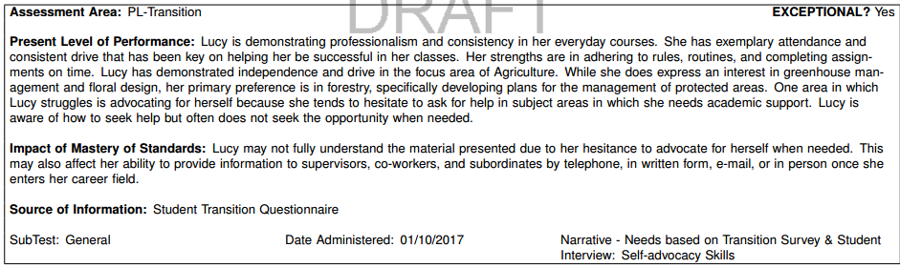
Example PLEP

Slide 35
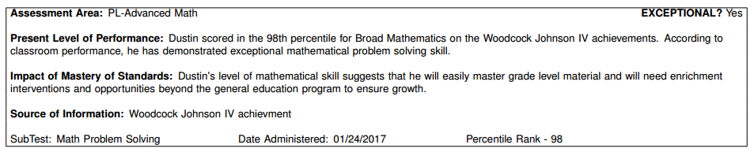
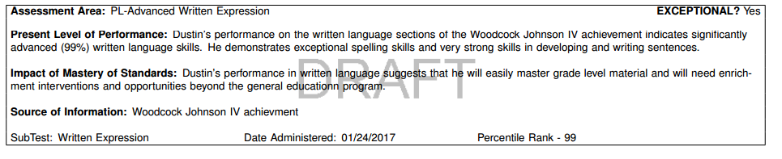
Example PLEP—Gifted

Slide 36

Let’s Practice
Must include:
  Student’s current assessment data
  Specific, accurate reflection of skills
  Narrative description about skills assessed
  Impact on mastery of standards
  Exceptional: yes or no
  Positive terms and language
  Must pass the “stranger test”
Provides the informational basis for generating goals, supports, accommodations, and services that are specifically designed to meet the student’s individual needs.

Slide 37
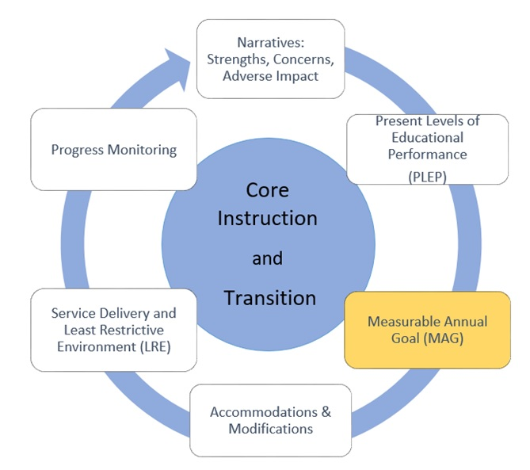
Measurable Annual Goals MAGs)

Slide 38
Measurable Annual Goals (MAGs)
Direct relationship to skills identified as exceptional in the PLEP
Skill deficit-specific
Individualized
Measurable: numbers/targets clearly identified within the goal statement
Focus is on accessing and participating within curriculum at increasingly higher levels of independence
A well written MAG addresses an identified deficit, which after intervention, will assist the student in reducing the adverse impact of the disability on their mastery of standards.

Slide 39
Measurable Annual Goals (MAGs)
Eligibility
Adverse Impact
Exceptional PLEPs
Measurable Annual Goal

Slide 40
Tennessee’s Special Education Framework and Alignment to Content Standards
OSERS issued a Dear Colleague letter on Nov. 16, 2015.
  “IEP teams must ensure that annual IEP goals are aligned with the State’s academic content standards for the grade in which the child is enrolled.”
  “Therefore, an IEP that focuses on ensuring that the child is involved in the general education curriculum will necessarily be aligned with the State’s content standards.”
The department created a reply documenting the Special Education Framework alignment to content standards.

Slide 41
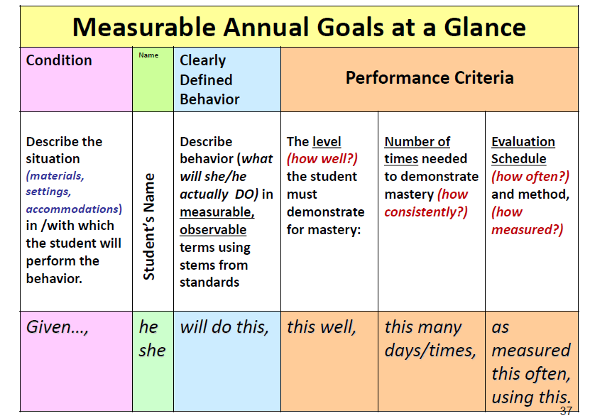

Slide 42
MAG Template
Given_______(condition/materials/setting/accommodation), _______(student name) will _______(do what measurable/ observable skill/behavior in functional terms), _____(to what extent/how well to determine mastery), ________(# of times/frequency/how consistently), by ________(how often) evaluated/determined by _____(measure).

Slide 43
MAG
Goals are: | Goals are not:
Specific, measurable | General concepts and ideas
Individualized to the student’s needs | Grade level curriculum
Related to an individual student’s skill deficits | Standards
Directly related to the individual student’s PLEP | Related to core instruction tutoring

Slide 44
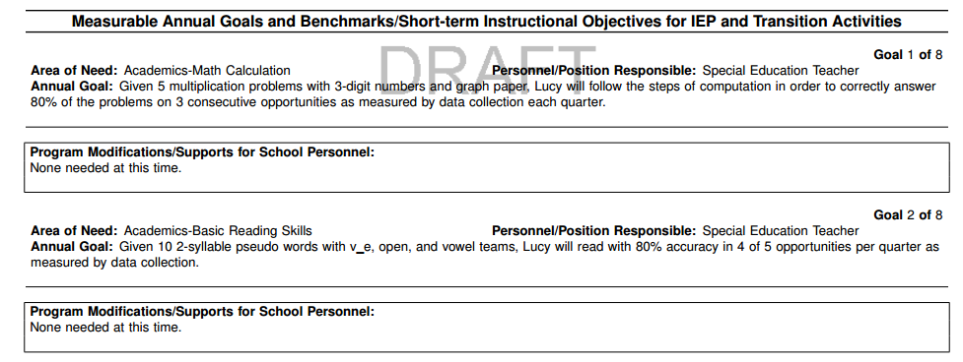
Example MAGs

Slide 45
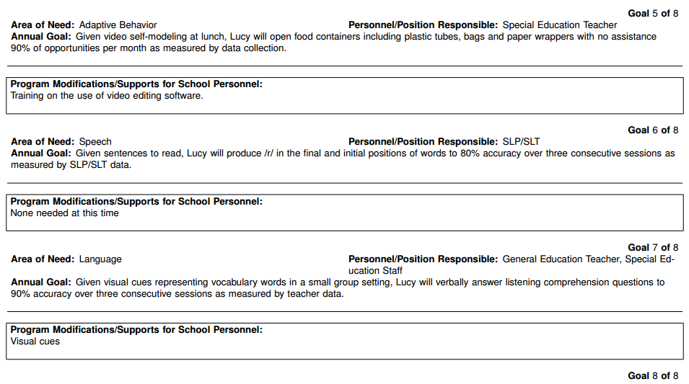
Example Goals

Slide 46
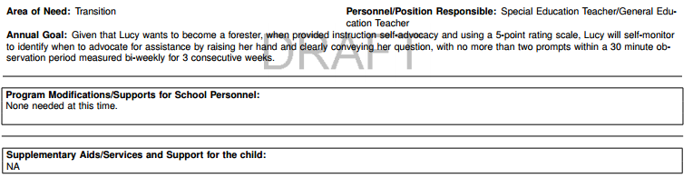
Example Goals

Slide 47
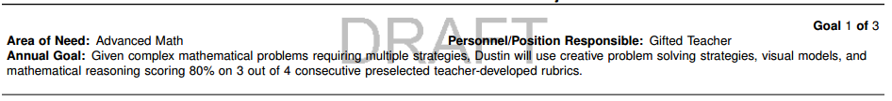
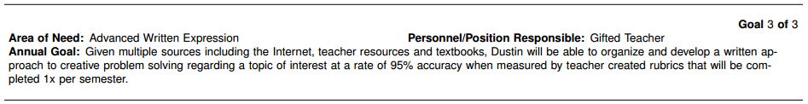
Example MAGs—Gifted

Slide 48
MAGs Evaluation Activity
When you review MAGs, ask:
  Is there a condition?
  Is the behavior/skill observable?
  Is there a criteria that includes:
    how well?
    how consistently?
    how often?
Ask:
What skills does the student require to master the content of the curriculum?

Slide 49
Measurable Annual Goal vs. Short-term Objectives
Measurable Annual Goal
Short-term objectives
Very specific, no longer broad
Includes criteria for mastery within the goal
May have more measurable annual goals if distinctly different skills
Instead, progress monitor to show progress toward the MAG
If you need short-term objectives, you can still use them
Required for students on alternate assessment

Slide 50
Short Term Objective Requirements
Required for students with significant cognitive disabilities assessed on an alternate assessment for accountability.
Short-term Objectives Are: | Short-term Objectives Are Not:
Skills that need to be directly taught | Accommodations
Student behaviors that demonstrate understanding and application of skills | Interventions or programs of curriculum
Separate skills required to meet the goal | Projected timelines of mastery aligned to progress reporting
Skills and behaviors that a student must master to achieve independence that are generalizable beyond school setting | Skills specific to the classroom or school setting only

Slide 51

 | Exceptional Area | General Outcome Measure (GOM) | Mastery Measure (MM) | Mastery Measure (MM)
A | Given… (condition/materials/setting/ accommodation)
B | student name
C | will do what
D | to what extent/at what mastery
E | in this many chances
F | with chances repeated this often
G | as measured by
Given 10, two-syllable pseudo words with close, open, and vce syllables
Given an instructional level text
Jonathan
Jonathan
will read
will read
65 words correct per minute
with 90% accuracy
in 4 of 5 opportunities
in 4 of 5 opportunities
per quarter
per quarter
a curriculum-based measure.
data collection.

Slide 52

Let’s Practice
A | Given… (condition/materials/setting/ accommodation)
B | student name
C | will do what
D | to what extent/at what mastery
E | in this many chances
F | with chances repeated this often
G | as measured by

Slide 53
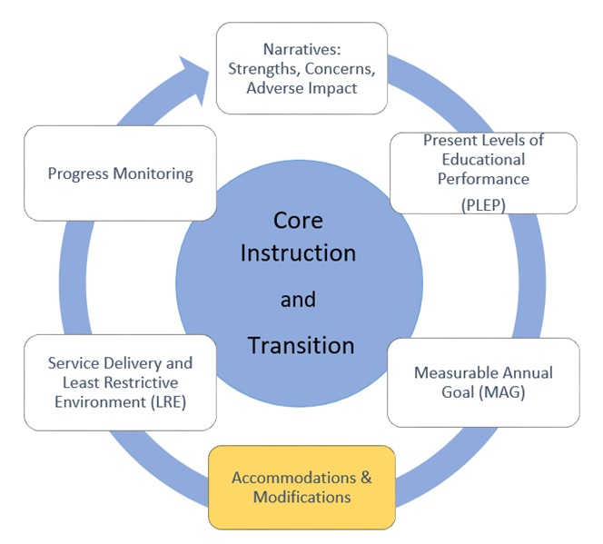
Accommodations

Slide 54
Accommodations and Modifications
Accommodations change how the student is taught or expected to learn.
  They provide equitable access during instruction and assessments and neither change the construct being assessed, nor compromise the integrity or validity of the assessment or content,
  are intended to reduce or even eliminate the effects of a student’s disability; and
  do not reduce learning expectations, if based on need.
Modifications change what the student is taught or expected to learn.
  They change what is being taught to or expected from the student.
  The least dangerous assumption would be that students are able to participate within the core curriculum without modifications unless student performance data indicates otherwise.

Slide 55
Modifications for Instruction and Access
Modifications are restrictive by nature and should be a last resort.
Changing what a student is taught has a long-term impact on the opportunity to graduate with a regular high school diploma. This further limits employment and college/technical school opportunities.
Students with modifications must still be provided access and participation within core instruction

Slide 56
Accommodations and Modifications Hierarchy Activity

Slide 57
Universal Designs for Learning (UDL)
Designing instructional spaces with UDL principles can minimize the need for individualized accommodations and modifications.
  Sidewalk ramps
  Crossing lights with sound
  Sensor faucets
  Picture/icon signs
  Automatic doors
  Fire alarms that flash and make noise
  Phone sound/vibrate/flash modes
  Font sizes
The American with Disabilities Act requires accessible design in all new buildings and renovations of public buildings.

Slide 58
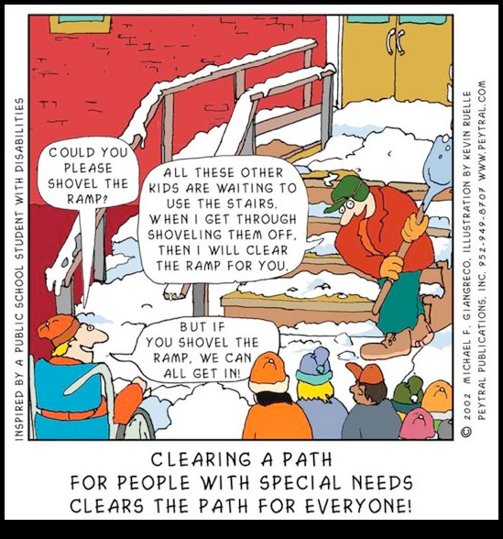
UDL Continued

Slide 59
Accommodations for Instruction and Access
Accommodations provide a bridge to access and participation for a student based on the impact of the area(s) of deficit.
These should be necessary accommodations for the student, not things the student may need on a few isolated opportunities or that there is no data to support.
The student should be encouraged to provide feedback on the effectiveness of the accommodation(s) selected.
Accommodations should not be selected to hide a disability or inflate the abilities of the individual; access and participation are the guide to selection.

Slide 60
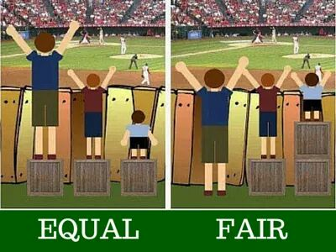
Accommodations Create Fair Access

Slide 61
Accommodation Selection
Expect all students to achieve grade-level academic content standards.
Learn about accommodations.
Review the student’s strengths.
Review the student’s PLEPs and MAGs.
Select accommodations that support the student’s current needs for access and participation.
  *Accommodations should provide access so the student can accurately reflect their current level of knowledge and mastery.
Administer accommodations during assessment.
Evaluate and improve accommodation use by talking to the student.

Slide 62
Participation in State Assessments
The Individuals with Disabilities Education Act (IDEA) and Title I of the Elementary and Secondary Education Act (ESEA) each require all students with disabilities to be included in State assessment systems. The prohibition against exclusion from participation or denial of benefits to, or discrimination against, individuals with disabilities contained in section 504 of the Rehabilitation Act and Title II of the Americans with Disabilities Act applies to state assessment and accountability systems.
Notes:
TNReady Accommodations/MSAA

Slide 63
Participation in State Assessments
In addition to state assessments, the IDEA (section 612(a)(16)) requires that all students with disabilities participate in district-wide assessment programs and that alternate assessments be provided for students with disabilities who cannot participate in grade-level assessments, even with accommodations.

Slide 64
State Assessment Participation Options
General grade-level assessment, with or without accommodations
  TNReady Achievement Grades 3–8
  End of Course (for secondary)
Alternate assessment based on alternate academic achievement standards
  Alternate for ELA and math grades 3–8 and 11
  Alternate science
  Alternate social studies

Slide 65
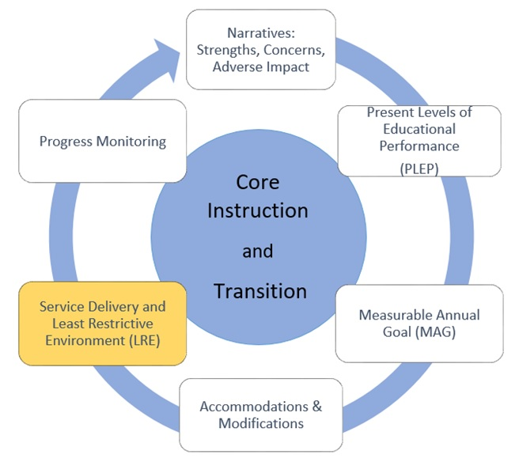
Service Delivery and LRE

Slide 66
What is LRE?
LRE is:
  Defined individually by the student's skills, strengths, and needs at that time, based on their current data
  Determined for each part of their day and may vary from subject to subject, hour by hour depending on what is determined least restrictive by the IEP team
  Determined at least at the annual IEP meeting
    The LRE for one IEP in no way predicts the LRE for future IEPs.
  Not dependent on the state assessment eligibility
    Students assessed on the alternate may be learning within the general education classroom during the whole or a portion of the day.
    Students assessed on TNReady may be learning within a separate setting during the whole or a portion of the day.

Slide 67
LRE Activity
Notes:
3 similar case studies with only one difference—the eligibililty

Slide 68
Students with Disabilities by Environment

Slide 69
Service Delivery and LRE
Services include: intervention, check-ins, interpreting, ancillary attendants, etc.
Special education services must be more intensive than Tier I, II, or III interventions
Services can be provided in any LRE setting that is determined appropriate for a student.

Slide 70
Tier II, Tier III or Special Education Intervention:
Core Instruction Plus A Skill Specific Intervention
Core Instruction
Tier II
Tier III
Special Education Intervention

Slide 71
Questions to Consider for Service Delivery
What accommodations/supports are needed to achieve the goal?
What services are being considered?
Are the services aligned to the student’s areas of deficit?
  For example: reading fluency, math calculation, written expression
Do the services relate to the measurable annual goal?

Slide 72
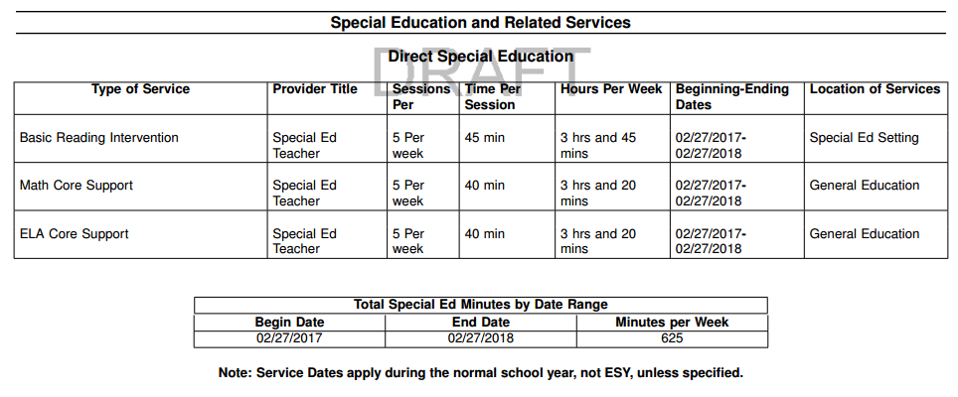
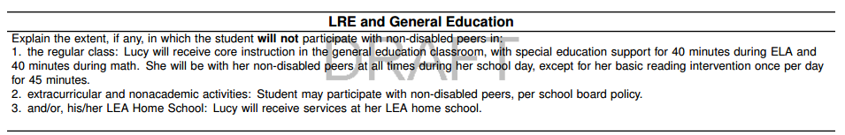
Example

Slide 73
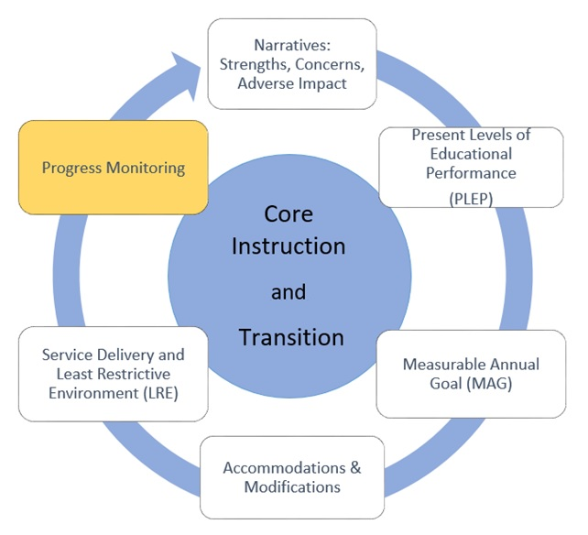
Progress Monitoring

Slide 74
Purpose of Progress Monitoring
Consistent progress monitoring can help the team determine:
  Effectiveness of intervention
  Student rate of learning
  Potential for meeting IEP goals (in a year, earlier, later)
  The student’s present level of performance
    This will guide future IEP goals.
  Need for additional intervention and/or supports
  Need for less intervention and/or supports
  Need for accommodations and/or modifications
    Which accommodation(s) and/or modifications are actually effective and needed?

Slide 75
Progress Monitoring
(adapted from M. Shinn and National Center on RTI)
General Outcome Measure
(Broad/Universal)
Is the student becoming a better reader?
Test something small to make statements about something big.
Track progress towards general curriculum goals.
Less frequent.
Assess on a standard & equivalent measure.
Comparison to others, typically national.
Rate of improvement specified.
Lacks information for diagnosis of instructional planning.
Informs program changes.
Mastery Measure
(Needs Based)
Did the student learn what I taught today/this week?
Test something small to speak to something small.
Track progress on specific skills based goals.
More often.
Assessment can change with the student.
Comparison to a clear criteria for mastery.
Fewer variables.
The label “mastery” may be misleading – must assess for maintenance and generalization.
Informs instructional changes.
GOM MM

Slide 76
Example Data and Progress Monitoring Sources
Observations
Student self-monitoring checklist
Written tests
Behavior charting
Work samples
Summative assessments
Formative assessments
Curricular Based Measures (CBMs)
Academic achievement
Functional performance
Social development
Physical development and management needs

Slide 77
Progress Monitoring and Data-based Decisions
Progress monitoring should occur for students with disabilities as frequently as for their nondisabled peers.
Ongoing assessment of student learning provides continuous feedback on the effectiveness of instruction and intervention.
Data indicates areas where a change in instruction and intervention may be required.
Data points can be used to make decisions regarding instruction and intervention. Once several data points are collected, a pattern of response can be investigated.

Slide 78
IEP Review

Slide 79
References
Kansas State Department of Education
http://www.ksde.org
Pennsylvania Department of Education
www.pattan.net
Tennessee Department of Education Website http://www.tennessee.gov/education/speced/secondary_trans.shtml
TOPS (Transition Outcomes Project) Information
http://cuttingedj.net/index.html
GAO report on Problems that Impede Youth Transition
http://www.gao.gov/assets/600/592329.pdf
NSTTAC - National Secondary Transition Technical Assistance Center
http://nsttac.org/
Transition Innovation – Region V Technical Assistance &
Continuing Education Center (TACE)
brown@ruralinstitute.umt.edu

Slide 80
Helpful Links
Free Resources
EasyCBM.com
DIBELS.com
Intervention Central
Universal Design for Learning
http://www.cast.org/
http://www.udlcenter.org/
Tennessee Department of Education Website http://www.tennessee.gov/education/speced/secondary_trans.shtml
TOPS (Transition Outcomes Project) Information
http://cuttingedj.net/index.html
GAO report on Problems that Impede Youth Transition
http://www.gao.gov/assets/600/592329.pdf
NSTTAC – National Secondary Transition Technical Assistance Center
http://nsttac.org/
Transition Innovation – Region V Technical Assistance &
Continuing Education Center (TACE)
brown@ruralinstitute.umt.edu
Special Education – State Personnel Development Grants Program
www.tnspdg.com

Slide 81
Blake Shearer
Blake.Shearer@tn.gov
Kate Martin
Kate.B.Martin@tn.gov
Joann Runion
Joann.Runion@tn.gov
Nancy Williams
Nancy.E.William@tn.gov
Alison Gauld
Alison.Gauld@tn.gov
Erin Lavery
Erin.Lavery@tn.gov

Slide 82

Districts and schools in Tennessee will exemplify excellence and equity such that all students are equipped with the knowledge and skills to successfully embark on their chosen path in life.
Excellence | Optimism | Judgment | Courage | Teamwork

