Slide 1
Incorporating Social and Personal Competencies Into Classroom Instruction and Educator Effectiveness
Module 4: Warmth and Support
Notes:
Have you ever wanted to increase effective classroom communications with your students? Would you like to encourage students to take more intellectual risks or to engage in problem-solving about class issues or concerns?
What were your experiences in creating a classroom environment where all students were willing to share their thoughts? Did you find that some students were reluctant to engage in the discussion?
This module gives you background information on how to develop a warm and supportive classroom where students feel comfortable engaging in classroom activities. In this module, you will learn the definition of warmth and support, identify warmth and support strategies as a best practice to support student social and personal competencies, understand the benefits for students, and view video examples of Tennessee teachers using warmth and support strategies. You will also receive guidance on next steps.

Slide 2
Importance of Warmth and Support
 | % Agree
Students at my school respect each others’ differences. | 33.68%
Students at my school trust each other. | 34.17%
Students at my school care about each other. | 39.19%
I have AT LEAST ONE teacher who cares about me. | 75.64%
I have AT LEAST ONE teacher who knows me well. | 58.80%
Source: Tennessee Department of Education, 2013-14
Notes:
Student-to-student and student-to-teacher relationships are critical for student success in school; however, not all students feel cared for or as though they trust each other. In a 2013-14 survey administered to almost 90,000 Tennessee middle and high school students, only 33 percent of the students agreed or strongly agreed that the students in their school respect others’ differences; and 34 percent agreed or strongly agreed that students in their school trust each other. Only 39 percent of students agreed or strongly agreed that students at their school cared about each other. Although there appears to be a lack of trust or concern among student-student relationships, the story is slightly better for student-teacher relationships, where 75 percent of students agreed or strongly agreed that they had at least one teacher who cared about them; and 59 percent agreed or strongly agreed that they had at least one teacher who knew them well.
As teachers, the ways we can create a positive classroom climate and culture for students to feel supported, cared for, and connected, has a dramatic effect on students’ social and personal competencies. So, what can you do about it? How can you help students learn to form more meaningful relationships in the classroom and create an environment that encourages trust, openness, and cooperation?
This module will provide you with some strategies to consider, specifically in implementing effective warmth and support.

Slide 3
10 Teaching Practices That Promote SEL
Student-Centered Discipline
Cooperative Learning
Teacher Language
Classroom Discussions
Responsibility & Choice
Self-Assessment & Self-Reflection
Social Teaching Practices
Instructional Teaching Practices
Warmth & Support
Balanced Instruction
Academic Press & Expectations
Competence Building
Notes:
Warmth and support strategies are integral for developing students’ social and personal competencies, as positive and meaningful relationships are central to their overall development. Warmth and support strategies can and should occur throughout the school day, as they create an environment where students know they are cared for, they feel valued, and they have regular opportunities and routines to be included and appreciated by their teachers and peers.
Warmth and Support is the fourth learning module in the Social and Personal Competencies Modules. If you have not already done so, you can review the Introduction to Social and Personal Competencies module to learn more about the goal and purposes of this series. Each of the ten modules in this series addresses one of the ten teaching practices that promote social and personal competencies as described in the Tennessee Toolkit called Incorporating Social and Personal Competencies into Classroom Instruction and Educator Effectiveness: A Toolkit for Tennessee Teachers and Administrators.

Slide 4

Introduction to Warmth and Support
Characteristics of a warm and supportive classroom can include:
creating an atmosphere for learning and personal development;
promoting a sense of comfort and security;
employing classroom procedures that meet the needs of all students; and
providing opportunities for students to take responsibility, advocate for themselves, and become motivated to learn.
Click Here
to download the handouts for Module 4.
Notes:
Warmth and support refer to the academic and social supports that students receive from their teacher and their peers. Characteristics of a warm and supportive classroom environment can include the following action(s):
creating an atmosphere for learning and personal development
promoting a sense of comfort and security
employing classroom procedures that meet the needs of all students; and
providing opportunities for students to take responsibility, advocate for themselves, and become motivated to learn.
Use of warmth and support strategies promotes a win-win environment and the opportunity to demonstrate the importance of learning for each person.
In a supportive classroom environment, everyone has the opportunity to develop strong academic and personal relationships with peers and teachers. According to Hattie (2009), “Building teacher-student relationships implies agency, efficacy, respect by the teacher for what the student brings to the class from home, culture, and peers and recognitions of the life of the student” and generates an academic effect size of 0.72. An effect size greater than 0.4 is shown to have a positive impact on student achievement.
If you have not already downloaded the handouts for this module, now is an excellent time to do so. You will be directed when to refer to each of them.

Slide 5
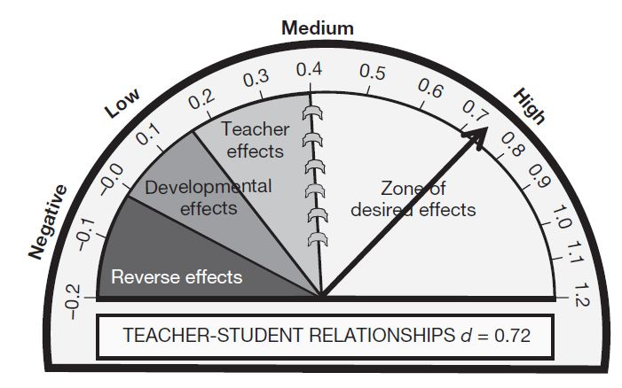
Impact of Building Teacher-Student Relationships
Hattie, 2009
Notes:
Impact of Building Teacher-Student Relationships
When teachers use warmth and support strategies, they create an environment that affords each student the opportunity to demonstrate their value and importance to the classroom community. In a supportive classroom environment everyone has the opportunity to develop meaningful relationships with peers and teachers. According to Hattie (2009), “Building teacher-student relationships implies agency, efficacy, respect by the teacher for what the student brings to the class from home, culture, and peers and recognitions of the life of the student” and generates an academic effect size of 0.72. An effect size greater than 0.4 is shown to have a positive impact on student achievement.

Slide 6
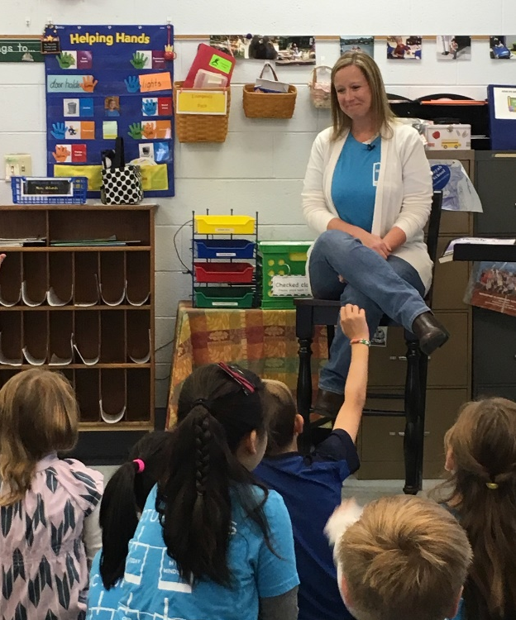
Objectives for This Module
Understand that teachers set the tone for individual and group interactions.
Acknowledge that behaviors are modeled, encouraged, and reinforced by everyone in the class.
Learn how warmth and support strategies improve the classroom environment.
Identify warmth and support strategies you can incorporate in your classroom.
Notes:
Each day teachers establish the tone for individual and group interactions. This tone is accomplished as the teacher models the desired behaviors and acknowledges each student as they engage with each other. As students engage in individual and group activities such as small groups, reading circles, hands-on science and academic activities, the desired behaviors are encouraged and reinforced by everyone in the class. Moreover, in a warm and supportive environment, the students’ comfort levels increase, and they learn it is “okay” to ask questions and even to make mistakes. Through this module, you will learn how your implementation of warmth and support strategies can improve the overall classroom environment, as well as student social and personal competencies, academic indicators, engagement, and connection to the school.
After you engage in this module, you will also be able to identify warmth and support best practices, strategies you can incorporate into your classroom, and resources to learn more.
At the completion of this module, you will be able to reflect on the presentation and plan a lesson with intentional implementation of warmth and support strategies.

Slide 7
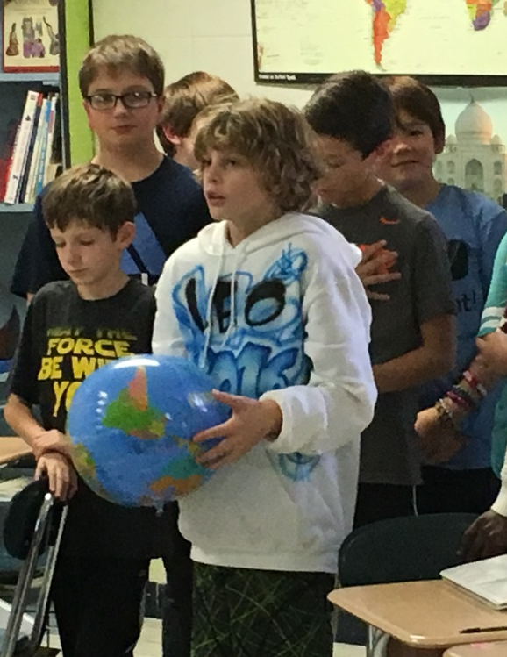
Benefits for Students
Students can
communicate more effectively,
provide quality feedback to others,
consider the perspectives of other students,
negotiate the sharing of resources and tasks, and
deal with conflicts as they arise.
Source: Wlodkowski, R. and Ginsberg, M. (1995)
Notes:
Wlodkowski and Ginsberg (1995) state that ”establishing a classroom tone that is friendly, caring and supportive, and that lets students explore the relationship between course material and personal and social experiences enhances, rather than undermines, students’ learning .” As students experience a warm and supportive classroom with a student-centered curriculum, not only do they have a more positive and respectful learning environment, they will also learn how to apply knowledge to real-life situations and learn more competencies to help them be successful in school and life.
A warm and supportive classroom also contributes to academic gains. Rimm-Kaufman, and Sandilos (2018) report that “Improving students' relationships with teachers has important, positive and long-lasting implications for both students' academic and social development.” Students who have close, positive and supportive relationships with their teachers will attain higher levels of achievement than those students with more conflict in their relationships.
Benefits include students who can:
communicate more effectively
provide quality feedback to others
consider the perspectives of other students
negotiate the sharing of resources and tasks
and deal with conflicts as they arise.

Slide 8
Alignment to TEAM Evaluation
Motivating Students
    The teacher consistently organizes the content so that it is personally meaningful and relevant to students.
Activities and Materials
  Activities and materials are relevant to the students’ lives and provide opportunities for student-to-student interactions.
Academic Feedback
    The teacher circulates to prompt student thinking, assess each student’s progress, and provide individual feedback.
Teacher Knowledge of Students
  Teacher practices regularly incorporate student interests and cultural heritage.
Instructional Plans
  Instructional plans include evidence that plan is appropriate for the age, knowledge, and interests of all learners and provides regular opportunities to accommodate individual student needs.
Notes:
Warmth and support strategies are reflected in the components of the Tennessee Educator Acceleration Model, commonly referred to as TEAM.
For example, the TEAM motivating students component embodies effective warmth and support strategies because it encourages teachers to make content more relevant for students. This will require that teachers get to know and understand their students’ interests and, when possible, embed some of the high-interest topics in their instructional practice. Warmth and support strategies are in the activities and materials, academic feedback, teacher knowledge of students, instructional plans, student work, and expectations components of the TEAM General Educator Rubric. Can you identify other, specific warmth and support components in the TEAM rubric?
This module will help you learn how to use warmth and support strategies in a way that is consistent with the “Significantly Above Expectations” category within the TEAM Rubric.

Slide 9
Alignment to TEAM Evaluation
Student Work
  Assignments require students to connect what they are learning to experiences, observations, feelings, or situations significant in their daily lives both inside and outside of school.
Expectations
  Teacher creates learning opportunities where all students can experience success.
Environment
  The classroom welcomes all members and guests.
Respectful Culture
  Teacher-student interactions demonstrate caring and respect for one another. Students exhibit caring and respect for one another.

Slide 10

Self-Assessment and Self-Reflection
How well do I implement warmth and support?
How do students respond when I implement elements of warmth and support?
See Handout 1
Notes:
Before you get started, take a few minutes to reflect on how you use warmth and support strategies in your own classroom and the ways students react to it. If it is helpful, reflect on your use of warmth and support strategies in a recent class, one that you can easily remember. Otherwise, try to think more holistically about your use of warmth and support during a typical day.
You can refer to “Handout 1, Warmth and Support Self-Assessment”, to reflect on how you implement warmth and support strategies in your classes.

Slide 11
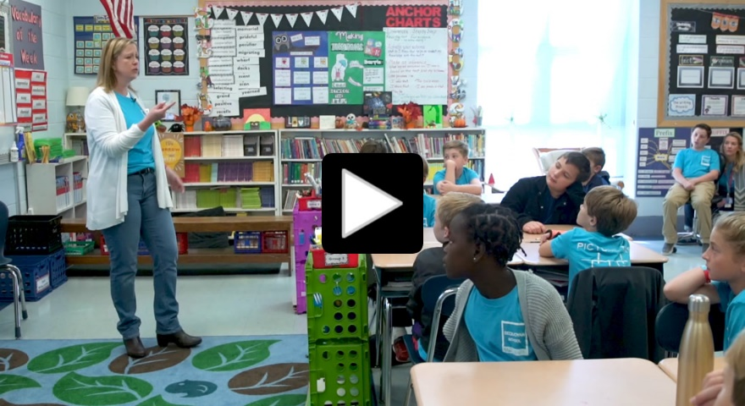
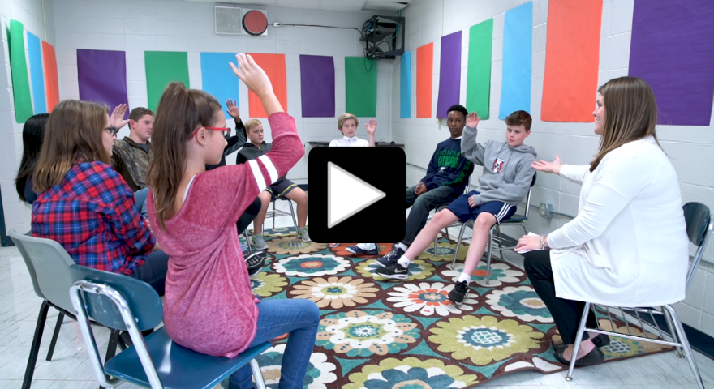
See it in Action
Elementary Example
Secondary Example
See Handout 2
Notes:
Now that you have reflected on your use of warmth and support strategies, take a deeper look at warmth and support in a Tennessee classroom.
Select one of the short videos based on whether you are interested in viewing an elementary or middle school classroom. As you watch the video, pay close attention to the teacher’s approach to implementing warmth and support strategies.
Refer to Handout 2, See It in Action Reflections: Warmth and Support, for some questions to reflect on as you watch the videos.
Warmth and support in the middle school
https://youtu.be/tp_PJUH6Ig8
Warmth and support in the elementary school
https://youtu.be/cKNufWEECL8

Slide 12

Exploring Warmth and Support
See Handout 4
Notes:
We need to see social and personal strategies, and we must attune to the importance of relationships between and among students and their teachers. Peer interactions have long been a focus in SPC efforts, but the quality of student-teacher [and peer to peer] relationships also have a substantial impact.
Because of the importance of a warm and supportive educational environment to the development of social and personal competencies, intentional efforts should be made to acknowledge the importance of relationships between students and teachers and among students. Peer interactions have long been a focus in SEL efforts, but the quality of student-teacher [and peer to peer] relationships also have a large impact and should also be emphasized. Teacher-student relationships characterized by warmth, trust, and low degrees of conflict are associated with social competence and positive school adjustment.
In a warm and supportive classroom, a student feels valued, heard, and safe. As you begin to implement warmth and support strategies in your classroom, there may be a need to design, test, and refine routines that best fit into your school culture. Moreover, there may be a need for differentiated levels of support to meet students’ needs (Lane et al., 2012; Lane et al., 2010). For example, a teacher may need to deliberately engage with a reticent student on a specific schedule…perhaps 2 minutes per day for ten consecutive days.
You can find out more in Handout 4. Reflection and Additional Information.

Slide 13
Learn More About Warmth and Support
Understanding of:
Teacher knowledge of students
Class activities designed to help students to care about each other
Class meetings/advisory groups
Supportive classroom environment
Planning warmth and support lessons
Notes:
There are multiple warmth and support practices that teachers can use to ensure that students feel safe, trusted and valued in the classroom, as well as develop student social and personal competencies. The remainder of this module will go into more detail about specific practices and examples of warmth and support practices. In the remainder of the module, we will explore each of these five practices.
Understanding of:
How teacher knowledge of each student and their interests contribute to learning
How class activities can enable students to get to know and care about one another and their teacher
How class meetings/advisory groups can be used to address common concerns and current issues
How a supportive classroom environment contributes to student success.
How lessons that reflect students’ interests can better engage students

Slide 14
Teacher Knowledge of Students
Learning styles
Likes and dislikes
Values
Family and home
Notes:
The more you know about your students, the easier your job will become. This includes learning more about their learning styles, likes, dislikes, values, family, and home environment. This knowledge will help you to better support your students in the classroom.
Teachers can gain knowledge of their students through a variety of activities such as games and themed assignments reflecting identified student interests. When completed, these activities help students get to know each other. One example is a student-created “postcard” introducing themselves, a favorite vacation, a hobby, or a pet. The students’ postcards can be shared by the student or posted on a bulletin board.
Greeting each child every day as they enter the classroom creates a way to develop a positive relationship with each child and a culture of open communication. Highly-effective teachers often view “hallway” or “bus room" duty as a time to informally interact with students – not just monitor student traffic. Research suggests that teachers who approach their work with a relational orientation and regularly engage students in conversations, build expectations for future interactions and student success.

Slide 15

Class Activities
Elementary
Describe how people are similar and different
Identify positive qualities of characters
Middle School
Analyze how behaviors affect others
Identify strategies to overcome misunderstanding
High School
Analyze how careful listening and talking can resolve conflicts
Create a peer mediation protocol
Classrooms in Action
Notes:
Warmth and support student activities should be appropriate for the students’ grade level. Teachers can integrate the activities with regular classroom instruction.
In elementary school classrooms, students may be asked to describe the ways that people are similar and different. An activity that a teacher could use to integrate into a reading activity might be asking students to describe some positive qualities of characters depicted in age-appropriate stories or poems.
In middle school classrooms, students might be asked to analyze how one’s behavior might affect others and identify ways to overcome misunderstanding within a group. This learning can take place in a history or social studies setting.
In high school classrooms, students might be asked to analyze how carefully listening and accurately talking help to resolve conflicts by creating a peer mediation protocol in class. This exercise could be used in ELA instruction or speech class.
As is the case with most social and personal competencies, students are continually expanding and developing their competencies within their contexts. However, it is important to regularly reinforce the competencies that students need to engage in within your classroom.
For additional ideas for student engagement with and academic integration of social and personal competency, please view other examples at the Classrooms in Action site: http://www.ilclassroomsinaction.org/sel.html

Slide 16
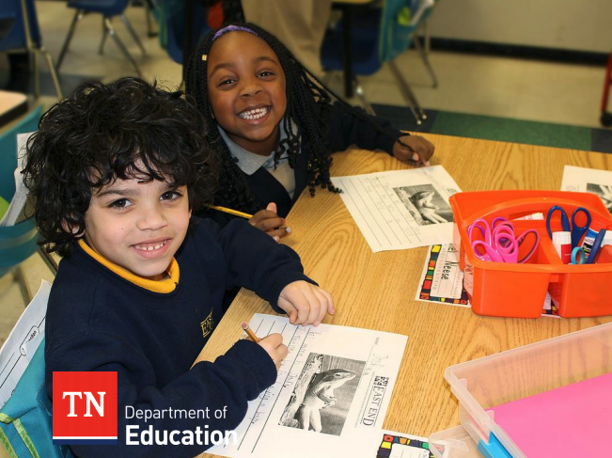

Class Activities
Click Here
to download the SPC Resource Guide.
See Handout 3
Notes:
To help you connect with and plan for the implementation of Tennessee’s Social and Personal Competencies with warmth and support, please refer to Handout 3: Warmth and support Reviewing Social and Personal Competencies and the Tennessee Department of Education’s K-12 Social and Personal Competencies Resource Guide, https://www.tn.gov/content/dam/tn/education/safety/safe_sch/SPC_Resource_Guide.pdf.

Slide 17
Class Meetings/Advisory Groups
Morning meetings/advisories create opportunities for
Greeting each other
Sharing important events
Practicing good listening skills
Interacting with others
“offer students a consistent, dependable opportunity to get to know themselves and each other, build social strengths, and to warm up their thinking selves…”
The Advisory Book (p. 10)
Notes:
Class Meetings/Advisory Groups
“…offers students a consistent, dependable opportunity to get to know themselves and each other, to build social strengths, to warm up their thinking selves in a wide variety of mentally challenging games and relevant activities, and to have fun doing so.” The Advisory Book, p.10
Warmth and support strategies are effective when used in classroom meetings or advisories. Through participation in advisories, teachers and students can model, practice, and learn SPC knowledge and skills.
Lasting about 20-30 minutes, a meeting/advisory can set the tone for the day and foreshadow students’ expectations for the week. This is a great time to share information about school events or news. During the morning meetings and/or advisories students should be encouraged to take risks by asking questions, voicing concerns, and engaging in authentic problem-solving in a safe environment.
Morning meetings/advisories also create opportunities for students and teachers to practice:
Greeting each other by name
Sharing important events in their lives
Good listening skills
Interacting with others by reciting a poem, singing songs or playing a game.
The meeting/advisory becomes a forum for: respectful learning; trust; student motivation; empathy and collaboration; and support for the development of other social and personal competencies.

Slide 18
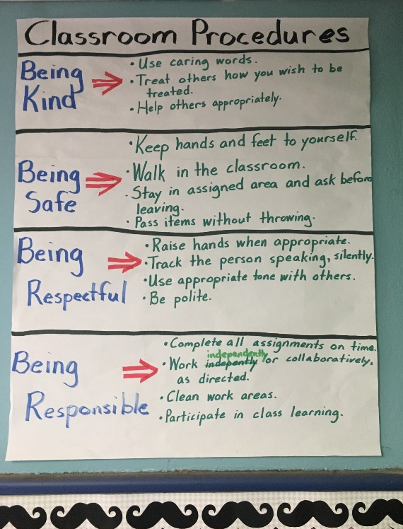
Supportive Classroom Environment
Recognition of each students’ value and contribution
Consistently positive classroom climate/culture
Engaging and relevant curriculum
Structures and processes enabling each student to feel safe
At least one caring adult and a caring peer community for each student
Students who are risk-takers and are comfortable sharing ideas, including concerns
A team approach to learning; a win-win philosophy
Notes:
There are multiple indicators of a supportive classroom environment. One indicator might be categorized as academic where highly effective educators engage all students through the provision of differentiated instructional strategies, and assessments for learning. Therefore, students have more options for demonstrating mastery. Other indicators might be categorized as more material or aesthetic and include classroom design for safety, security, and comfort. In this type of environment, the opportunity for academic success increases because meeting the students’ social and personal competency needs allow for greater focus and commitment to learning.
Characteristics of a warm and supportive classroom environment include:
the recognition of each students’ value and contribution to the learning environment
a consistently positive classroom climate/culture
delivery of an engaging and relevant curriculum
use of structures and processes enabling each student to feel safe
at least one caring adult and a caring peer community for each student
students who are risk-takers and are comfortable sharing ideas, including concerns
a team approach to learning, a win-win philosophy
Classroom procedures, such as meetings and advisories , also contribute to a warm and supportive classroom by helping to ensure a sense of consistency classroom procedures, positive feelings, class community, and relationships with other students and the teacher .

Slide 19
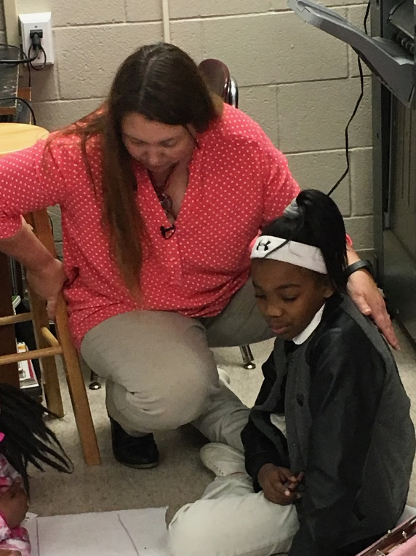
Planning Warmth and Support Lessons
Select a venue to introduce and practice this strategy.
Model the strategy by using good and “not-so-good” examples.
Select a topic or multiple topics which reflects student interests.
Allow time for student-to-student interactions.
Monitor student conversations to listen for their use of warmth and support strategies.
Acknowledge student use of the strategy.
Provide feedback to reinforce the practiced strategy.
See Handout 3
Notes:
“Handout 3 Planning for Warmth and Support” provides you with a planning template, guiding questions, resources, and a section to write your notes to as you plan to deliver a lesson with embedded warmth and support strategies.
Consider these additional tips to ensure effective implementation of warmth and support in your classroom.
Select a venue to introduce and practice this strategy.
Model the strategy by using good and “not-so-good” examples.
Select a topic or multiple topics which reflect student interests.
Allow time for student-to-student interactions.
Monitor student conversations to listen for their use of warmth and support strategies.
Acknowledge student use of the strategy.
Provide feedback to reinforce the practiced strategy.
Please take a few minutes to review Handout 3

Slide 20
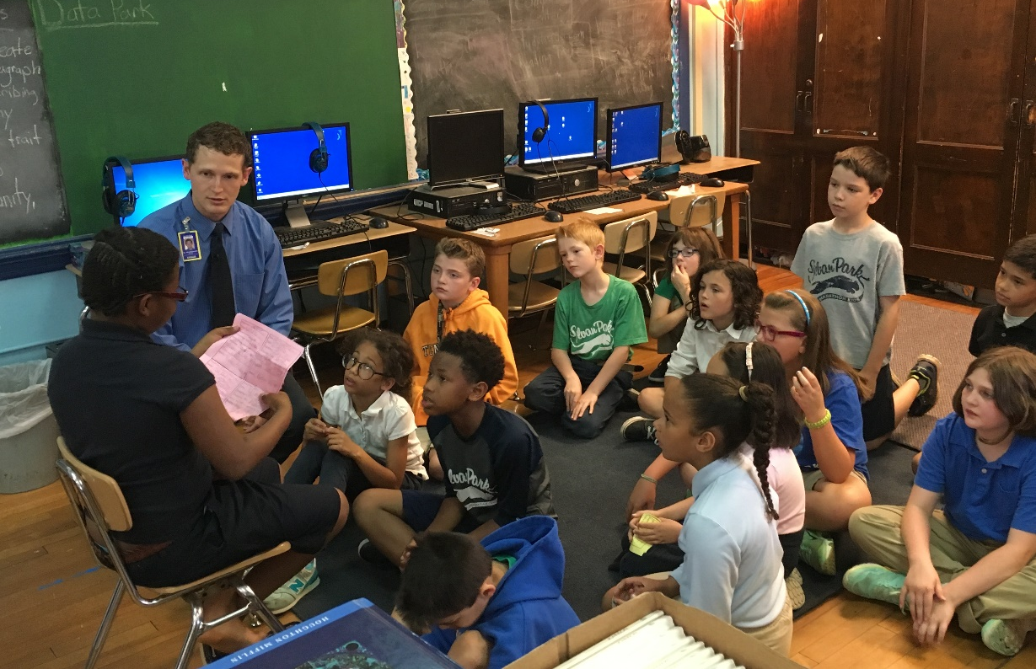
Summary
SPC practices enable individuals to learn about “the knowledge, skills, attitudes, and behaviors that individuals need to make successful choices”
Source: Center for Academic, Social, and Emotional Learning (2014)
Notes:
Warmth and support strategies are used with students of all ages and abilities, in a variety of situations across subject areas, and for different purposes. Teachers who plan to implement warmth and support activities need: knowledge of their students’ backgrounds and interests; to prepare and deliver lessons that reflect students’ interests; design class activities which promote students caring about one another; facilitate class meetings/advisory groups to address common concerns/issues and co-develop with their students a supportive classroom environment.
Well-planned warmth and support strategies help to improve school climate and classroom interactions in a way that promotes student social and personal competencies and prepares students for success in the classroom and school, as well as in the world and workforce.
The Center for Academic, Social, and Emotional Learning (CASEL) 2014 reports that implementation of SPC practices enables individuals to learn about “the knowledge, skills, attitudes, and behaviors that individuals need to make successful choices.”

Slide 21
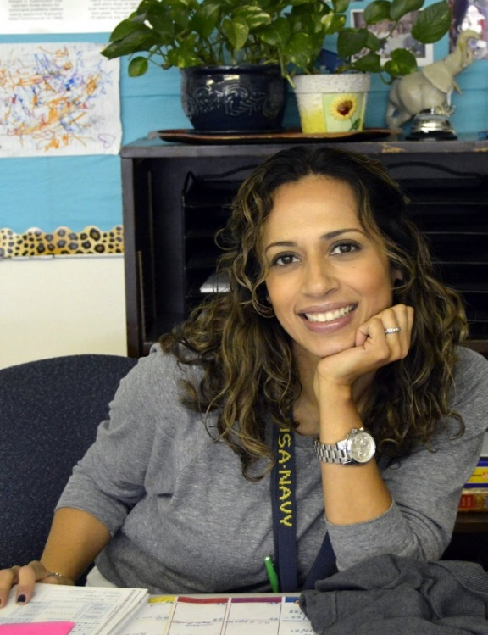
Reflect and Plan for the Future
Set a goal.
Involve your students.
Be reflective.
See Handout 4
Notes:
Implementing warmth and support strategies that support student social and personal competencies can be complex, as they require to know your students better and develop deeper relationships with your students. To help you plan for using warmth and support more effectively in your class, complete the final handout, “Handout 4, Warmth and Support Reflection and Additional Information.” It contains questions for reflection that can lead to concrete action steps to impact your use of cooperative learning. This handout also provides additional resources that you can call on to find more information about warmth and support, as well as the references cited in the module’s facilitator guide. As you consider your own plan of action, keep in mind the following helpful hints:
Set a goal. Identify realistic goals for yourself in implementing warmth and support strategies in your classroom. Also, be mindful of what warmth and support strategies may look like depending on your students and the grade and subject you teach. Ask yourself if you need to teach students how to use this SPC strategy. In what ways will you model the desired behavior?
Involve students. As you learn more about your students’ interests, explore ways to incorporate their interests into lesson plans, class activities, individual, and group work.
Be reflective. Based on the benefits associated with a warm and supportive classroom, what changes do you plan to make in planning, implementing, and evaluating warmth and support in your classes? How will you know if the changes you make are beneficial to your students?
If you are reviewing this information to better understand the TEAM Rubric, consider how you might share your action steps with coaches, mentor teachers, administrators, or those who might observe your class. They will benefit from knowing your efforts and may be able to provide feedback on your actions.

Slide 22

Module Evaluation
For more information, please contact:
Pat Conner Executive Director Student Support Pat.Conner@tn.gov (615) 253-0018 | Kimberly Daubenspeck Training and Development Coordinator Kimberly.Daubenspeck@tn.gov (615) 532-0469
Click Here
To complete a short evaluation of this module.
Notes:
The Tennessee Department of Education developed this online module in collaboration with the Center on Great Teachers and Leaders and the Appalachia Regional Comprehensive Center, which are funded by the U.S. Department of Education. If you want to find out more information about the online modules or SPC, please contact the Office of Safe and Supportive Schools, Division of Student Support Services, at the Tennessee Department of Education.
Thank you again for participating in the warmth and support online module. We encourage you to complete the online evaluation of the learning module. We also encourage you to review the other online modules that provide knowledge, tools, resources, and strategies to embed SPC within your classes.
Evaluation Link: https://warmthandsupport.questionpro.com

Slide 23

References
Bucholz, J. and J. Sheffler. (2009) Creating a Warm and Inclusive Classroom Environment: Planning for All Chlildren to Feel Welcomed, Electronic Journal for Inclusive Education, Vol.2 (4)
CASEL. (2014) Cambridge Public Schools (MA) Morning Meeting Components, retrieved at https://www.cpsd.us/departments/health_education/social_and_emotional_learning___s_e_l_/morning_meeting_components/
Christenson, S. L., & Havsy, L. H. (2004). “Family-school-peer relationships: Significance for social-emotional and academic learning.” In J. E. Zins, R. P.Weissberg, M. C.Wang, & H. J.Walberg (Eds.), Building academic success on social and emotional learning: What does the research say? (pp. 59–75). NewYork: Teachers College Press.
Classrooms in Action: Social Emotional Learning Standards Supports A collaborative project of IL Classrooms in Action, Illinois State University and Illinois State Board of Education. This site is maintained by the ISBE Content Specialists. http://www.ilclassroomsinaction.org/sel.html
Cornelius-White, J. (2007). Learner-Centered Teacher Student Relationships Are Effective: A Meta-Analysis. Review of Educational Research, 77(1), 113–143.

Slide 24
References
Hattie, J. (2009). Visible Learning: A Synthesis of 800 Meta-Analyses Relating to Achievement. Routledge.
John W. Gardner Center Handout. 2007. Learning: Active Listening Guidelines. And Open-Ended Questions
Marloes, M.H.G, et al. (2016). Social dynamics in the classroom: Teacher support and conflict and the peer ecology. Teacher and Teacher Education, (53). p30-40)
Tennessee Department of Education. (2015). Incorporating social and emotional learning into classroom instruction and educator effectiveness: A toolkit for Tennessee teachers and administrators. Nashville, TN Tennessee Department of Education.
Wlodkowski, Raymond and Margery Ginsberg. Diversity & Motivation: Culturally Responsive Teaching. San Francisco: Jossey-Bass, 1995. (Baker, 2006; Baker, Clark, Maier, & Viger, 2008; Hamre & Pianta, 2001; Pianta & Stuhlman, 2004; Rimm-Kaufman & Hamre, 2010.
Teachstone Effective Teacher-Child Interactions and Child Outcomes: A Summary of Research on the Classroom Assessment Scoring System (CLASS) PreK-3.

Slide 25
This work was originally produced at least in part by the Center on Great Teachers and Leaders and the Appalachia Regional Comprehensive Center with funds from the U.S. Department of Education under cooperative agreement numbers S283B120021 and S283B120023, The content does not necessarily reflect the views or policies of the U.S. Department of Education nor does mention of trade names, commercial products, or organizations imply endorsement by the U.S. Government
Notes:
{music}

