Slide 1
Incorporating Social and Personal Competencies Into Classroom Instruction and Educator Effectiveness
Module 3: Responsibility and Choice
Notes:
As a student, how did you learn to become responsible for your learning? For making good choices, both in and out of school? How did you develop the ability to become a responsible decision maker? As an educator, what can you do to help students make better choices and become more responsible for their learning and their social interactions, both in school and beyond?
This module explores responsibility and choice practices that you can implement in the classroom to support students’ development of their social and personal competencies, including responsible decision-making and self-management skills.

Slide 2
Importance of Responsibility and Choice
Most of my teachers… | % Agree
Challenge all students to do their personal best | 70.65%
Assign work that allows me to be creative and think for myself | 54.51%
Often connect what I am learning to life outside the classroom | 48.59%
Help me get excited about what I am learning in my classes | 39.05%
Source: Tennessee Department of Education, 2013-14
Notes:
Your students will take greater responsibility for their learning when the learning activities they engage in are connected to their personal goals, interests, and experiences. Students who take greater responsibility may be described as more autonomous learners or students who engage in self-directed learning, in which the learner develops and monitors personal goals and is motivated and persistent in achieving those goals. Further, student motivation increases when teachers provide students with developmentally appropriate choices that students find interesting and engaging.
So how do Tennessee students feel about the responsibility and choice practices in their classrooms? In a survey administered to almost 90,000 middle and high school students in Tennessee in 2013-14, 54 percent of the students agreed or strongly agreed that most teachers at their school allow them to be creative and think for themselves. Similarly, about 49 percent of the students who responded agreed or strongly agreed that most of their teachers often connect what they are learning to life outside of the classroom. Fewer than 40 percent of the students who responded agreed or strongly agreed that most of their teachers helped them to get excited about what they are learning in class.
Responsibility and choice can motivate students to achieve personal and academic goals. But not all choice is effective, and you should consider strategies that provide appropriate choices that scaffold your students’ development as they take on greater responsibility for their learning and their actions inside and outside of class. This module will provide you with strategies to consider for effectively promoting responsibility and choice to lead to greater student academic, personal, and social outcomes.

Slide 3
10 Teaching Practices That Promote SEL
Student-Centered Discipline
Cooperative Learning
Teacher Language
Classroom Discussions
Responsibility & Choice
Self-Assessment & Self-Reflection
Social Teaching Practices
Instructional Teaching Practices
Warmth & Support
Balanced Instruction
Academic Press & Expectations
Competence Building
Notes:
Responsibility and choice refer to approaches in which teachers allow students to make responsible decisions about their work and interactions in their classrooms. When students develop the social and personal competencies needed to become responsible decision makers in the classroom context, students may use those competencies in situations outside of the classroom when faced with personal choices and decisions.
Responsibility and Choice is the third learning module in the Social and Personal Competencies Modules series of ten modules. If you have not already, you can review the Introduction to Social and Personal Competencies module to learn more about the goal and purposes of this series. We developed each module to address one of the ten teaching practices that promote social and personal competencies, as described in the Tennessee Toolkit titled Incorporating Social and Personal Competencies into Classroom Instruction and Educator Effectiveness: A Toolkit for Tennessee Teachers and Administrators.

Slide 4
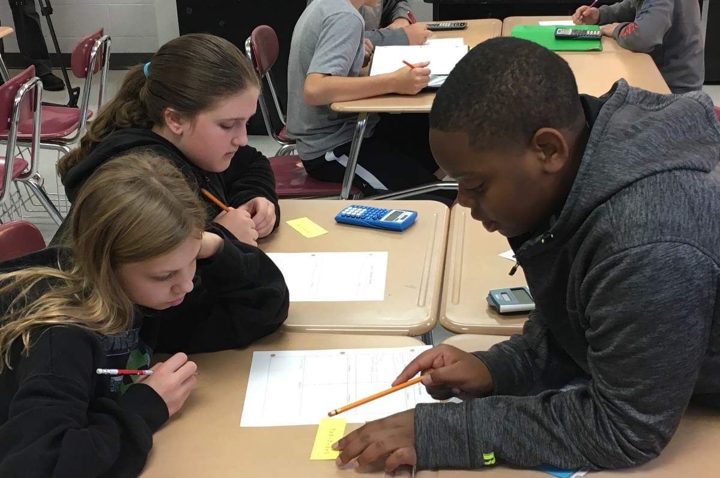

Introduction to Responsibility and Choice
Responsibility and choice practices support:
Goal-setting
Awareness of others
Communication
Responsible decision-making
Click Here
to download the handouts for Module 1.
Notes:
Responsibility and choice are essential instructional practices that facilitate development of a variety of social and personal competencies students need to be successful in school, work, and life. Providing students with opportunities to be responsible learners and make good decisions and choices is critical, as students constantly face choices in school, social settings, or their personal lives.
Responsibility and choice practices support a range of social and personal competencies, including goal-setting, awareness of others, and communication, in addition to responsible decision-making. Responsible decision-making, one of the five core competencies in the Tennessee Social and Personal Competencies, is the ability to make constructive and respectful choices about personal behavior and social interactions based on consideration of ethical standards, safety concerns, social norms, the realistic evaluation of consequences of various actions, and the well-being of self and others. When students make responsible decisions, they evaluate the consequences—positive and negative—of the choices they make for themselves and others. These decisions can occur in academic and social settings, both in and out of the classroom.
If you have not already downloaded the handouts for this module, now is an excellent time to do so. You will be directed when to refer to each of them.

Slide 5
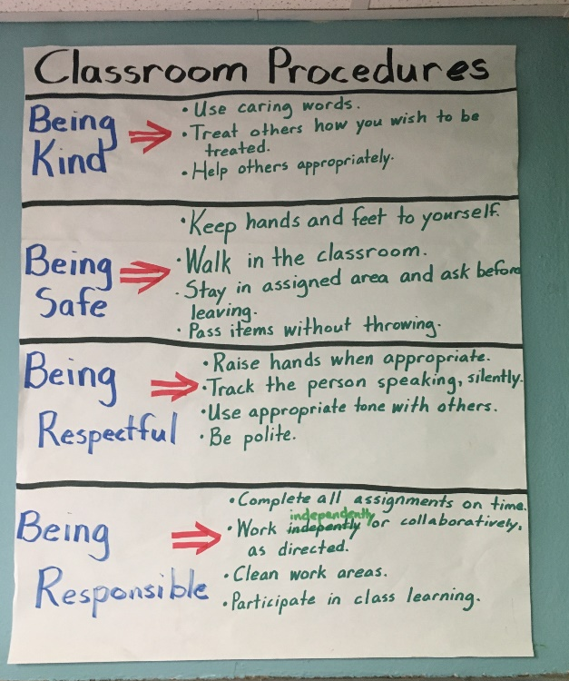
Objectives for This Module
Learn how responsibility and choice practices may influence the social, personal, and academic competencies.
Identify strategies to help students effectively engage with responsibility and choice practices.
Develop next steps to implement strategies that promote responsibility and choice.
Notes:
Through this module, you will learn how responsibility and choice influence students’ development of social, personal, and academic competencies. You will learn how to create opportunities for students to become responsible and self-directed learners and make relevant and effective choices that can both motivate students and be manageable for you as a teacher. For example, you will learn about self-directed learning, incorporating democratic norms, student-led conferences, peer tutoring, and service learning.
Additionally, you will see examples of Tennessee teachers incorporating academic and social strategies that promote responsibility and choice in their classrooms.
At the completion of this module, you will reflect on what you have learned and develop a plan for incorporating at least one of the strategies in this module that promotes responsibility and choice.

Slide 6
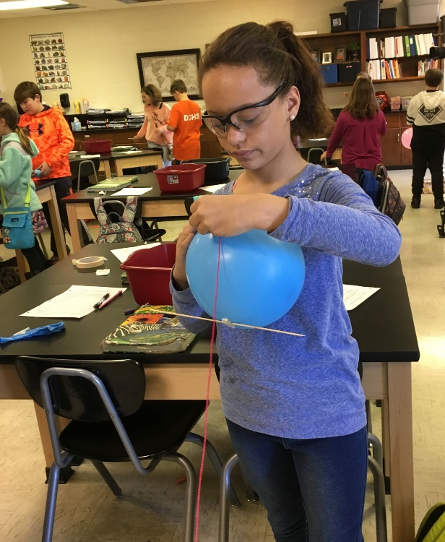
Benefits for Students
Students:
Demonstrate responsibility with materials and accept responsibility for the classroom
Accept responsibility for their actions, both positive and negative
Hold each other accountable and have opportunities to help their peers or teacher
Can help improve their class and school community
Sources: Bierman, et al., 2008; Fishman, 2014
Notes:
Students experience multiple benefits when teachers engage in responsibility and choice practices. For example, students develop social and personal skills that can help them monitor their progress toward goals and provide specific feedback to their peers. To successfully engage in these practices, students also have to learn to manage their feelings, thoughts, and behaviors, as well as the strategies they use to guide their learning. Similarly, students can become more responsible learners when they accept responsibility for the materials and resources they use for learning—even when those resources are other people.
Evan Fishman (2014) indicates that students who accept responsibility for their actions are likely to feel greater control over those actions and become self-motivated, especially in academic situations. However, to have the most impact, teachers should not try to impose responsibility on students or hold students accountable for their actions and learning outcomes in the traditional sense. Instead, you can help students develop their sense of responsibility, helping them recognize that they can influence their learning environment to reach the academic goals they set for themselves. Also, when students develop a sense of responsibility, they are more likely to exhibit self-regulation strategies and develop a sense of internal obligation to reach their goals. Responsible students report going beyond surface-level learning more than their peers who do not feel responsible for their learning.
Additional social and personal competencies that students develop when teachers implement responsibility and choice practices include problem-solving skills, like the capacity to define problems, to generate and reflect on solutions, and to consider the implications on others for potential solutions (Bierman, et al., 2008). You can easily incorporate responsibility and choice practices into your repertoire to benefit students of all ages, abilities, and backgrounds.

Slide 7

Alignment to TEAM Evaluation
Activities and Materials
    Activities and materials provide students with choices.
    Activities demand self-direction and self-monitoring.
Questioning
  Students generate questions that lead to further inquiry and self-directed learning.
Academic Feedback
  The teacher engages students in giving specific and high-quality feedback to one another.
Grouping Students
    All students in groups know their roles, responsibilities, and group work expectations.
Thinking
  The teacher provides opportunities where students monitor their thinking to insure that they understand what they are learning, are attending to critical information, and are aware of the learning strategies that they are using and why.
Expectations
  Students take initiative and follow through with their own work.
Managing Student Behavior
  The teacher and students establish clear rules for learning and behavior.
Notes:
Elements of responsibility and choice practices can be found within multiple components of the Tennessee Educator Acceleration Model, sometimes referred to as TEAM. For example, responsibility and choice practices can be seen within the activities and materials component of the TEAM, as students can choose the activities and materials they use in the classroom, while other activities demand self-direction and self-monitoring. Similarly, it can be found within the questioning, academic feedback, group students, thinking, expectations, and managing student behavior components of the TEAM General Educator Rubric. This module will help you learn how to promote responsibility and choice in a way that is consistent with the “Significantly Above Expectations” category within the TEAM Rubric.

Slide 8

Self-Assessment and Self-Reflection
How wellor how often do you
How well do I offer choice to promote responsible decision making?
How do students respond when I implement choice and promote responsible decision making?
See Handout 1
Notes:
Before you get started, take a few minutes to reflect on how you promote responsibility and choice in your classroom. What strategies do you use? How confident do you feel in monitoring and evaluating academic and social and personal learning as a result of allowing for greater student responsibility? How do students react when given opportunities to develop responsibility and have choices? If it’s helpful, reflect on your use of strategies in a recent class, one that you can easily remember. Otherwise, try to think more holistically about your use of responsibility and choice during a typical day.
You can refer to Handout 1, Responsibility and Choice Self­-Assessment, to reflect on how you implement these practices in your classroom.

Slide 9
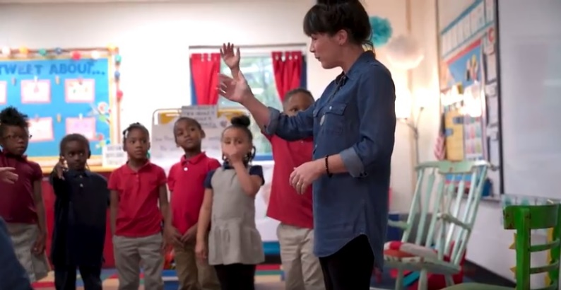

See It in Action
Elementary Example
Secondary Example
See Handout 2
Notes:
Now that you’ve reflected on your use of responsibility and choice, take a deeper look at these practices in action. Select one of the short videos based on whether you’re interested in viewing an elementary or secondary classroom, or perhaps both! As you watch the video, pay close attention to how the teacher proactively supports students to manage their learning during opportunities that promote responsibility and choice. You’ll find some reflection questions in Handout 2, See It in Action Reflections, that you might ask yourself as you watch.
Responsibility and Choice in the Middle School: https://youtu.be/_tSE6SynNc4
Responsibility and Choice in the Elementary School: https://youtu.be/bbTr2dFt1RA

Slide 10
Exploring Responsibility and Choice
Source: d’ailly, 2004
Notes:
Students from all backgrounds and developmental levels can engage in responsibility and choice practices; although, the way that they engage in those practices might differ. For example, not all students come to school with the same motivation for success or have the same understanding about their roles as students. Students who come from cultures that promote independent thinking and interactions are more likely to value making their own choices, whereas students from more communal cultures are more intrinsically motivated when presented with choices that have more value to the group or are decided on with an elder (D’ailly, 2004; Katz & Assor, 2007).
In the remainder of the module, we will provide specific practices that you can engage in with your students that exemplify responsibility and choice. Specifically, you’ll learn more about self-directed learning strategies, democratic norms and procedures, student-led conferences, peer tutoring, and service-learning.

Slide 11
General Principles: Developing Autonomous Learners
General principles include:
Connect content to student values, interests, and goals;
Listen to students more often;
Allow students to demonstrate responsibility with materials;
Ask students what they want or need;
Respond to student-generated questions;
Avoid giving solutions or using directives; and
Avoid overreliance on extrinsic motivators.
Sources: Katz & Assor, 2007; Stefanou, Perencevich, DiCinto & Turner, 2004
Notes:
Through the integration of responsibility and choice practices in the classroom, your students are more likely to become autonomous learners. Autonomous learners take greater responsibility for their learning. They make their own choices, take actions on their own to realize their personal goals, and persist on tasks even when faced with challenges (Assor, Kaplan & Roth, 2002). Further, students who perceive themselves as autonomous learners report greater curiosity, increased involvement in schoolwork, and more enjoyment in schoolwork compared to their peers who do not perceive themselves as autonomous (Stefanou, Perencevich, DiCinto & Turner, 2004).
You can enact general principles of responsibility and choice to support autonomous, self-directed learners in the classroom. General principles include (Katz & Assor, 2007; Stefanou, Perencevich, DiCinto & Turner, 2004):
Connect content to student values, interests, and goals;
Listen to students more often;
Allow students to demonstrate responsibility with materials;
Ask students what they want or need;
Respond to student-generated questions;
Avoid giving solutions or using directives; and
Avoid overreliance on extrinsic motivators

Slide 12
Choice: The Gateway to Responsibility
Organizational | Procedural | Cognitive
Students are given opportunities to:
Choose group members Choose evaluation procedure Take responsibility of due dates Participate in creating and implementing classroom rules Choose seating arrangement | Choose materials to use in class projects Choose the way competence will be demonstrated Display work in an individual manner Discuss their wants Handle materials | Discuss multiple approaches and strategies Find and justify multiple solutions Create personal goals based on interest or values Re-evaluate errors Receive informational feedback Have less teacher talk time Ask questions
Source: Evans & Boucher, 2015; Katz & Assor, 2007; Pattal, Cooper & Wynn, 2010; Rose & Meyer, 2002
Notes:
Choice: The Gateway to Autonomous Learners
On the surface, student choice may appear simple to implement in the classroom; however, there’s more to choice than just giving students an option or two. Researchers note that the act of choosing, in and of itself, is not motivational (Evans & Boucher, 2015; Katz & Assor, 2007, Patall, Cooper & Wynn, 2010). Instead, to have a positive impact on students, the choices you provide must be personally relevant and meaningful. To help make the distinction, some people distinguish picking and choosing. Picking is when you decide between two similar options, such as picking between pencil and paper or computer, whereas, choosing occurs when the options are personally relevant to students and connect to their personal goals, interests, or values. In other words, choices are motivational, and picking is not.
The Universal Design for Learning framework (Rose & Meyer, 2002) suggests that meaningful choices for students are culturally relevant, age-appropriate, and personalized to students’ interests and lives. Because not all students have the same interests and experiences, it is vital to form meaningful relationships with your students and learn more about them so you can offer more relevant choices to your students.
So, what are some appropriate choices you can provide? Choices can be simple, such as choices for organizing student work, like allowing students to choose whom they want to work with and where they’ll physically do their work. Students can also make choices about the procedures they use, such as offering students a choice of materials and how they’ll demonstrate learning. Teachers can offer sophisticated cognitive choices through questioning and interactions with students, in which students have to justify or argue their position or to evaluate their own and others’ solutions or ideas.

Slide 13
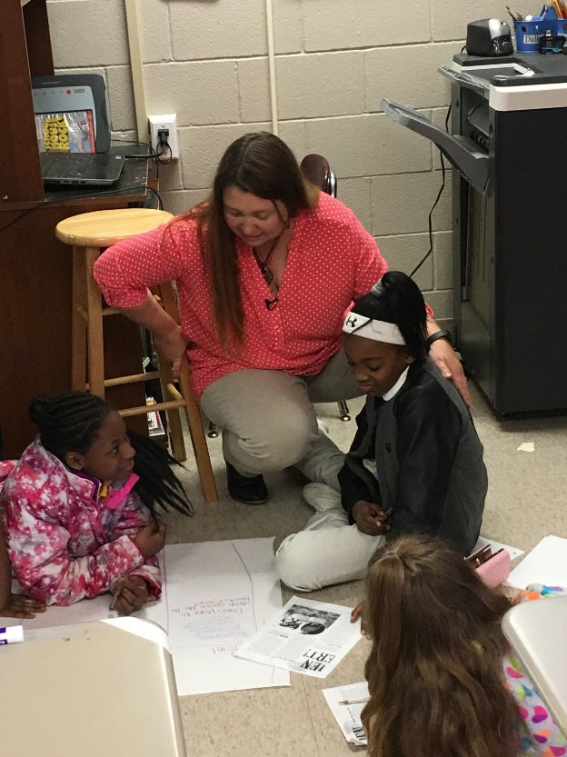
Providing Effective Choices
Relevant and interesting
3-5 options
Intermediate difficulty
Not too different
Provide processing time
Access to resources
Sources: Assor, Kaplan & Roth, 2002; Beymer & Thomson, 2015; Evans & Boucher, 2015; Patall, Cooper & Robinson, 2008
See Handout 3a
Notes:
Much like Goldilocks’ quest for a good bowl of porridge, choices have to be “just right” for students, or they can have negative consequences. But what is just right for one student may not be for all. For example, some students can feel overwhelmed if they don’t feel like they have a clear understanding of what they are being asked to do. Fortunately, researchers have identified some critical parameters when providing students opportunities to make choices in the classroom (Assor, Kaplan & Roth, 2002; Beymer & Thomson, 2015; Evans & Boucher, 2015; Patall, Cooper & Robinson, 2008).
Components of effective choices include:
Choices should be personally relevant and interesting to students, linking to their personal goals, interests, and/or values. If the choice is not interesting to the students, it’s likely to be ineffective.
Offer between three to five options. Some students may need scaffolding to benefit from the larger number of choices, as too many choices can lead to “choice overload.” You may consider using choice boards, interactive menus, or “learning menus” that provide activities using different formats, such as “must dos and may do,” or “appetizers, entrée, dessert,” as ways to organize choices for students.
When offering choices with tasks, the tasks should be in the intermediate range of difficulty for students, based on their abilities and developmental level. If you provide choices that are too easy or too hard, students may become bored or overwhelmed and not engage with the choices.
Tasks should not be too different from each other or vary widely in difficulty or rigor.
Provide time for students to process, make a choice, and weigh their decisions.
Provide students access to adequate resources and support to complete their chosen tasks successfully.
As you progress through this module, we encourage you to consider characteristics or strategies of responsibility and choice that you want to take action on in your classroom. While some of the practices require collaboration across classrooms, such as peer tutoring or service-learning, you may still want to investigate them and plan for future implementation at your school. You will find multiple handouts broken out by topic. Choose the topic and corresponding handouts that you wish to focus on as you progress through the module. Review the tips to implement providing effective choices in Handout 3a, which includes a link to the Tennessee Department of Education’s K-12 Social and Personal Competencies Resource Guide.

Slide 14
Self-Directed Learning
Planning
Monitoring
Evaluating
Sources: Ertmer & Newby, 1996; Gibbons, 2002
Notes:
Encouraging self-directed learning is a key practice for promoting responsibility and choice. Self-directed learning requires a variety of social and personal competencies, including self-awareness, self-management, and social awareness.
Self-directed learning occurs when students—or anyone for that matter—take on the responsibility of learning a new skill or increasing their knowledge on their own volition. There is no one “right” approach for self-directed learning, as two people could attempt to learn the same skill or knowledge each taking a different approach, requiring more or less time to learn, and engaging in the learning in different settings. (Gibbons, 2002). Although you may assume that self-directed learning occurs on one’s own, don’t assume that individuals who do not seek external support from others are more knowledgeable in a particular subject or skill. Asking questions is an important strategy for self-directed learners.
There are three steps you can follow to teach students to become self-directed learners: planning for, monitoring, and evaluating their learning (Ertmer & Newby, 1996). Each step requires students to demonstrate a variety of social and personal competencies, and it is critical that students are explicitly taught how to engage in these learning strategies.
Planning. In the planning stage, students exhibit self-awareness, self-management, and social awareness skills, three of Tennessee’s social and personal competencies. In planning, students set goals for their learning. Their goals can be based on academic standards, social and personal competencies, or a combination. Goals can be customized to each student’s interests, values, and experiences. Similarly, students should create plans for accomplishing their goals, and identify resources they need to accomplish them, often working with their teacher to do so.
Monitoring. The monitoring stage also affords opportunities for students to develop social and personal competencies, such as self-awareness and self-management. In this stage, students assess progress toward their learning targets or engage in self- or peer-assessment. You can use a variety of strategies, tools, and resources with students. These may include formative checks like questioning, exit tickets, checklists, rubrics, or activity requirements or guidelines. If you find that students aren’t making sufficient progress, help them return to their goals and determine if they should modify their current strategies or revise their goals.
Evaluating. Monitoring occurs during learning and can result in changes to goals and the actions students take. Evaluation comes at the end of learning. To support self-directed learning, evaluation should go beyond determining whether student responses are simply correct or not. Evaluation requires students to reflect on their learning and the strategies they used to learn. Students may reflect on both their academic goals and the social and personal competencies they used to support learning. Review Module 7: Self-Assessment and Self-Reflection for additional information on monitoring and evaluating goals.

Slide 15

Metacognition
Making thinking visible:
observe closely and describe what’s there;
build explanations and interpretations;
reason with evidence;
make connections;
consider different viewpoints and perspectives;
capture the heart and form conclusions;
wonder and ask questions; and
uncover complexity and go below the surface of things.
Visit the Visible Thinking Website from Harvard’s Project Zero.
Source: Ritchhart, Church and Morrison, 2011, pp. 11, 13
See Handout 3b
Notes:
A key component of self-directed learning for learners at all developmental stages is metacognition. Simply put, metacognition is thinking about your thinking. It goes beyond demonstrating new skills and knowledge and incorporates extended thinking about the topic, the skills you’ve developed, and how that has expanded your thinking. Metacognition is often associated with extended thinking, which is linked to Depth of Knowledge Level 4. The Depth of Knowledge Levels serve as a framework for the cognitive complexity of the Tennessee content standards.
In addition, educators and researchers at Harvard’s Project Zero call metacognition “making thinking visible.” They have developed principles or practices that students of all ages can engage in to make their thinking visible, such as making close observations and learning to describe things in detail. Students can also make their thinking visible by learning to reason with evidence or by making connections with prior knowledge or past content. You can find more information and a long list of activities you can incorporate in any classroom with students of most ages on their Visible Thinking website (Ritchhart, Church, and Morrison, 2011, pp. 11, 13).
Do you want to focus on strategies to promote self-directed learning in your classroom? Or maybe you’d like to explore and implement strategies to help make thinking more visible. Refer to handout 3b for additional resources and to determine whether you plan to focus on self-directed learning for your work related to this module.

Slide 16
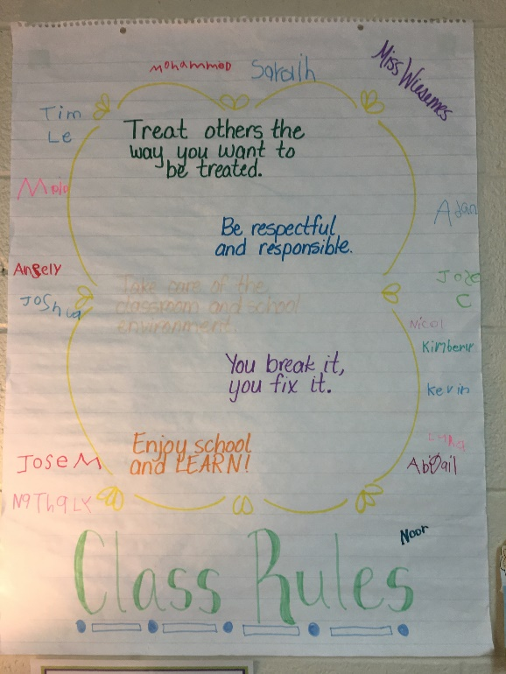
Norms of Democracy
Popular sovereignty
Freedom
Equality
Individualism
Social responsibility
Source: Wraga, 1998; Stefanou, et al., 2004; Turabik & Gun, 2016
Notes:
All democracies strive to maintain a balance between personal freedoms and social responsibilities. The same is true for democratic classrooms, in which students have significant responsibility for determining norms and running the classroom. William Wraga (1998) describes five principles of democracy that can be applied to classroom norms and procedures.
Popular sovereignty. To the greatest extent possible, students participate in decisions that impact them. This principle goes beyond making group decisions by taking a vote, but rather by having students make meaningful decisions. For example, students can create and monitor the norms and procedures for how the classroom operates, and develop structures that give students the opportunity to explore and manage issues that arise during class, at school, or in the community at large.
Freedom. Teachers should create a balance between freedom and control in the classroom, as too much freedom can lead to a lack of discipline and reduced responsibility. You can support creating a sense of freedom by providing students with opportunities to reflect on and think critically about personal and social actions in the classroom. Reflections can occur during class meetings where students grapple with resolutions to school- or community-based problems, or during academic discussions where students discuss their point of view acknowledging others may have different viewpoints.
Equality. Democratic classrooms ensure that students have equal opportunity to contribute to group work and class discussions, and teachers ensure that all students have equal access to the curriculum.
Individualism. Be sure student interests and backgrounds are taken seriously and are incorporated into learning when possible. Classroom management is designed to help students develop self-control and self-directed action.
Social responsibility. Individualism is complemented by a commitment to others in the classroom. Students engage in social responsibility through participation in the resolution of classroom issues and contributing to classroom decisions. Your students can learn how to contribute to small groups, the classroom and school, and the wider democratic society.
A democratic classroom leadership style motivates students and increases student participation and completion of work, even when the leader is absent from the room (Stefanou et al., 2004). Students develop and apply a variety of social and personal competencies, such as curiosity, critical thinking, problem-solving, perspective taking, compromise, and arbitration when engaged in democratic classrooms (Turabik & Gun, 2016). Furthermore, when students are given input on and support for how their democratic classroom operates, they reflect on their values, the values of the education process, and how the values reflect greater principles of democracy found outside of schools.

Slide 17
Establishing and Nurturing Democratic Classroom Norms
Use developmentally appropriate language and examples.
Balance between personal freedoms and social responsibilities.
Execute and monitor rules, norms, and procedures.
Encourage student voice.
Remind and redirect students.
Reflect on the effectiveness of rules, norms, and procedures.
Source: Evans & Vaandering, 2016; Graham, 2017; Landau & Gathercoal, 2000
See Handout 3c
Notes:
Similar to other new classroom practices you implement with your students, you will want to scaffold the experience, starting with structured processes and procedures, then gradually releasing control to students to become more responsible for their learning. Throughout the process, it is important that you, as a classroom leader, enable and inspire students to participate and cooperate in class.
You should not impose a vision for how a democratic classroom operates; instead, ensure students have a voice in determining how a democratic class will operate and how they will monitor what is and isn’t working. This imposition is particularly true of teachers who have significantly different cultural backgrounds and experiences from their students. Student voice is a critical component of democratic classroom norms, but once established, classroom leaders must have high expectations and provide high levels of support. In restorative practices, that is referred to as “doing things with people” rather than doing things to them, for them, or not doing anything (Evans & Vaandering, 2016; Graham, 2017). So how can you do that?
Some steps to consider in developing a democratic classroom include the following:
Teach students about their freedoms using developmentally appropriate language and examples. For example, for younger students, freedom might include discussing the freedom to learn whereas older students may discuss examples from democratic society and law (Landau & Gathercoal, 2000, p. 451).
Facilitate students understanding the balance between personal freedoms and social responsibilities. For example, the Judicious Discipline framework (Landau & Gathercoal, 2000, p. 451)) suggests students can focus on four areas of responsibility, including health and safety, property loss and damage, educational purpose, and serious disruption.
Execute and monitor classroom rules, norms, and procedures you have co-developed with your students. To do this, provide students meaningful opportunities to develop, execute, and monitor classroom norms; develop examples and non-examples, provide opportunities to practice; engage in meaningful structures to hold each other accountable; obtain explicit feedback on how well they are implementing them; and offer suggestions for changes in the future. See Module 1: Student-Centered Discipline for more information.
Encourage student voice in the classroom through offering students opportunities to brainstorm ideas, to debate, to vote, to become the “expert” through a passion project, and to engage with social media in productive ways.
Remind and redirect students, when necessary, to encourage continued learning about the democratic norms or provide other supports as they learn and practice new behaviors. The goal is supporting students in achieving worthwhile aims, not attempting to control student behavior (Graham, 2017).
Offer opportunities for students to reflect on the effectiveness of class rules, norms, and procedures by displaying anchor charts or posters of procedures that students have co-developed. Furthermore, class meetings provide students with opportunities to explore classroom issues, even resolve or mediate conflicts. To learn more about setting up classroom meetings, review Module 4, Warmth and Support.
Are you interested in moving from classroom rules to incorporating student voice to implement and monitor democratic norms? Or perhaps you have tried democratic norms and want to revisit them? Refer to handout 3c for additional resources and to determine whether you plan to focus on democratic classroom norms for your work related to this module.

Slide 18
Student-led Conferences
Benefits include:
Increased responsibility for meeting personal goals
Increased opportunities to demonstrate learning
Opportunities for self-assessment and self-reflection
Improved communication and collaboration between students, parents, and teachers
Enhanced social skills
Sources: Borba & Olvera, 2001; Cleland, 1999; Hackman, 1996; Conderman, Ikan & Hatcher, 2000
Notes:
Student-led conferences are another approach you can take to promote responsibility and choice in your classroom. Student-led conferences afford students the opportunity to apply the academic, social, and personal competencies they develop in the classroom with their parents. Students use the opportunity to accept the responsibility for reporting progress on their goals, including their academic, social and personal, and health and physical goals. Students of all grades and developmental stages, including students with individual education programs (or IEPs), benefit from student-led conferences. (Borba & Olvera, 2001; Cleland, 1999; Hackman, 1996; Conderman, Ikan & Hatcher, 2000).
Research on student-led conferences suggests multiple benefits, including (Borba & Olvera, 2001; Cleland, 1999; Hackman, 1996):
Increased student responsibility for meeting personal goals
Increased opportunities to demonstrate learning through more authentic assessment processes beyond typical tests or grades
Additional opportunities for self-assessment and self-reflection on what students have and have not learned
Improved communication and collaboration between students, parents, and teachers
Enhanced social skills as students practice for conferences, engage in structures to guide them, and lead the actual conference.
Student-led conferences can be particularly beneficial for students with IEPs (Conderman, Ikan & Hatcher, 200) because they afford students more voice within the IEP process. IEP conferences are typically conducted without the student present, which can lead students to distrust and misunderstand the process. Building in student-led components into the IEP process has the potential to engage students more and build more trust in the process.

Slide 19
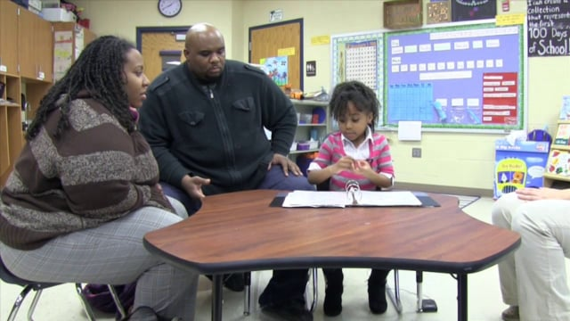
Implementing Student-led Conferences
Prepare the students.
Determine a format to collect evidence.
Set student goals.
Teach, model, and practice.
Host the conference.
Evaluate the conference.
Sources: Borba & Olvera, 2001; Conderman, Ikan & Hatcher, 2000; Hackman, 1996
See Handout 3d
Notes:
Student-led conferences take some planning and preparation, but many teachers feel they are worth the effort (Cleland, 1999). While there are several models to consider, student-led conferences generally include at least the following steps (Borba & Olvera, 2001; Conderman, Ikan & Hatcher, 2000; Hackman, 1996):
Prepare the participants. Not only will students have greater roles and responsibilities, but there are expectations for parents as well. Prepare students and parents well ahead of time to understand that students will lead the conversations and what to expect. Send out ample reminders of the purpose and the roles and responsibilities of parents, teachers, and students during the conference, especially for parents who have never participated in this format before.
Determine a format to collect evidence. Many schools have students collect artifacts in a digital or print portfolio, but other formats are possible, including three-ring binders, print or digital file folders, or data notebooks, to name a few. While students will set their goals, teachers will set some parameters regarding the kind of information students should collect, how students will analyze those artifacts, and the amount of choice students have in selecting those artifacts.
Set student goals. Similar to other aspects of responsibility and choice, students can set academic, social, and personal goals for the conference and everyone should understand the student’s goals for the meeting. Students set their goals at the onset of the grading period and share their progress during the conference.
Teach, model, and practice. To encourage student confidence, skill-building, and organization, you can help students use rubrics, checklists, scripts, question prompts, sentence starters, or other means. You can have students practice using the tools and communicating their evidence with teachers, peers, or other adults who can also provide constructive feedback. Some areas to practice may include walking into the room, greeting parents, tips for presenting materials, and how to best close a conference.
Host the conference. Conferences may be held after school or during specially designated release days. Conferences can occur with a single family in a classroom, or several conferences may occur simultaneously within the same room. Parents may use question prompts or guidelines you’ve provided, but the student leads the conference. You’re available as a facilitator—providing support, as necessary.
Evaluate the conference. Students, parents, and teachers should evaluate the experience, as the idea of conferencing is better considered an ongoing process rather than a discrete event. Informal evaluations could occur through a question at the end, such as “How did this conference help you understand my learning?” whereas others may want to include a formal questionnaire or survey. You and your students should reflect more deeply following the conference to realign or establish new goals for the next conference.
While many parents report positive experiences with student-led conferences, some may still want private time with you to ask additional questions. Be sure to leave time during the conference in case a parent makes that request.
Are you already incorporating student-led conferences, or is it something you are interested in? Student-led conferences are a programmatic approach that can take coordination and collaboration across several teachers or an entire campus. If you and your colleagues are interested in integrating student-led conferences in the future, refer to handout 3d for additional resources and to work on a plan for integrating student-led conferences in the future.

Slide 20
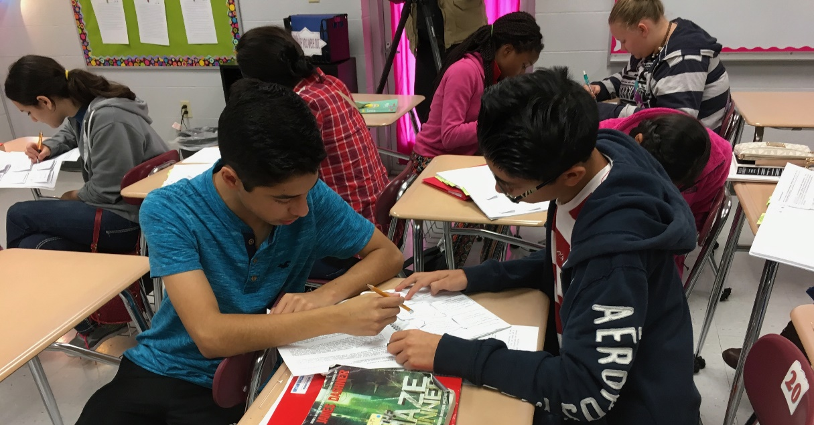
Peer Tutoring
Other terms for peer tutoring:
Peer-assisted learning
Peer monitoring
Peer facilitation
Peer-mediated instruction
Sources: Bowman-Perrott, Mahadevan, Etchells, 2016; Bowman-Perrott et al., 2013; Burns, 2006; Jones, 2007; Miller, 2005
Notes:
Peer tutoring is another strategy backed by research that aligns with responsibility and choice practices and has multiple benefits for students and their teachers (Bowman-Perrott, Mahadevan, Etchells, 2016; Bowman-Perrott et al., 2013; Miller, 2005), including academic, social and personal, and behavioral outcomes. Peer tutoring is effective with students of all ages, backgrounds, and learning needs (Bowman-Perrott, Mahadevan, Etchells, 2016; Burns, 2006; Jones, 2007; Miller, 2005), In much of the research, both tutors and tutees report benefits as a result of the process, and many report the benefit of the process outweighs concerns about missing instructional time with the teacher. There is no difference in impact based on the duration of peer tutoring students participate in, with positive benefits seen with as little as 280 minutes per pair (Bowman-Perrott et al., 2013).
Peer tutoring can also be referred to as peer-assisted learning, peer monitoring, peer facilitation, or peer-mediated instruction and can even occur using technology through e-tutoring. Students can engage in peer tutoring with students of different ages, called cross-age tutoring; in small groups; or in pairs within whole-class instruction.
The critical feature is that students work in pairs, one as a tutor and one as the “tutee,” to focus on academic, social, or behavioral goals. In some models, students can swap roles so that everyone has a chance to benefit from being a tutor as well as receive support for their learning goals.

Slide 21
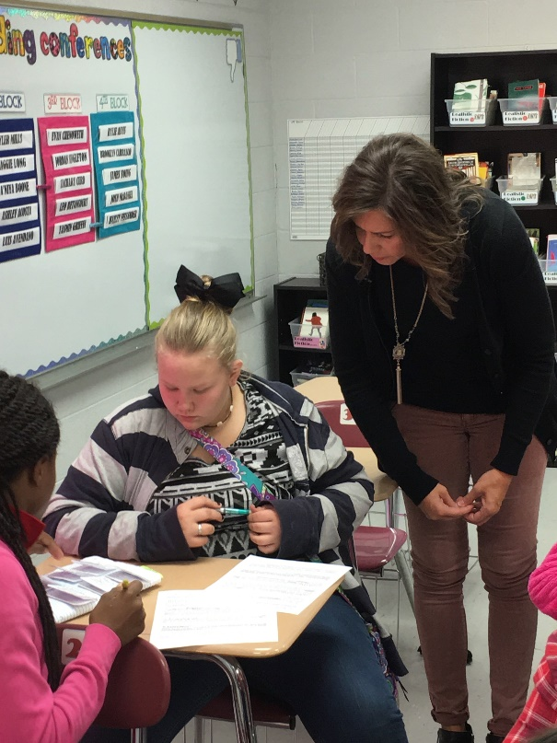
Implementing Peer Tutoring
Identify goals
Identify content and context
Ascertain or develop resources
Train peer tutors
Strategically pair students
Evaluate peer tutoring effectiveness
Sources: Burns, 2006; Miller, 2005
See Handout 3e
Notes:
Multiple approaches exist to implement peer tutoring practices effectively. You can use the following implementation tips with any peer tutoring approach (Burns, 2006: Miller, 2005).
Identify the goals for peer tutoring. Students benefit from explicit goals for tutoring, such as focusing on vocabulary or academic language, summarizing resources, or comprehension. They can generate personal learning or social and personal goals drawn from the learning outcomes initiated by the teacher or curriculum. Both members of the peer tutor dyad need to understand whether they are working on academic, behavior, or social outcomes and what their partners’ goals are.
Identify the content and context. In most models, peer tutors work on material that has been presented in class or is assigned reading. You provide questions to your students to use to review material or to aid in reviewing and comprehending reading assignments. An alignment should exist between the needs of the students being tutored and the content knowledge and capabilities of the students doing the tutoring.
Ascertain or develop tutoring resources. Both students doing the tutoring and those being tutored will require resources that support the tutoring process, such as a reminder of roles and responsibilities, checklists, or a means to record data from the session.
Train peer tutors in your selected model. Students require training, modeling, and practice to understand the role of tutoring. For example, in the Pause, Prompt, Praise model explored by Eila Burns (2006), student tutors have to be taught to truly pause for at least five seconds before prompting their peer with guidance rather than giving them an answer. It’s a natural inclination for many students to jump right in and give answers or read unfamiliar students to their peers, which can reduce learning outcomes. Be sure to model and practice the specific tutoring behaviors you expect from students for the model you’ve selected.
Strategically pair students. Determining appropriate pairing may take some time and practice. Cross-age tutoring can rely on older students who have been trained as tutors and so may be able to tutor younger students with a range of needs. Pairing same-age students within a class can be trickier, and you need to consider each student’s specific needs, personality, and ability level. Several models allow both members of a pair to serve in both roles, usually with the stronger student serving as a tutor first. In some cases, you can create groups of similar ability and mix the pairs within the group over several days. The rotation ensures all students have an opportunity to provide and receive tutoring.
Evaluate the effectiveness of your peer tutoring program. Monitor student pairs as they are working, both for progress on their academic or social goals as well as the effectiveness of the tutoring process. Periodically reflect on and evaluate the effectiveness of the entire peer tutoring program. You may need to provide data to parents and administrators as well as to the students in the program on what is working and what might change.
Are you interested in implementing peer tutoring? Can you do this at your classroom or grade level? Or do you need to coordinate a larger effort across your campus? Refer to handout 3e for additional resources, including links to different models, and to determine whether you plan to focus on peer tutoring for your work related to this module.

Slide 22

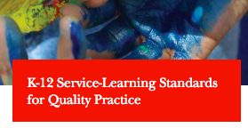
Service Learning
Service should be meaningful.
Service learning clearly links to the curriculum.
Service learning provides opportunities for student voice.
Students should monitor their progress and reflect on learning.
Download the Standards
Source: Chung & McBride, 2015; Mantooth & Fritz, 2006
See Handout 3f
Notes:
Service learning includes a clearly articulated plan that provides opportunities for students to research relevant issues within a designated community, which could be the classroom or school or the local or broader community. Students design an appropriate project to address the identified issue, take action by implementing their project, and reflect and evaluate their project (Chung & McBride, 2015). Service learning provides opportunities for students to develop a range of social and personal competencies, with actions and reflection embedded throughout the project that explicitly promote responsible decision-making within a real-world context. Service learning emphasizes service to the community and student learning as they apply new knowledge and skills in a real-world setting. Thus, not all service activities necessarily meet the definition of service. For example, going to a local park to pick up trash in isolation does not necessarily meet this definition of service learning.
Students and the community receive multiple benefits for engaging in service learning projects. For example, students can develop a range of academic and social and personal outcomes, including a reduction in negative student behaviors (Chung & McBride, 2015). Additionally, schools and communities form stronger relationships and a sense of respect between both settings (Mantooth & Fritz, 2006).
Service learning can be a big commitment and difficult for individual teachers to implement on their own. However, many teachers feel the benefits for students to master academic outcomes and develop social and personal competencies outweigh the challenges. You may want to work with a team made up of faculty and staff and local community members to identify and implement the best service learning projects for your students.
You can use some of the following suggestions to begin to plan service learning projects in your school. These are based on some of the K-12 Service-Learning Standards for Quality Practice from the National Youth Leadership Council (2008). You can download the full standards and indicators from the NYLC website and find additional information about implementing service learning in Handout 3f. Suggestions for service learning include the following:
Service should be meaningful. The best service-learning projects are mutually beneficial to students and the community in which they live. Connect with school, district, and community leaders to develop ideas.
Service learning clearly links to the curriculum. No teacher has time to implement any activity that isn’t directly tied to meeting learning goals. Service learning is an instructional strategy, not just a fun project. Brainstorm real-world connections to content standards, units, or big ideas from your curriculum then seek a match to a community need.
Service learning provides opportunities for student voice. Giving students an active opportunity to plan, implement, and evaluate their service-learning experiences instills plenty of opportunities for choice and responsibility. Students may still need oversight by knowledgeable adults, but consider whether you can provide planning templates, work plans with timelines, or even sample questions students can use to survey community members and their peers to shape their projects.
Students should monitor their progress and reflect on learning. Students should receive time and ongoing supports to monitor the impact of their service-learning project. You can set up a schedule for team meetings both with and without key community members, either in person or using technology. Students can engage in individual or group reflections through discussions in class or via a project website, web conferencing, or social media. Much of your students’ content learning is going to go beyond what multiple-choice and short-answer questions can measure. Consider ways students can document their learning using project artifacts, images and photos, video, or presenting to the larger community either through web conferencing or even with a special night of project expositions.
Service learning requires commitment and is often implemented with older students, but it can have a significant impact on promoting responsibility. Do you have a course that can benefit from incorporating the components of service learning as a means to promote student responsibility? Or perhaps there is a project that your students can engage in that uses the elements of service learning in your school community? Refer to handout 3f for additional resources and to determine whether you plan to focus on service learning for your work related to this module.

Slide 23

Reflect and Plan for the Future
Set a goal.
Find more information.
Involve your students.
Document and share your progress.
See Handout 4
Notes:
To help you plan for using responsibility and choice more effectively in your class, complete the final handout, “Handout 4, Responsibility and Choice Reflection and Additional Information.” It contains questions for reflection that can lead to concrete action steps to impact your use of responsibility and choice practices. This handout also includes the references cited in the module’s facilitator guide. As you consider your plan of action, keep in mind the following guidance:
Set realistic goals. Identify realistic goals for yourself in implementing responsibility and choice. Be sure you and your students have the necessary social and personal and academic competencies to engage in the practices. You may want to start with limited opportunities and build on your responsibility and choice practices over time. Also, be mindful of the developmental level your students are in, and select responsibility and choice practices that align with your students’ current capabilities to ensure success.
Involve students. Let students know you want to try out new strategies that will help them be better learners than when they began. You may be asking them to provide input as you do.
Be reflective. Based on the benefits associated with responsibility and choice, what changes do you plan to make in planning, implementing, and evaluating responsibility and choice in your classes or school? How will you know if the changes you make are beneficial to your students?
If you’re reviewing this information to understand the TEAM Rubric better, consider how you might share your action steps with coaches, mentor teachers, administrators, or those who might observe your class. They will benefit from knowing about your efforts and may be able to provide feedback on your actions.

Slide 24


Module Evaluation
For more information, please contact:
Pat Conner Executive Director Student Support Pat.Conner@tn.gov (615) 253-0018 | Kimberly Daubenspeck Director Special Projects Kimberly.Daubenspeck@tn.gov (615) 532-0469
Click Here
To complete a short evaluation of this module.
Notes:
The Tennessee Department of Education developed this online module in collaboration with the Appalachia Regional Comprehensive Center and the Center on Great Teachers and Leaders, which are funded by the U.S. Department of Education. If you want to find out more about the online modules or SPC, please contact the Office of Safe and Supportive Schools, Division of Student Support Services, at the Tennessee Department of Education.
Thank you again for participating in the Responsibility and Choice online module. We encourage you to complete the online evaluation of the learning module. We also encourage you to review the other online modules that provide knowledge, tools, resources, and strategies to embed SPC within your classes.
Responsibility and Choice: https://responsibilityandchoice.questionpro.com

Slide 25
References
Assor, A., Kaplan, H., & Roth, G. (2002). Choice is good, but relevance is excellent: Autonomy-enhancing and suppressing teacher behaviors predicting students’ engagement in schoolwork. British Journal of Educational Psychology, 72(2), 261-270.
Beymer, P. N., & Thomson, M. M. (2015). The effects of choice in the classroom: Is there too little or too much choice? Support for Learning, 30(2), 105-120.
Bierman, K. L., Domitrovich, C. E., Nix, R. L., Gest, S. D., Welsh, J. A., Greenberg, M. T., Blair, C., Nelson, K. E., & Gill, S. (2008). Promoting academic and social-emotional school readiness: The Head Start REDI Program, Child Development, 79(6), 1802-1817.
Borba, J. A., & Olvera, C. M. (2001). Student-led parent-teacher conferences. The Clearing House, 74(6), 333-336.
Bowman-Perrott, L., Mahadevan, L., Etchells, M. (2016). Assessing the academic, social, and language production outcomes of English Language Learners engaged in peer tutoring: A systematic review. Education and Treatment of Children, 39(3), 359-388.
Bowman-Perrott, L., Davis, H., Vannest, K., Williams, L., Greenwood, C., Parker, R. (2013). Academic benefits of peer tutoring: A meta-analytic review of single-case research. School Psychology Review, 42(1), 39-55.
Burns, E. (2006). Pause, prompt and praise—peer tutored reading for pupils with learning difficulties. British Journal of Special Education, 33(2), 62-67.

Slide 26
References
Chung, S., & McBride, A. M. (2015). Social and emotional learning in middle school curricula: A service learning model based on positive youth development. Children and Youth Services Review, 53.
Cleland, J. B. (1999). We Can Charts: Building blocks for student-led conferences. The Reading Teacher, 52(6), 588-595.
Conderman, G., Ikan, P. A., & Hatcher, R. E. (2000). Student-led conferences in inclusive settings. Intervention in School and Clinic, 36(1), 22-26.
d’Ailly, H. (2004). The role of choice in children’s learning: A distinctive cultural and gender difference in efficacy, interest, and effort. Canadian Journal of Behavioral Science, 36(1), 17-29.
Ertmer, P. A., & Newby, T. J. (1996). The expert learner: Strategic, self-regulated, and reflective. Instructional Science, 24(1), 1–24.
Evans, K., & Vaandering, D. (2016). The little book of restorative justice in education. New York: Good Books
Evans, M., & Boucher, A. R. (2015). Optimizing the power of choice: Supporting student autonomy to foster motivation and engagement in learning. Mind, Brain, and Education, 9(2), 87-91.
Fishman, E. J. (2014). With great control comes great responsibility: The relationship between perceived academic control, student responsibility, and self-regulation. British Journal of Educational Psychology, 84(4), 685-702.

Slide 27
References
Gibbons, M. (2002). The self-directed learning handbook. San Francisco: Jossey-Bass.
Graham, E. J. (2017). Authority or democracy? Integrating two perspectives on equitable classroom management in urban schools. The Urban Review.
Hackman, D. G. (1996). Student-led conferences at the middle level: Promoting student responsibility. NASSP Bulletin, 80(578), 31-36.
Jones, V. (2007). ‘I felt like I did something good’—the impact on mainstream pupils of a peer tutoring programme for children with autism. British Journal of Special Education, 34(1), 3-9.
Katz, I., & Assor, A. (2007). When choice motivates and when it does not. Educational Psychology Review, 19(4), 429-442.
Landau, B. M., & Gathercoal, P. (2000). Creating peaceful classrooms. Judicious Discipline and class meetings. Phi Delta Kappan, 81(6), 450-454.
Mantooth, L. J., & Fritz, C. A. (2006). Benefits of service-learning in Tennessee 4-H youth development: A Delphi study. NACTA Journal, 50(3), 38-44.
Miller, M. A. (2005). Using peer tutoring in the classroom: Applications for students with emotional/behavioral disorders. Beyond Behavior, 15(1), 25-30.

Slide 28
References
Miller, M. A. (2005). Using peer tutoring in the classroom: Applications for students with emotional/behavioral disorders. Beyond Behavior, 15(1), 25-30.
Patall, E. A., & Cooper, H., & Wynn, S. R. (2010). The effectiveness and relative importance of choice in the classroom. Journal of Educational Psychology, 102(4), 896-915.
Patall, E. A., Cooper, H., & Robinson, J. C. (2008). The effects of choice on intrinsic motivation and related outcomes: A meta-analysis of research findings. Psychological Bulletin, 134(2), 270-300.
Ritchhart, R., Church, M., & Morrison, K. (2011). Making thinking visible. How to promote engagement, understanding, and independence for all learners. San Francisco, CA: Jossey-Bass.
Rose, D. H., & Meyer, A. (2002). Teaching every student in the digital age. Universal Design for Learning. Alexandria, VA: Association for Supervision and Curriculum Development.
Stefanou, C. R., Perencevich, K. C., DiCinto, M., & Turner, J. C. (2004). Supporting autonomy in the classroom: Ways teachers encourage student decision making and ownership. Educational Psychologist, 39(2), 97-110.
Tennessee Department of Education. (2014). Tennessee school climate survey. 2103 annual state report. Nashville, TN: Author.
Turabik, T., & Gun, F. (2016). The relationship between teachers’ democratic classroom management attitudes and students’ critical thinking dispositions. Journal of Education and Training Studies, 4(12), 45-57.
Wraga, W. G. (1998). Democratic leadership in the classroom: Theory into practice. Paper presented at the meeting of Czech National Civic Education Conference, Olomouc, Czech Republic, August 24-25.

Slide 29
This work was originally produced at least in part by the Center on Great Teachers and Leaders and the Appalachia Regional Comprehensive Center with funds from the U.S. Department of Education under cooperative agreement numbers S283B120021 and S283B120023, The content does not necessarily reflect the views or policies of the U.S. Department of Education nor does mention of trade names, commercial products, or organizations imply endorsement by the U.S. Government
Notes:
{music}

