Slide 1
Introduction to De-escalation
Dr. April Ebbinger, NCSP |
Director of School Psychology Services

Slide 3
Objectives
Participants following this session will be able to:
Define and understand how school climate impacts problem behavior.
Define rational detachment and precipitating events.
Identify communication skills and define how effective communication assists during de-escalation.
Identify strategies to utilize during de-escalation.
Implement de-escalation strategies.
Discuss why de-briefing is necessary for students and staff.

Slide 4
Agenda
Introductions
School and Classroom Climate
Precipitating Factors and Rational Detachment
Communication Skills
Level 1: Anxiety
Level 2: Defensive
Level 3: Risk Behaviors
Coping Model

Slide 5

Introductions
2. I'm a pro!
3. I need a refresher!
1. I'm a novice!
Which statement best represents your confidence level in de-escalating a student?
Notes:
Introductions

Slide 6
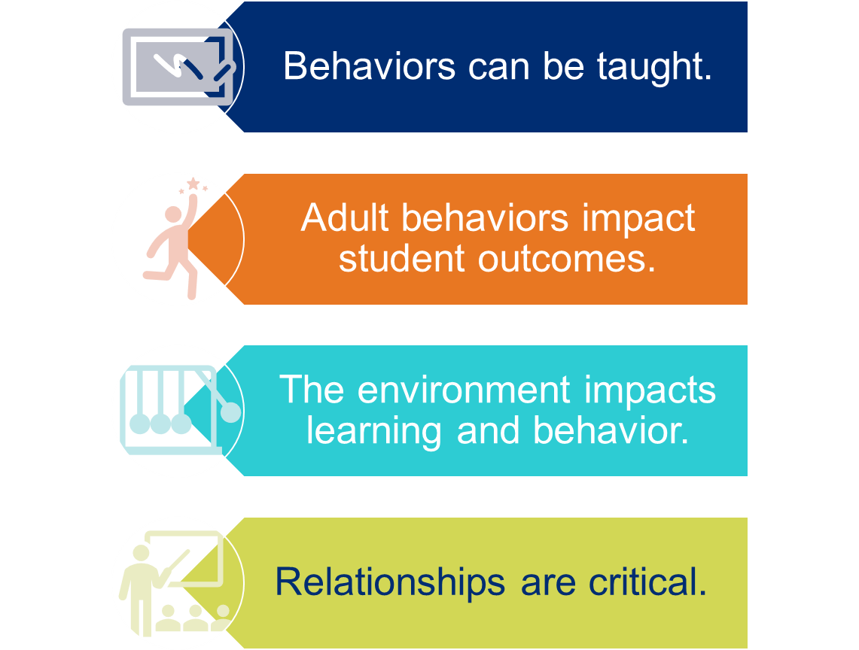
Foundational Beliefs

Slide 7
School and Classroom Climate

Slide 8

Guiding Question:
In your small groups discuss the following:
How does climate impact students’ behaviors and your ability to de-escalate situations?

Slide 9
What is Climate?
Key Components of Climate
Teaching & Learning
Relationships
Environment
Safety
Notes:
The climate of a school/and or educational program is often described as how students, teachers, and staff feel about the school. It can be a climate that encourages students, teachers, and staff to engage or disengage in being part of the school community.
Teaching & Learning- when students are taught the same behavior expectations those principles become part of the school culture/climate thus improving learning opportunities. Teaching the expectations alone will not change the behavior. Teaching behaviors along with opportunies to practice and providing meaningful reinforcement together work to improve classroom/school climate.
Relationships- students need to feel supported and motivated to achieve, they must feel valued and supported in their relationships with other students, teachers, and school leaders, feel a sense of connection to school, and be meaningfully engaged in the school community.
School safety-For students to focus on learning, they must feel safe and secure while at school and free from threats or physical violence, bullying or harassment, and acceptance of differences
School environment- For students to feel engaged and motivated to learn, they should be in environments that value academic rigor and high expectations for student achievement, establish clear rules and procedures, and provide physical surroundings that are attractive and well-maintained. This includes supportive discipline- Rules and disciplinary procedures are perceived to be clear, well communicated and reasonable. School leaders, teachers, and other staff should be perceived as fair in implementing rules and procedures. Fairness requires consistency and equity in applying rules, including consistency across individual teachers and school staff.

Slide 10

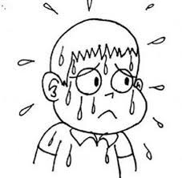


Consider the Climate
The humid climate
The self-motivating climate
The cold climate
The stormy climate
Credit: Alan McLean
Notes:
Describe the different classroom settings.
Humid classroom- In this classroom, students are under challenged and over dependent on the teacher. Empty praise is handed out and students don’t take risks.
Cold Classroom- We all know what this feels like. If you have to go into one of these classrooms, you can’t wait to leave and wish you could bring the students with you.
Stormy classroom- In this classroom, the climate is uncomfortable as some students feel threatened and some feel neglected, and no one knows where they stand. There also may be a consistent struggle for power and respect.
Self-motivating classroom- In this classroom, there is autonomy within structure, genuine praise and encouragement, and students take responsibility for their own behavior and learning.

Slide 11
The kids who need the most love will ask for it in the most unloving ways.
          Source: Russel Barkley
Notes:
Read the quote.

Slide 12
Fight or Flight
“De-escalation techniques go against our natural fight - or – flight reflexes. Remaining calm and professionally detached is not natural and therefore is a skill that will need to be practiced.”
-Elizabeth Smith

Slide 13
Factors to Consider

Slide 14



Behavior influences behavior.
What factors might impact your ability to remain consistent and calm in your response?

Slide 15
Precipitating Factors
Factors that may influence a person’s behavior.
Lack of sleep or food
Changes in routine
Changes in home routine
Medication changes
Others?

Slide 16
Rational Detachment
“You are the worst teacher I have ever met.”
“You are so dumb!”
This is the fifth incident with this student in your class this week.
Rational detachment is recognizing the need to remain professional by managing your own behavior and attitude.

Slide 17
Communication Skills

Slide 18
Guiding Question:
In your small groups discuss the following:
How do you know someone is not interested in what you are saying?

Slide 19
Forms of Communication
Verbal
Nonverbal
Paraverbal

Slide 20
Verbal Communication
Short, simple, & clear
“Are you okay?”
Positively phrased & respectful
“You seem lost. How may I help you?”

Slide 21
Nonverbal Communication
Personal Space
Body Language
Communication through Touch
Listening with Empathy

Slide 22
Paraverbal
Tone
Volume
Rhythm of Speech
Notes:
“Do you know who I am?”
“Do YOU know who I (emphasized am?”

Slide 23

Listening with Empathy
Remain non-judgmental
Give your undivided attention
Listen to facts and feelings
Allow time for silence and reflection
Paraphrase what you understand

Slide 24
Escalation Cycle

Slide 25
Activity:
Find a partner! Face your partner with 10 feet of space between you. Wait for next instructions.

Slide 26
What are the first signs of escalation?
What does it look like?
What does it sound like?
What does it feel like?

Slide 27

Our Choice
How adults respond to challenging behavior can either de-escalate or escalate students.

Slide 28
Our Responsibility
“When little people are overwhelmed by big emotions, it’s our job to share our calm. Not join their chaos.”
-L.R. Knost

Slide 29
Level 1: Anxiety
Anxiety
What behaviors do you exhibit when you are anxious?

Slide 30
Supportive Techniques
Intervene
Engage non-judgmentally
Show support: “How can I help you?”
Listen
Allow silence
Reflect
Repeat what the person has said
Provide options: “Do you need a break?”
Ask open-ended questions: “Can you tell me more?”
Avoid telling them how you feel
Should be brief
Avoid interrupting or assuming

Slide 31
Responding Positively
SAY THIS
Say this… | Not that…
Jacob, thank you for remembering to walk in the hallway. | Jacob, don’t even think about running in the hallway.
 | Jade, your behavior is completely unacceptable! Get it together!
 | Juan, I don’t know what’s gotten into you today!
 | Jasmine, not again! You must follow the rules just like everyone else!
NOT THAT

Slide 32
Level 2: Defensive
Defensive

Slide 33
What if the student continues to escalate?
Ignore abusive statements or questions.
Answer questions with rational responses:
  Student-“Why do I have to do this stupid work anyway?”
  Teacher-“All students must show me they have mastered the subject and this assignment will help show me that.”

Slide 34
What if the student continues to escalate?
Suggest alternative behavior: “When you lower your voice, then I can hear your concerns and help you find a solution,” or “Would you like to take a break and get a drink of water?”
Provide consequence: “If you continue to throw things, then I will have to call an administrator.”
Offer choices: “Would like you to continue our meeting calmly or would you prefer to stop now and continue tomorrow?”

Slide 35

Things to avoid
Forcing a student to talk
Using sarcasm
Telling a student how you feel
Giving advice
Blaming the student for the situation
Arguing with the student

Slide 36
Level 3: Risk Behavior
Risk Behavior

Slide 37
Safety Interventions
Keeping yourself safe
Keeping the student in crisis safe
Keeping others around them safe

Slide 38



Other interventions
Remove items that could be dangerous
Remove other people
Ask another staff member to help
Keep space between you and student
Call for help

Slide 39
De-escalation Practice

Slide 40
Example Script
Behavior | Useful Phrases
Be aware and attentive | “Tell me about what’s upsetting you.” “I see you are balling your fists. Are you angry? Is that right? Tell me what happened.” “Are you okay?”
Acknowledge the difficulty with empathy | “It’s very frustrating to be late for lunch.” “It must be difficult to try a new assignment by yourself.”
Encourage more information | “Tell me more about what happened.” “Help me understand what you are saying.”
Make a statement guessing the meaning | “Were you angry with Ms. Johnson because she held you after class which made you late for lunch?” “Were you frustrated with Ms. Miller because she was unable to help you when you raised your hand?”
Take action | “Let’s go grab lunch together and we can talk about this some more.” “When you are ready to talk, I will be right over here. Then, we can find a solution together.”

Slide 41
Example Script Together
Teacher: “I see you rubbing your hands together. Is everything okay?”
Teacher: “Are you feeling frustrated?”
Teacher: “What are you frustrated about?”
Teacher: “So, you’re frustrated about missing practice and now you can’t start at the game. Is that right?”
Teacher: “I would be frustrated too if missing practice was out of my control, and I couldn’t start in the game.”
Teacher: “Would you like to talk to your coach to discuss why you missed practice? I can’t promise you he will change his decision, but at least you will feel heard.”

Slide 42
Guiding Questions:
Using the sentence starters provided, work with a partner to role play. Be ready to share the experience with the group.
Notes:
See handout of sentence starters.

Slide 43
What happens after the incident?

Slide 44
Guiding Question:
In your small groups discuss the following:
Why is it important to debrief with the student and the staff involved?

Slide 45
Tension Reduction: Coping Model
C
Control: Ensure that emotional and physical control is regained.
O
Orient: What happened? Where? When? Why?
P
Patterns: Look for patterns for behavior.
I
Investigate: Alternatives to behaviors.
N
Negotiate: Future approaches, expectations, and behavior.
G
Give: Support and encouragement.

Slide 46
Closing

Slide 47
Today was the absolute worst day ever
And don’t try to convince me that
There’s something good in every day
Because, when you take a closer look,
This world is a pretty evil place.
Even if
Some goodness does shine through once in a while
Satisfaction and happiness don’t last.
And it’s not true that
It’s all in the mind and heart
Because
True happiness can be obtained
Only if one’s surroundings are good
It’s not true that good exists
I’m sure you can agree that
The reality
Create
My attitude
It’s all beyond my control
And you’ll never in a million years hear me say that
Today was a good day
When you change the way, you look at things, the things you look at change.
Source: Chanie Gorkin (2015)
12th grader Brooklyn, NY
Notes:
Language matters: I’m going to read this poem to you (Click and read the slide normally).
Encouraging, right?
Let’s try it another way (Click and read the slide from the bottom up).
This poem was written by a 12th grader named Chanie Gorkin from Brooklyn, NY in 2015. She said, “I wanted to show how your day is really based on how you look at things.” Isn’t it interesting that the same words can have a very different connotation when simply read in a different order? (Click) that the way you look at things has the power to change the very things you are looking at.

Slide 48
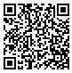
Feedback
Please click on the link in the chat or use the QR code below to provide feedback from today's session.
Notes:
https://stateoftennessee.formstack.com/forms/special_populations_feedback_survey_copy

Slide 49
Contact Information
Dr. April Ebbinger, NCSP
Director of School Psychology Services
April.Ebbinger@tn.gov
615-626-5102

Slide 50
FRAUD, WASTE, or ABUSE
Citizens and agencies are encouraged to report fraud, waste, or abuse in State and Local government.
•
NOTICE: This agency is a recipient of taxpayer funding. If you observe an agency director or employee engaging in any activity which you consider to be illegal, improper or wasteful, please call the state Comptroller’s toll-free Hotline:
•
1-800-232-5454
•
Notifications can also be submitted electronically at:
•
http://www.comptroller.tn.gov/hotline

