Slide 1
Infrastructure Planning grants
Grants Management Webinar
July 2024
Notes:
Introduction

Slide 2
Agenda
Overview
Starting Points
Project Activities
Project Administration
Files
Monitoring
Other requirements

Slide 3
Overview
Funded through the Rural Economic Opportunity Act
Purpose -
  To help you better understand your system and what needs your system has
  To help you prepare better applications for funding for system repairs and improvements
  To support distressed counties and financially distressed utility systems
FY24 IPG maximum grant amount increased from $50K to $500K
5% Matching funds are required
Project activities completed within 24 months
FY24 IPG Application will be submitted using SmartSimple
Notes:
This is a rendering of the Jackson Pop-Up Shops

Slide 4
SmartSimple Application Process
SmartSimple Grant Management System portal found here
Once registered, our staff can affiliate you to the proper entity (Community or Utility District)
Utility Districts or Communities who have not previously registered can do so by clicking the button highlighted in the next slide. If needed, please reach out to your local development district or grant administrator.
Notes:
This is a rendering of the Jackson Pop-Up Shops

Slide 5
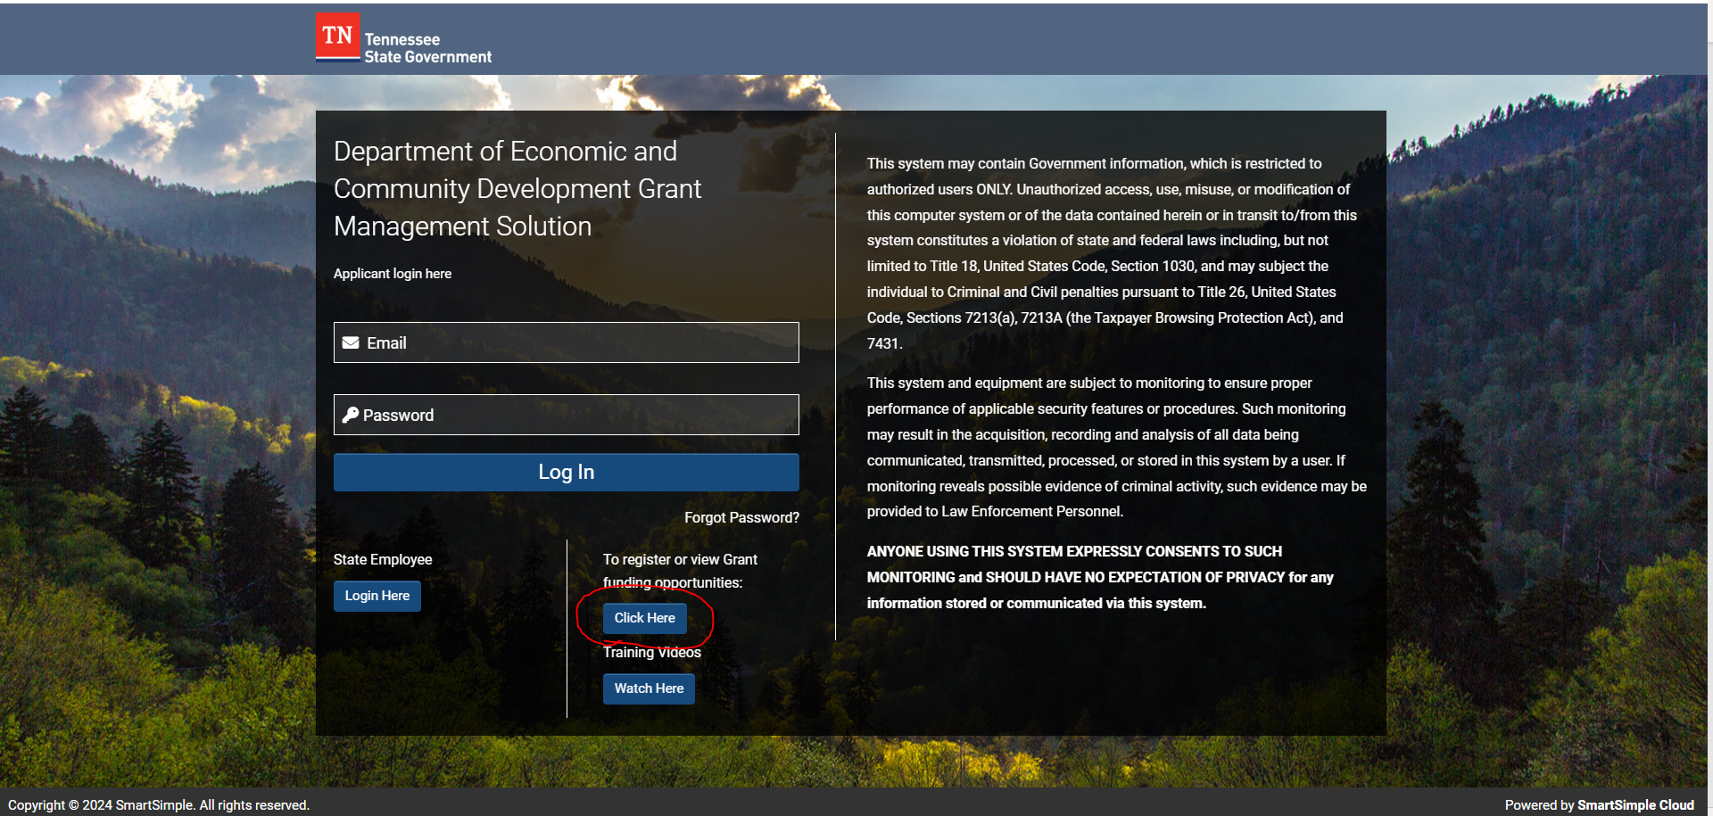
SmartSimple Application Process
Notes:
This is a rendering of the Jackson Pop-Up Shops

Slide 6
Starting Points
Cities and Utility Districts with an open Infrastructure Planning Grant (IPG) contract may apply for the FY24 application but cannot be awarded unless the previous contract has been completed and closed out.
Project will be monitored upon request. This is usually requested when 50% of project activities are completed. Procurement documentation and project outputs will be the monitoring focus.

Slide 7
FY 24 IPG Activities
“IPG Activities Guide” can be found here : IPG Activities Guide
Max grant amount allowable per activity category is $200K. Three categories may be applied for in any one application.
Water & Sewer System Mapping and Modeling: IPG funds can be used for system mapping or GIS modeling.
  Project activities implemented by contracted Engineering Firm; or,
  Project activities implemented by Cities or Utility District if documentation of sufficient qualifications can be demonstrated.

Slide 8
FY 24 IPG Activities
Water System Analysis activities may include:
  Water Loss Study & Analysis
  Hydraulic Analysis
  Rate Study
  Cyber Security Analysis
  Water Tank Inspections
  Area Wide Optimization Program (AWOP)
Sewer System Analysis activities may include:
  Infiltration/Inflow Study and Analysis
  Rate Study
  Tennessee Plant Optimization Program (TNPOP) – Wastewater Treatment Facilities

Slide 9
FY 24 IPG Activities
Asset Management Program activities may include:
  Asset Management Plans – Must be conducted according to TDEC guidelines, found here (Link: TDEC AMP Guidance)
  Operation Costs Analysis
  Staff Training/Certification
  Equipment Acquisition that assist with planning
    District/Zone Meters
    Basin/Flow Monitoring Meters
    GPS units and district locators
    Other equipment like CCTV equipment or jetters may be considered if proper qualifications are provided and are demonstrated to assist with long-term planning activities.
The Grantee agrees to be responsible for the accountability, maintenance, management, and inventory of all property purchased totally or in part with funds provided under this Grant Contract. The Grantee shall maintain a perpetual inventory system for all equipment purchased with funds provided under this Grant Contract and shall submit an inventory control report with closeout documentation.

Slide 10
FY 24 IPG Activities
Regionalization Plan/Study activities may include:
  Rate Study
  System Mapping/Modeling
  Consolidation Analysis
  Regional Reporting
Regionalization Plan/Study activity request will need to provide documentation supporting agreements between proposed utility districts.

Slide 11
Project Administration
Up to 5% of the awarded grant amount may be used for Project Administration
If awarded, these funds will be listed under Professional Fees. Please provide details of proposed funding amount and duties that will be included with project administration under “Budget Narrative” in the application.
Request for Qualifications (RFQ) process will need to be completed to procure project administrator and stay within compliance of the local procurement policy.
If a Utility District has a standing administrative contract with an existing engineering firm that was properly procured, then said firm may be used for project activities implementation. However, grant administration funds are for professional grant administrators only. See slide below.

Slide 12
Procurement
Procurement must be competitive and transparent
Follow local procurement procedures and keep good documentation of the process and results
  Generally, communities can accept quotes for items up to a certain level (maybe $10,000) and have to do formal bidding for items above that amount
  Professional services contracting cannot be based on price but are based on meeting your qualifications
We will review procurement at monitoring!
Notes:
The whole project is considered an ECD project, even if the match is paying for part of it. So, if you are using the match to pay for engineering, you still have to follow the ECD/state procurement rules
Check your community’s procurement rules for professional services and for getting bids

Slide 13
Procurement
Professional Services (engineering and/or some inspection services)
  Send at least 3 letters to companies who could provide the service
  Give them time to respond
  Have a selection committee and qualifications to select service provider
  Document the process
Admin funding is available. Please use it to hire a professional grant administrator
Let us know if you have questions before you start your grant project!
Notes:
The whole project is considered an ECD project, even if the match is paying for part of it. So, if you are using the match to pay for engineering, you still have to follow the ECD/state procurement rules
Check your community’s procurement rules for professional services and for getting bids

Slide 14
Procurement
3 ways to comply with procurement requirements
  Procure professional services, activities, or equipment for this project specifically
  Show procurement of professional services that cover these types of activities for another recent grant (maybe CDBG or ARC)
  Show procurement of professional services that cover these types of activities for your community or utility district in the past
Must be able to show documentation of procurement process and scoring
Notes:
The whole project is considered an ECD project, even if the match is paying for part of it. So, if you are using the match to pay for engineering, you still have to follow the ECD/state procurement rules
Check your community’s procurement rules for professional services and for getting bids

Slide 15
Procurement – Bid Tabs
Follow local rules for opening bids
Save all documentation
TNECD will review if you want us to, but that is not required
Let us know if there is a significant change from your application/contract based on the bids you get
Notes:
The whole project is considered an ECD project, even if the match is paying for part of it. So, if you are using the match to pay for engineering, you still have to follow the ECD/state procurement rules
Check your community’s procurement rules for professional services and for getting bids

Slide 16
Files
Can keep files electronically or in hard copy
TNECD must be able to access them on a monitoring visit
Keep contract, invoices, bid documents, all ECD communication, and all other relative documentation
Keep files for 5 years after the close of the contract

Slide 17
Monitoring
TNECD will be conducting monitoring during the project
These may be on site or conducted remotely – mostly remotely right now
The main focus of the monitoring is to ensure that you did what you said you were going to do and what the contract said you were going to do, that you followed procurement policies, and that you have good records

Slide 18
Other Requirements
We want your success stories! Take pictures! Let us know how this helps you understand your systems, apply for other funds, prevent problems, etc.
Think about project outcomes when completing application
All documents must be submitted electronically
Projects must be completed in 24 months – but you can definitely finish sooner
It is important that you ask when you have questions as soon as they arise, rather than waiting until too late
Periodically review this presentation

Slide 19
Questions?
Brooxie Carlton
Brooxie.Carlton@tn.gov
Lynn Tutor
P.Lynn.Tutor@tn.gov
https://www.tn.gov/ecd/rural-development/infrastructure-planning-grant.html

